Slide 1


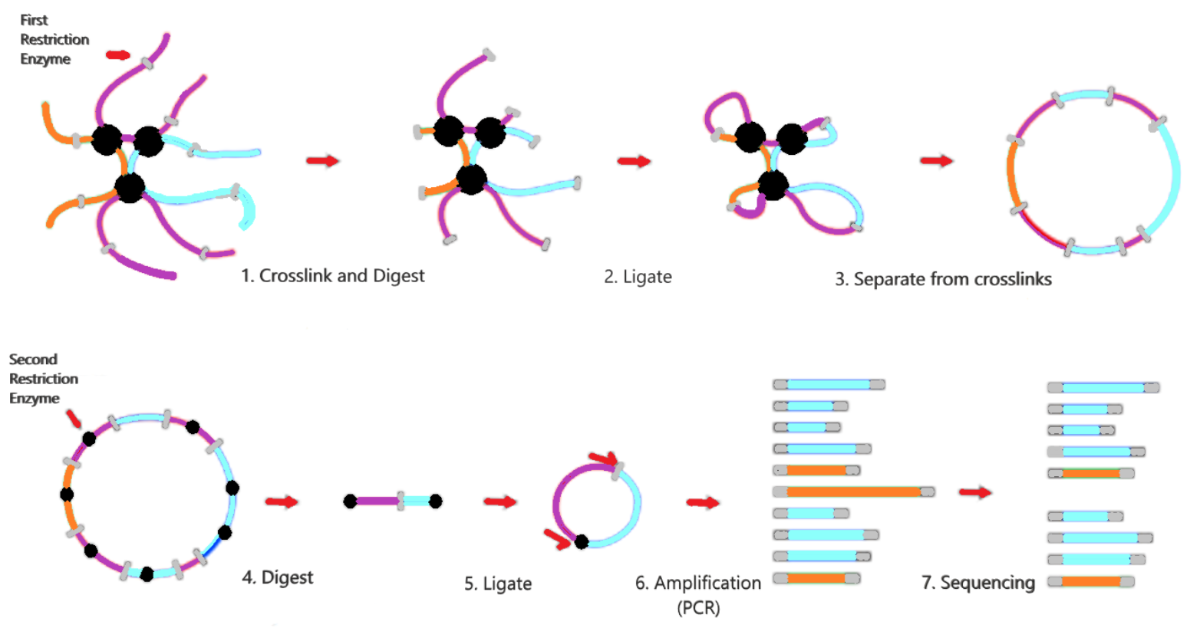
Connecting the Dots: Deep Learning and its Application in Identifying Chromatin Regulatory Loops
Nathan Angell¹, Jarrod Dube¹, Christopher Hemme PhD², and Steven Weicksel PhD¹
Bryant University, Smithfield RI¹ University of Rhode Island, South Kingstown RI²
3D Organization of the Genome Controls Gene Expression
Background:
The genome is structured in a 3D organized way consisting of chromatin loops.
Problem:
Many of the details that control and regulate chromatin loops is not well understood.
Approach:
Using Circular Chromosome Conformation Capture (4C) we mapped chromatin interactions with a CNN computer learning model.
Notes:
Hello my name is Nathan Angell and I will be presenting on (read the title). Our research began this summer with working on Zebrafish Embryos to study the 3D genome structure. This 3D structure consists of chromatin loops which is important in gene expression and important for normal cell function. And we know that any changes to this structure, can lead to diseases such as cancer.
As of now, we know very little about these chromatin loops and how they are controlled in the cell. So we used a process called 4C to try to look at how chromatin is formed and to thoroughly study it. This process, separates these loops in order to discover how chromatin is ordered and regulated through mapping and sequencing.
We believe that as we study different time points in the Zebrafish embryo development, we will be able top track different times points with the goal of better understanding the gene expression and how chromatin is organized within the genome.

Slide 2
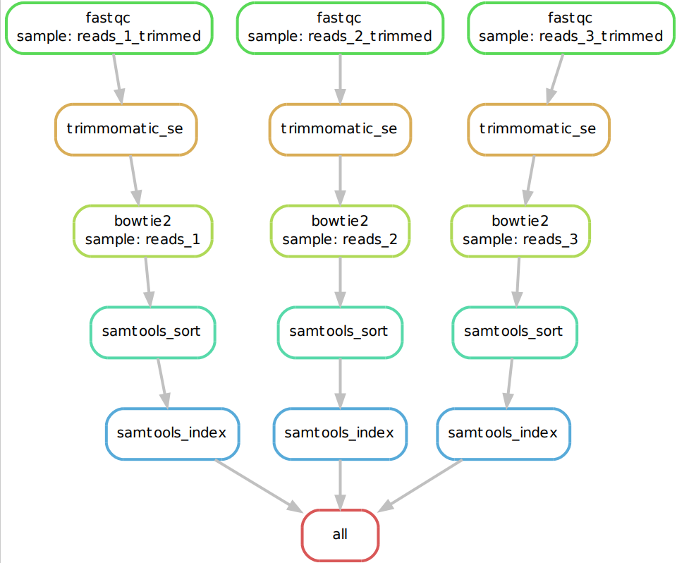
Data Pipeline Identifies Loop Formation
High Throughput sequencing experiments create large datasets that are not generally organized.
Our pipeline is as follows:
Organizes
Gets rid of unwanted data that we do not need
Notes:
With this in mind, the 4C process generates vast amounts of data that is not generally organized.
So, we decided to create a data pipeline to resolve this issue. This data pipeline organizes and gets rid of any unwanted data that we do not need.

Slide 3
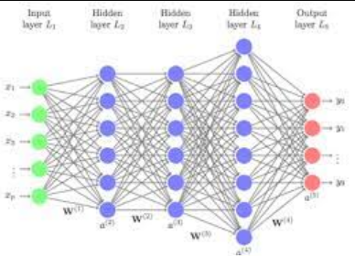
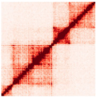
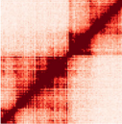
Deep Learning - Convolutional Neural Network (CNN)
CNN identifies connections that are not obvious based on traditional analysis.
This has the potential to enhance the discovery of new connections within the genome that may have gone unnoticed otherwise
Notes:
We will program the data pipeline to output these kinds of images, shown to the left, to see which genes are close to each other visually.
We will input these images into our deep learning model, our Convolutional Neural Network, that we believe will have the potential to enhance the discovery of new connections within the genome.

