Slide 1
Demand-to-Replenishment Engine
From weekly demand forecasts to safety stock, reorder points and a service-level vs inventory trade-off
Supply Chain & Data Analytics portfolio project | 500 store-item series, 260 weeks, 52-week out-of-sample simulation

Slide 2
A seasonal forecast cuts the inventory needed for 95% service by a third or more
4.3%
−34% to −52%
85% vs 98%
test WAPE with LightGBM, against 5.9% for the best simple method and 13.9% for a 13-week moving average
inventory days vs the moving average at 95% realized service (lead time 1 to 3 weeks)
realized service when the target was 95%: moving average vs LightGBM
Accuracy on this dataset is best-case: the series behave like generated data (flat within months, steps at month boundaries).
The method comparison and the forecast-to-safety-stock chain are what transfers to real data.
2

Slide 3
The question is not the forecast itself but what service level costs in inventory
Weekly replenishment, one order per store-item per week
Order = forecast over lead time + review period, plus a buffer for forecast error
Too little buffer: lost sales. Too much: working capital and waste
Planners often use a flat moving average and a days-of-cover rule
Questions answered
How predictable is weekly store-item demand?
How much inventory does each forecast need for the same service level?
Does a textbook safety-stock formula hold up?
How sensitive is the answer to supplier lead time?
Do ABC service tiers pay off?
3

Slide 4
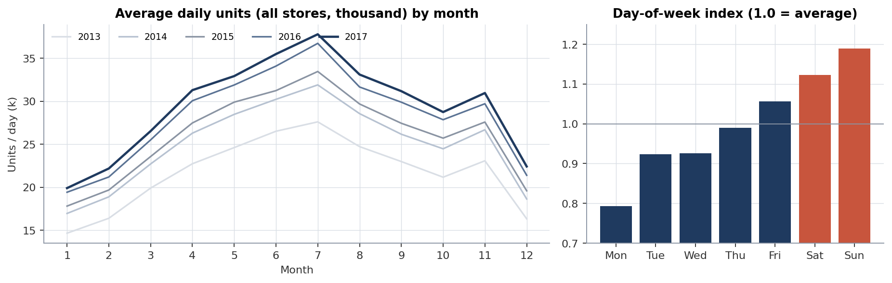
500 clean daily series over five years, with one flag: the data looks generated
Item | Detail
Source | Kaggle playground, public GitHub mirrors
Rows | 913,000 daily
Series | 10 stores × 50 items
Period | 2013-01-01 to 2017-12-31
Checks | No nulls, duplicates or gaps
Missing | Price, cost, lead time, stockouts
Units grew 35% from 2013 to 2017, peak in summer, Sunday 1.19× / Monday 0.79× the average day.
After removing day-of-week effects, daily demand moves 0.6% within a month but jumps ~11% at month boundaries (40× a mid-month change).
4

Slide 5
Method: measure forecast error, turn it into buffers, test the policy on held-out weeks
Weekly demand
Forecast
Interval error σ
Policy parameters
Simulation
260 weeks × 500 series
LightGBM, 4-week gap features, 3 benchmarks
Measured over lead time + review period
Safety stock, reorder point, order-up-to
52 test weeks, lost sales, weekly review
Time-ordered split: train → validation (2016-07-04 to 2016-12-26) → test (2017-01-02 to 2017-12-25); the test year is never used for tuning.
σ comes from validation errors only, so safety stock is set without knowing the test outcome.
Methods are compared at equal realized service, not at the same nominal z.
5

Slide 6
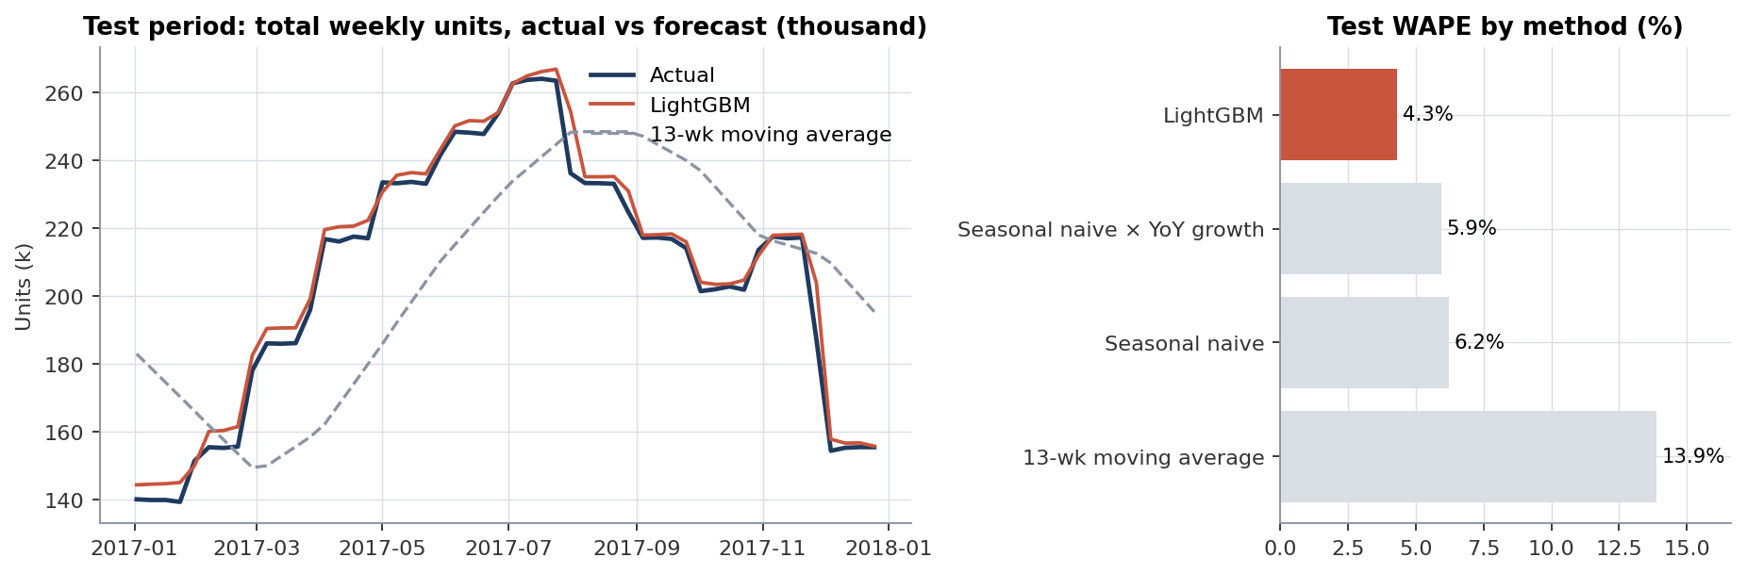
LightGBM errs 4.3% a week; the moving average lags the seasonal ramp at 13.9%
27% lower WAPE than the best simple method
Bias 1.5%: slight over-forecast
WAPE by class: A 3.9%, B 5.5%, C 6.8%
72% of model gain comes from last year's same-week demand
6

Slide 7
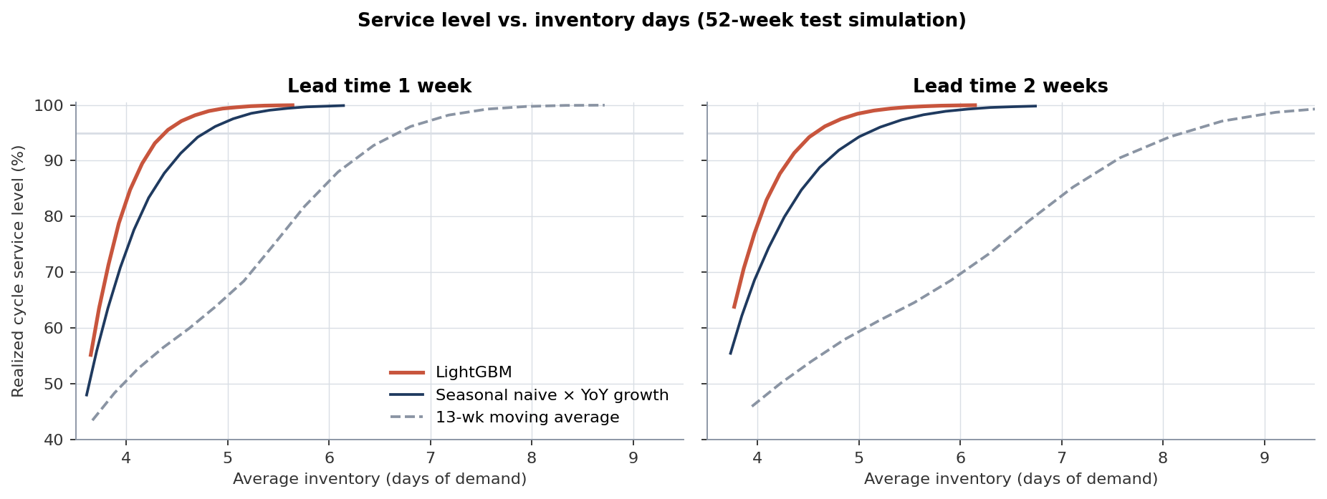
At the same service level, the better forecast sits well to the left on inventory days
To reach 95% (1-week lead time): 4.4 days with LightGBM, 4.8 with the seasonal benchmark, 6.7 with the MA
The moving average needs far more stock to climb the same curve
7

Slide 8
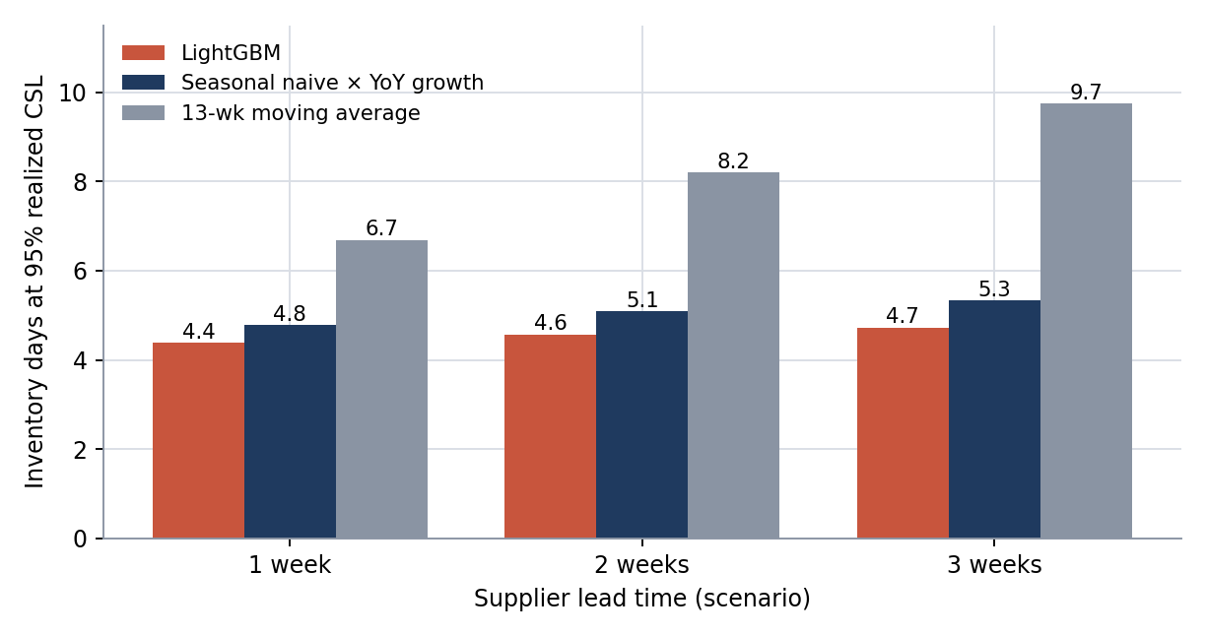
Lead time hardly moves inventory once the forecast is good
Lead time 1 → 3 weeks adds 0.34 days with LightGBM and 3.06 days with the MA
Buffer above the zero-safety-factor level: 0.56–0.62 days (LightGBM) vs 2.9–5.6 days (MA)
Lead time is a scenario: it is not in the data
8

Slide 9
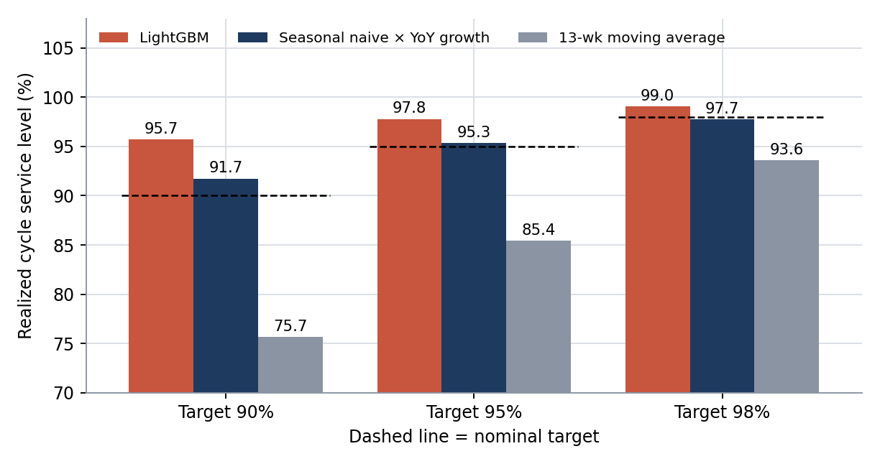
A nominal 95% target is only as good as the forecast behind it
Target 95% delivered 85.4% with the moving average and 97.8% with LightGBM
For the MA, empirical σ was 1.31–1.63× the √(time) rule; for LightGBM 0.99–1.01×
Back-test realized service every cycle
9

Slide 10
ABC service tiers cost more inventory and added almost no service here
Policy (LightGBM, 1-wk lead time) | Inventory days | Fill rate | Realized CSL
Uniform 95% | 4.62 | 99.94% | 97.8%
Tiered A98 / B95 / C90 | 4.77 | 99.96% | 98.2%
Uniform 90% | 4.43 | 99.87% | 95.7%
A: 311 items, 80% of volume
B: 123 items, 15%
C: 66 items, 5%
Tiered A98/B95/C90 holds 3.2% more stock than uniform 95% for +0.02 pt fill rate
All items are fast movers; the 66 C items hold 5% of volume
10

Slide 11
Recommendations: fix the forecast and the buffer sizing first
# | Action | Priority | Expected outcome (simulated) | Measure
1 | Replace the moving average with a seasonal forecast | High | −34% to −52% inventory days at equal service | WAPE, bias, FVA
2 | Size safety stock per series from measured σ; refresh each cycle | High | Realized service close to target | Realized vs nominal CSL
3 | Back-test on real data with promotions and stockout flags | High | Realistic error and buffer sizing | ≥52 weeks real history
4 | Fix the forecast before funding lead-time reduction | Medium | Avoids paying for lead time a good forecast neutralises | Inventory days by supplier
5 | Keep uniform service targets until item cost data exists | Low | No extra stock for tiering | Re-test with margin data
Outcomes come from one simulated year; none has been observed in operations.
11

Slide 12
Limitations: read absolute numbers as best case
Data looks generated (steps at month boundaries), so accuracy and inventory days are optimistic
No prices, costs, lead times, shelf life or stockout data: inventory in days, lead time as scenario, sales treated as demand
Simplified policy: no MOQ, pack size, capacity, supplier variability; lost sales
σ from 26 validation weeks (H2 2016) applied to a full year; one test year, no uncertainty bands; series share one calendar
Model not refit during the test year; +1.5% test bias slightly flatters service
12

Slide 13
Next step: run the same chain on a real extract with costs and lead times
What transfers
What to add
Forecast-to-buffer calculation chain
Equal-realized-service comparison
Simulator with built-in checks
Power BI-ready tables
Unit cost and holding cost, to express inventory in money
Real lead times and supplier variability
Promotions and stockout flags
Rolling refits and a bias-tracking dashboard
13

