Slide 1
WORKSHOP
Multi-Platform React
2019/11/1

Slide 2
Who are we?
Jakub Římal
  frontend team leader (web-based)
  web, Smart TVs, set-top boxes
Matej Čepil
  frontend team leader (mobile & native)
  Android, iOS, Apple TV, Android TV

Slide 3
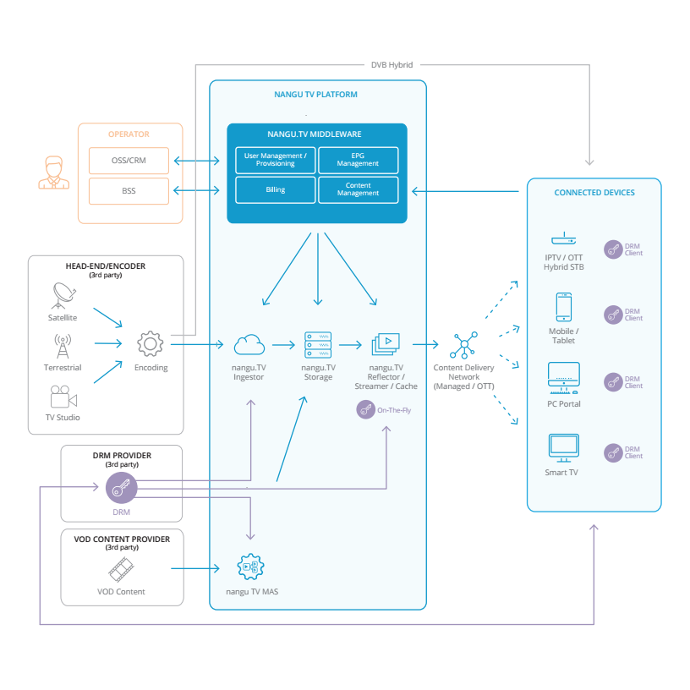
What do we do?

Slide 4
… and who are you?
Anyone from the outside of Europe?
Anyone from the Czech Republic? :)
Who does apps in React?
Who does apps in React Native?
Who was on some party yesterday?

Slide 5
Our plan for today
Create multi-platform app which runs on web, mobile and TV

Slide 6
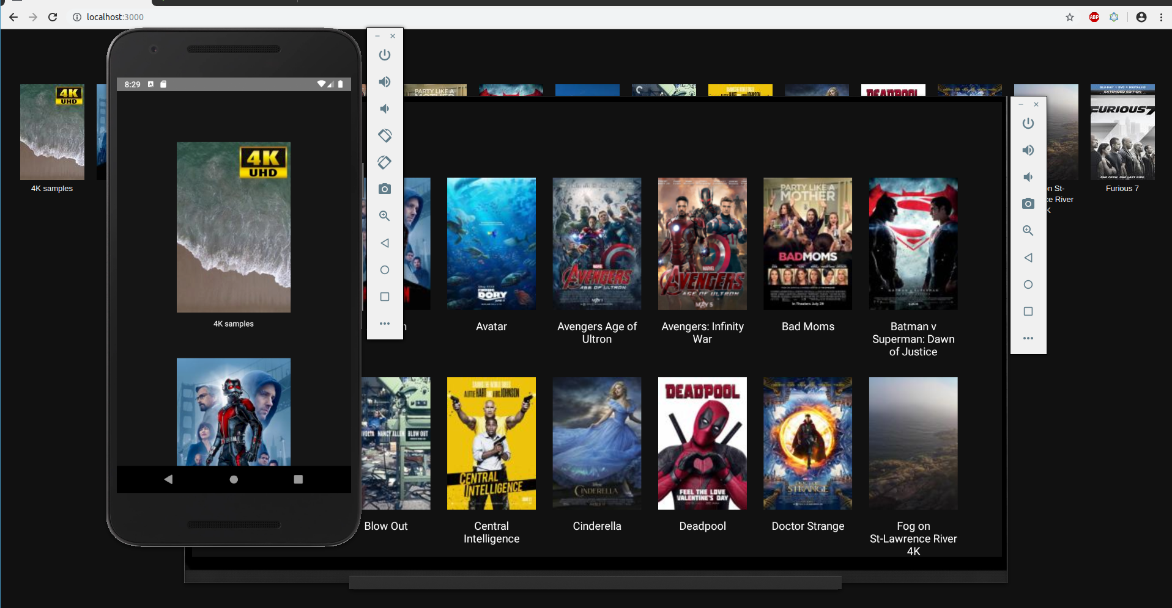
Our plan for today
Create multi-platform app which runs on web, mobile and TV

Slide 7
Our plan for today
Create simple React project
Add React Native to an existing React project
Implement a bit more complicated (add styles, more components)
version of the app for web only
Add primitives
Use existing styles for native
Finalize styles and behavior so it looks and behave the same on both platforms
Create mobile layout and use it for both (native mobile app
and web app running on mobile device)
(Optional) Add some animations

Slide 8
1. Create simple React project
yarn create react-app my-reactive-workshop
cd my-reactive-workshop
yarn && yarn start

Slide 9
Create simple React Native project
npx react-native init myNativeReactiveWorkshop
cd myNativeReactiveWorkshop
yarn start #keep_this_terminal_running
Now run your emulator (e.g. with Android Studio)
npx react-native run-android

Slide 10
2. Add React Native to an existing React project
(see http://facebook.github.io/react-native/docs/integration-with-existing-apps.html)
add script "start-native": "react-native start" to your package.json file
copy „android“ folder from the project created with react-native init and paste it to the project root
copy „app.json“ file from the project created with react-native init and paste it to the project root
merge „.gitignore“ file from the project created with react-native init with the one in the current project (probably copy everything except node.js section)
(optional) unify app/package name

Slide 11
2. Add React Native to an existing React project (2)
copy „App.js“ file from the project created with react-native init and paste it to the project root
copy „index.js“ file from the project created with react-native init, paste it to the project root and rename it to „index.native.js“
rename src/index.js file to src/index.web.js
rename all files containing web components from *.js to *.web.js
yarn add react-native
Now you should be able to start both React (with yarn start) and React native (with yarn start-native) apps but in fact it is just two different apps inside one project, see the rest of the workshop to have the real multi-platfrom app. :)

Slide 12
Clone the repository
In your workspace (next to your already existing projects):
git clone https://github.com/nangutv/reactive-workshop.git
cd reactive-worshop
git checkout step-1-basic-react-app
yarn && yarn start

Slide 13
Explore the project and ...
git checkout step-2-basic-react-native-app
yarn && yarn start-native #keep_this_terminal_running
Now run your emulator (e.g. with Android Studio)
npx react-native run-android

Slide 14
3. Implement a bit more complicated (add styles, more components) version of the app for web only
git checkout step-3-complete-web-app

Slide 15
4. Add primitives
5. Use existing styles for native
git checkout step-4-native-app-is-able-to-run

Slide 16
6. Finalize styles and behavior so it looks and behave the same on both platforms
git checkout step-5-native-app-works-completely
git checkout step-6-correct-styling-everywhere

Slide 17
7. Create mobile layout and use it for both (native mobile app and web app running on mobile device)
git checkout step-7-special-style-for-mobile

Slide 18
8. (Optional) Add some animations

Slide 19
And what about adding React to an existing React Native project?
See the „start-from-native“ git branch for more:
git checkout start-from-native

Slide 20
Summary
Abstraction (for component)
Abstraction (for styles)
Abstraction (for everything where you need something platform-specific)

Slide 21
Thank you

