Slide 1
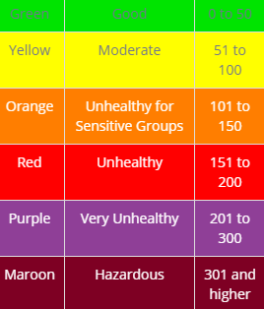

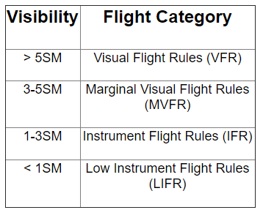
Air Quality Description
Visibility | Flight Category
>5 SM | VFR
3-5 SM | MVFR
1-3 SM | IFR
<1 SM | LIFR
Good
Moderate
Unhealthy for Sensitive Groups
Unhealthy
Very Unhealthy
Hazardous

