Slide 1


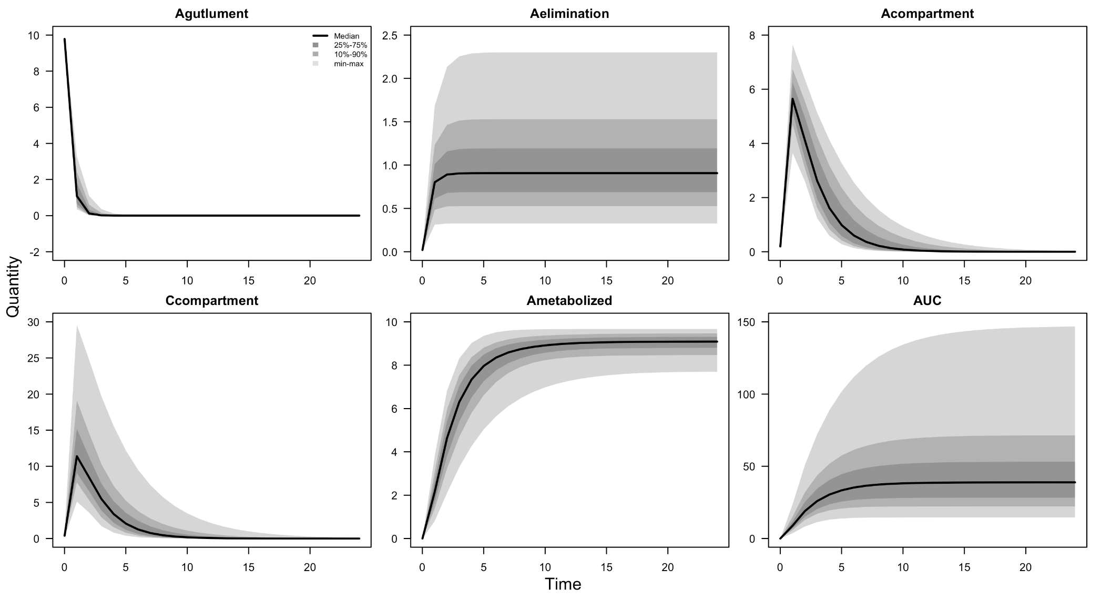
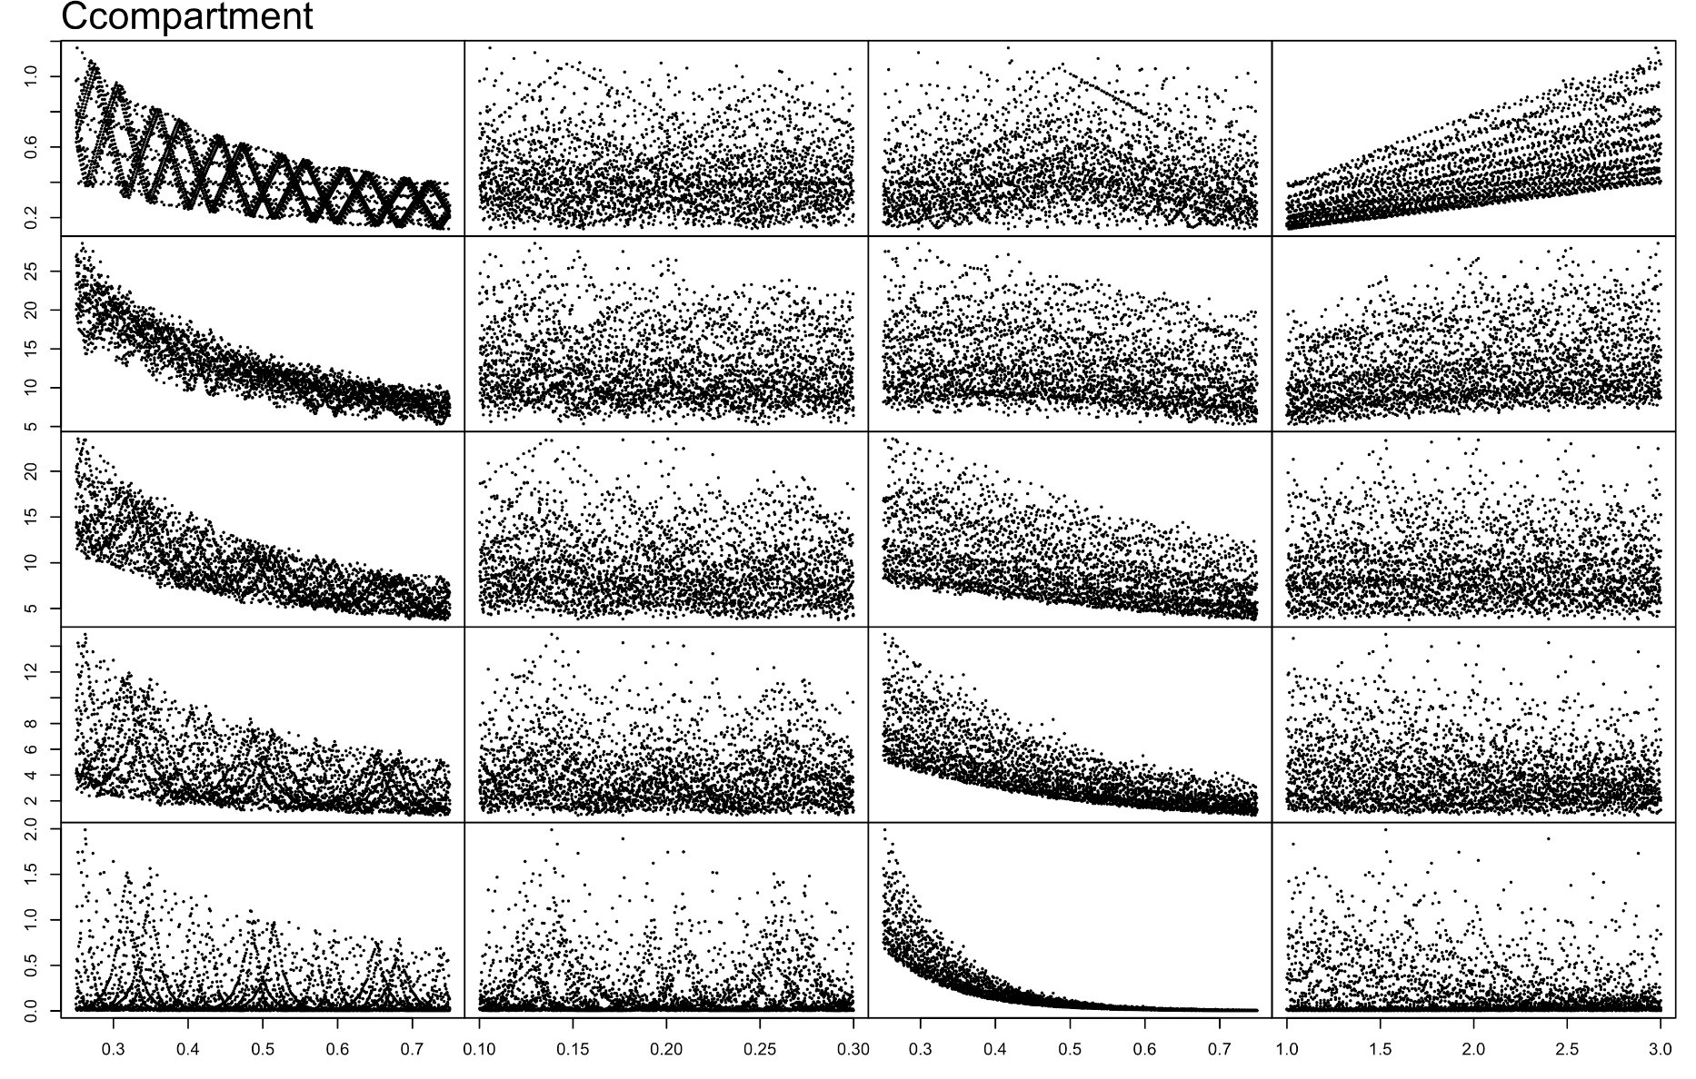
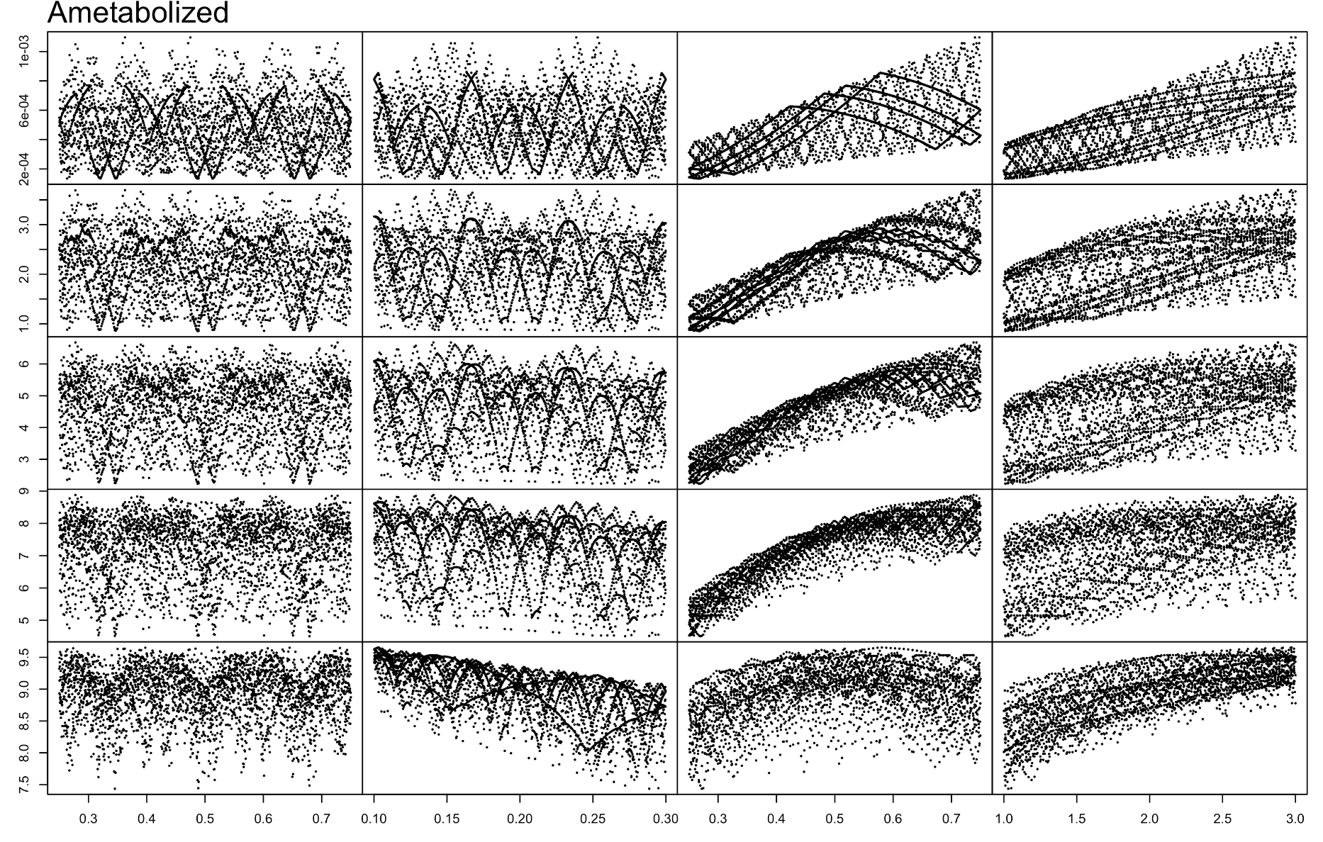
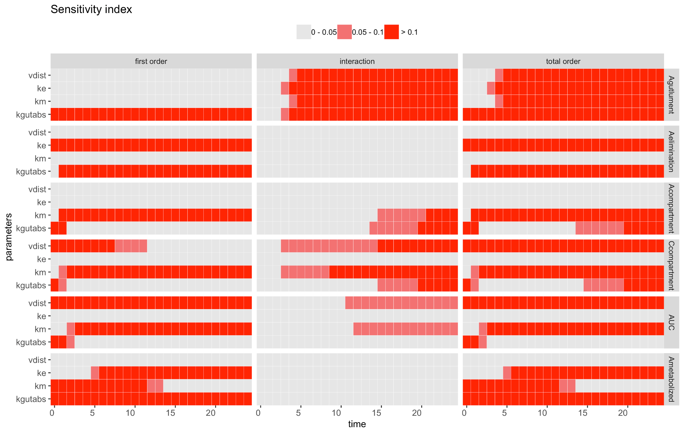
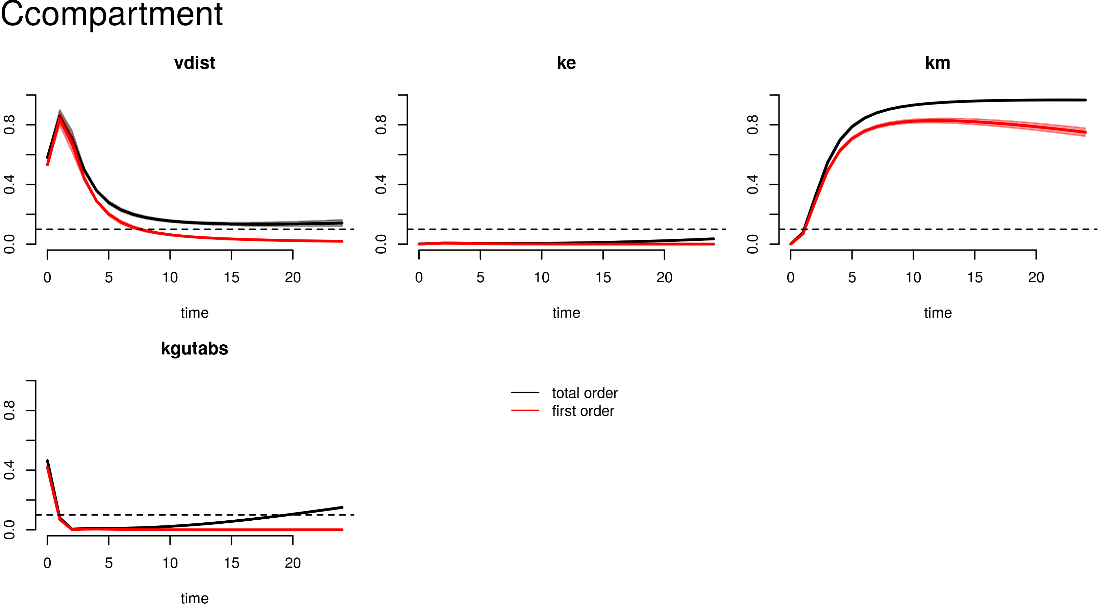
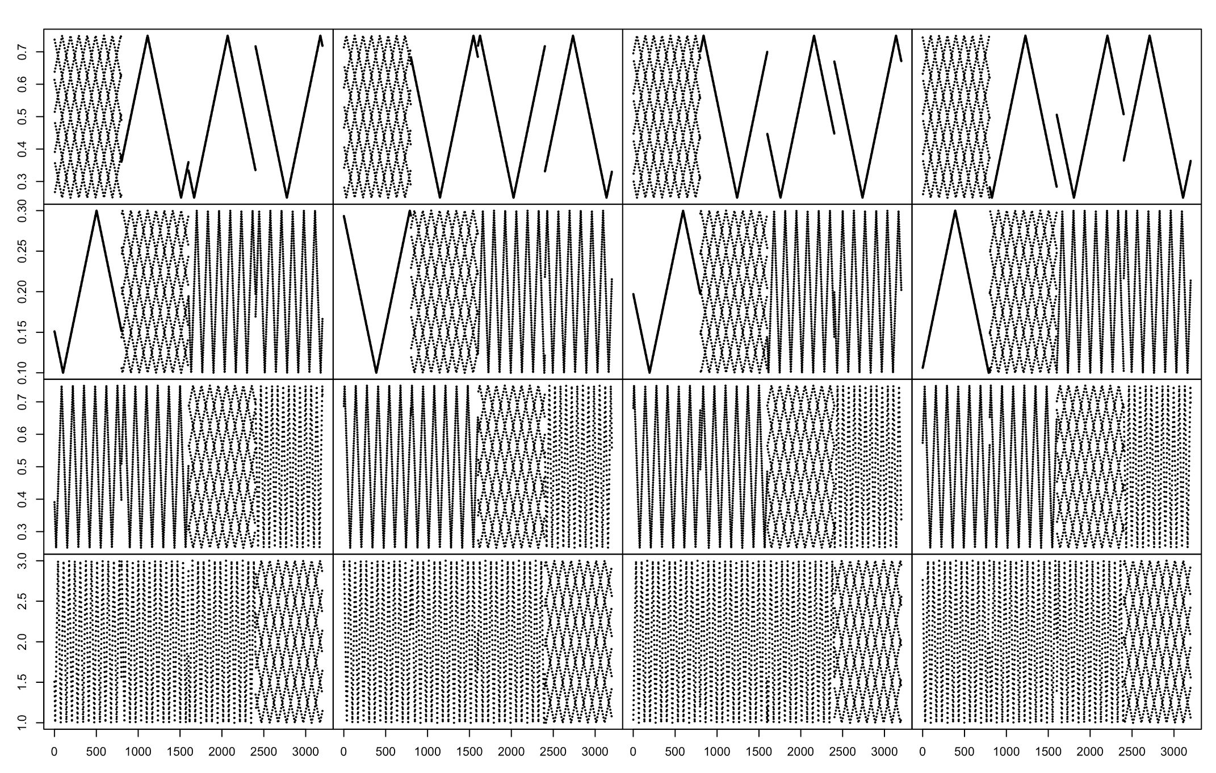
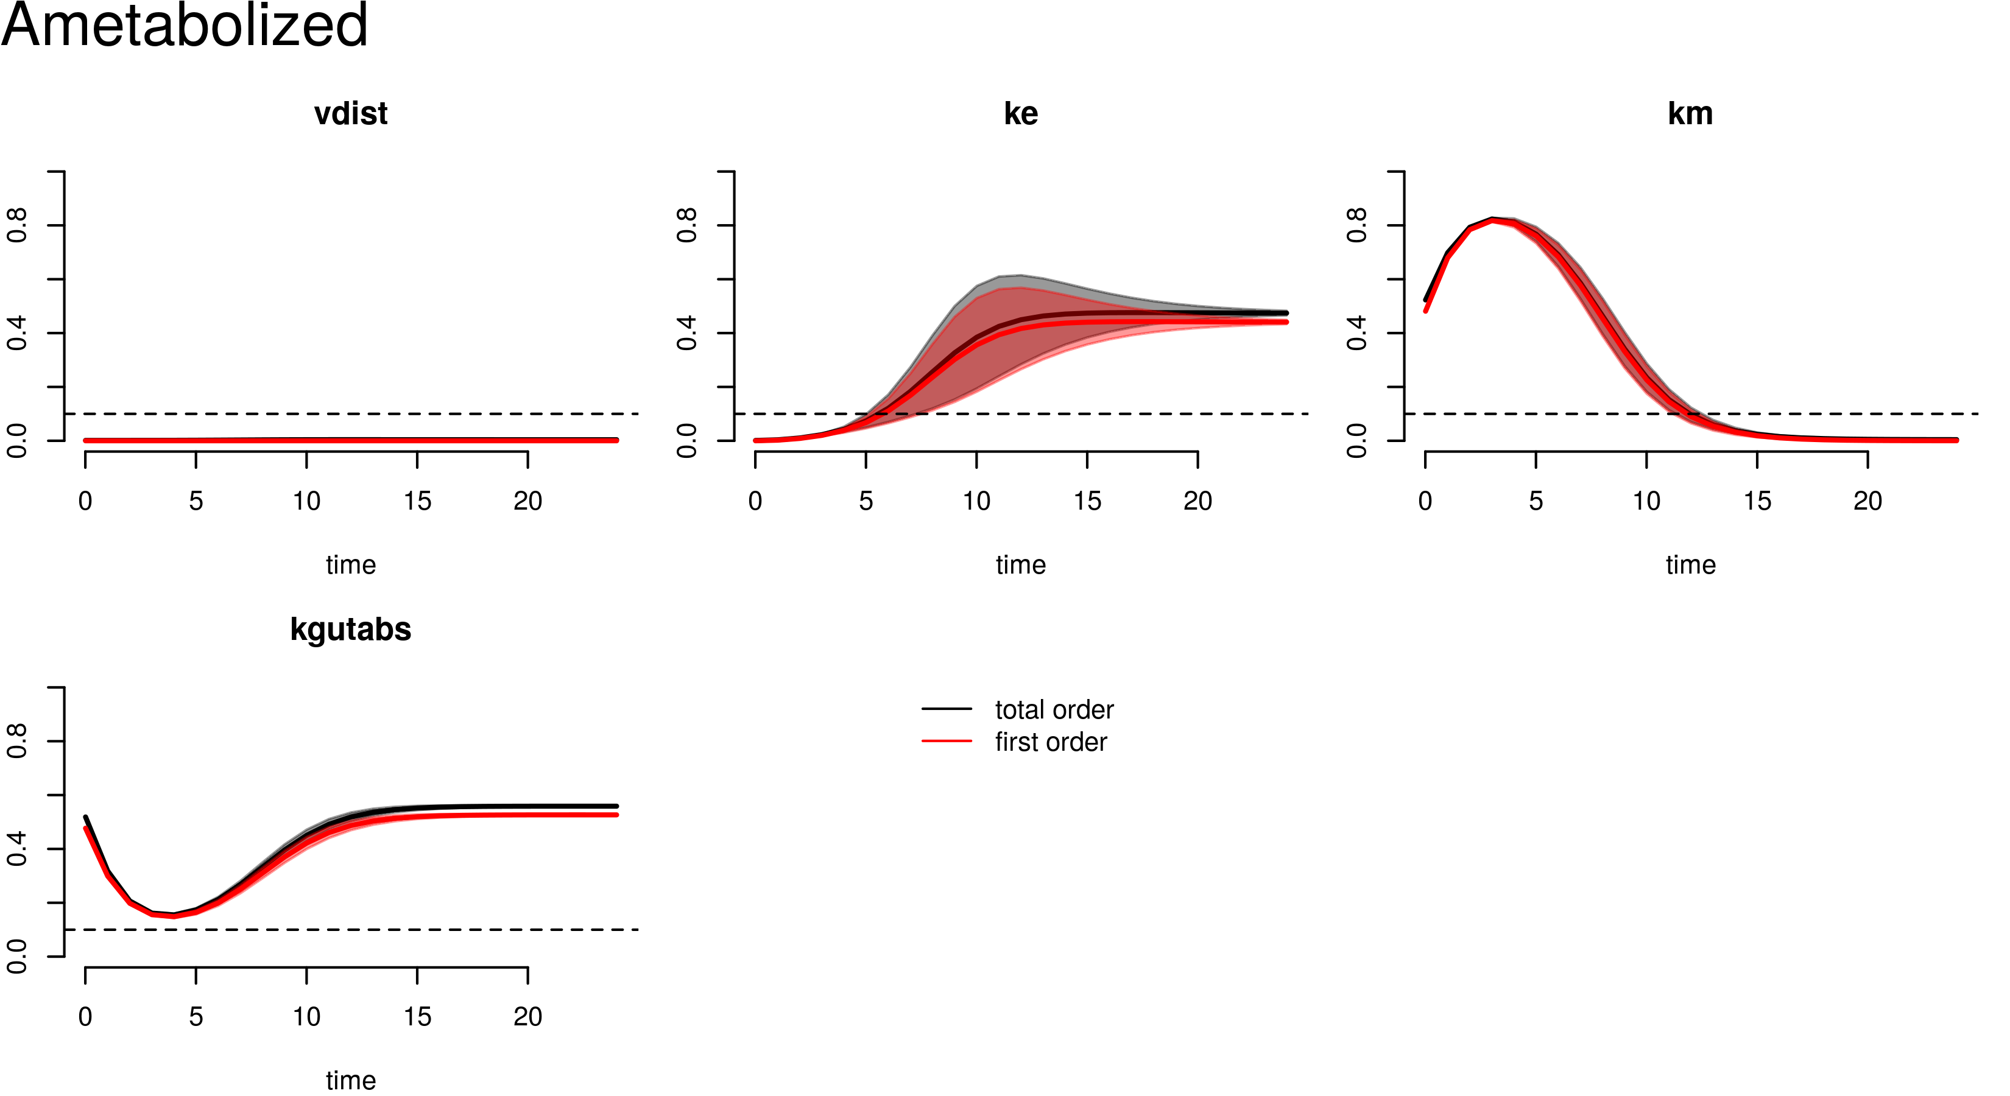
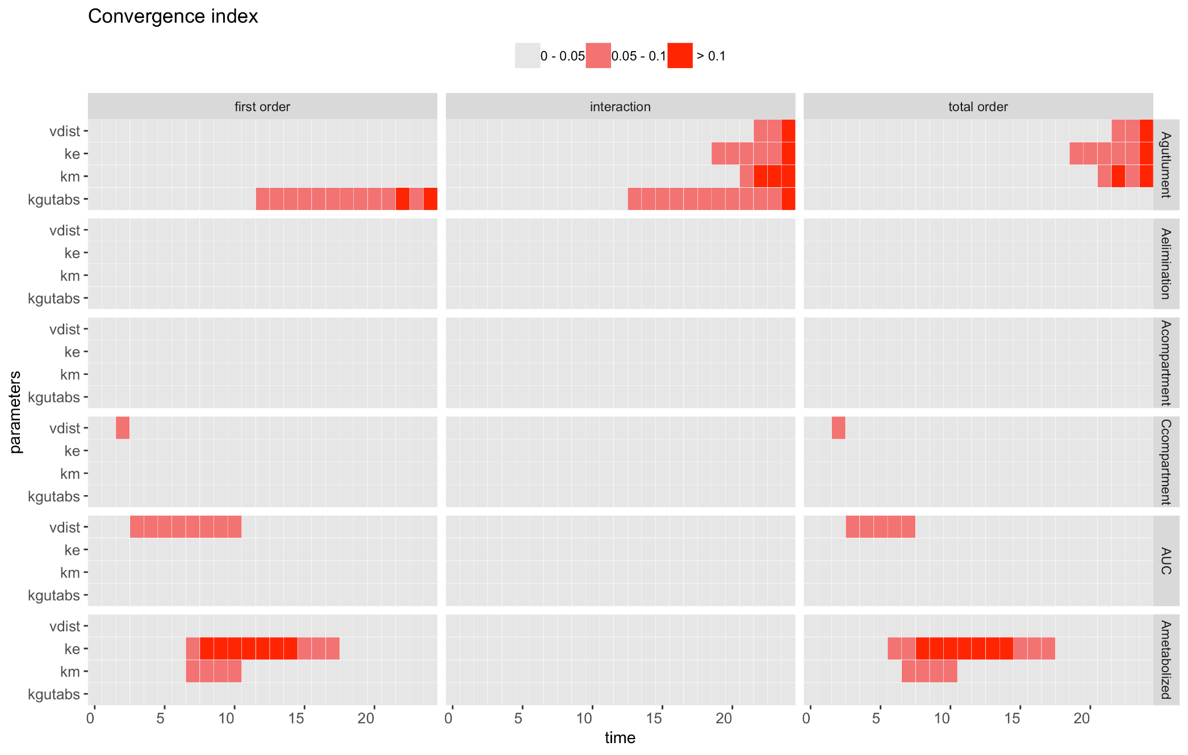
pksensi: an R package to apply sensitivity analysis in pharmacokinetic modeling
Nan-Hung Hsieh¹, Brad Reisfeld², Weihsueh A. Chiu¹
¹Department of Veterinary Integrative Biosciences, College of Veterinary Medicine and Biomedical Sciences, Texas A&M University, College Station, TX 77845, USA
² Chemical and Biological Engineering & School of Biomedical Engineering, Colorado State University, Fort Collins, CO 80521, USA
Introduction
Work Flow
Perspective
Sensitivity analysis is a mathematical technique to investigate how variations in model parameters affect model outputs. An increasing number of studies use global sensitivity analysis (GSA) to determine which model parameters contribute to high variation in model predictions. This technique has also been applied in pharmacology and toxicology research [1,2]. Pharmacokinetic modeling describes the changes in the concentrations or amounts of a substance within model compartments over time. The goal of sensitivity analysis in pharmacokinetic research is to examine the sensitivity of output variables (e.g. compound concentration in blood or tissues) in pharmacokinetic models responds to input parameters, such as anatomical, physiological, and kinetic constants [2]. It can be further applied to parameter prioritization and parameter fixing before model calibration [3].
In our previous work [3], we developed an approach to apply global sensitivity analysis workflow to reduce the computational burden in the Bayesian, Markov Chain Monte Carlo (MCMC)-based calibration process of a physiologically based pharmacokinetic (PBPK) model. We used GNU MCSim [4], an effective simulation package for Bayesian population PBPK modeling, to calibrate the model. We found that the extended Fourier Amplitude Sensitivity Test (eFAST), a type of global sensitivity analysis algorithm, had the best balance of efficiency and accuracy for a complex, multi-compartment, multi-dataset, and multi-metabolite PBPK model. Also, we found some efficient visualization approaches that can be used to distinguish between “influential” and “non-influential” parameters. We also found a useful approach for communicating the parameter sensitivity in decision making.
Model
construction
Parameter
matrix generation
Pharmacokinetic modeling
(Decoupling simulations)
Visualization &
decision making
This package is still under experimental and maturing status, we are continuous improve its function and collect user feedback. Your comment is very valuable!
Instead of eFAST method, we will add the Sobol method in this package and compare the usability with eFAST.
Also, we’ll integrate pksensi to another R package/ecosystem to make it more feasible for R users.
The PK model code can be written based on R deSolve package’s format or used the GNU MCSim or C language.
The input file for GNU MCSim can be generated through the pksensi’s built-in function generate_infile().
We adopted eFAST (extended Fourier Amplitude Sensitivity Test), a widely used global sensitivity analysis approach in biomathematical modeling,.
To test the convergence and robustness of the sensitivity measurement, we included a random phase-shift approach to replicate sampling from random starting points across parameter space.
One of the solutions is to perform PK modeling under the pure R programming environment by linking pksensi with deSolve package.
The pksensi can also link with GNU MCSim to compile the model code, used in solving each system of equations, which is more computationally efficient.
Apply built-in functions to visualize and check the convergence and influence of model parameters, providing a means to assess the robustness of the sensitivity measurement.
The “cut-off”-based approach in this package can accurately distinguish between “influential” and “non-influential” parameters.
Example (One-compartment PBTK model)
Model construction
PK modeling & uncertainty analysis
Parameter effect on model output across time
# ------------------------------------------------
# pbtk1cpt_v2.model (Modified from R httk package)
# ------------------------------------------------
# States and Outputs
States = { Aelimination, Agutlument, Ametabolized,
Acompartment, AUC};
Outputs = { Ccompartment };
# Parameters
vdist = 0.5;
ke = 0.2;
km = 0.5;
kgutabs = 2.0;
# Dynamics
Dynamics {
Ccompartment = Acompartment / vdist;
dt (Aelimination) = ke * Agutlument;
dt (Agutlument) = - kgutabs * Agutlument - dt (Aelimination);
dt (Ametabolized) = km * Acompartment;
dt (Acompartment) = kgutabs * Agutlument - dt (Ametabolized);
dt (AUC) = Ccompartment;
} End.
t = 0.01h
t = 1.01h
t = 2.01h
t = 4.01h
Motivations
t = 12.01h
We present here an R package, called pksensi, which is designed to make sensitivity analysis more accessible and “reproducible” in pharmacological and toxicological researches. This package can investigate both parameter uncertainty and sensitivity in pharmacokinetic models, such as PBPK, and advanced compartment absorption and transit models with multivariate model output. The design concepts of pksensi are:
The uncertainty analysis is a crucial step before model calibration. Through this visualization approach, we can easily recognize whether the simulated outputs can accurately predict the same concentration profile as the in-vivo experiment under the setting of parameter ranges.
vdist
ke
km
kgutabs
vdist
ke
km
kgutabs
Scatter plot of parameter value-related output of concentration of central compartment (left) and metabolized (right) under the time-points of 0.1, 1,.01 2.01, 4.01, and 12.01 h.
The scatter plot can provide strong evidence and help us understand the parameter effect on model output. High correlation, high influence.
Heatmap visualization
Time-dependent sensitivity and convergence indices
Decision making
Cross-platform: Models can run on Windows/MacOS/Linux
Freedom: All related packages are free and open source
Integrated application: Users can run pharmacokinetic models in R with script that were written in C or GNU MCSim
Decision making: The output results and visualization tools can be used to easily determine which parameters have "non-influential" effects on the model output and can be fixed in model calibration.
> check(x, SI.cutoff = 0.05, vars = "Ccompartment")
Sensitivity check ( Index > 0.05 )
----------------------------------
First order:
vdist km kgutabs
Interaction:
vdist km kgutabs
Total order:
vdist km kgutabs
Unselected factors in total order:
ke
Convergence check ( Index > 0.05 )
----------------------------------
First order:
vdist
Interaction:
Total order:
vdist
> check(x, SI.cutoff = 0.05, vars = "Ametabolized")
Sensitivity check ( Index > 0.05 )
----------------------------------
First order:
ke km kgutabs
Interaction:
Total order:
ke km kgutabs
Unselected factors in total order:
vdist
Convergence check ( Index > 0.05 )
----------------------------------
First order:
ke km
Interaction:
Total order:
ke km
The Agutlument and Acompartment are the state variable that describes the quantity of compound in gut lumen and central compartment (mol), Ccompartment is the chemical concentration in plasma that can be used to compare with observed results in a pharmacokinetic experiment (mol/L).
The chemical will be eliminated and metabolized from the human body to Aelimination and Ametabolized .
The kgutabs is the absorption rate constant that describes the chemical absorption from the gut lumen into gut tissue through first-order processes (/h), vdist is the volume of distribution(L), ke is the elimination rate constant (/h), and km is the metabolic rate constant (/h).
Aelimination
ke
Agutlument
(input)
kgutabs
Acompartment
km
Ametabolized
Installation and functions
Parameter matrix generation
# To in install pksensi, you can use following method (in R):
install.packages("pksensi") # get latest version from CRAN
install_github("nanhung/pksensi") # get the development version from GitHub
Replication 1
Replication 2
Replication 3
Replication 4
vdist
> check(x, SI.cutoff = 0.05)
Sensitivity check ( Index > 0.05 )
----------------------------------
First order:
vdist ke km kgutabs
Interaction:
vdist ke km kgutabs
Total order:
vdist ke km kgutabs
Unselected factors in total order:
Convergence check ( Index > 0.05 )
----------------------------------
First order:
vdist ke km kgutabs
Interaction:
vdist ke km kgutabs
Total order:
vdist ke km
Top-left:
Evaluation of the sensitivity and convergence indices in the central compartment. Under the given cut-off of 0.05, the elimination rate constant (ke) doesn’t have any impact on the concentration of the central compartment overtime. Besides, the distribution volume (vdist) can’t reach the acceptable convergence under the given sample number.
Workflow | Function | Description
Installation | mcsim_install | Download and install the specific verson of MCSim
 | mcsim_version | Check MCSim version
Compilation | model_compile | Compile MCSim model code
Parameter generation | rfast99 | Create the sequences for each parameter by eFAST
PK modeling | generate_infile | Generate MCSim input file
 | solve_mcsim | Solve ODE through MCSim
 | solve_fun | Solve ODE through R deSolve package
Visualization & decision making | pksim | PK plot of the outputs based on the given parameter (Uncertainty analysis)
 | plot | Time-dependent sensitivity (with 95 % CI)
 | check | Check sensitivity measurement for parameter fixing
 | heat_check | Create heatmap to overview the result of GSA
ke
km
Top-right:
Evaluation of metabolized.
The plot function is used to visualize the time-course of sensitivity (main and total order) and convergence (calculated from the 95% confidence interval across replications). The dashed line represents the cut.off that can use to distinguish the influence and non-influential parameters.
The check method provides a summary of parameter sensitivity and convergence. The argument of SI.cutoff and CI.cutoff are used to determine the cut-off for these two indices (default = 0.05).
Bottom-left:
Global evaluation. This function can assess the model with multivariate outputs, such a PBPK model. It’s an effective tool to investigate the influence of parameters before model calibration.
kgutabs
Model evaluation
Acknowledgements
Source code & Link
References
In this case, we quantify the impact of 4 model parameters on all output variables during 24-hour time period post intake. We assume a uniform distribution for the estimate of each parameter. The parameter ranges are assumed to be (0.25, 0.75) for vdist, (0.1, 0.3) for ke, (0.25, 0.75) for km, and (1, 3) for kgutabs.
The sample number is 800 with 4 model parameters, which generate the model evaluation of 3,200. The replication is set to 20. The above figure only plotted by 4 replication.
Based on our previous study, we proposed the heatmap visualization approach to distinguish “influential” and “non-influential” parameters with a cut-off. Through the given argument order (default = 0.05 and 0.1), we can select the specific order of sensitivity measurement that we’re interested in.
The heatmap provides an effective plotting method to overview the parameter influence and convergence.
This work was funded, in part, by grant 1U01FD005838 from the U.S. FDA. The poster reflects the views of the author and should not be construed to represent FDA’s views or policies. We want to thank Dr. Frederic Bois for his comments and discussions.
Package website: https://nanhung.rbind.io/pksensi/
Package’s repo: https://github.com/nanhung/pksensi
Poster’s: repo: https://github.com/nanhung/SOT2019
[1] Ring, Caroline L., et al. "Identifying populations sensitive to environmental chemicals by simulating toxicokinetic variability." Environment international 106 (2017): 105-118.
[2] McNally, Kevin, Richard Cotton, and George D. Loizou. "A workflow for global sensitivity analysis of PBPK models." Frontiers in pharmacology 2 (2011): 31.
[3] Hsieh, Nan-Hung, et al. "Applying a global sensitivity analysis workflow to improve the computational efficiencies in physiologically-based pharmacokinetic modeling." Frontiers in pharmacology 9 (2018).
[4] Bois, Frédéric Y. "GNU MCSim: Bayesian statistical inference for SBML-coded systems biology models." Bioinformatics25.11 (2009): 1453-1454.
[5] Pearce, Robert G., et al. "Httk: R package for high-throughput toxicokinetics." Journal of statistical software 79.4 (2017): 1.

