Slide 1
Miracle Software Systems Corporate Standards - Title Page
Subtitle : Using python for CRUD Operation
Name : GUNREDDY NIKHIL REDDY
Date : September-11-2024

Slide 2
Project Overview
Project Architecture
Design Application
Testing & Debugging
Challenges Faced
Learning
Conclusion

Slide 3
Project Overview
Objective:
Develop a simple To-Do List application using Python.
Functionalities:
Add, Edit, Delete, and View tasks.
Learning Goals:
Gain fundamental understanding of Python programming.
Learn data handling and basic CRUD operations.

Slide 4
Objective:
Develop a simple To-Do List application using Python.
Implement functionalities to add, edit, delete, and view tasks.
Gain a fundamental understanding of Python programming.
Learn data handling and basic CRUD (Create, Read, Update, Delete) operations.
Enhance problem-solving and coding skills through practical application.
Prepare for more advanced Python projects by mastering these basics

Slide 5
Functional Requirements
Add Tasks
View Tasks
Edit Tasks
Delete Tasks

Slide 6
Project Architecture
INSTALL IDE, PYTHON
GIT HUB
DESIGN APPLICATION
TESTING & DEBUGGING

Slide 7
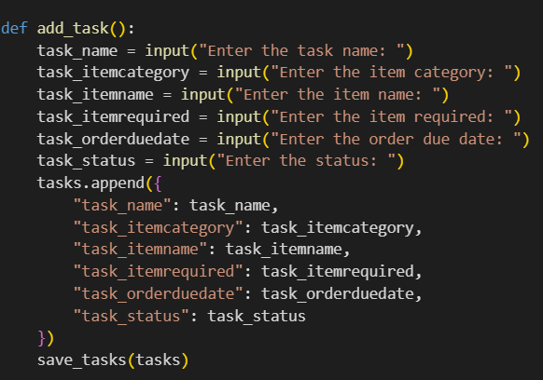
Design Application
ADD TASK :-
The “Add Task” feature allows users to input a new task into the To-Do List by providing details such as the task name and description. This task is then stored in the application’s data structure, making it available for future viewing and management

Slide 8
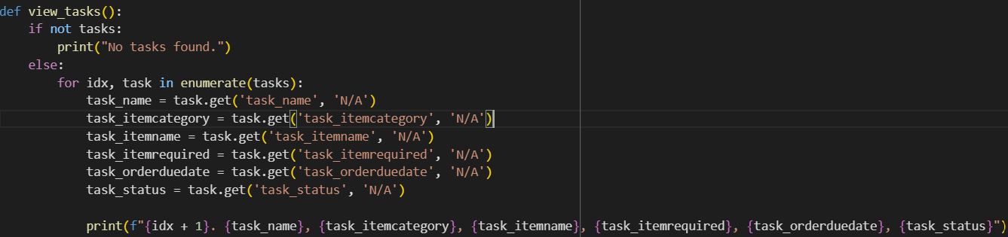
Design Application
VIEW TASK :-
The “View Task” feature allows users to see a list of all the tasks they have added to the To-Do List. This functionality displays each task’s details, such as the task name and description, enabling users to keep track of their pending and completed tasks.

Slide 9
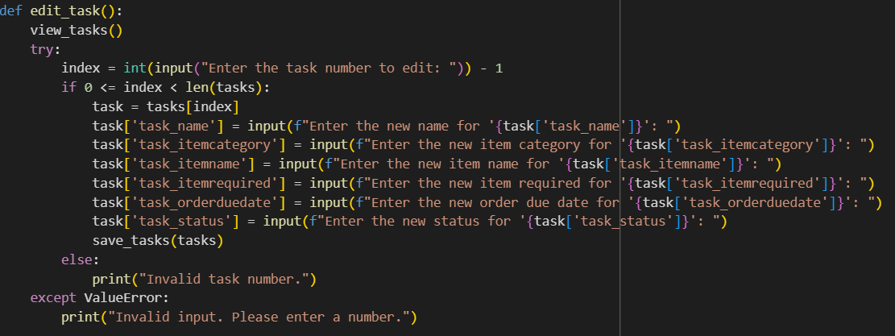
Design Application
EDIT TASK :-
The “Edit Task” feature allows users to modify the details of an existing task in the To-Do List. Users can update information such as the task name and description, ensuring that their task list remains accurate and up-to-date

Slide 10
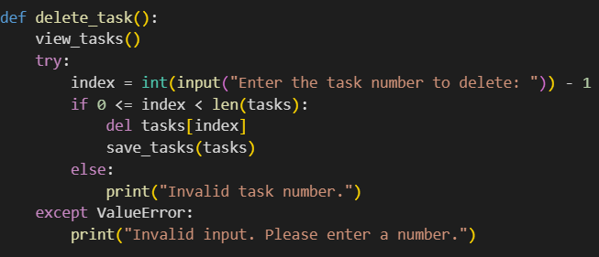
Design Application
DELETE TASKS :-
The “Delete Task” feature allows users to remove a task from the To-Do List. By selecting a specific task, users can permanently delete it, ensuring their list remains organized and clutter-free.

Slide 11
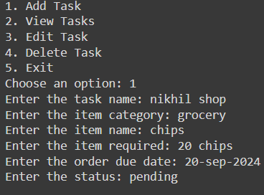
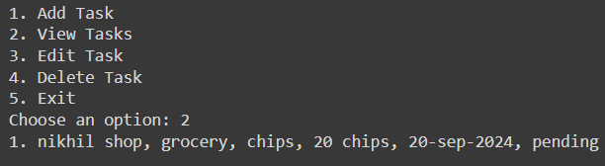
TESTING & DEBUGGING
Testing and debugging ensure that all functionalities of the To-Do List application work correctly and efficiently. By identifying and fixing errors, you can improve the application’s reliability and user experience
ADD TASK O/P
VIEW TASK O/P

Slide 12
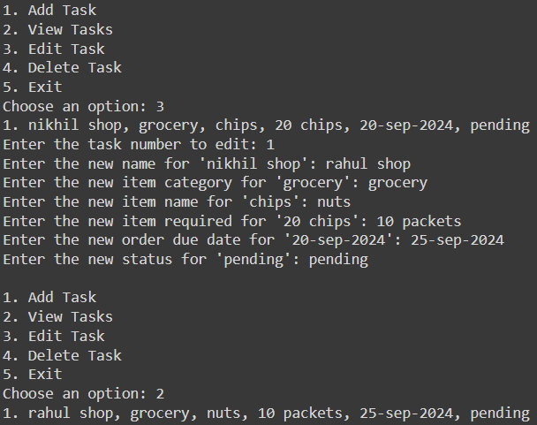
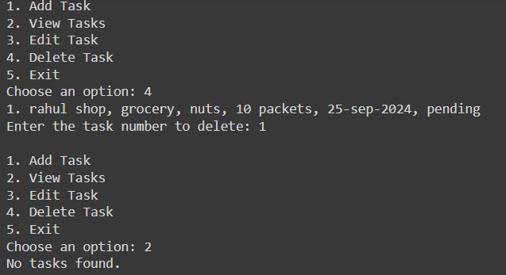
TESTING & DEBUGGING
EDIT TASKS O/P
DELETE TASKS O/P

Slide 13
Challenges Faced
Attempted to execute Python code in Visual Studio Code.
Encountered issues with Visual Studio Code configuration.
Troubleshooting the problem did not resolve the issue.
Decided to switch to Google Colab for execution.
Imported necessary libraries in Google Colab.
Uploaded required files and ensured all dependencies were met.
Successfully ran the Python code.
Output generated as expected.
Successfully completed execution in Google Colab without further issues.
Visual Studio Code may need a deeper configuration fix (to investigate).
Google Colab offers a good backup environment for running Python code.

Slide 14
Learning
Create Application Framework: Set up project structure and core modules.
Build Basic Functionality: Implement CRUD operations for task management and integrate data storage. Integrate Advanced Capabilities: Add features like task prioritization and optimize performance.
Conduct Testing and Debugging: Test, debug, and handle edge cases. Update and Maintain Git Repository: Commit changes, manage branches, and push updates.
Conclusion
This project aims to build practical Python skills through the creation of a To-Do List application that incorporates essential CRUD operations. By completing this project, you’ll gain a solid understanding of Python programming and data handling fundamentals

