Slide 1

SMART INDIA HACKATHON 2026
TITLE PAGE
Problem Statement ID – 26189
Problem Statement Title- AI-Powered Criminal Network Analysis System
Theme- Blockchain & CyberSecurity
PS Category- Software
Team ID-
Team Name- NIRVANA

Slide 2
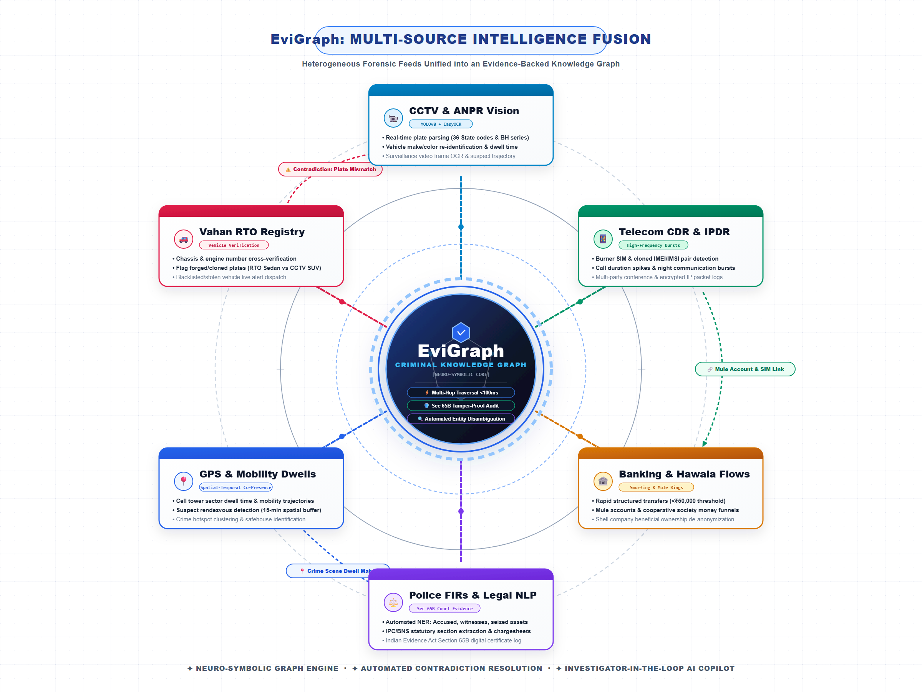
EviGraph: AI-Powered Criminal Network Analysis System
NIRVANA
How It Addresses the Problem :
➢ Breaks Data Silos → Unifies fragmented investigation sources into a single connected view, reducing manual cross-referencing.
➢ Reveals Hidden Connections → Multi-Hop Graph Analysis exposes indirect relationships that may be difficult to identify through record-by-record investigation.
➢ Identifies Key Actors & Clusters → Degree & Betweenness Centrality helps identify highly connected individuals, important intermediaries and suspicious clusters.
➢ Vehicle Identity & Verification → CCTV vehicle analysis + plate recognition using YOLOv8 + RTO verification helps identify suspicious or conflicting vehicle identities.
➢ Spatial-Temporal Analysis → Correlates who, where and when to identify potential co-presence, movement patterns and find location history to identify Hotspots.
Innovation And Uniqueness Of The Solution :
➢ AI-Assisted Investigation: Enables investigators to ask natural-language questions and receive relevant relationships, analytical insights and supporting evidence.
➢ Evidence-Backed Analysis → Links discovered relationships, patterns and anomalies to their supporting evidence and source records, with confidence scores , enabling investigator validation.
➢ Human-in-the-Loop Decision Support → AI surfaces connections, patterns and evidence, while the investigator retains control over interpretation and final decisions.
Explanation of Proposed Solution :
EviGraph is an AI-powered Criminal Network Analysis System that converts heterogeneous investigation data into a unified, evidence-backed knowledge graph.
➢ Multi-Source AI Data Processing: Unifies FIRs, CDRs, financial records, CCTV feeds, and location data, while NLP-based entity extraction and normalization identifies persons, phones, vehicles, accounts, and events.
➢ Criminal Knowledge Graph: Converts extracted entities and relationships into an interconnected graph, providing a unified visual representation of the entire criminal network.

Slide 3















TECHNICAL APPROACH
NIRVANA
Working Flowchart
KEY STEPS
Investigator Findings(Leads,Evidences)
SHA-26 Hash Generation
•Multi-Source Data Ingestion: Collects and extracts data from multiple sources like FIR,CDR
CCTV, Location, Financial ,other records.
•Data Validation & Normalization : Clean, validated, standardized and de-duplicated data to create reliable investigation records
•Parallel Processing : OCR extracts text from uploaded documents(FIR), YOLO model extracts vehicle and finds number of persons from CCTV footage then vehicle information then info is verified in RTO records.
•Entity Resolution : Unifies duplicate entities(Identify and link the same person, phone
or vehicle across different records).
•Network Graph : Builds a relationship graph connecting entities to reveal links, clusters and criminal networks.
•Graph Analysis : Detects key suspects(High connections entity), communities, anomalies and multi-hop connections(hidden relations), Hotspots by mapping location and timeline .
•SHA-256 Hash generation & Audit : Generates hashes for evidences and maintain an immutable blockchain audit trail while keeping sensitive evidence off-chain.
•Evidence Integrity Check : Whenever evidence is accessed, its current hash is compared with the blockchain-recorded hash to identify Verified & Trusted evidence or Tampering Alerts.
FIR
CDR
CCTV
Financial
Location
Other
Hyperledger Fabric
Investigator Login
Create/Select Existing Case
Multi-Source Data Ingestion
Data Validation And Normalization
Key Suspects, Hotspots Discovery
Verification feedback loop
Evidence Integrity Check
Parallel Processing
Graph Analysis
OCR YOLOv8+OpenCV Structured
Data Parsing
Generates Criminal Network Graph
Community, Anamoly Detection & Multi-Hop Discovery
Entity Resolution
NO
Extracts text from Documents
Extracts Vehcile Info
YES
✅ Verified & Trusted
Processes CDR , Bank,
Location data
⚠️Tampered Alert
TECHNOLOGY STACK
Frontend(UI)
Backend
Data Analytics
Data & Security
Blockchain & Integrity, Deployment
• YOLOv8 -Vehicle/person detection from CCTV
• OpenCV + EasyOCR – Image/video processing, OCR-based text extraction.
• NetworkX + Louvain – Criminal-network &
community analysis
• NLP / NER — Entity and
relationship extraction
• Scikit-learn — Anomaly
/risk analysis
• SQLite – Case &
investigation data
• JWT / OAuth 2.0 – Secure authentication.
• bcrypt / Argon2 : Securely hashes passwords.
• Audit Logging – Track every sensitive administrative/
Investigation action.
• Datasets –CDR, FIR,RTO CCTV, financial,location data
• React + Vite + TypeScript– Interactive Investigation dashboard
• Tailwind CSS – Responsive and secure UI design
•React Flow + Recharts — Network graphs and analytical visualizations
• Python + FastAPI High performance REST
API
• Pydantic — Data validation
• RESTAPIs – Secure communication between frontend and backend
• Uvicorn : Backend
server
• Hyperledger Fabric – Permissioned evidence ledger
• SHA-256 Hashing – Generates a digital fingerprint of evidence to verify integrity
• Off-chain Storage – Sensitive evidence remains outside blockchain.
• Git/GitHub+ Docker: Reproducible deployment & version
control.

Slide 4




FEASIBILITY AND VIABILITY
NIRVANA
Feasibility :
Viability :
⚠️ Potential Challenges & Mitigations
🔧TECHNICAL :
• Technically Feasible: Built using proven technologies FastAPI, React, YOLOv8, OpenCV, EasyOCR, NetworkX & Scikit-learn.
• Evidence Integrity: Planned permissioned blockchain for
evidence hashes, case actions & access logs.
• Data Integration: FastAPI APIs can integrate authorized
sources like FIR/legal records, CDR and RTO databases,
enabling unified investigation and evidence correlation.
📈 Scalable: SQLite prototype can scale to PostgreSQL for production deployment.
♻ Sustainable: Modular architecture allows future AI,
data-source and security upgrades without major redesign.
Data Quality & Entity Resolution --
Missing, inconsistent or conflicting records may cause incorrect entity links affecting investigation results.
Strategy : Adding confidence score for generated relationships + multi-source cross verification + normalization and Data validation (Investigators verify generated relationships and insights before action).
1
⚙️ OPERATIONAL :
• Fits the existing investigator → evidence → analysis
→ decision workflow.
• Investigator-friendly dashboard for evidence search & analysis
• Graph + timeline + evidence views reduce manual
cross-referencing.
• Human-in-the-loop approach keeps investigators in control.
AI Accuracy – OCR, vehicle/person detection and anomaly detection can produce false positives/negatives
Strategy : Human-in-the-loop validation(Investigator not the model , makes the final decision by verifying results) + continuous model evaluation
⊕ Extensible: New datasets, AI models and
authorized agency sources can be integrated.
🚀 Deployable: Can be deployed in real
police/institutional environments.
2
Data Privacy & Access Control – Investigation data contains highly sensitive information.
Strategy : Secure RBAC(Role Based Access Control) + Audit Logs: Restrict sensitive operations by roles like Investigator / Analyst /Super admin and records critical actions.
⚖️ LEGAL AND SECURITY:
• Compliance: Follows applicable data protection laws
and cybersecurity regulations.
• Security: Role-based access, audit trails and blockchain-
based integrity checks protect sensitive evidence.
• Adoption: Can be aligned with required legal approvals
while streamlining investigation workflows.
3
Trust-ready: Permissioned blockchain
can secure evidence integrity while
sensitive data remains off-chain.
Evidence Integrity – Investigation evidence must
remain verifiable and tamper-evident.
Strategy : Generate a SHA-256 hash for evidence and
record the hash/audit event on a proposed permissioned
Hyperledger Fabric network, whenever evidence is accessed,
its current hash is compared with blockchain recorded hash
to identify whether evidence is tampered or not ; sensitive
evidence itself remains off-chain(Sensitive evidence is
securely stored outside the blockchain; only its hash is
recorded on-chain).
4
💰 FINANCIAL:
• Cost-effective: Uses open-source technologies and
existing infrastructure, minimizing development and
deployment costs.
• Scalable: Cloud/on-premise deployment and modular
blockchain integration allow costs to scale with usage.
Cost-effective: Uses mostly open-source
technologies, reducing software licensing costs.

Slide 5
IMPACT AND BENEFITS
NIRVANA
DIRECT IMPACT ON TARGET USERS
BENEFITS OF THE SOLUTION
👮 Investigators
• Connects FIR, CDR, CCTV, financial, RTO & location evidence in one view resulting in Faster investigations by reducing manual cross-referencing
• Keeps the investigation investigator in control through human-validated AI insights.
👥 Social
• Stronger public safety through faster identification of suspicious networks and connections.
• Reduces dependence on purely manual investigation and helps investigators handle complex cases.
🛡️ SOC / Intelligence Analysts
• Graph and timeline analysis makes relationships, hotspots and key actors
faster and easier to interpret.
• Provides an explainable trail from evidence → relationship → insight.
💰 Economic & Operational Benefits
• Reduces investigator time spent manually correlating multiple datasets
• Cost-effective deployment using predominantly open-source technologies and existing investigation infrastructure..
🏛️ Senior Officers / Investigation Managers
• Case progress becomes easier to review and audit.
• Standardized investigation records improve coordination between teams/agencies.
🛡️Security & Strategic Benefits
• Supports controlled access and auditability for sensitive investigation data.
• Strengthens evidence integrity through SHA-256 verification and audit trails
• Creates a foundation for AI-assisted, data-driven digital investigation. .
⚖️ Authorized Agencies
• Secure role-based access prevents unauthorized evidence exposure.
• Evidence hashes + audit trails strengthen chain-of-custody assurance.
• Supports controlled case/evidence transfer between authorized agencies.

Slide 6
RESEARCH AND REFERENCES
NIRVANA
➢ Criminal Network Analysis & Knowledge Graphs
• Criminal Investigations and Network Analysis
George Mason University — Used for: Extracting actors, entities and
relationships from textual data and constructing dynamic criminal-network
knowledge graphs.
Link:https://cina.gmu.edu/projects/using-deep-learning/
• ROXANNE Research Platform: Automate Criminal Investigations
Fabien et al., INTERSPEECH 2021 — Used for: multimodal speech, text,
video and criminal-network analysis
Link: https://www.isca-archive.org/fabien21_interspeech.pdf
➢ Graph Analytics & Community Detection
• Fast Unfolding of Communities in Large Networks
Blondel et al., 2008 — Used for: Louvain community detection and
criminal - group clustering
Link: https://arxiv.org/pdf/0803.0476
➢ Computer Vision & Evidence Extraction
• Ultralytics YOLOv8
Ultralytics — Used for: person and vehicle detection in CCTV evidence
Link : https://docs.ultralytics.com/models/yolov8
• OpenCV – Open Source Computer Vision Library
OpenCV Foundation — Used for: CCTV preprocessing, image enhancement
and tracking
Link: https://docs.opencv.org/5.0/
• EasyOCR
JaidedAI — Used for: license-plate and text extraction from visual evidence
Link (Repository): https://github.com/JaidedAI/EasyOCR
➢ Evidence Integrity & Blockchain
• Hyperledger Fabric
Hyperledger Foundation — Used for : permissioned evidence records and auditability
Link : https://hyperledger-fabric.readthedocs.io/en/release-2.5/
• FIPS 180-4 – Secure Hash Standard
NIST — Used for : SHA-256 evidence fingerprinting and integrity verification
Link : https://nvlpubs.nist.gov/nistpubs/FIPS/NIST.FIPS.180-4.pdf
➢ NLP & Knowledge Extraction
• spaCy – Named Entity Recognition (NER)
Explosion / spaCy — Used for: extracting Person, Location & other entities from FIRs, reports
Link : https://spacy.io/usage/linguistic-features
➢ Retrieval-Augmented Investigation
• Retrieval-Augmented Generation for Knowledge-Intensive NLP Tasks
Lewis et al., 2020 — Used for: evidence-backed AI investigation, retrieving relevant
records/documents before generating investigation answers.
Link : https://arxiv.org/pdf/2005.11401
➢ Technical Foundation
• React — Used for: building the interactive investigator interface.
Link: https://react.dev/
• FastAPI — Used for: building the backend API that connects the investigation dashboard
Link : https://fastapi.tiangolo.com/
• Scikit-learn — Used for: machine-learning tasks such as risk/anomaly analysis, model evaluation
Link : https://scikit-learn.org/stable/getting_started.html
• SQLite — Used for: storing case, evidence and investigation data.
Link : https://www.sqlite.org/docs.html

