Slide 1

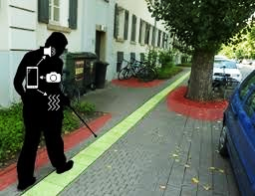
Smart Navigation System For Visually Impaired People

Slide 2
Team Members
Sl no | Roll No | Name
1 | CB.EN.U4CSE21044 | Picheri Likitha
2 | CB.EN.U4CSE21046 | Ragala Tejdeep
3 | CB.EN.U4CSE21056 | Shri Venkatakrishnan

Slide 3
SMART NAVIGATION FOR VISUALLY IMPAIRED PEOPLE
Project Description
The Smart Navigation System is designed to assist visually impaired individuals in navigating their surroundings autonomously. Using advanced sensors, it provides real-time feedback on obstacles and routes, enhancing safety and independence for the visually impaired.

Slide 4










Process Flow Overview
A->B->C
STEP 1
The user gives audio input of destination to the mobile phone
STEP 2
We locate the closest waypoint to the user and query the database to find stored route
STEP 3
We fetch the route begin navigation using audio output
STEP 4
We navigate the user in real-time by locating him at regular intervals and updating distance to next view point
STEP 5
We perform analysis on cloud to find most used routes
TECHNICAL QUESTIONS
How do you locate user using BLE beacons
How is data stored in the database

Slide 5
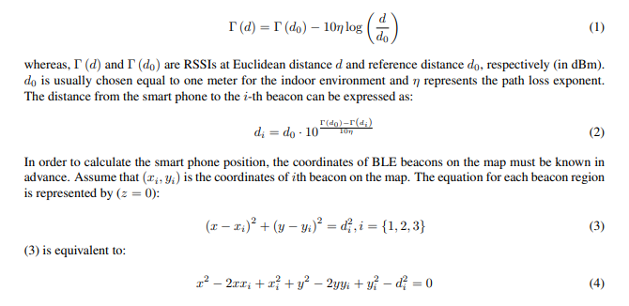
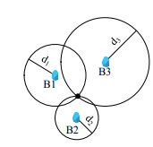
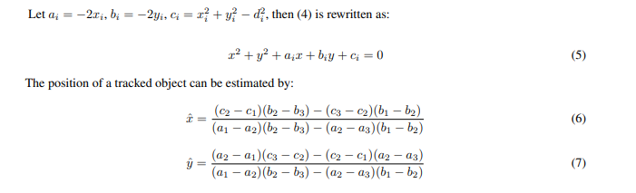
How do you locate user using BLE beacons
Received signal strengths from these beacons are calculated via the following formula
TRIANGULATION

Slide 6
How is data stored in the database
ID | Waypoint
1 | Library
2 | MBA
3 | Store
4 | Anokha Hub
SRC | DEST | ROUTE
1 (Lib) | 3 (Store) | 1 (Lib) -> 2 (MBA) -> Right Turn -> 3 (Store)
SRC | DEST | Distance
1 (Lib) | 2 (MBA) | 200m
2 (MBA) | 3 (Store) | 250m
3 (Store) | 4 (Anokha Hub) | 50m

Slide 7






KEY PROCESSES INVOLVED
W1
1
Process Voice Input for destination
Gets location of next using
Calculates distance to the next way point
Send route and current location to AWS
2
2
3
4
3
1
4

Slide 8

Communication technologies & Transmission protocols
Wi-Fi Connectivity
BLE Beacons
Wi-Fi connectivity enables smart navigation system to connect to local Wi-Fi networks, providing access to the internet and allowing communication with online cloud services
[ TCP-IP]
Transmits Bluetooth signals that can be detected by nearby devices equipped with Bluetooth capabilities, such as smartphones or ESP32 devices.
These beacons are strategically placed to mark specific locations or points of interest along the navigation route, providing spatial references and enabling the system to determine the user's location relative to these beacons

Slide 9
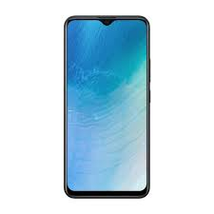
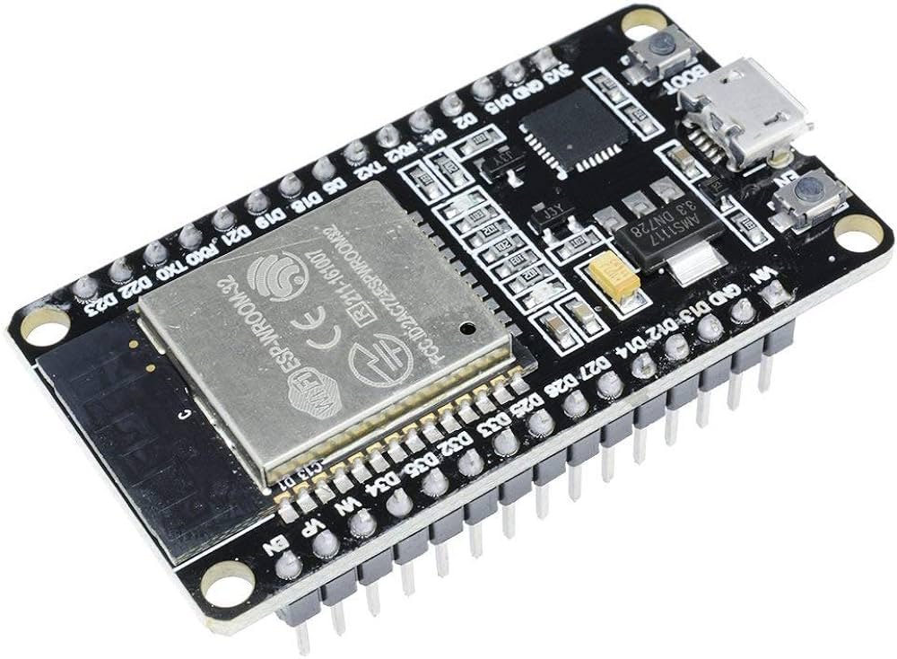
Hardware components
Mobile Phone (It acts like actuators as well, providing haptic feedback and audible alerts to guide visually impaired individuals through a smart navigation system, enhancing their spatial awareness and safety.)
Acts as Bluetooth Beacon (Transmit signals to smartphones, enabling precise location tracking and guidance through indoor environments)

Slide 10
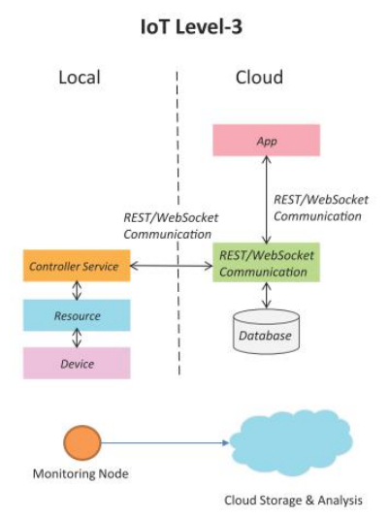
DEPLOYMENT
Our level-3 IoT system has a single node.
Data is stored and analyzed in the cloud and application is cloud- based

Slide 11
Start
Software Flowchart
Input Destination using Audio
Use Destination to get route
Start Navigation
Check ultrasonic sensor
Provide audio navigation
Update Distance using triangulation
Route is sent to cloud
If current location == Destination
No
Yes
Stop

Slide 12
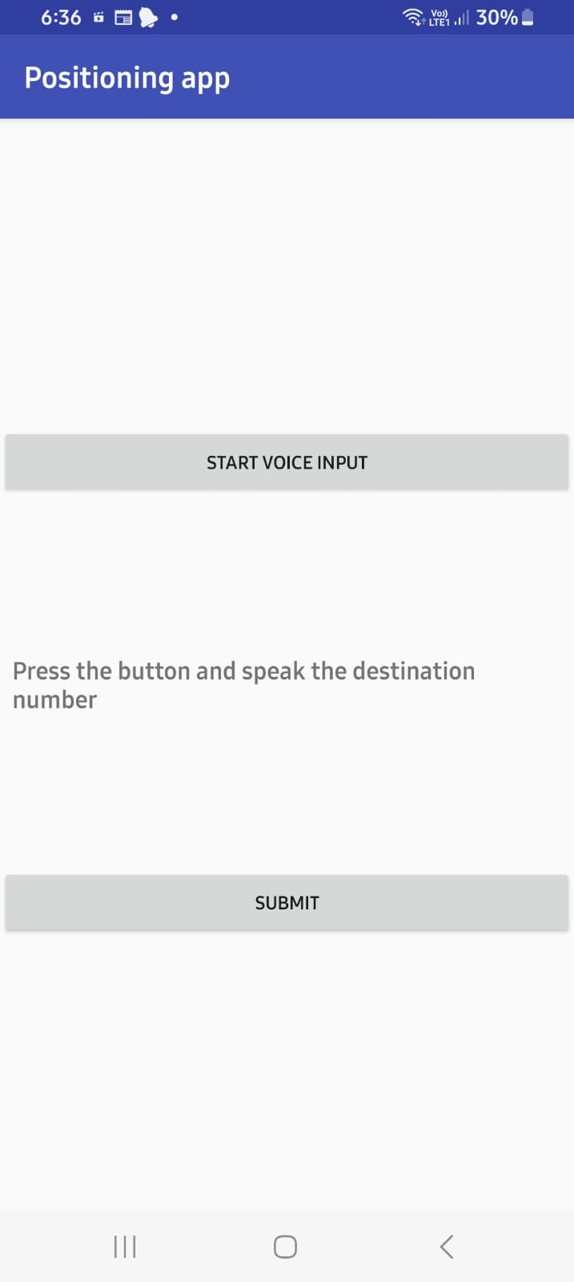
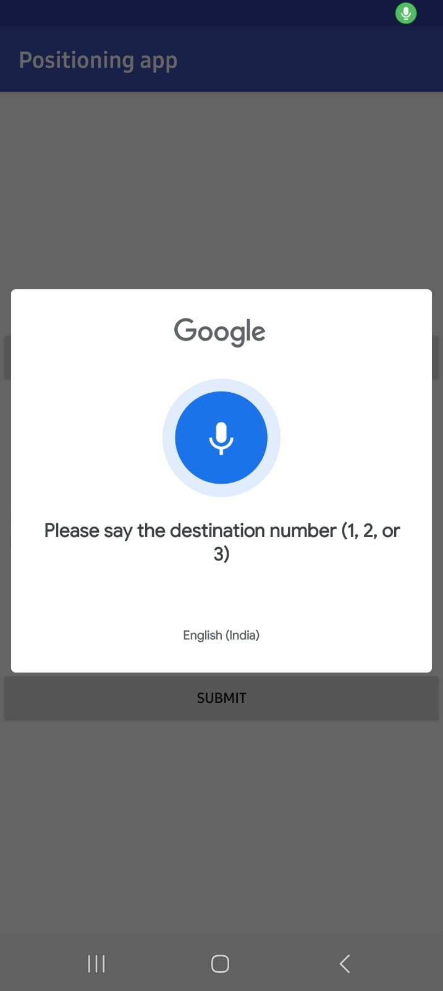
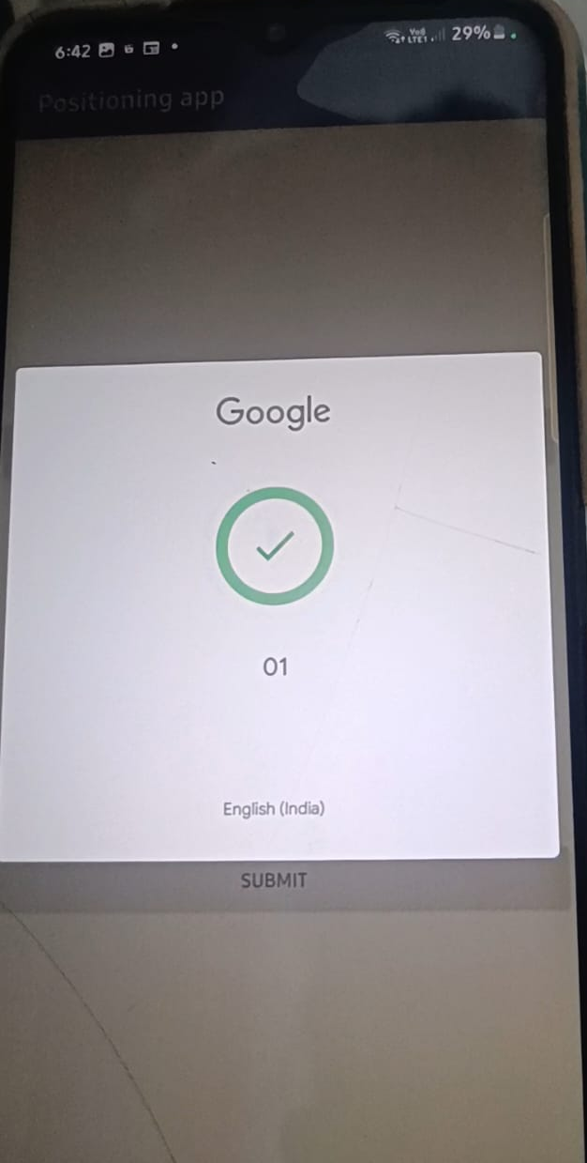
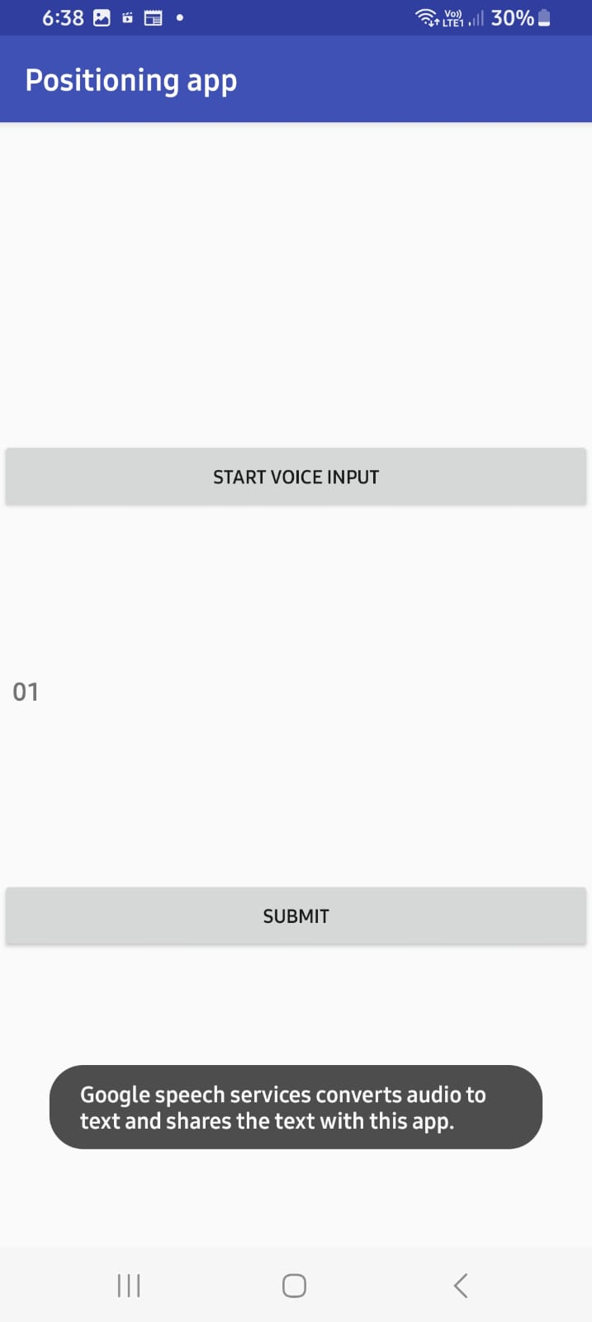
UI Screens
Voice Input

Slide 13
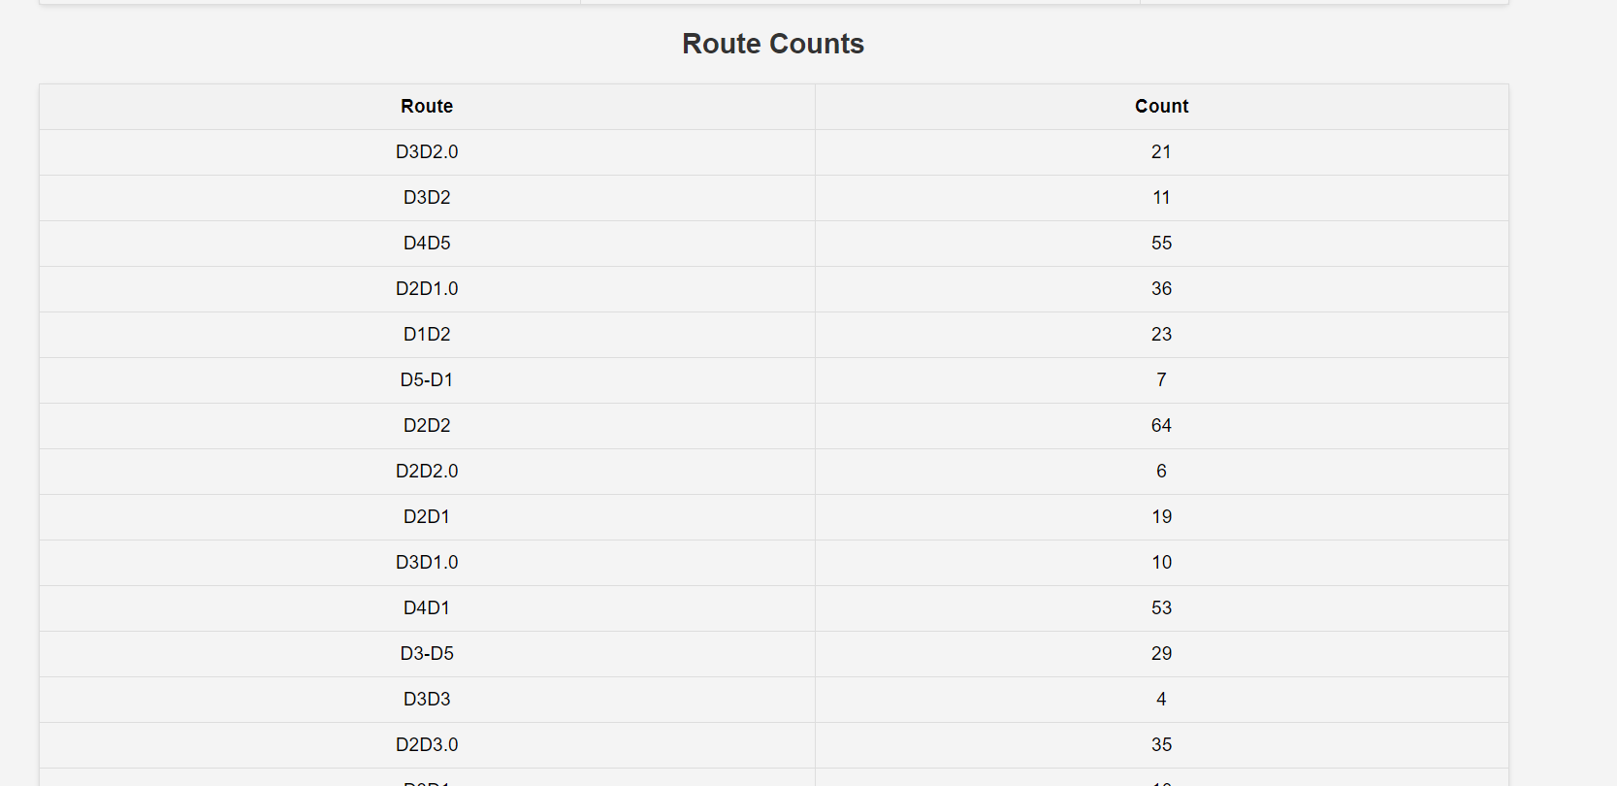
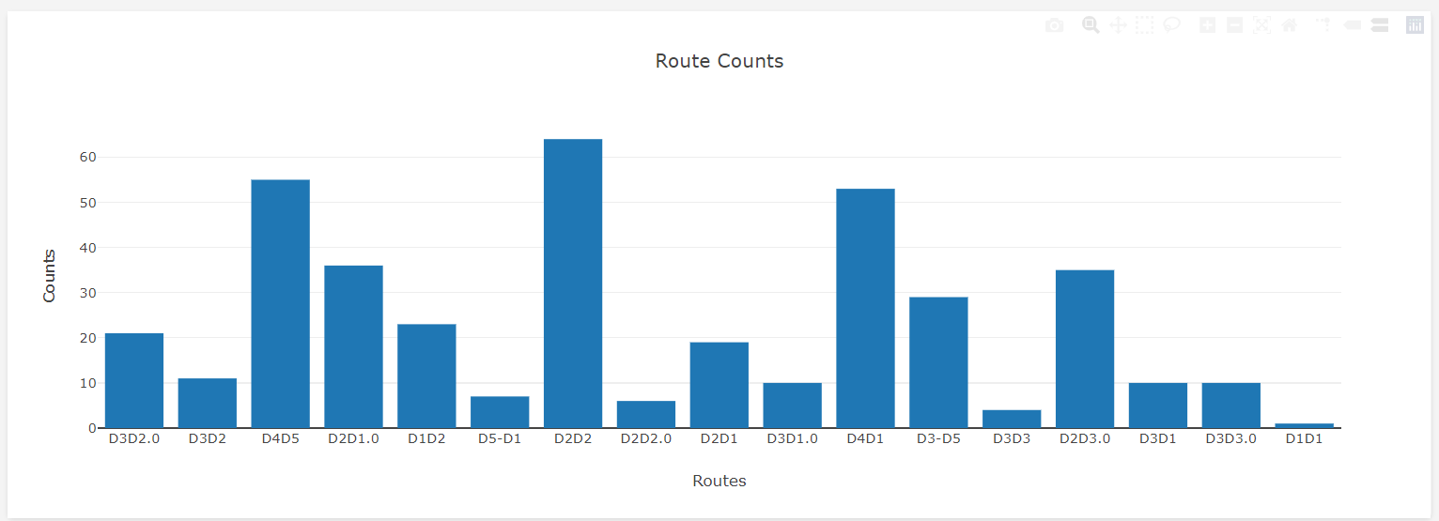
Data Analysis

Slide 14
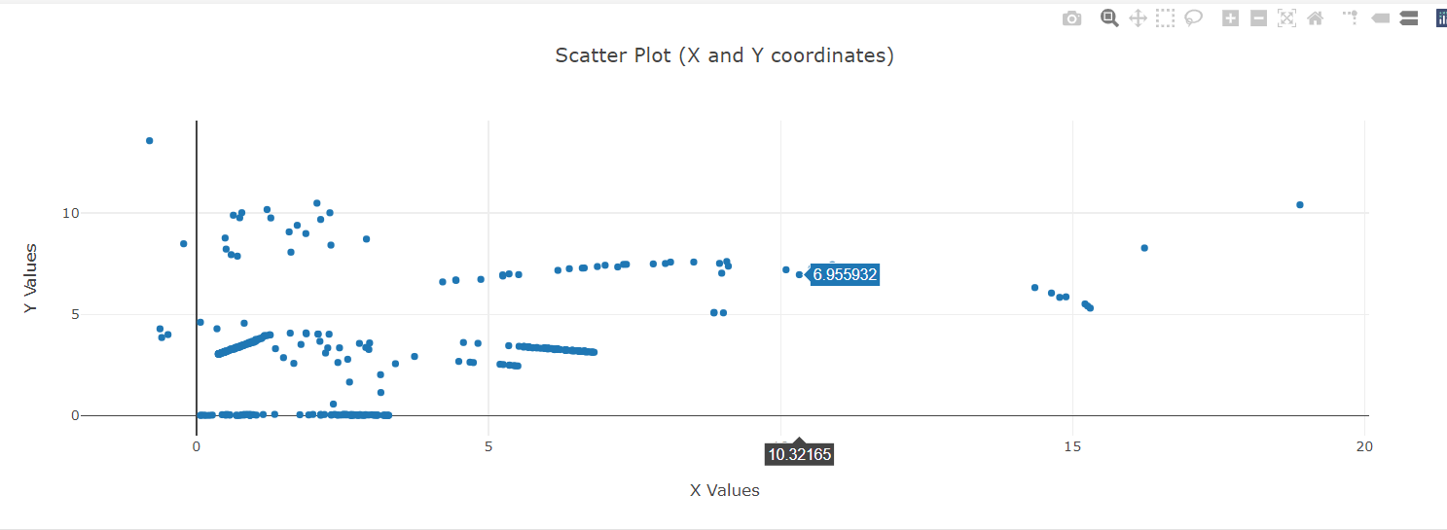
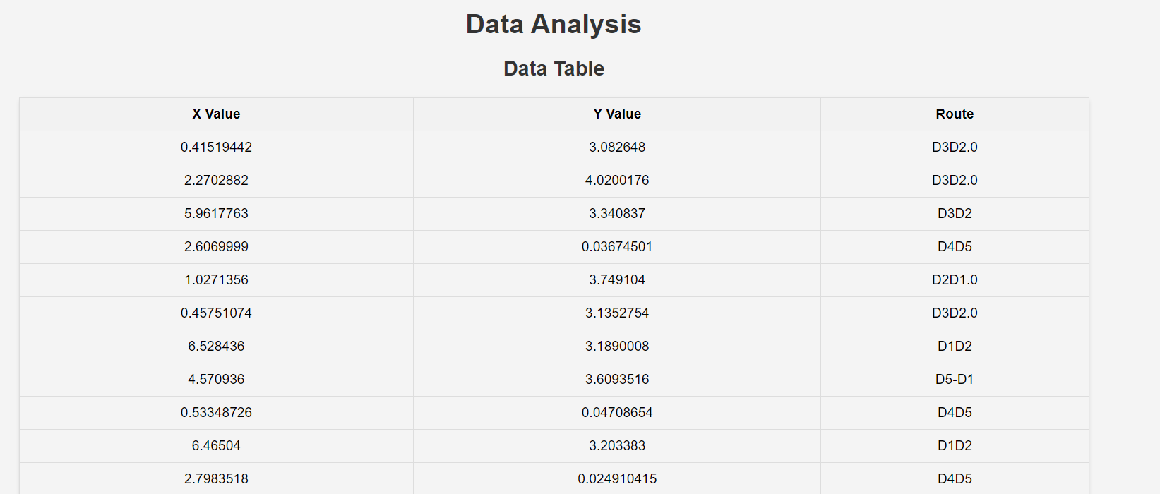
Data Analysis

Slide 15
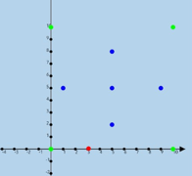



BEACONS
D3
Our Graph with notations
D1
D5
D2
DESTINATION LANDMARKS
D4
CURRENT
LOCATION

Slide 16
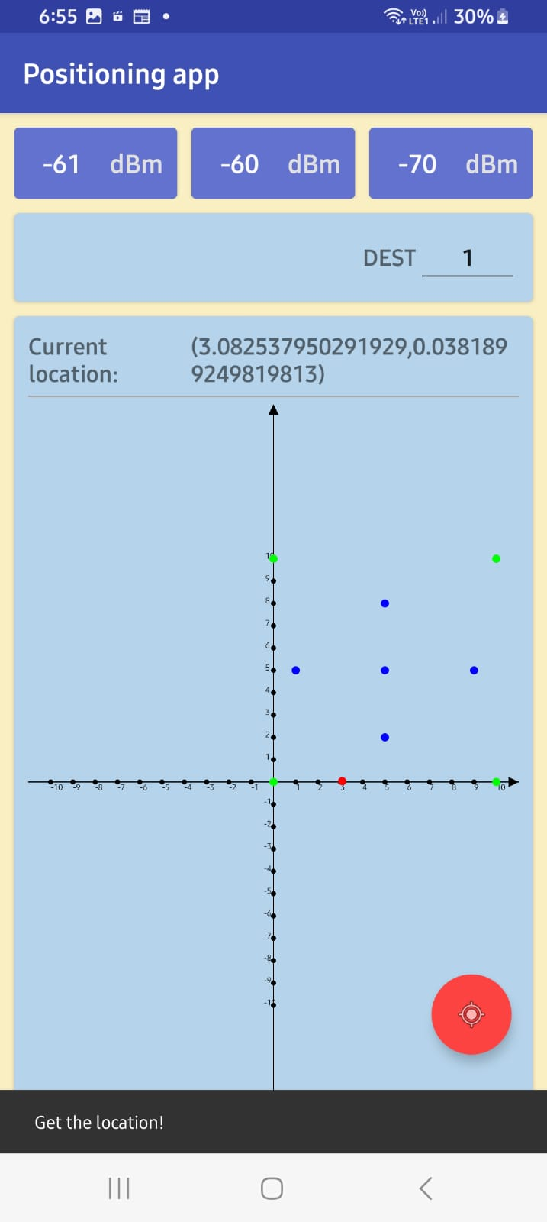
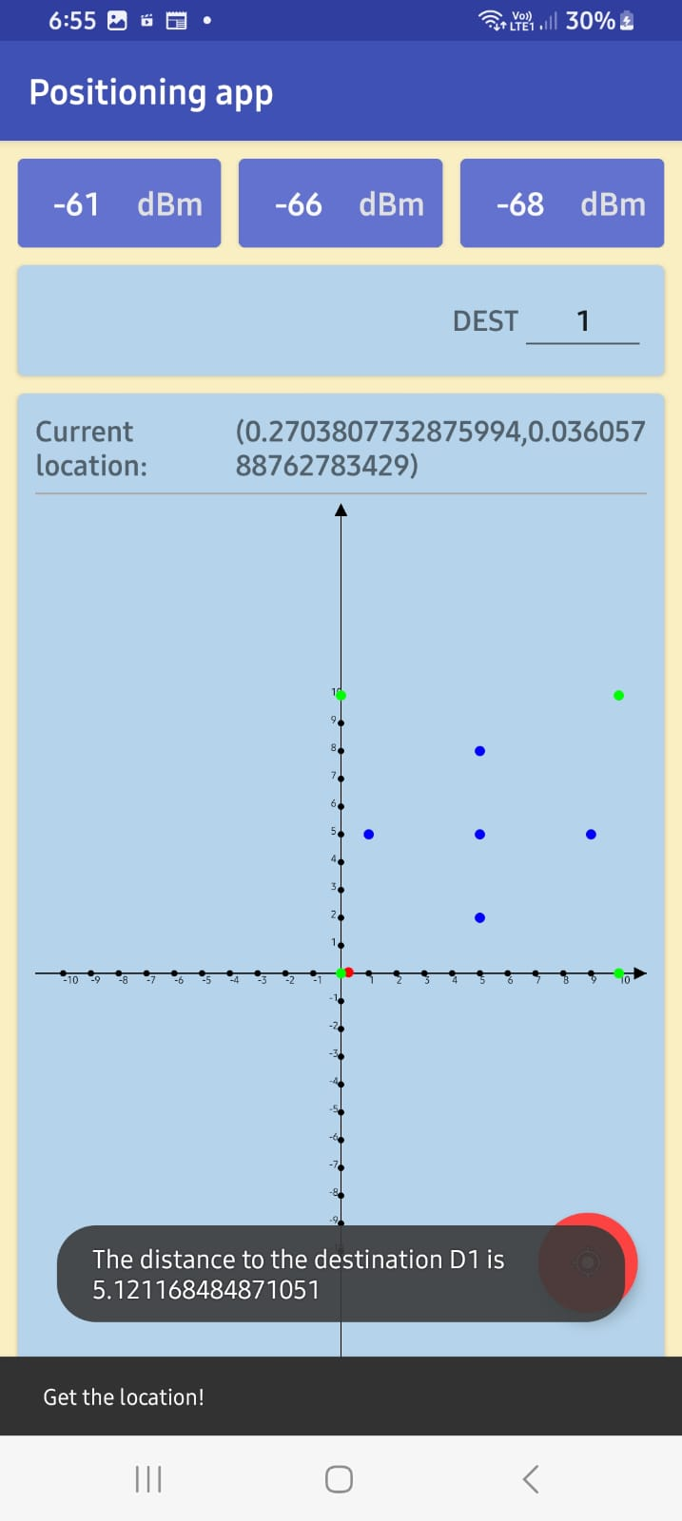
App Screen
Calculates and voices out distance to destination

Slide 17


Analysis of Data Stored in Cloud
2. We also use Machine Learning to predict the estimated time to reach destination
1. We analyse the route requested maximum number of times Every time a user requests a particular destination we increase count of the corresponding route by 1

Slide 18
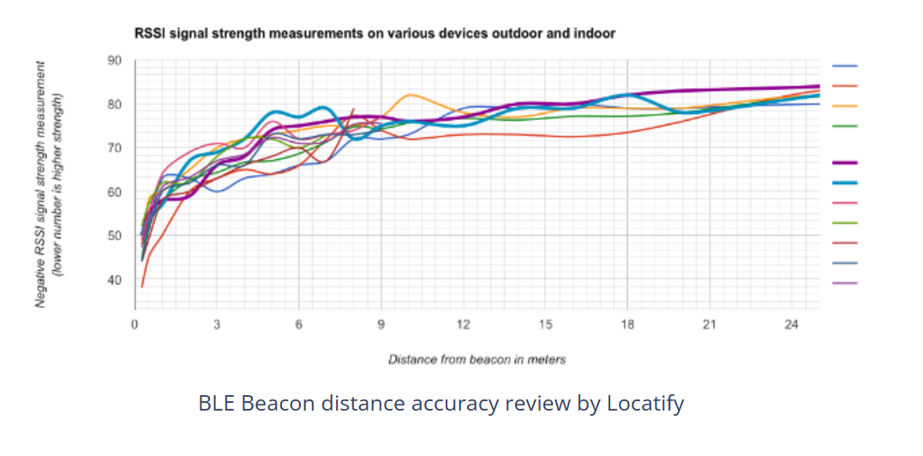
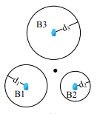

Key challenges involved
The edge case of user not in intersection of 3 beacon regions
May not be the most cost efficient solution given the number of beacons that need to deployed for achieving good accuracy
When we perform position triangulation using beacons, we get around +- 2 meters accuracy of location if the smartphone is within 6 meters range of 2-3 beacons. That means a lot of beacons, which in some environments is not possible and the measurement isn’t really that precise.

Slide 19
THANK YOU

