Slide 1

AMCAT DATA
Exploratory Data Analysis

Slide 2
About me
My name is Enugandula Mahendra, and I am a graduate in Computer Science and Engineering.
I have developed a strong passion for technology and its real-world applications, supported by a solid foundation in computer science areas such as programming, data structures, algorithms, and software development during my studies.
I want to learn Data Science to harness the power of data in making informed decisions and solving complex problems. As data continues to grow in volume, mastering Data Science will allow me to apply analytical techniques and machine learning to drive innovation and contribute to data-driven strategies across various industries
Accenture Solutions Private Limited
Position: Associate Application Development Associate
Domain: Amazon Web Services Duration: Feb 2022 - Mar 2024 (2 yrs 2 mos) Location: Hyderabad, Telangana, India (Remote)
LinkedIn: enugandula-7901-nani www.linkedin.com/in/enugandula-7901-nani
GitHub: nani7901 github.com/nani7901

Slide 3
Why EDA ?
Exploratory Data Analysis (EDA) is crucial for understanding data and uncovering insights before diving into complex analyses. Here are a few reasons why EDA is essential:
Understanding Data Structure: EDA helps identify the types of data, distributions, and relationships within the dataset, allowing for a deeper comprehension of the underlying patterns.
Identifying Outliers and Anomalies: Through visualizations and summary statistics, EDA reveals outliers and anomalies that may affect the results of subsequent analyses.
Informing Feature Selection: EDA guides the selection of relevant features for modeling by highlighting which variables contribute significantly to the outcome.
Formulating Hypotheses: By observing trends and patterns, EDA helps in formulating hypotheses that can be tested in further analyses.
Improving Model Performance: A thorough EDA ensures better data quality and prepares the dataset for modeling, ultimately improving the performance of predictive models.
Visual Storytelling: EDA provides powerful visualizations that communicate findings effectively, making it easier to share insights with stakeholders.

Slide 4
Business Problem and Use case domain understanding
As companies prioritize diversity, equity, and inclusion (DEI) initiatives, ensuring fair pay practices becomes crucial for HR teams. This study aims to determine whether gender, along with factors like specialization, significantly impacts salary outcomes for recent engineering graduates. Identifying and addressing potential gender-based salary gaps can help organizations create more equitable compensation systems, enhancing employee satisfaction and retention.
This project leverages the Aspiring Mind Employment Outcome (AMEO) 2015 dataset to conduct a comprehensive analysis of gender-based salary disparities across various engineering specializations. By examining employment outcomes such as salary and job titles, this study aims to provide actionable insights for businesses in the tech, engineering, and HR sectors to foster equitable pay practices and ensure gender parity in compensation. Furthermore, it offers academic institutions valuable data to better understand the salary expectations of their engineering graduates, enabling them to refine their curricula and career services to align with evolving industry demands and enhance graduate employability.

Slide 5
Objective of the Project:
Identify Salary Disparities:
To determine whether there are significant salary differences between male and female graduates across various engineering specializations.
Analyze Gender Imbalance:
To explore which specializations exhibit the most significant gender imbalances in terms of representation and pay.
Uncover Salary Trends:
To identify specializations where female graduates earn salaries comparable to or higher than male graduates and those where males are predominantly paid more.
Provide Insights for Equity:
To deliver valuable insights for organizations and academic institutions on gender equity in salaries, supporting the development of fair compensation policies and fostering diversity and inclusion within the engineering workforce.

Slide 6
Summary of the Data
The dataset contains information on 3998 candidates, with 38 columns that cover various aspects such as personal information, academic qualifications, and skill assessments.
There are 29 numerical columns and 9 categorical columns.
The data includes details like candidate ID, salary, date of joining and leaving, designation, job location, gender, date of birth, academic scores, college information, and AMCAT scores.
These variables provide insights into factors affecting salary, such as academic performance, skill levels, and personality traits.
The dataset aims to analyze the impact of various factors on a candidate's salary and provide insights into hiring trends in the tech industry.
This data can be used to develop predictive models to identify factors that contribute to high salaries and create strategies for attracting and retaining top talent.

Slide 7
Exploratory Data Analysis:
Loading and Understanding the data.
Data Cleaning.
Uni-Variate Analysis.
Bi-Variate Analysis.
Insights and Conclusion.

Slide 8
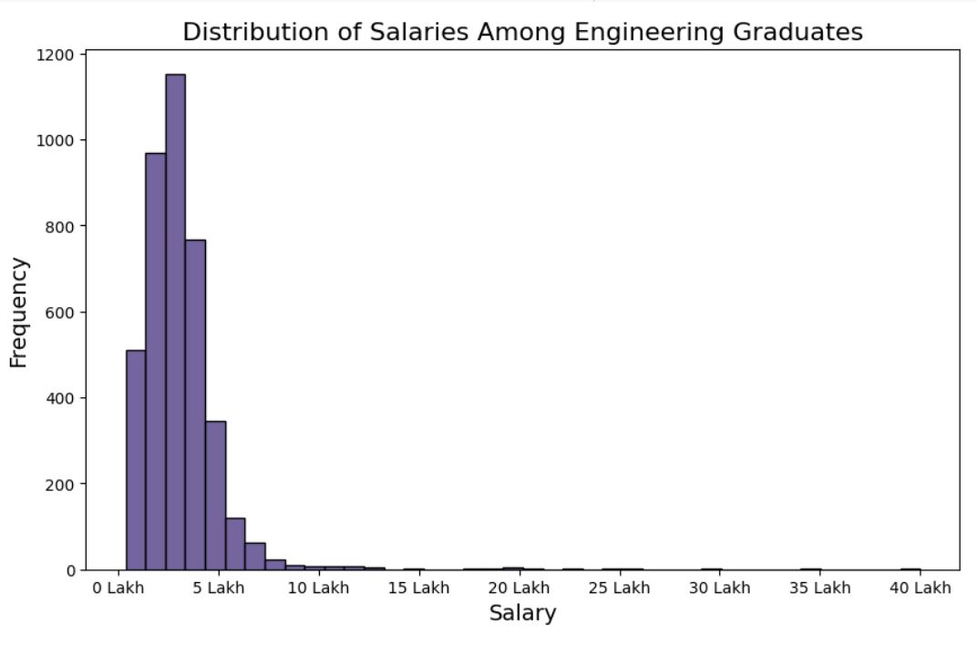
UNI-VARIATE ANALYSIS
The salary distribution is heavily right-skewed, with the majority of salaries clustered between 0 and 500,000, peaking around 200,000 to 300,000. There are a few extreme outliers beyond 1 million, indicating that while most individuals earn lower salaries, a small number earn significantly higher amounts

Slide 9
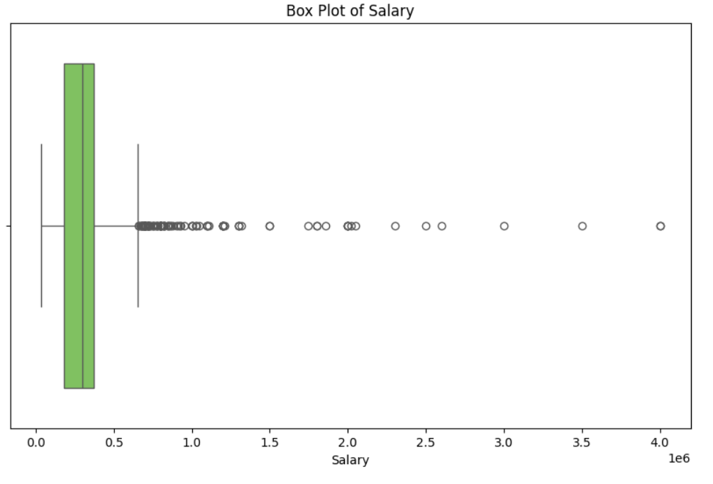
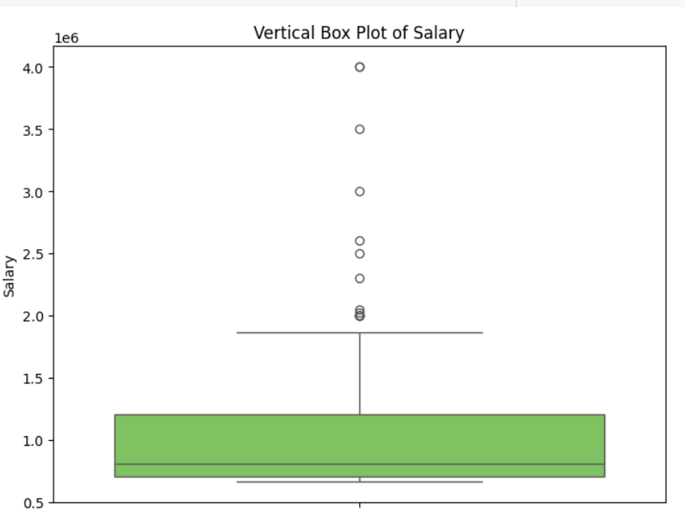
The left plot presents a horizontal box plot, while the right plot shows a vertical one. The median salary is approximately 0.4 million, with most salaries concentrated in the lower range. Several outliers are present, with some salaries surpassing 3 million. These box plots effectively highlight the salary range, median, and outliers, offering a clear view of the overall distribution and helping to identify any extreme values.

Slide 10
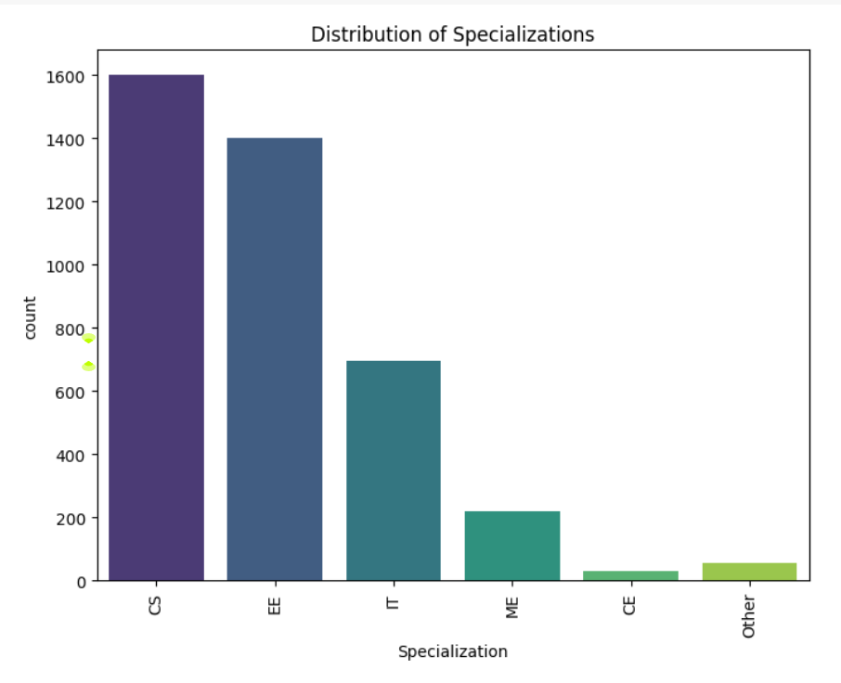
The most common specialization is CS, followed by EE and IT.

Slide 11
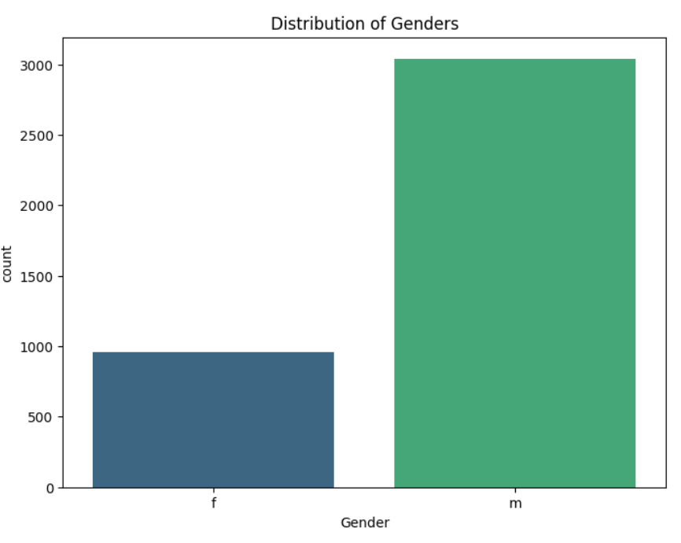
The gender distribution within the dataset reveals a pronounced majority of male participants. The countplot vividly illustrates this disparity, with the male category significantly outnumbering their female counterparts.

Slide 12
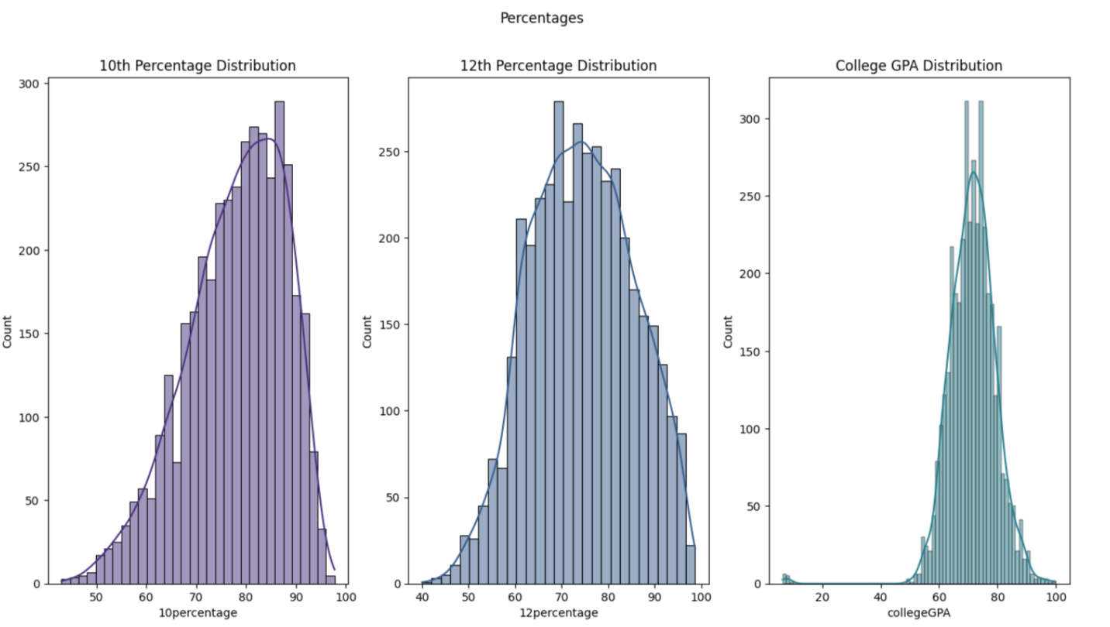
The histograms illustrate the distributions of 10th and 12th percentage scores, along with college GPA scores. Notably, all distributions exhibit a leftward skew, indicating a higher concentration of students with lower scores compared to those with higher scores. This trend suggests that a significant number of students are performing at the lower end of the scoring spectrum, which may warrant further investigation into the factors influencing academic performance. Most of the aspirants got 50 to 100 percentages in 10th, 12th and College but there are some students who failed in college(i.e.below 20%) .

Slide 13
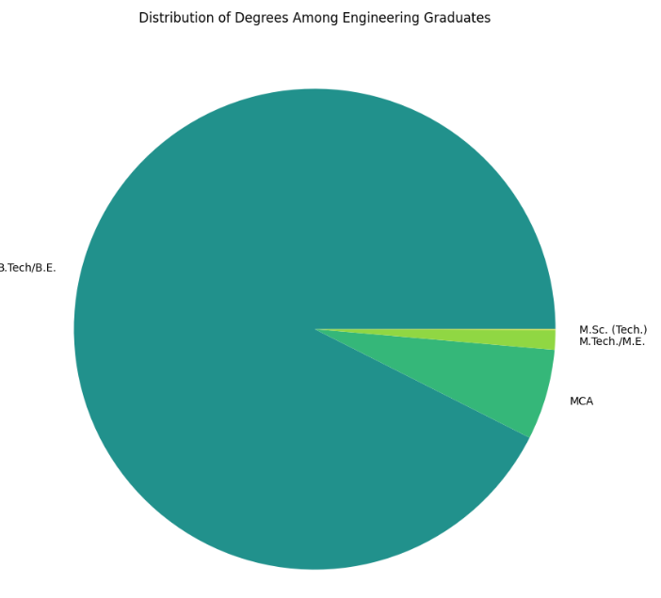
The pie chart indicates that a substantial majority of engineering graduates possess a B.Tech or B.E. degree, suggesting that most students pursue a bachelor's in engineering prior to considering further education. The smaller percentage of graduates holding M.Sc. (Tech.), M.Tech./M.E., or MCA degrees reflects a notable inclination toward specialization or research-focused studies after completing their undergraduate programs.

Slide 14
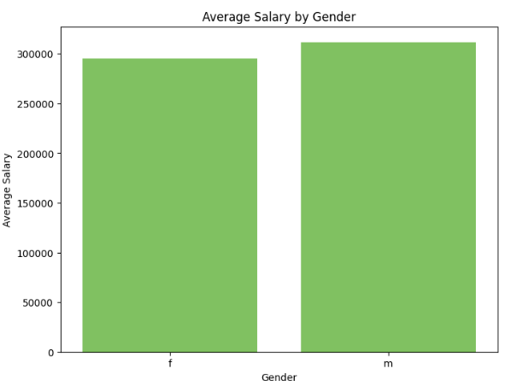
BI VARIATE ANALYSIS
The bar chart displays average salaries by gender, revealing that men earn more on average than women. This disparity is often attributed to factors such as gender discrimination, career choices, and work experience differences. It's essential to recognize that this chart reflects average salaries, and there is significant variability within each gender group.

Slide 15
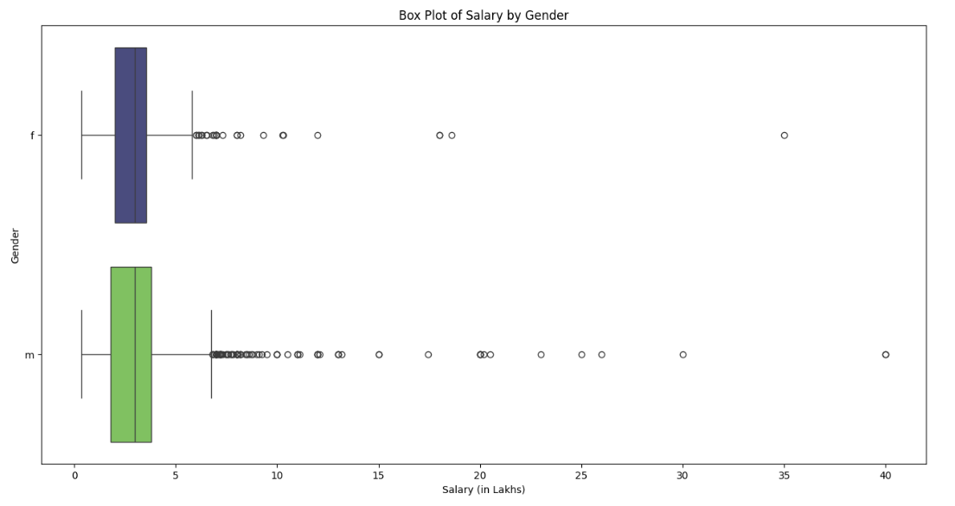
The median salary for both males and females is nearly identical. However, the maximum salary for males significantly surpasses that of females, with the highest salary approaching 40 LPA.

Slide 16
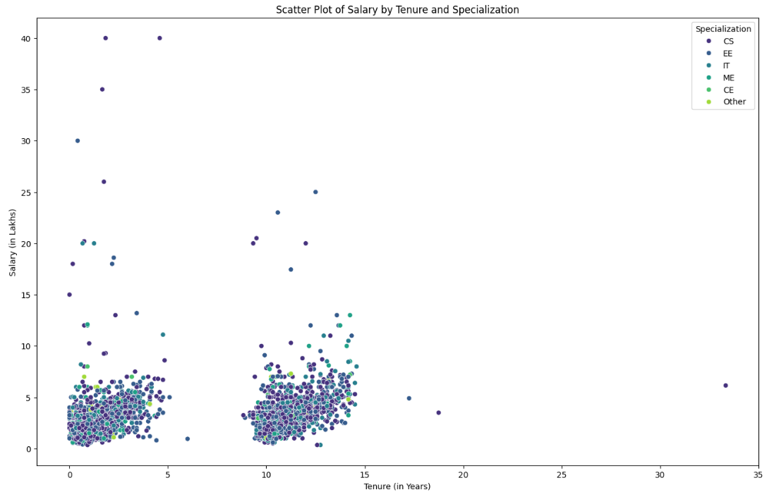
The tenure period appears to have little effect on salary, with individuals earning higher salaries generally having less than five years of experience. Additionally, those with a specialization in CS command the highest salary packages.

Slide 17
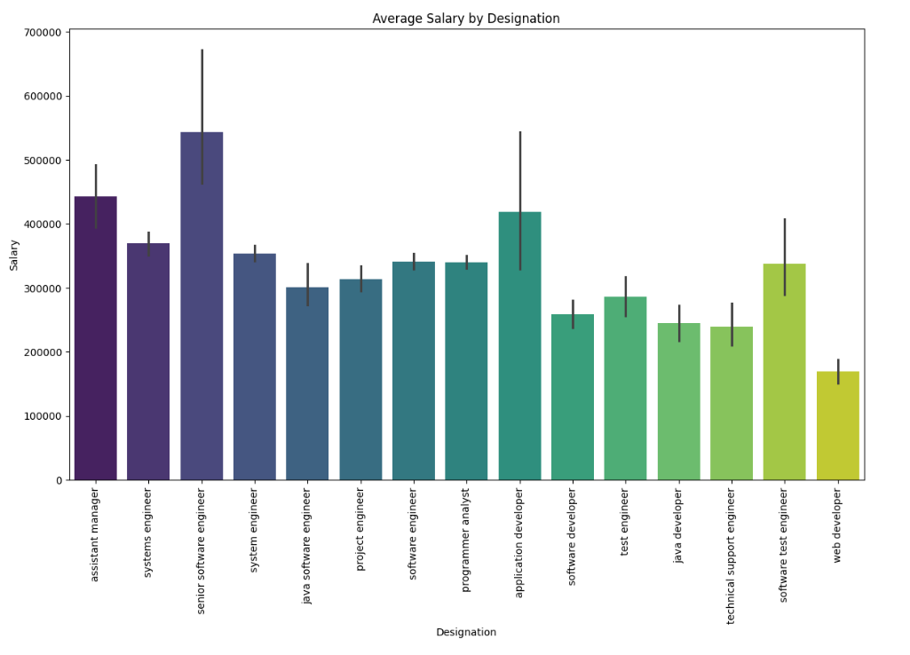

Slide 18
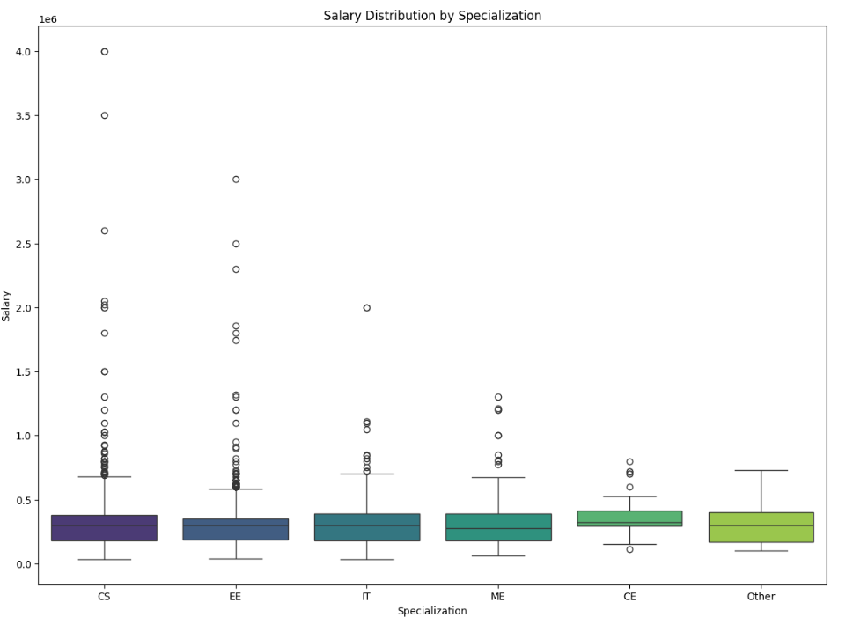
The median salaries for CS, EE, IT, ME, and other specializations are nearly identical. However, CE specialization offers significantly lower salary packages compared to CS, EE, IT, and ME. Salaries for CS and IT are almost equivalent.

Slide 19
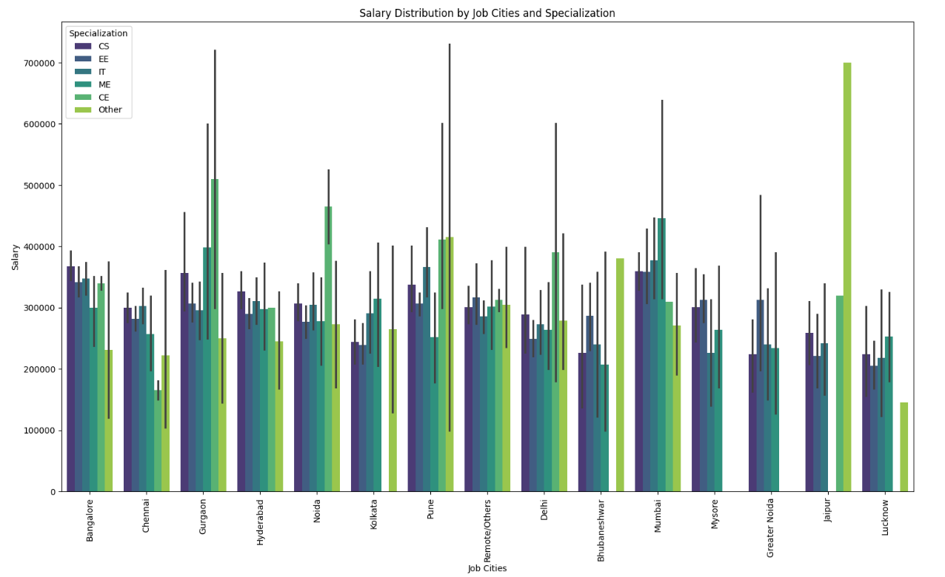

Slide 20
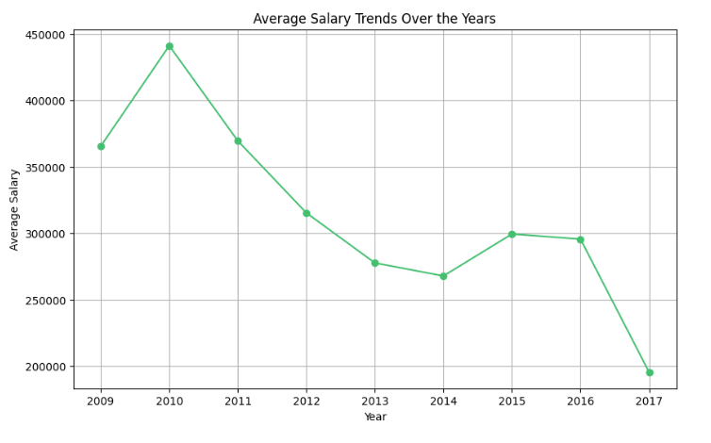
The plot illustrates the average salary trends over the years, highlighting a peak in 2010, followed by a decline until 2014. After a resurgence in 2015 and 2016, the average salary experienced a sharp decline in 2017. Overall, the data indicates fluctuations in average salaries, with a notable downward trend in recent years.

Slide 21
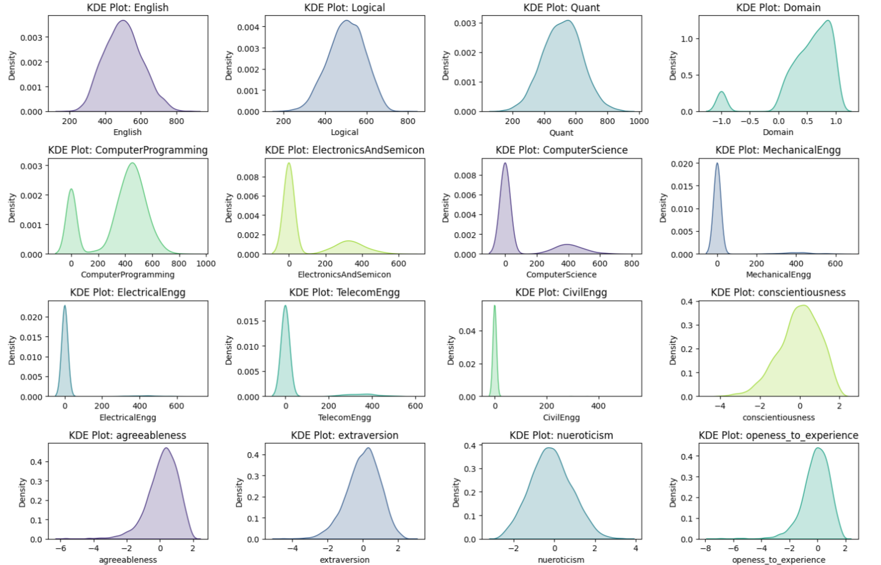

Slide 22
Conclusion
Most of the aspirants are male from CS and EE department from Tier-1 Colleges and they work in IT domain,mostly in Mumbai and Bangalore cities with an average salary of 3LPA and maximum salary of 40LPA
Most of the female aspirants prefer CS, EE, IT departments rather than mechanical,civil and they also prefer to work in IT domain mostly in Mumbai, Pune cities with an average salary of 2.9LPA and maximum salary around 36-37 LPA.
Bangalore is most sought out place for working but most of the students from Tier-1 college work in Greater Noida.
Software Engineer and Software developer are the most popular roles among the aspirants whereas senior software engineer and assisatant manager roles have the highest salary package.

Slide 23

THANK YOU

