Slide 1
DS-670:Capstone:big Data & data Science Insurance Fraud Detection
Ravindra Babu Ponnapula

Slide 2
Project Overview
Objective: Develop a predictive model to identify potentially fraudulent insurance claims.
Dataset: Insurance claims data with multiple features.
Target Variable: Fraudulent (Yes/No)

Slide 3
Introduction to Insurance Fraud
Defining Insurance Fraud
Conceptual Definition: Intentional deception in insurance claim processes to obtain financial benefits
Typologies of Fraud:
Soft Fraud: Exaggeration of legitimate claims
Hard Fraud: Completely fabricated claims or staged incidents

Slide 4
Economic Impact
Global Perspective:
Estimated annual insurance fraud losses: $40-80 billion in the United States alone
Approximately 10-20% of all insurance claims show fraudulent characteristics
Significant economic burden on insurance companies and consumers

Slide 5
Business Need
Fraud is a pervasive issue that significantly impacts the insurance industry, leading to increased premiums for honest customers and substantial financial losses for companies. There is a critical need for more sophisticated and accurate fraud detection methods to:
Reduce financial losses due to fraudulent claims
Improve the efficiency of claims processing
Maintain fair pricing for honest customers
Enhance overall trust in the insurance system
Our project addresses this need by developing an advanced, data-driven fraud detection system that can quickly and accurately identify potentially fraudulent claims.

Slide 6
Problem Definition
The primary problem this project aims to solve is:
How can we develop a robust, accurate, and scalable machine learning system to automatically detect fraudulent insurance claims in real-time, reducing financial losses for insurance companies while maintaining a positive experience for legitimate claimants?
Sub-problems include:
Identifying the most relevant features for fraud detection
Handling imbalanced datasets (as fraudulent claims are typically a small percentage of total claims)
Developing models that can adapt to evolving fraud tactics
Creating an interpretable system that can provide insights into why a claim is flagged as potentially fraudulent

Slide 7
Analyze 15-20 relevant papers/sources, taking notes on:
Methodologies used
Key findings and results
Limitations and gaps identified
Synthesize the information to identify trends, common approaches, and areas needing further research.

Slide 8
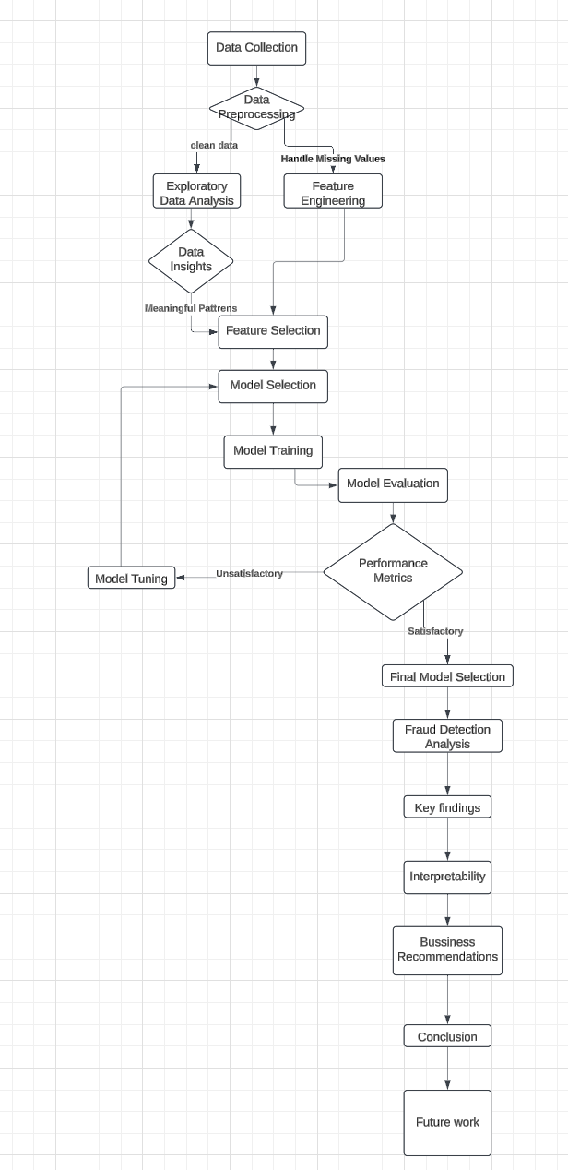
Flow Chat

Slide 9
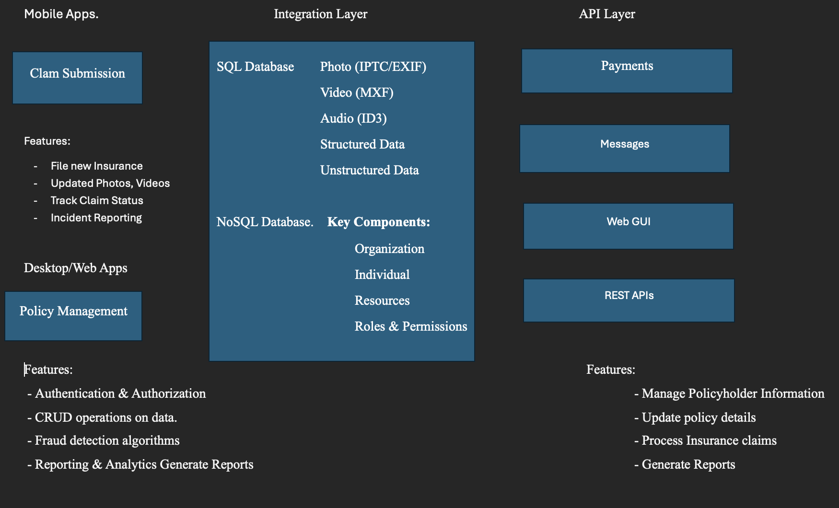
Architecture

Slide 10
Literature Review Methodology
Search Strategy
Databases Consulted:
IEEE Xplore
ACM Digital Library
ScienceDirect
Google Scholar
Search Keywords:
"Insurance fraud detection"
"Machine learning in fraud analysis"
"Predictive modeling for insurance claims"
"Fraud detection algorithms"

Slide 11
Key Theoretical Frameworks
Existing Fraud Detection Approaches
Rule-Based Systems
Pros: Simple, interpretable
Cons: Limited adaptability, high false-positive rates
Statistical Methods
Techniques: Logistic Regression, Discriminant Analysis
Strengths: Statistical significance, interpretability
Limitations: Assumes linear relationships
Machine Learning Approaches
Supervised Learning:
Random Forest
Gradient Boosting Machines
Support Vector Machines
Unsupervised Learning:
Clustering techniques
Anomaly detection algorithms

Slide 12
Theoretical Gaps and Research Opportunities
Identified Limitations in Existing Research
Data Imbalance
Most fraud datasets have significant class imbalance
Traditional algorithms struggle with minority class detection
Feature Engineering Challenges
Limited research on comprehensive feature selection
Need for domain-specific feature engineering techniques
Interpretability vs. Performance Trade-offs
Complex models often sacrifice explainability
Increasing demand for interpretable AI in financial domains

Slide 13
Plan
Week 1-2: Data preprocessing and exploratory data analysis
Week 3-4: Feature engineering and initial model development (Random Forest, Gradient Boosting)
Week 5-6: Advanced model development (Deep Learning, LSTM for sequential data)
Week 7-8: Reinforcement Learning model and LLM-based approach for text analysis
Week 9-10: Full-stack product development, including API and web interface

Slide 14
Thank You

