Slide 1
QuickRoutes
By Martin Mitev

Slide 2
What is its purpose?
Supplies a typical logistics firm with a management system where each employee can view and manage the aspects relevant to them, such as other employees, client complaints, deliveries, products, routes, and vehicles
Incorporates a dynamic “security level” system that determines each user’s permissions but can also be tweaked by the super admins
Takes advantage of a native “router” dynamically switching between different pages, and allowing registering new pages through the db.txt file
Sorts data by different properties, allows searching by a keyword, as well as choosing which columns to view

Slide 3
At what stage is the development?
At this point, the security level system is completely developed, i.e the system recognizes who can do what
Functioning authentication, as well as fetching users and different pages/categories directly from the text file
Employee page containing statically loaded sorted employees by total salary (as determined by the polymorphic method calculating the salary)
Ability to add, edit, and delete entities is in development
Only employee page has content

Slide 4
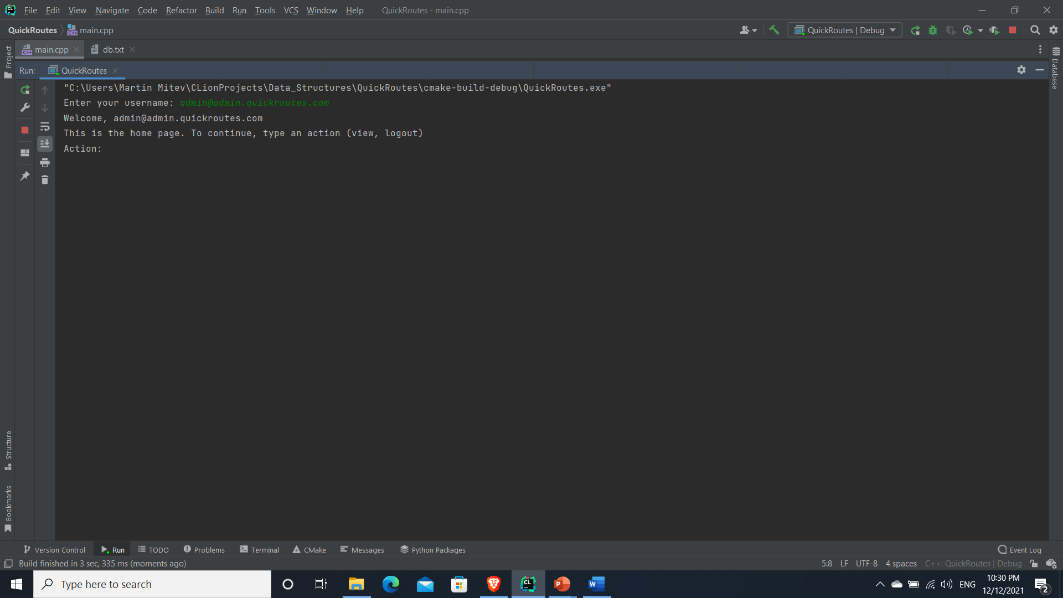
How does it work?

Slide 5
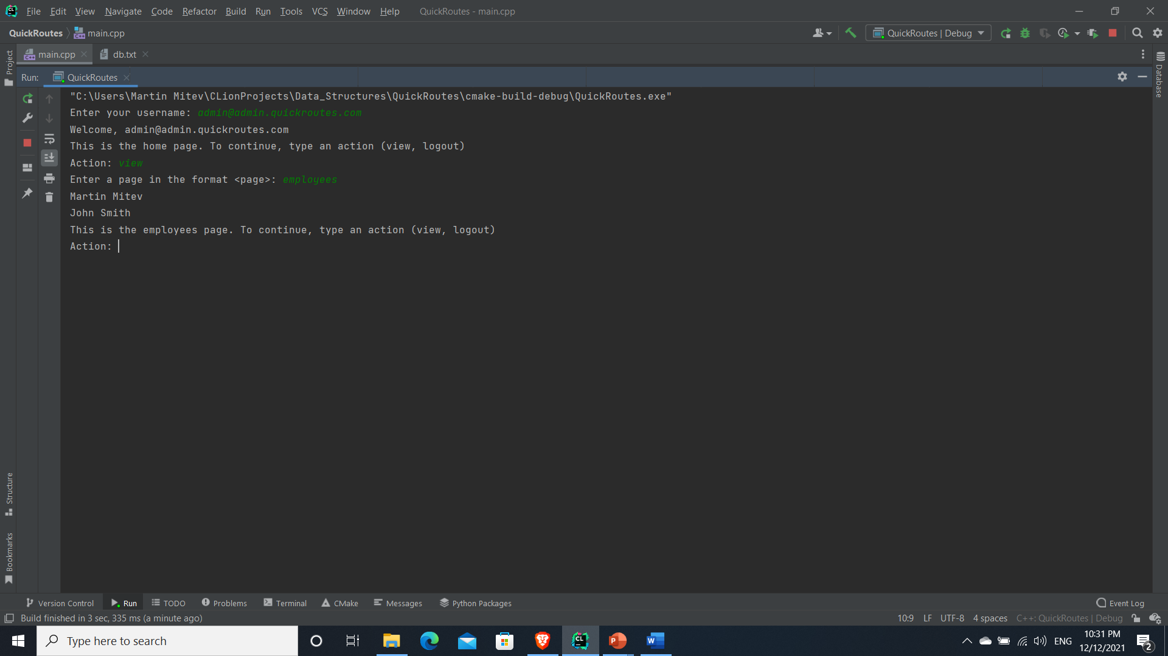

Slide 6
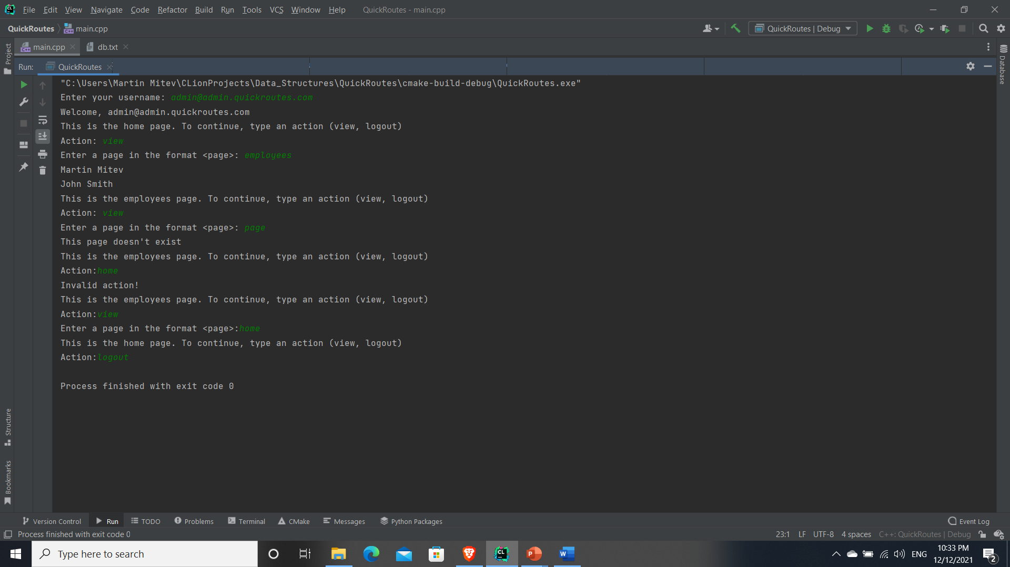

Slide 7
Algorithms?
Initial idea was to use quicksort for the sorting - Mergesort allows to easily change the sorting order and property, as it does not rely on a pivot; its fast enough - O(NlogN)
Boyer-Moore SPM for searching by keyword - currently it is used to search for entities in the database

Slide 8
GitHub
https://github.com/nanibaba/quickroutes.git

