Slide 1
DIY
PROJECT

Slide 2
GROUP
18

Slide 3
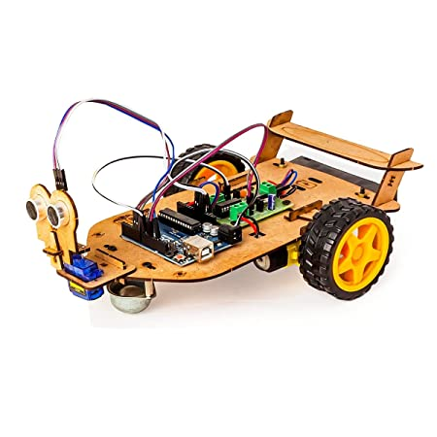
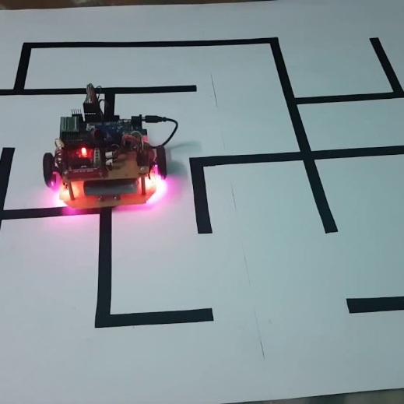
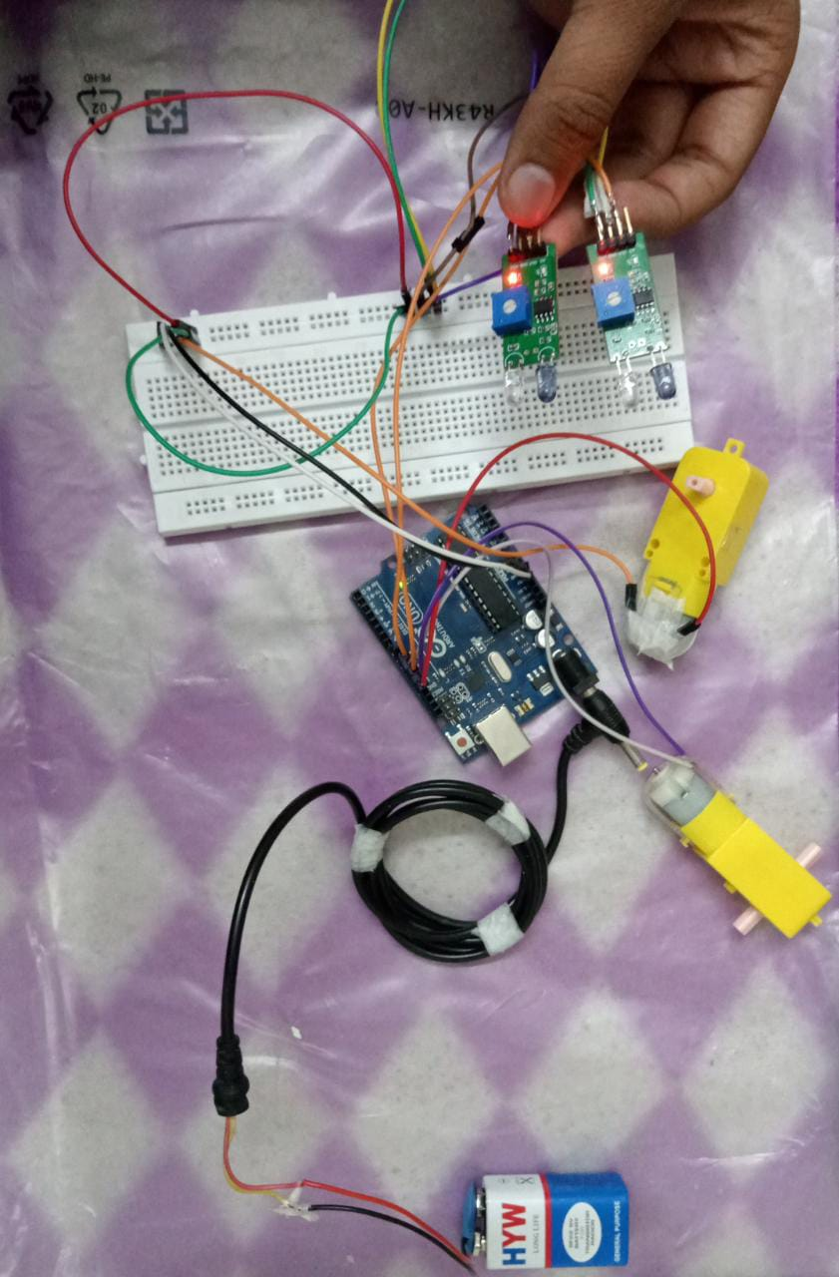
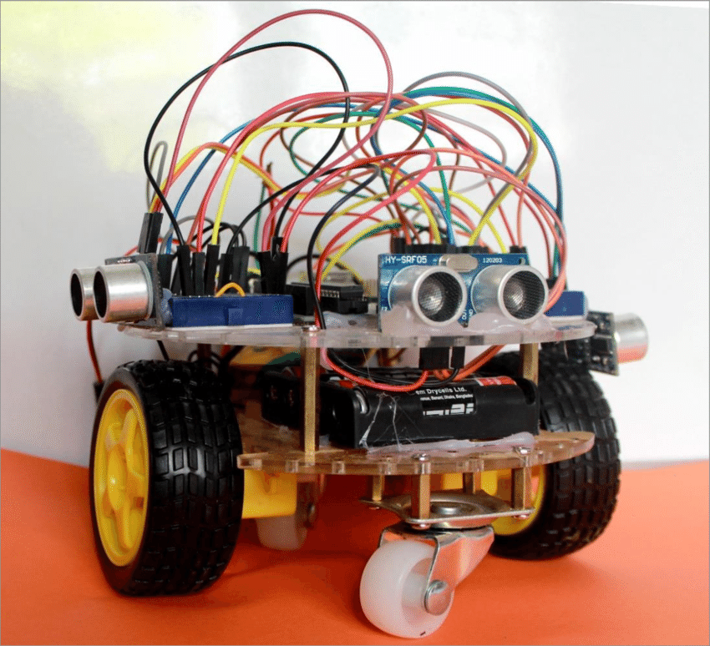
MAZE SOLVING CUM
PATH FOLLOWER
A Maze solving robot is designed to move in a maze and escape through it by following its walls. A maze solving robot is quiet similar to a line follower.

Slide 4
Objectives :
The Robot must be capable of following a line.
It shuld be capable of taking various degrees of turn.
The robot must be insensitive to enviromental factors such as lighting and noise.
It must allow calibration of the lines’s darkness threshold.
Scalability must be a primary concern in the design.
It also shows the distance travelled by it through LCD display.

Slide 5
Our Team
v
HARSHVARDHAN
He is doing the coding part.
JAY TANDIA
He is doing the CAD design part.
DURGA PRASAD
He is doing assembly.
SAI VARUN
He is done the coding part.
YASH LANDGE
He is doing the video editing part.

Slide 6
Main Components
IR Sensor
Arduino Uno
Gear Motors
It is a device that emits the light in order to sense some object of the surrounding.
Arduino uno is a low cost, flexible, and easy-to-use programmable microcontroller board.
Gear motors are used in applications that require high output torque and lower output shaft rotational speed.
Units - 2
Units - 1
Units - 4

Slide 7
TIMELINE
WEEK 4
Assembly of our bot and solving any bugs { if there } .
Video editing and representing our working model.
WEEK 3
Gathering data and information about the project.
WEEK 2
Work on coding part and cad part of body of our bot.
WEEK 1

Slide 8
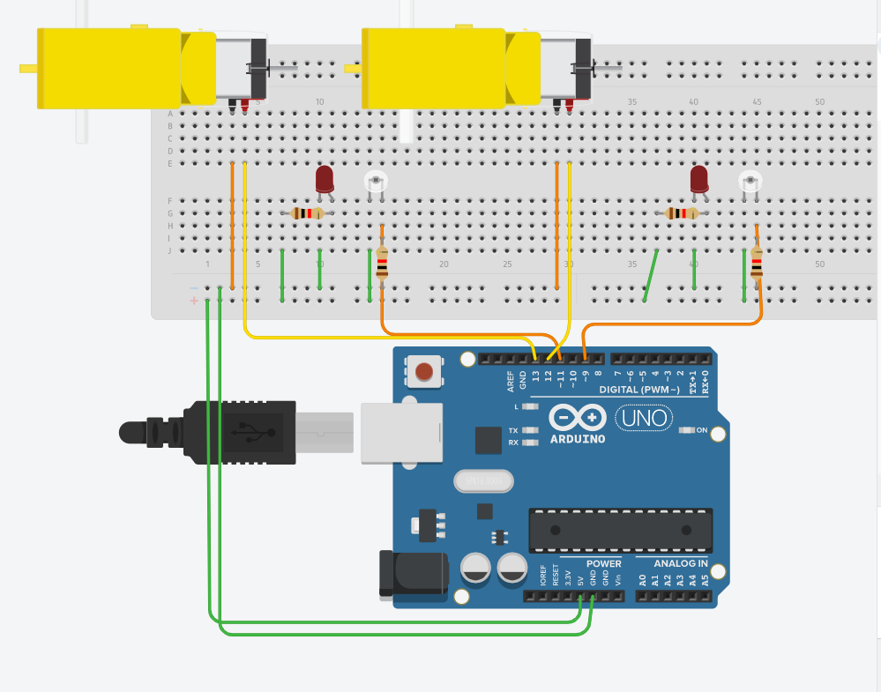
Circuit Design

Slide 9
Code for Prioritizing the Path
IR1 = <PIN 1>IR2 = <PIN 2>IR3 = <PIN 3>void setup { DECLARE IR1 IR2 AND IR3 AS INPUTS}void loop { IR1 = digitalRead(<PIN 1>) IR2 = digitalRead(<PIN 2>) IR3 = digitalRead(<PIN 3>) if (IR1 == LOW && IR2 == HIGH && IR3 == LOW) { Forward(); } if (IR1 == HIGH && IR2 == LOW && IR3 == LOW) { Left(); } if (IR1 == LOW && IR2 == LOW && IR3 == HIGH) { Right(); } if (IR1 == HIGH && IR2 == LOW && IR3 == HIGH) { Left(); } if (IR1 == HIGH && IR2 == HIGH && IR3 == LOW) { Left(); } if (IR1 == LOW && IR2 == HIGH && IR3 == HIGH) { Forward(); } if (IR1 == LOW && IR2 ==LOW && IR3 == LOW)//Dead End { U_Turn(); } if (IR1 == HIGH && IR2 == HIGH && IR3 == HIGH) { Left(); } if (IR1 == HIGH && IR2 == HIGH && IR3 == HIGH)//End of Maze { Stop(); } }

Slide 10
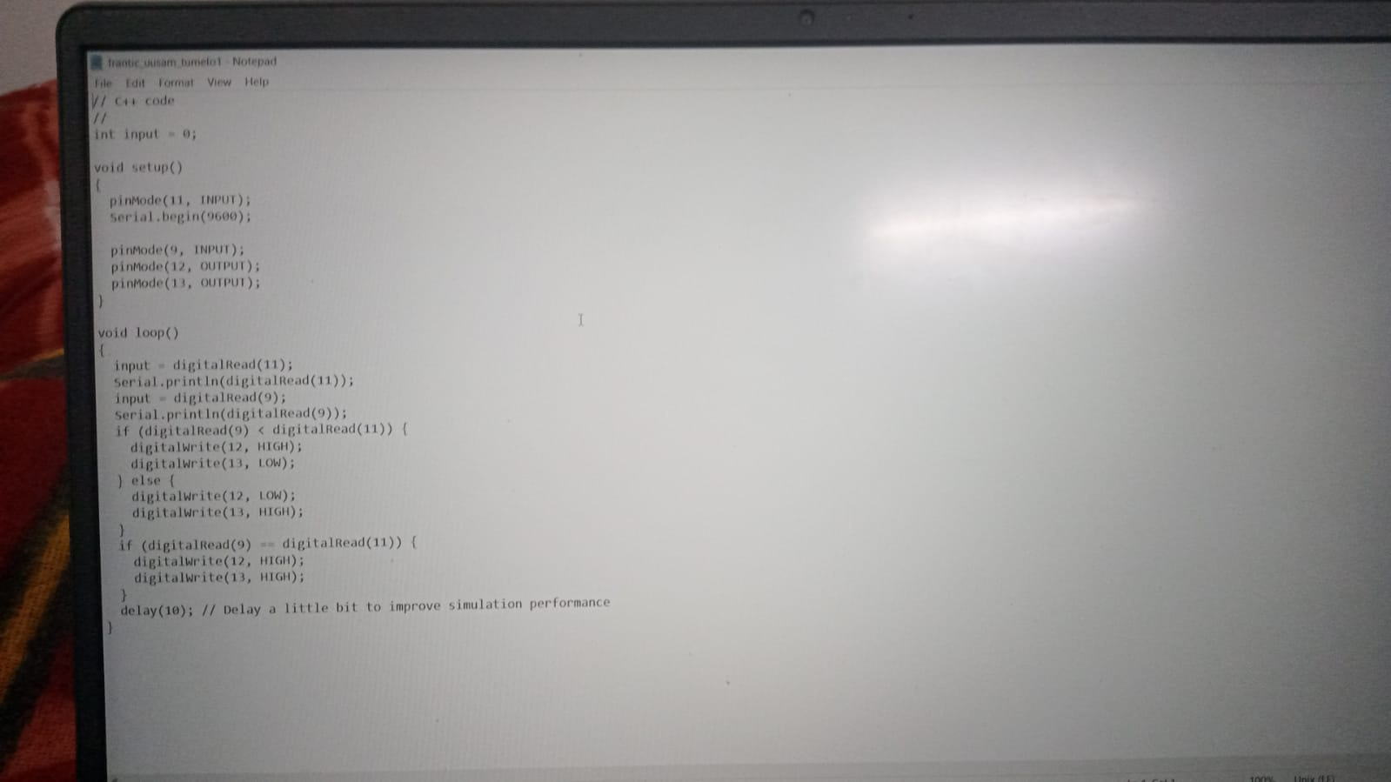
Code for Moving on Path

Slide 11
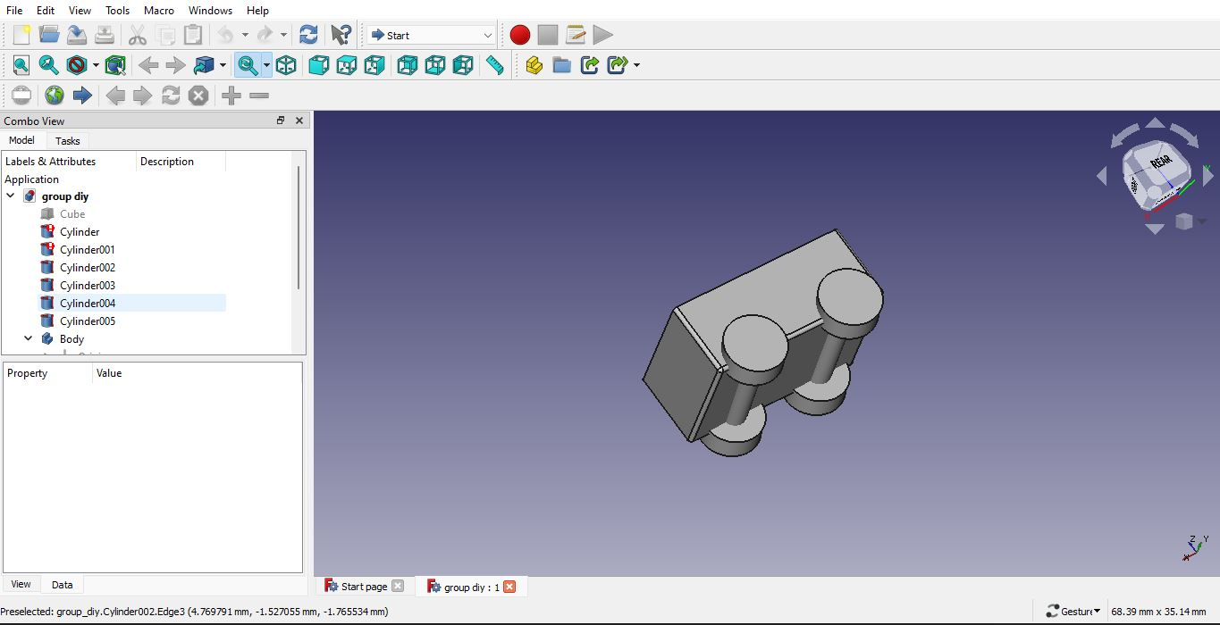
CAD Design

Slide 12
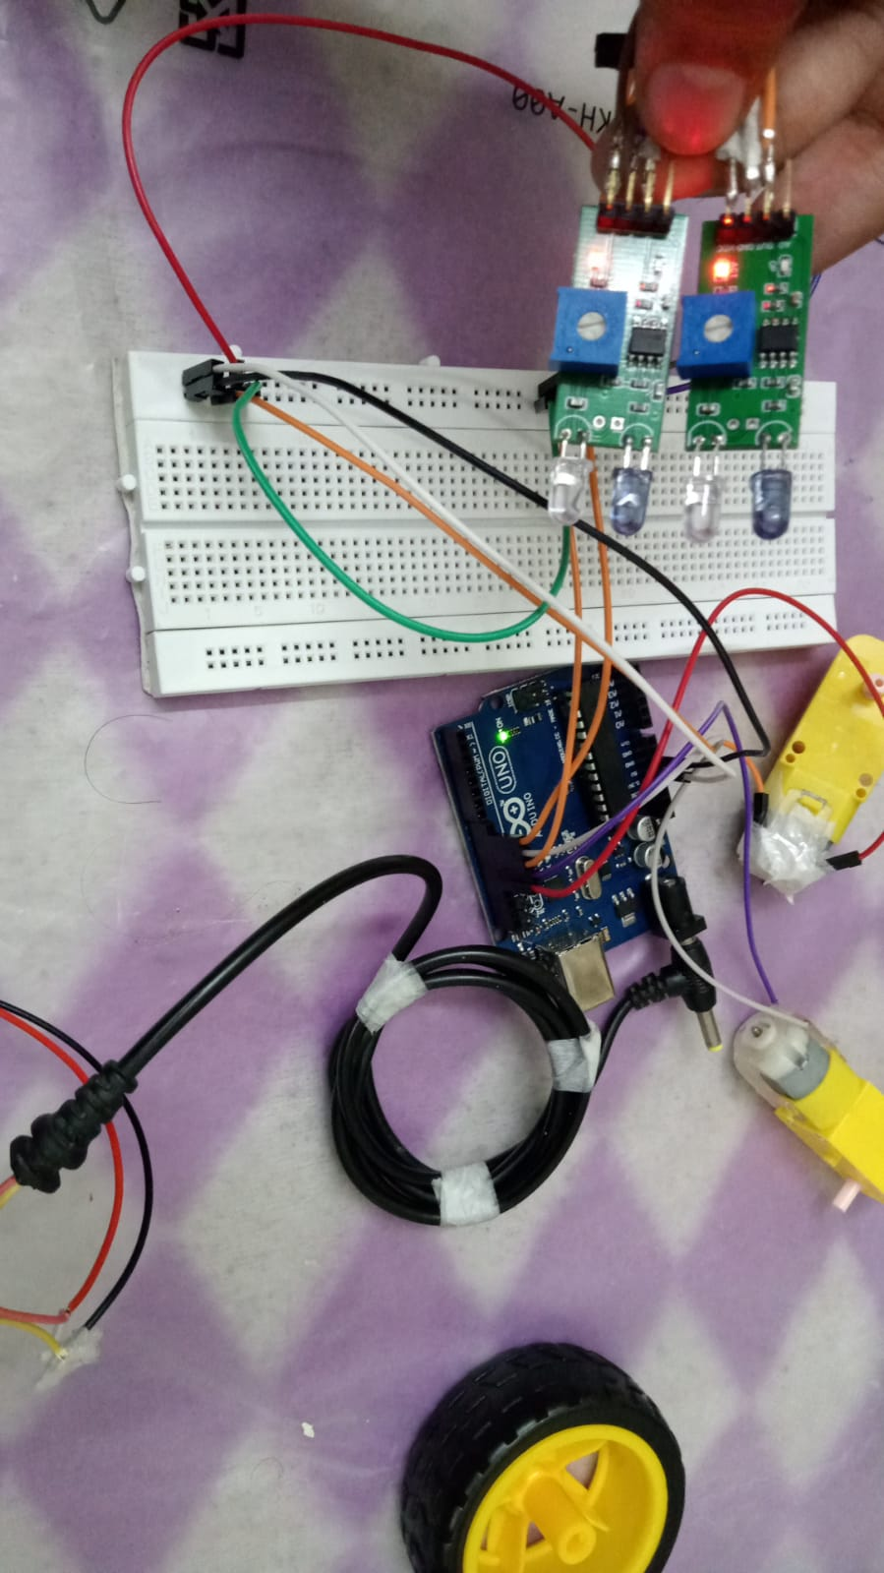

Slide 13
Future Scope :
Line following robot based materials supply system can play a vital role in
The field of hospitality. Line following robot’s application over electronics
Engineering can’t be underestimated. In India many people show
Reluctance to get admitted in a hospital because of cost issues. The cost
for cure can be reduced by using the robots in government and private
Hospitals. It can be very beneficial for the patients as well. Also, monitoring
Of every patient is very difficult for the nurses, given the fact that there are
very few of them. So a camera can be placed in the line following robot,
From which the status for every patients can be handle from a single room.
In the bed of the patient an accelerometer can be placed from which if a
patient have a heart attack then that device can operate an alarm circuit.
The line follower robots can also be improved by using RFID tags so that
Accuracy of the system increases.

Slide 14
Total Cost
2 IR sensors = 70 rupee
4 gear motor = 368 rupee
Audino uno = 400 rupee
4 Grip tyres =79 rupee
TOTAL COST =917 rupee

Slide 15
THANK YOU!!

