Slide 1
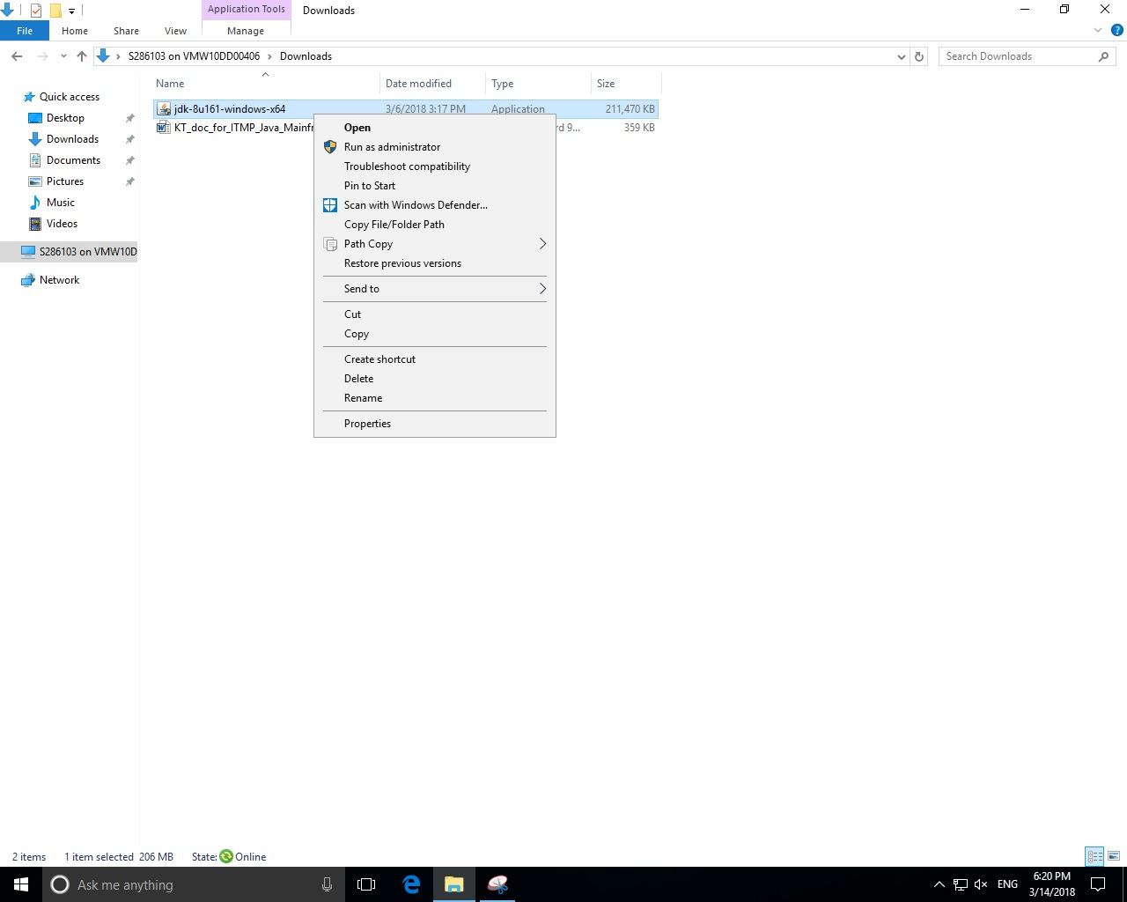
AEP Presentation

Slide 2
Tortoise Git

