Slide 1
Real-Time Voting Application
Course: Advanced Object-Oriented Programming
Presented By-
2310030032 - K. Pramodh
2310030065 - C. Sreeneel
2310030092 - N. Mohith
2310030190 – N. Rishi

Slide 2
AGENDA
INTRODUCTION 4
OBJECTIVES 5
SURVEY 6-8
FEATURES 9
TECHNOLOGY & TOOLS 10 CLASS DIAGRAM 11

Slide 3
AGENDA
SYSTEM DESIGN 12
DESIGN & ARCHITECTURE 13
DEPLOYMENT WORKFLOW 14
ROLES 15
CONCLUSION 16

Slide 4
INTRODUCTION
This project focuses on developing a Real-Time Voting Application, a system that allows users to cast and track votes instantly through a web or mobile interface. By leveraging real-time processing, the application ensures that results are updated dynamically as votes are cast.
A Real-Time Voting Application is a digital platform designed to facilitate quick and seamless voting processes. It enables participants to cast their votes, view live updates of results, and ensures transparency and accuracy through immediate data synchronization. Such applications are commonly used in events, surveys, elections, and polls.
Purpose and Significance of the Application:
To streamline the voting process, making it more efficient and user-friendly.
To eliminate delays in vote counting and result declaration.
To enhance transparency and trust by providing real-time updates and reducing the risk of tampering or errors.
To cater to diverse use cases, from organizational decision-making to large-scale public elections.

Slide 5
OBJECTIVES
Enable Real-Time Voting and Result Tracking: Develop a system that allows users to cast their votes and view results instantly, ensuring immediate updates and enhancing the voting experience.
Ensure Data Security and Integrity Using OOP Principles: Implement robust object-oriented programming (OOP) methodologies to safeguard sensitive voting data, maintain system integrity, and prevent unauthorized access or tampering.
Provide a User-Friendly Interface: Design an intuitive and accessible interface that simplifies the voting process, ensuring ease of use for all participants, regardless of technical expertise.

Slide 6
SURVEY OF EXISTING WEBSITES/APPS:
SurveyMonkey
Technology Used:
Developed using a combination of JavaScript (React, Angular) for frontend.
Backend likely utilizes Python, Node.js, or Java.
Data storage with SQL or NoSQL databases.
Hosted on cloud services like AWS or Azure.
Weaknesses:
Limited features in the free version.
Not designed for election-style or highly secure voting.
Lacks robust fraud prevention mechanisms.

Slide 7
SURVEY OF EXISTING WEBSITES/APPS:
ElectionBuddy
Technology Used:
Likely developed using secure frameworks like Django (Python) or Ruby on Rails.
Encrypted database storage for votes.
Uses blockchain or other secure methodologies for fraud prevention.
Hosted on secure cloud platforms ensuring encrypted data transmission.
Weaknesses:
Complex setup, requiring knowledge of election management tools.
Paid versions can be costly depending on scale and features.
Limited customization compared to general survey platforms.

Slide 8
SURVEY OF EXISTING WEBSITES/APPS:
Google Forms
Technology Used:
Frontend built with JavaScript and Google Material Design.
Backend integrated with Google Sheets and Google Cloud services.
Authentication managed via Google Accounts.
Weaknesses:
Limited fraud prevention and no secure way to prevent duplicate votes.
Results aren’t real-time and lack advanced reporting or analytics.
Not suitable for large-scale, secure voting needs.

Slide 9
FEATURES
User Registration and Authentication: The application ensures a secure onboarding process by allowing users to register with unique credentials. Authentication mechanisms, such as passwords or OTP verification, protect user accounts and ensure only authorized individuals can participate in the voting process.
Casting and Recording Votes: The system provides an intuitive interface for users to cast their votes seamlessly. Once submitted, votes are securely recorded in the database, ensuring accuracy and transparency while maintaining voter anonymity.
Displaying Real-Time Results: The application dynamically updates and displays voting results in real-time. This feature enables participants to track the progress instantly, fostering transparency and reducing delays in result announcements.
Preventing Duplicate Voting: Robust algorithms and unique user identification mechanisms ensure that each user can vote only once. This prevents fraud and maintains the integrity of the voting process.

Slide 10
TECHNOLOGY & TOOLS
Language: Java , Version : 23 Java ensures the application is scalable, secure, and efficient, leveraging its robust object-oriented features.
Data Structures: HashMap and List HashMap: For fast access to voting data and prevention of duplicate votes. List : For maintaining ordered collections like user or vote records.
IDE/Compiler: Eclipse IDE
Other Tools: HTML, CSS , JAVASCRIPT : For a clean, intuitive user interface. MongoDB: For efficient, scalable data storage and retrieval.

Slide 11
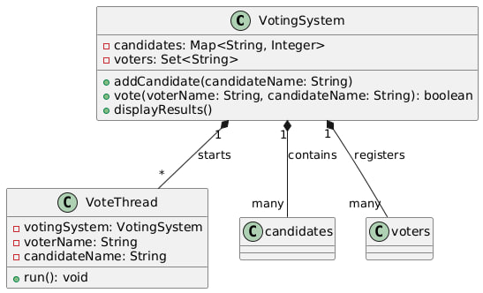
CLASS DIAGRAM

Slide 12
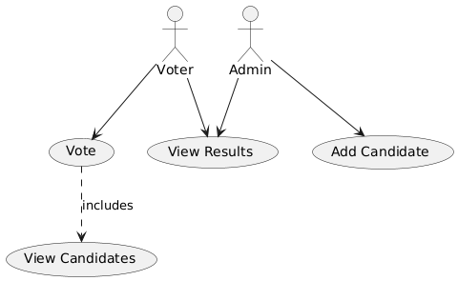
USE CASE DIAGRAM

Slide 13
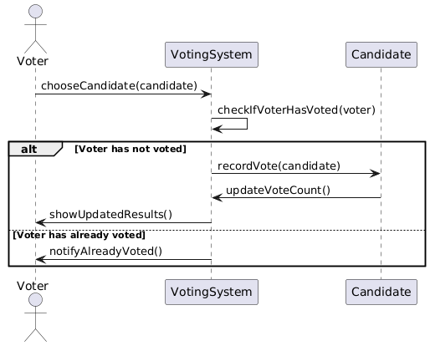
INTERACTION DIAGRAM

Slide 14
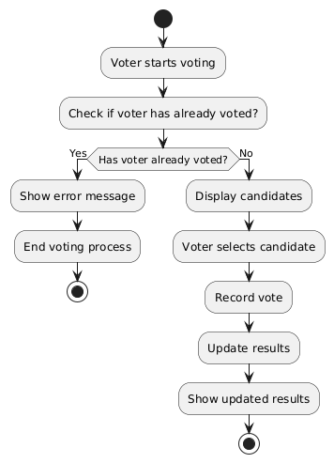
ACTIVITY DIAGRAM

Slide 15
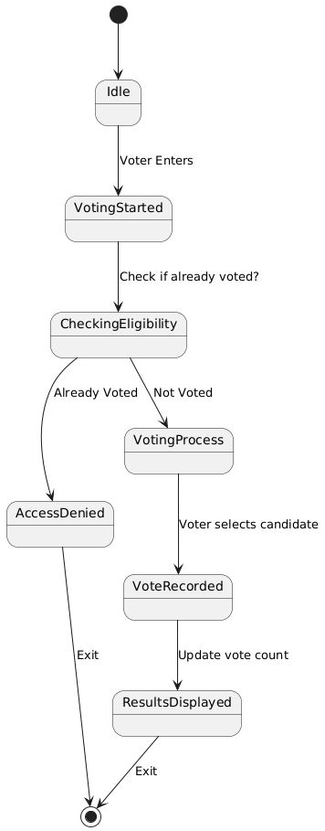
STATE-CHART DIAGRAM

Slide 16
SYSTEM DESIGN
A modular approach ensures scalability, maintainability, and efficiency.
1. High-Level Architecture:
Presentation Layer: User interface for voter interaction.
Logic Layer : Processes votes, ensures validations, and updates results in real-time.
Data Layer : Manages data storage and retrieval with HashMap, List, or a database.
2. Key Components:
Voters : Register, authenticate, and cast votes securely.
Admin : Oversees the voting process and resolves disputes.
Voting Module : Validates user credentials & records votes while ensuring each user can vote only once.
Results Module: Updates and displays real-time results dynamically & provides insights like voter
turnout and vote percentage breakdowns.

Slide 17
DESIGN AND ARCHITECTURE
Model (Data Management)
Stores and manages voting data.
Uses HashMap (for storing user votes) and List (for maintaining candidates).
Ensures data consistency and integrity.
View (Console/CLI Interaction)
Provides a command-line interface for users to vote and view results.
Displays candidate lists, vote counts, and error messages.
Controller (User Input & Logic Handling)
Receives user input (vote selection, results request).
Validates user choices and updates the model accordingly.
Interacts between Model and View to ensure smooth application flow.

Slide 18
DEVELOPMENT WORKFLOW
Requirement Analysis
User registration, voting, and result display.
Data structures HashMap for vote storage List for managing candidates.
Design Phase
Adopted MVC Architecture for modular development
Designed data flow and class structure
Coding and Implementation
Developed model: Classes for candidates and votes
Built Controller: Handles input validation and voting logic
Created View: CLI-based interface for user interaction
Testing and Debugging
Simulated different voting scenarios.
Deployment & Maintenance
Deployed application on local/cloud server
Planned future enhancements and scalability

Slide 19
ROLES
1. Pramodh (2310030032) – Backend & Database Management
Develops the Model (data structures, HashMap, Lists). Manages data persistence and integrity.
Implements database connectivity.
2. Sreeneel (2310030065) – Controller & Business Logic
Develops the Controller to handle user input and application logic. Ensures smooth
communication between Model and View. Implements validation, error handling, and
performance optimization.
3. Mohith (2310030092) – Frontend & User Interaction
Designs and implements the View (CLI-based interaction). Ensures user-friendly display of
voting results. Enhances UI experience for better accessibility.
4. Rishi (2310030190) – Testing & Deployment
Conducts unit and integration testing for bug fixes. Ensures system stability and security.
Handles final deployment and performance monitoring.

Slide 20
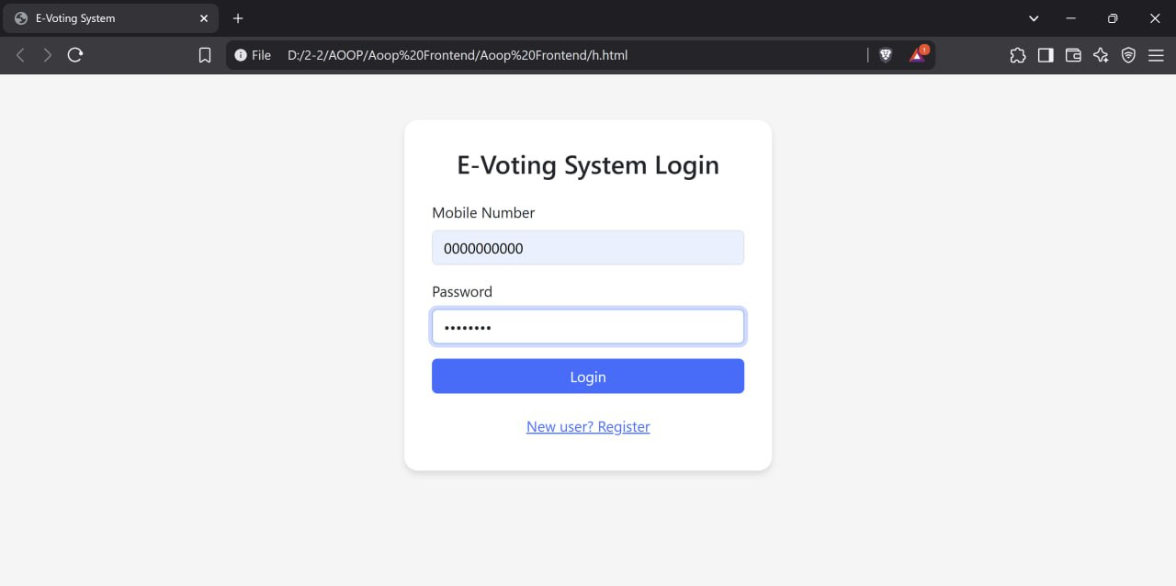
E-VOTING SYSTEM LOGIN

Slide 21
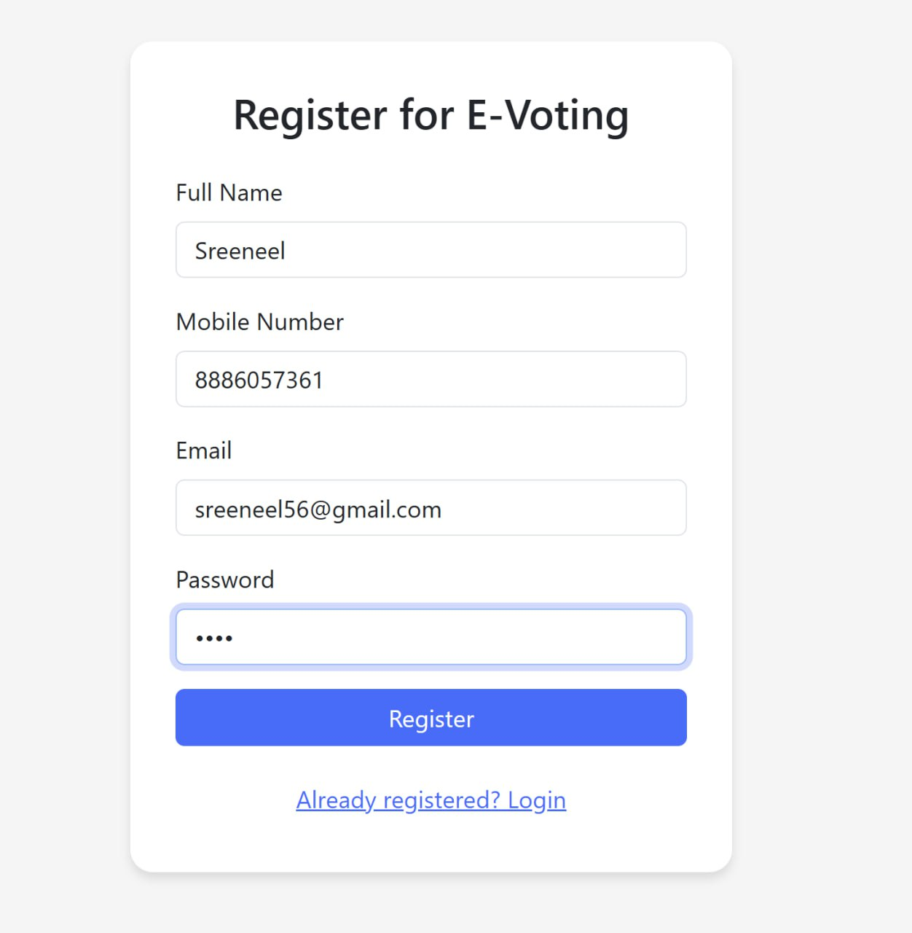
REGISTRATION OF E-VOTING

Slide 22
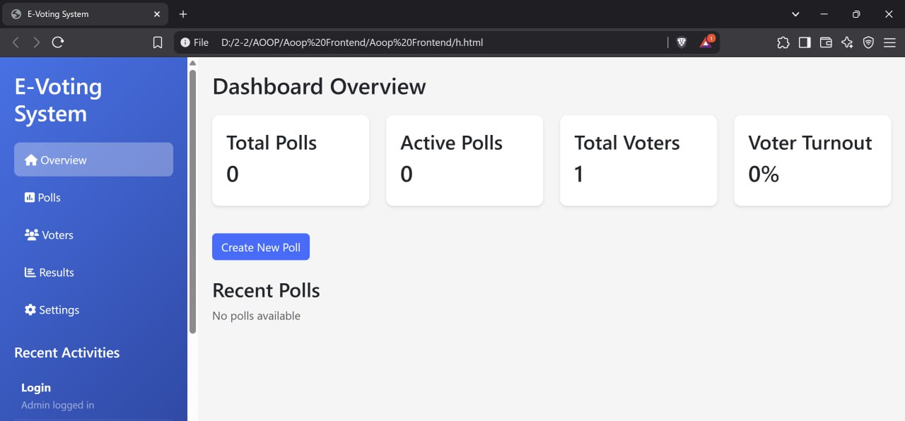
ADMIN DASHBOARD

Slide 23
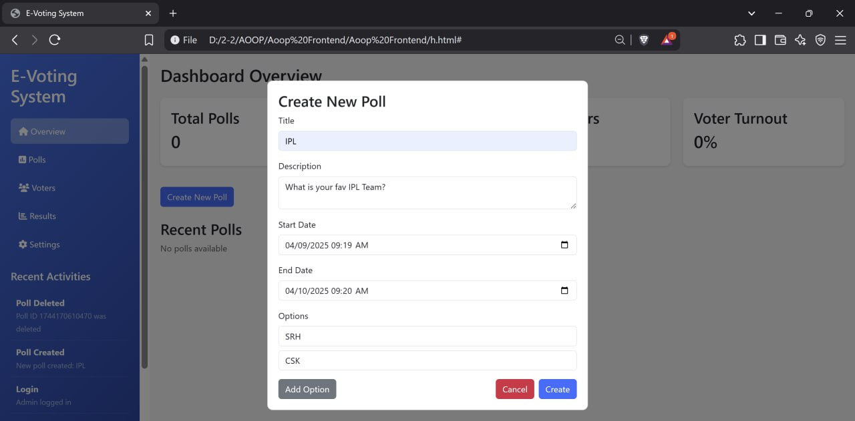
CREATE NEW POLL

Slide 24
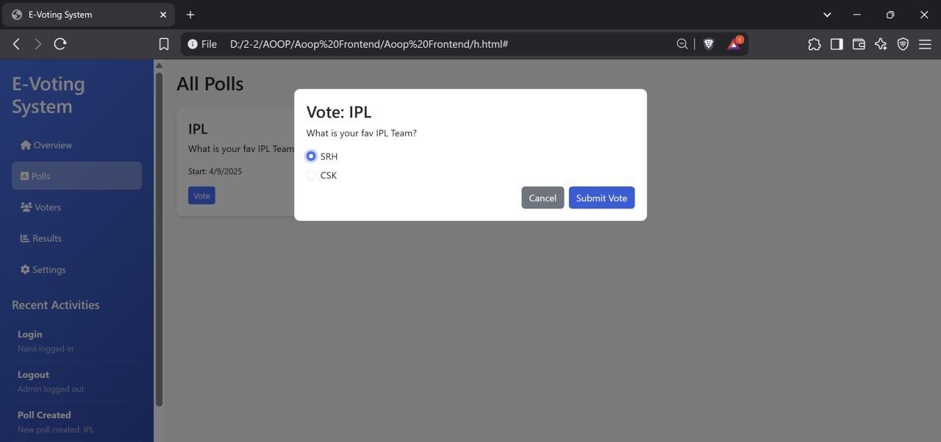
VOTING INTERFACE

Slide 25
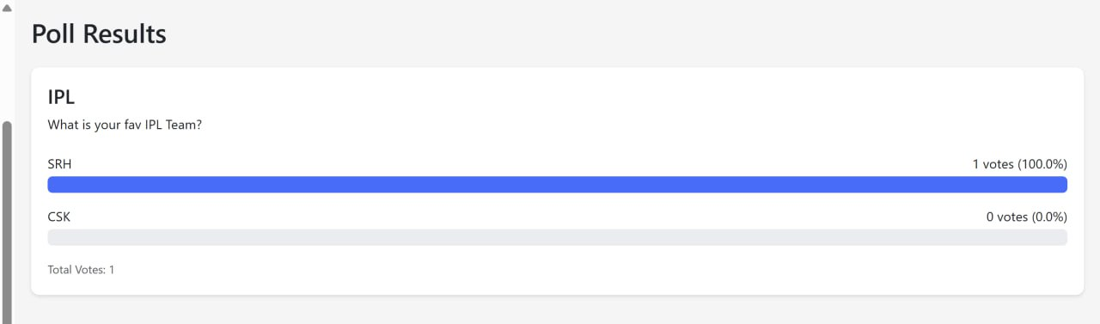
POLL RESULTS

Slide 26
CONCLUSION
The Real-Time Voting Application successfully achieves its objectives of providing a secure, efficient, and user-friendly platform for voting. Through real-time updates, robust data handling, and seamless user interaction, it simplifies the voting process while ensuring transparency and accuracy.
The use of Java and OOP principles ensures scalability, maintainability, and security.
Real-time result tracking enhances user trust and reduces delays.
The modular design, incorporating the User, Voting, and Results modules, ensures flexibility and efficiency.
The Real-Time Voting Application paves the way for future innovations in digital voting systems.

Slide 27
THANK YOU

