Slide 1

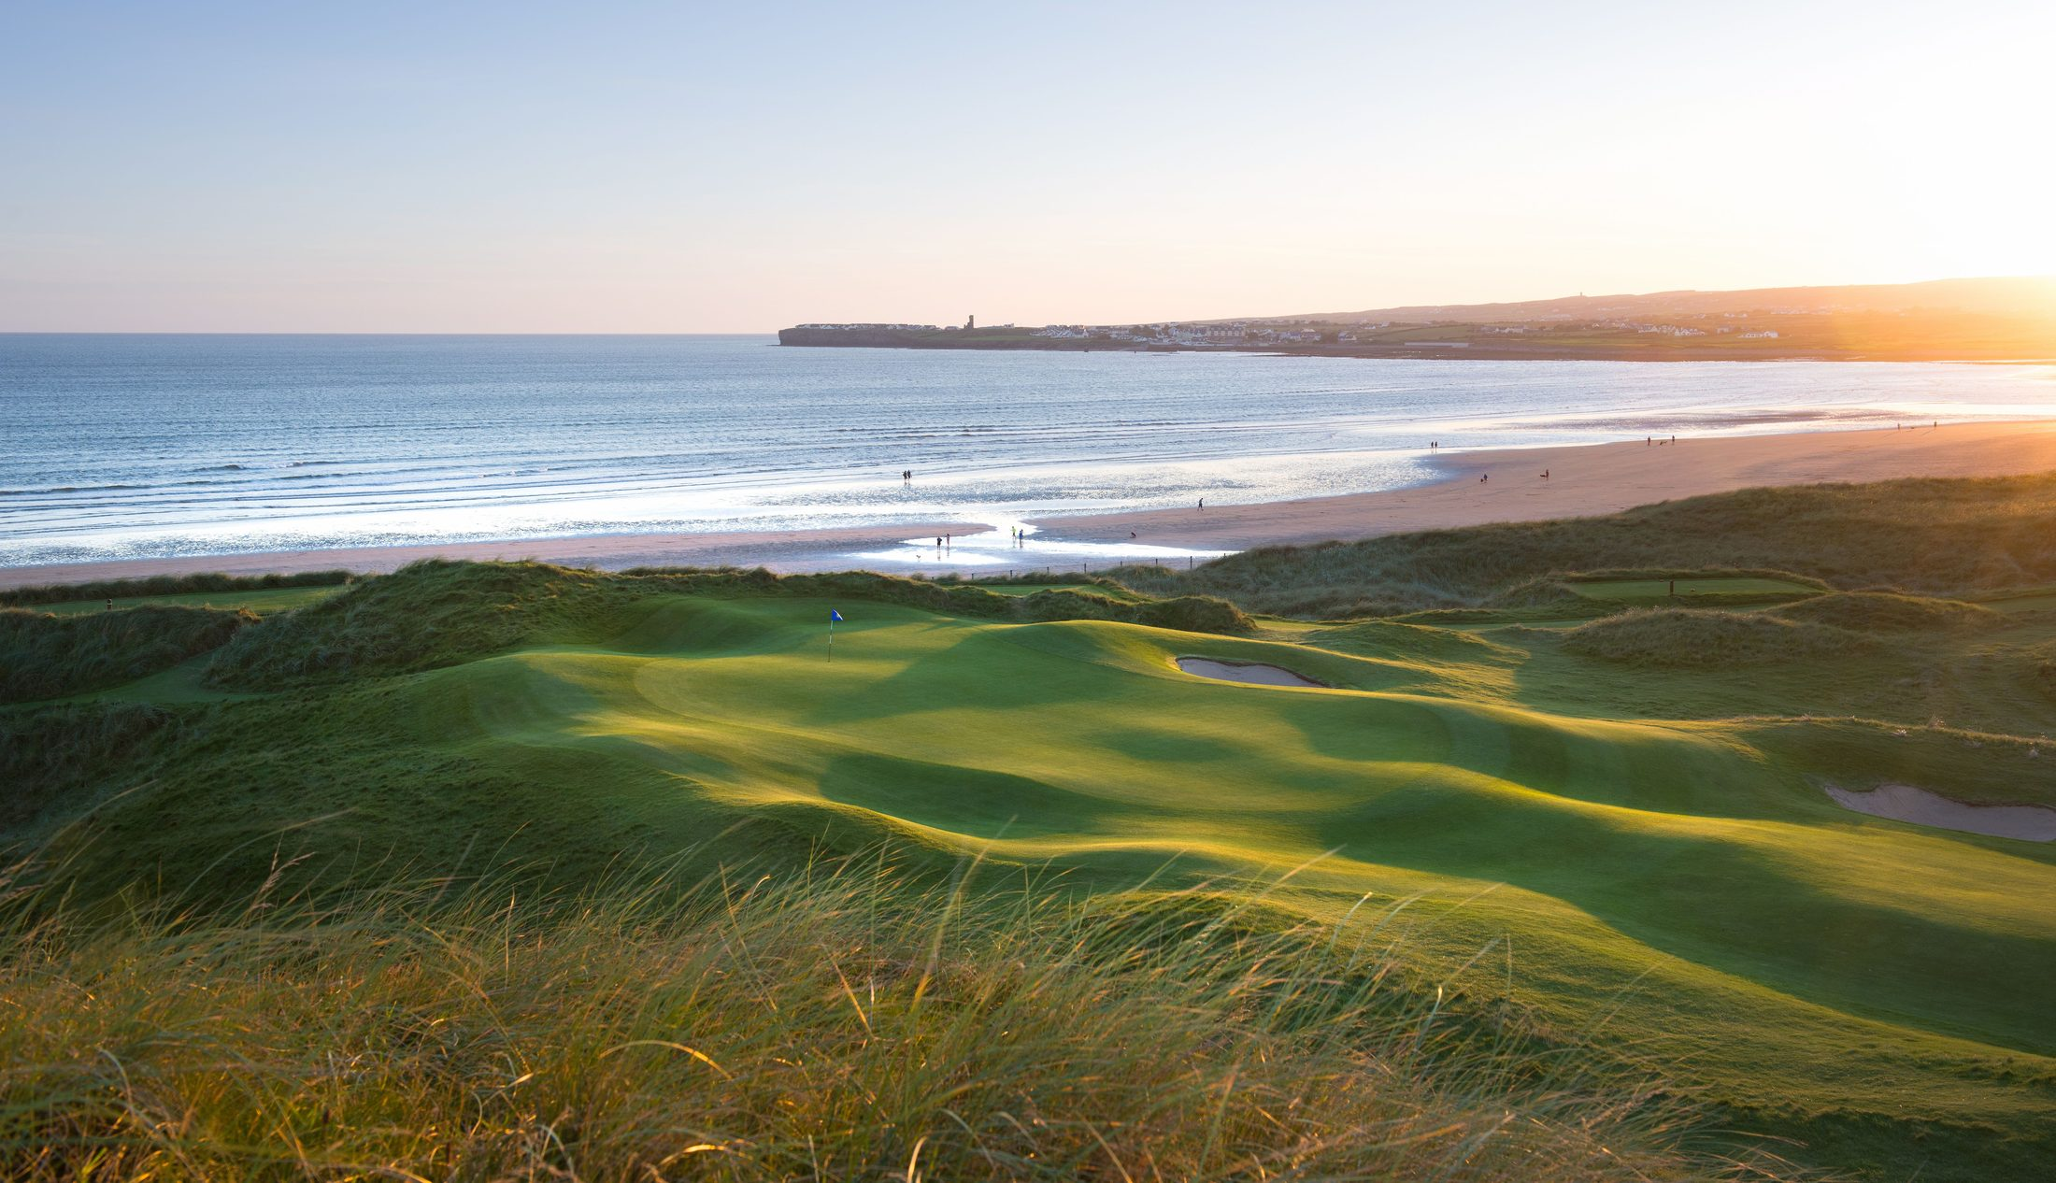

West Ireland
Hosted Tour · Small Group
10–17 October 2027
CDN $6,495 per person
INCLUSIONS
6 rounds of golf
Killeen Castle · Lahinch · County Sligo
Enniscrone · Carne · Galway Bay
7 nights accommodations
Daily breakfast
Coach transport
On-tour host
CONTACT
Terry Benson
celticgolftours@centreholidays.com
Centre Holidays · TICO #50018114

