Slide 1
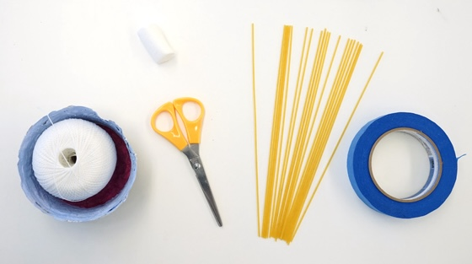
Who builds the tallest Spaghetti Tower?
Description
Work as a team to build a spaghetti tower, using limited materials, that can stand on the ground or on any solid surface.
Materials:
Each team gets the same set of supplies
20 sticks of dry spaghetti
one meter of string
one role of tape
two marshmallows
One pair of scissors

Slide 2
Rules
Write a stepwise plan (similar to pseudocode) before beginning construction.
Choose a unique name for your team.
The team that constructs the tallest tower wins. In the event of a tie in height, the team with the superior plan will be declared the winner.
The spaghetti tower must be sturdy enough to remain standing until all teams' towers have been measured and photographed.
The tower's height will be measured from its lowest structural point on the ground or base to its highest point, regardless of its placement.
You have a time limit of 30 minutes to complete the challenge.

Slide 3
Questions?

