Slide 2
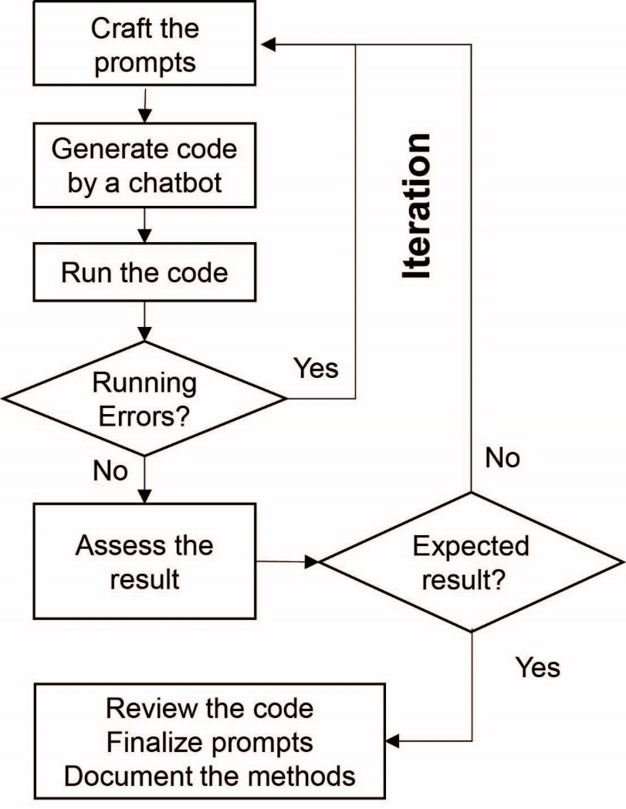
A practical procedure for AI assisted programming
Draft prompts
Draft prompts

