Slide 1
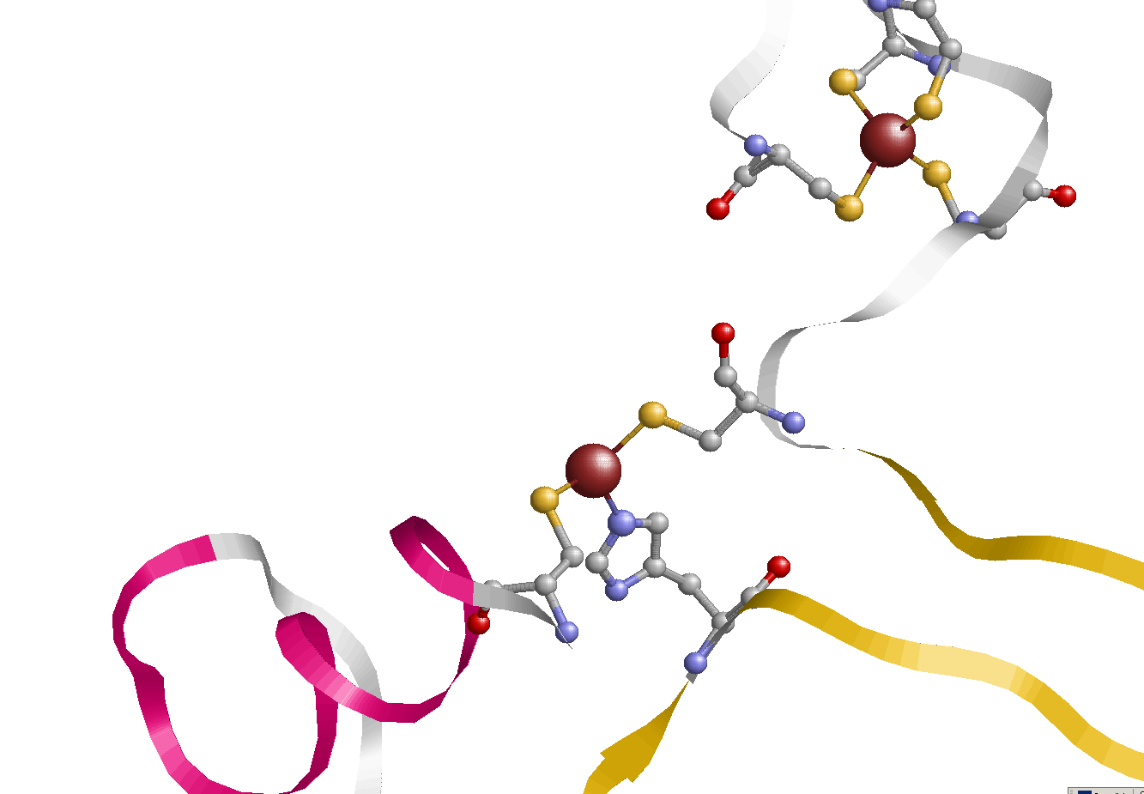
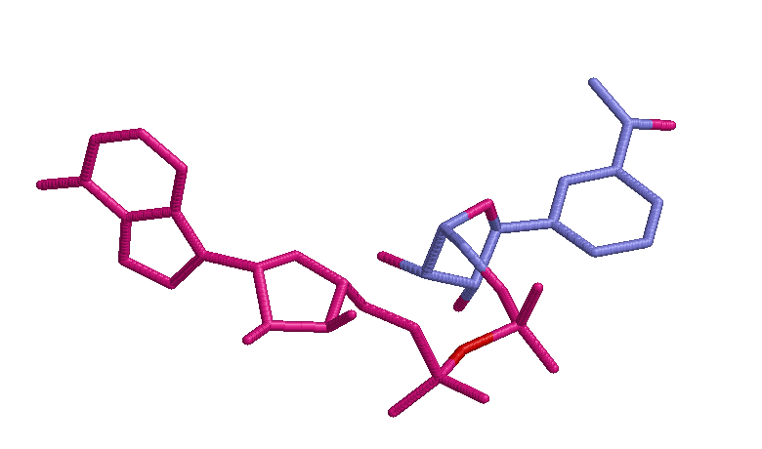

Zinc-binding proteins
Structural (4-coordinated)
Catalytic (3-coordinated)
Cys100
Zn402
Cys103
Cys97
Cys111
NAD
Cys174
DMS
Zn401
Cys46
His67
Alcohol dehydrogenases
2010-02-09
Nanjiang Shu
Notes:
Describing function of these two zinc-binding proteins.
DMS (Dimethyl sulfoxide) ligand in the catalytic zinc-binding site. And in it’s inactivated state, it is water molecule??
Alochol dehydrogenase facilitate the interconversion between alcohols and aldehydes or ketones with the reduction of NAD+ to NADH.
DNA binding proteins, zinc-binding (zinc finger) is critical to the stability of the structure since the protein is too small to form a hydrophobic core C2H2
Many transcription factors (such as Zif 268), regulatory proteins, and other proteins interact with DNA contain zinc-fingers)
For example 1A1K, Complex (zinc finger /DNA) the size of protein is around ~100 amino acids
Zinc is required for the biological function of > 300 enzymes, including DNA synthesis, normal growth, brain development, behavioural response, reproduction, fetal development, membrane stability, bone formation and wound healing.
Structure Zinc, involved in DNA replication and reverse transcription and it is critical for a number of metalloproteins
Alcohol dehydrogenases (EC 1.1.1.1) are a group of seven dehydrogenase enzymes that occur in many organisms and facilitate the interconversion between alcohols and aldehydes or ketones. In humans and many other animals, they serve to break down alcohols which could otherwise be toxic; in yeast and many bacteria, some alcohol dehydrogenases catalyze the opposite reaction as part of fermentation.
The CAS number for this type of the enzyme is [9031-72-5].
NADH: Nicotinamide adenine dinucleotide (NAD+ or in older notation DPN+) is an important coenzyme found in cells.
PhospholipaseE C: phospholipase is en enzyme that converts phospholipids into fatty acids and other lipophilic substances
Hydrolase: hydrolase is an enzyme that catalyzes the hydrolysis of a chemical bond. For example, an enzyme that catalyzed the following reaction is a hydrolase:
A–B + H2O → A–OH + B–H
1AH7: PhospholipasE C from bacillus cereus

Slide 2
Cys100
Zn402
Cys103
Cys97
Cys111
NAD
Cys174
DMS
Zn401
Cys46
His67
Notes:
Describing function of these two zinc-binding proteins.
DMS (Dimethyl sulfoxide) ligand in the catalytic zinc-binding site. And in it’s inactivated state, it is water molecule??
Alochol dehydrogenase facilitate the interconversion between alcohols and aldehydes or ketones with the reduction of NAD+ to NADH.
DNA binding proteins, zinc-binding (zinc finger) is critical to the stability of the structure since the protein is too small to form a hydrophobic core C2H2
Many transcription factors (such as Zif 268), regulatory proteins, and other proteins interact with DNA contain zinc-fingers)
For example 1A1K, Complex (zinc finger /DNA) the size of protein is around ~100 amino acids
Zinc is required for the biological function of > 300 enzymes, including DNA synthesis, normal growth, brain development, behavioural response, reproduction, fetal development, membrane stability, bone formation and wound healing.
Structure Zinc, involved in DNA replication and reverse transcription and it is critical for a number of metalloproteins
Alcohol dehydrogenases (EC 1.1.1.1) are a group of seven dehydrogenase enzymes that occur in many organisms and facilitate the interconversion between alcohols and aldehydes or ketones. In humans and many other animals, they serve to break down alcohols which could otherwise be toxic; in yeast and many bacteria, some alcohol dehydrogenases catalyze the opposite reaction as part of fermentation.
The CAS number for this type of the enzyme is [9031-72-5].
NADH: Nicotinamide adenine dinucleotide (NAD+ or in older notation DPN+) is an important coenzyme found in cells.
PhospholipaseE C: phospholipase is en enzyme that converts phospholipids into fatty acids and other lipophilic substances
Hydrolase: hydrolase is an enzyme that catalyzes the hydrolysis of a chemical bond. For example, an enzyme that catalyzed the following reaction is a hydrolase:
A–B + H2O → A–OH + B–H
1AH7: PhospholipasE C from bacillus cereus

Slide 3
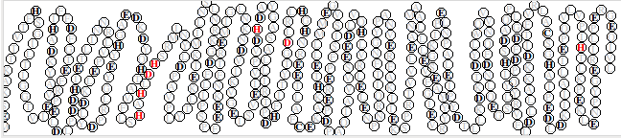

Slide 4
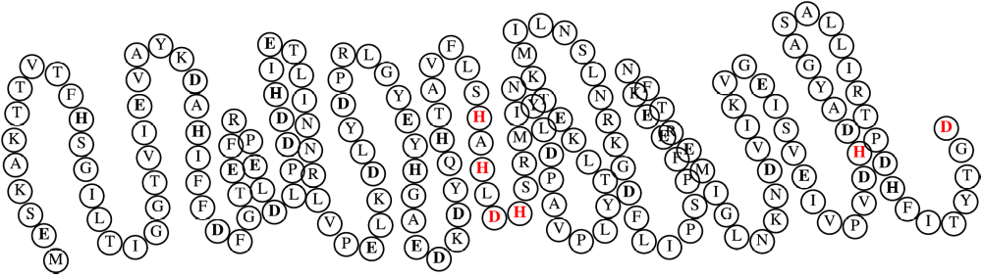
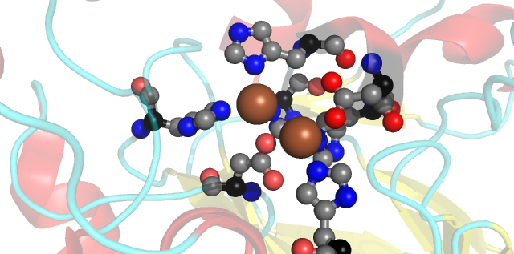
PredZinc

Slide 5

PredZinc

