Slide 1
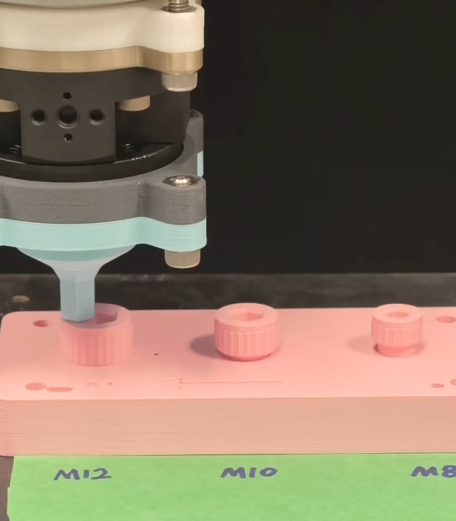
PAPER-ALIGNED GROUP REVIEW
Learning-Based Tactile Posterior-Guided Search for Robotic Hex-Socket Engagement
Paper-aligned group review
Nan Jinyao
30 August 2026
Learning guides where to search. Measured contact decides engagement.
Notes:
Good morning. This work studies how a robot can find and enter a hex socket after visual alignment has brought the driver close to the screw head. We use one low-force tactile scan to guide the remaining search. The learned model provides partial directional evidence, not a final answer. It can shorten the route, but capture, recovery, force limits and the terminal engagement check remain in the physical control loop. I will begin with the wider unscrewing task that motivates this problem.
Source: Paper title, Abstract, and Introduction, p.1; control architecture, Fig. 2, p.4.

Slide 2
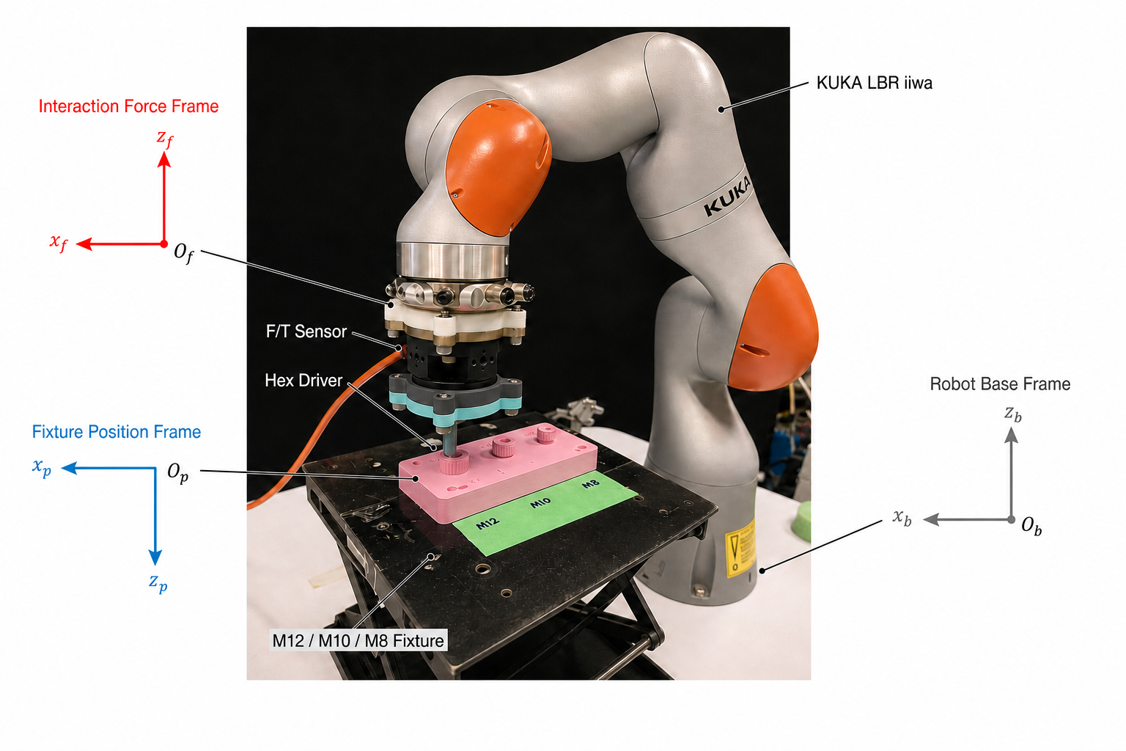
02
PROBLEM
● Problem Task Framework Simulation Hardware Discussion
The background task is robotic hex-socket unscrewing
Vision and CAD first bring the driver above the screw head.
The driver must enter the recessed hex socket before torque can be applied.
Only then can the robot turn the screw, release the thread and extract it.
Task context only: complete unscrewing was not evaluated in this paper.
Nan Jinyao · Paper-aligned group review
Introduction · hardware setup
2
Notes:
The wider task is robotic hex-socket unscrewing, which appears in automated disassembly and maintenance. A robot must locate the fastener, bring the correct driver to the screw head, enter the recessed socket, establish torque coupling, turn until the thread is released, and finally extract the screw. Each stage depends on the previous one. If the driver never enters the socket, even a good torque controller cannot act. This paper focuses on one early stage within that larger physical sequence.
Source: Introduction and automated-unscrewing context, p.1; reference [1]; scope statement, p.1.

Slide 3
03
PROBLEM
● Problem Task Framework Simulation Hardware Discussion
Engagement is the gate before torque can begin
1
2
3
4
5
Visual alignment
Geometric engagement
Torque coupling
Thread release
Extraction
SCOPE OF THIS PAPER
Geometric engagement is the enabling gate; downstream unscrewing stages are outside the demonstrated claim.
The paper studies the engagement gate, before the screw is turned.
Nan Jinyao · Paper-aligned group review
Introduction · Discussion
3
Notes:
The stage studied here is geometric engagement. The driver has reached the screw head, but it still has to find the recess, enter it and settle at the required depth. Only after that can the robot test first-turn coupling and apply useful torque. Our experiments stop at a verified geometric dwell. They do not show that the screw turns, that the thread releases or that extraction succeeds. Keeping this boundary clear lets us examine the search problem without mixing in later torque-related failures.
Source: Introduction and explicit task boundary, p.1; verified-engagement definition, Sec. II-A, p.2; Discussion, p.13.

Slide 4
04
PROBLEM
● Problem Task Framework Simulation Hardware Discussion
Vision gets close, but the last few millimetres remain uncertain
σᵥ = 2 mm
driver at x₀
M8 CAD-prior spread
Rᵥ = 4.895 mm
true center C
truncated support
capture disk
small clearance
capture is local
truncated CAD support
The remaining visual/CAD error can be as large as the useful capture range.
Nan Jinyao · Paper-aligned group review
Sec. I–II · M8 prior
4
Notes:
Vision and CAD can bring the driver near the socket, but the remaining error can still be large compared with the capture region of the chamfer. At stable top contact, the tool position is known while the true socket center is not. In the M8 study, we represent this uncertainty with a truncated planar prior using a two-millimetre standard deviation and a 4.895-millimetre radius. These are the paper's M8 settings, not general camera specifications. A physical search is still needed after visual alignment.
Source: Introduction, pp.1-2; task variables, Sec. II-A, p.2; M8 prior, Eq. (13), p.3.

Slide 5
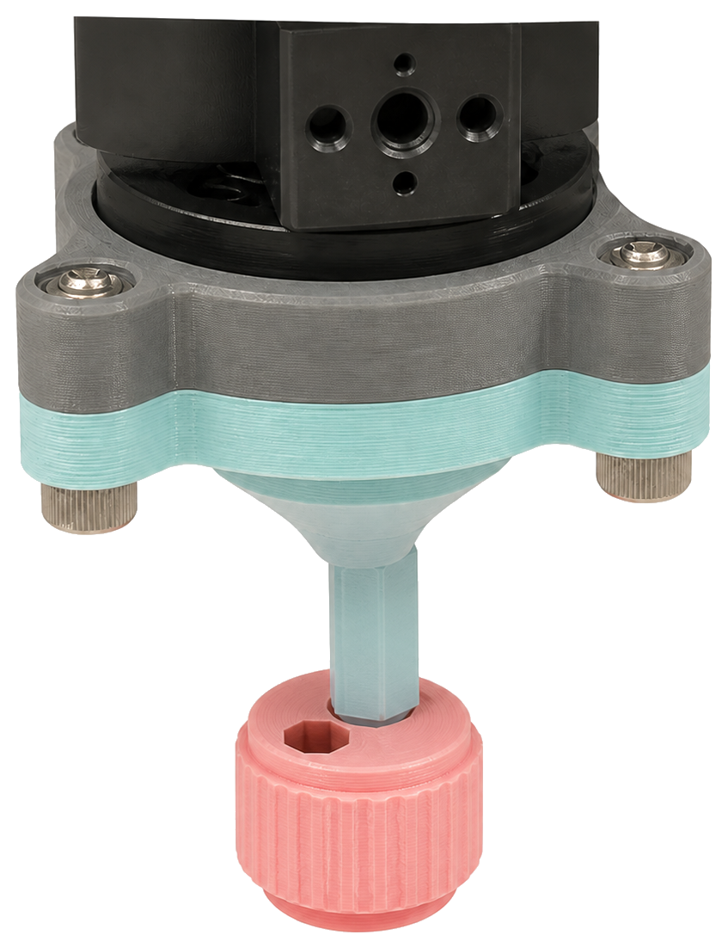
05
PROBLEM
● Problem Task Framework Simulation Hardware Discussion
Compliance corrects local errors, but it does not choose the route
RCC and admittance let the geometry absorb small alignment errors.
A larger offset still needs a decision about where to touch next.
The paper therefore treats compliance and search as different parts of the problem.
Compliance handles local contact. It does not remove the need for search.
Nan Jinyao · Paper-aligned group review
Introduction · contact mechanics
5
Notes:
Compliance is the usual first safeguard in part mating. It lets the contact geometry correct a small offset and reduces the chance of jamming or excessive load. But if the driver is outside the capture region, compliance does not tell the robot where to touch next. A search route is still required. In this work, learning does not replace admittance or remote-center compliance. It only proposes where to spend early search motion, while the same compliant controller executes the contact and checks the result.
Source: Introduction and related work, p.1; shared admittance and RCC controller, Sec. III-D, Eqs. (26)-(30), pp.5-6.

Slide 6

06
PROBLEM
● Problem Task Framework Simulation Hardware Discussion
A global spiral covers the prior, but it repeats work
A global outward spiral can cover the whole CAD-prior region.
The first tactile observation has already ruled out some of that region.
The goal is to spend motion only where uncertainty remains.
Safe coverage is useful, but unnecessary contact travel costs time and effort.
Nan Jinyao · Paper-aligned group review
Introduction · Sec. III-C
6
Notes:
A global outward spiral is a reasonable baseline because it covers the uncertain region without trusting a learned estimate. The cost is repeated work. It expands from the original contact even when the first tactile observation has made some directions much less likely than others. The robot therefore spends path length and time checking places that touch has already weakened. Our aim is not to remove the spiral's physical safeguards. It is to use tactile evidence to begin the remaining search in a more useful part of the prior.
Source: Abstract and Introduction, p.1; Outward baseline definition, Sec. IV-A, p.6.

Slide 7
07
PROBLEM
● Problem Task Framework Simulation Hardware Discussion
This conical scan reveals bearing better than radial distance
near: same ε remains inside capture
d⊥ = r |sin ε| d∥ = r cos ε
The ray reaches the capture disk only if d⊥ ≤ rₑff and d∥ > 0.
far: same ε creates a larger d⊥
The same direction error is harmless nearby and a complete miss farther away.
Nan Jinyao · Paper-aligned group review
Sec. II-B · Eqs. (6)–(7)
7
Notes:
The conical scan often gives a useful bearing toward the socket, but it is less certain about the radial distance. This difference matters. The same angular error may still cross the capture disk when the center is nearby, yet miss it completely when the center is farther away. The scan does not directly observe that distance. So the best angular bin should not be treated as a full socket pose, and the model should not turn one direction estimate into an exact center point.
Source: Introduction direction-distance gap, p.1; Direction-distance ambiguity, Sec. II-B, Eqs. (6)-(7), p.3.

Slide 8
08
PROBLEM
● Problem Task Framework Simulation Hardware Discussion
How much motion should one tactile cue command?
same bearing cue
Ignore touch
pay for global coverage
Trust it fully
risk a wrong endpoint
Bound the move
keep residual search
unknown radial offset
The problem is not whether touch is useful, but how much authority it should receive.
Nan Jinyao · Paper-aligned group review
Introduction · Sec. II-B
8
Notes:
This leaves a practical decision. If we ignore the cue, we pay for a full search. If we trust it as a complete pose estimate, we may move too far or pass beside the socket. The paper takes a middle position. Directional evidence is combined with the existing planar prior, and only a supported part of that belief becomes direct travel. The rest remains inside a finite residual search. The main question is therefore how much motion this incomplete tactile observation should be allowed to command.
Source: Introduction, pp.1 and 3; belief update and shortcut rule, Sec. III-B and III-C, Eqs. (13)-(19), pp.3-5.

Slide 9
09
PROBLEM
● Problem Task Framework Simulation Hardware Discussion
Learning guides the search, while physics verifies engagement
LEARNING AUTHORITY
01
02
03
CONICAL PROBE
BOUNDED ROUTE
PHYSICAL VERIFICATION
collect one repeatable tactile signal
shortcut only as far as the belief supports
capture, recovery and dwell decide the outcome
Learning proposes motion. The physical loop keeps the final authority.
Nan Jinyao · Paper-aligned group review
Abstract · Sec. III · Fig. 2
9
Notes:
Our answer is to keep learning on the routing side of the system. One low-force scan produces a circular direction posterior and rough contact support. This evidence reweights the CAD prior, supports a short capped move, and leaves unresolved uncertainty to local search. Learning stops there. Measured contact decides capture, the compliant controller manages insertion and recovery, guards enforce wrench and tilt limits, and a separate depth dwell decides the terminal event. A prediction can change where the robot searches, but it cannot certify engagement.
Source: Abstract, p.1; framework and Fig. 2, pp.3-4; physical verification, Sec. III-D, pp.5-6.

Slide 10
10
PROBLEM
● Problem Task Framework Simulation Hardware Discussion
The paper makes three contributions
1 One low-force conical touch produces direction and contact-support evidence.
2 That evidence becomes a capped shortcut followed by finite residual search.
3 All routes share the same compliant capture, recovery and terminal logic.
The contribution is the split between learned guidance and guarded execution.
Nan Jinyao · Paper-aligned group review
Introduction · contributions
10
Notes:
The first contribution is the observation: one phase-indexed conical touch gives a circular direction posterior and contact support while keeping distance uncertainty visible. The second is the action rule: this posterior becomes a bounded shortcut followed by finite residual search through one compliant controller. The third is the evaluation: paired M8 studies examine representation, task effort and recovery, followed by cross-size simulation and selected hardware runs. Those hardware runs show mechanism and feasibility, but they do not provide a randomized policy success rate.
Source: Introduction contribution list and scope statement, p.1; Experiments, Sec. IV-A to IV-F, pp.6-12.

Slide 11
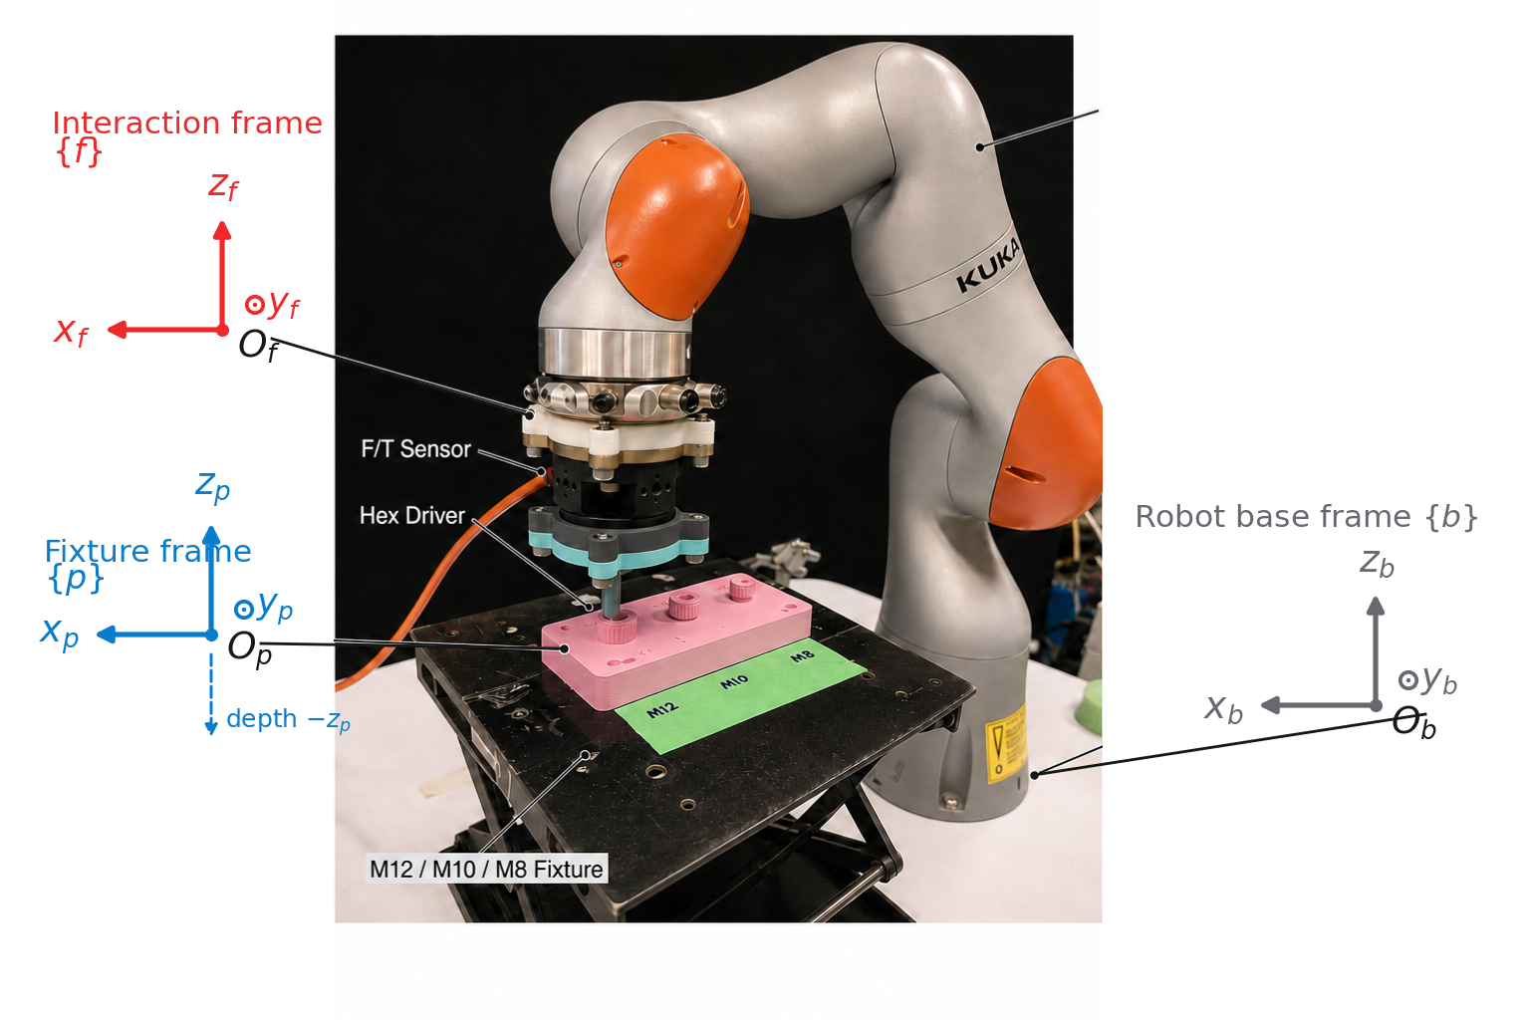
11
TASK
Problem ● Task Framework Simulation Hardware Discussion
The task runs from stable top contact to verified engagement
x₀ is the first stable top contact in fixture frame {p}.
C is the unknown socket center; engagement depth grows along −zₚ.
The demonstrated endpoint is geometric engagement, not screw turning.
The start state and endpoint are fixed before policies are compared.
Nan Jinyao · Paper-aligned group review
Sec. II-A · Fig. 1
11
Notes:
The trial begins when the driver reaches stable top contact on the screw head. The paper defines the robot-base frame, fixture frame and force-sensing tool frame, with planar search written in the fixture frame. The known starting position is x-zero, and the socket center C is unknown. From there, the robot probes, searches, detects a capture cue and attempts insertion. The endpoint is a verified geometric dwell at the required depth. Upstream visual approach and downstream screw turning are not part of this trial.
Source: Experimental platform and frames, Fig. 1, pp.1-2; Task and observations, Sec. II-A, p.2.

Slide 12
12
TASK
Problem ● Task Framework Simulation Hardware Discussion
Online control never sees the true socket center
ONLINE INPUTS
OFFLINE GRADING ONLY
Robot pose
True center C
Measured wrench
Privileged contact labels
Probe phase ϕ
Offline direction error
CAD prior p₀(C)
Controller state
Privileged-center baseline
Ground-truth geometry appears only in offline grading.
Nan Jinyao · Paper-aligned group review
Sec. II-A
12
Notes:
During a trial, the controller reads robot pose, the six-axis wrench, probe phase and the registered CAD prior. It also records the four channels used by the tactile model. The true socket center and simulator contact labels are held back for offline grading. So center markers and capture disks shown in the figures are explanatory; the policy never sees them. The height channel is also not used as a learned insertion detector. Physical capture and terminal engagement are checked separately from the model output.
Source: Online observations and withheld variables, Sec. II-A, Eqs. (1)-(3), p.2; Fig. 4 caption, p.5.

Slide 13
13
TASK
Problem ● Task Framework Simulation Hardware Discussion
Success needs capture, safe depth progress and a terminal dwell
γcap(tc) · γdwell(tb) · γsafe[0,tb] = 1
1
2
3
4
Stable touchdown
Capture cue
Bottom-mode dwell
Verified event
Tₘₐₓ = 130 s
The event must occur before 130 s and without a force-limit stop.
Nan Jinyao · Paper-aligned group review
Sec. II-A · Eqs. (4)–(5)
13
Notes:
A trial is not successful at the first apparent drop. A measured capture cue must occur first. The driver must then make enough axial progress and remain in bottom mode for the required dwell, with the safety condition true throughout. This terminal event must happen before the 130-second limit. Only then is the trial counted as verified engagement. Completion time, planar path and the contact-work proxy are interpreted under this definition. Force-limit, protected-stop and exhausted-budget exits remain failures, even if part of the insertion looked promising.
Source: Verified-engagement predicate and measures, Sec. II-A, Eqs. (4)-(5), p.2; experiment measures, Sec. IV-A, p.6.

Slide 14
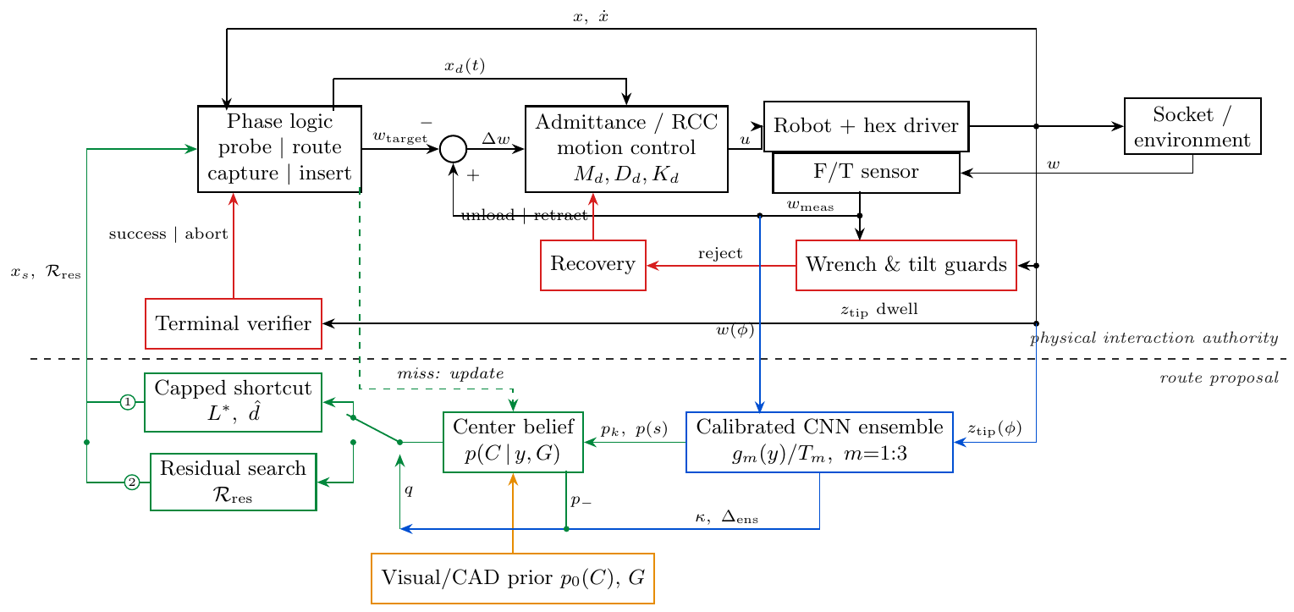
14
FRAMEWORK
Problem Task ● Framework Simulation Hardware Discussion
The method keeps inference, planning and verification separate
Blue learns, green plans, black executes and red guards.
Nan Jinyao · Paper-aligned group review
Sec. III · Fig. 2
14
Notes:
The architecture has three clear parts. First, learned tactile inference turns the conical scan into a direction posterior and contact support. Second, the prior and planning path build a center belief, choose a bounded shortcut and plan the remaining search. Third, the physical loops execute contact, recover from rejected attempts, enforce limits and check the terminal dwell. The dashed line in the framework is the authority boundary. Learning proposes a route above it, while measured physics owns capture and completion below it.
Source: Framework overview, Sec. III, p.3; control architecture, Fig. 2 and caption, p.4.

Slide 15
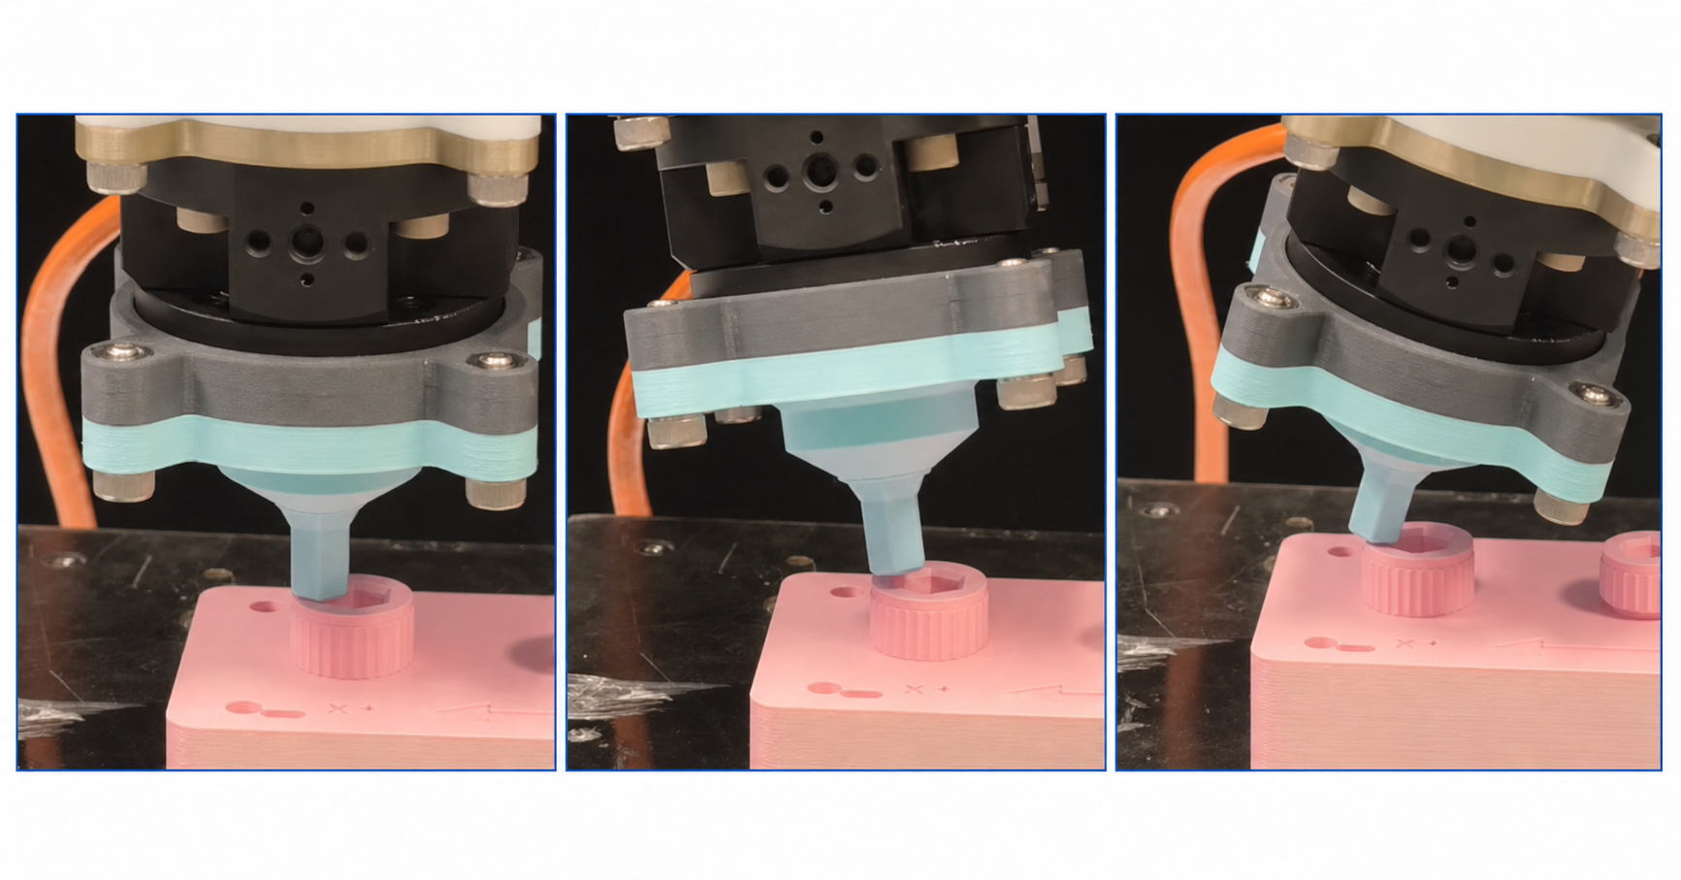
15
FRAMEWORK
Problem Task ● Framework Simulation Hardware Discussion
A 15-degree conical scan creates a repeatable contact fingerprint
Start from stable top contact.
Run a low-force 15° conical motion.
Use probe phase ϕ to organize the observation.
Probe phase is an observation coordinate, not the direction to the socket center.
Nan Jinyao · Paper-aligned group review
Sec. II-A · Fig. 3
15
Notes:
After stable top contact, the tool performs a low-force conical motion with a 15-degree angle. Because the motion is prescribed, changes in force, bending torque and height can be indexed by scan phase. That phase is not the direction from the tool to the socket center; it only says where the tool is within the cone. This is an active sensing action, not an insertion attempt. Wrench and tilt guards remain active while the fingerprint is collected, and route planning starts after the observation is formed.
Source: Conical observation, Sec. II-A, Eq. (2), p.2; closed-loop tactile-guided search, Fig. 3 and caption, p.4.

Slide 16
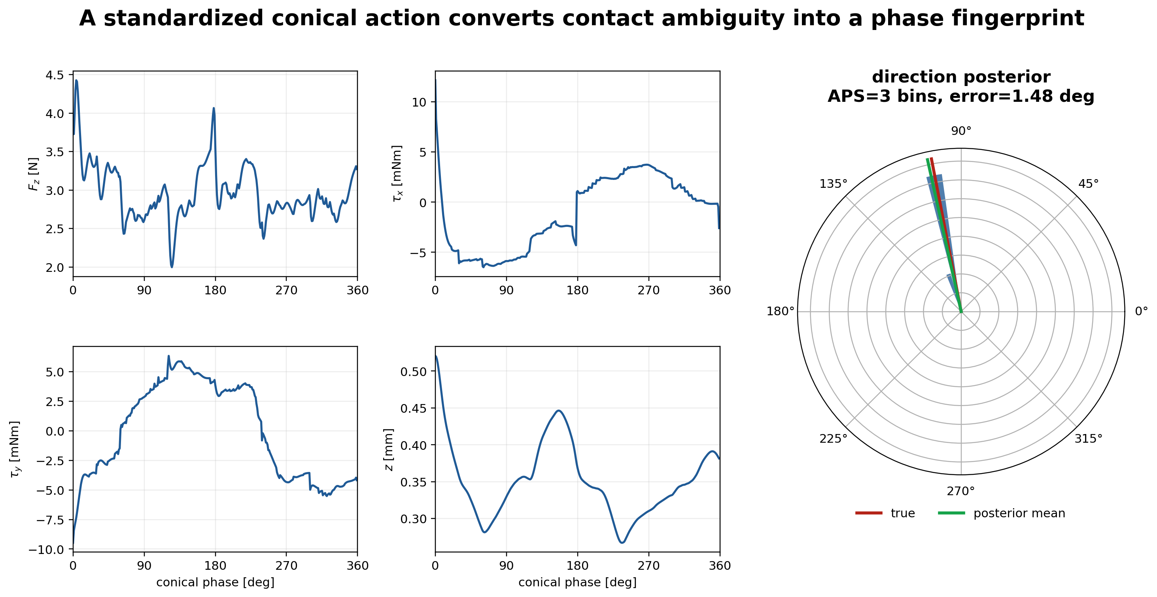
16
FRAMEWORK
Problem Task ● Framework Simulation Hardware Discussion
Four phase-aligned channels describe one touch
Hardware records 240 raw samples; periodic interpolation creates the 4×360 input without smoothing the raw signal.
Nan Jinyao · Paper-aligned group review
Sec. II-A · Eqs. (2)–(3)
16
Notes:
The model receives axial force F-z, bending torques tau-x and tau-y, and tip height z-tip. Samples are ordered around the circular probe phase and mapped to 360 phase locations with periodic linear interpolation, giving a four-by-360 input. This standardizes the input shape; it does not smooth the raw signal. In the highlighted hardware run, the scan contains 240 raw timestamped samples. Those remain the measured record, while interpolation produces the fixed model input. The height channel adds context but is not the terminal detector.
Source: Observation tensor and interpolation, Sec. II-A, Eqs. (2)-(3), p.2; 240-sample hardware trace, Sec. IV-F and Fig. 8, pp.8-10.

Slide 17
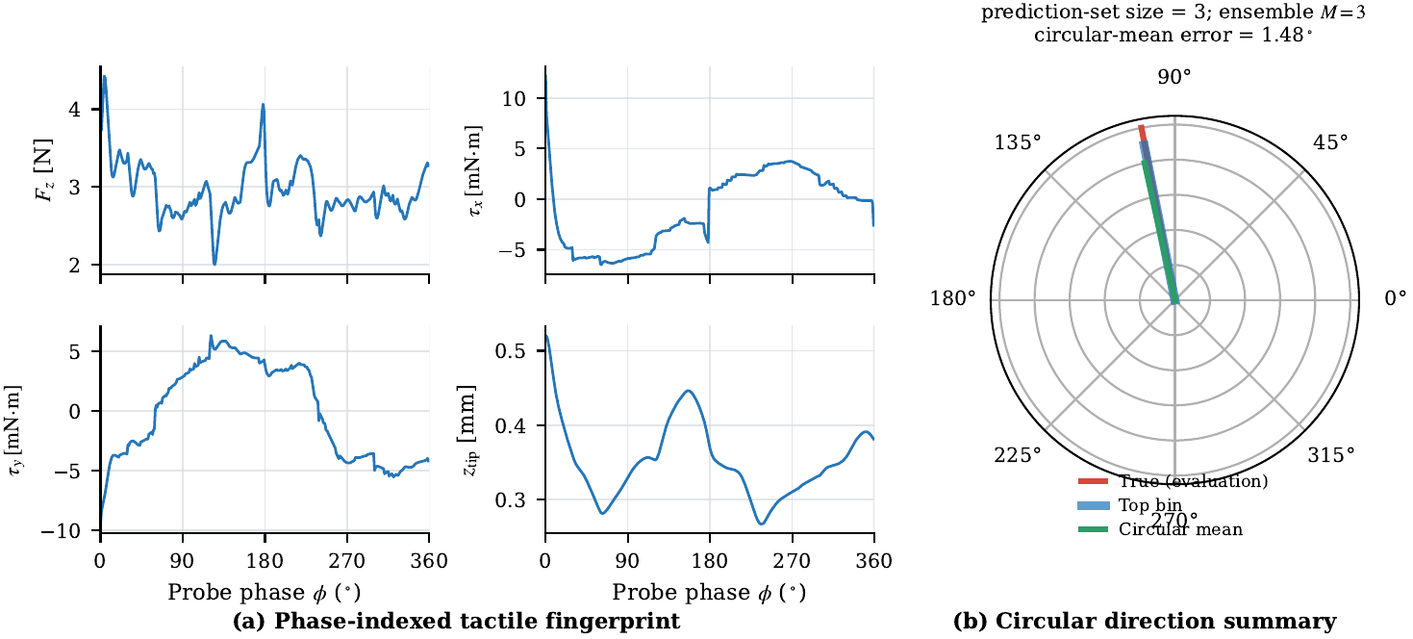
17
FRAMEWORK
Problem Task ● Framework Simulation Hardware Discussion
Three calibrated models produce a circular direction posterior
4 × 360 signal
3 calibrated models
48 direction bins
posterior + contact support
The model describes direction evidence. It does not estimate the socket center.
Nan Jinyao · Paper-aligned group review
Sec. III-A · Eqs. (8)–(12)
17
Notes:
Three separately trained models map the four-by-360 signal to 48 angular bins. Each model is temperature calibrated, and their probability distributions are averaged. From this circular posterior, we compute a mean direction and concentration. A separate head gives rough contact support, and differences between the members show ensemble disagreement. The output is still only a description of the tactile observation. It is not a two-dimensional center estimate, and neither the highest bin nor the contact-support score counts as physical capture or task success.
Source: Circular tactile posterior, Sec. III-A, Eqs. (8)-(12), p.3; Fig. 3, p.4.

Slide 18
18
FRAMEWORK
Problem Task ● Framework Simulation Hardware Discussion
The posterior updates the CAD prior without inventing distance
TRUNCATED CAD PRIOR
TACTILE-REWEIGHTED BELIEF
4096
CAD-prior particles
angular + contact-support weighting
direction
tactile reweighting
distance
left uncertain
The output is a weighted center belief, not a single predicted point.
Nan Jinyao · Paper-aligned group review
Sec. III-B · Eqs. (13)–(15)
18
Notes:
The CAD prior is represented by 4,096 possible socket-center particles. For each particle, the tactile posterior supplies the probability of its direction, and contact support supplies a rough radial likelihood. These terms update the particle weights. A small uniform component prevents one uncertain scan from erasing the geometric prior. The result is often an extended region along a likely bearing, not a single point. Touch narrows where the center may be, but the remaining distance uncertainty stays visible and is passed to the planner.
Source: Center-belief update and weighted quantiles, Sec. III-B, Eqs. (13)-(15), p.3.

Slide 19
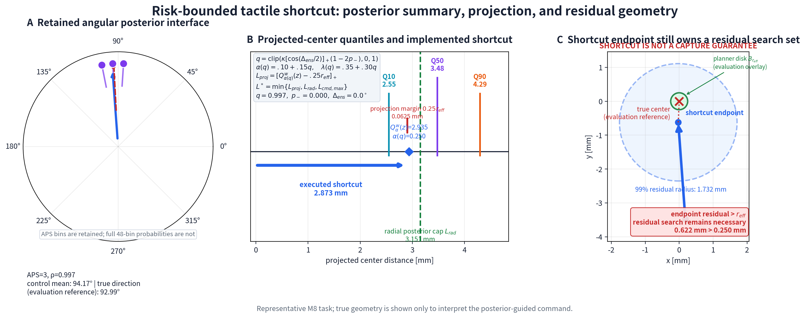
19
FRAMEWORK
Problem Task ● Framework Simulation Hardware Discussion
Supported posterior mass becomes a short, capped move
Projected support, radial support and the command limit all cap the shortcut.
Nan Jinyao · Paper-aligned group review
Sec. III-C · Eqs. (16)–(19)
19
Notes:
To choose the move, the weighted particles are projected onto the estimated direction. A quality score combines posterior concentration, disagreement between ensemble members and the amount of belief behind the current contact. This changes the supported projection quantile and the allowed fraction of radial support. The shortcut is the smallest of the projection budget, radial budget and an optional command cap, with a capture-radius margin. If reverse mass reaches 0.20, the shortcut is zero. The endpoint is a conservative search command, not a predicted center or guaranteed capture point.
Source: Quality-adaptive shortcut and residual radius, Sec. III-C, Eqs. (16)-(19), pp.3-5; Fig. 4, p.5.

Slide 20
20
FRAMEWORK
Problem Task ● Framework Simulation Hardware Discussion
Uncertain or reversed cues receive less authority
2.873 mm
clear shortcut
1.732 mm
clear residual
0.903 mm
ambiguous shortcut
3.402 mm
ambiguous residual
0 mm
reverse-mass veto
Clear evidence moves farther; ambiguous evidence moves less; reversed evidence turns the shortcut off.
Nan Jinyao · Paper-aligned group review
Sec. III-C · Fig. 4
20
Notes:
Here the controller turns observation quality into a motion budget. A clear, concentrated posterior with good ensemble agreement can support a longer shortcut. If the posterior is broad or the models disagree, the shortcut becomes smaller. Mass pointing behind the current contact reduces it further. Once that reverse mass reaches 0.20, the shortcut is set to zero and the system falls back to residual search. These quantities change how far the robot may move. They do not change the capture rule or the terminal decision.
Source: Paper Sec. III-C, Eqs. (16)-(19), Fig. 4, pp. 3-5.

Slide 21
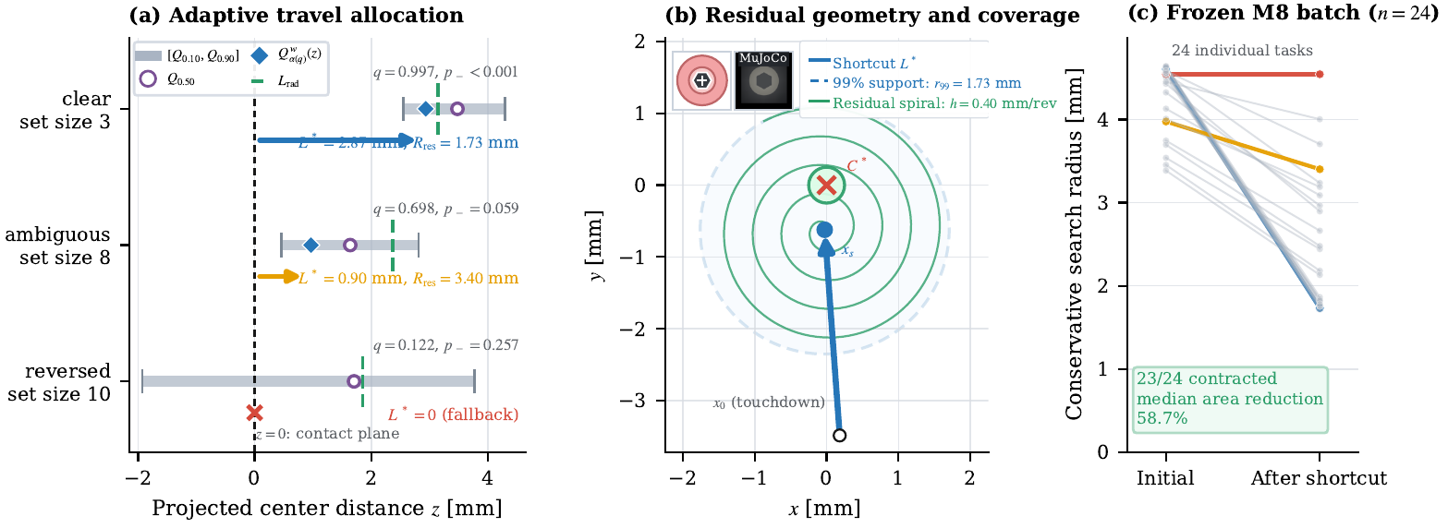
21
FRAMEWORK
Problem Task ● Framework Simulation Hardware Discussion
A missed shortcut removes inconsistent center hypotheses
1
execute a guarded segment
2
reject capture at a valid endpoint
3
downweight centers near the missed segment
4
rebuild the residual region
A measured valid miss is useful evidence for the next search action.
Nan Jinyao · Paper-aligned group review
Sec. III-C · Eqs. (20)–(21)
21
Notes:
After a shortcut is executed, the robot checks what actually happened. If the endpoint is valid, guarded contact is maintained, and capture is rejected, the travelled segment becomes negative evidence. Center particles that should probably have produced capture along that segment are downweighted. The remaining belief is then rebuilt around the measured endpoint, not the ideal command. No such update is made when the endpoint is invalid or unobserved. This lets the system learn from a physical miss without claiming that it knows the true center.
Source: Paper Sec. III-C, Eqs. (20)-(21), p. 5.

Slide 22
22
FRAMEWORK
Problem Task ● Framework Simulation Hardware Discussion
Two variants search the remaining region differently
SHARED POSTERIOR-SUPPORTED SHORTCUT
PGS-O
PGS-G
local Archimedean spiral
entropy-grid contacts
simple coverage of the residual disk
information and coverage minus travel cost
Both variants share the same shortcut, physical controller and verifier.
Nan Jinyao · Paper-aligned group review
Sec. III-C · Eqs. (22)–(25)
22
Notes:
PGS-O and PGS-G share the same probe, posterior, bounded shortcut, belief update, controller, recovery, and verifier. Only the residual search changes. PGS-O uses a finite local Archimedean spiral. PGS-G selects grid contacts using expected information, likely capture coverage, switching cost, and travel cost. If more contact is no longer informative, the grid falls back to coverage. The comparison therefore asks whether the extra planning is worthwhile in these small residual regions. It does not give either variant more authority over capture or success.
Source: Paper Sec. III-C, Eqs. (22)-(25), pp. 5-6; Sec. IV-A, p. 6.

Slide 23
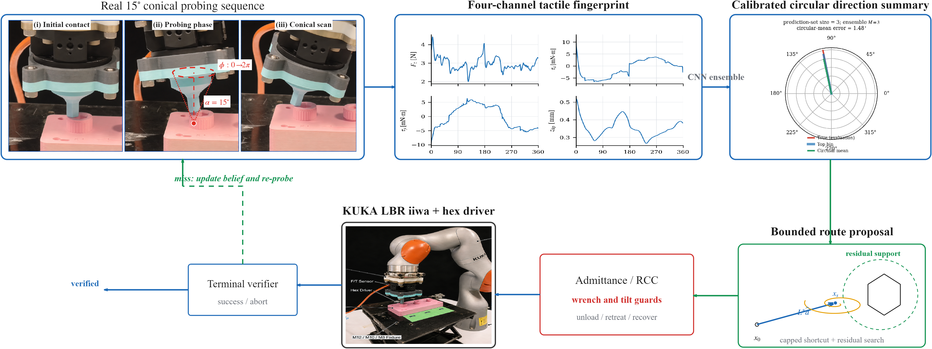
23
FRAMEWORK
Problem Task ● Framework Simulation Hardware Discussion
The physical loop still controls capture, recovery and termination
capture handoff
compliant insertion
bounded recovery
terminal dwell
The route can change, but the physical safety and terminal rules do not.
Nan Jinyao · Paper-aligned group review
Sec. III-D · Eqs. (26)–(30)
23
Notes:
Every proposed route is executed through the same task-frame admittance and RCC controller. A capture cue only hands control to an insertion attempt; it does not certify success. If depth progress stalls or tilt becomes too large, recovery unloads, retracts, returns upright, and retouches from the measured state. At most three post-capture recoveries are allowed, and safety limits can still end the trial. Engagement is accepted only after measured depth reaches the registered tolerance and the bottom-mode dwell holds. The network proposes motion, while physical interaction controls capture, recovery, and termination.
Source: Paper Sec. III-D, Eqs. (26)-(30), pp. 5-6.

Slide 24
24
SIMULATION
Problem Task Framework ● Simulation Hardware Discussion
All four policies face the same 24 M8 tasks
24
1.74–4.88 mm
130 s
paired Sobol tasks
initial offset
shared budget
The nuisance tuple is frozen across methods.
All methods use the same physical controller and verifier.
Paired tests use only tasks completed by both methods.
Only the routing policy changes.
Nan Jinyao · Paper-aligned group review
Sec. IV-A
24
Notes:
The main simulation benchmark uses 24 M8 task tuples fixed before any method comparison. Each tuple varies offset, socket phase, friction, contact dynamics, target force, sensing delay, and the model and noise seeds. Every policy receives the same tuple, the same 130-second budget, the same physical controller, the same safety limits, and the same terminal check. The four policies are PGS-O, PGS-G, global Outward search, and Direct-4C with up to three physical rays. There is no simulator reset or budget extension, so route choice is the main controlled difference.
Source: Paper Sec. IV-A, p. 6.

Slide 25
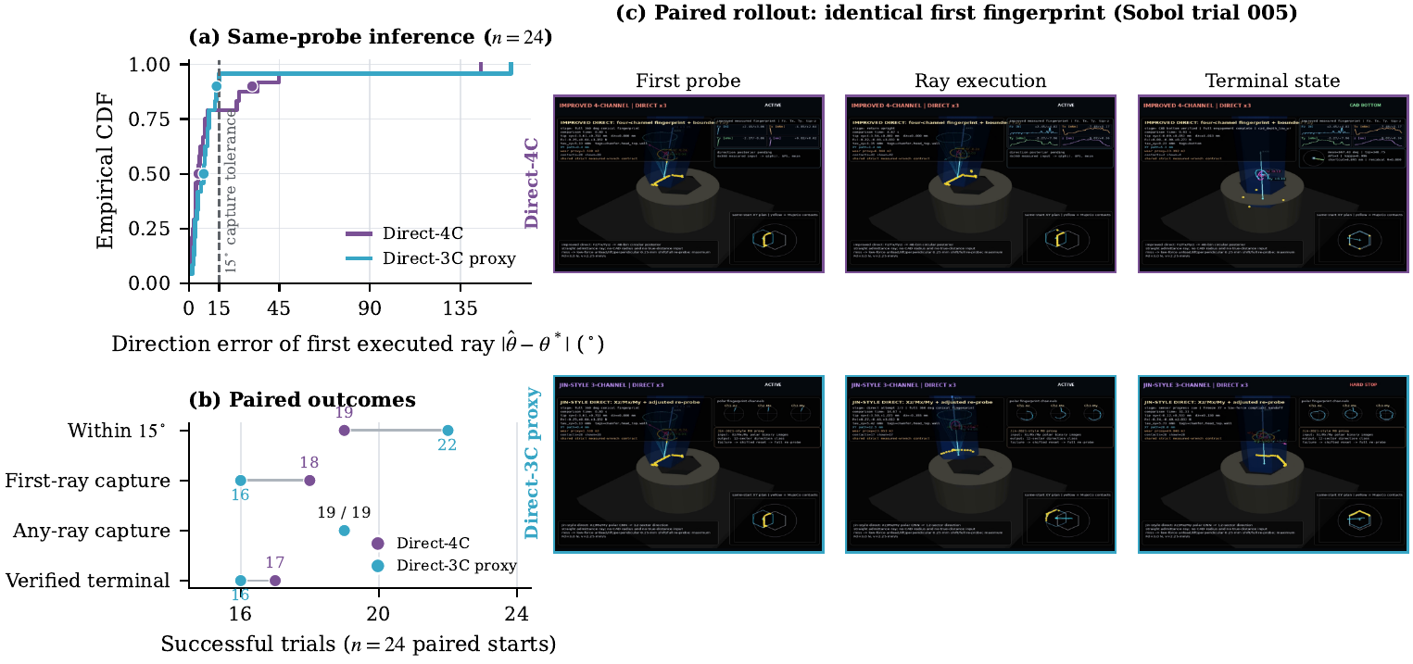
25
SIMULATION
Problem Task Framework ● Simulation Hardware Discussion
Four channels improve the median error, but the result is mixed
Median 4.75° vs 7.41°, but p90 31.45° vs 13.79°; any-ray capture is 19/24 for both.
Nan Jinyao · Paper-aligned group review
Table I · Fig. 5
25
Notes:
This ablation holds the first probe, task, noise, ray budget, and post-capture controller fixed. Direct-4C reduces the median executed-direction error from 7.41 to 4.75 degrees. Its tail is worse, however: the 90th-percentile error is 31.45 degrees, compared with 13.79 for the Direct-3C proxy. Any-ray capture ties at 19 of 24, and verified terminal counts are 17 versus 16. So the result is mixed. We keep the four-channel representation because it supports the circular posterior and routing interface, not because it is uniformly more accurate.
Source: Paper Sec. IV-B, Table I, p. 6; Fig. 5, p. 7.

Slide 26
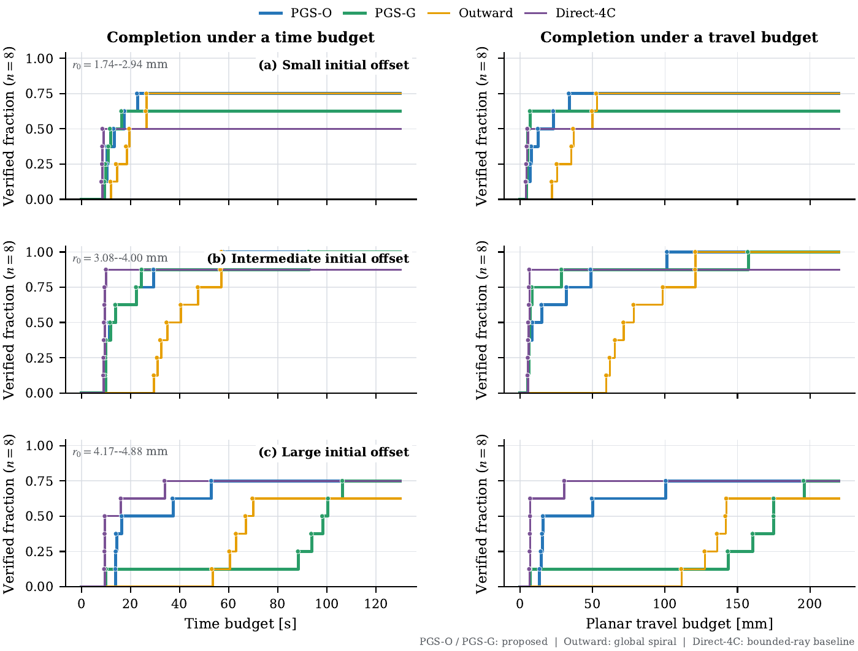
26
SIMULATION
Problem Task Framework ● Simulation Hardware Discussion
Engagement counts remain close across the search policies
PGS-O 20/24, PGS-G 19/24, Outward 19/24 and Direct-4C 17/24.
Nan Jinyao · Paper-aligned group review
Table II · Fig. 7
26
Notes:
Across the 24 paired M8 tasks, PGS-O reaches verified engagement in 20 cases. PGS-G and Outward each reach 19, while Direct-4C reaches 17. These counts are close, and the paper does not claim that the one-case difference proves a success-rate advantage. The medians among successful trials in Table II are also descriptive because each method succeeds on a different subset. The cleaner efficiency comparison therefore uses the same 19 tasks completed by both PGS-O and Outward. Keeping that denominator fixed is essential for the next result.
Source: Paper Sec. IV-C, Table II, p. 7; Fig. 7, p. 9.

Slide 27
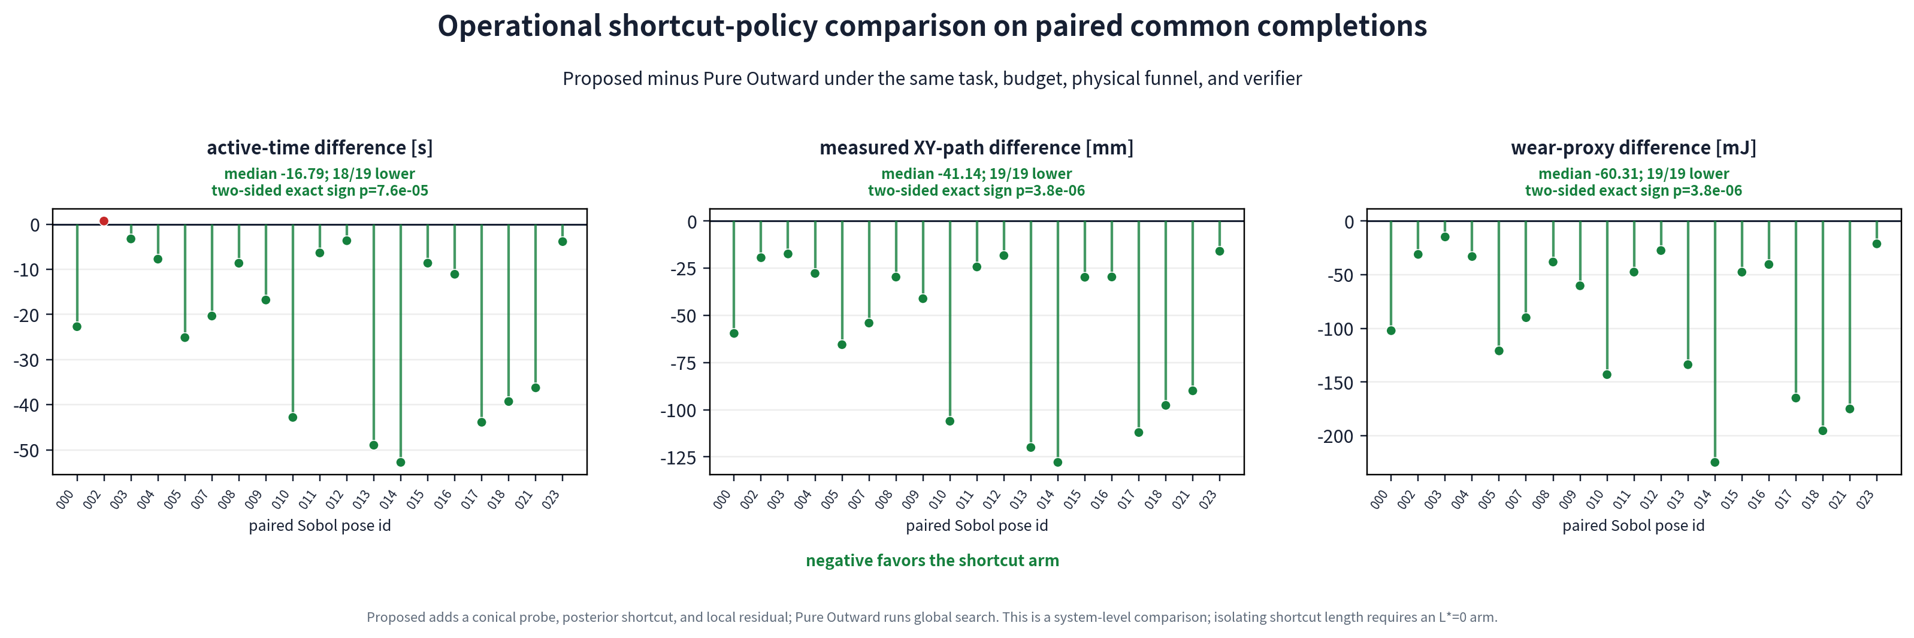
27
SIMULATION
Problem Task Framework ● Simulation Hardware Discussion
PGS-O cuts travel and time on 19 joint completions with Outward
Median gaps versus Outward are −41.14 mm and −16.79 s on the 19 joint completions.
Nan Jinyao · Paper-aligned group review
Sec. IV-C · paired differences
27
Notes:
This is the strongest quantitative result in the paper. PGS-O completed 20 of 24 tasks overall, while Outward completed 19 of 24. The same 19 tasks were completed by both, so those runs form the paired subset. PGS-O has a shorter measured planar path in all 19 pairs. The median paired gap is minus 41.14 millimeters, with an exact sign-test value of 3.8 times 10 to the minus 6. Time is lower in 18 of 19 pairs, with a median gap of minus 16.79 seconds and p equal to 7.6 times 10 to the minus 5. These are paired medians, not percentages or means.
Source: Paper Sec. IV-D, pp. 6-7; Table II, p. 7; paired-efficiency figure.

Slide 28
28
SIMULATION
Problem Task Framework ● Simulation Hardware Discussion
The entropy grid brings no advantage here
−0.061 mm
PGS-G − PGS-O path
p = .465
paired path test
+0.536 s
PGS-G − PGS-O time
p = .196
paired time test
19 shared completions
The local spiral already covers these small residual regions efficiently.
Nan Jinyao · Paper-aligned group review
Sec. IV-C
28
Notes:
PGS-G and PGS-O share 19 completed tasks, allowing a paired comparison of their residual searches. The median path gap, PGS-G minus PGS-O, is minus 0.061 millimeters, with p equal to 0.465. The median time gap is plus 0.536 seconds, with p equal to 0.196. Neither result supports an advantage for the entropy grid. In this benchmark the residual regions are only a few millimeters wide, so a local spiral already covers them with little waste. Larger regions might behave differently, but these 24 starts do not show that benefit.
Source: Paper Sec. IV-D, p. 7; Discussion, p. 13.

Slide 29
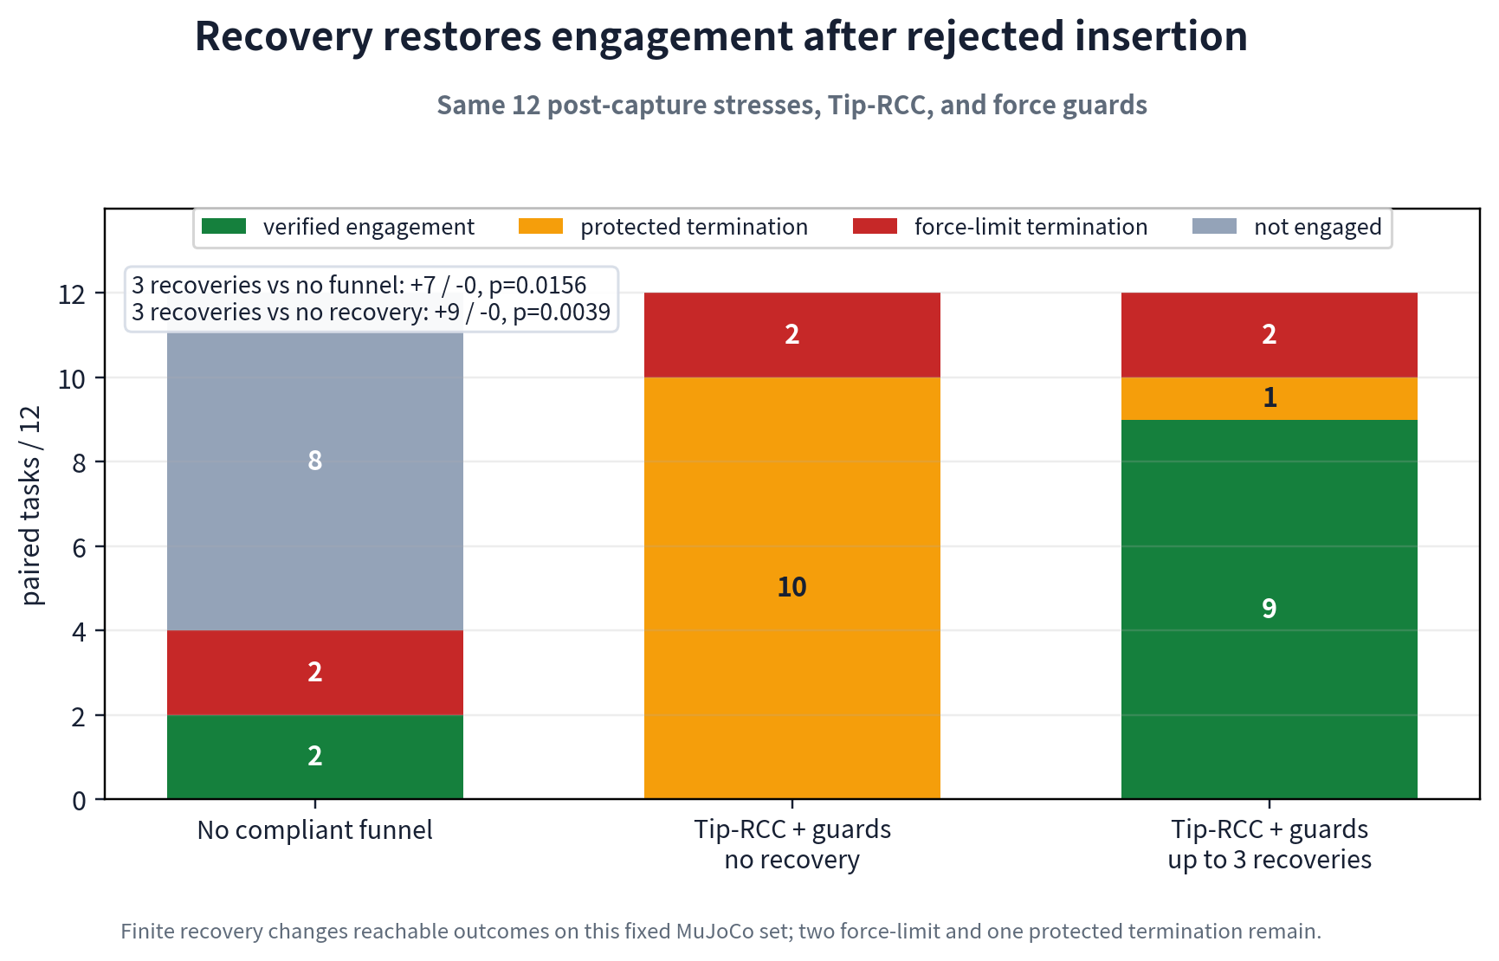
29
SIMULATION
Problem Task Framework ● Simulation Hardware Discussion
Recovery changes difficult post-capture outcomes
No recovery gives 0/12; up to three recoveries gives 9/12, with two force-limit and one protected exit remaining.
Nan Jinyao · Paper-aligned group review
Sec. IV-D · recovery ablation
29
Notes:
Recovery is tested on a separate fixed set of 12 difficult post-capture cases. The RCC and wrench guards stay the same; only the recovery allowance changes. With recovery disabled, none of the 12 cases reaches verified engagement. Allowing up to three recoveries produces nine verified engagements, with an exact paired p value of 0.00390625. Two force-limit exits and one protected exit remain. Recovery therefore changes which states are reachable after a rejected insertion, but it is not a guarantee. It also tests a different mechanism from the search-policy comparison.
Source: Paper Sec. IV-D, p. 7; recovery ablation; Eq. (29), p. 5.

Slide 30
30
SIMULATION
Problem Task Framework ● Simulation Hardware Discussion
Cross-size simulation shows no clear fine-tuning benefit
Interface
Dev M10
Dev M12
Test M10
Test M12
M8 zero-shot
12/0/0
10/1/1
12/0/0
10/0/1
Calibration only
12/0/0
10/0/1
12/0/0
11/0/0
Anchored fine-tuning
12/0/0
10/0/2
10/1/1
10/0/2
Privileged center
12/0/0
11/0/1
12/0/0
12/0/0
Each cell: verified / force-limit / protected termination · n = 12
The result supports keeping residual search and physical guards outside the transferred network.
Nan Jinyao · Paper-aligned group review
Sec. IV-E · Table III
30
Notes:
This is a cross-size simulation study, not a sim-to-real result. The M8 observation model is evaluated on M10 and M12 using zero-shot transfer, calibration-only transfer, and anchored fine-tuning of the narrow heads. Table III shows no steady held-out improvement from anchored fine-tuning. Some force-limit and protected exits also remain. The useful conclusion is therefore modest: this batch does not show that fine-tuning is necessary or better. The residual search, contact controller, safety guards, and terminal check remain fixed outside the transferred observation model.
Source: Paper Sec. IV-E and Table III, pp. 7-8.

Slide 31
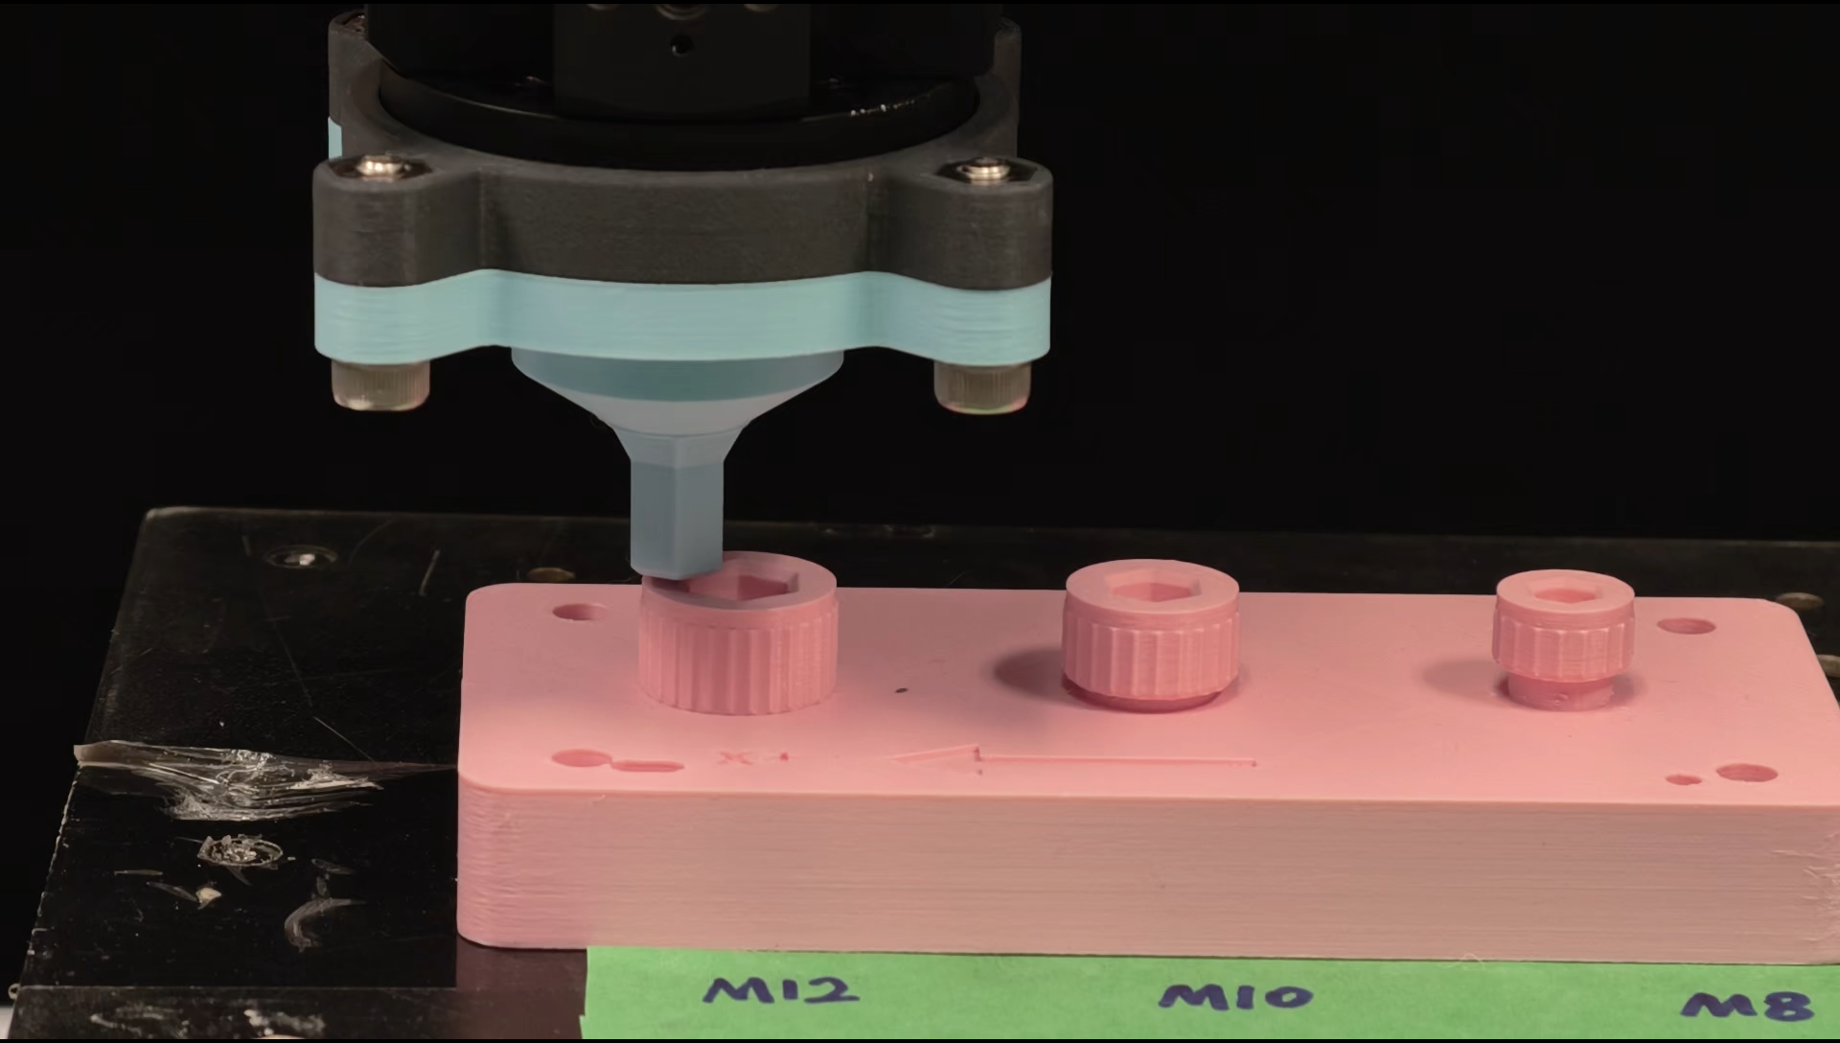
31
HARDWARE
Problem Task Framework Simulation ● Hardware Discussion
Real hardware needs a model trained on the installed stack
26 / size
registered scans
78 / 78
acquisition-valid
installed stack
model refit
78/78 describes valid scan acquisition, not engagement success.
Nan Jinyao · Paper-aligned group review
Sec. IV-F · Table IV
31
Notes:
Real contact signals differ from simulation because the installed stack adds friction, stiction, printed-part deformation, sensor bias, registration error, and gravity moment at the Bota sensor. The campaign records 26 conical scans for each of M8, M10, and M12. All 78 scheduled traces pass the acquisition checks. That is an acquisition result, not 78 engagement successes. The circular observation model used on the robot is therefore fitted again on installed-stack signals. This addresses the immediate observation mismatch, but not session drift, wear, temperature change, or every shift across socket size.
Source: Paper Sec. IV-F, p. 8; Table IV, p. 10; Discussion, p. 13.

Slide 32
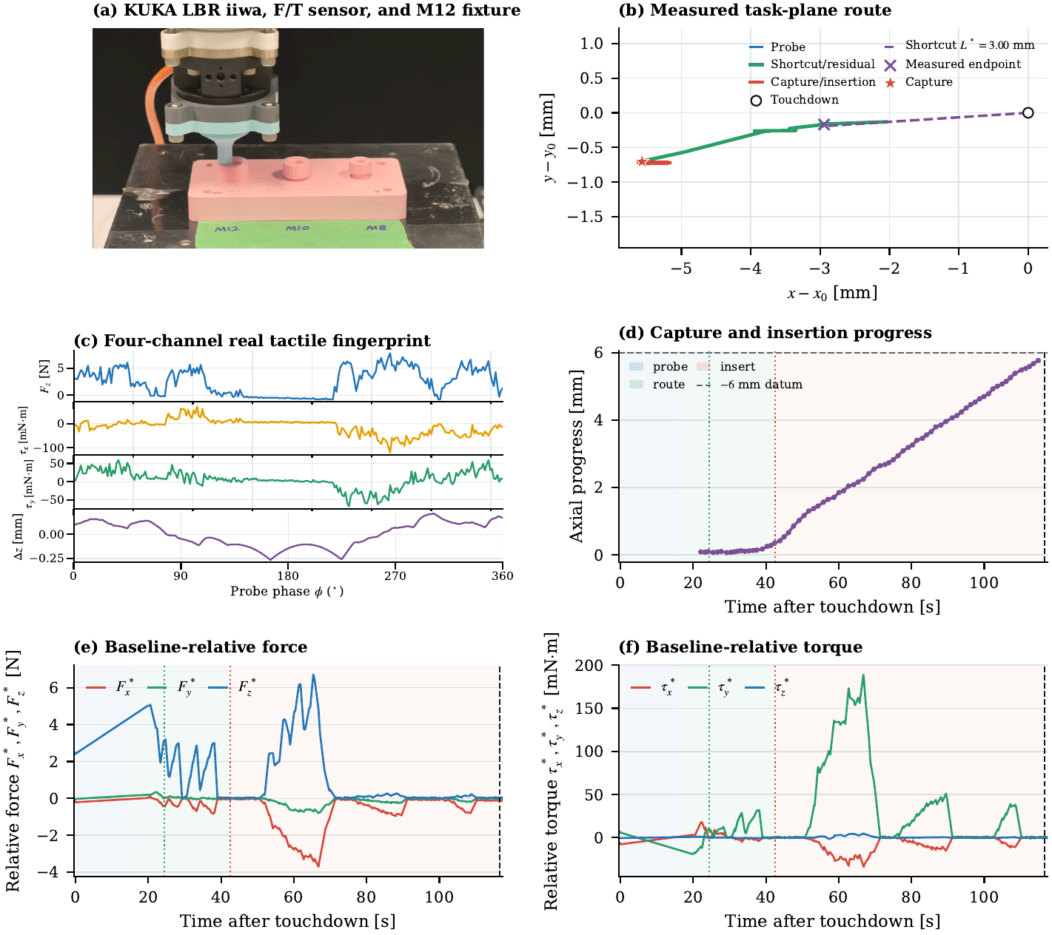
32
HARDWARE
Problem Task Framework Simulation ● Hardware Discussion
One M12 run shows the full closed-loop mechanism
3.00 mm shortcut, valid miss, negative-evidence replan, capture at 42.45 s and terminal candidate at 116.63 s.
Nan Jinyao · Paper-aligned group review
Sec. IV-F · Fig. 8
32
Notes:
This named M12 PGS-G run is shown from touchdown to the terminal event without mixing trials. The hardware records 240 raw scan samples, which periodic interpolation maps to the 4-by-360 model input without smoothing. The controller commands a 3.00-millimeter shortcut. The measured endpoint differs by only 0.054 millimeters, but capture is rejected. That valid miss updates the belief, and the residual route captures at 42.45 seconds. A terminal candidate is logged at 116.63 seconds with 5.792 millimeters of measured insertion depth. The run demonstrates the full mechanism, not a general rate.
Source: Paper Sec. IV-F, pp. 8-9; Fig. 8, p. 10.

Slide 33
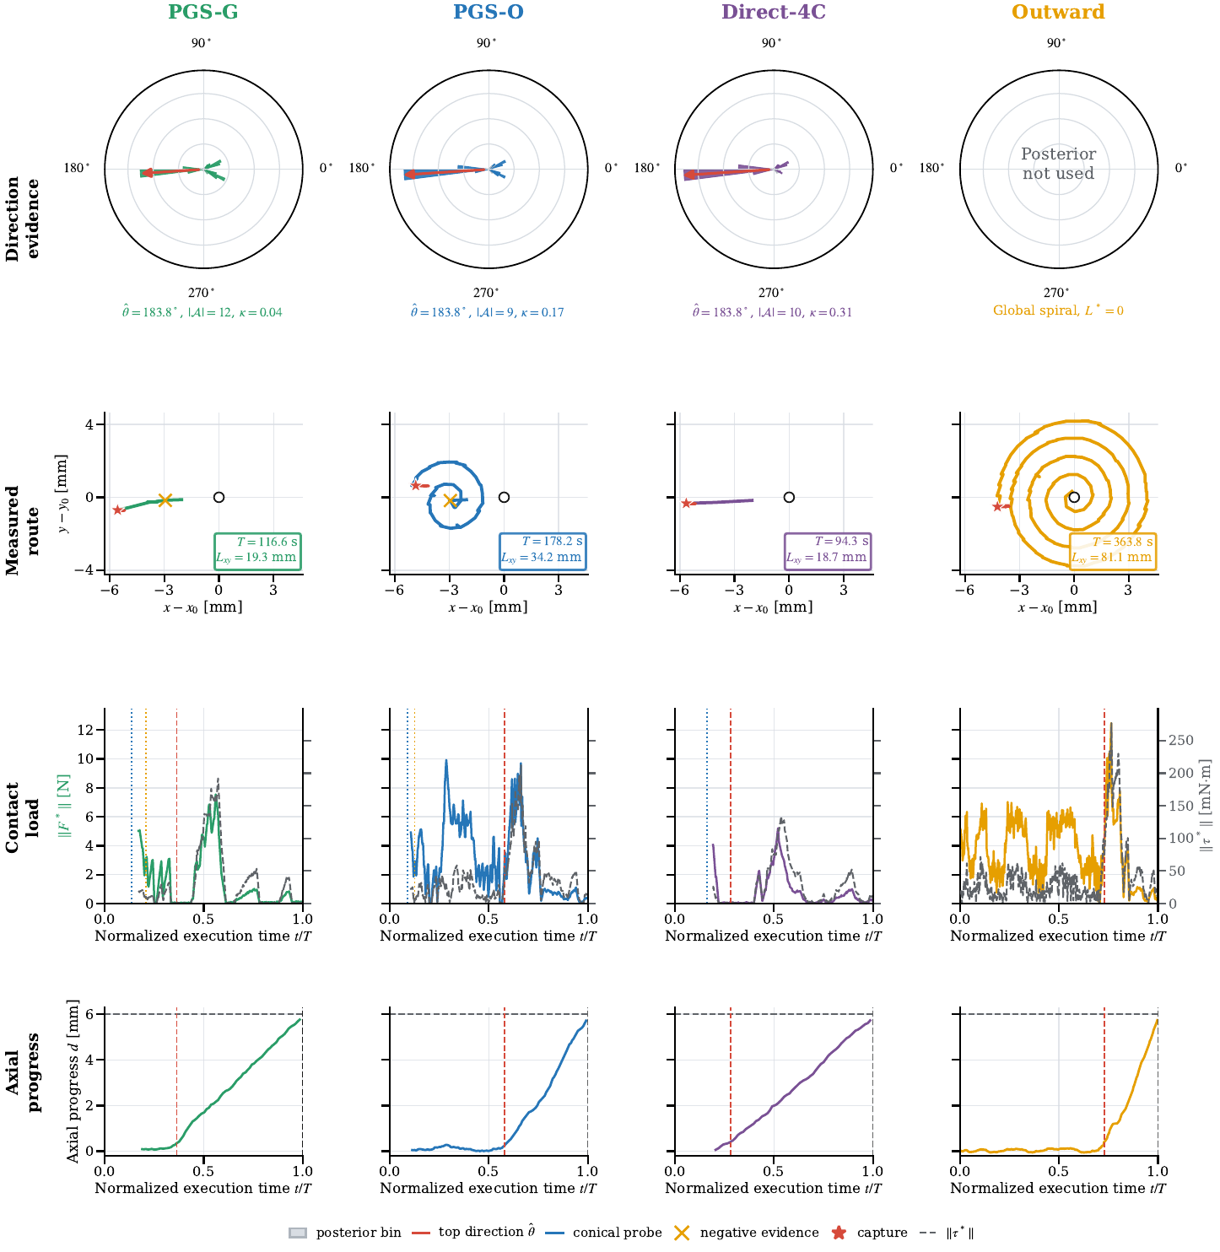
33
HARDWARE
Problem Task Framework Simulation ● Hardware Discussion
The hardware evidence shows feasibility, not a success rate
Hardware record
Method(s)
Runs
Recorded outcome
Registered conical scans
acquisition
26 / size
78 / 78 valid traces
M12 fixed-seed
PGS-O, PGS-G, Outward, Direct-4C
1 / method
three terminal; Outward after extension
M10 fixed-start
PGS-G
2
both reached terminal depth
Named / fixed-start mechanism evidence · no randomized hardware denominator
Named and fixed-start runs show the mechanism, but they do not provide a randomized policy denominator.
Nan Jinyao · Paper-aligned group review
Sec. IV-F · Table IV · Figs. 8–10
33
Notes:
The hardware evidence has three parts: the 78 acquisition-valid scans, one fixed-seed M12 run for each policy, and two fixed-start M10 pilots. Selected M12 PGS-O, PGS-G, and Direct-4C runs reach terminal events. Outward exceeds the 130-second budget and reaches engagement only after extension. The two M10 pilots reach terminal depth. These records let us inspect routes, loads, capture, and termination on the real system. They do not estimate a randomized success rate or policy-level speed. The Bota wrench is also baseline-relative at the sensor origin, not a certified absolute tool-tip wrench.
Source: Paper Sec. IV-F, Figs. 8-10, pp. 8-12; Table IV, p. 10.

Slide 34
34
DISCUSSION
Problem Task Framework Simulation Hardware ● Discussion
The evidence supports a narrow but useful claim
ESTABLISHES
DOES NOT ESTABLISH
Touch can allocate bounded search motion
PGS-G superiority
PGS-O reduces paired travel and time
A fine-tuning benefit
A randomized hardware success rate
Recovery helps on a fixed stress set
A capture guarantee
Selected hardware runs demonstrate feasibility
Torque coupling or thread release
The paper is strongest when the validity boundary stays explicit.
Nan Jinyao · Paper-aligned group review
Discussion
34
Notes:
The evidence supports a limited set of claims. A conical touch can update direction and contact support without estimating the full socket pose. That belief can allocate a capped shortcut while leaving unresolved uncertainty to residual search. On 19 joint M8 completions, PGS-O reduces path and time relative to Outward. Recovery changes outcomes on a fixed stress set, and selected hardware runs show feasibility. The evidence does not establish PGS-G superiority, a fine-tuning benefit, a randomized hardware rate, a capture theorem, certified tool-tip wrench, or successful screw turning and extraction.
Source: Paper Discussion and Conclusion, p. 13; Proposition 1, p. 4; Table IV, p. 10.

Slide 35
35
DISCUSSION
Problem Task Framework Simulation Hardware ● Discussion
Touch can shorten search when physical verification keeps authority
“
A conical tactile cue can shorten the route when it only controls a bounded shortcut and the unresolved uncertainty stays inside guarded search and verification.
1
Touch changes where search motion is spent.
2
Residual search absorbs the missing distance information.
3
Measured contact and terminal dwell decide success.
A conical tactile cue can shorten the route when it only controls a bounded shortcut and the unresolved uncertainty stays inside guarded search and verification.
Nan Jinyao · Paper-aligned group review
Conclusion
35
Notes:
The opening question was whether one tactile touch can shorten search without being allowed to declare success. The paired M8 result says yes for PGS-O against global Outward search. The method works by treating direction as partial evidence: only a supported distance becomes direct travel, and the remaining uncertainty stays inside bounded search. Capture, recovery, safety, and the final dwell remain physical decisions. That separation also keeps the conclusion honest. This study ends at verified geometric engagement. First-turn coupling, slip, thread release, and extraction still require their own evidence and control rules.
Source: Paper Abstract and Contributions, p. 1; Discussion and Conclusion, p. 13.

Slide 36
36
APPENDIX
Problem Task Framework Simulation Hardware Discussion
Backup: the shortcut bound keeps its assumptions visible
ASSUMPTIONS
P̂w[z ≥ L* + 0.25 rₑff] ≥ 1 − α(q)
L* ≤ λ(q) Q⁽ʷ⁾₀.₉₉(‖C − x₀‖)
Fixed weighted-particle set
p₋ < 0.20 and L* > 0
Exact endpoint execution
No guarantee after distribution shift
Retained posterior support ≠ capture guarantee
The proposition retains posterior support; it does not guarantee capture.
Nan Jinyao · Paper-aligned group review
Sec. III-C · Proposition 1
36
Notes:
Proposition 1 is an action-allocation bound, not a performance guarantee. It assumes a fixed weighted-particle set, reverse mass below 0.20, a positive shortcut, and exact execution of the commanded endpoint. Under those conditions, the shortcut retains at least one minus alpha of the empirical projected mass and remains capped by the radial quantile. The result does not say that the true center follows this empirical belief or that the path reaches the capture region. Distribution shift, tracking error, boundary truncation, contact dynamics, and an exhausted search budget all remain outside the bound.
Source: Paper Sec. III-C, Proposition 1 and Eqs. (18)-(19), p. 4; Discussion, p. 13.

Slide 37
37
APPENDIX
Problem Task Framework Simulation Hardware Discussion
Backup: full M8 outcomes and paired denominators
Comparison
Overall count
Paired denominator
What is reported
PGS-O
20 / 24
19 vs Outward
median path/time gap
PGS-G
19 / 24
19 vs PGS-O
median path/time gap
Outward
19 / 24
19 vs PGS-O
complete-policy baseline
Direct-4C
17 / 24
24 vs 3C proxy
representation ablation
Recovery R3
9 / 12
12 vs R0
paired binary exact test
Overall completion counts and conditional paired-efficiency subsets are different quantities.
Nan Jinyao · Paper-aligned group review
Sec. IV-B–D · Tables I–II
37
Notes:
The denominators need to stay separate. Overall verified counts are reported out of 24 starts: 20 for PGS-O, 19 for PGS-G, 19 for Outward, and 17 for Direct-4C. The PGS-O versus Outward efficiency result uses only their 19 joint completions. The PGS-G versus PGS-O comparison also uses 19 shared completions. The representation ablation uses 24 matched probes and starts, while recovery uses a different set of 12 fixed stresses. Medians among successful trials are descriptive. Mixing these groups would create comparisons that the experiment did not support.
Source: Paper Table I, p. 6; Table II and Sec. IV-D, p. 7; recovery study, p. 7.

Slide 38
38
APPENDIX
Problem Task Framework Simulation Hardware Discussion
Backup: the next study should close the hardware evidence gap
P0 Randomized hardware repetitions
Pre-register starts, denominators and terminal rules.
P1 First-turn coupling
Test torque transfer separately from engagement.
P2 Observation robustness
Track session drift, wear, temperature and size shift.
P3 Larger residual regions
Re-test whether information planning earns its cost.
Each new experiment should close one named validity gap.
Nan Jinyao · Paper-aligned group review
Derived from Discussion
38
Notes:
The main remaining evidence gap is a randomized hardware study. The next experiment should register starts across several offsets and socket sizes, keep the same time budget and terminal rule, and report every start with the full failure taxonomy. Repeated paired runs would support both a hardware engagement rate and a fair efficiency comparison. The observation model should also be checked across sessions, wear, and temperature changes. First-turn torque coupling can be studied separately if the intended claim expands beyond geometric engagement. Until those studies are complete, the present hardware claim should remain feasibility and mechanism.
Source: Derived from the limitations in Paper Discussion, p. 13, and the hardware evidence boundary in Table IV, p. 10.

Slide 39
DECLARATION
I hereby declare that this work is my original work and it has been written by me in its entirety. I have duly acknowledged all the sources of information which have been used in the work.
NAN JINYAO
Signature
Date
30 August 2026
[Insert real signature here]
No signature was synthesized.
39
Notes:
This final slide contains the declaration requested for the review. The wording should remain unchanged in the delivered presentation. Nan Jinyao's name and the final document date are included, while the signature area remains a placeholder until the author supplies a real signature asset. No signature has been generated, copied, or inferred here. The page records authorship and acknowledgment of the sources used in the work. It does not add scientific evidence, and nothing should follow it in the final slide file.
Source: Required author declaration supplied with the meeting request; real signature asset pending.

