Slide 1
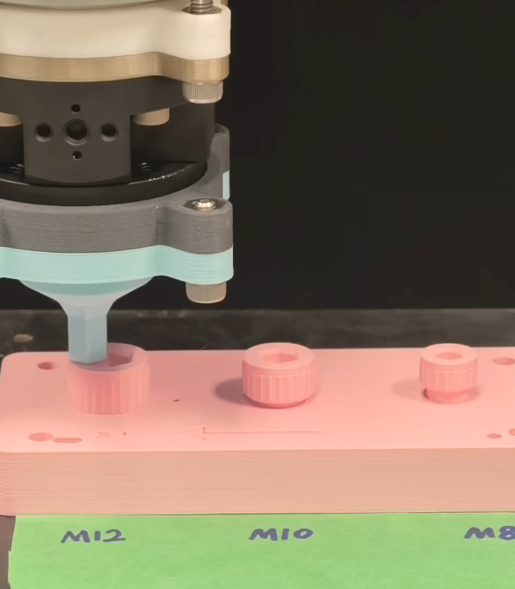
PAPER-ALIGNED GROUP REVIEW
Learning-Based Tactile Posterior-Guided Search for Robotic Hex-Socket Engagement
Detailed paper-aligned group review
Nan Jinyao
29 August 2026
Learned touch proposes where to search. Physical interaction decides engagement.
Notes:
Purpose
Open the journal-review presentation with the paper's formal title, central question, and exact task boundary.
Speaker notes
Good afternoon. This work is titled Learning-Based Tactile Posterior-Guided Search for Robotic Hex-Socket Engagement. The question is deliberately narrow: after vision and CAD have brought a hex driver onto the screw head, can one low-force tactile observation reduce the remaining search effort without giving a learned model authority to declare success? The proposed answer is to use touch as partial evidence. A conical probe produces a circular posterior over direction and a contact-support estimate. That evidence updates a planar prior, supports only a bounded shortcut, and leaves unresolved uncertainty to a guarded physical search. Capture, recovery, and the terminal dwell remain independent of the network. I will first define why the direction-distance ambiguity matters, then build the framework layer by layer, and finally examine the simulation and hardware evidence. The demonstrated scope ends at verified geometric engagement, before any screw turning. Let me begin with the paper's answer in one picture.
Discussion notes
Q1: Is this a full robotic unscrewing system?
A1: No. The paper starts at stable top contact and stops at verified geometric engagement. Torque coupling, thread release, and extraction are outside the demonstrated scope.
Q2: What is the learned component allowed to decide?
A2: It may propose a direction-conditioned, bounded search move. It may not certify capture, engagement, or task completion.
Q3: Why use the word Search rather than Control in the title?
A3: Search is the paper's formal title and scientific focus. Control refers to the shared compliant execution and guard layer inside the framework.
Source map
Paper title, Abstract, Introduction contribution list and scope statement, p.1; Fig. 1 for the hardware hero image.
Permitted claim
The paper studies learning-based tactile posterior-guided search for verified geometric hex-socket engagement.
Claim not supported
The work demonstrates full autonomous unscrewing or successful torque application.

Slide 2
02
PROBLEM
● Problem Task Framework Simulation Hardware Discussion
One tactile touch should shorten the search without being allowed to declare success
LEARNING AUTHORITY
01
02
03
LOW-FORCE PROBE
BOUNDED SHORTCUT + RESIDUAL
INDEPENDENT VERIFIER
one phase-indexed observation
learning allocates search motion
capture, safety and dwell own outcome
The paper’s complete answer in one slide.
Nan Jinyao · Paper-aligned group review
Abstract · Sec. III · Fig. 2
2
Notes:
Purpose
State the complete method and authority boundary in under one minute.
Speaker notes
Here is the complete argument of the paper. We make one prescribed, low-force conical touch and interpret the resulting phase-indexed force, bending-torque, and height signal with a calibrated ensemble. The output is not a socket-center estimate. It is a circular direction posterior plus rough contact support. We combine that evidence with the existing CAD prior over possible centers. Only the well-supported part of the posterior becomes a short, capped move. Whatever remains uncertain is handled by either a local outward spiral or an entropy-grid residual route. Most importantly, the route proposal sits above an authority line. The physical loop still checks capture from measured contact, performs compliant insertion, recovers from rejected attempts, enforces wrench and tilt limits, and requires an independent bottom dwell. So the one-sentence takeaway is: learned touch can decide where to spend search motion, but it cannot decide that engagement has occurred. To see why this split is needed, we should first place engagement inside the larger unscrewing sequence.
Discussion notes
Q1: Why not let the network output the center directly?
A1: The conical signal is usually more informative about bearing than radial offset. A point center would hide that ambiguity and could authorize an unsafe overshoot.
Q2: What happens when the posterior is weak or points backward?
A2: Its direct-motion budget contracts; if posterior mass behind the current contact reaches 0.20, the shortcut is set to zero.
Q3: Does residual search mean the tactile model failed?
A3: No. Residual search is an intentional part of the policy that handles uncertainty the observation cannot resolve.
Source map
Abstract, p.1; control architecture and authority split, Sec. III and Fig. 2, p.4; Discussion and Conclusion, p.13.
Permitted claim
One tactile observation can support a bounded shortcut while guarded residual search and independent verification retain physical authority.
Claim not supported
The model predicts the exact socket center or detects engagement on its own.

Slide 3
03
PROBLEM
● Problem Task Framework Simulation Hardware Discussion
Socket engagement is the gate before torque can begin
1
2
3
4
5
Localization
Geometric engagement
Torque coupling
Thread release
Extraction
SCOPE OF THIS PAPER
Geometric engagement is the enabling gate; downstream unscrewing stages are outside the demonstrated claim.
This study stops at verified geometric engagement.
Nan Jinyao · Paper-aligned group review
Introduction · Discussion
3
Notes:
Purpose
Narrow the task from complete unscrewing to the geometric engagement gate that precedes torque.
Speaker notes
Hex-socket unscrewing is often discussed as a torque-control problem, but torque control cannot begin until the driver has entered the recessed socket. The larger operation can be viewed as localization, geometric engagement, first-turn coupling, thread release, and extraction. This paper isolates the second stage. The robot begins after a visual or CAD estimate has brought the tool to a stable top contact. It then searches laterally, detects a physical capture cue, inserts compliantly, and accepts the trial only after a safe terminal-depth dwell. This separation is important for interpreting every result that follows. A terminal event means that the driver reached and maintained the geometric engagement condition defined in the paper. It does not show that the driver coupled under torque, that the fastener broke free, or that the screw was extracted. By studying this gate separately, we can ask a clean question about how touch changes search effort. The next slide shows why a nominally small residual localization error makes that gate nontrivial.
Discussion notes
Q1: Why stop before applying torque?
A1: Torque introduces additional failure modes such as first-turn slip, coupling loss, thread release, and extraction. They require separate contact rules and evidence.
Q2: What exactly is the endpoint in this study?
A2: A sensor-side capture followed by safe depth progress and the prescribed steady bottom-mode dwell before the time limit.
Q3: Can the hardware terminal runs be called unscrewing successes?
A3: No. They are verified geometric-engagement runs only.
Source map
Introduction opening and explicit scope statement, p.1; verified-engagement definition, Sec. II-A, Eqs. (4)-(5), p.2; Discussion and Conclusion, p.13.
Permitted claim
Geometric socket engagement is a necessary gate before torque can be applied, and it is the endpoint evaluated here.
Claim not supported
A verified terminal dwell demonstrates torque coupling, thread release, or screw extraction.

Slide 4
04
PROBLEM
● Problem Task Framework Simulation Hardware Discussion
Residual alignment error can rival the available capture range
σᵥ = 2 mm
driver at x₀
M8 visual/CAD prior
Rᵥ = 4.895 mm
true center C
truncated support
capture disk
rₑff
safe capture radius
truncated CAD support
A safe global search is wasteful; a blind direct ray can miss.
Nan Jinyao · Paper-aligned group review
Sec. I–II · M8 prior
4
Notes:
Purpose
Make the residual alignment uncertainty concrete relative to the socket's limited capture geometry.
Speaker notes
At stable top contact, the controller knows the tool position, which I denote by x-zero, but it does not know the true socket center C. The visual and CAD estimate is represented as a planar distribution rather than a trusted point. For the M8 study, the prior uses a two-millimeter standard deviation and is truncated at a radius of 4.895 millimeters. That range is comparable to the few-millimeter geometry in which chamfer and compliance can guide the driver into capture. If the tool descends too early, it stays on the screw head. A global outward spiral is designed to cover the region, but it revisits locations that the first contact may already make unlikely. The design opportunity is to use the tactile cue to contract where we search, without pretending that it removes all uncertainty. This geometric tension motivates the literature gap: existing methods provide compliance, exploration, or tactile inference, but they do not directly resolve how much motion authority an incomplete cue should receive.
Discussion notes
Q1: Where do sigma_v = 2 mm and R_v = 4.895 mm apply?
A1: They parameterize the truncated M8 visual/CAD prior used in the paper's particle belief; they are not universal camera-error values.
Q2: Is the capture radius the same as the prior radius?
A2: No. The prior radius bounds possible center locations. The effective capture radius is size-specific and comes from clearance, chamfer geometry, and compliant slack.
Q3: Why not simply increase compliance?
A3: Compliance can absorb small errors, but it does not choose where to contact next when the residual offset exceeds the passive capture region.
Source map
Introduction, pp.1-2; task variables and prior, Sec. II-A, p.2; M8 particle prior, Eq. (13), p.3; shortcut geometry, Fig. 4, p.5.
Permitted claim
The M8 prior spans a few-millimeter region that can be comparable to the available capture geometry, so search remains necessary after visual alignment.
Claim not supported
The stated prior parameters are a measured universal vision error or an exact capture-range measurement.

Slide 5
05
PROBLEM
● Problem Task Framework Simulation Hardware Discussion
Existing methods leave the motion-authority question unresolved
Compliance handles small misalignment
Global search covers uncertainty, but revisits ruled-out space
Tactile inference reveals direction, not reliable distance
Belief/contact planning can choose actions, but needs a safe authority boundary
The gap is not whether touch is informative—it is how much motion that information may command.
Nan Jinyao · Paper-aligned group review
Introduction · Refs. [2]–[33]
5
Notes:
Purpose
Position the research gap by organizing prior work around what it does and does not decide.
Speaker notes
The related work can be read as a progression of capabilities. Compliance and remote-center mechanisms let geometry correct small mating errors, but they do not decide the next contact when the offset is larger. Global search provides coverage, but it spends motion without using directional evidence already present in touch. Belief-space, contact-implicit, and complementarity methods reason more explicitly about uncertainty and contact modes, although their general planning problem is broader than the last few millimeters considered here. Tactile pose estimation and active extrinsic sensing show that prescribed contact motions can reveal geometry. More recent learned tactile, visuotactile, and insertion policies extend the sensing and adaptation capability. Yet one operational question remains exposed for this probe: when touch indicates bearing more reliably than distance, how far should the robot actually move? Final engagement also still needs explicit force and timing rules. This paper addresses that missing motion-authority decision, rather than proposing a new general contact planner. The next slide turns the gap into a simple geometric choice.
Discussion notes
Q1: Is this paper claiming that belief-space planning cannot solve the task?
A1: No. Those methods are important context. The paper targets a narrower action-allocation rule for one tactile observation near the socket.
Q2: Are FORGE or other recent methods quantitatively compared?
A2: No. Their sensing, action, and terminal rules are not reproduced, so the paper does not assign them a numerical baseline row.
Q3: What is novel relative to tactile pose identification?
A3: The emphasis is converting incomplete directional evidence into a bounded action and residual search while keeping verification outside learning.
Source map
Introduction literature funnel and references [2], [4]-[33], p.1; baseline disclaimer concerning related force-guided and belief-space work, Sec. IV-A, p.6.
Permitted claim
Prior work motivates compliance, tactile inference, and uncertainty-aware planning; this paper focuses on the unresolved action distance justified by incomplete tactile direction evidence.
Claim not supported
The paper proves superiority over all belief-space, tactile-insertion, or diffusion-policy methods.

Slide 6
06
PROBLEM
● Problem Task Framework Simulation Hardware Discussion
The missing decision is how far a directional cue should be trusted
same bearing cue
Ignore touch
pay for global coverage
Overcommit
miss when radius is wrong
Bound authority
move only supported distance
unknown radial offset
Bearing evidence and radial uncertainty must be separated.
Nan Jinyao · Paper-aligned group review
Sec. II-B · Eqs. (6)–(7)
6
Notes:
Purpose
Define the core research question as selecting a safe travel distance along an uncertain bearing.
Speaker notes
Suppose the tactile scan gives a plausible bearing from the current contact toward the socket. That still leaves a continuum of possible centers along the same ray. If we ignore the cue, we fall back to a global search and waste the useful contact. If we treat the bearing as a complete pose estimate and move to a guessed endpoint, we may overshoot a small socket or pass beside it. The key decision is therefore not simply which direction to move, but how far that direction should be trusted. The paper answers with two safeguards. First, the tactile posterior reweights a planar prior that still contains radial uncertainty. Second, the controller converts only a supported quantile of that belief into direct travel, subject to a radial fraction and a command cap. The remaining region is searched explicitly. This framing changes learning from point prediction into motion-budget allocation. Before showing the equations, I want to make the resulting authority boundary completely explicit.
Discussion notes
Q1: Could distance be learned from the same four channels?
A1: Possibly with different data and validation, but this paper preserves the observed direction-distance ambiguity instead of claiming reliable radial regression.
Q2: Why use a quantile rather than the posterior mean?
A2: A quantile provides a direct retained-mass interpretation and avoids turning asymmetric or multimodal support into one potentially unsafe mean endpoint.
Q3: What prevents a long shortcut when direction looks sharp but points the wrong way?
A3: Ensemble disagreement and posterior mass behind the contact reduce the quality score; reverse mass at or above 0.20 disables the shortcut.
Source map
Introduction direction-distance gap, p.1; Direction-distance ambiguity, Sec. II-B, Eqs. (6)-(7), p.3; shortcut rule, Sec. III-C, Eqs. (16)-(19), pp.3-5.
Permitted claim
The method treats travel distance as a risk-bounded decision derived from a posterior-weighted planar belief.
Claim not supported
A reliable radial offset is directly inferred from the conical scan.

Slide 7
07
PROBLEM
● Problem Task Framework Simulation Hardware Discussion
Learning is useful only if it allocates search rather than certifies engagement
LEARNING MAY PROPOSE
LEARNING MAY NOT CERTIFY
May estimate direction
May not observe the true center
AUTHORITY
BOUNDARY
May estimate contact support
May not call capture
May propose a capped route
May not certify terminal engagement
The dashed authority line is the safety argument.
Nan Jinyao · Paper-aligned group review
Abstract · Sec. III · Discussion
7
Notes:
Purpose
Establish the non-negotiable authority split between learned route proposals and physical task certification.
Speaker notes
This authority split is the central safety and validity principle of the paper. Above the line, learning may summarize the conical observation, reweight the CAD prior, and propose a bounded shortcut plus a residual route. Below the line, measured interaction remains in charge. A capture cue only hands control to a compliant insertion attempt; it does not force insertion and does not count as success. If progress stalls or tilt grows, the controller recovers to a searchable contact state. Every wrench and tilt component is guarded, and a force-limit event ends the trial. Finally, engagement is accepted only after the independent depth-based bottom dwell is satisfied within the time budget. This separation matters because the observation model can shift with friction, compliance, registration, sensor bias, or the installed tool stack. A weak learned cue may still shorten a route, but it cannot sign off on its own result. With that contract fixed, we can state the paper's contributions without overstating what learning does.
Discussion notes
Q1: Is the independent verifier formally certified?
A1: No. It is a deterministic sensor-side predicate with explicit depth, dwell, safety, and time rules; the paper does not claim formal system certification.
Q2: Can a predicted high contact-support score trigger success?
A2: No. Contact support contributes to belief weighting only. Capture and terminal acceptance use the physical loop.
Q3: What happens after a physical guard is violated?
A3: A force-limit stop ends the trial; protected post-capture exits and budget or terminal rejection also count as failures in the benchmark.
Source map
Abstract and Introduction authority statements, p.1; Fig. 2 and Sec. III, p.4; compliant capture, recovery, and verification, Sec. III-D, Eqs. (26)-(30), pp.5-6; Discussion, p.13.
Permitted claim
Learning proposes bounded routing, while measured capture, recovery, safety guards, and terminal verification remain separate.
Claim not supported
The neural model provides a safety certificate or determines successful engagement.

Slide 8
08
PROBLEM
● Problem Task Framework Simulation Hardware Discussion
The work contributes a tactile cue, a bounded action rule, and a guarded loop
1 Phase-indexed tactile cue
Direction + contact support from one low-force conical touch
2 Risk-bounded action rule
Posterior-supported shortcut + finite residual search
3 Shared physical controller
Capture, recovery, guards and final dwell are route-independent
Observation, action allocation and physical verification remain distinct.
Nan Jinyao · Paper-aligned group review
Introduction · Contributions
8
Notes:
Purpose
Summarize the paper's three contributions and preview the progressive method zoom-in.
Speaker notes
The paper makes three linked contributions. First, it extracts a phase-indexed tactile observation from one low-force conical touch. A calibrated ensemble produces a circular direction posterior and a rough contact-support estimate while leaving radial ambiguity visible. Second, it turns that partial evidence into action. The posterior reweights a finite planar prior, a quality-adaptive rule allocates a capped shortcut, and either a local spiral or an entropy grid searches the residual region through the same compliant controller. Third, it evaluates the complete split between learned guidance and physical checking. The study includes paired M8 search, a controlled direct-ray representation check, recovery ablation, cross-size simulation, registered conical acquisition at M8, M10, and M12, and selected real-robot mechanism runs. These contributions should be judged together: a tactile cue, a bounded action rule, and a guarded execution loop. I will now define the task and outcome precisely, because the experimental conclusions are only meaningful once the start state, hidden variables, and verified endpoint are frozen.
Discussion notes
Q1: Which contribution is the main algorithmic novelty?
A1: The key method contribution is converting a circular tactile posterior and planar prior into a quality-adaptive bounded shortcut plus residual search.
Q2: Does the evaluation establish randomized hardware performance?
A2: No. Hardware provides acquisition evidence and selected named or fixed-start mechanism checks, not a policy-level success rate.
Q3: Why include both PGS-O and PGS-G?
A3: They share the same posterior shortcut and physical loop, allowing the study to ask whether a more task-aware residual planner improves on a local spiral.
Source map
Introduction contribution list, p.1; method overview, Sec. III, pp.3-6; experiment structure, Sec. IV-A to IV-F, pp.6-12.
Permitted claim
The contributions are a phase-indexed tactile cue, a bounded posterior-guided action rule with residual search, and a paired evaluation under shared physical guards.
Claim not supported
Each component independently guarantees engagement or generalizes to arbitrary sockets and hardware.

Slide 9
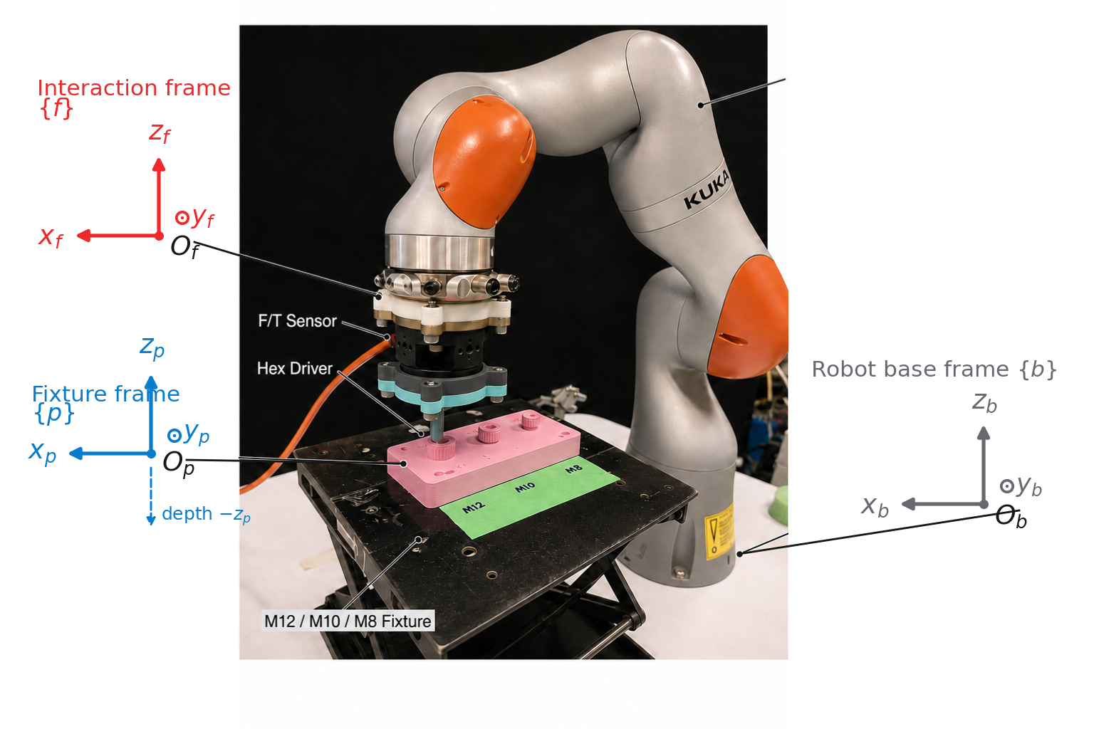
09
TASK
Problem ● Task Framework Simulation Hardware Discussion
The task begins at stable top contact and ends at verified geometric engagement
Unknown socket center C and first stable contact x₀ are expressed in fixture frame {p}.
The conical scan runs after touchdown; engagement depth grows along −zₚ.
The endpoint is a sensor-side geometric event—not screw turning.
Start and endpoint are fixed before evaluating any policy.
Nan Jinyao · Paper-aligned group review
Sec. II-A · Fig. 1
9
Notes:
Purpose
Define the trial start, endpoint, coordinate frames, and unknown geometric state.
Speaker notes
The task begins at the first stable top contact. In the paper's convention, frame b is the robot base, frame p is the fixture and socket plate, and frame f is the force-sensing tool interaction frame. All planar quantities are written in the fixture frame, and all z axes point upward, so engagement depth grows along negative z-p. The known initial tool location is x-zero. The unknown socket center is C. A truncated visual or CAD prior distributes possible centers over a finite planar support around that contact. From this state, the robot performs the conical observation, plans its route, searches for a measured capture cue, and attempts compliant insertion. The trial ends successfully only at verified geometric engagement, not at the first apparent drop or at the model's preferred location. This coordinate and state definition lets us separate commanded motion, measured motion, and privileged grading information. That distinction is the subject of the next slide: what the controller may observe online, and what it must never use.
Discussion notes
Q1: Why express planar motion in the fixture frame?
A1: The socket geometry and registered task plane are fixed there, making offsets, paths, and insertion depth interpretable across robot commands.
Q2: Is x-zero the visual estimate of the center?
A2: No. It is the tool position at first stable top contact. The unknown center C is represented by a prior around that state.
Q3: Does the task start before touchdown?
A3: No. The analyzed engagement trial starts from stable top contact; upstream visual approach is assumed rather than evaluated.
Source map
Fig. 1 and caption, pp.1-2; Task and observations, Sec. II-A, p.2; Eqs. (1)-(5).
Permitted claim
The controller searches from a known stable-contact tool state x0 toward an unknown planar socket center represented by a finite CAD prior.
Claim not supported
The upstream visual approach or global socket localization is evaluated as part of this paper.

Slide 10
10
TASK
Problem ● Task Framework Simulation Hardware Discussion
Online control never observes the true center
ONLINE INPUTS
OFFLINE GRADING ONLY
Robot pose
True center C
Measured wrench w
Simulation contact labels
Probe phase ϕ
Direction error θ̂−θ*
CAD prior p₀(C)
Controller state
Privileged center baseline
Privileged geometry is used only for offline grading and analysis.
Nan Jinyao · Paper-aligned group review
Sec. II-A
10
Notes:
Purpose
Separate online controller inputs from true-center and contact labels used only for offline grading.
Speaker notes
Online, the controller has a deliberately limited information set. It reads the robot pose, the six-axis wrench, probe phase, the registered socket geometry, and the visual or CAD prior. During the conical scan, it also records the axial-force, bending-torque, and tip-height channels that feed the observation model. It never receives the true center C or simulator contact labels. Those variables are held back and appear only in offline grading and explanatory figures. This matters when reading plots that show a center marker or a capture disk: those marks help us assess the route after the fact; they are not controller inputs. The height channel needs the same caution. It records the tool motion synchronized with the wrench signal, but the paper explicitly does not treat it as an insertion detector. Capture and bottom mode come from separate physical predicates. With privileged information removed from online control, we can now define exactly what must happen before any trial is counted as successful.
Discussion notes
Q1: Does simulation expose ground-truth contacts to the planner?
A1: No. Ground-truth center and contact labels are withheld from online policies and used only for offline checking.
Q2: Why include z_tip if it cannot detect insertion?
A2: It provides phase-aligned geometric context to the tactile model; terminal depth is evaluated by an independent runtime predicate.
Q3: What wrench is measured?
A3: The controller reads six components at the interaction sensor frame. Hardware plots are same-run baseline-relative at the Bota sensor origin, not certified tip wrench.
Source map
Sec. II-A, Eq. (1) and observation description, p.2; Eqs. (2)-(3); Fig. 4 grading-label caption, p.5; hardware wrench qualification, Fig. 8 caption and Discussion, pp.10 and 13.
Permitted claim
Online routing uses pose, measured wrench, phase-indexed observation channels, registered geometry, and a CAD prior; truth labels remain offline.
Claim not supported
Ground-truth center, simulator contact labels, or z_tip-based success labels are available to the deployed policy.

Slide 11
11
TASK
Problem ● Task Framework Simulation Hardware Discussion
Success requires capture, safe depth progress, and a terminal dwell
γcap(tc) · γdwell(tb) · γsafe[0,tb] = 1
1
2
3
4
Stable touchdown t₀
Sensor-side capture γcap
Bottom-mode dwell γdwell
Verified event V
Tₘₐₓ = 130 s
V must occur before Tₘₐₓ = 130 s and without a force-limit stop.
Nan Jinyao · Paper-aligned group review
Sec. II-A · Eqs. (4)–(5)
11
Notes:
Purpose
Freeze the verified-engagement predicate and conditional efficiency measures before showing results.
Speaker notes
A trial is not successful at the first apparent capture. The paper requires a sequence and a safety condition. First, a measured sensor-side capture predicate must occur at time t-c. Then the tool must make sufficient axial progress and remain in bottom mode for the prescribed dwell, producing t-b. Safety must remain true throughout, and t-b must occur before the 130-second limit. Only this combined event is called verified engagement. For verified trials, the paper reports completion time from touchdown to the terminal dwell, measured planar path length, and a contact-work proxy formed from force-motion and torque-rotation terms. That last quantity is a comparative proxy, not a direct measurement of wear or electrical energy. Peak wrench and exit reason are retained to interpret failures. A force-limit stop, protected post-capture stop, or exhausted search or time budget is a failure. Freezing this definition avoids counting visually plausible intermediate states. Next, I will show why the directional estimate alone still cannot choose a safe endpoint.
Discussion notes
Q1: Why require both capture and bottom dwell?
A1: Capture marks a possible geometric handoff; sustained depth progress under safety guards rejects transient or false capture cues.
Q2: Are time and path medians computed over all trials?
A2: Table II's within-method medians are over verified trials and are descriptive. Inferential efficiency comparisons use paired differences on joint completions.
Q3: Is E_w physical wear or consumed energy?
A3: No. It is explicitly a contact-work proxy used for comparative interpretation.
Q4: Can a late engagement after 130 seconds count?
A4: Not in the benchmark. Exceeding T_max is a failure unless a separately described extension is used only as a mechanism check.
Source map
Verified event and measures, Sec. II-A, Eqs. (4)-(5), p.2; experiment measure definitions, Sec. IV-A, p.6; Table II, p.7.
Permitted claim
Verified engagement requires capture, a safe terminal-depth dwell, and completion within 130 seconds; efficiency measures are interpreted under that endpoint.
Claim not supported
Any capture cue, visible insertion, or post-budget engagement is automatically a benchmark success.

Slide 12
12
TASK
Problem ● Task Framework Simulation Hardware Discussion
The same angular error can be safe nearby and fatal farther away
near: same ε remains inside capture
d⊥ = r |sin ε| d∥ = r cos ε
The ray reaches the capture disk only if d⊥ ≤ rₑff and d∥ > 0.
far: same ε creates a larger d⊥
Direction-only prediction cannot select a safe endpoint because the probe never observes r.
Nan Jinyao · Paper-aligned group review
Sec. II-B · Eqs. (6)–(7)
12
Notes:
Purpose
Use planar geometry to show why a direction-only prediction cannot determine endpoint distance.
Speaker notes
Let r be the unknown distance from the current contact x-zero to the true center, and let epsilon be the circular error between the predicted and true bearings. For an ideal planar ray, the closest lateral miss is r times the absolute sine of epsilon, while the forward projection is r times the cosine of epsilon. The ray can intersect the effective capture disk only if the lateral gap is no larger than r-effective and the projection remains forward. The consequence is simple but important: the same angular error may be harmless when the socket is nearby and a complete miss when it is farther away. The conical scan does not directly observe r, so even a sharp direction posterior is insufficient to select a safe endpoint. This is why the paper does not convert the top angular bin into a center coordinate. It first updates a planar center belief and then allocates travel from that belief. The next slide summarizes how uncertainty changes that allocation before we examine each computation.
Discussion notes
Q1: What does r_eff represent?
A1: It is a size-specific safe planar capture radius derived from hex clearance, chamfer geometry, and compliant contact slack.
Q2: Does a zero angular error guarantee capture?
A2: Only under the ideal planar geometry and forward-ray conditions; real tracking, contact, safety, and budget limits still apply.
Q3: Why require a positive forward projection?
A3: A center behind the current contact is not reached by advancing along the estimated ray, even if its perpendicular gap is small.
Source map
Direction-distance ambiguity, Sec. II-B, Eqs. (6)-(7), p.3.
Permitted claim
For a fixed angular error, lateral miss grows with the unknown radial offset, so a direction estimate alone cannot safely determine travel distance.
Claim not supported
Angular accuracy by itself determines capture probability or guarantees a successful ray.

Slide 13
13
TASK
Problem ● Task Framework Simulation Hardware Discussion
Uncertainty determines how much authority the learned cue receives
CLEAR
AMBIGUOUS
REVERSED
concentrated + agreeing → longer supported move
spread or disagreement → smaller move
posterior mass behind contact ≥ 0.20 → L* = 0
Confidence changes travel, not the engagement decision.
Nan Jinyao · Paper-aligned group review
Sec. III-A–C · Fig. 4
13
Notes:
Purpose
Introduce the qualitative rule that stronger, consistent evidence receives more direct-motion authority.
Speaker notes
The design principle is quality-adaptive authority. When the circular posterior is concentrated, ensemble members agree, and little posterior mass lies behind the current contact, the observation can support a longer direct move. When the posterior is spread out or the models disagree, the supported quantile becomes more conservative and a larger residual region is left for physical search. If too much posterior mass points behind the contact, the method assigns no shortcut at all. Notice what this rule does not say. It does not label an observation good or bad with one classification threshold, and it does not let confidence certify success. Instead, multiple uncertainty diagnostics change how much of a finite center belief is converted into motion. The residual search is therefore not an afterthought; it is where unresolved evidence is deliberately placed. This principle connects perception to action while preserving graceful fallback. We can now zoom out once, view the complete architecture, and then trace the information flow from probing to posterior, belief update, route, and physical verification.
Discussion notes
Q1: Which diagnostics control the travel budget?
A1: Circular concentration, ensemble disagreement, and reverse posterior mass enter the quality score; planar weighted quantiles and an optional command cap then bound travel.
Q2: Is entropy directly used in the shortcut length?
A2: No. Entropy is retained as a diagnostic and is used in the PGS-G residual utility, while the shortcut quality uses concentration, disagreement, and reverse mass.
Q3: Does a zero shortcut terminate the task?
A3: No. It means direct travel is withheld; residual coverage remains available under the physical loop.
Source map
Circular posterior diagnostics, Eqs. (9)-(12), p.3; quality and shortcut rule, Eqs. (16)-(17), pp.3-4; Fig. 4, p.5.
Permitted claim
Observation uncertainty modulates direct-travel authority, including a zero-shortcut fallback, while residual search handles remaining support.
Claim not supported
One scalar confidence score proves that the tactile direction is correct.

Slide 14
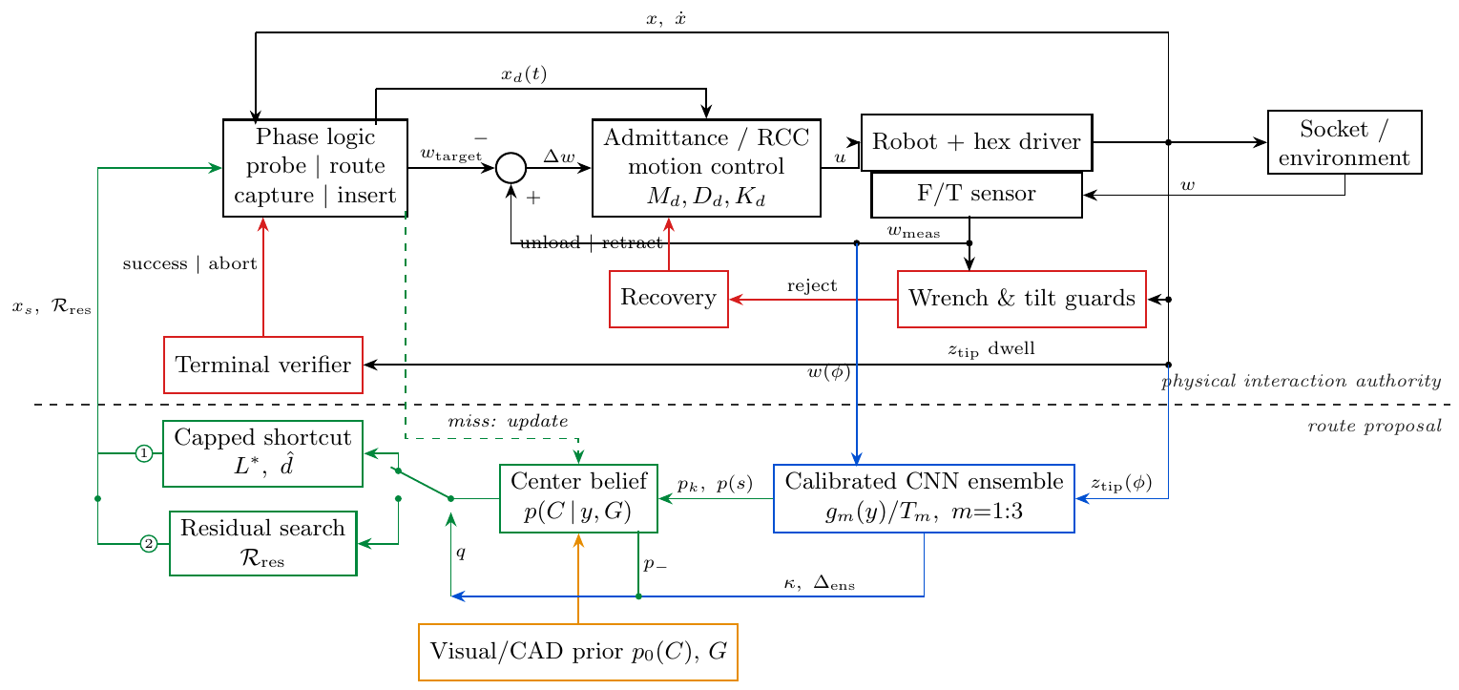
14
FRAMEWORK
Problem Task ● Framework Simulation Hardware Discussion
The framework separates inference, belief-space routing, and physical control
Blue learns; green allocates; black executes; red guards.
Nan Jinyao · Paper-aligned group review
Sec. III · Fig. 2
14
Notes:
Purpose
Show the complete framework and the dashed authority line before progressively zooming into its modules.
Speaker notes
Figure 2 organizes the framework into three functional layers. The blue path performs learned tactile inference from the conical observation. The orange prior and green path combine that circular evidence with planar geometric support, allocate a bounded shortcut, and construct the residual route. Below the dashed authority line, the black loop executes contact through the shared task-frame admittance and RCC controller. The red loop separately enforces wrench and tilt guards, performs recovery, and checks the terminal condition. This separation also defines the policy comparisons. PGS-O and PGS-G change how the remaining belief is searched; Outward removes the tactile shortcut and covers globally; Direct-4C spends a limited budget on physical rays. Yet every task-level policy uses the same capture controller and terminal check. The architecture is therefore not a feed-forward learned controller. It is an inference-and-routing proposal embedded inside guarded closed-loop interaction. I will reuse this same view as we zoom in, beginning with the active tactile observation that creates the evidence.
Discussion notes
Q1: Which blocks are learned?
A1: The circular direction and contact-support inference blocks are learned. Belief weighting, shortcut allocation, residual routing, compliant control, guards, recovery, and verification are explicit.
Q2: Why call this closed loop if the scan occurs once?
A2: Measured endpoints, capture rejection, negative evidence, residual replanning, recovery, and verification all feed subsequent physical actions; Direct-4C may also probe again after a missed ray.
Q3: Are controller gains changed between policies?
A3: No. The main benchmark fixes the task tuple, budget, capture controller, and terminal check across policies.
Source map
Framework overview, Sec. III opening, p.3; control architecture, Fig. 2 and caption, p.4; baseline definitions and shared-controller protocol, Sec. IV-A, p.6.
Permitted claim
The framework explicitly separates learned tactile inference and belief-space routing from shared physical control, guards, recovery, and verification.
Claim not supported
The complete controller is end-to-end learned or policies use different success criteria.

Slide 15
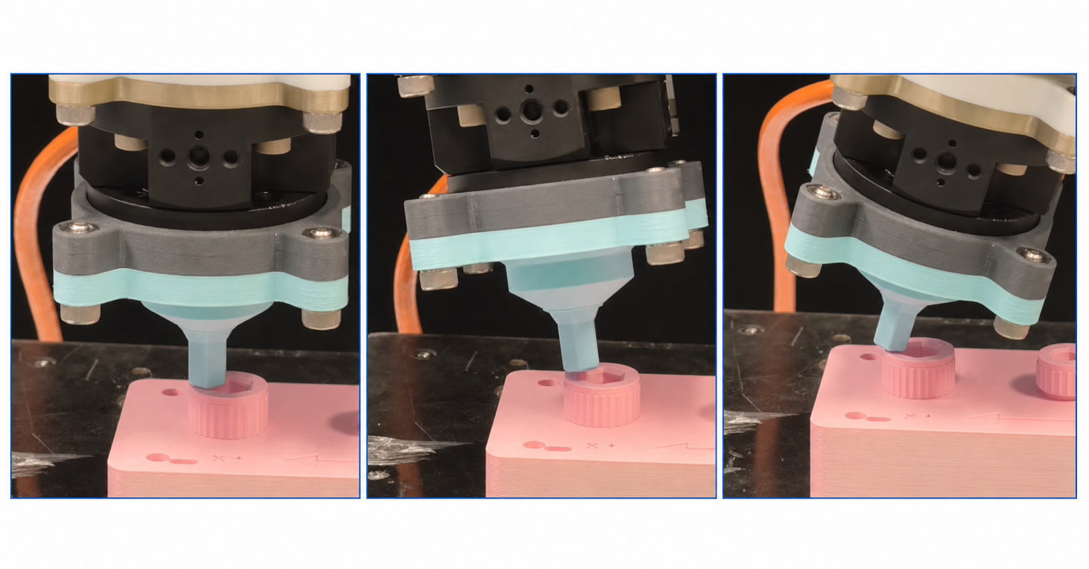
15
FRAMEWORK
Problem Task ● Framework Simulation Hardware Discussion
A low-force conical motion turns contact into a phase-indexed signal
Begin from stable top contact.
Execute a 15° conical scan under low force.
Index the recorded interaction by probe phase ϕ—not by center bearing θ.
Active touch creates a repeatable observation coordinate.
Nan Jinyao · Paper-aligned group review
Sec. II-A, III · Fig. 3
15
Notes:
Purpose
Explain how the prescribed low-force conical motion turns contact into a phase-indexed active observation.
Speaker notes
The observation begins only after stable top contact. The tool executes a 15-degree, low-force conical motion while maintaining guarded interaction with the screw head. This is active sensing: the prescribed motion creates a repeatable change in contact geometry, and the force, bending moment, and tool height vary with the scan phase. The phase variable phi describes where the tool is within this conical cycle. It is not the planar bearing theta from the current contact to the socket center. Confusing those two angles would turn the signal into the wrong geometric quantity. The real keyframes in Figure 3 show first contact, probing, and the complete cone; the learned posterior is computed only after this observation is placed on a common circular phase grid. Throughout the motion, the physical wrench and tilt guards remain active. The probe is therefore informative but intentionally low authority: it produces evidence rather than a task decision. Next, I will define the four-channel observation contract and reconcile the raw hardware sample count with the model input size.
Discussion notes
Q1: Why use a conical rather than a purely planar circle?
A1: The prescribed cone modulates contact load and geometry while maintaining low-force contact, generating phase-dependent axial force, bending torque, and height cues.
Q2: Is the 15-degree value learned?
A2: No. It is the prescribed probe geometry used in the study.
Q3: Does the probe itself search for capture?
A3: Its primary role is observation. Capture decisions and route execution remain in the downstream physical loop.
Source map
Task observation, Sec. II-A, Eq. (2), p.2; closed-loop tactile-guided search, Fig. 3 and caption, p.4.
Permitted claim
A prescribed 15-degree low-force conical motion creates a phase-indexed tactile observation under active physical guards.
Claim not supported
Probe phase is the socket-bearing angle or the probe alone verifies capture.

Slide 16
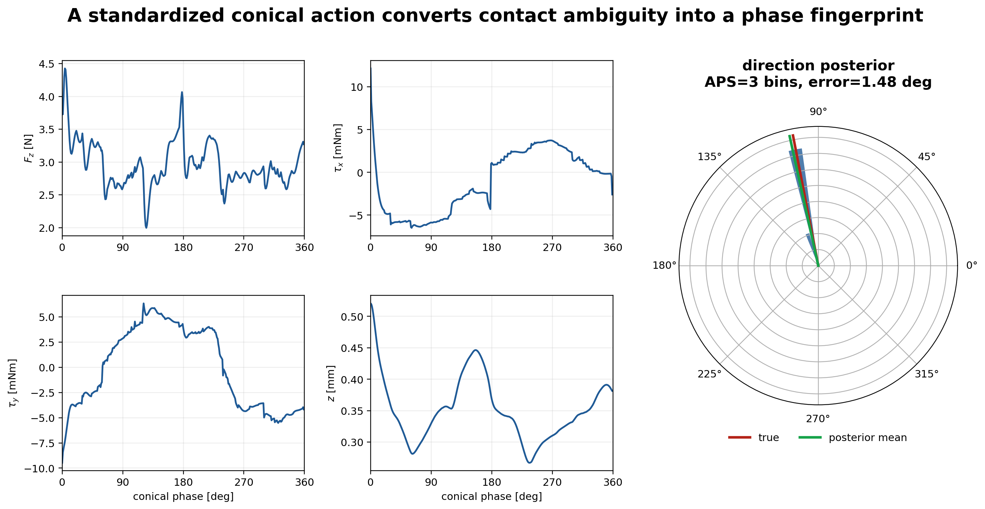
16
FRAMEWORK
Problem Task ● Framework Simulation Hardware Discussion
The model receives four channels resampled on the contact phase
Hardware records 240 raw samples; periodic interpolation produces 4×360 model input and does not smooth the raw signal.
Nan Jinyao · Paper-aligned group review
Sec. II-A · Eqs. (2)–(3) · Fig. 8
16
Notes:
Purpose
Specify the four model channels and explain the 240-raw-sample versus 360-phase-sample distinction.
Speaker notes
The model input has four channels: axial force F-z, bending torques tau-x and tau-y, and tip height z-tip. Each channel is ordered around the conical phase and linearly interpolated with periodic boundary conditions onto 360 phase locations, giving a four-by-360 tensor. This operation standardizes the representation across recordings; it does not smooth the raw signal. The hardware run highlighted later contains 240 raw scan samples. Those timestamped measurements remain the evidence record, while periodic interpolation maps them to the model's fixed 360-point phase grid. The two numbers therefore refer to different stages, not conflicting versions of the experiment. In the hardware plots, height may be centered on its scan mean for display, but that does not change its role in inference. The paper also states that height is not an insertion detector. Keeping this contract precise is essential when comparing simulated and installed-stack observations. With the input defined, the next step is to see what the three calibrated models output.
Discussion notes
Q1: Why 360 phase points?
A1: It gives a fixed circular input format for the network and supports periodic boundary conditions; the paper does not claim it is an optimized sampling rate.
Q2: Does interpolation fabricate extra physical measurements?
A2: No. It evaluates a periodic linear interpolant on a common grid. The underlying hardware evidence remains the 240 raw samples.
Q3: Are the raw hardware curves filtered or smoothed for the figures?
A3: No. The paper describes them as raw, unsmoothed timestamped records; same-run baseline subtraction and stated coordinate or display transforms are separate.
Q4: Can z_tip be used as a success label?
A4: Not by the learned observation model. Terminal depth and dwell are checked independently in the physical loop.
Source map
Observation tensor and periodic interpolation, Sec. II-A, Eqs. (2)-(3), p.2; one-run 240-sample hardware signal, Sec. IV-F and Fig. 8, pp.8 and 10.
Permitted claim
Hardware records 240 raw scan samples in the highlighted run; periodic linear interpolation produces the fixed 4 x 360 model input without smoothing the raw evidence.
Claim not supported
There are 360 independent hardware measurements, or interpolation improves the physical signal quality.

Slide 17
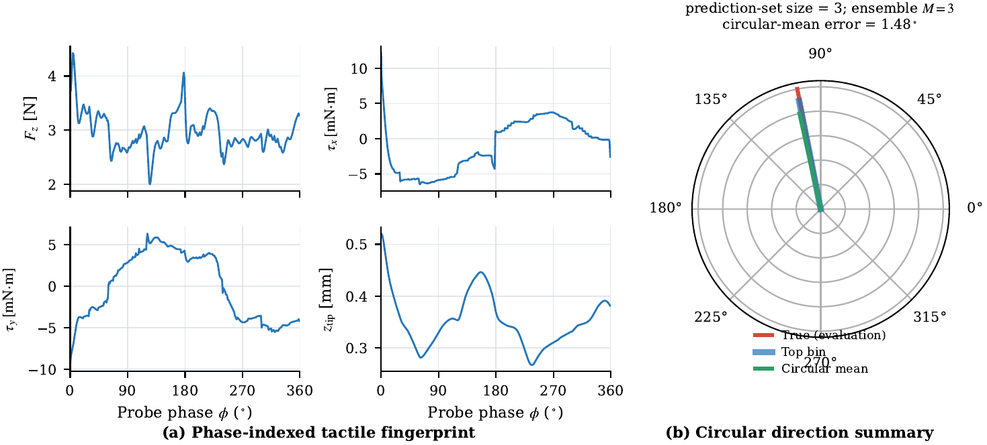
17
FRAMEWORK
Problem Task ● Framework Simulation Hardware Discussion
Three calibrated models produce a circular posterior, not a center estimate
4 × 360 signal
3 calibrated members
48 direction bins
circular posterior + contact support
The learned interface describes the observation; it never outputs socket center or capture.
Nan Jinyao · Paper-aligned group review
Sec. III-A · Eqs. (8)–(12)
17
Notes:
Purpose
Explain the calibrated ensemble's circular direction posterior and separate contact support from center estimation.
Speaker notes
Three separately trained models map the four-by-360 observation to logits over 48 direction bins. Each member is temperature calibrated, and the paper averages their softmax probabilities to form one circular posterior. From that distribution we compute a circular mean direction and a concentration. A second head estimates rough contact support. The output remains deliberately factorized: direction is represented over the circle, and contact support affects how radial belief is weighted. No head outputs a two-dimensional socket center. The ensemble also provides disagreement information that a single averaged posterior could hide. One notation point is worth fixing now. The ensemble size is always three. The adaptive prediction set may contain three, eight, ten, or another number of angular bins depending on the posterior; that set size is not the number of models. The posterior is therefore a calibrated description of the observation, not a capture event. On the next slide, I will distinguish the uncertainty diagnostics extracted from this same distribution and explain why no single one is sufficient.
Discussion notes
Q1: Why use 48 bins rather than continuous angle regression?
A1: The circular categorical posterior preserves multimodality and supports calibrated mass sets and belief weighting. The paper does not claim 48 is uniquely optimal.
Q2: How are ensemble members combined?
A2: Each member's temperature-scaled softmax distribution is computed, then the three distributions are averaged bin by bin.
Q3: Is contact support a binary capture prediction?
A3: No. It is a rough observation score used in particle weighting; physical capture is checked separately.
Q4: Does top-bin direction equal the final shortcut endpoint?
A4: No. Direction defines a ray; posterior-weighted planar quantiles and explicit caps determine how far the shortcut may travel.
Source map
Circular tactile posterior, Sec. III-A, Eqs. (8)-(10), p.3; Fig. 3 and caption, p.4.
Permitted claim
A three-member calibrated ensemble produces a 48-bin circular direction posterior and a separate rough contact-support estimate.
Claim not supported
The ensemble regresses the exact two-dimensional socket center or declares physical capture.

Slide 18
18
FRAMEWORK
Problem Task ● Framework Simulation Hardware Discussion
Different uncertainty diagnostics expose different failure modes
κ
Aε
H(p)
Δens
p₋
concentration
adaptive prediction set
spread / entropy
member disagreement
reverse mass
These quantities are descriptive gates on route authority—not interchangeable confidence scores.
A tight average posterior can still hide member disagreement; no single scalar is enough.
Nan Jinyao · Paper-aligned group review
Sec. III-A · Eqs. (9)–(12)
18
Notes:
Purpose
Distinguish posterior concentration, prediction-set support, entropy, ensemble disagreement, and reverse mass as different diagnostics.
Speaker notes
Several uncertainty summaries are retained because they reveal different failure modes. Circular concentration, rho, measures how strongly the averaged posterior points in one resultant direction. The adaptive prediction set records how many high-probability bins are needed to retain the prescribed mass, so it makes angular support visible. Entropy measures the overall spread of the averaged posterior in nats. Ensemble disagreement, Delta-ensemble, instead takes the largest circular separation among the three members' top bins. A posterior can look concentrated after averaging while its members disagree, or look broad while all members agree that the observation is intrinsically diffuse. These quantities are therefore not interchangeable. After the posterior reweights planar particles, reverse mass adds a geometric check: it measures weighted support behind the current contact along the proposed ray. Contact support is another separate output used in radial weighting. None of these diagnostics is a capture predicate. They only characterize how much routing authority the observation deserves. The next slide shows how the circular posterior becomes a planar center belief without inventing a distance estimate.
Discussion notes
Q1: Why keep both entropy and concentration?
A1: Both summarize the averaged posterior but emphasize different structure; entropy measures total spread, while circular concentration measures resultant directional strength.
Q2: Why is ensemble disagreement needed after averaging?
A2: Averaging can conceal member-to-member conflict. The maximum top-bin separation exposes epistemic inconsistency among the three trained models.
Q3: Is adaptive prediction-set coverage a hardware guarantee?
A3: No. It summarizes calibrated angular support under the calibration lineage; distribution shift can invalidate coverage.
Q4: Where is reverse mass computed?
A4: After circular evidence has reweighted the planar center particles and those particles are projected onto the estimated ray.
Source map
Circular mean, concentration, adaptive prediction set, ensemble disagreement, and entropy, Sec. III-A, Eqs. (9)-(12), p.3; reverse mass and quality, Sec. III-C, Eq. (16), p.3.
Permitted claim
The method retains multiple complementary diagnostics because posterior spread, member disagreement, and backward planar support are distinct.
Claim not supported
Any one diagnostic is a calibrated probability of physical engagement or a universal out-of-distribution detector.

Slide 19
19
FRAMEWORK
Problem Task ● Framework Simulation Hardware Discussion
The tactile posterior reweights the CAD prior without inventing distance
TRUNCATED CAD PRIOR
TACTILE-REWEIGHTED BELIEF
N = 4096
prior particles
angular + contact-support weighting
angular weight
from tactile posterior
radial support
kept explicit
The result is a planar center belief, not a point prediction.
Nan Jinyao · Paper-aligned group review
Sec. III-B · Eqs. (13)–(15)
19
Notes:
Purpose
Show how tactile angular evidence reweights, rather than replaces, the finite CAD prior over socket centers.
Speaker notes
The planar belief begins with 4,096 center particles drawn from the truncated visual or CAD prior. For M8, each particle is an offset from x-zero under the two-millimeter isotropic Gaussian, truncated at 4.895 millimeters. The tactile posterior contributes the probability of each particle's angular bin. The contact-support head contributes a rough radial likelihood. These terms multiply the prior support and are normalized into new particle weights. A small uniform component, 0.02 in the weighting rule, prevents one shaky observation from deleting geometric support entirely. The result is still a distribution over possible centers, often extended along a bearing. In other words, tactile evidence changes which prior locations are plausible; it does not manufacture a measured radial coordinate. Weighted empirical quantiles can now answer action questions such as how much posterior mass lies ahead and how far support extends. Those quantiles are the bridge from inference to bounded travel. On the next slide, I will step through the shortcut budget and its explicit zero-motion condition.
Discussion notes
Q1: Why use particles rather than a parametric Gaussian update?
A1: Particles preserve truncation, directional reweighting, and potentially non-Gaussian or multimodal support while supporting direct weighted quantiles.
Q2: What is the purpose of the 0.02 uniform term?
A2: It prevents an uncertain tactile reading from assigning effectively zero weight to otherwise valid geometric support.
Q3: Is the radial likelihood learned as metric distance?
A3: No. It is a rough likelihood tied to contact support and prior radius; the paper keeps radial ambiguity explicit.
Q4: Does the controller know the center markers shown in Figure 4?
A4: No. Ground-truth center and capture marks in that figure are for grading only.
Source map
Planar particle prior and tactile reweighting, Sec. III-B, Eqs. (13)-(15), p.3; M8 particle parameters in Eq. (13); Fig. 4 caption, p.5.
Permitted claim
The circular posterior and contact support reweight a 4,096-particle planar CAD prior while preserving radial uncertainty.
Claim not supported
The tactile network observes or predicts an exact metric center distance.

Slide 20
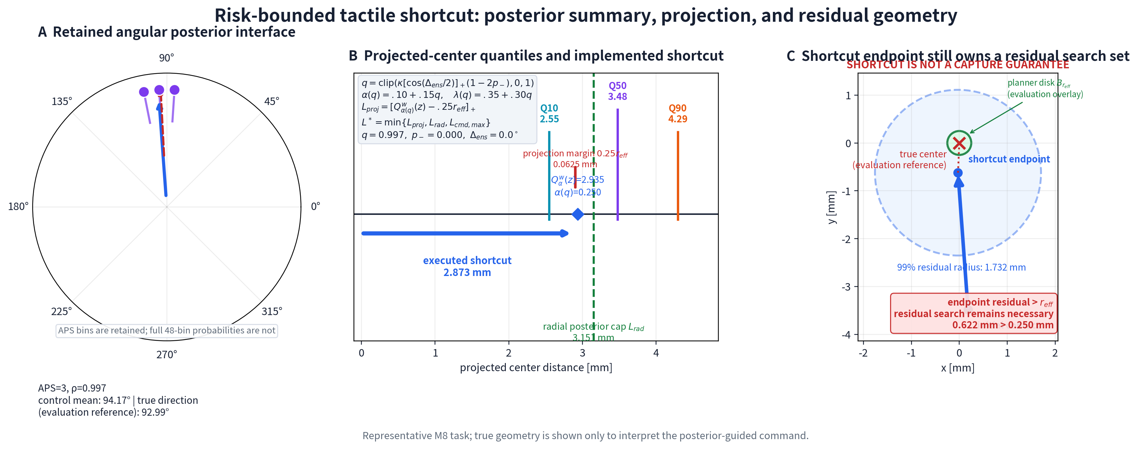
20
FRAMEWORK
Problem Task ● Framework Simulation Hardware Discussion
Only well-supported posterior mass becomes direct travel
L* is capped by projected support, radial support and the command limit; p₋ ≥ 0.20 turns the shortcut off.
Nan Jinyao · Paper-aligned group review
Sec. III-C · Eqs. (16)–(19) · Fig. 4
20
Notes:
Purpose
Explain the quality-adaptive equations that convert supported posterior mass into a capped shortcut.
Speaker notes
To allocate direct travel, each weighted particle is projected onto the estimated direction. The posterior mass with nonpositive projection is p-minus, the mass behind the current contact. Observation quality q combines circular concentration, the cosine penalty from ensemble disagreement, and a reverse-mass penalty, then clips the result to zero-one. That quality adjusts two budgets: alpha ranges from 0.10 to 0.25 for the supported projection quantile, and lambda ranges from 0.35 to 0.65 for the allowed fraction of the 99th-percentile radial support. The projection budget also stops a quarter of the effective capture radius short. The commanded length is the minimum of projection support, radial support, and an optional command cap. If p-minus is at least 0.20, the shortcut is exactly zero. Otherwise the endpoint is x-zero plus this length along the circular-mean ray. A residual radius is then computed around that endpoint. The rule therefore converts confidence into limited authority, not unrestricted motion. Figure 4 makes the behavior tangible in three frozen cases.
Discussion notes
Q1: Why use both L_proj and L_rad?
A1: L_proj preserves forward posterior mass with a capture margin, while L_rad prevents travel from becoming too large relative to overall radial support.
Q2: Are alpha(q), lambda(q), and the 0.20 threshold learned?
A2: No. They are hand-designed routing parameters in the paper and should be treated as such.
Q3: What does the optional cap L_c do?
A3: It imposes an external maximum command length even when posterior-derived budgets are larger.
Q4: Does a long shortcut imply high probability of immediate capture?
A4: No. It means more direct travel is supported by the current empirical belief; capture still requires measured physical evidence.
Source map
Quality score and adaptive budgets, Sec. III-C, Eq. (16), p.3; shortcut length and endpoint, Eq. (17), pp.3-4; residual radius, Eq. (19), p.4.
Permitted claim
The shortcut is the minimum of posterior-supported projection, radial, and command budgets, with a zero shortcut when reverse mass reaches 0.20.
Claim not supported
The shortcut endpoint is the predicted socket center or is guaranteed to lie inside the capture region.

Slide 21
21
FRAMEWORK
Problem Task ● Framework Simulation Hardware Discussion
Clear, ambiguous, and reversed cues receive different motion budgets
2.873 mm
clear shortcut
1.732 mm
clear residual
0.903 mm
ambiguous shortcut
3.402 mm
ambiguous residual
0 mm
reversed shortcut
A learned cue changes how much ground is skipped—not whether residual search exists.
Nan Jinyao · Paper-aligned group review
Sec. III-C · Fig. 4
21
Notes:
Purpose
Translate the shortcut equations into clear, ambiguous, and reversed physical cases.
Speaker notes
These three frozen M8 examples show how the same rule changes the motion budget. In the clear case, the posterior is concentrated, ensemble agreement is strong, and reverse mass is negligible. The controller allocates 2.873 millimeters of direct travel and leaves a 1.732-millimeter residual search radius. In the ambiguous case, broader angular support and lower quality reduce the shortcut to 0.903 millimeters, leaving 3.402 millimeters for residual coverage. In the reversed case, posterior mass behind the contact exceeds the guard, so the shortcut becomes zero and the method falls back to search. The prediction sets contain three, eight, and ten bins respectively; those numbers describe supported angular bins, not the three-member ensemble. Across the frozen 24-task M8 batch, Figure 4 reports contraction of the conservative search disk in 23 cases, with a median area reduction of 58.7 percent. That is a belief-geometry diagnostic, not an engagement-rate result. These cases build intuition for the formal retained-mass statement on the next slide.
Discussion notes
Q1: Why does the ambiguous case still move directly?
A1: Some forward support remains, but lower quality selects a more conservative quantile and radial fraction, preserving a larger residual region.
Q2: Does 58.7 percent area reduction equal path reduction?
A2: No. It describes the median contraction of a conservative belief-derived search disk, not measured route length or task time.
Q3: Are the three examples representative performance statistics?
A3: They are frozen mechanism examples selected to show the rule's response; policy performance is evaluated later on all paired tasks.
Q4: Does zero shortcut mean the tactile observation is discarded?
A4: It withholds direct travel. The belief and residual-search machinery can still use available support under explicit coverage.
Source map
Adaptive allocation examples and frozen-batch contraction, Fig. 4(a)-(c) and caption, p.5; shortcut and residual definitions, Eqs. (17) and (19).
Permitted claim
The frozen examples allocate 2.873/1.732 mm, 0.903/3.402 mm, and zero shortcut for clear, ambiguous, and reversed evidence respectively.
Claim not supported
These three cases establish an average task-success advantage or a guaranteed percentage reduction in executed path.

Slide 22
22
FRAMEWORK
Problem Task ● Framework Simulation Hardware Discussion
The shortcut retains posterior mass; it does not guarantee capture
ASSUMPTIONS
P̂w[z ≥ L* + 0.25 rₑff] ≥ 1 − α(q)
L* ≤ λ(q) Q⁽ʷ⁾₀.₉₉(‖C − x₀‖)
Fixed weighted-particle set
p₋ < 0.20 and L* > 0
Shortcut endpoint reached exactly
Retained posterior support ≠ capture guarantee
The proposition allocates empirical posterior support under assumptions; it is not a capture theorem.
Nan Jinyao · Paper-aligned group review
Sec. III-C · Proposition 1
22
Notes:
Purpose
State Proposition 1 as an empirical posterior-mass allocation result, with all assumptions and non-guarantees visible.
Speaker notes
Proposition 1 formalizes what the shortcut preserves, not what the robot will capture. Assume reverse mass is below 0.20, the shortcut length is positive, the weighted particle set remains fixed, and the commanded endpoint is reached exactly. Then at least one minus alpha of the empirical posterior mass projects beyond the shortcut endpoint plus the quarter-capture-radius margin. The shortcut is also bounded by lambda times the 99th-percentile radial support. These statements follow directly from the weighted-quantile construction. They explain why the move does not consume all plausible forward support. But the proposition does not say that the true center was sampled from this posterior, that the observation model remains calibrated under shift, or that the endpoint enters the capture disk. Real tracking error, prior truncation, finite search budget, boundary effects, and contact dynamics remain outside the result. I therefore describe it as posterior mass retention under exact execution, never as a capture theorem. Once a real shortcut is executed, its measured success or miss can add new physical evidence, which is the next step.
Discussion notes
Q1: What exactly is guaranteed by Proposition 1?
A1: Under its stated assumptions, it bounds retained empirical posterior mass ahead of the endpoint and bounds shortcut length relative to radial support.
Q2: Does the proposition guarantee the true socket lies in the retained set?
A2: No. That would require additional assumptions connecting the empirical posterior to the true center under deployment distribution.
Q3: Why assume exact endpoint execution?
A3: The proof uses the commanded endpoint directly. Tracking error changes the segment and therefore the retained-mass geometry.
Q4: Does the proposition cover residual-search completion?
A4: No. Finite spiral or grid coverage can still be limited by truncation, tracking, safety stops, or exhausted budget.
Source map
Proposition 1, proof, and Eq. (18), p.4; residual radius Eq. (19); limitations, Discussion, p.13.
Permitted claim
Under fixed-particle, positive-shortcut, low-reverse-mass, exact-endpoint assumptions, the rule retains a quantified amount of empirical posterior support.
Claim not supported
Proposition 1 guarantees capture, successful engagement, calibrated deployment coverage, or complete residual-search coverage.

Slide 23
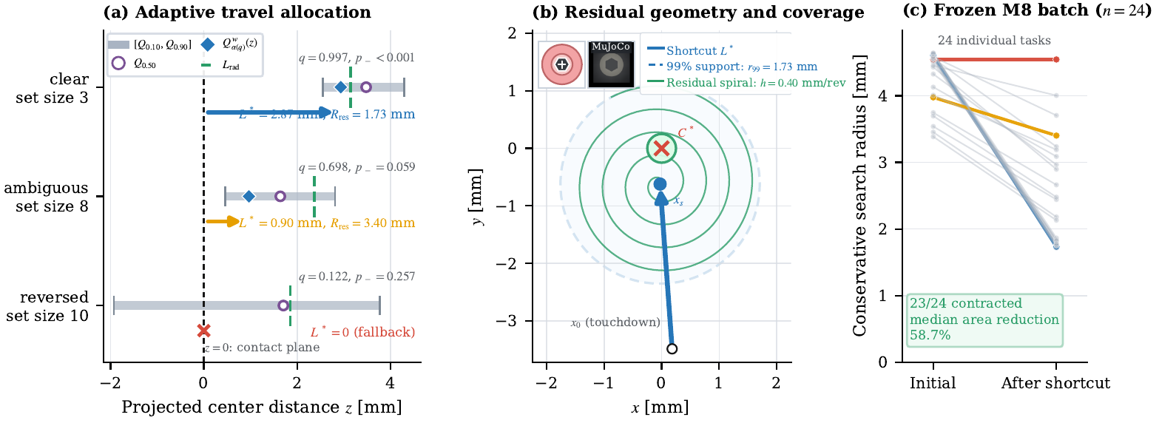
23
FRAMEWORK
Problem Task ● Framework Simulation Hardware Discussion
A valid shortcut miss becomes negative evidence
1
execute guarded segment
2
reject capture at valid endpoint
3
downweight particles near missed segment
4
rebuild residual geometry
Only a measured valid miss updates the belief; an invalid or unobserved endpoint does not.
Nan Jinyao · Paper-aligned group review
Sec. III-C · Eqs. (20)–(21)
23
Notes:
Purpose
Show how a valid executed shortcut miss becomes measured negative evidence for replanning.
Speaker notes
The shortcut is not only a command; once executed, it becomes a physical observation. For the measured segment from x to x-a, the planner computes each particle's shortest planar distance to that segment and maps it through a smooth capture-likelihood model. If the endpoint is valid, the robot remains in guarded contact, and physical capture is rejected, particles that should likely have produced capture along that segment are downweighted by one minus their capture likelihood. The weights are then normalized, and the residual geometry is rebuilt around the measured endpoint rather than the ideal command. A small likelihood floor prevents total particle extinction. This is intentionally a soft update because capture sensing and contact geometry are imperfect. An invalid endpoint, an unobserved endpoint, or a guard termination does not authorize the negative-evidence update. The method therefore learns from a verified miss without pretending to observe the true center. This closes the perception-action loop: action tests the belief, measured rejection revises it, and only then does the residual policy choose what remains to search.
Discussion notes
Q1: Why is the miss update soft rather than deleting every nearby particle?
A1: Capture sensing and geometry are imperfect; a smooth likelihood and floor avoid brittle elimination from one possibly noisy rejection.
Q2: Can a force-limit exit be interpreted as negative evidence?
A2: No. The update requires a valid measured endpoint in guarded contact with capture specifically rejected.
Q3: Is the commanded or measured endpoint used?
A3: The residual belief and geometry are rebuilt around the measured endpoint.
Q4: Does negative evidence reveal the true center?
A4: No. It only reduces support for centers that were likely to have caused capture along the observed segment.
Source map
Measured shortcut, smooth capture likelihood, and miss update, Sec. III-C, Eqs. (20)-(21), p.5; same-run hardware example of negative-evidence replanning, Sec. IV-F and Fig. 8, pp.8-10.
Permitted claim
A valid, guarded, measured shortcut miss softly downweights center particles expected to have produced capture and triggers residual replanning.
Claim not supported
Every failed action is safe to treat as negative evidence, or the update identifies the true center.

Slide 24
24
FRAMEWORK
Problem Task ● Framework Simulation Hardware Discussion
PGS-O and PGS-G differ only in how they search what remains
SHARED POSTERIOR-SUPPORTED SHORTCUT
PGS-O
PGS-G
finite local Archimedean spiral
entropy-grid contacts
simple coverage of residual disk
information + capture coverage − travel
The shortcut, controller, recovery and verifier are shared.
Nan Jinyao · Paper-aligned group review
Sec. III-C · Eqs. (22)–(25)
24
Notes:
Purpose
Define PGS-O and PGS-G as two residual-search variants sharing the same posterior shortcut and physical loop.
Speaker notes
After the shared posterior-guided shortcut, the two proposed variants differ only in how they cover the remaining region. PGS-O draws a finite local Archimedean spiral around the measured shortcut endpoint, with pitch h-sp and radius set by the remaining 99-percent support after subtracting the effective capture radius. PGS-G instead selects from a finite grid of remaining contact actions. Its utility rewards expected information gain and the probability that a candidate segment covers likely capture disks, while charging for switching and travel. If further contact is not informative, it falls back to plain coverage rather than forcing entropy to decrease indefinitely. Both variants use the same belief update, negative evidence, capture handoff, compliant controller, recovery, guards, terminal dwell, and 130-second benchmark budget. Therefore PGS-G is a more task-aware residual planner, not a more authoritative verifier. The paper tests whether that extra planning improves the small residual regions in this benchmark; we should not assume the answer in advance. Before the comparison, the final method layer is the physical loop shared by every policy.
Discussion notes
Q1: What is the precise difference between PGS-O and global Outward?
A1: PGS-O first takes the posterior-supported shortcut and then spirals only over the local residual region. Outward starts a global Archimedean search without tactile guidance.
Q2: What terms appear in the PGS-G utility?
A2: Expected information gain, likely capture-disk coverage, a switching cost, and a travel cost over the remaining action set.
Q3: Must PGS-G always reduce posterior entropy?
A3: No. When further informative contact is not useful, the planner falls back to coverage.
Q4: Does the paper show PGS-G outperforming PGS-O?
A4: No. The paired benchmark later shows no significant path or time advantage for PGS-G.
Source map
PGS-O spiral, Eq. (22), p.5; PGS-G utility and action selection, Eqs. (23)-(25), pp.5-6; policy definitions, Sec. IV-A, p.6; paired comparison, Sec. IV-D, p.7.
Permitted claim
PGS-O and PGS-G share the shortcut and guarded physical loop; they differ in local spiral versus entropy-and-coverage grid residual routing.
Claim not supported
PGS-G is proven or empirically shown to outperform PGS-O in this benchmark.

Slide 25
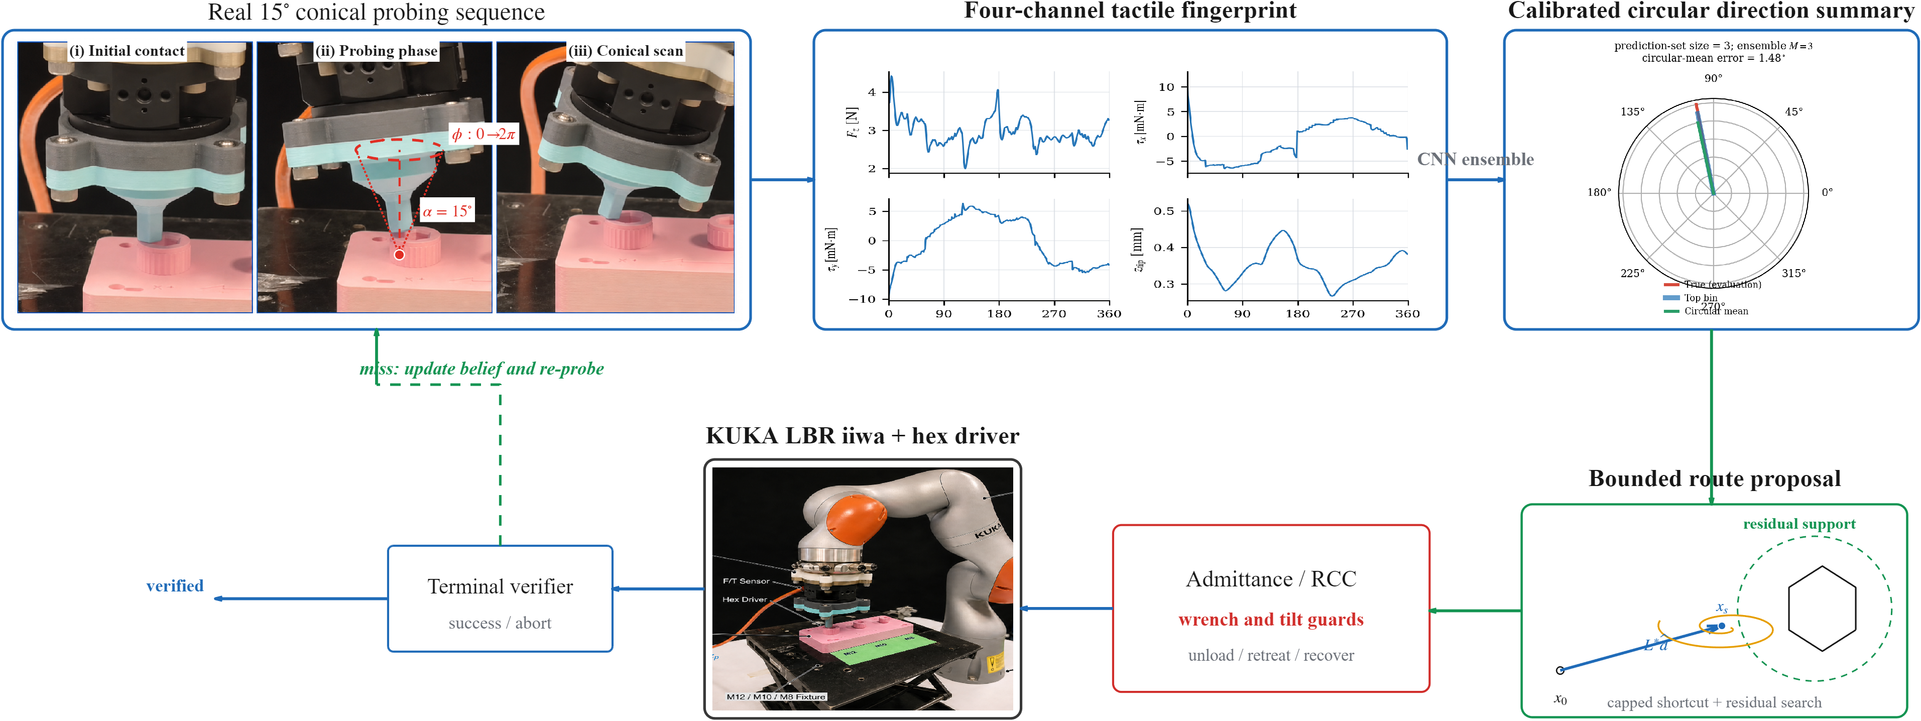
25
FRAMEWORK
Problem Task ● Framework Simulation Hardware Discussion
The physical loop owns capture, recovery, safety, and the final decision
capture handoff
compliant insertion
unload / retract / upright / retouch
terminal dwell
Direct-ray attempts and post-capture recoveries are different budgets; at most three recoveries are allowed.
Nan Jinyao · Paper-aligned group review
Sec. III-D · Eqs. (26)–(30)
25
Notes:
Purpose
Close the method section by assigning capture, insertion, recovery, guards, and terminal acceptance to the shared physical loop.
Speaker notes
Every route is executed through the same task-frame admittance and RCC controller, with rate saturation and a causal first-order wrench filter. Safety checks each wrench component against its limit and also bounds tool tilt. A measured capture cue only hands control to an insertion attempt; it does not force the attempt to continue. If depth progress stalls or tilt becomes excessive, recovery unloads for 0.10 seconds, retracts 0.35 millimeters over 0.15 seconds, returns upright, and retouches for 0.20 seconds from the measured state. At most three such post-capture recoveries are allowed. This budget is distinct from Direct-4C's budget of up to three physical rays; one counts rejected insertion recovery, the other counts search attempts. Engagement is accepted only when measured axial progress satisfies the registered depth tolerance and the independent bottom dwell while safety remains true. Force-limit or exhausted-budget events end the trial. We have now separated every authority clearly. The next section can ask whether the representation, routing, and recovery actually improve task evidence under paired conditions.
Discussion notes
Q1: What triggers recovery rather than immediate failure?
A1: A rejected insertion with stalled progress or excessive tilt can invoke the guarded recovery operator; an actual force-limit violation ends the trial.
Q2: Why distinguish three recoveries from three direct rays?
A2: They are different mechanisms and denominators: recoveries restore contact after capture rejection, while direct rays are repeated search-and-probe attempts in Direct-4C.
Q3: Is the wrench used at the physical tool tip?
A3: The controller uses the measured interaction wrench. Hardware evidence is baseline-relative at the Bota origin and is not certified as absolute tip wrench.
Q4: What makes the final decision independent of learning?
A4: The terminal predicate uses measured depth, dwell, and safety conditions; no posterior or neural score appears in the acceptance rule.
Source map
Task-frame admittance and filtering, Sec. III-D, Eqs. (26)-(27), pp.5-6; componentwise safety, recovery, and terminal predicates, Eqs. (28)-(30), p.6; Direct-4C ray budget, Sec. IV-A, p.6.
Permitted claim
Shared compliant execution, componentwise guards, bounded recovery, and an independent depth-dwell predicate own the physical and terminal decisions.
Claim not supported
A learned capture score can override guards, recovery logic, or the terminal dwell.

Slide 26
26
SIMULATION
Problem Task Framework ● Simulation Hardware Discussion
Five questions organize the evidence
1
RQ1 Does the four-channel representation help?
2
RQ2 Does posterior guidance reduce task effort?
3
RQ3 Does the entropy grid beat the local spiral?
4
RQ4 Does finite recovery change outcomes?
5
RQ5 What transfers across size and to hardware?
Each result answers one question with its own denominator and evidence boundary.
Nan Jinyao · Paper-aligned group review
Sec. IV-A–F
26
Notes:
Purpose
Use this slide to establish: Five questions organize the evidence
Speaker notes
I will organize the evidence around five questions rather than walk through figures as an inventory. First, does the four-channel representation change the direction that the controller actually executes? Second, does posterior-guided search reduce task effort relative to global Outward search? Third, does the entropy-grid residual improve on the simpler local spiral? Fourth, does bounded recovery change what states are reachable after a rejected insertion? Fifth, what transfers across socket sizes and onto hardware? Each question has a different denominator and therefore a different permissible conclusion. The strongest efficiency result is paired on joint completions. The recovery result comes from a separate fixed stress set. The hardware records are named or fixed-start mechanism checks. Keeping these evidence classes separate is essential for the rest of the presentation.
Discussion notes
If asked why hardware is not a sixth statistical question, answer that the paper provides acquisition coverage and selected closed-loop feasibility records, but no randomized population sample. The evidence hierarchy is revisited on Slides 35-37 and Appendix A12.
Source map
Paper Sec. IV-A to IV-F, PDF pp. 6-12; Paper Discussion, PDF p. 13
Permitted claim
The experiments address distinct representation, efficiency, residual-search, recovery, transfer, and hardware questions.; Different claims use different paired sets and denominators.
Claim not supported
All figures form one common statistical benchmark.; Selected hardware runs estimate a policy success rate.

Slide 27
27
SIMULATION
Problem Task Framework ● Simulation Hardware Discussion
Every M8 policy faces the same 24 tasks, budget, and physical controller
24
1.74–4.88 mm
130 s
paired Sobol tasks
initial offset
shared budget
Same frozen nuisance tuple per method
Same admittance/RCC, guards and verifier
Paired tests wherever outcomes share a start
Only the routing policy changes.
Nan Jinyao · Paper-aligned group review
Sec. IV-A
27
Notes:
Purpose
Use this slide to establish: Every M8 policy faces the same 24 tasks, budget, and physical controller
Speaker notes
The main benchmark contains twenty-four task tuples fixed before comparing policies. A Sobol design varies planar offset, socket phase, friction, contact dynamics, target force, sensing delay, and posterior and noise seeds together. Radial offset spans 1.74 to 4.88 millimeters. Every policy receives the same tuple, the same 130-second active budget, the same capture controller, and the same terminal verifier. There is no simulator reset and no budget extension within a trial. This design matters because route choice is the intended difference, while physical capture and verification remain common. Direct policies may use up to three physical rays, but a missed ray unloads, shifts 0.25 millimeters, and performs a complete new probe in the same rollout. Those actions and their time are not free retries.
Discussion notes
Likely question: are the twenty-four starts sufficient for a broad success guarantee? No. They support paired comparisons on this frozen batch, not an asymptotic or population guarantee. Full nuisance ranges and exit rules are available in Appendices A08-A09.
Source map
Paper Sec. IV-A, PDF p. 6; Paper Table II, PDF p. 7
Permitted claim
The M8 comparison is paired across 24 frozen task tuples.; All policies share the 130 s budget, capture controller, and terminal check.
Claim not supported
The batch proves performance over all possible starts.; Each direct ray is an independent trial or simulator reset.

Slide 28
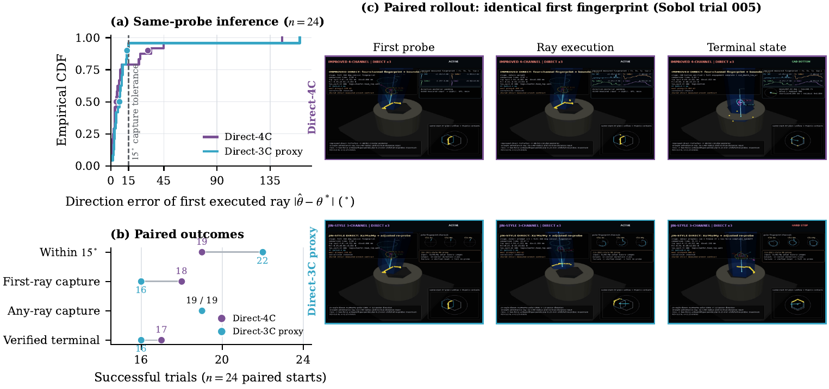
28
SIMULATION
Problem Task Framework ● Simulation Hardware Discussion
Four channels improve the median direction error, but not the tail
Median 4.75° vs 7.41°; p90 31.45° vs 13.79°; any-ray 19/24 both; verified 17/24 vs 16/24.
Nan Jinyao · Paper-aligned group review
Table I · Fig. 5
28
Notes:
Purpose
Use this slide to establish: Four channels improve the median direction error, but not the tail
Speaker notes
This controlled ablation holds the first conical touch, task tuple, noise seed, ray budget, and post-capture controller fixed. Direct-4C has a lower median executed-direction error than the Direct-3C proxy: 4.75 versus 7.41 degrees. However, its 90th-percentile error is worse: 31.45 versus 13.79 degrees. Direct-4C is within fifteen degrees in 19 of 24 cases, compared with 22 of 24 for the proxy. First-ray capture is 18 versus 16, but the paired McNemar value is 0.6875. Any-ray capture ties at 19 of 24, and verified terminal counts are 17 versus 16. The result is deliberately mixed. We retain the four-channel representation because it supports the circular posterior and downstream routing, not because this batch proves uniformly better direction accuracy or engagement.
Discussion notes
Direct-3C is our task-specific three-channel, twelve-sector proxy inspired by contact-pose work. It is not a reproduction of Jin et al.'s complete controller. If challenged on significance, point to Table I: none of the binary paired differences establishes superiority.
Source map
Paper Sec. IV-B and Table I, PDF p. 6; Paper Fig. 5, PDF p. 7
Permitted claim
Direct-4C has the lower median error but a heavier error tail in this batch.; Any-ray capture ties at 19/24, and terminal counts differ by one.
Claim not supported
Direct-4C is uniformly more accurate or significantly more successful.; Direct-4C outperforms the full method of Jin et al.

Slide 29
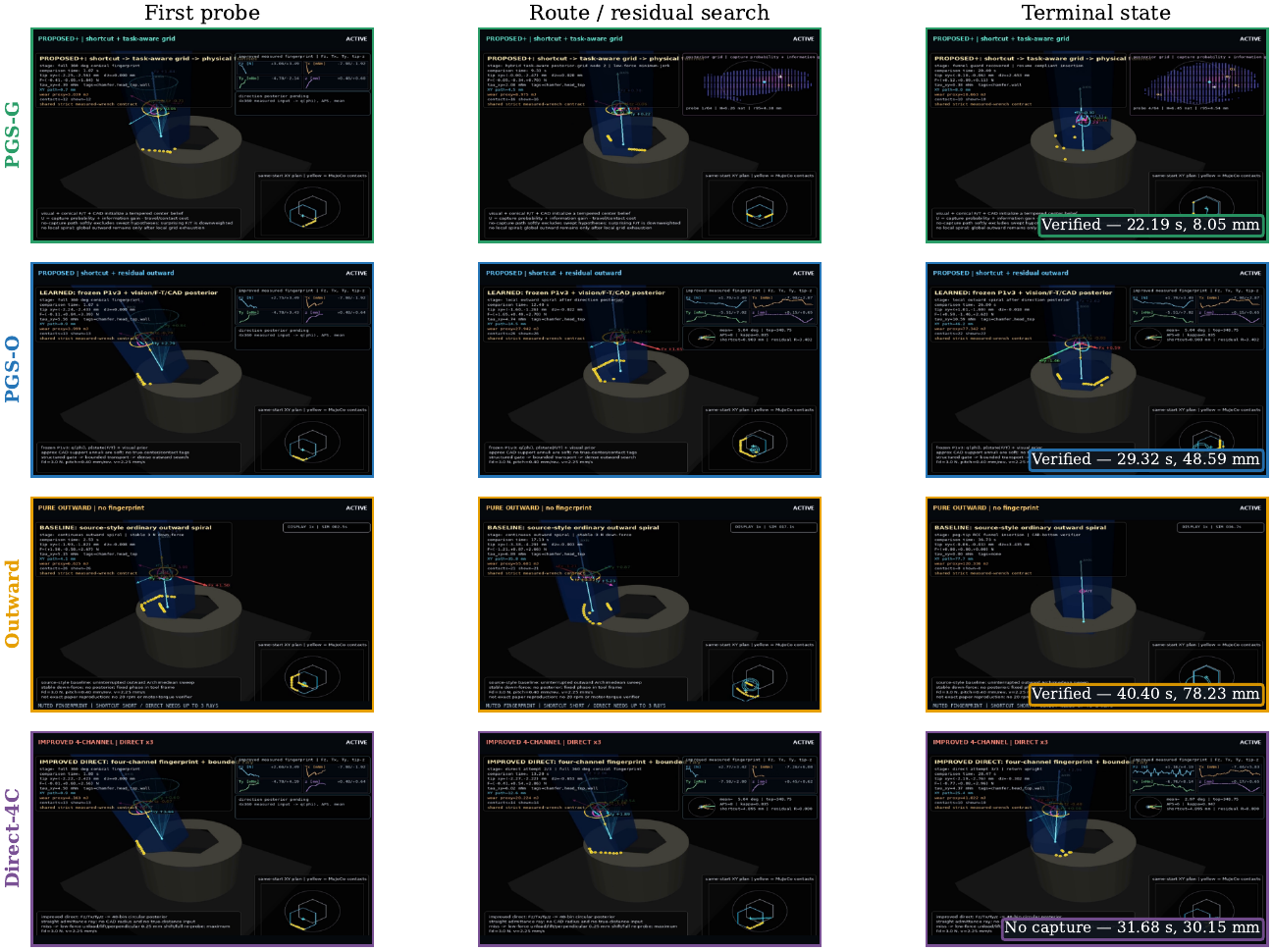
29
SIMULATION
Problem Task Framework ● Simulation Hardware Discussion
One muted-touch case explains why bounded guidance still needs residual search
This is one mechanism case: PGS-G, PGS-O and Outward verify; Direct-4C exhausts its ray budget without capture.
Nan Jinyao · Paper-aligned group review
Fig. 6 · Sobol 016
29
Notes:
Purpose
Use this slide to establish: One muted-touch case explains why bounded guidance still needs residual search
Speaker notes
This is one mechanism case, Sobol 016, not a population ranking. The first tactile cue is weak, so PGS-G spends it on only a short bounded move and then selects residual contacts. PGS-O uses the same principle but covers the remaining region with a local outward spiral. Global Outward ignores the tactile posterior and pays for coverage from the original contact. Direct-4C commits its limited budget to physical rays and, in this case, exhausts them without capture. PGS-G, PGS-O, and Outward eventually reach CAD-bottom verification in the recorded rollout. The lesson is not that one residual policy is always superior. It is that a directional cue can be useful without being accurate enough to determine an endpoint. Residual search retains responsibility for unresolved distance and for tactile misses.
Discussion notes
If the video is played, state before playback that frame spacing is normalized for narrative order; efficiency is determined from raw recorded time and path, not from visual playback duration. Ground-truth center marks are for offline grading only.
Source map
Paper Sec. IV-C, PDF pp. 6-8; Paper Fig. 6, PDF p. 8; Unscrewing_NanJinyao_0729.pptx mechanism media, supporting only
Permitted claim
Sobol 016 demonstrates why a bounded cue still needs residual search.; The displayed frames describe one frozen trial.
Claim not supported
This case estimates method-level success or efficiency.; The controller observes the plotted true center or contact labels online.

Slide 30
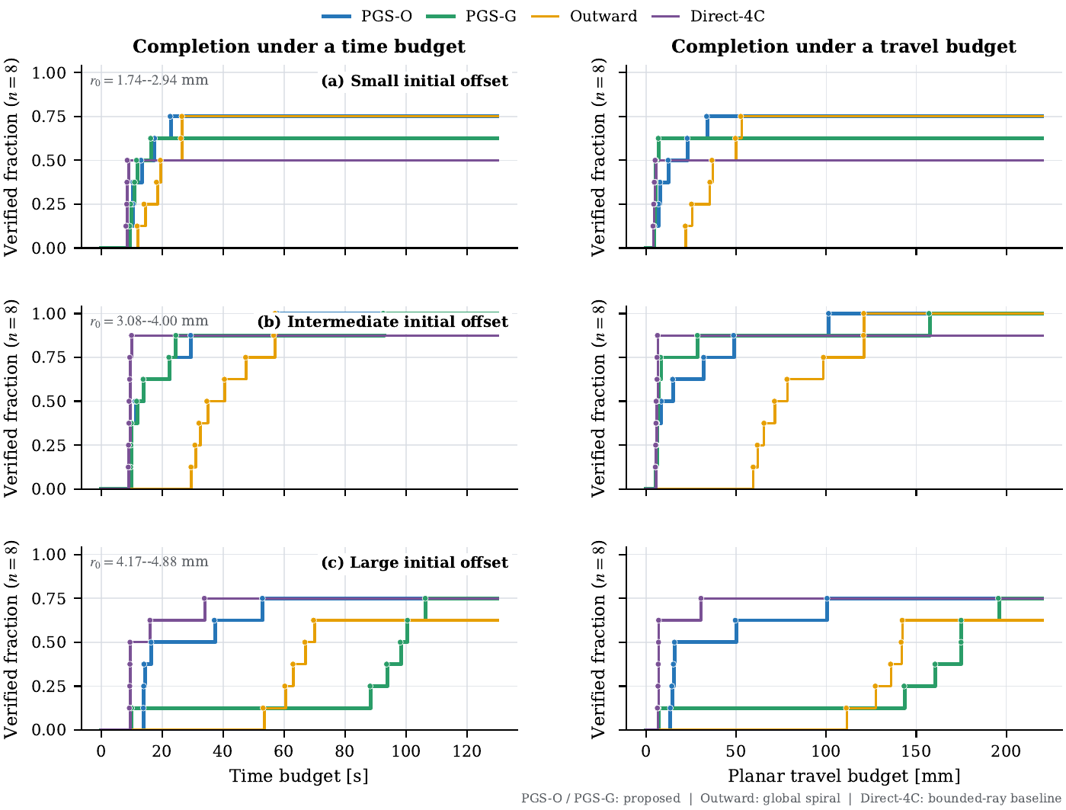
30
SIMULATION
Problem Task Framework ● Simulation Hardware Discussion
Engagement counts are comparable; the stronger result is paired efficiency
PGS-O 20/24 · PGS-G 19/24 · Outward 19/24 · Direct-4C 17/24.
Nan Jinyao · Paper-aligned group review
Table II · Fig. 7
30
Notes:
Purpose
Use this slide to establish: Engagement counts are comparable; the stronger result is paired efficiency
Speaker notes
Across all twenty-four paired M8 tasks, PGS-O reaches verified engagement in 20 cases. PGS-G and Outward each reach 19, while Direct-4C reaches 17. These counts show that posterior-guided routing did not trade away the engagement count in this batch, but I will not call 20 versus 19 an identical rate or a statistically established success advantage. The successful-subset medians in Table II are descriptive: PGS-O has 13.87 seconds and 14.52 millimeters, PGS-G 13.74 seconds and 6.76 millimeters, Outward 34.63 seconds and 71.27 millimeters, and Direct-4C 9.22 seconds and 6.07 millimeters. Because those medians use different successful subsets, the defensible efficiency claim comes next from the nineteen tasks completed by both PGS-O and Outward.
Discussion notes
If asked whether PGS-G is best because its table median path is 6.76 mm, answer no: successful-subset medians have different membership. The paired PGS-G versus PGS-O analysis on Slide 32 is the appropriate comparison.
Source map
Paper Table II, PDF p. 7; Paper Fig. 7, PDF p. 9; Paper Sec. IV-C and IV-D, PDF pp. 6-7
Permitted claim
Verified counts are PGS-O 20/24, PGS-G 19/24, Outward 19/24, and Direct-4C 17/24.; Table medians are conditional descriptive summaries.
Claim not supported
PGS-O and Outward have identical success counts.; Successful-subset medians alone establish a policy ranking.

Slide 31
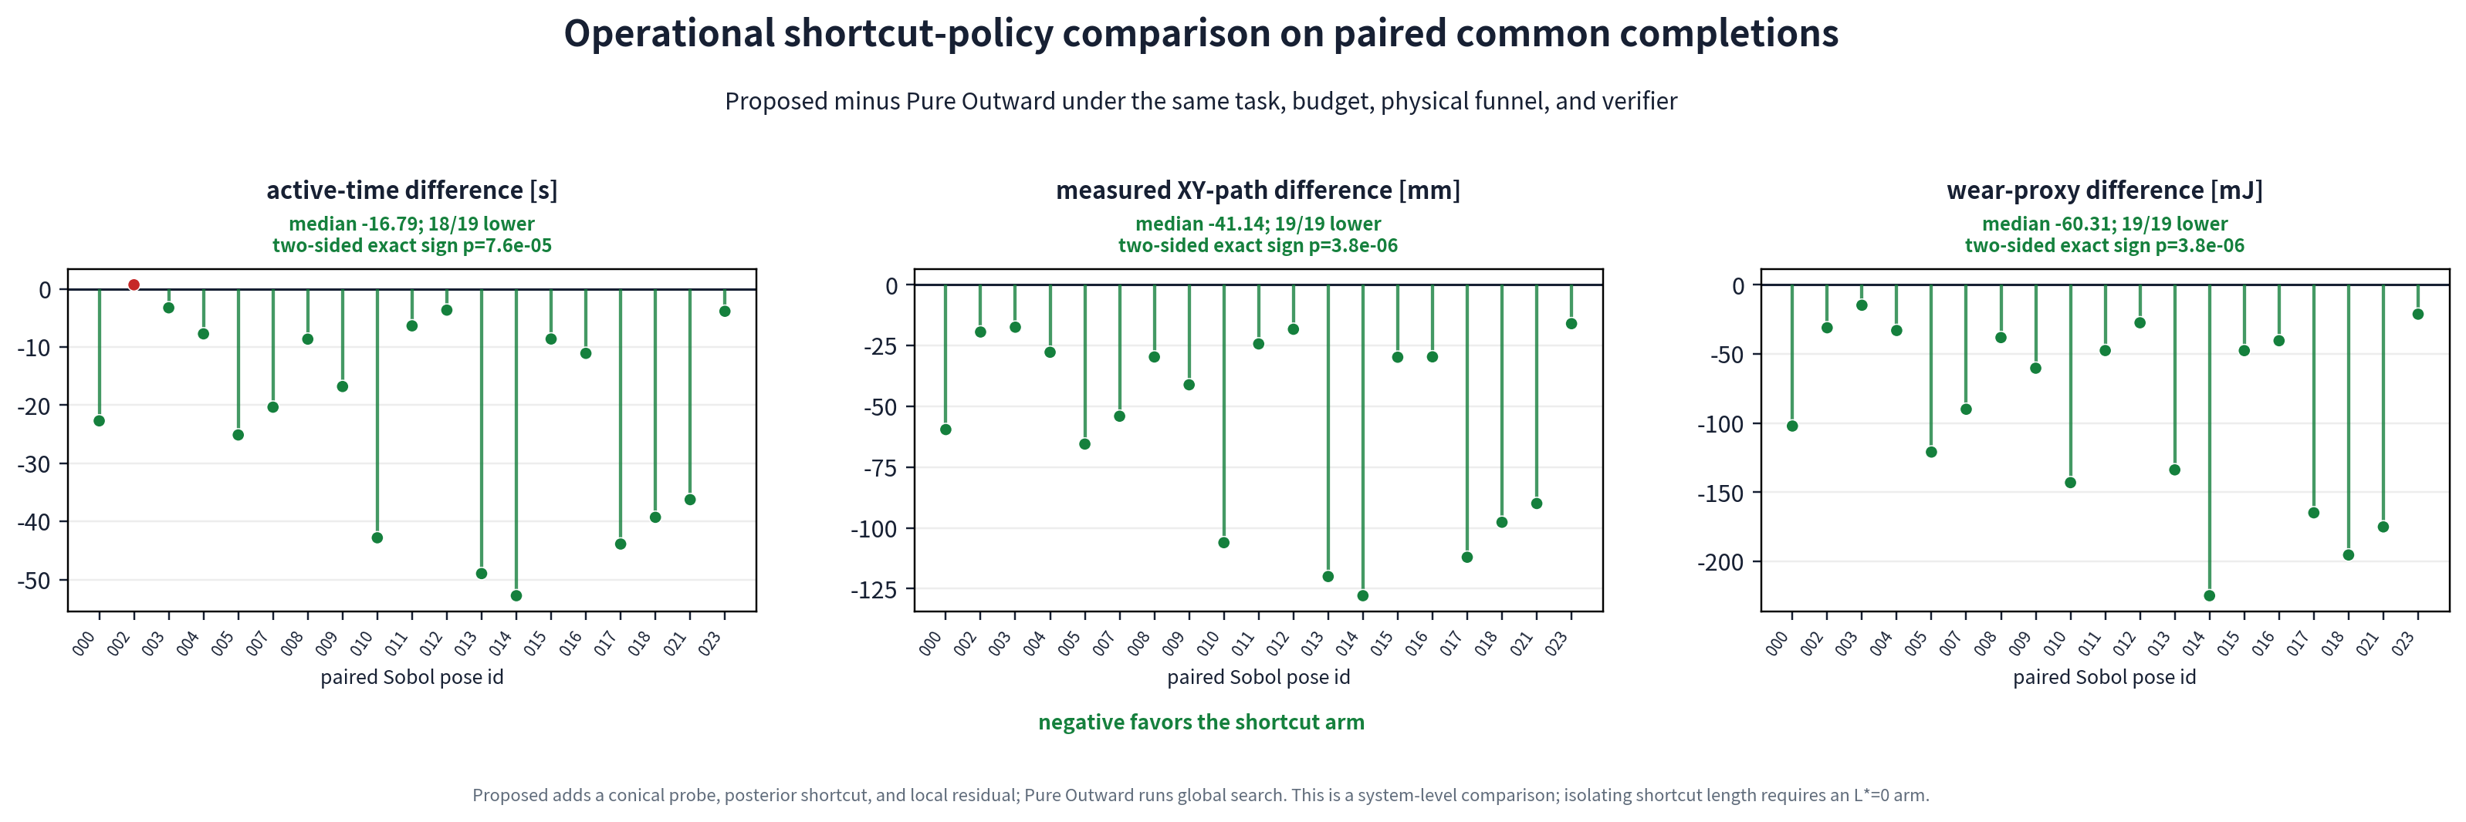
31
SIMULATION
Problem Task Framework ● Simulation Hardware Discussion
On 19 joint completions, PGS-O saves 41.14 mm and 16.79 s versus Outward
Paired median gaps: path −41.14 mm (19/19 shorter, p = 3.8×10⁻⁶); time −16.79 s (18/19 lower, p = 7.6×10⁻⁵).
Nan Jinyao · Paper-aligned group review
Sec. IV-C · paired-difference figure
31
Notes:
Purpose
Use this slide to establish: On 19 joint completions, PGS-O saves 41.14 mm and 16.79 s versus Outward
Speaker notes
This is the strongest quantitative result in the paper. PGS-O and Outward share nineteen completed tasks; that is the denominator. On this joint-completion subset, PGS-O has a shorter measured planar path in all 19 pairs. The paired median gap, PGS-O minus Outward, is negative 41.14 millimeters, with a two-sided exact sign-test value of 3.8 times 10 to the minus 6. Completion time is lower in 18 of 19 pairs, with a paired median gap of negative 16.79 seconds and p equal to 7.6 times 10 to the minus 5. These are median paired differences, not percentages and not means. The comparison evaluates the complete probe, shortcut, and local-residual policy against global coverage; it does not isolate shortcut length as a single causal variable.
Discussion notes
If asked for a pure shortcut ablation, acknowledge that a same-probe, same-residual arm with forced L-star equal to zero would be required. Also clarify the paper's wording: PGS-O completes 20/24 overall; nineteen is the joint-completion subset with Outward.
Source map
Paper Sec. IV-D, PDF pp. 6-7; Paper Table II, PDF p. 7; Paired-difference source figure m8_paired_efficiency.pdf
Permitted claim
On 19 joint completions, PGS-O is shorter in 19/19 and faster in 18/19.; Paired median gaps are -41.14 mm and -16.79 s.
Claim not supported
Path is reduced by 41.14 percent.; The paired result applies to all 24 tasks or isolates the shortcut alone.

Slide 32
32
SIMULATION
Problem Task Framework ● Simulation Hardware Discussion
The entropy grid does not outperform the local spiral in this benchmark
−0.061 mm
PGS-G − PGS-O path, median
p = .465
paired path test
+0.536 s
PGS-G − PGS-O time, median
p = .196
paired time test
19 shared completions
On 19 shared completions, neither paired difference supports superiority.
Nan Jinyao · Paper-aligned group review
Sec. IV-C
32
Notes:
Purpose
Use this slide to establish: The entropy grid does not outperform the local spiral in this benchmark
Speaker notes
PGS-G and PGS-O share nineteen completions, allowing a direct paired comparison of their residual-routing choices. The median paired path gap is negative 0.061 millimeters; PGS-G is shorter in 11 of 19 pairs, with Wilcoxon p equal to 0.465. The median paired time gap is positive 0.536 seconds; PGS-G is faster in only 7 of 19 pairs, with p equal to 0.196. Therefore this benchmark does not establish an efficiency advantage for the entropy grid. The residual regions are already only a few millimeters wide, so a local spiral covers them with little waste. Grid actions also pay unloading, switching, and repeated-contact costs, while close utility scores remain sensitive to model error. Larger residual sets or a better calibrated likelihood might change the result, but these twenty-four starts do not show that advantage.
Discussion notes
Recommended positioning for the paper: keep PGS-O as the primary result and present PGS-G as a technically motivated variant with a negative current result. Do not infer equivalence; the current data simply fail to establish superiority.
Source map
Paper Sec. IV-D, PDF pp. 6-7; Paper Discussion, PDF p. 13
Permitted claim
No significant paired efficiency advantage of PGS-G over PGS-O is established in this batch.; Small residual regions and contact-switching costs are plausible explanations discussed by the paper.
Claim not supported
PGS-G outperforms PGS-O.; The entropy grid can never help on larger or different tasks.

Slide 33
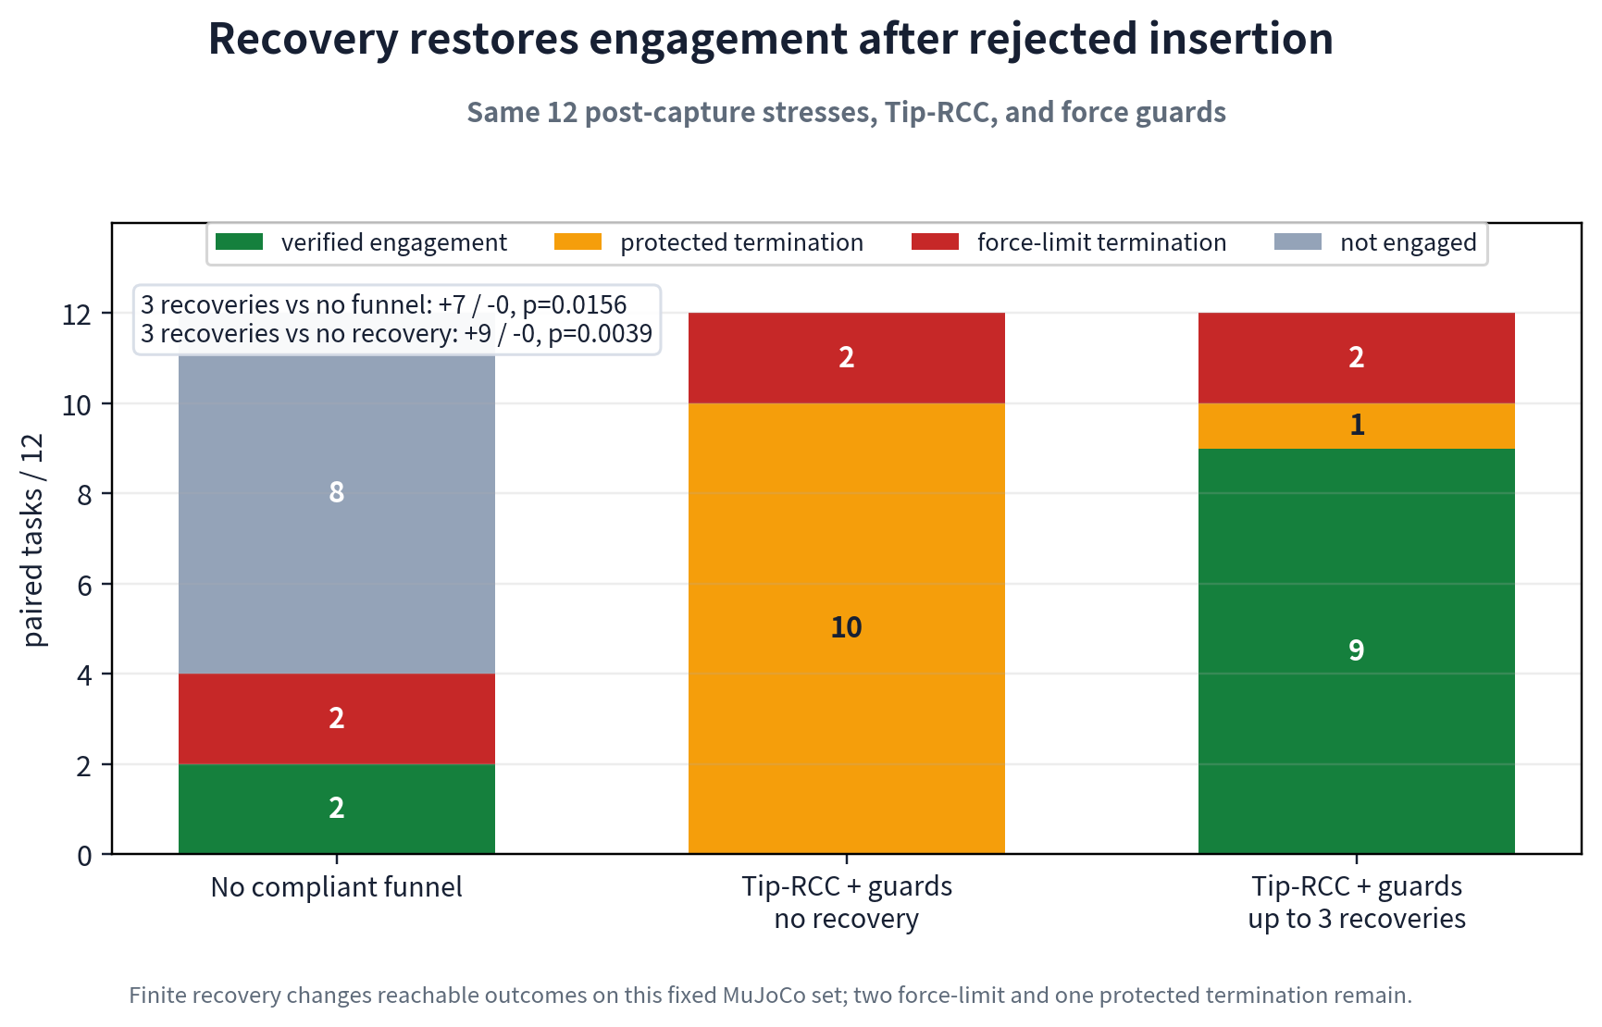
33
SIMULATION
Problem Task Framework ● Simulation Hardware Discussion
Recovery restores 9 of 12 stressed cases, but remains non-guaranteed
No recovery: 0/12. Up to three recoveries: 9/12, exact two-sided p = .00390625; two force-limit and one protected exit remain.
Nan Jinyao · Paper-aligned group review
Sec. IV-D · recovery ablation
33
Notes:
Purpose
Use this slide to establish: Recovery restores 9 of 12 stressed cases, but remains non-guaranteed
Speaker notes
Recovery is tested on a separate, fixed twelve-case post-capture stress set. The RCC and wrench guards remain unchanged; only the recovery allowance changes. With recovery disabled, none of the twelve cases reaches verified engagement. Allowing at most three recoveries produces nine verified engagements, with no paired case moving in the opposite direction. The exact two-sided paired value is 0.00390625. Two force-limit exits and one protected exit remain, so recovery is not a success guarantee. Mechanistically, recovery unloads, retracts, uprights, retouches, and restarts the dwell from the measured state. It releases wedging and stale compliant displacement after a rejected insertion. It does not estimate the socket center, remove persistent bias, or alter the learned posterior's authority. This study isolates post-capture reachability, not task-level search quality.
Discussion notes
If the legacy three-arm plot includes a no-funnel condition, identify it as supplementary mechanism context. The paper's central paired inference is R0 0/12 versus up-to-three recoveries 9/12 under the same RCC and guards.
Source map
Paper Sec. IV-D, PDF p. 7; Paper Eq. (29), PDF p. 5; Figure asset m8_r3_paired_ablation_en.png
Permitted claim
Up to three recoveries increase verified outcomes from 0/12 to 9/12 on the fixed stress set.; Recovery changes reachable post-rejection states but does not guarantee success.
Claim not supported
Recovery guarantees engagement.; The recovery result estimates performance on the 24-task search benchmark or on hardware.

Slide 34
34
SIMULATION
Problem Task Framework ● Simulation Hardware Discussion
Cross-size tests do not establish a benefit from anchored fine-tuning
Interface
Dev M10
Dev M12
Test M10
Test M12
M8 zero-shot
12/0/0
10/1/1
12/0/0
10/0/1
Calibration only
12/0/0
10/0/1
12/0/0
11/0/0
Anchored fine-tuning
12/0/0
10/0/2
10/1/1
10/0/2
Privileged center
12/0/0
11/0/1
12/0/0
12/0/0
Each cell: verified / force-limit / protected termination · n = 12
Cross-size simulation is not sim-to-real evidence; held-out results show no steady fine-tuning benefit.
Nan Jinyao · Paper-aligned group review
Sec. IV-E · Table III
34
Notes:
Purpose
Use this slide to establish: Cross-size tests do not establish a benefit from anchored fine-tuning
Speaker notes
This is a simulation cross-size study, not sim-to-real transfer. For each of M10 and M12, the protocol uses 72 training, 36 validation, and 36 calibration scans split by sixfold symmetry. The encoder remains fixed; only contact-state and direction heads are updated with an L2 anchor to M8. On held-out tests, M8 zero-shot records 12 verified M10 cases and 10 M12 cases. Calibration-only records 12 and 11. Anchored fine-tuning records 10 and 10, with one M10 force-limit and protected exits remaining. These cells also list force-limit and protected terminations; other trials end by budget or terminal rejection. The conclusion is negative but useful: anchored fine-tuning does not steadily exceed zero-shot or calibration-only transfer, so residual search and physical guards remain outside the transferred network.
Discussion notes
Do not describe fine-tuning as harmful in general; the evidence says it is not consistently superior in this protocol. Privileged-center rows are an upper-reference condition, not a deployable policy. Hardware adaptation is a separate evidence line.
Source map
Paper Sec. IV-E and Table III, PDF pp. 7-8
Permitted claim
Anchored fine-tuning shows no steady held-out gain over zero-shot or calibration-only cross-size simulation.; Cross-size simulation motivates keeping physical search and guards outside the learned interface.
Claim not supported
Fine-tuning is necessary or proven beneficial.; Table III demonstrates sim-to-real transfer.

Slide 35
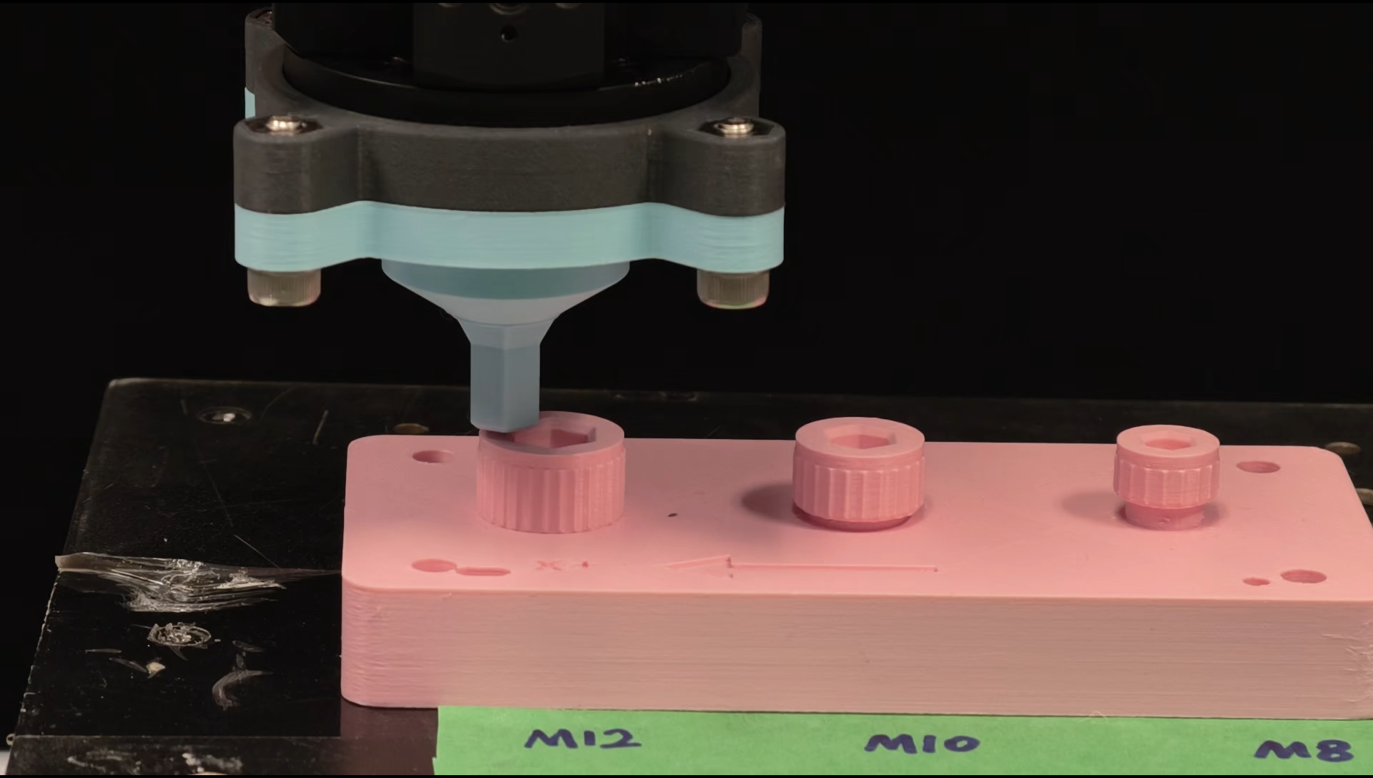
35
HARDWARE
Problem Task Framework Simulation ● Hardware Discussion
Real signals require an installed-stack observation model
26 / size
registered conical scans
78 / 78
acquisition-valid traces
4 × 360
phase-aligned model input
78/78 is an acquisition result, not a task-success rate; development holdouts are not untouched qualification data.
Nan Jinyao · Paper-aligned group review
Sec. IV-F · Table IV
35
Notes:
Purpose
Use this slide to establish: Real signals require an installed-stack observation model
Speaker notes
The hardware scan campaign separates acquisition from engagement. For each socket size, M8, M10, and M12, there are twenty-six scheduled conical traces: sixteen clean records, four development holdouts, four quarantined points, and two repeated sentinels. All seventy-eight scheduled traces passed acquisition checks. That is a 78-of-78 acquisition result, not seventy-eight engagement successes and not seventy-eight training examples. The phase-aligned real signals differ clearly from rendered signals because the installed stack includes friction, stiction, printed-part deformation, sensor bias, registration error, and gravity moment at the Bota origin. Therefore the circular observation model used on the robot was fitted again on real installed-stack signals. This addresses the immediate observation mismatch, but it does not solve session drift, wear, temperature changes, or shifts across socket size.
Discussion notes
The M12 holdouts were already seen during development, so they cannot be called an untouched qualification set. If asked about zero-shot accuracy, answer that the final paper does not make a numerical zero-shot hardware claim; it reports the mismatch and refitting decision.
Source map
Paper Sec. IV-F, PDF p. 8; Paper Table IV, PDF p. 10; Paper Discussion, PDF p. 13
Permitted claim
All 78 scheduled multisize conical traces passed acquisition checks.; The robot observation model was refitted on installed-stack real signals.
Claim not supported
78/78 is a task success rate or training-set size.; Real refitting resolves drift, wear, temperature, or unseen-size shift.

Slide 36
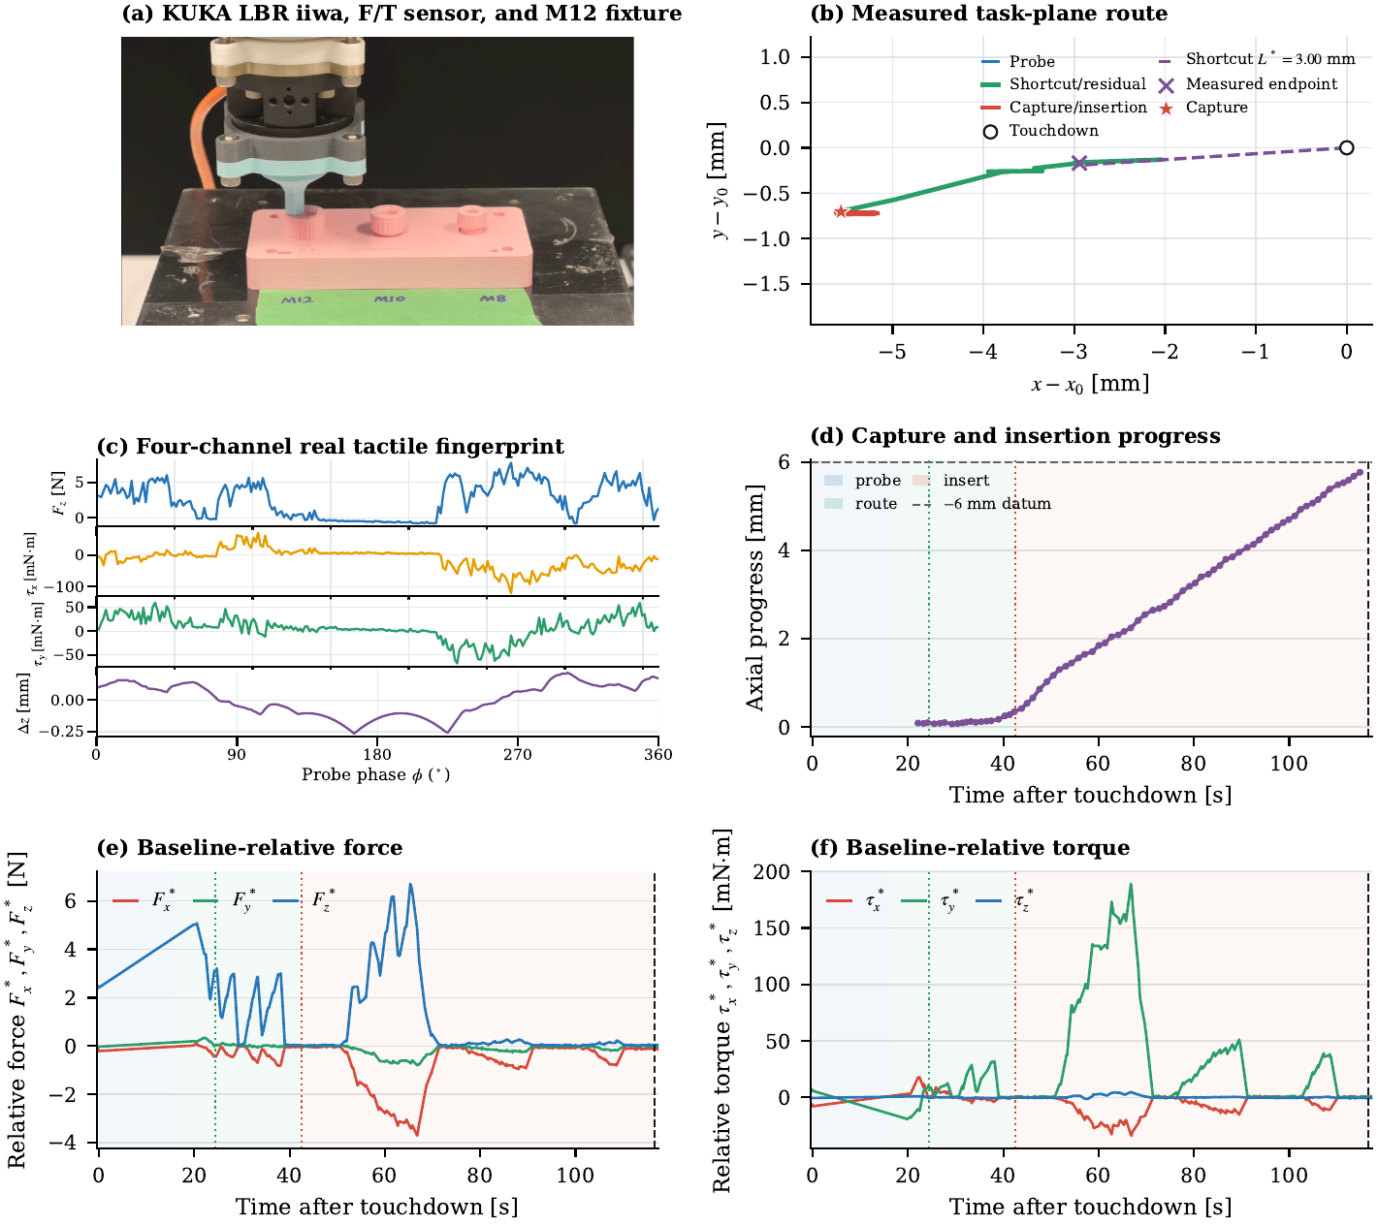
36
HARDWARE
Problem Task Framework Simulation ● Hardware Discussion
Selected M10/M12 runs demonstrate the mechanism, not a success rate
Named M12 PGS-G: 3.00 mm shortcut; 0.054 mm endpoint error; miss → negative-evidence replan; capture 42.45 s; terminal candidate 116.63 s; depth 5.792 mm.
Nan Jinyao · Paper-aligned group review
Sec. IV-F · Figs. 8–10 · Table IV
36
Notes:
Purpose
Use this slide to establish: Selected M10/M12 runs demonstrate the mechanism, not a success rate
Speaker notes
The main hardware trace is one named M12 PGS-G run from touchdown to terminal logging, without mixing trials. Its 240 raw scan samples produce a 3.00-millimeter shortcut after phase preprocessing. The measured endpoint differs from the command by 0.054 millimeters and does not capture. That valid miss supplies negative evidence, after which the residual route captures at 42.45 seconds. A terminal candidate is logged at 116.63 seconds with 5.792 millimeters of measured insertion depth. Other named M12 PGS-O, PGS-G, and Direct-4C records reach terminal events; Outward exceeds the 130-second budget and engages only after extension. Two fixed-site M10 PGS-G pilots reach terminal depths of 4.834 and 4.726 millimeters. These are feasibility and mechanism records from chosen starts, not randomized rates or policy-level speed estimates.
Discussion notes
Avoid converting the M12 registry into three-of-four success or the M10 pilots into two-of-two success. Figure 10 badges use run-specific timing; do not reconcile them into a common 130-second comparison. Hardware wrench is baseline-relative at the Bota sensor origin.
Source map
Paper Sec. IV-F, PDF pp. 8-9; Paper Figs. 8-10, PDF pp. 10-12; Paper Table IV, PDF p. 10; 实验结果.pptx Slides 2-7, media only
Permitted claim
The named M12 PGS-G trace demonstrates shortcut miss, negative-evidence replan, capture, and terminal logging in one run.; Selected M10/M12 runs establish closed-loop feasibility at fixed or named starts.
Claim not supported
The hardware records estimate success probability or policy speed.; The selected M12 methods all satisfy the same 130 s benchmark.

Slide 37
37
DISCUSSION
Problem Task Framework Simulation Hardware ● Discussion
The evidence supports bounded search guidance, with clear validity limits
ESTABLISHES
DOES NOT ESTABLISH
Posterior-supported motion allocation
PGS-G superiority
PGS-O paired path/time reduction
Fine-tuning benefit
Randomized hardware success rate
Recovery effect on fixed stress set
Capture guarantee or certified tip wrench
Selected M10/M12 hardware feasibility
Torque coupling / thread release / extraction
The contribution is useful because the boundary is explicit.
Nan Jinyao · Paper-aligned group review
Discussion
37
Notes:
Purpose
Use this slide to establish: The evidence supports bounded search guidance, with clear validity limits
Speaker notes
The evidence supports four bounded statements. First, a conical tactile signal can update a circular direction and contact-support belief without estimating the full socket pose. Second, the posterior can allocate a capped shortcut while leaving unresolved mass to residual search. Third, on nineteen joint M8 completions, PGS-O reduces paired planar path and completion time relative to global Outward. Fourth, bounded recovery changes outcomes on a fixed simulated stress set, and selected hardware runs show that the perception-action-contact chain can execute on the robot. The evidence does not establish PGS-G superiority, a benefit from anchored fine-tuning, a randomized hardware success rate, or a theorem of capture. It also does not provide certified absolute tip wrench. Most importantly, the terminal event establishes geometric engagement only, not first-turn coupling, slip resistance, thread release, or extraction.
Discussion notes
Use this slide as the claim ledger during questions. If a proposed sentence exceeds the right-hand boundary, either move it to future work or acquire new evidence. Proposition assumptions are detailed in A06 and hardware provenance in A12-A13.
Source map
Paper Discussion and Conclusion, PDF p. 13; Paper Proposition 1, PDF p. 4; Paper Table IV, PDF p. 10
Permitted claim
The work demonstrates bounded tactile search guidance, paired PGS-O efficiency, recovery effect on a fixed stress set, and selected hardware feasibility.; The demonstrated terminal scope is geometric engagement.
Claim not supported
The work demonstrates full unscrewing or torque coupling.; The proposition, hardware cases, or cross-size study establish general success guarantees.

Slide 38
38
DISCUSSION
Problem Task Framework Simulation Hardware ● Discussion
The paper is defensible as a geometric-engagement study
“
A conical tactile cue can shorten search when its authority is limited to a posterior-supported shortcut and unresolved uncertainty remains inside guarded physical search and verification.
DISCUSSION DECISIONS
1
Keep PGS-O primary and position PGS-G as a variant?
2
Minimum randomized hardware study before submission?
3
Submit at geometric terminal scope, or add first-turn coupling first?
A conical tactile cue can shorten search when its authority is limited to a posterior-supported shortcut and unresolved uncertainty remains inside guarded physical search and verification.
Nan Jinyao · Paper-aligned group review
Conclusion
38
Notes:
Purpose
Use this slide to establish: The paper is defensible as a geometric-engagement study
Speaker notes
The paper's defensible contribution is narrow and coherent. One low-force conical touch provides partial directional evidence. The controller spends only the supported portion of that evidence on a capped shortcut, keeps the remaining uncertainty inside finite residual search, and leaves capture, recovery, safety, and terminal verification to a shared physical loop. This separation explains both the positive and negative results: PGS-O saves motion against global coverage, the entropy grid adds no demonstrated advantage on these small residual regions, and hardware evidence remains feasibility rather than a rate. I propose three decisions for discussion. Should PGS-O be the primary method and PGS-G a variant? What randomized paired hardware campaign is the minimum required before journal submission? Finally, should submission retain the geometric terminal scope, or should first-turn torque coupling be added before claiming a broader unscrewing contribution?
Discussion notes
This is the end of the 45-minute main presentation. Open appendix slides only in response to the committee's chosen decision path. The closing sentence should remain about bounded search authority, not autonomous unscrewing.
Source map
Paper Abstract and Contributions, PDF p. 1; Paper Discussion and Conclusion, PDF p. 13
Permitted claim
The paper is a geometric-engagement and bounded-search study.; PGS-O can be positioned as the primary empirical result while PGS-G remains a tested variant.
Claim not supported
The paper already demonstrates complete unscrewing.; The committee must accept one predetermined submission strategy.

Slide 39
39
APPENDIX
Problem Task Framework Simulation Hardware Discussion
A01 · Coordinate frames, notation and online/offline authority
Symbol
Meaning
Online?
{b}, {p}, {f}
base, fixture, interaction frames
yes
x₀, w, ϕ
touchdown, wrench, probe phase
yes
C, contact labels
true center / privileged labels
no
θ* and offline metrics
grading references
no
All planar geometry is expressed in {p}; learned outputs never receive privileged labels online.
Nan Jinyao · Paper-aligned group review
Sec. II-A · Fig. 1
39
Notes:
Purpose
Use this slide to establish: A01 · Coordinate frames, notation and online/offline authority
Speaker notes
This appendix fixes the coordinate and authority conventions used throughout the paper. Frame b is the robot base, frame p is the registered fixture or socket plate, and frame f is the force-sensing tool interaction frame. All planar beliefs and routes are expressed in frame p, and engagement depth increases along negative z-p. The online controller knows the first stable contact x-zero, robot pose, the measured six-axis wrench, probe phase, and the truncated visual or CAD prior. It does not know the true socket center C, simulator contact labels, or ground-truth capture geometry. Those privileged quantities appear only in offline grading and explanatory figures. This separation matters whenever a plot shows the true center, capture disk, or contact tags: they clarify evaluation, but they are never inputs to online routing or terminal verification.
Discussion notes
If asked about registration uncertainty, note that the prior represents planar center uncertainty, while the hardware discussion separately acknowledges fixture and TCP registration error. The paper does not claim a certified metrology chain.
Source map
Paper Fig. 1 and Sec. II-A, PDF p. 2; Paper Fig. 4 caption, PDF p. 5
Permitted claim
The controller uses pose, wrench, phase, and a visual/CAD prior online.; True center and simulator contact labels are reserved for offline checking.
Claim not supported
Ground-truth center or capture labels guide online actions.; The coordinate registration is certified or error-free.

Slide 40
40
APPENDIX
Problem Task Framework Simulation Hardware Discussion
A02 · Verified-engagement predicate and failure taxonomy
Verified: capture precedes bottom-mode dwell, safety holds, and tb ≤ 130 s.
Conditional efficiency: Teng, planar path Lxy and contact-work proxy Ew are reported only for verified trials.
Failure labels retain budget exhaustion, force-limit termination, protected termination and terminal rejection.
V = {∃ tc < tb ≤ Tmax : γcap(tc) γdwell(tb) γsafe[0,tb] = 1}
Contact-work proxy is not wear and not energy consumption.
Nan Jinyao · Paper-aligned group review
Sec. II-A · Eqs. (4)–(5)
40
Notes:
Purpose
Use this slide to establish: A02 · Verified-engagement predicate and failure taxonomy
Speaker notes
The outcome predicate is intentionally stricter than a capture cue. A trial must first produce sensor-side capture at time t-c. It must then reach bottom mode and hold that predicate continuously for the required dwell by a time t-b no later than 130 seconds. The safety predicate must remain valid over the interval; a force-limit stop prevents verified engagement. Completion time is measured from stable touchdown to the verified dwell. Planar path integrates measured tip motion, and the contact-work proxy integrates absolute translational and rotational wrench-work terms. A force-limit stop, protected post-capture stop, or exhausted search budget is a failure. This taxonomy prevents a transient descent, a capture candidate, or a video label from being counted as engagement. On hardware, named terminal records are still reported as mechanism cases rather than population outcomes.
Discussion notes
If asked about a terminal candidate versus a verified terminal, use the exact source record. The main hardware case reports a terminal candidate at 116.63 s, while Table IV records named terminal outcomes. Do not silently upgrade any earlier capture-only record.
Source map
Paper Eqs. (4)-(5), PDF p. 2; Paper Eq. (30), PDF p. 6; Paper Sec. IV-A, PDF p. 6
Permitted claim
Verified engagement requires capture followed by a safe persistent bottom dwell within the task budget.; Capture-only, protected, force-limit, and budget exits are not verified engagement.
Claim not supported
Any insertion depth crossing or capture cue is success.; Old PPT labels override the paper predicate.

Slide 41
41
APPENDIX
Problem Task Framework Simulation Hardware Discussion
A03 · Model split, symmetry, augmentation and calibration lineage
phase-indexed scans
sixfold symmetry split
train / validation / calibration
3 independently trained members
temperature calibration
frozen evaluation lineage
Calibration data tune uncertainty interfaces; they do not become online privileged state.
Nan Jinyao · Paper-aligned group review
Sec. III-A · IV-E
41
Notes:
Purpose
Use this slide to establish: A03 · Model split, symmetry, augmentation and calibration lineage
Speaker notes
This lineage slide separates paper-stated facts from implementation details that require an artifact audit. The paper states that three separately trained models produce forty-eight direction-bin logits and are temperature calibrated before averaging. It also states that cross-size M10 and M12 data use 72 training, 36 validation, and 36 calibration scans per size, with the sets separated by sixfold symmetry. During anchored adaptation, the encoder remains fixed and only the contact-state and direction heads are updated. A concentration and source-agreement gate can suppress the shortcut. The paper does not provide a complete augmentation recipe or enough detail to claim that every implementation split is untouched. Any additional augmentation, checkpoint-selection, or seed statement on this slide must be read directly from frozen training manifests before submission, rather than inferred from the older presentation.
Discussion notes
Likely question: were hardware holdouts untouched? No. The paper explicitly says the M12 holdouts had been seen during development. Keep simulation cross-size splits, hardware development partitions, and model-member training lineage separate.
Source map
Paper Sec. III-A, PDF p. 3; Paper Sec. IV-E, PDF pp. 7-8; Paper Sec. IV-F, PDF p. 8
Permitted claim
The ensemble has three separately trained, temperature-calibrated members over 48 bins.; Cross-size adaptation fixes the encoder and separates train, validation, and calibration scans by sixfold symmetry.
Claim not supported
An unreported augmentation recipe or untouched split is established by the paper.; M12 hardware holdouts form a pristine test set.

Slide 42
42
APPENDIX
Problem Task Framework Simulation Hardware Discussion
A04 · Posterior diagnostics beyond top-1 accuracy
Diagnostic
Question answered
Not equivalent to
κ
Is average posterior concentrated?
member agreement
Aε
How many bins retain target mass?
capture probability
H(p)
How spread is the posterior?
geometric reachability
Δens
Do members point together?
entropy
p₋
How much mass points behind?
center distance
Diagnostics gate motion authority; none is a success detector.
Nan Jinyao · Paper-aligned group review
Sec. III-A · Eqs. (9)–(12)
42
Notes:
Purpose
Use this slide to establish: A04 · Posterior diagnostics beyond top-1 accuracy
Speaker notes
A top direction alone cannot describe whether a shortcut is justified. The circular mean supplies the executed bearing, while concentration measures how tightly the average posterior wraps around that bearing. The adaptive prediction set records how many high-probability bins are needed to retain the selected mass. Ensemble disagreement instead measures the largest gap among the members' top bins. Entropy measures overall spread, and reverse posterior mass asks how much weighted center belief lies behind the proposed direction. These diagnostics are deliberately not interchangeable: a posterior may be concentrated while ensemble members disagree, or diffuse while their top bins agree. The shortcut quality combines concentration, disagreement, and reverse mass, whereas APS and entropy remain useful telemetry. None of these quantities is a capture detector or a calibrated probability of task success. Physical capture and terminal verification remain independent.
Discussion notes
Clarify that the three-bin prediction set shown in Fig. 3 is not the ensemble size, although both happen to equal three in that example. Also avoid interpreting softmax magnitude as success probability.
Source map
Paper Eqs. (8)-(12), PDF p. 3; Paper Fig. 3, PDF p. 4; Paper Eq. (16), PDF p. 3
Permitted claim
Concentration, APS, entropy, ensemble disagreement, and reverse mass diagnose different aspects of uncertainty.; These diagnostics regulate route authority, not task success.
Claim not supported
APS size equals ensemble size by definition.; Posterior confidence is a calibrated probability of engagement.

Slide 43
43
APPENDIX
Problem Task Framework Simulation Hardware Discussion
A05 · Radial likelihood and shortcut parameters
Quantity
Role
Paper value / rule
N
CAD-prior particles
4096
σᵥ, Rᵥ
M8 prior spread / truncation
2 mm / 4.895 mm
α(q)
retained projected mass
0.10 + 0.15q
λ(q)
radial cap factor
0.35 + 0.30q
p₋ gate
reverse-mass veto
L* = 0 if p₋ ≥ 0.20
Lc
optional command cap
minimum with other caps
The 0.02 uniform term prevents one shaky observation from erasing geometric support.
Nan Jinyao · Paper-aligned group review
Sec. III-B–C · Eqs. (13)–(19)
43
Notes:
Purpose
Use this slide to establish: A05 · Radial likelihood and shortcut parameters
Speaker notes
The center belief combines learned angular evidence with hand-designed geometric support. For M8, 4,096 particles are sampled from a truncated planar Gaussian with sigma two millimeters and radius 4.895 millimeters. Each weight includes the posterior probability of the particle's angular bin and a radial likelihood tied to the contact-support head. A small uniform term, 0.02, prevents one uncertain observation from deleting geometric support. Shortcut quality maps to alpha from 0.10 to 0.25 and lambda from 0.35 to 0.65. A quarter of the effective capture radius is retained as a projected margin, and reverse mass at or above 0.20 forces zero direct travel. These are designed risk-allocation parameters, not learned physical constants. The effective radius itself is a conservative planning surrogate derived per socket size, not an exact capture boundary.
Discussion notes
If asked for sensitivity, acknowledge that the final paper does not provide a full hyperparameter sweep. A submission-strength follow-up would vary the reverse-mass threshold, quantile schedule, command cap, and effective radius on frozen tasks.
Source map
Paper Eqs. (13)-(17), PDF p. 3; Paper Fig. 4, PDF p. 5
Permitted claim
The radial likelihood and shortcut schedule are explicit, conservative design choices.; A small uniform term preserves geometric support under uncertain observations.
Claim not supported
The hand-designed thresholds are optimal or learned from data.; The effective capture radius is an exact physical capture boundary.

Slide 44
44
APPENDIX
Problem Task Framework Simulation Hardware Discussion
A06 · Proposition 1: statement, proof idea and assumption ledger
ASSUMPTIONS
L* ≤ Lproj ⇒ retained projected mass ≥ 1 − α(q)
L* ≤ Lrad ⇒ radial travel remains capped by Q⁽ʷ⁾₀.₉₉
Empirical fixed-particle posterior
Exact endpoint execution
No distribution shift during the bound
Finite residual coverage evaluated separately
Retained posterior support ≠ capture guarantee
The proof constrains allocated support. It does not prove the executed path captures the socket.
Nan Jinyao · Paper-aligned group review
Sec. III-C · Proposition 1
44
Notes:
Purpose
Use this slide to establish: A06 · Proposition 1: statement, proof idea and assumption ledger
Speaker notes
Proposition 1 is a posterior-mass retention statement, not a capture theorem. It assumes reverse mass below 0.20, a positive shortcut, a fixed weighted-particle set, and exact execution of the commanded endpoint. Because L-star is bounded by the lower projected quantile, at least one minus alpha of the empirical weighted mass remains beyond the endpoint plus the retained quarter-radius margin. Because L-star is also bounded by the radial cap, it cannot exceed lambda times the weighted 99th-percentile radius. The proof follows directly from the definition of the weighted empirical quantiles. What is not covered is equally important: model misspecification, distribution shift, finite particle error, boundary truncation, tracking error, or insufficient residual-search time. A real endpoint miss therefore remains a measured event that must update the belief and be handled by physical control.
Discussion notes
If a reviewer asks for probabilistic safety, state that the proposition conditions empirical allocation for a fixed posterior. It is not a conformal coverage result over deployed tasks and provides no force, contact, or capture guarantee.
Source map
Paper Proposition 1 and Eq. (18), PDF p. 4; Paper Discussion, PDF p. 13
Permitted claim
The shortcut retains a stated fraction of fixed empirical posterior mass under exact endpoint execution.; The result bounds allocated travel relative to the weighted radial quantile.
Claim not supported
Proposition 1 guarantees capture, safety, or full residual coverage.; The bound remains valid under arbitrary distribution shift or tracking error.

Slide 45
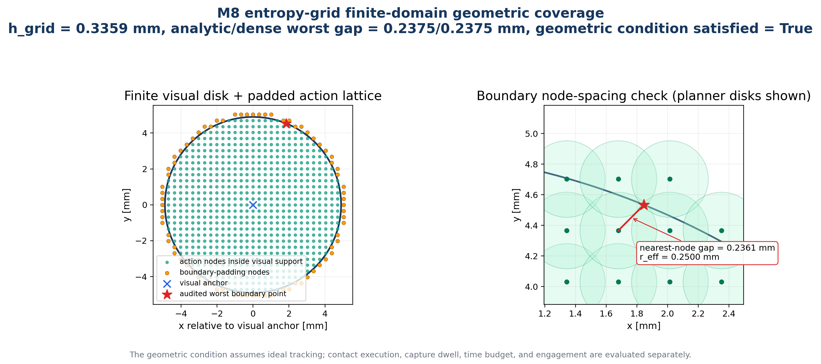
45
APPENDIX
Problem Task Framework Simulation Hardware Discussion
A07 · PGS-G utility, switching and geometric coverage
The finite-domain grid satisfies its geometric spacing condition under ideal tracking; contact execution, time budget and engagement are separate.
Nan Jinyao · Paper-aligned group review
Sec. III-C · Eqs. (23)–(25)
45
Notes:
Purpose
Use this slide to establish: A07 · PGS-G utility, switching and geometric coverage
Speaker notes
PGS-G chooses among remaining candidate moves using four terms. Expected information gain rewards an observation that is predicted to separate hit from miss beliefs. A capture-coverage term rewards a segment likely to intersect a particle's effective capture disk. A fixed switching cost and a distance cost penalize extra contact actions and travel. The next action is selected only from the remaining action set. This utility explains why PGS-G is not an entropy-minimization controller: when another contact has little information value, coverage can dominate, and entropy need not decrease monotonically. It also explains the negative benchmark result. On small residual disks, candidate utilities may be close, the likelihood is approximate, and unloading and touching again can erase a modest geometric benefit. The formulation is technically meaningful, but the current paired data do not show superiority over PGS-O.
Discussion notes
Potential next ablation: retain the same shortcut and physical controller while varying information, coverage, switching, and distance terms one at a time on larger residual regions. Current results cannot identify which utility term helps or hurts.
Source map
Paper Eqs. (23)-(25), PDF p. 5; Paper Sec. IV-D, PDF pp. 6-7; Paper Discussion, PDF p. 13
Permitted claim
PGS-G balances information, likely capture coverage, switching, and travel.; The current benchmark does not establish a PGS-G advantage.
Claim not supported
PGS-G minimizes entropy monotonically.; The utility weights are proven optimal or each term has an isolated causal effect.

Slide 46
46
APPENDIX
Problem Task Framework Simulation Hardware Discussion
A08 · Full M8 outcomes and conditional metrics
Method
Verified / 24
Interpretation
PGS-O
20
primary posterior-guided variant
PGS-G
19
entropy-grid residual variant
Outward
19
global Archimedean spiral
Direct-4C
17
bounded-ray baseline
Counts alone do not establish superiority; conditional efficiency and paired denominators are reported separately.
Nan Jinyao · Paper-aligned group review
Sec. IV-B–C · Table II
46
Notes:
Purpose
Use this slide to establish: A08 · Full M8 outcomes and conditional metrics
Speaker notes
This table should be read row by row without turning conditional medians into an unconditional ranking. PGS-O records 20 verified outcomes, median successful completion time 13.87 seconds, path 14.52 millimeters, contact-work proxy 28.48 millijoules, and hard, protected, budget exits of 3, 0, and 1. PGS-G records 19, 13.74, 6.76, 9.54, and 4, 0, 1. Outward records 19, 34.63, 71.27, 120.38, and 4, 1, 0. Direct-4C records 17, 9.22, 6.07, 13.67, and 3, 0, 4. Median peak force across all starts is 7.33, 7.69, 7.45, and 7.33 newtons respectively. These peak-force summaries are descriptive, not separate success criteria. Contact-work is a proxy, not measured wear or energy consumption.
Discussion notes
Why can Direct-4C have the shortest successful median but fewer completions? It finishes quickly when a ray lands in the capture basin, while missed cases exhaust the ray budget. This selection effect is why joint-completion pairing is required for efficiency inference.
Source map
Paper Table II, PDF p. 7; Paper Sec. IV-A, PDF p. 6
Permitted claim
The table reports verified counts, successful-subset medians, median trial peak force, and mutually exclusive exit classes.; Contact-work E_w is explicitly a proxy.
Claim not supported
Table medians are unconditional population estimates.; E_w directly measures wear, damage, or consumed energy.

Slide 47
47
APPENDIX
Problem Task Framework Simulation Hardware Discussion
A09 · Paired-statistics denominators and exact tests
Comparison
Denominator
Statistic
PGS-O − Outward
19 joint completions
median path/time gap; exact sign test
PGS-G − PGS-O
19 shared completions
median path/time gap; exact paired test
Recovery R3 − R0
12 fixed stresses
paired binary exact test
Direct-4C − 3C proxy
24 same probes / starts
paired representation analysis
Never mix overall engagement counts with joint-completion efficiency subsets.
Nan Jinyao · Paper-aligned group review
Sec. IV-C
47
Notes:
Purpose
Use this slide to establish: A09 · Paired-statistics denominators and exact tests
Speaker notes
The denominator changes with the question. The task-level count table uses all twenty-four paired starts. PGS-O versus Outward efficiency uses only the nineteen starts completed by both methods; it yields exact sign tests for nineteen path signs and eighteen favorable time signs. PGS-G versus PGS-O also uses nineteen shared completions, but Wilcoxon tests retain the magnitude and sign of paired gaps. Direct-4C versus Direct-3C binary outcomes use exact McNemar tests on all twenty-four paired starts, while their error medians and 90th percentiles are descriptive. Recovery uses twelve fixed paired stresses and an exact two-sided binary comparison. No failed trial is assigned an artificial time or path, and no curve is smoothed, interpolated, or filled in. These choices avoid inventing efficiency for tasks that did not reach the verified terminal set.
Discussion notes
If asked about survival analysis or censored-time models, acknowledge that the paper instead separates completion counts from paired efficiency among joint completions. A future larger study could preregister a censored model, but it is not part of the current claim.
Source map
Paper Sec. IV-A and IV-D, PDF pp. 6-7; Paper Table I, PDF p. 6; Paper Table II, PDF p. 7
Permitted claim
Each statistical result is tied to its explicit paired denominator.; Failed trials receive no imputed efficiency value.
Claim not supported
The paired median gaps apply to failures or all 24 starts.; Missing outcomes were interpolated, smoothed, or assigned the budget limit.

Slide 48
48
APPENDIX
Problem Task Framework Simulation Hardware Discussion
A10 · Recovery evidence: R3, R0 and no-funnel interpretation
The clean causal contrast is R3 versus no recovery with the same RCC and guards: +9 / −0, p = .00390625.
Nan Jinyao · Paper-aligned group review
Sec. IV-D
48
Notes:
Purpose
Use this slide to establish: A10 · Recovery evidence: R3, R0 and no-funnel interpretation
Speaker notes
The paper's inferential recovery comparison is R0 versus R3 under the same RCC and wrench guards. R0 allows no recovery and reaches zero of twelve verified engagements. R3 allows up to three recovery cycles and reaches nine of twelve, with no reverse paired case and exact two-sided p equal to 0.00390625. Two force-limit and one protected termination remain. A legacy no-compliant-funnel arm may be shown only as supplementary mechanism context; it changes more than recovery and therefore is not the basis of the paper's isolated recovery claim. The physical interpretation is that RCC and guards alone can leave the system safely trapped after a rejected insertion, while a bounded unload, retract, upright, and retouch sequence restores a searchable state. This is reachability evidence on a fixed simulation stress set, not robustness certification.
Discussion notes
Keep pre-capture direct-ray attempts and post-capture recovery cycles separate. Each has a maximum of three, but they solve different problems and use different counters. Do not report the no-funnel arm as part of the paper's primary paired test.
Source map
Paper Sec. III-E and Eq. (29), PDF p. 5; Paper Sec. IV-D, PDF p. 7; Legacy recovery figure, supplementary only
Permitted claim
R3 versus R0 isolates recovery allowance under the same RCC and guards.; Recovery restores a searchable state after some rejected insertions.
Claim not supported
The no-funnel arm isolates recovery or proves the compliant funnel's full causal effect.; Three recovery cycles guarantee engagement.

Slide 49
49
APPENDIX
Problem Task Framework Simulation Hardware Discussion
A11 · Cross-size adapter, abstention and one-use test lineage
Interface
Dev M10
Dev M12
Test M10
Test M12
M8 zero-shot
12/0/0
10/1/1
12/0/0
10/0/1
Calibration only
12/0/0
10/0/1
12/0/0
11/0/0
Anchored fine-tuning
12/0/0
10/0/2
10/1/1
10/0/2
Privileged center
12/0/0
11/0/1
12/0/0
12/0/0
Each cell: verified / force-limit / protected termination · n = 12
The encoder stays fixed; only contact-state and direction heads adapt with an M8 anchor. Uncertainty gates can abstain from shortcutting.
Nan Jinyao · Paper-aligned group review
Sec. IV-E · Table III
49
Notes:
Purpose
Use this slide to establish: A11 · Cross-size adapter, abstention and one-use test lineage
Speaker notes
The cross-size adapter preserves a narrow learning interface. The encoder is frozen, and only contact-state and circular-direction heads are updated with an L2 anchor to the M8 weights. A concentration and source-agreement gate can suppress direct travel when the adapted and source directions disagree or the adapted posterior is weak; residual search and every physical guard remain unchanged. Development and held-out cells in Table III must remain distinct because development performance helped select the adapter. The held-out results do not show a stable benefit from anchored fine-tuning. This entire lineage is simulated M8-to-M10/M12 transfer. The hardware observation model is a separate real-signal fit, and the paper explicitly states that M12 hardware holdouts were already seen during development. Therefore neither line should be described as a pristine one-use sim-to-real test.
Discussion notes
If asked what would establish necessity, propose a preregistered three-arm hardware comparison: frozen source, calibration-only, and anchored adaptation on the same untouched starts, with model selection completed before test exposure.
Source map
Paper Sec. IV-E and Table III, PDF pp. 7-8; Paper Sec. IV-F, PDF p. 8
Permitted claim
The adapter can abstain by suppressing shortcut authority while keeping physical search unchanged.; Held-out simulation does not establish that fine-tuning is necessary.
Claim not supported
The cross-size table is hardware or sim-to-real evidence.; The present hardware holdouts constitute an untouched one-use test.

Slide 50
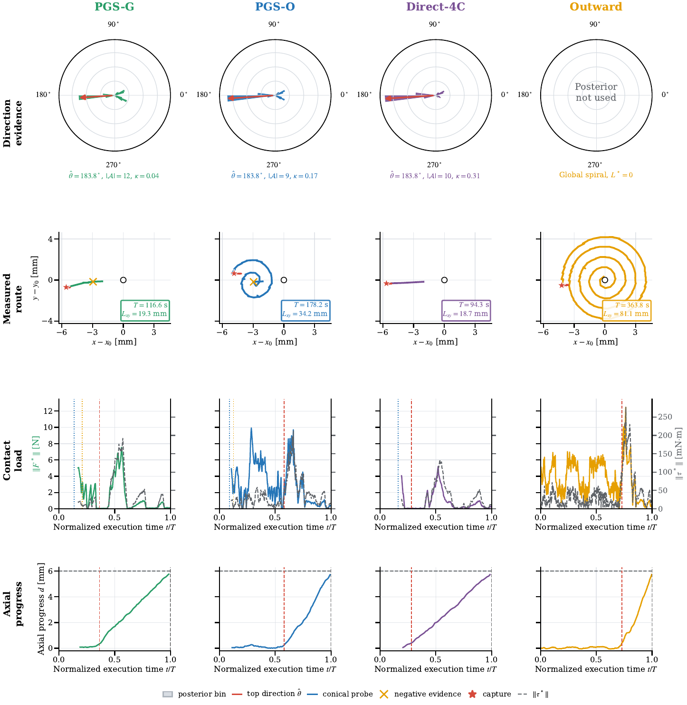
50
APPENDIX
Problem Task Framework Simulation Hardware Discussion
A12 · Hardware acquisition partition and named-run registry
Hardware record
Method(s)
Runs
Recorded outcome
Registered conical scans
acquisition
26 / size
78 / 78 valid traces
M12 fixed-seed
PGS-O, PGS-G, Outward, Direct-4C
1 / method
three terminal; Outward after extension
M10 fixed-start
PGS-G
2
both reached terminal depth
Named / fixed-start mechanism evidence · no randomized hardware denominator
26 scans per size = 16 clean + 4 development holdout + 4 quarantine + 2 sentinels; named and fixed-start runs are mechanism checks.
Nan Jinyao · Paper-aligned group review
Sec. IV-F · Table IV · Figs. 8–10
50
Notes:
Purpose
Use this slide to establish: A12 · Hardware acquisition partition and named-run registry
Speaker notes
The hardware registry has two evidence levels. Acquisition covers twenty-six conical traces per size, seventy-eight total. Each size contains sixteen clean records, four development holdouts, four quarantined points, and two repeated sentinels. All scheduled traces pass acquisition checks, but the partitions serve different modeling and diagnostic roles. Closed-loop evidence is much smaller: one named or fixed-seed M12 record per PGS-O, PGS-G, Direct-4C, and Outward, plus two fixed-site M10 PGS-G pilots. Table IV reports what those records contain; it does not estimate a rate. The selected M12 figures preserve same-run timestamps, routes, force, torque, axial progress, capture, negative evidence, and terminal markers. Wrench is baseline-relative at the Bota sensor origin, without certified gravity correction or moment transfer to the tool tip.
Discussion notes
The raw registry should include run identifiers and immutable file hashes before submission. Video titles from the old result deck must be relabeled as named mechanism records; words such as successful must not substitute for the terminal predicate.
Source map
Paper Sec. IV-F, PDF pp. 8-9; Paper Table IV and Fig. 8, PDF p. 10; Paper Figs. 9-10, PDF pp. 11-12
Permitted claim
The registry contains 78 acquisition-valid scans and a small set of named closed-loop records.; Hardware traces are raw, timestamped, and baseline-relative at the sensor origin.
Claim not supported
All 78 records are training samples or engagement successes.; Named M12 and fixed-site M10 runs form a randomized benchmark.

Slide 51
51
APPENDIX
Problem Task Framework Simulation Hardware Discussion
A13 · Evidence-version audit
Potential drift
Final paper-aligned wording
Search / Control
Search in title; control framework in method
240 / 360
240 raw hardware samples; 4×360 periodic input
Interpolation
phase standardization; no raw-signal smoothing
July 29 / July 30
use manuscript evidence state, not old-slide status
Hardware wrench
same-run baseline at Bota origin; no certified tip shift
When old PPT wording conflicts with the manuscript, the manuscript controls.
Nan Jinyao · Paper-aligned group review
Paper manuscript · project artifacts
51
Notes:
Purpose
Use this slide to establish: A13 · Evidence-version audit
Speaker notes
Three version issues are resolved here. First, the formal title on the fourteen-page paper uses Posterior-Guided Search. Control remains appropriate only for the shared framework and physical loop. Second, 240 and 360 describe different stages: hardware records 240 raw SCAN rows, then periodic phase interpolation produces the four-by-360 model input. The interpolation fixes phase format and does not smooth the raw signal. Third, the July 29 summary slide reported zero verified bottom outcomes in the records then available. The final paper uses later selected M12 and M10 terminal records, so the earlier status cannot govern the new presentation. Likewise, old hardware videos labeled successful must be relabeled by their actual capture or terminal event. The paper's final tables and predicates control every visible claim.
Discussion notes
A second internal wording issue is also fixed: Table II gives PGS-O 20/24 and Outward 19/24. Nineteen is their joint-completion subset, not both methods' total. Preserve this distinction in every chart and note.
Source map
Paper title page, PDF p. 1; Paper Eqs. (2)-(3), PDF p. 2; Paper Fig. 8, PDF p. 10; Unscrewing_NanJinyao_0729.pptx Slide 32, superseded status only; Verified preprocessing code: infer_conical_direction.py
Permitted claim
The formal method title uses Search, while Control names the framework layer.; Hardware raw 240-sample scans are periodically resampled to a 4x360 model input.
Claim not supported
The model input has only 240 phase bins or hardware records 360 raw rows.; The July 29 zero-terminal status overrides the final paper's later evidence.

Slide 52
52
APPENDIX
Problem Task Framework Simulation Hardware Discussion
A14 · Prioritized next experiments and decision criteria
P0 Randomized hardware repetitions
Pre-register starts, denominators and terminal rule
P1 First-turn coupling study
Separate engagement from torque-transfer success
P2 Observation robustness
Session drift, wear, temperature and socket-size shift
P3 Larger residual regions
Test whether information planning earns its cost
Each extension closes one named validity gap rather than broadening the headline claim prematurely.
Nan Jinyao · Paper-aligned group review
Derived from Discussion
52
Notes:
Purpose
Use this slide to establish: A14 · Prioritized next experiments and decision criteria
Speaker notes
The next experiments should close the paper's largest evidence gaps rather than add more selected demonstrations. Priority one is a preregistered randomized or counterbalanced hardware benchmark with untouched starts, shared fixture-reset rules, and the paper's verified geometric terminal predicate fixed before execution. Priority two is a same-probe, same-residual shortcut ablation with L-star forced to zero, which would isolate the shortcut from other differences against Outward. Priority three is a larger-residual benchmark for PGS-G, with utility-term ablations and calibrated contact likelihoods. Priority four is a hardware adaptation necessity test comparing frozen source, calibration-only, and anchored heads. If the research claim is expanded beyond engagement, add an independent first-turn torque-coupling and slip criterion before thread release or extraction. These are proposed study designs, not results already supported by the paper.
Discussion notes
Suggested decision gates: report exact denominators and confidence intervals; predefine force, protected, budget, and terminal-rejection exits; lock model and thresholds before untouched tests; inspect fixture wear between runs. The committee should choose scope before choosing sample size.
Source map
Paper Discussion, PDF p. 13; Evidence gaps derived from Sec. IV-D to IV-F, PDF pp. 6-12
Permitted claim
These experiments are prioritized proposals addressing identified evidence gaps.; A torque-coupling criterion is required before broadening the claim beyond geometric engagement.
Claim not supported
The proposed experiments have already been run or passed.; Adding more selected videos would establish a randomized hardware rate.

Slide 53
53
APPENDIX
Problem Task Framework Simulation Hardware Discussion
A15 · Selected references and Direct-3C proxy disclaimer
Compliance and part mating: classic RCC / impedance and contact-rich assembly.
Belief/contact planning: action selection under uncertain contact geometry.
Active and learned tactile sensing: compact state evidence from prescribed touch.
Direct-3C is a task-specific engineering proxy used for representation ablation; it is not a reproduction of the complete method in Jin et al.
Representation ablation ≠ external-method reproduction
The comparison supports a representation claim only.
Nan Jinyao · Paper-aligned group review
References [2]–[33]
53
Notes:
Purpose
Use this slide to establish: A15 · Selected references and Direct-3C proxy disclaimer
Speaker notes
The related-work positioning is intentionally narrow. Classical compliance and impedance explain how mating geometry can absorb small errors. Belief-space, contact-planning, and force-guided exploration motivate reasoning under contact uncertainty. Active extrinsic sensing and contact-pose identification show that prescribed motion can reveal geometry. Learned tactile and visuotactile work demonstrates richer representations, while insertion and force-control studies motivate explicit physical guards. The present contribution is not a reproduced benchmark against all of these systems; their sensing, actions, and terminal rules differ. In particular, Direct-3C is our engineering proxy using three polar channels and a twelve-sector decision for this task. It is inspired by contact-pose ideas but is not the complete Jin et al. controller. Accordingly, the ablation can compare the two implemented representations, but it cannot claim superiority over Jin et al. or over the broader state of the art.
Discussion notes
If the committee requests a quantitative literature row, answer that a fair row requires reproducing sensing, action, budget, and terminal definitions. The paper currently cites FORGE and belief-space work for context without assigning them a numerical score.
Source map
Paper Introduction and references [2], [4]-[30], PDF pp. 1 and 13-14; Paper Sec. IV-A and IV-B, PDF p. 6
Permitted claim
Direct-3C is a task-specific proxy used for a controlled representation check.; Prior work motivates compliance, active sensing, and belief-guided contact planning.
Claim not supported
Direct-3C reproduces Jin et al.'s full method.; The current experiments establish superiority over FORGE, belief-space planning, or the tactile-learning literature.

Slide 54
DECLARATION
I hereby declare that this work is my original work and it has been written by me in its entirety. I have duly acknowledged all the sources of information which have been used in the work.
NAN JINYAO
Signature
Date
29 August 2026
[Insert real signature here]
No signature was synthesized.
54
Notes:
Purpose
Use this slide to establish: Declaration
Speaker notes
This final page records the required originality declaration and must remain the absolute last slide. The visible text should read exactly: I hereby declare that this work is my original work and it has been written by me in its entirety. I have duly acknowledged all the sources of information which have been used in the work. The author line should show NAN JINYAO. Insert only the author's genuine signature asset after it is supplied and approved. Until then, retain an explicit signature placeholder; do not generate, imitate, or infer a handwritten signature. The date must be the actual final document date used for the submitted presentation, not a guessed meeting date. Nothing should follow this slide, including references, backups, hidden media pages, or production notes.
Discussion notes
Production check: replace the placeholder only with a user-supplied real signature; update the date at final export; confirm all sources are acknowledged in the deck and notes. Placeholder: [NAN JINYAO - INSERT REAL SIGNATURE ASSET HERE].
Source map
User-provided meeting email and declaration instruction in pasted-text.txt
Permitted claim
Exact required declaration text, author name NAN JINYAO, genuine signature asset or explicit placeholder, and actual final document date.
Claim not supported
A synthesized or inferred signature.; A fabricated signing date or any slide placed after the declaration.

