Slide 1
Software Development on Java
Dzmitry Marchankau 2023

Slide 2
Multi platform programming
Platforms in modern world
Responsive web design
Mobile app multi-platform development

Slide 3
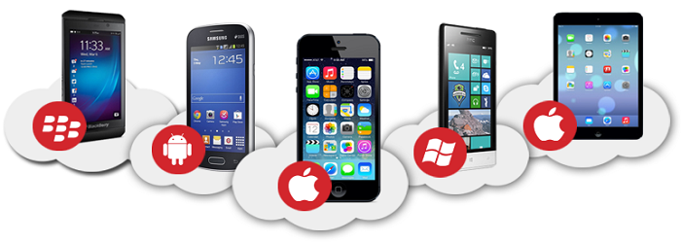
Mobile platforms

Slide 4
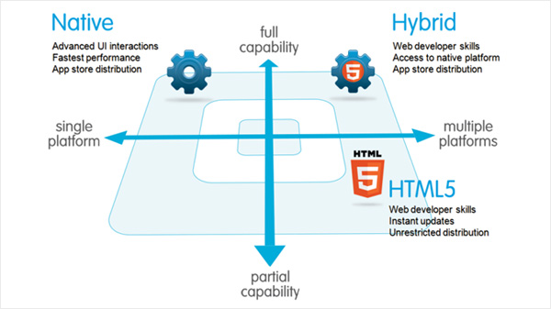
Mobile platforms development

Slide 5
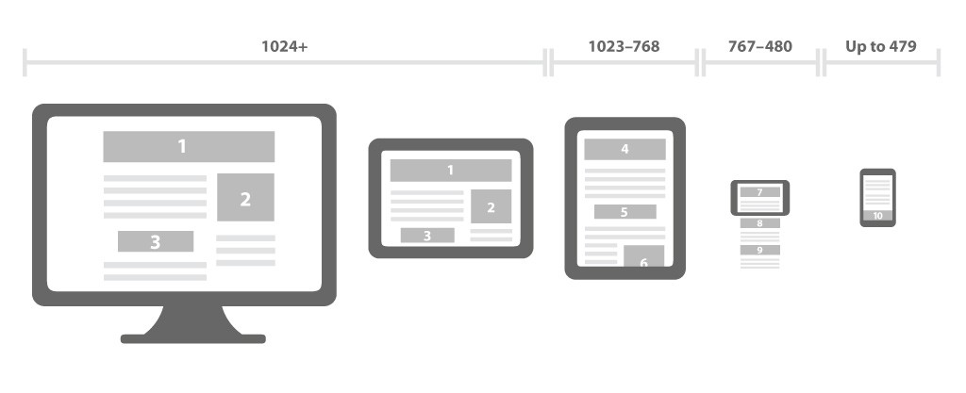
Responsive web design

Slide 6
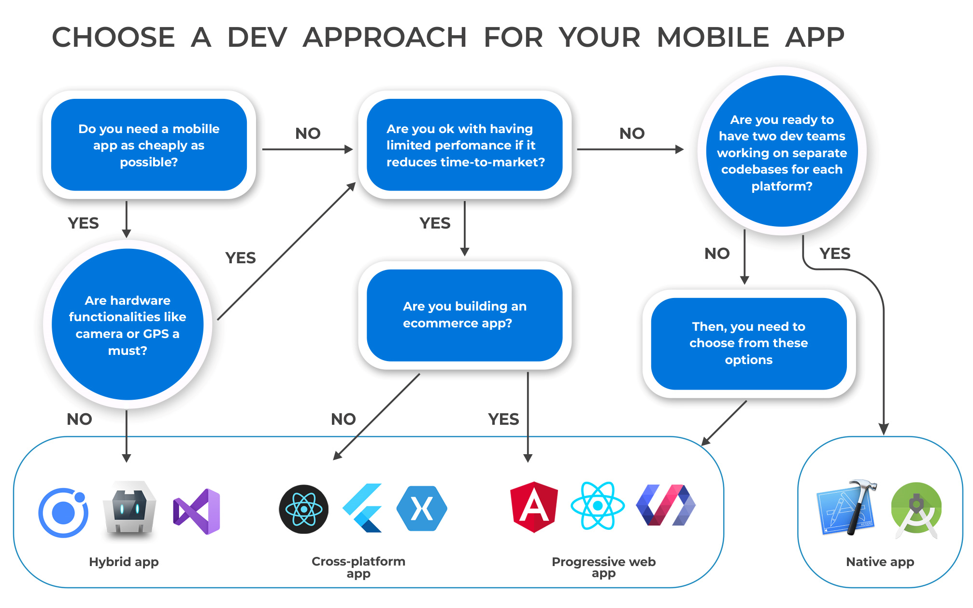
Mobile development

Slide 7
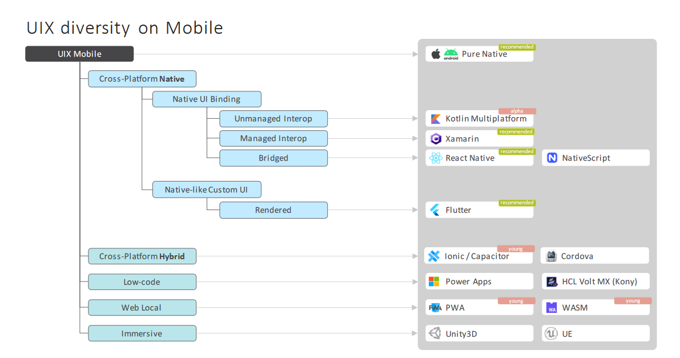
Mobile development

Slide 8
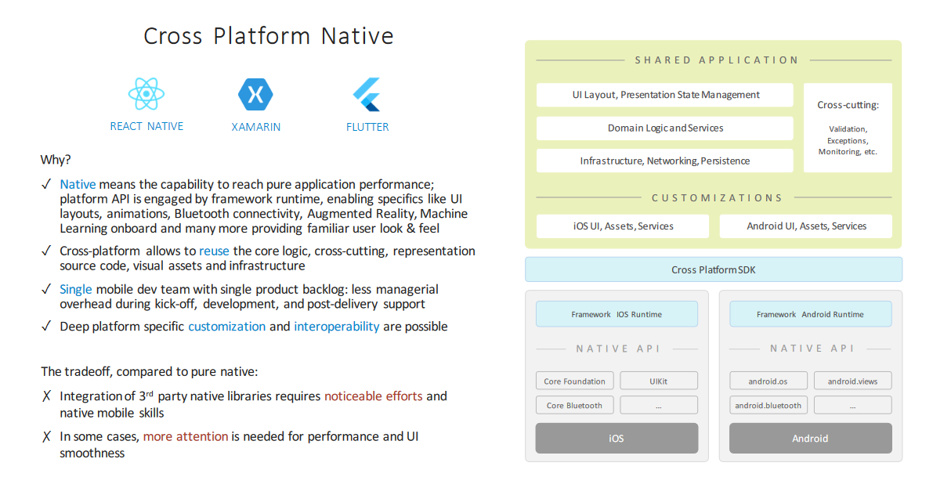
Mobile development

Slide 9
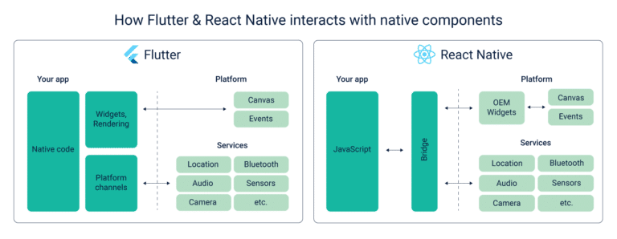
Flutter vs React Native

Slide 10
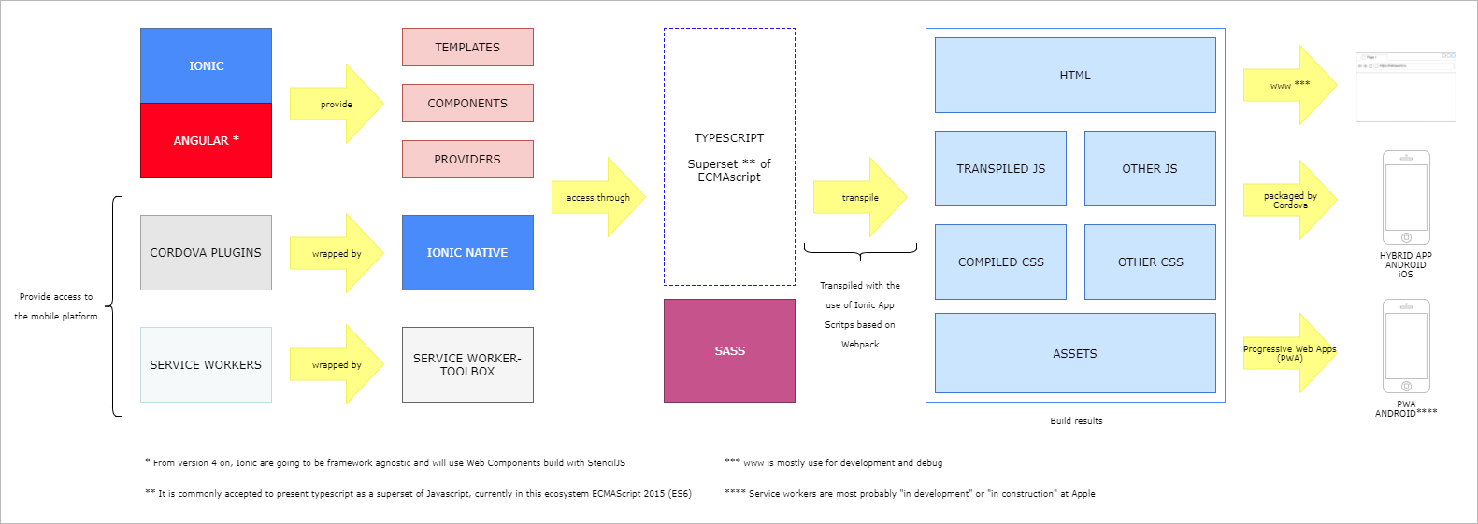
Ionic overview

Slide 11
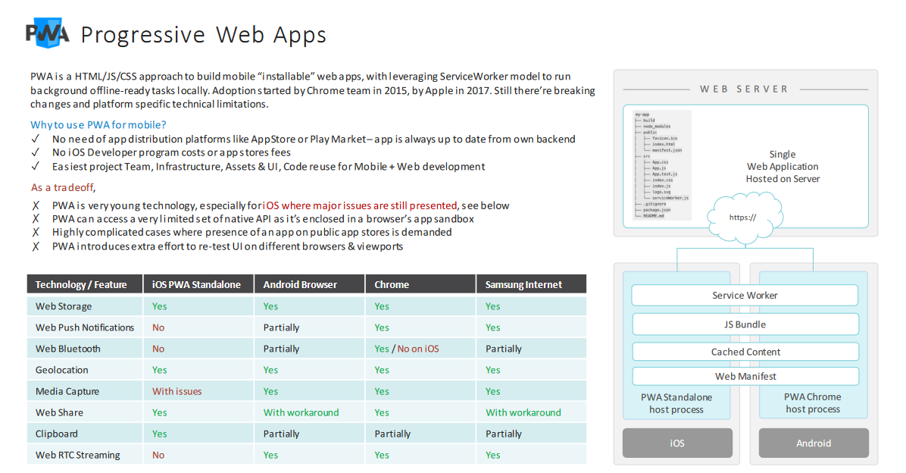
Mobile development

Slide 12
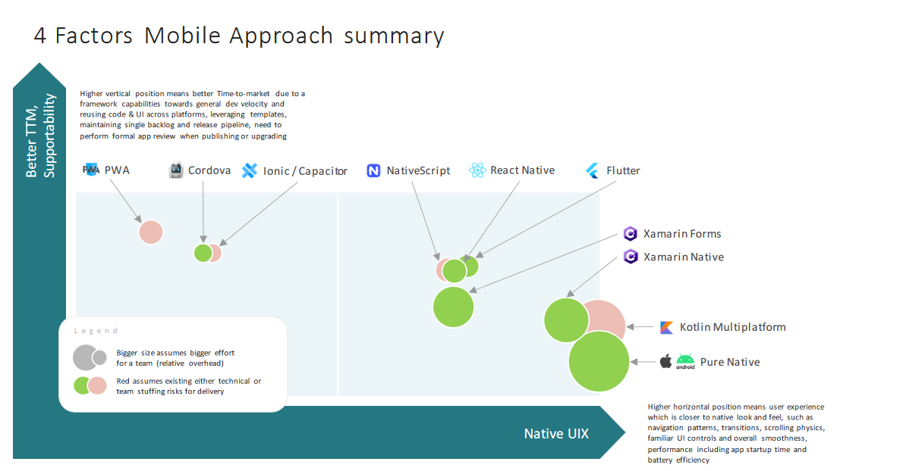
Mobile development

Slide 13
Questions ?

