Slide 1
Software Development Models
and Methodologies
Waterfall
Agile
Scrum
Assignment 01 Presentation
Kanban
DevOps
Spiral
Waterfall • Agile • Scrum • Kanban • DevOps • Spiral
Goal
Compare six development approaches, explain when to use each one, and justify the best choice for a student team project.
Prepared by: Lynn
Course: Software Engineering
Repository: SE-Assignment01
Video flow
1. Quick overview
2. Agile vs Waterfall
3. Comparison table
4. My recommended model
Notes:
[Sources] - Assignment brief uploaded by user: /mnt/data/Software Engineering - Assignment 1.pdf

Slide 2
Presentation Map
A clear structure for the 10–12 minute explanation
Required models: Waterfall, Agile, Scrum, Kanban, DevOps, and Spiral
01
02
03
04
Six-model overview
Agile vs Waterfall
Comparison table
My choice for a student team
Name and describe all six models in short, simple language.
Explain why one is adaptive and the other is sequential.
Highlight flexibility, customer involvement, documentation, and project fit.
Recommend one model and justify the choice clearly.
Notes:
[Sources] - Assignment brief uploaded by user: /mnt/data/Software Engineering - Assignment 1.pdf

Slide 3
Models 1–3
Definition, best-fit project context, and one real-world example
1
Waterfall Model
Traditional
Linear phases completed one after another; strong upfront planning and heavy documentation.
Best for: Stable requirements, compliance-heavy work, and safety-critical systems.
Example: NASA mission operations systems.
2
Agile Methodology
Iterative
Short delivery cycles, continuous feedback, adaptive planning, and frequent improvement.
Best for: Fast-changing digital products where user feedback matters early.
Example: Lockheed Martin described using agile development for an Air Force system.
3
Scrum Framework
Agile
Time-boxed sprints with defined roles, recurring events, and inspect-and-adapt cadence.
Best for: Cross-functional teams that need structure plus flexibility.
Example: Salesforce says Scrum is the main workflow for about 70% of its teams.
Notes:
[Sources] - IBM. Agile vs. Waterfall: What's the Difference? https://www.ibm.com/think/topics/agile-vs-waterfall - NASA. Agile: From Software to Mission System. https://ntrs.nasa.gov/api/citations/20160006387/downloads/20160006387.pdf - Atlassian. What is Agile? https://www.atlassian.com/agile - Lockheed Martin. Agile Software Development for Air Force Weapon System. https://news.lockheedmartin.com/2018-09-18-Lockheed-Martin-Embraces-Agile-Software-Development-to-Evolve-Signals-Intelligence-Capabilities-for-Air-Force-Weapon-System - Atlassian. What is Scrum? https://www.atlassian.com/agile/scrum - Salesforce Trailhead. Learn About Scrum. https://trailhead.salesforce.com/content/learn/modules/scrum-and-kanban-at-salesforce/learn-about-scrum

Slide 4
Models 4–6
These approaches are especially useful when flow, deployment, or risk is central
4
Kanban
Visual flow
Visualizes work on a board, limits WIP, and improves throughput by smoothing flow.
Best for: Support, maintenance, and operations-heavy work with shifting priorities.
Example: Toyota made kanban part of just-in-time production across all plants in 1963.
5
DevOps
Culture + practice
Connects development and operations through automation, CI/CD, monitoring, and shared ownership.
Best for: Cloud or SaaS products with frequent releases and high uptime needs.
Example: AWS positions DevOps as a core operating model for rapid, reliable delivery.
6
Spiral Model
Risk-driven
Builds in repeated cycles that identify risks, evaluate alternatives, and refine the solution.
Best for: Large, expensive, or technically uncertain projects.
Example: NASA’s TReK project is a documented Spiral Model case study.
Notes:
[Sources] - Atlassian. What is Kanban? https://www.atlassian.com/agile/kanban - Toyota Motor Corporation. Development and Deployment of the Toyota Production System. https://www.toyota-global.com/company/history_of_toyota/75years/text/entering_the_automotive_business/chapter1/section4/item4.html - AWS. What is DevOps? https://aws.amazon.com/devops/what-is-devops/ - AWS. DevOps on AWS. https://aws.amazon.com/devops/ - Barry Boehm / SEI. Spiral Development: Experience, Principles, and Refinements. https://www.sei.cmu.edu/documents/5439/2000_003_001_13655.pdf - NASA. TReK project case study. https://ntrs.nasa.gov/citations/19990064487

Slide 5
Agile vs Waterfall
The clearest contrast in planning, customer feedback, and response to change
Waterfall
Agile
Planning style
Detailed upfront plan and fixed sequence of phases.
Planning style
Adaptive planning in short iterations or increments.
Change handling
Late changes are difficult and expensive.
Change handling
Change is expected and integrated into the process.
Customer role
Usually strongest at the start and near final delivery.
Customer role
Frequent feedback throughout development.
Documentation
Heavy documentation and milestone approvals.
Documentation
Enough documentation, but working software comes first.
Best fit
Stable scope, regulated processes, predictable delivery.
Best fit
Evolving products, learning loops, and fast response.
Notes:
[Sources] - IBM. Agile vs. Waterfall: What's the Difference? https://www.ibm.com/think/topics/agile-vs-waterfall - Atlassian. What is Agile? https://www.atlassian.com/agile

Slide 6
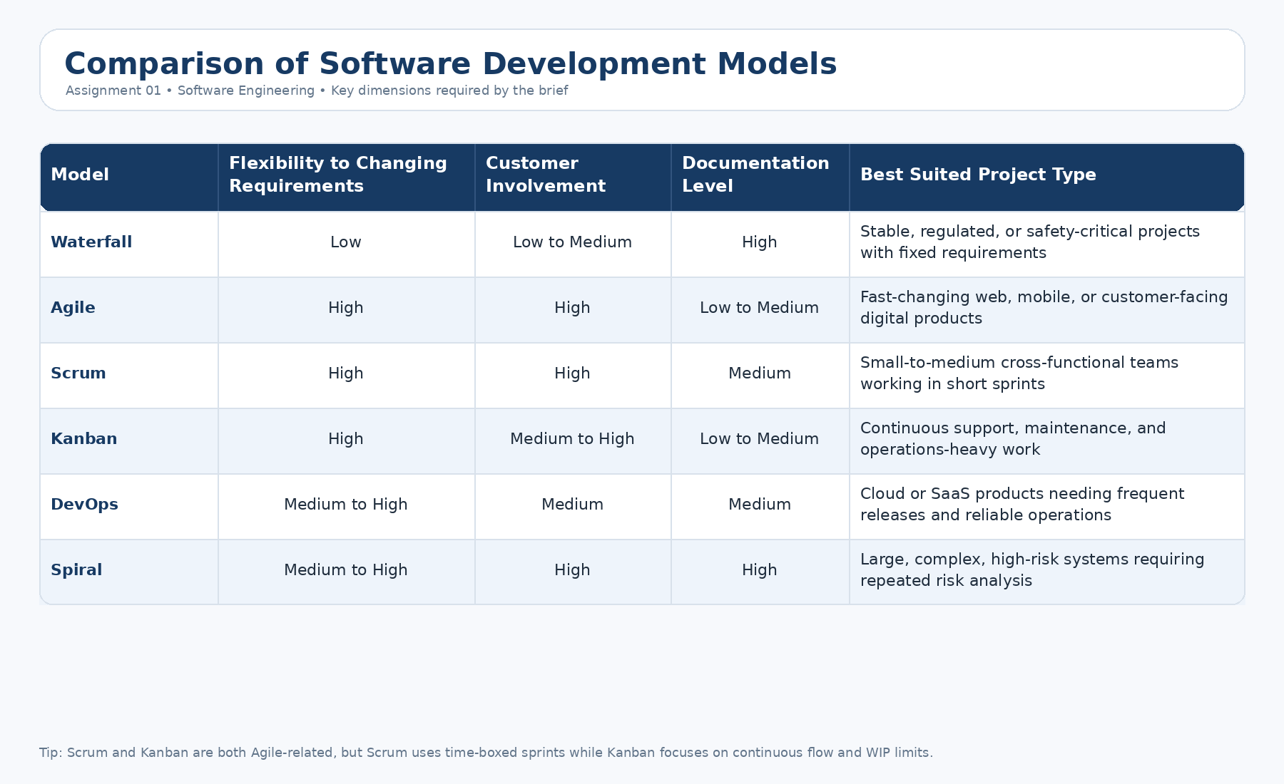
Comparison Table
The four required dimensions from the assignment brief
Quick read: Agile, Scrum, and Kanban rank highest on flexibility; Waterfall and Spiral require the most documentation.
Notes:
[Sources] - Assignment brief uploaded by user: /mnt/data/Software Engineering - Assignment 1.pdf - Comparison table image generated for this deck from the assignment content and supporting references. - IBM. Agile vs. Waterfall. https://www.ibm.com/think/topics/agile-vs-waterfall - Atlassian. What is Agile? https://www.atlassian.com/agile - Atlassian. What is Scrum? https://www.atlassian.com/agile/scrum - Atlassian. What is Kanban? https://www.atlassian.com/agile/kanban - AWS. What is DevOps? https://aws.amazon.com/devops/what-is-devops/ - SEI. Spiral Development: Experience, Principles, and Refinements. https://www.sei.cmu.edu/documents/5439/2000_003_001_13655.pdf

Slide 7
My Choice for a Student Team Project
Scrum offers the best balance of structure, communication, and adaptability
1. Structure
2. Communication
Sprints, sprint goals, and regular reviews help students divide work into manageable pieces.
Daily check-ins and retrospectives reduce misunderstandings and uneven workload.
SCRUM
3. Flexibility
The team can improve the product step by step when ideas or requirements change.
A student project needs enough process to stay organized, but not so much process that it slows the team down. Scrum fits that middle ground very well.
Notes:
[Sources] - Atlassian. What is Scrum? https://www.atlassian.com/agile/scrum - Salesforce Trailhead. Learn About Scrum. https://trailhead.salesforce.com/content/learn/modules/scrum-and-kanban-at-salesforce/learn-about-scrum

Slide 8
Conclusion
There is no universal best model—only the best fit for a given project
Waterfall
Best when requirements are fixed and traceability matters.
Agile
Best when learning and adaptation drive value.
Scrum
Best when a small team needs rhythm and accountability.
Kanban
Best when work arrives continuously and flow matters.
DevOps
Best when delivery speed and operational reliability must improve together.
Spiral
Best when technical or project risk is too high to ignore.
Thank you
Questions?
Notes:
[Sources] - IBM. Agile vs. Waterfall: What's the Difference? https://www.ibm.com/think/topics/agile-vs-waterfall - Atlassian. What is Agile? https://www.atlassian.com/agile - Atlassian. What is Scrum? https://www.atlassian.com/agile/scrum - Atlassian. What is Kanban? https://www.atlassian.com/agile/kanban - AWS. What is DevOps? https://aws.amazon.com/devops/what-is-devops/ - SEI. Spiral Development. https://www.sei.cmu.edu/documents/5439/2000_003_001_13655.pdf

