Slide 1
Some 4D polytope compounds
Nan Ma
March 2020

Slide 2
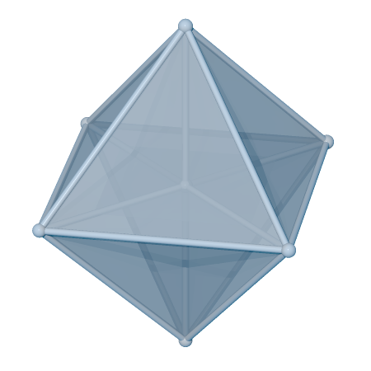
The 16-cell is a 4D polytope, the 4D equivalent of the octahedron
8 vertices, 24 edges, 32 faces (2D), 16 cells (3D)

Slide 3
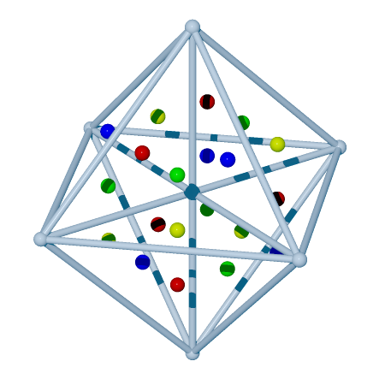
The 16-cell is a 4D polytope, the 4D equivalent of the octahedron
8 vertices, 24 edges, 32 faces (2D), 16 cells (3D)
Face count (32) = vertex count (8) * 4
There are 32 face centers.
We can partition 32 face centers into 4 groups
Such that each group has 8 points
Each group forms a 16-cell

Slide 4
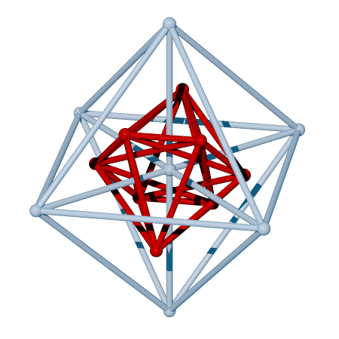
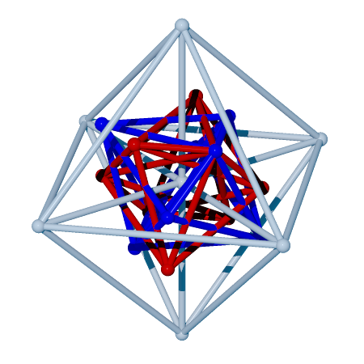
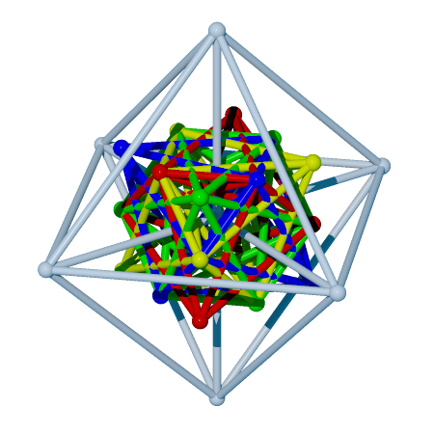
1 group: 8 face centers
2 groups: 8*2 face centers
4 groups: all 32 face centers

Slide 5
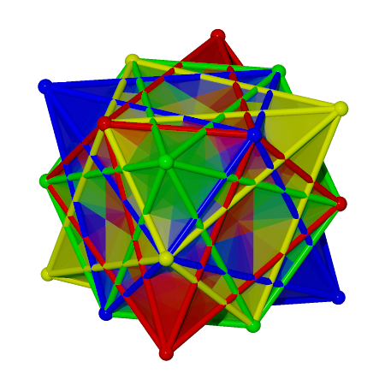
This is a compound of four 16-cells
Edges only, with the original (gray)
With transparent faces. No original

Slide 6
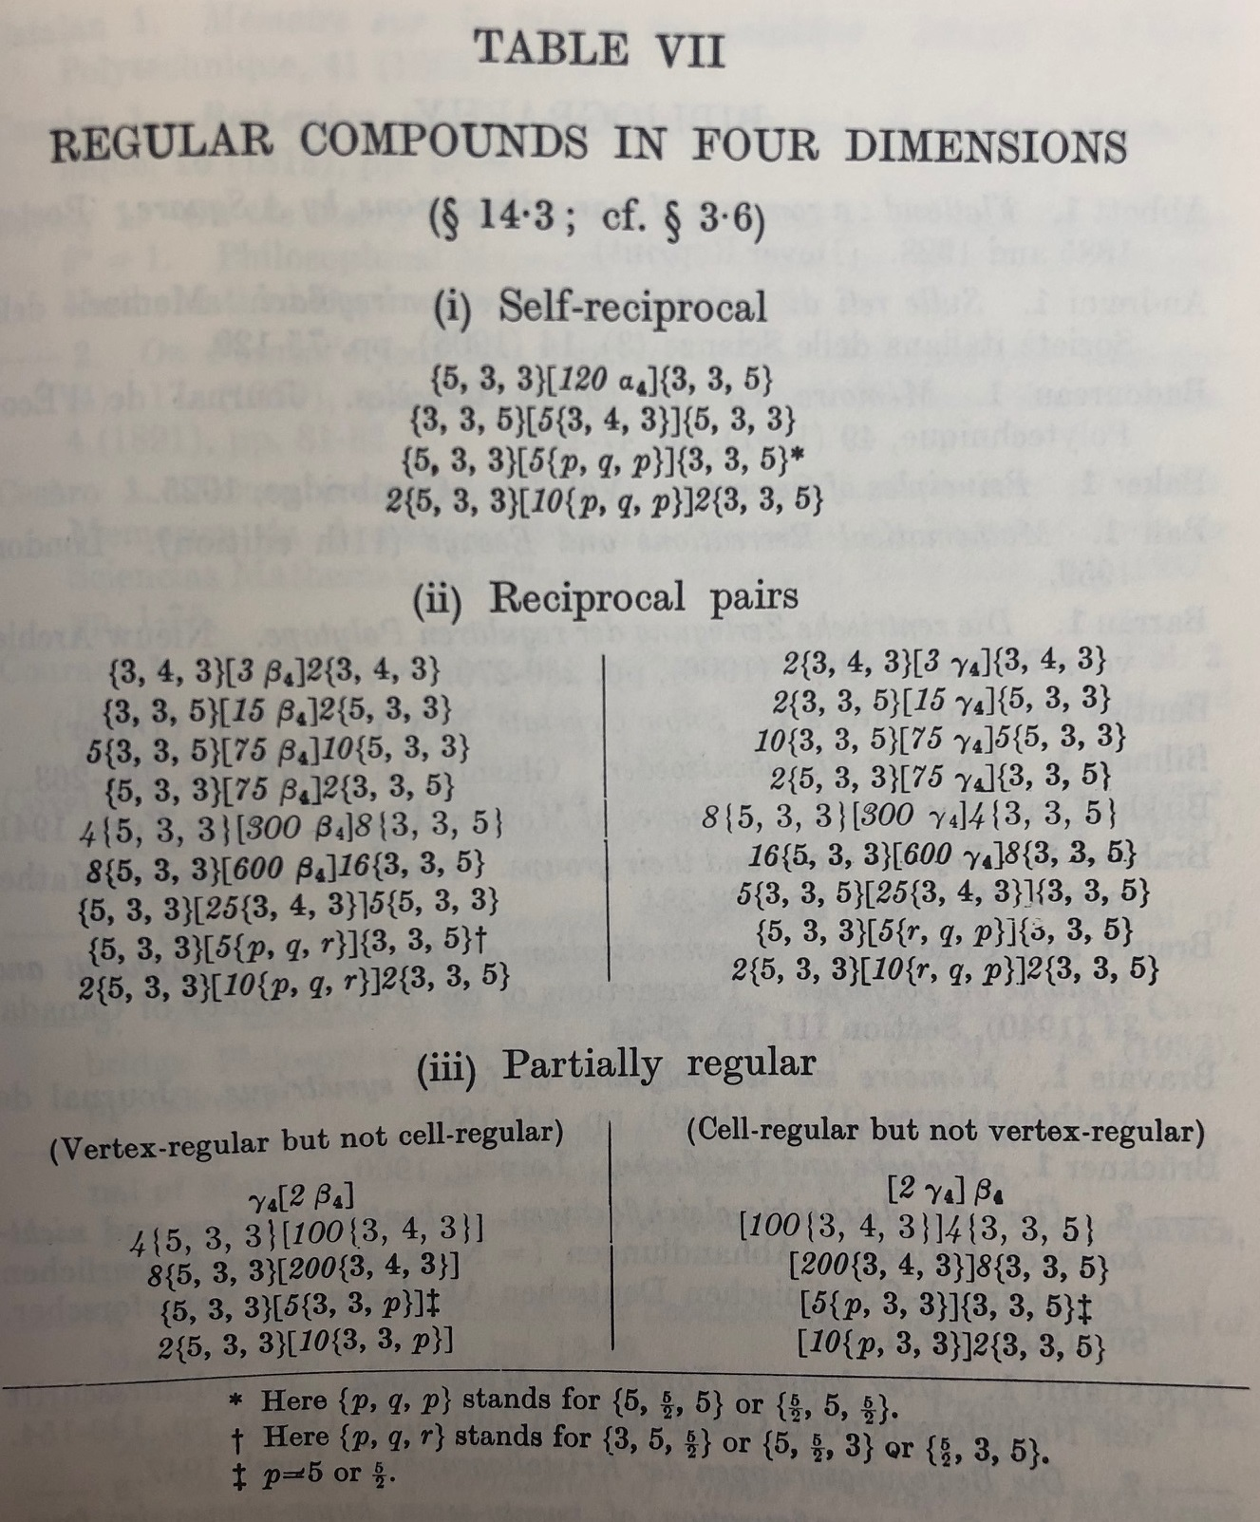
This compound is not regular:
Not face-transitive
Not there in Coxeter’s book

Slide 7
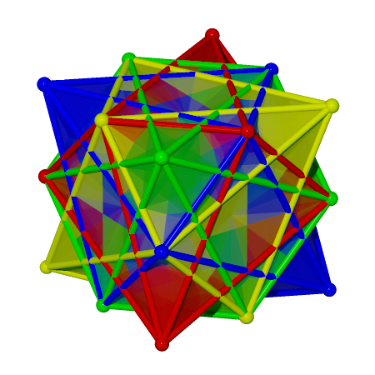
Chiral pair
(x,y,z,w) -> (x,y,z,-w)
Hard to spot the differences when we project away w
Similar to 5 tetrahedra compound

Slide 8
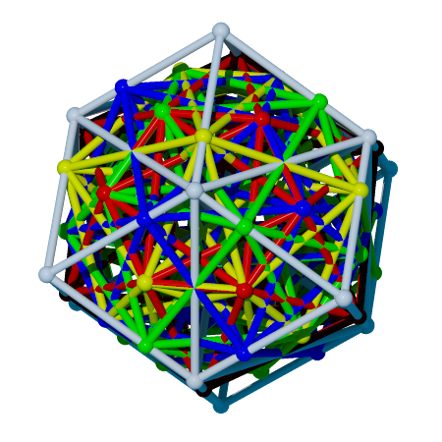
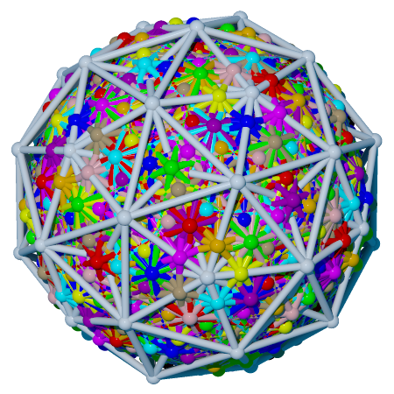
24-cell: 96/24 = 4 components
600-cell: 1200/120 = 10 components

Slide 9
There’s no counterpart from 5-cell, 8-cell, or 120-cell
120-cell for example: 600 vertices, 720 face centers.
5-cell: 5 vertices, 10 face centers, but the angles don’t work

Slide 10
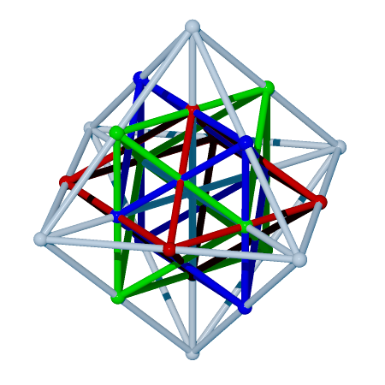
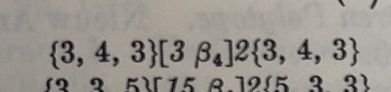
We can also use edge centers.
16-cell: 24 edge centers/8 vertices = 3 components
Well known:
three 16-cell compound in a 24-cell
Regular
Non-chiral

Slide 11
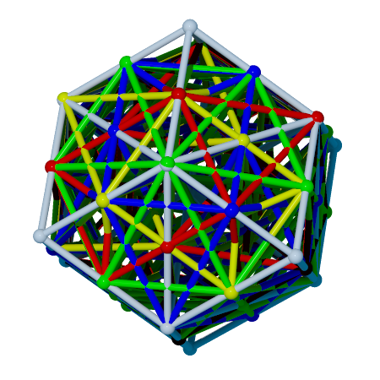
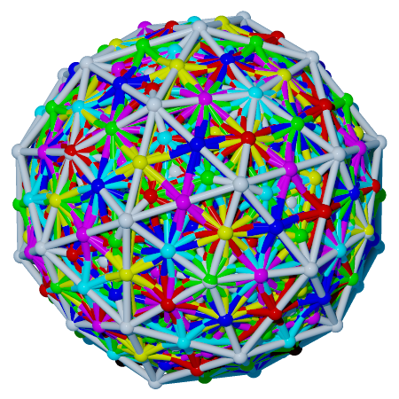
24-cell: 96/24 = 4 components
600-cell: 720/120 = 6 components

Slide 12
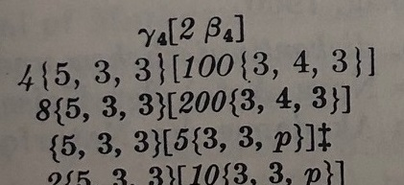
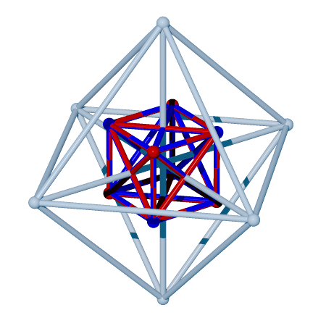
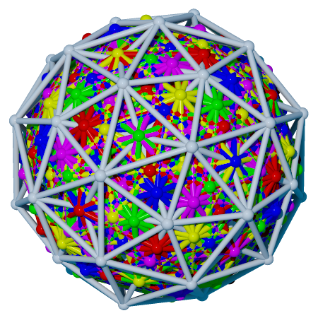
We can also use cell centers.
16-cell: 16 cells/8 vertices = 2 components
600-cell: 600 cells/120 vertices = 5 components
Both are regular compounds.

Slide 13
Questions?
Source code and all images in https://github.com/nanma80/compound-polytopes

