Slide 1
Polytope Compounds
David Richter, Paulo Freire, Scott Vorthmann, Nan Ma

Slide 2

2D
Compound of 2 triangles
Not all vertices and edges are connected
Convex hull: regular hexagon
Overall 6-fold symmetry

Slide 3
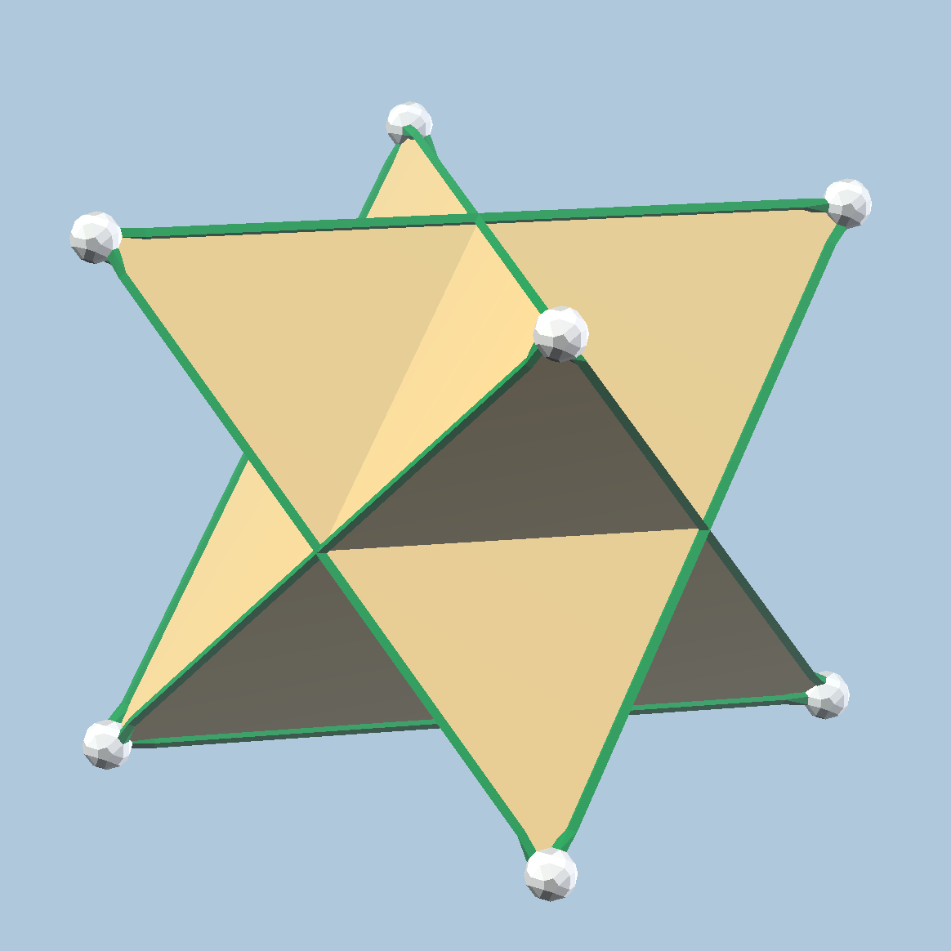
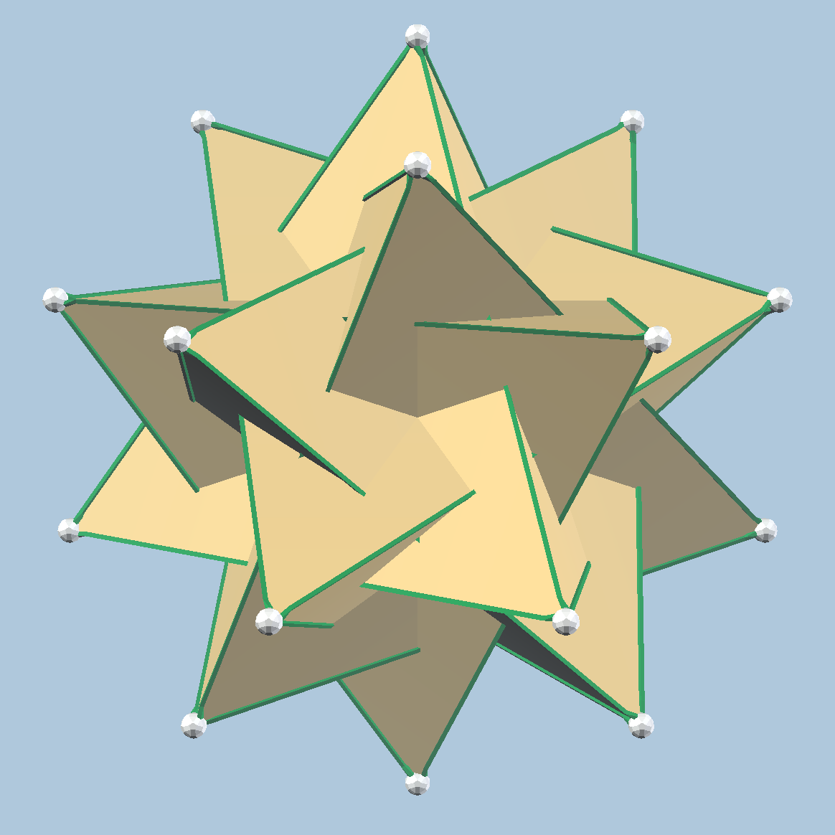
3D
Compound of 2 tetrahedra
Convex hull: cube
Compound of 5 tetrahedra
Convex hull: dodecahedron

Slide 4
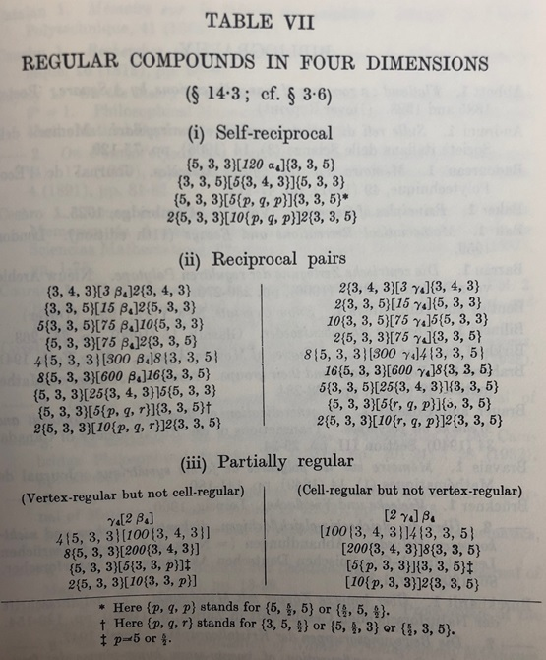
4D regular compounds
Coxeter listed in Regular Polytopes
We (David, Paulo, Scott, Nan) were trying to build a Zome model of the first one
120 5-cells. Convex hull: 120-cell

Slide 5
4D regular compounds
Coxeter listed in Regular Polytopes
We (David, Paulo, Scott, Nan) were trying to build a Zome model of the first one
120 5-cells. Convex hull: 120-cell
After some calculation, we found by connecting vertices of the regular 120-cell, we can construct 840 5-cells

Slide 6
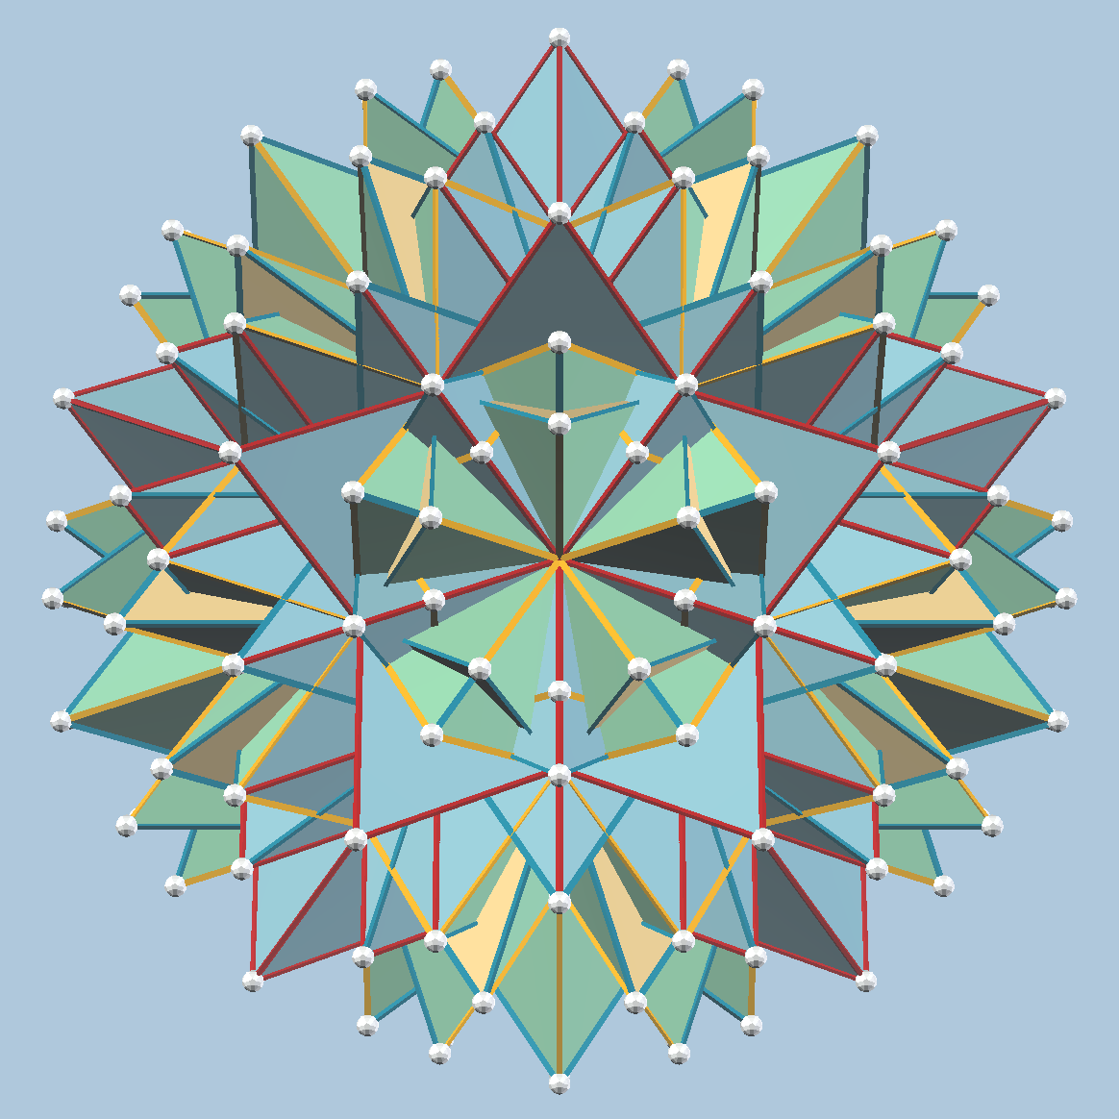
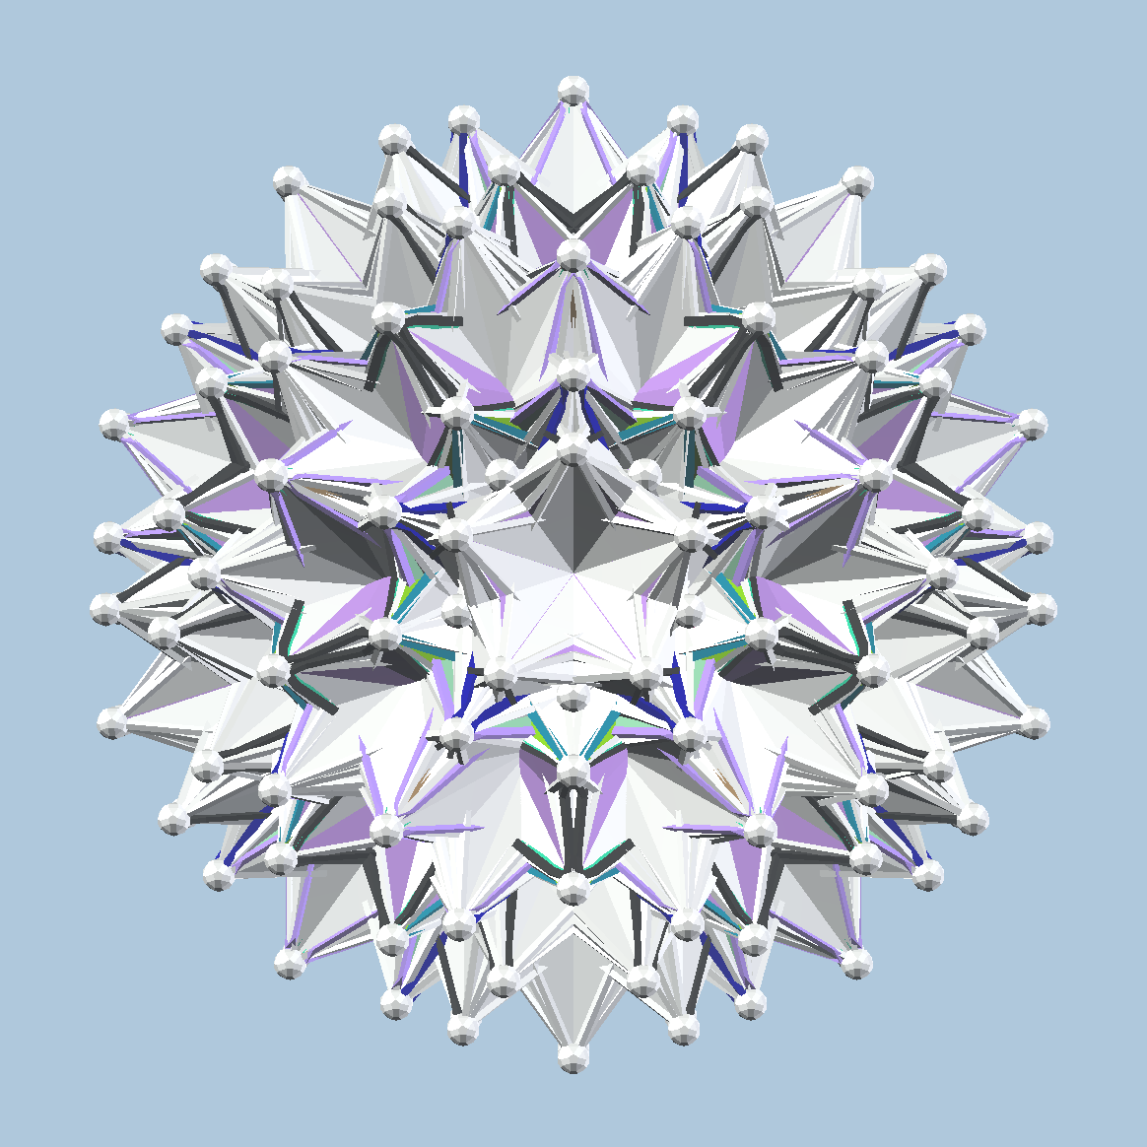
840 == 120 + 720

Slide 7
Compound of 120 5-cells
In Coxeter’s list
H4 symmetry (like the 120-cell)
120 * 5 = 600 vertices from 5-cells
Every 120-cell vertex appears in one 5-cell.

Slide 8
Compound of 720 5-cells
Not in Coxeter’s list
Also H4 symmetry (like the 120-cell)
Verified to be vertex, edge, face, edge, cell transitive

Slide 9
Compound of 720 5-cells
Not in Coxeter’s list
Also H4 symmetry (like the 120-cell)
Verified to be vertex, edge, face, edge, cell transitive
In 2018, McMullen published it:
New Regular Compounds of 4-Polytopes, in New Trends in Intuitive Geometry, pp.307-320

Slide 10
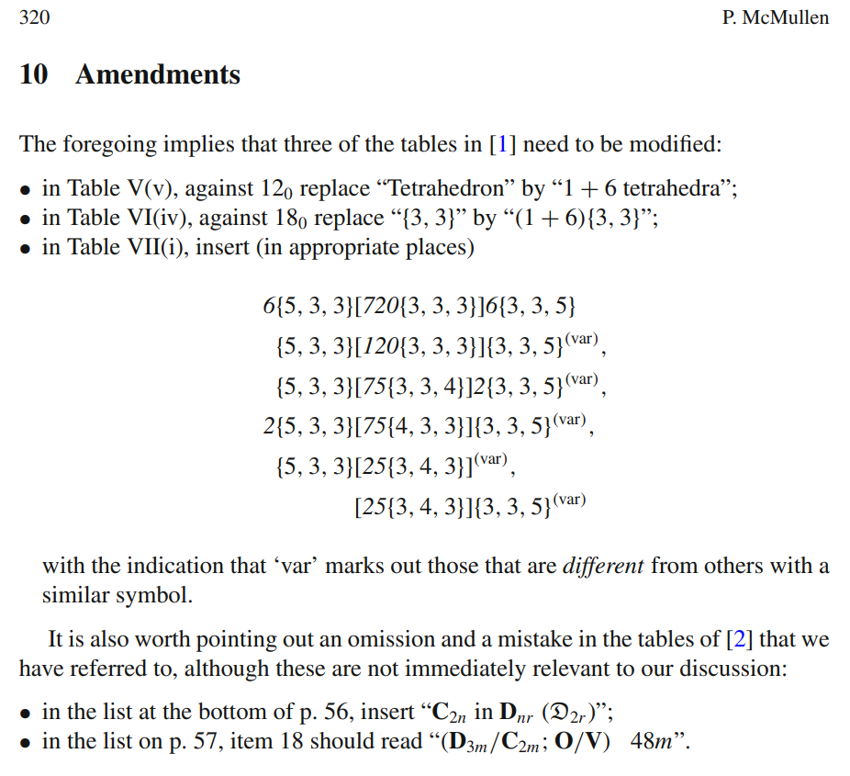
Compound of 720 5-cells
In 2018, McMullen published this compound, together with 5 more
Amendments to Coxeter’s book
According to McMullen, now this list is complete (for convex polytope components)
We rediscovered the compound of 720 5-cells.

Slide 11
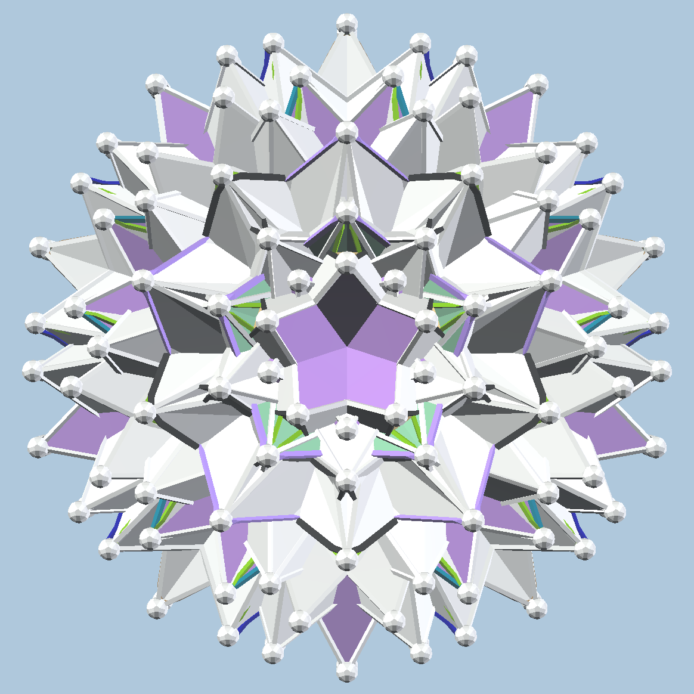
Another compound of 120 5-cells
720 5-cells has 720*5 = 3600 = 600*6 vertices
Each vertex is used 6 times
We can partition the 720 5-cells into 6 “cosets”, each with 120 5-cells.
Each coset is a compound of 120 5-cells, different from the original
Symmetry group: 1200 (H4: 14400)

Slide 12
Another compound of 120 5-cells
McMullen’s 720 5-cells
Coxeter’s 120 5-cells
120
120
120
120
120
120
120 (var)
120
720 5-cells, partitioned into 6 compounds, each with 120

Slide 13
Mirrored compounds of 120 (var)
McMullen’s 720 5-cells
Coxeter’s 120 5-cells
20 | 20 | 20 | 20 | 20 | 20
20 | 20 | 20 | 20 | 20 | 20
20 | 20 | 20 | 20 | 20 | 20
20 | 20 | 20 | 20 | 20 | 20
20 | 20 | 20 | 20 | 20 | 20
20 | 20 | 20 | 20 | 20 | 20
120 (var)
120
Mirrored 120 (var)
Two independent ways to partition 720 to 6 * 120

Slide 14
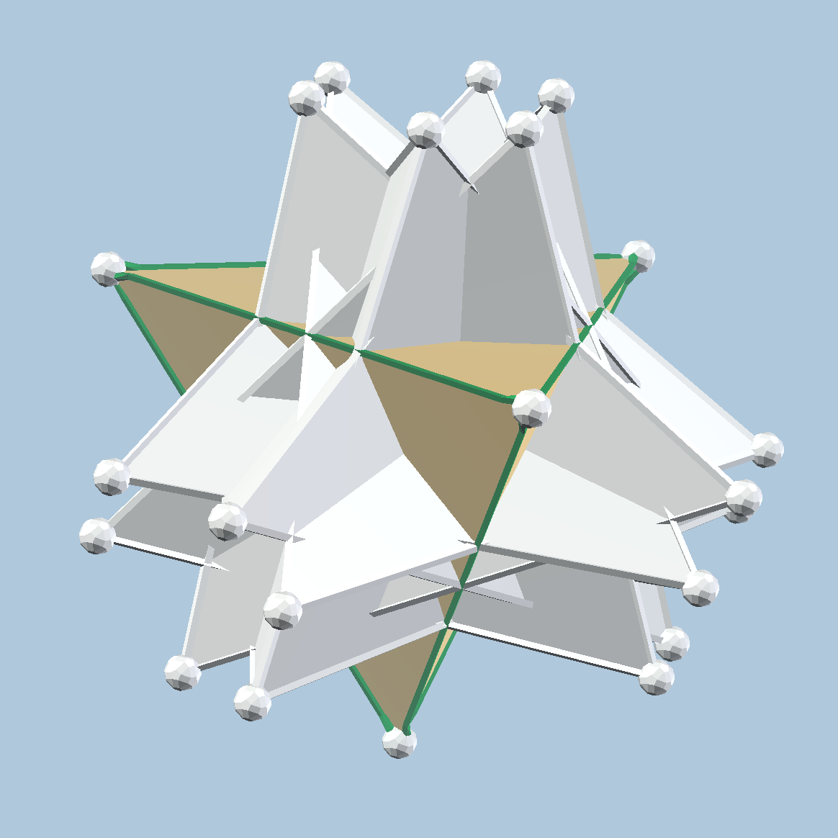
Starting from one vertex
Start from a vertex of 120-cell and start to construct 5-cells
We get 7 5-cells: 1 green, 6 white
By H4, the green 5-cell generates the Coxeter’s 120
By H4, any one white 5-cell generates McMullen’s 720
By isoclinic rotation in 4D (lower symmetry than H4), any one white 5-cell generates McMullen’s 120

Slide 15
I computed all the data of fully regular or vertex regular 4D polytope compounds with convex components
Coxeter’s list
McMullen’s amendments
Some have the similar pattern as these 5-cells in the 120-cell.
All my data in JSON: https://github.com/nanma80/compound-polytopes/tree/master/data/json
vZome models with screenshots: https://github.com/nanma80/compound-polytopes/tree/master/data/vZome

