Slide 1
Node Gosper Curve
Hexagonal lattice
Select 7 nodes
Scale the 7 nodes to 7 centers.
Make 7 copies of the template.
No gap, no overlap
Repeat infinitely

Slide 2
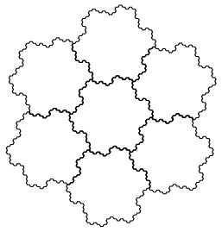
Gosper Island
Limit of Gosper node
Fractal
7 copies == enlarged version of itself

Slide 3
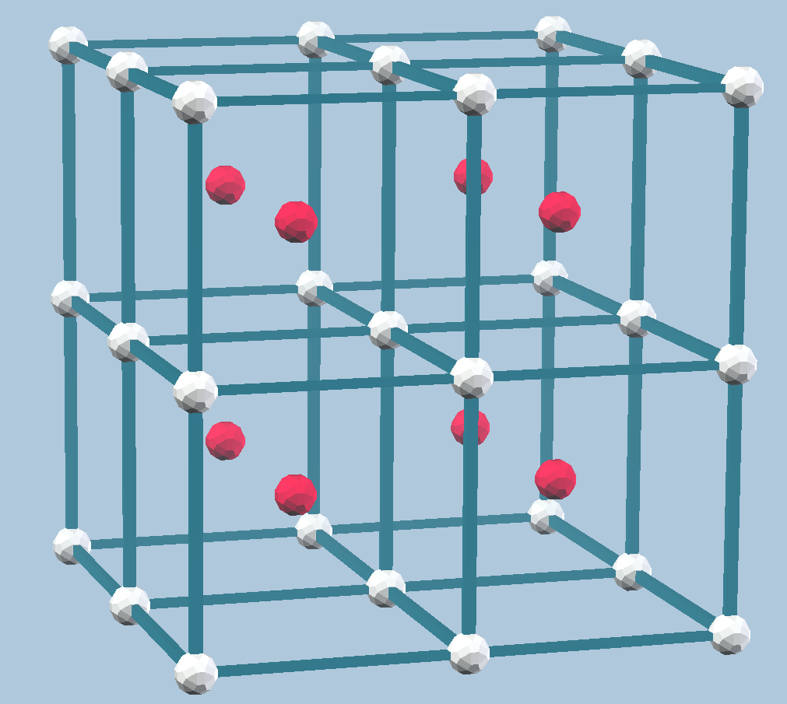
3D: body-centered cubic lattice
Stack cubes in 3D
Union the cube vertices (white) and the cube centers (red): body-centered cubic lattice (bcc)

Slide 4
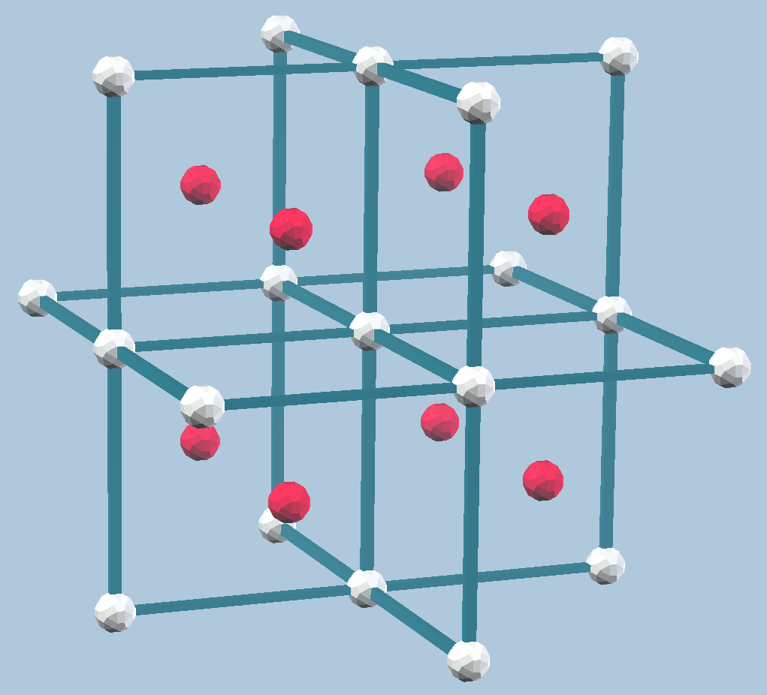
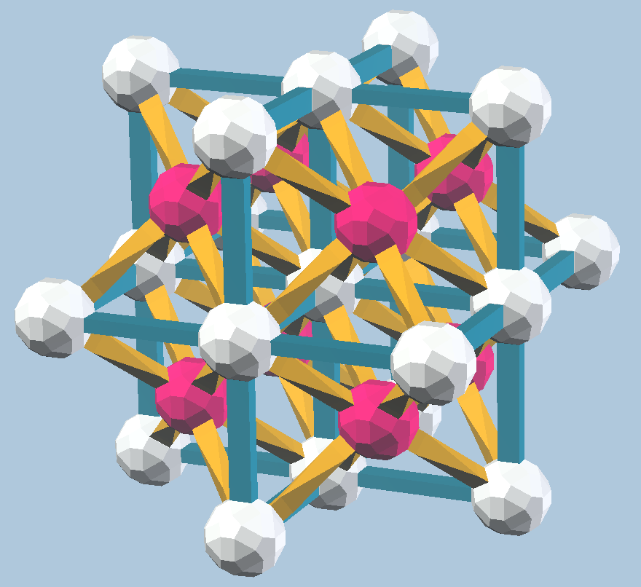
Magnificent 27
Select the 27 nodes closest to origin
This is our template
Another view

Slide 5
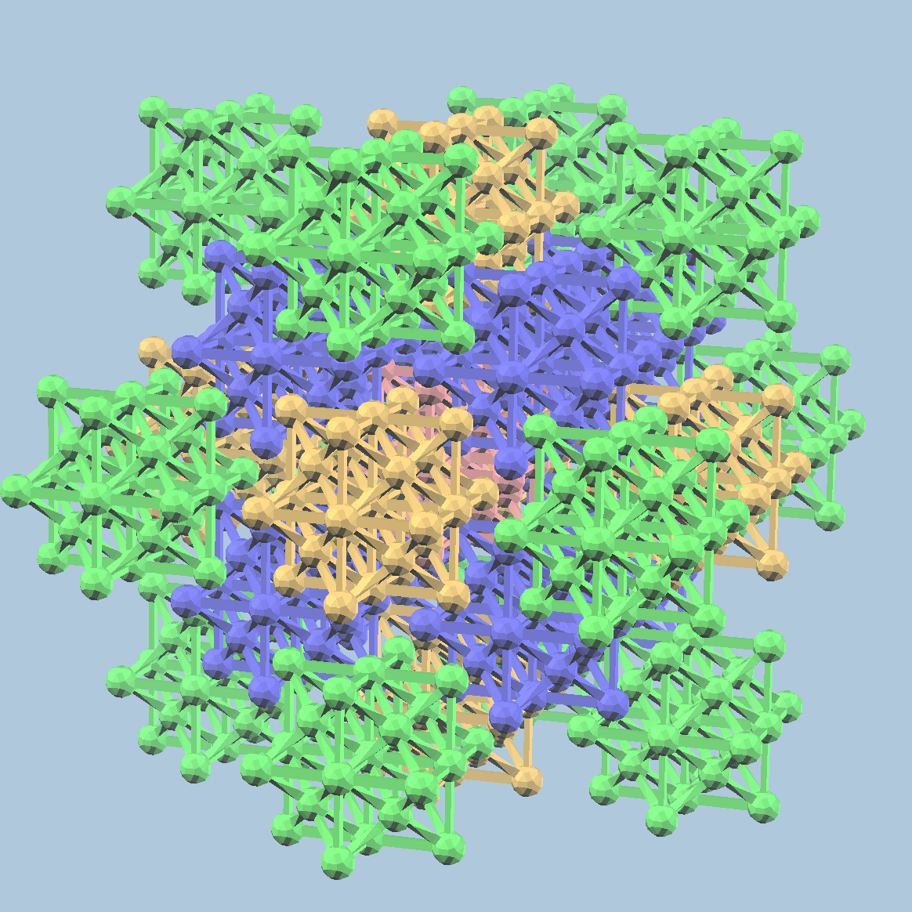
Scale up nodes by 3 to get centers
Make 27 copies and translate to the centers. 27^2 nodes
No gap, no overlap. Filling bcc lattice.

Slide 6
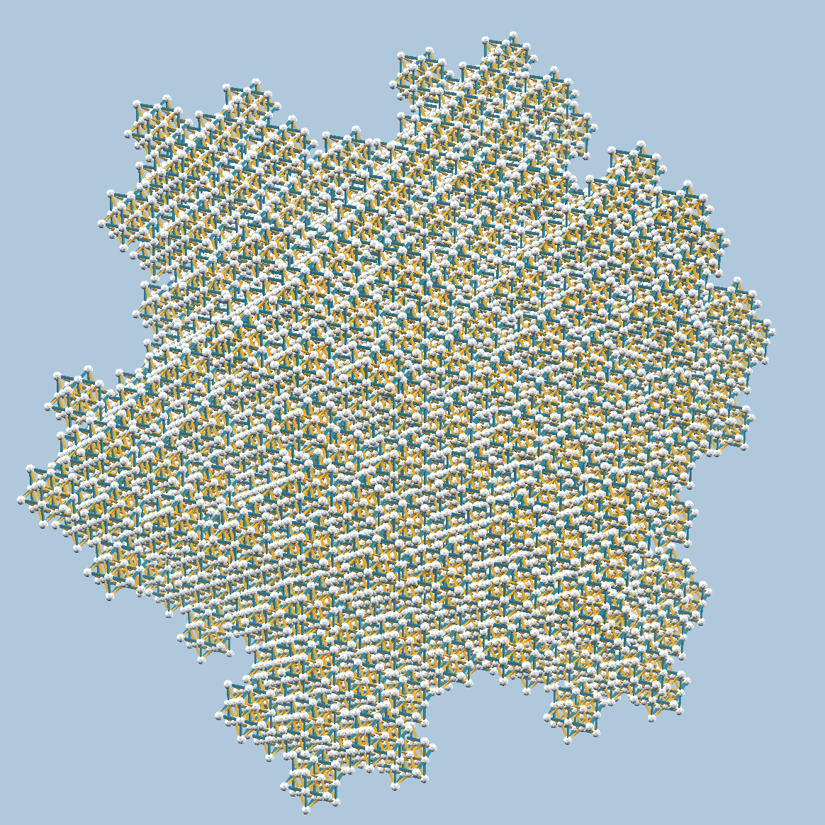
This process can go on forever
Picture on the right: 27^3 nodes

Slide 7
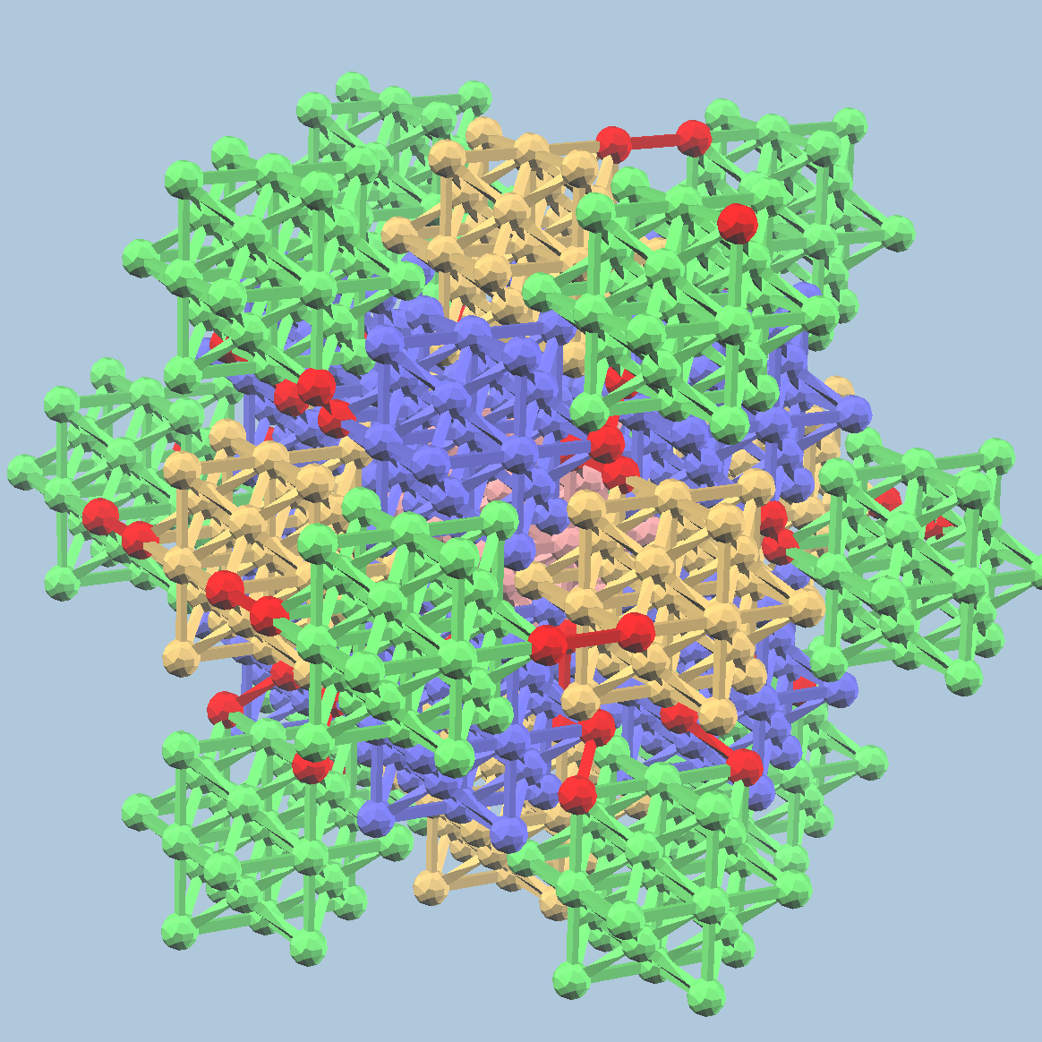
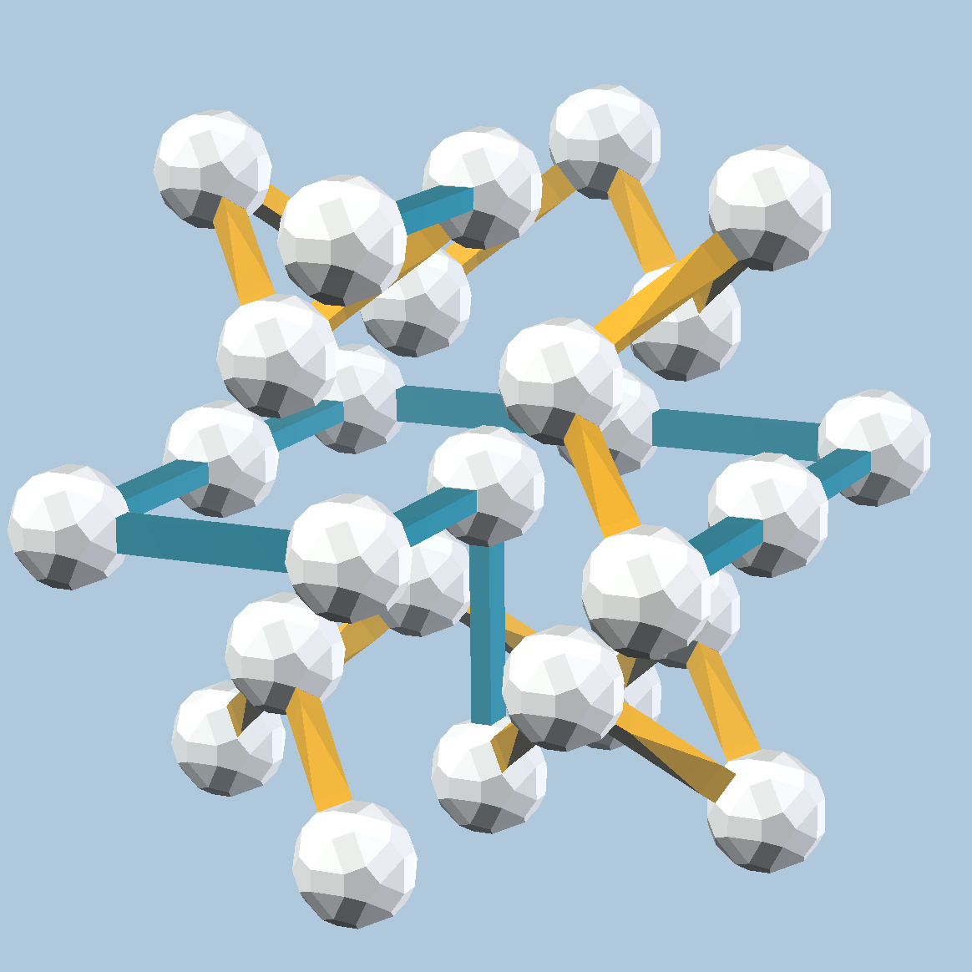
Make a path
Appears to be doable
with two lengths (yellow, blue)

Slide 8
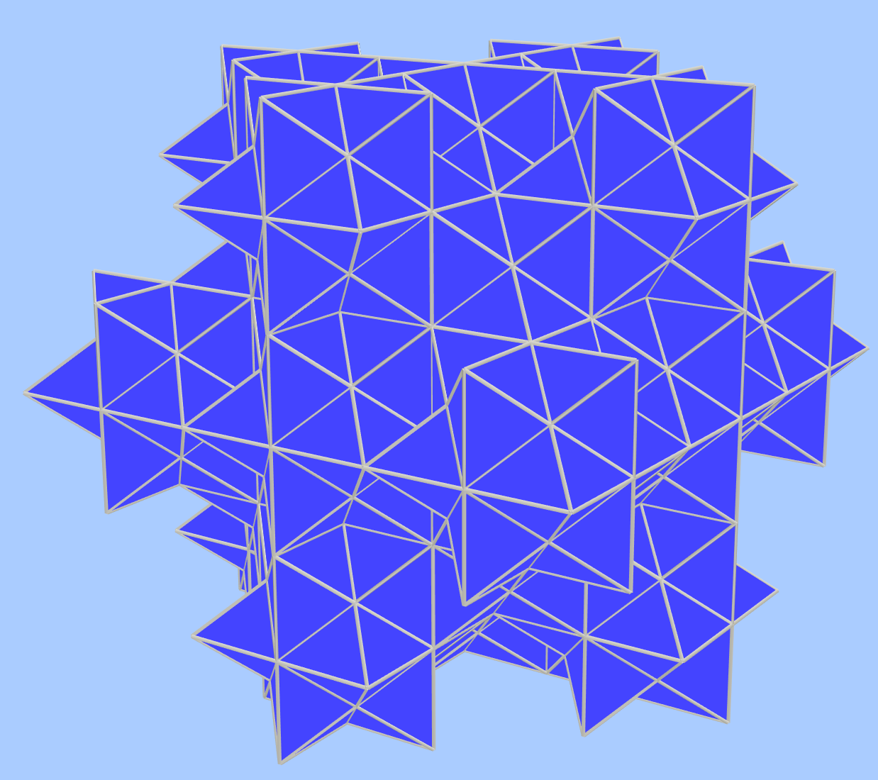
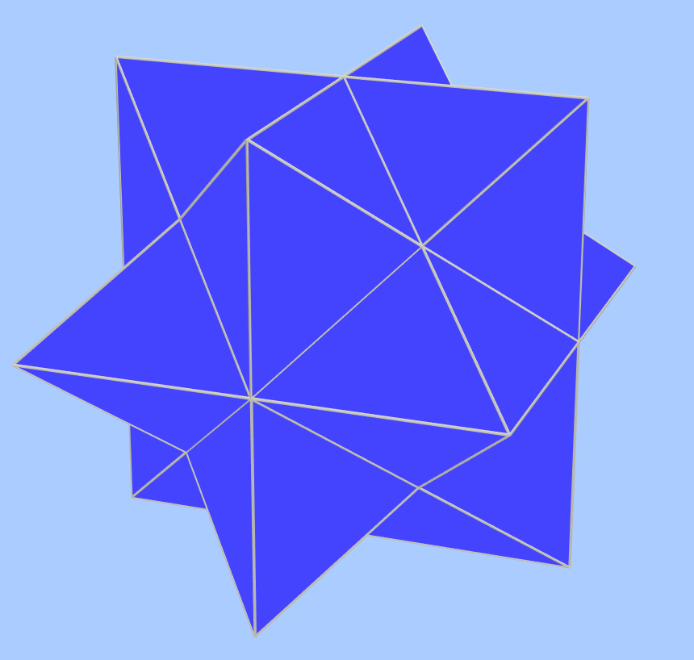
The 27 nodes are the vertices of a stellated rhombic dodecahedron
This shape can fill the 3D Euclidean space
Stack 27 SRD to get the next shape

Slide 9
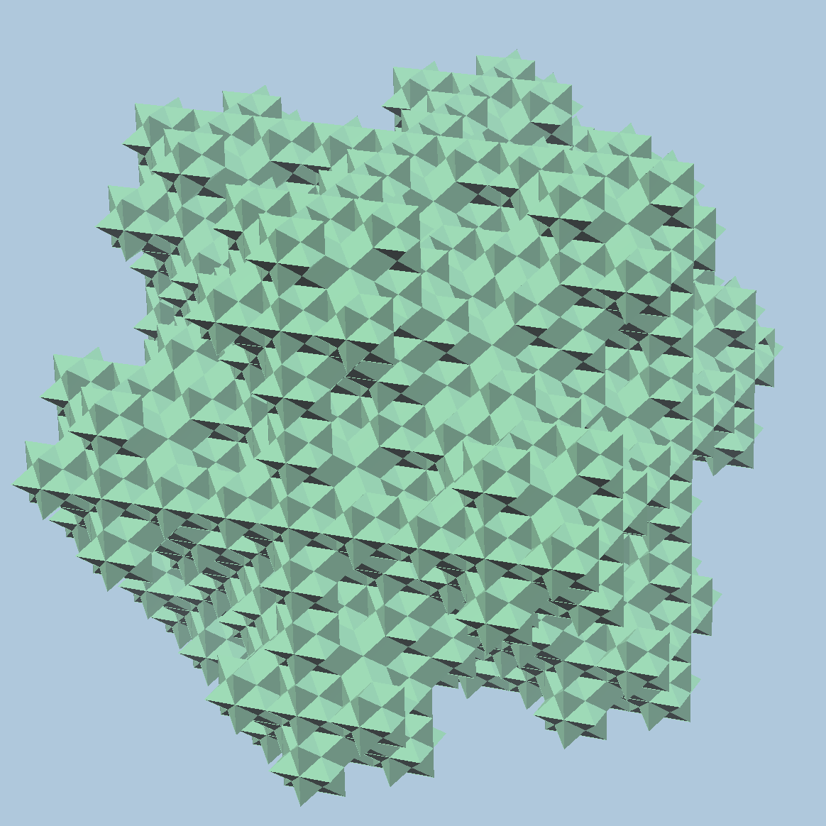
Keep on stacking 27 of previous shape to get a new one
In the limit, the surface is a fractal
27 copies of itself == itself scaled up 3 times

Slide 12
Open questions
Face-centered cubic lattice (fcc). Not sure if there’s any clump that can be used.
Any other clumps in bcc with a path with the same step length?

