Slide 1
Projection and Intersection
Nan Ma
Feb 2020

Slide 2
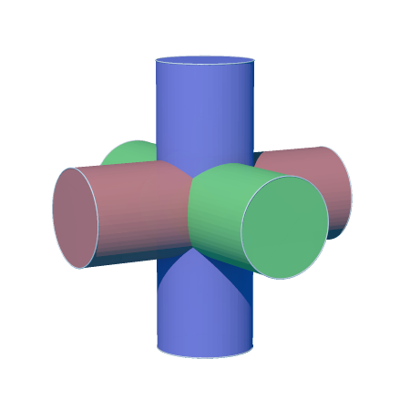
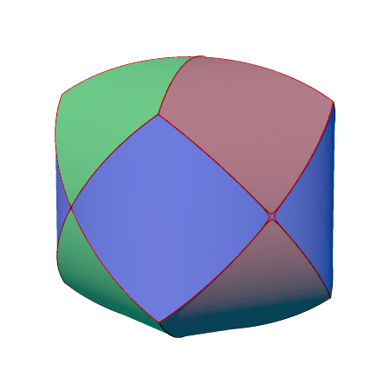

Slide 3
Union of 3 cylinders: {points: contained by at least 1 cylinder}
Intersection of 3 cylinders: {points: contained by all 3 cylinders}

Slide 4
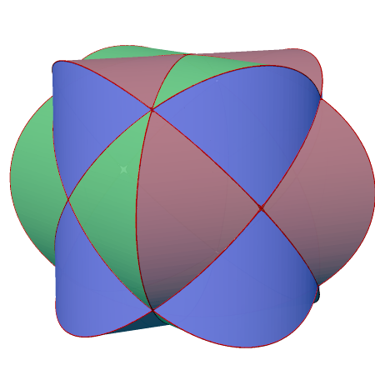
{points: contained by at least 2 cylinders}
(1 int 2) union (1 int 3) union (2 int 3)
Union of 3 cylinders: {points: contained by at least 1 cylinder}
Intersection of 3 cylinders: {points: contained by all 3 cylinders}
3D prints…

Slide 5
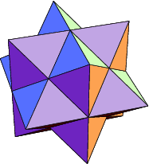

→ Stellate →
→ Stellate →

Slide 6
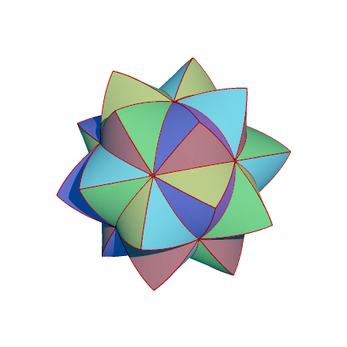
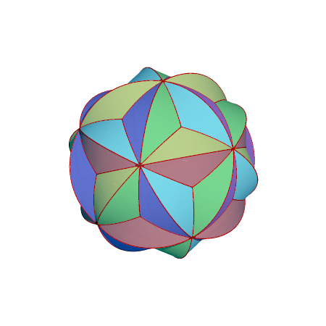
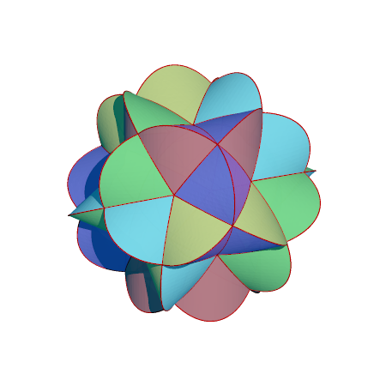
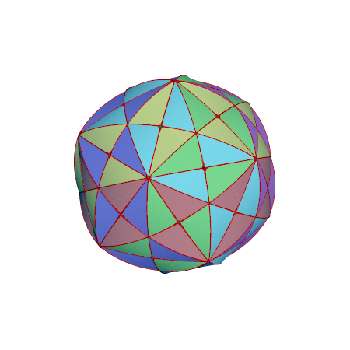
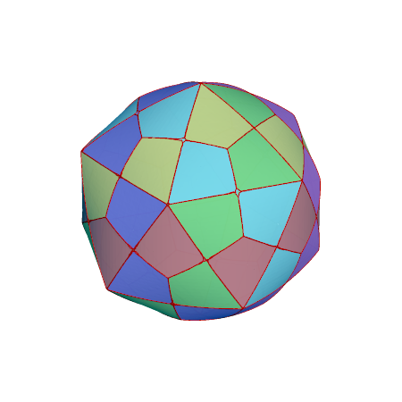
6 cylinders, connecting opposite vertices of an icosahedron
In at least 2 cylinders
In at least 3 cylinders
In at least 4 cylinders
In all 6 cylinders
3D prints…
In at least 5 cylinders

Slide 7
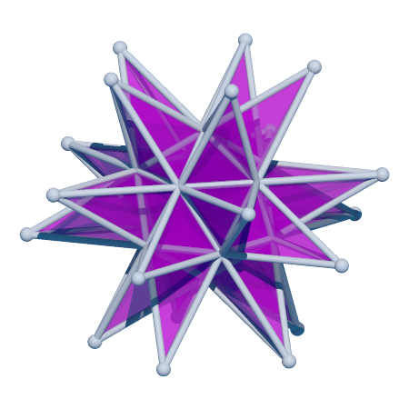
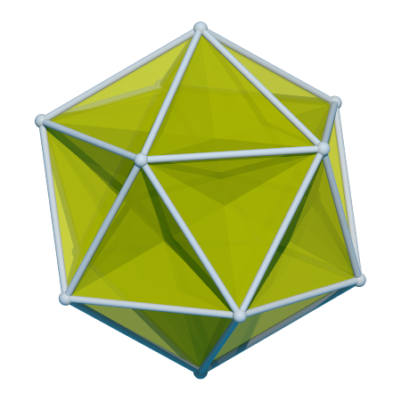

Slide 8
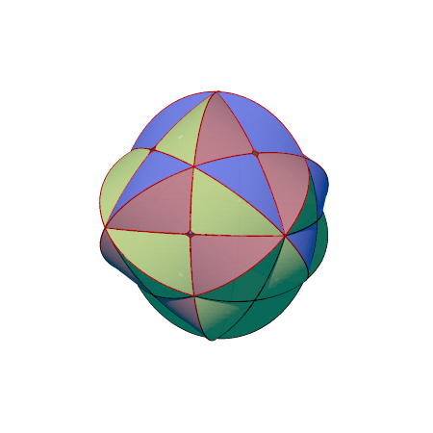
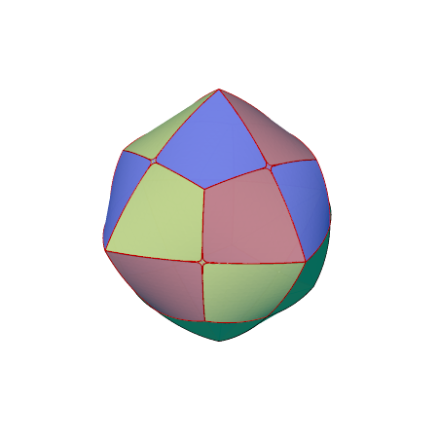
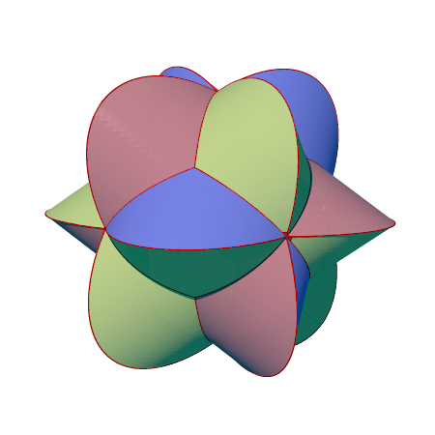
4 cylinders, connecting opposite vertices of a cube
In at least 2 cylinders
In at least 3 cylinders
In all 4 cylinders

Slide 9
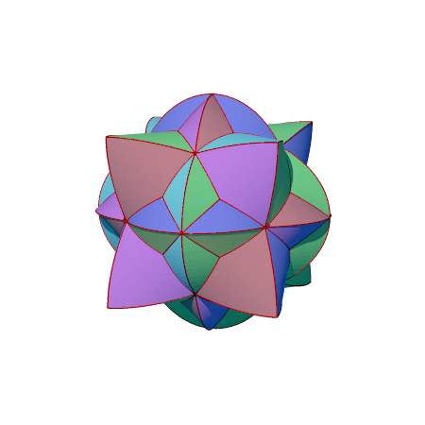
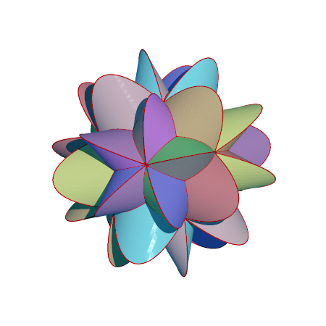
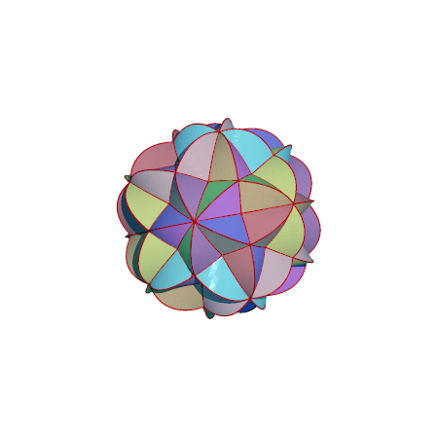
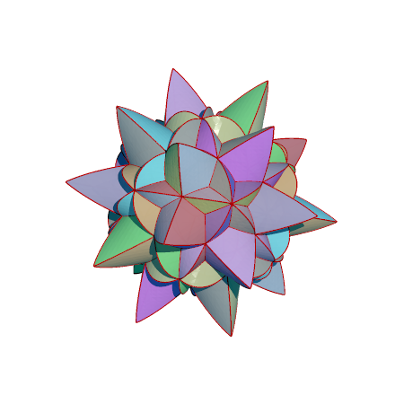
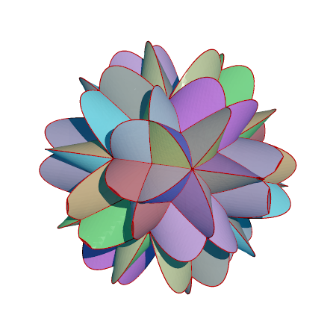
Other interesting shapes
3 out of 6 cylinders
(edges of cube)
3 out of 10 cylinders (vertices of dodeca)
2 out of 10 cylinders (vertices of dodeca)
2 out of 15 cylinders
(edges of dodeca)
3 out of 15 cylinders
(edges of dodeca)

Slide 10
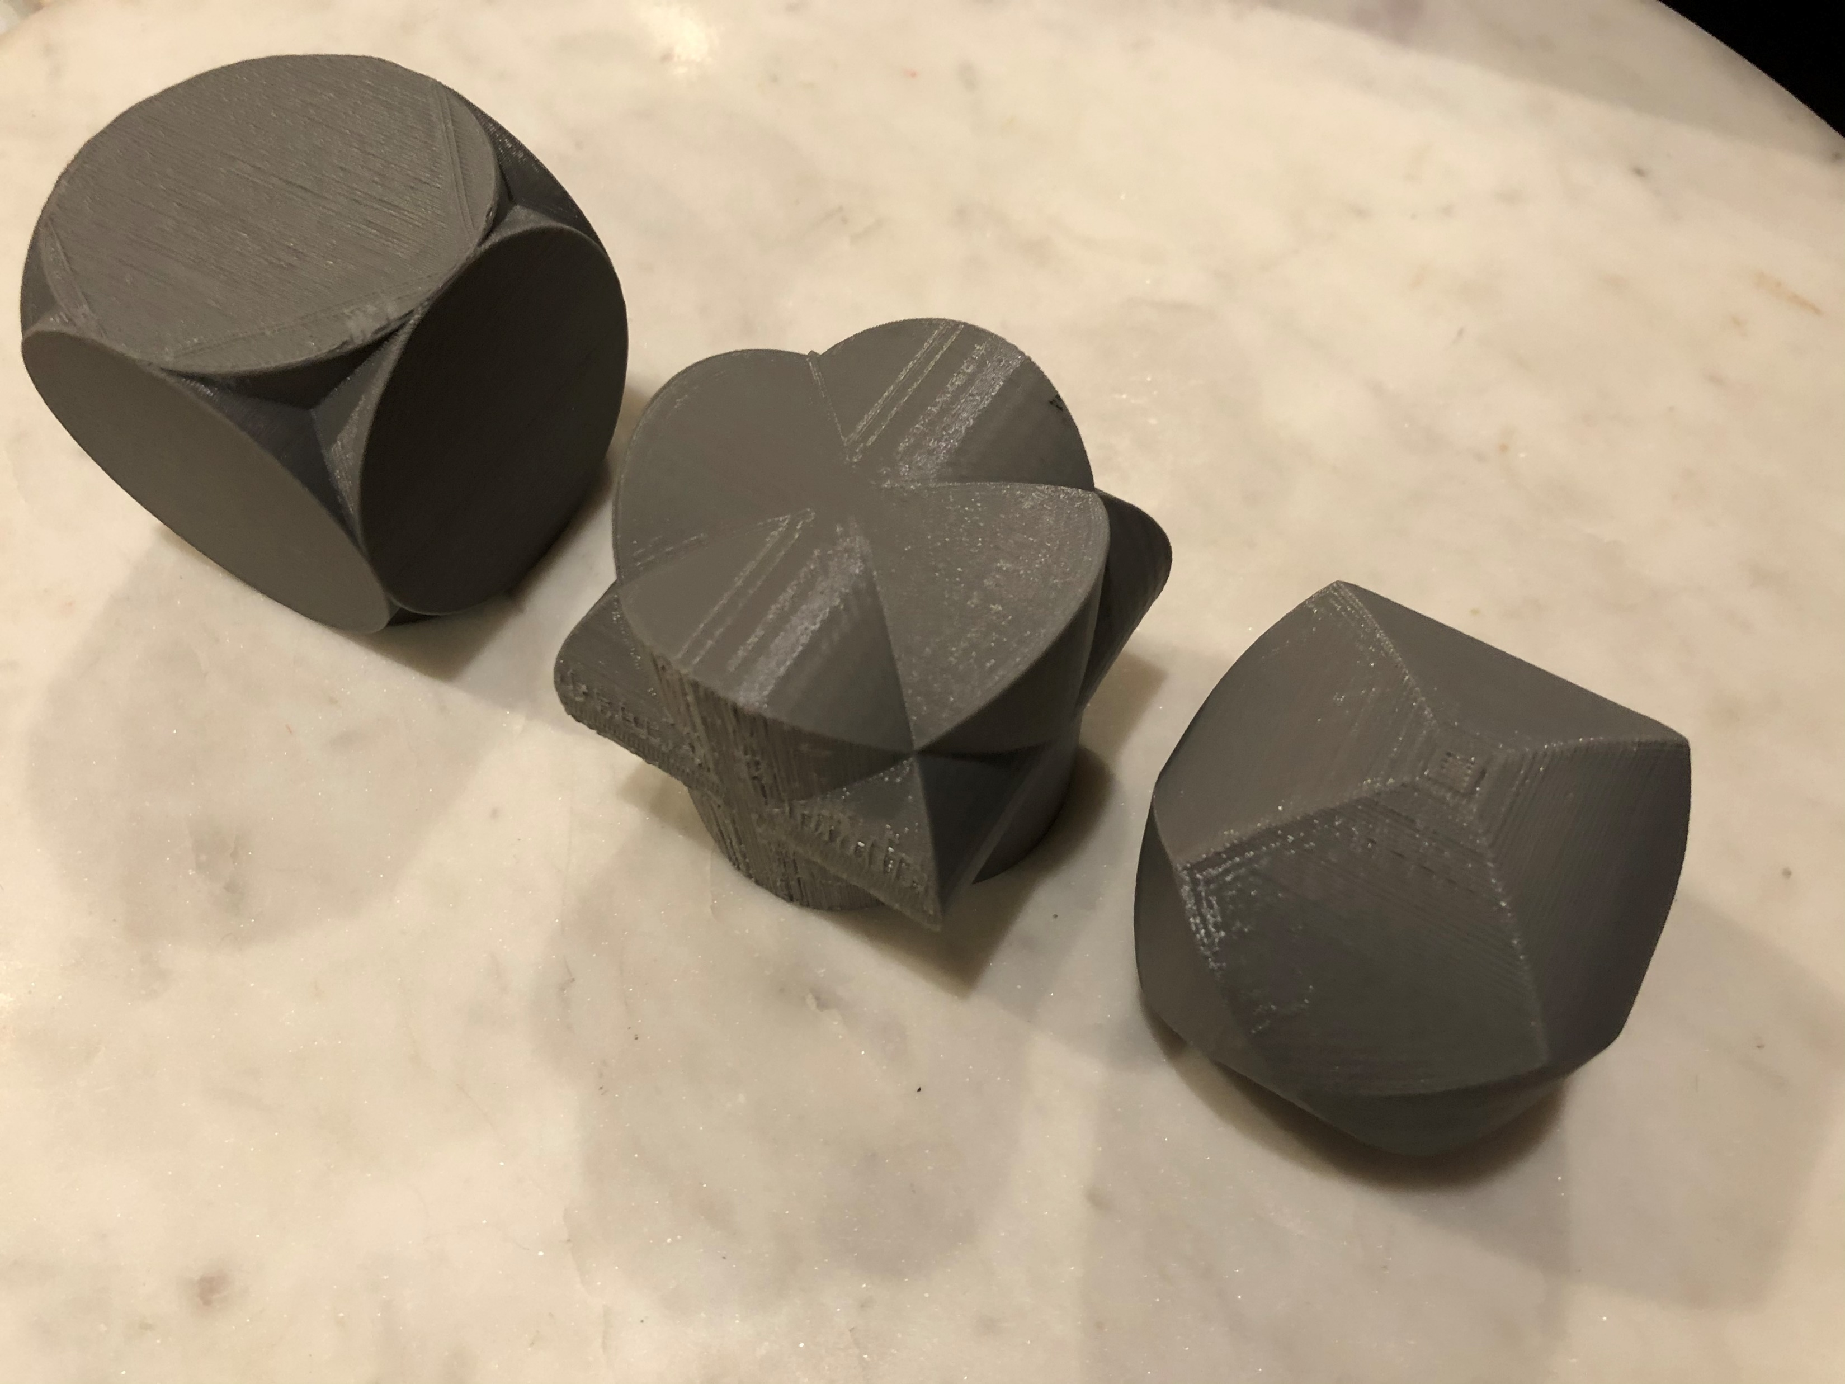
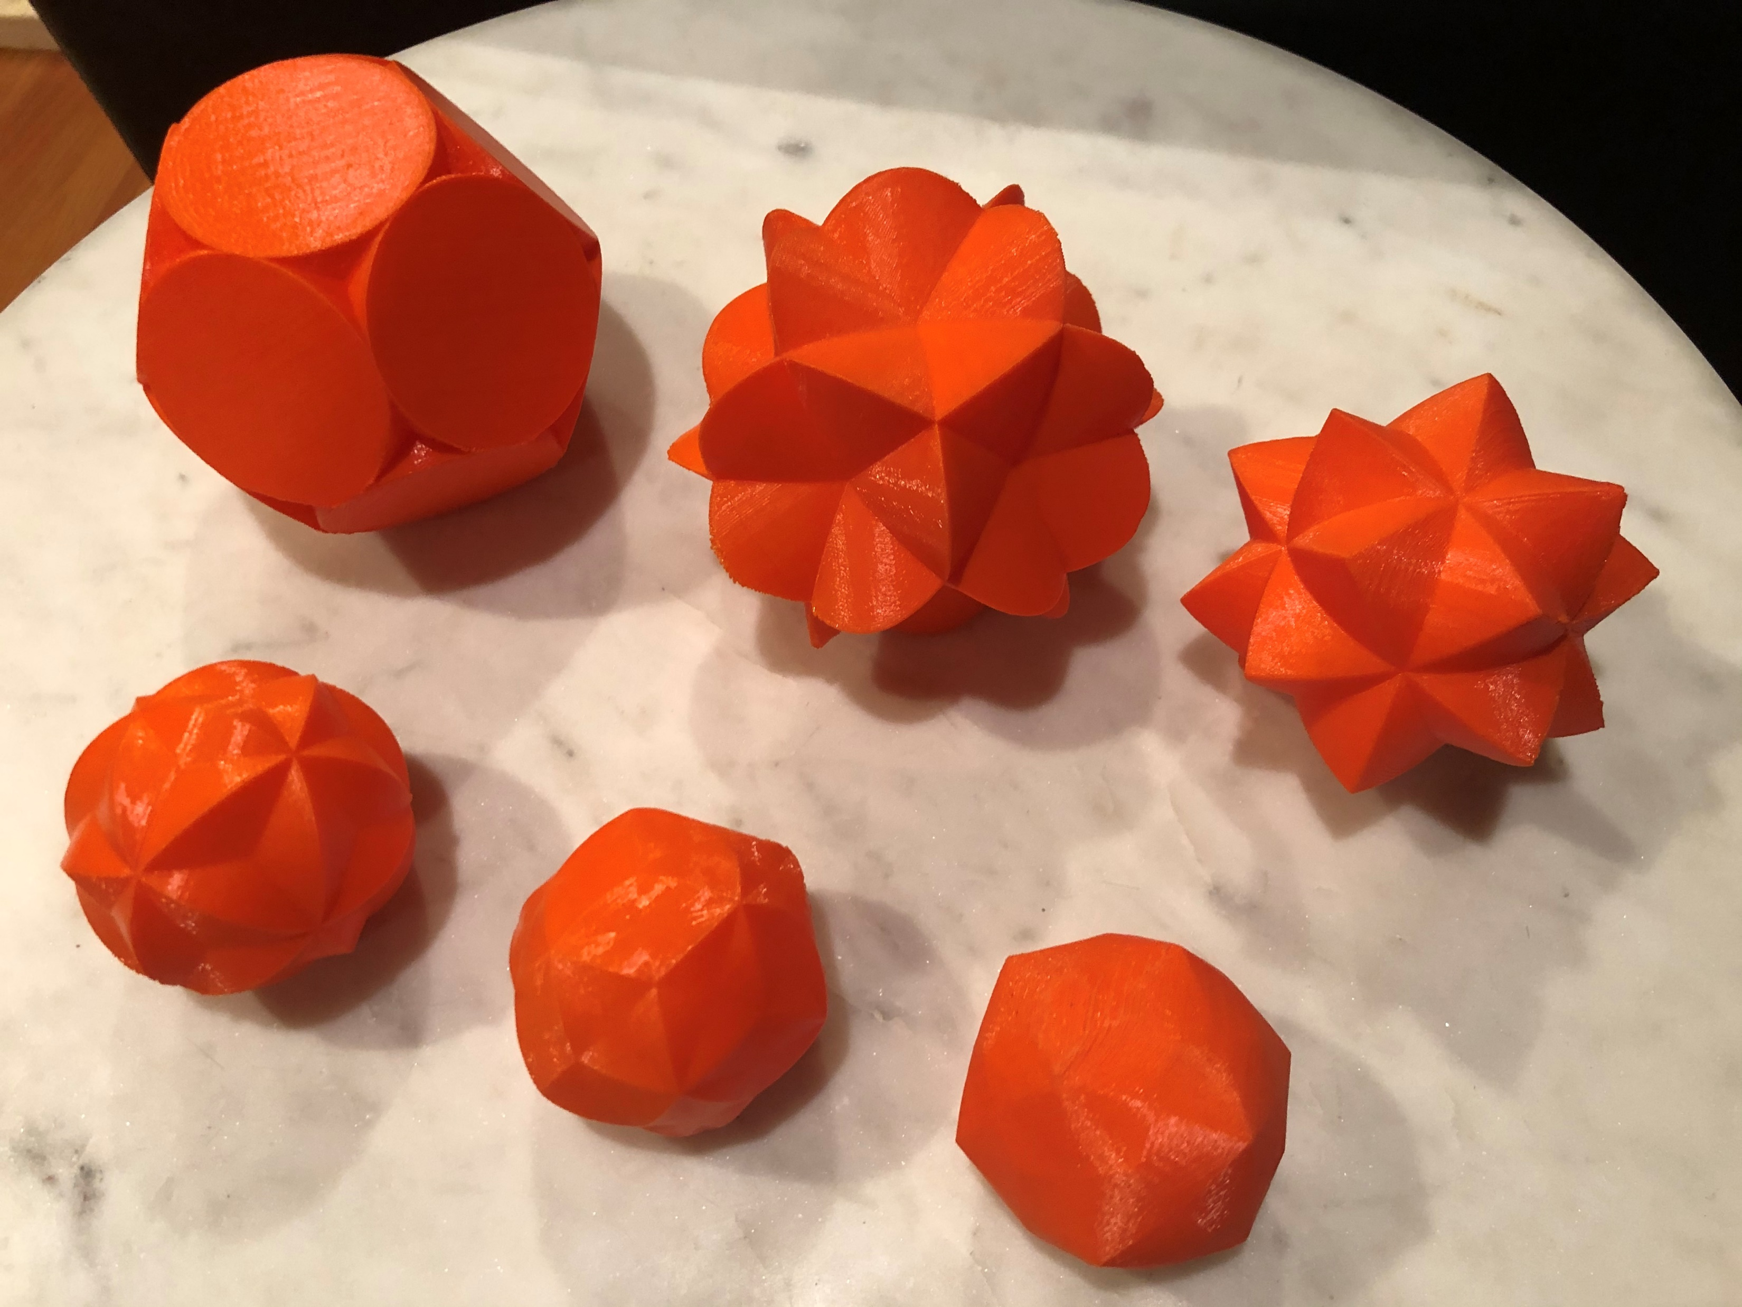
3D printed 3-cylinder and 6-cylinder series

Slide 11
Paper models are possible
Images and source code in
https://github.com/nanma80/cylinders
Questions about the intersections of cylinders?

