Slide 1
MINI-PROJECT EDA
By
Nanmaran Anbupalam

Slide 2
Dataset Overview
Lifestyle and Wellbeing data is collected from the survey hosted at http://www.authentic-happiness.com.
The survey includes 23 questions about or personal and professional lifestyle and calculates a work-life balance score based on our answers.
The current dataset contains 15,972 individual entries collected from July 2015 to March 2021.
Surveys are completed by males and females across a broad range of ages which are classified into 4 distinct groups (Less than 20, 21-35, 36-50, 51 or more)
The insights derived form this survey can be used to deduce the drivers of stress, BMI and sense of achievement for the population.

Slide 3
COLUMNS IN THE DATA – EXPLAINED
COLUMN NAME | DATA COLLECTED | SCALE
FRUITS VEGGIES | HOW MANY FRUITS OR VEGETABLES DO YOU EAT EVERYDAY? | 0-5
DAILY STRESS | HOW MUCH STRESS DO YOU TYPICALLY EXPERIENCE EVERYDAY? | 0-5
PLACES VISITED | HOW MANY NEW PLACES DO YOU VISIT? (over 12 months) | 0-10
CORE CIRCLE | HOW MANY PEOPLE ARE VERY CLOSE TO YOU? | 0-10
SUPPORTING OTHERS | HOW MANY PEOPLE DO YOU HELP ACHIEVE A BETTER LIFE? (over 12 months) | 0-10
SOCIAL NETWORK | WITH HOW MANY PEOPLE DO YOU INTERACT WITH DURING A TYPICAL DAY? | 0-10
ACHIEVEMENT | HOW MANY REMARKABLE ACHIEVEMENTS ARE YOU PROUD OF? | 0-10
DONATION | HOW MANY TIMES DO YOU DONATE YOUR TIME OR MONEY TO GOOD CAUSES? (over 12 months) | 0-5
BMI RANGE | WHAT IS YOUR BODY MASS INDEX (BMI) RANGE? | Under 25 = 1, Over 25 = 2
TODO COMPLETED | HOW WELL DO YOU COMPLETE YOUR WEEKLY TO-DO LISTS? | 0-10
FLOW | IN A TYPICAL DAY, HOW MANY HOURS DO YOU EXPERIENCE "FLOW"? | 0-10
DAILY STEPS | HOW MANY STEPS (IN THOUSANDS) DO YOU TYPICALLY WALK EVERYDAY? | 0-10
LIVE VISION | FOR HOW MANY YEARS AHEAD IS YOUR LIFE VISION VERY CLEAR FOR? | 0-10

Slide 4
COLUMNS IN THE DATA – EXPLAINED
COLUMN NAME | DATA COLLECTED | SCALE
SLEEP HOURS | ABOUT HOW LONG DO YOU TYPICALLY SLEEP? | 0-10
LOST VACATION | HOW MANY DAYS OF VACATION DO YOU TYPICALLY LOSE EVERY YEAR ? | 0-10
DAILY SHOUTING | HOW OFTEN DO YOU SHOUT OR SULK AT SOMEBODY? | 0-10
SUFFICIENT INCOME | HOW SUFFICIENT IS YOUR INCOME TO COVER BASIC LIFE EXPENSES? | 1 = Not Sufficient 2 = Sufficient
PERSONAL AWARDS | HOW MANY RECOGNITIONS HAVE YOU RECEIVED IN YOUR LIFE? | 0-10
TIME FOR PASSION | HOW MANY HOURS DO YOU SPEND EVERYDAY DOING WHAT YOU ARE PASSIONATE ABOUT? | 0-10
WEEKLY MEDITATION | IN A TYPICAL WEEK, HOW MANY TIMES DO YOU HAVE THE OPPORTUNITY TO THINK ABOUT YOURSELF? | 0-10
WORK LIFE BALANCE SCORE | SCORE CALCULATED BY AH.COM ALGORITHM AND REPORTED TO USER IN THE FIRST REPORT | 0-1000

Slide 5
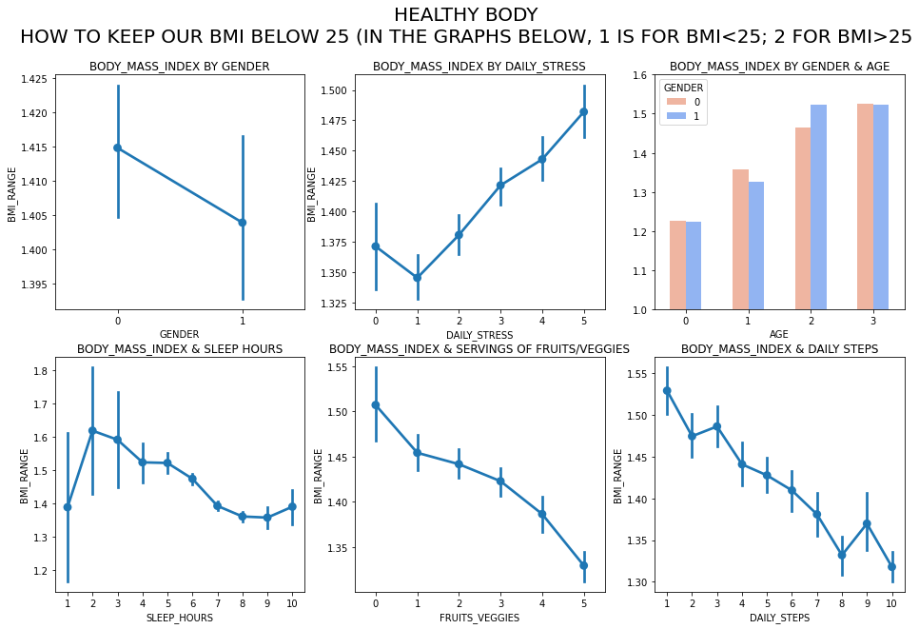

Slide 6
CORRELATION TABLE FOR BMI VS OTHER FACTORS
LIVE_VISION 0.000088
TIME_FOR_PASSION 0.006237
GENDER 0.010766
SUFFICIENT_INCOME 0.011863
PERSONAL_AWARDS 0.019007
ACHIEVEMENT 0.019699
SOCIAL_NETWORK 0.019843
CORE_CIRCLE 0.025965
FLOW 0.026761
LOST_VACATION 0.036683
SUPPORTING_OTHERS 0.038558
DAILY_SHOUTING 0.060470
TODO_COMPLETED 0.061508
DONATION 0.064543
WEEKLY_MEDITATION 0.078189
DAILY_STRESS 0.083110
FRUITS_VEGGIES 0.092976
SLEEP_HOURS 0.098156
PLACES_VISITED 0.108054
DAILY_STEPS 0.131465
AGE 0.197100
WORK_LIFE_BALANCE_SCORE 0.252026
BMI_RANGE 1.000000

Slide 7
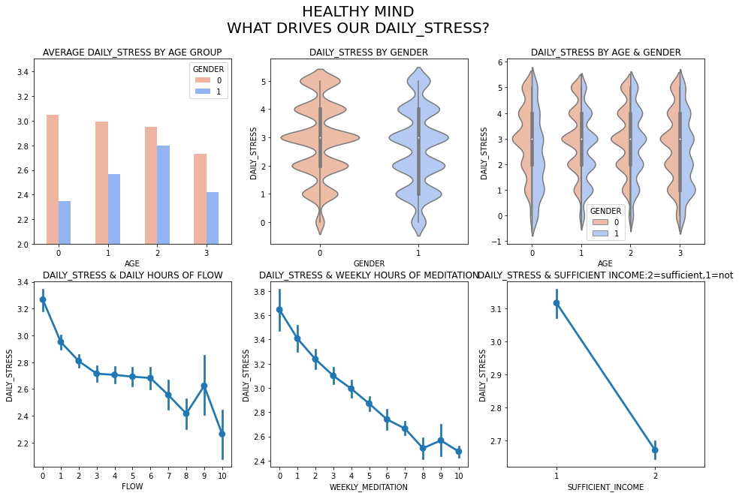

Slide 8
CORRELATION TABLE FOR STRESS VS OTHER FACTORS
SOCIAL_NETWORK 0.020930
AGE 0.027380
SUPPORTING_OTHERS 0.029852
DONATION 0.037721
PERSONAL_AWARDS 0.042535
DAILY_STEPS 0.065511
BMI_RANGE 0.083110
FRUITS_VEGGIES 0.094535
ACHIEVEMENT 0.110943
CORE_CIRCLE 0.120238
GENDER 0.122585
FLOW 0.129903
LIVE_VISION 0.134155
PLACES_VISITED 0.134857
SUFFICIENT_INCOME 0.144573
SLEEP_HOURS 0.157037
TIME_FOR_PASSION 0.158141
TODO_COMPLETED 0.163727
LOST_VACATION 0.196953
WEEKLY_MEDITATION 0.218660
DAILY_SHOUTING 0.302669
WORK_LIFE_BALANCE_SCORE 0.365399
DAILY_STRESS 1.000000

Slide 9
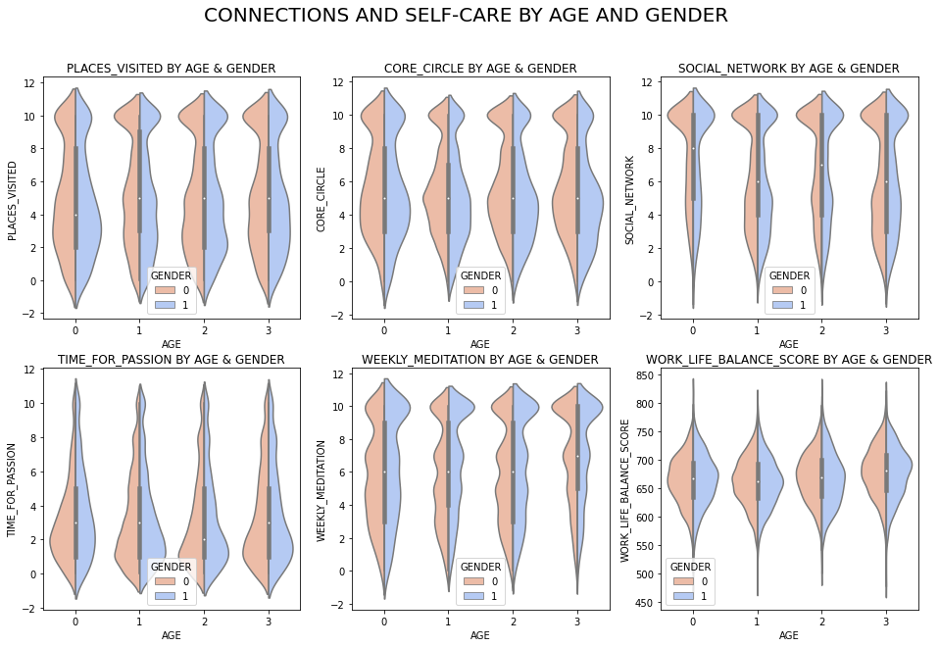

Slide 10
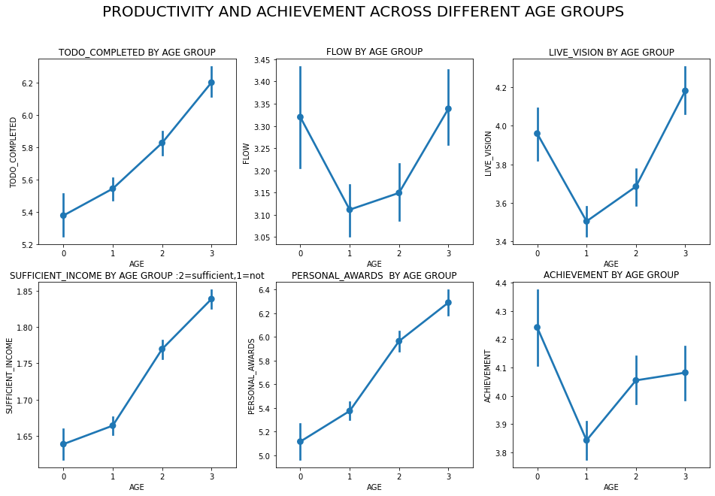

Slide 11
CORRELATION TABLE FOR WORK LIFE BALANCE VS OTHER FACTORS
CORRELATION TABLE FOR WORK LIFE BALANCE VS OTHER FACTORS
GENDER 0.039911
AGE 0.119958
SLEEP_HOURS 0.196420
BMI_RANGE 0.252026
LOST_VACATION 0.266318
DAILY_SHOUTING 0.273143
DAILY_STRESS 0.365399
SUFFICIENT_INCOME 0.403554
SOCIAL_NETWORK 0.412580
WEEKLY_MEDITATION 0.416229
DAILY_STEPS 0.422981
FRUITS_VEGGIES 0.452256
DONATION 0.458825
LIVE_VISION 0.471319
FLOW 0.478218
PERSONAL_AWARDS 0.504225
CORE_CIRCLE 0.507594
TIME_FOR_PASSION 0.516979
PLACES_VISITED 0.529673
TODO_COMPLETED 0.545503
SUPPORTING_OTHERS 0.548854
ACHIEVEMENT 0.561241
WORK_LIFE_BALANCE_SCORE 1.000000
GENDER 0.000598
LOST_VACATION 0.000727
AGE 0.008742
BMI_RANGE 0.019699
DAILY_SHOUTING 0.044488
SLEEP_HOURS 0.045261
DAILY_STRESS 0.110943
SUFFICIENT_INCOME 0.113779
FRUITS_VEGGIES 0.162901
WEEKLY_MEDITATION 0.164713
DAILY_STEPS 0.185946
DONATION 0.233697
SOCIAL_NETWORK 0.249025
PLACES_VISITED 0.257960
CORE_CIRCLE 0.289460
TODO_COMPLETED 0.304972
LIVE_VISION 0.320680
SUPPORTING_OTHERS 0.360077
TIME_FOR_PASSION 0.368936
FLOW 0.386577
PERSONAL_AWARDS 0.396180
WORK_LIFE_BALANCE_SCORE 0.561241
ACHIEVEMENT 1.000000

Slide 12
