Slide 1
Mini Project 3
Nanmaran Anbupalam

Slide 2
Problem Statement
Predicting and classifying the shots on target (shots on goal) for Chelsea.
Shots on target is a good indicator of the number of goals a team will score in a match.
More shots on target usually correlates to more goals.
The goal is to create a model that accurately predicts and classifies the number of shots in target for a fixture using the available data.
Use this model and the features used in the model to set targets for the features in future matches.
This is will help improve the shots on target and hopefully help the team to score more goals.

Slide 3
API and data
The API used to retrieve the data was API-Football. It is RESTful API hosted by API-Sports.
Data can be accessed used unique IDs for every team and league which is available on API dashboard.
The team ID for Chelsea (49) and the league ID for the Premier League (39) was used to get the fixture IDs for all matches played across 7 seasons. A total of 266 matches.
The fixture IDs were used to get match statistics for all the matches, and this was used to create the dataframe.

Slide 4
Dataframe
Data columns (total 17 columns):
# Column Non-Null Count Dtype
--- ------ -------------- -----
0 shots_on_goal 265 non-null float64
1 shots_off_goal 265 non-null float64
2 total_shots 265 non-null int64
3 blocked_shots 265 non-null float64
4 shots_insidebox 265 non-null int64
5 shots_outsidebox 265 non-null float64
6 fouls 265 non-null float64
7 corners 265 non-null float64
8 offsides 265 non-null float64
9 possession 265 non-null float64
10 yellow_cards 265 non-null float64
11 red_cards 265 non-null float64
12 saves 265 non-null float64
13 total_passes 265 non-null int64
14 accurate_passes 265 non-null int64
15 pass_accuracy 265 non-null float64
16 SoG_Class 265 non-null int64
SoG Class was a new column created to classify the number of shots on target.
Class 0:
shots on goal <=3
Class 1:
3 < shots on goal < 6
Class 2:
shots on goal > 6

Slide 5
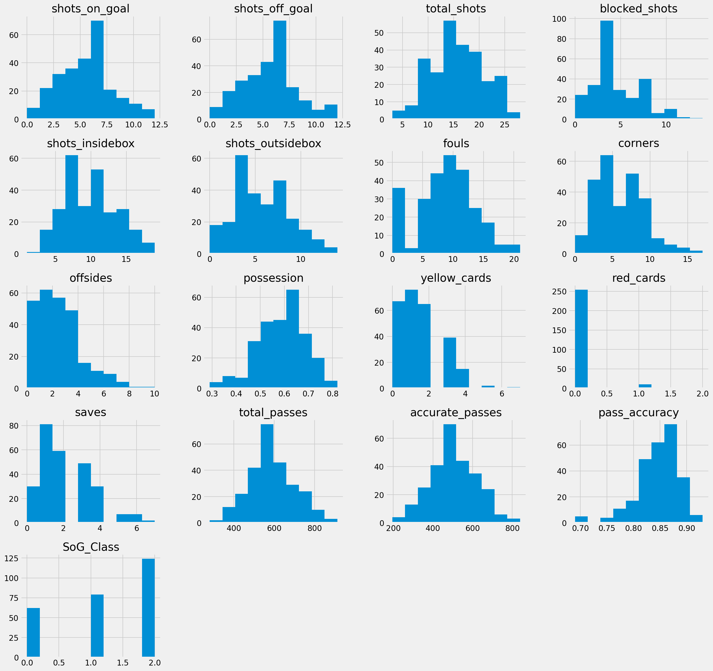

Slide 6
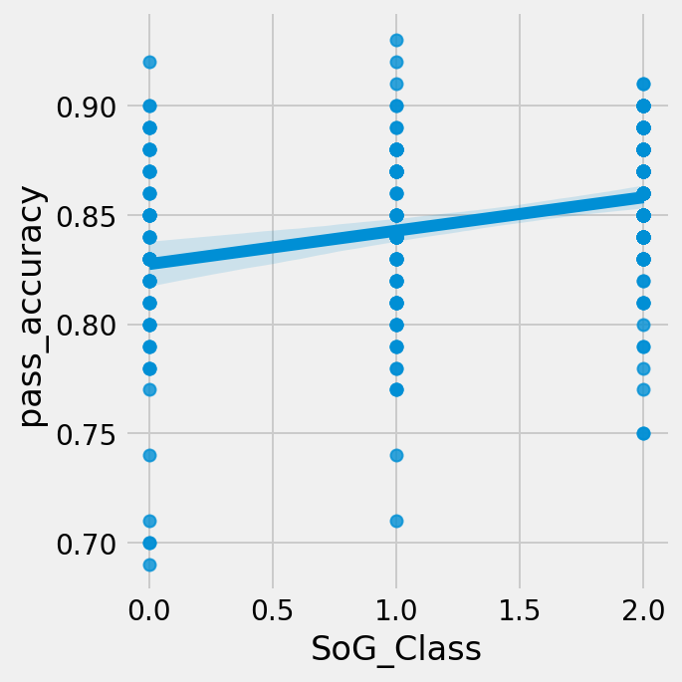
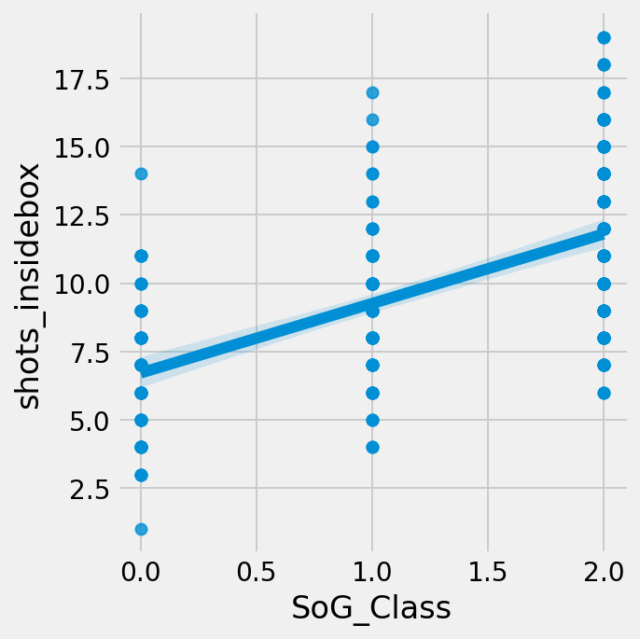
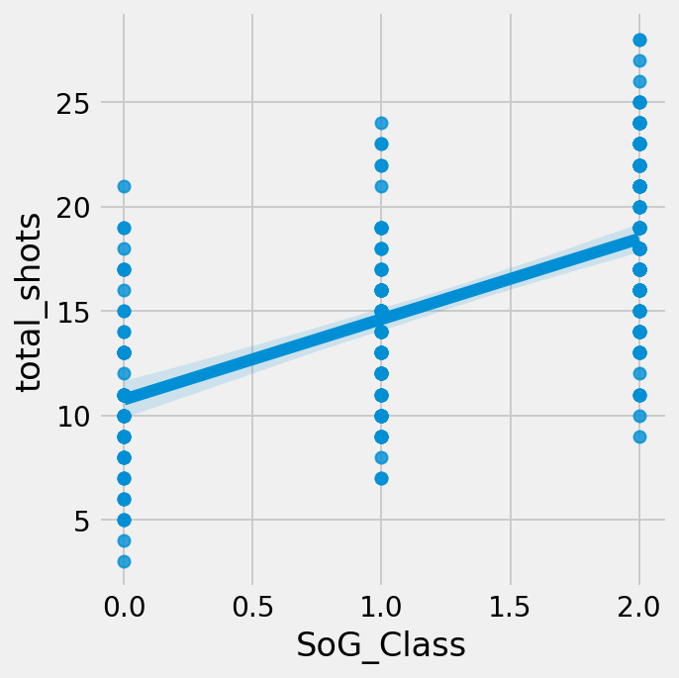
Features vs SoG Class

Slide 7
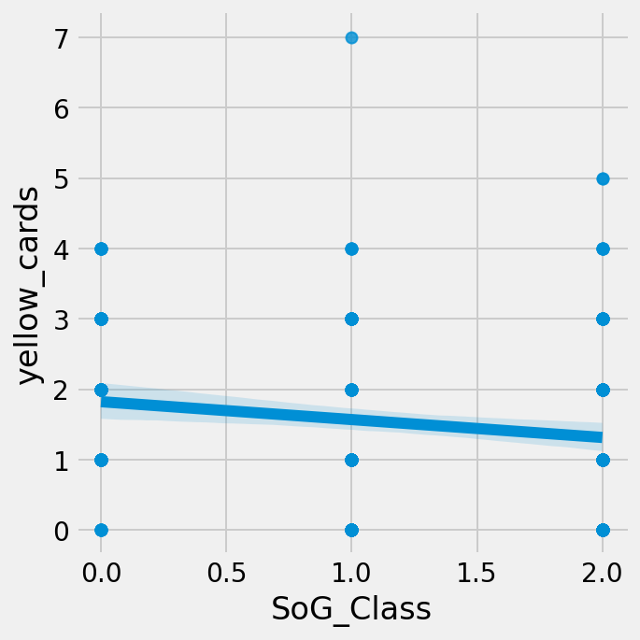
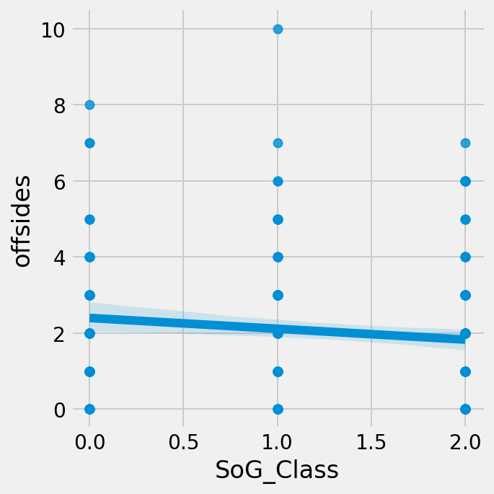
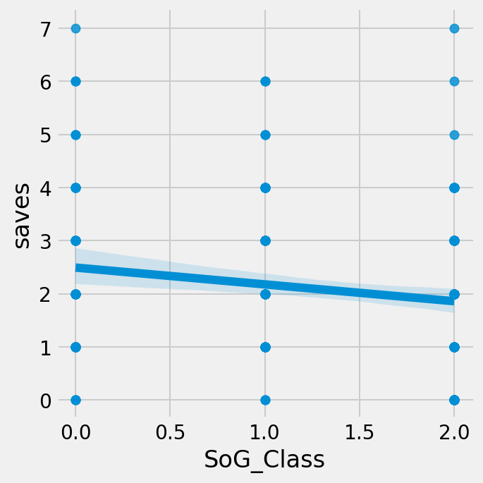
Features vs SoG Class

Slide 8
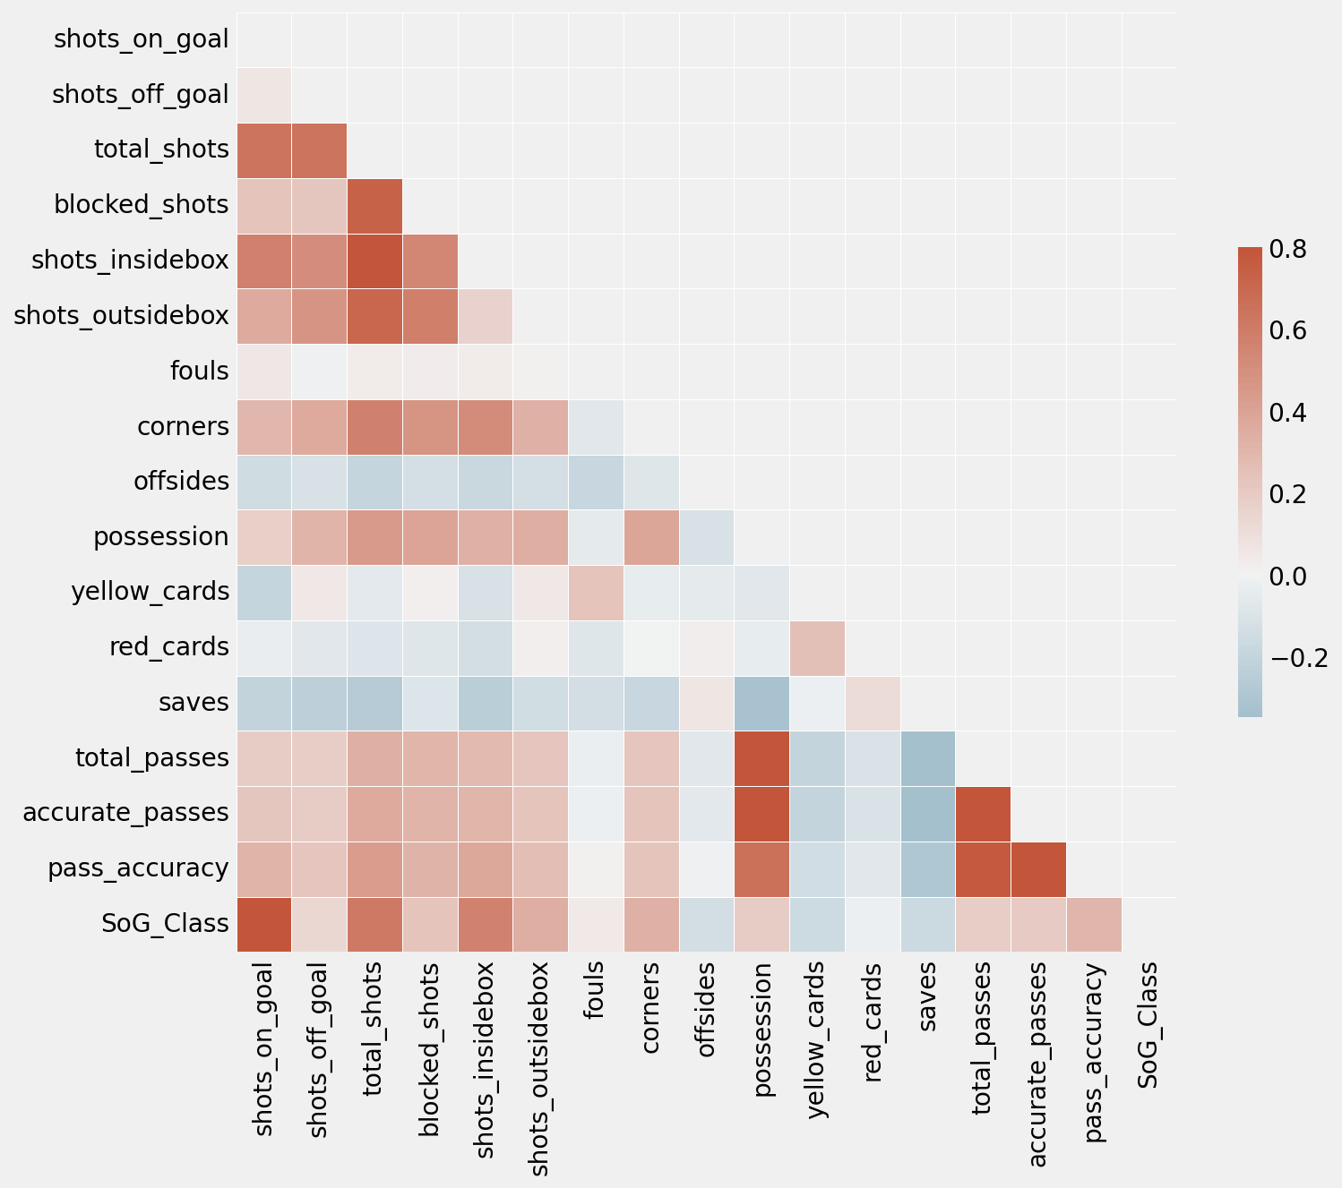
Correlation
Correlation of features with SoG Class
shots_on_goal 1.000000
shots_off_goal 0.068289
total_shots 0.634449
blocked_shots 0.230476
shots_insidebox 0.579646
shots_outsidebox 0.368047
fouls 0.053910
corners 0.297232
offsides -0.151538
possession 0.180669
yellow_cards -0.192172
red_cards -0.030992
saves -0.206946
total_passes 0.193328
accurate_passes 0.219488
pass_accuracy 0.316764
SoG_Class 0.877749

Slide 9
Features and Target
features = 'total_shots', 'blocked_shots', 'shots_insidebox', 'shots_outsidebox', 'fouls', 'corners', 'possession', 'offsides','yellow_cards', 'red_cards', 'saves', 'total_passes', 'pass_accuracy'
outcome = 'SoG_Class’
Test and Train samples were first split: test size = 0.2, random state = 42
The train samples were then resampled using SMOTE to get equal number of samples in every class.

Slide 10
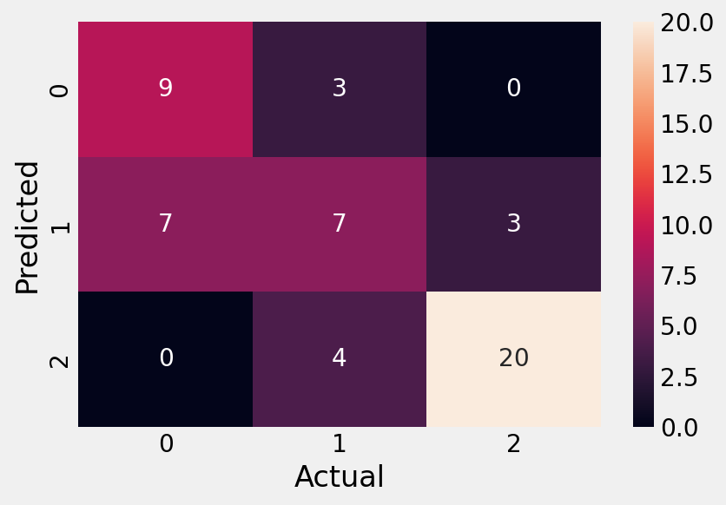
Logistic Regression
Hyperparameters used:
multi_class =‘multinomial’, solver=‘lgbfs’, penalty=‘12’, C=0.5
Accuracy score = 0.6792452830188679
Repeated Stratified K-fold Cross Validataion Score = Mean Accuracy: 0.595
Accuracy score = 0.6792452830188679
precision recall f1-score support
0 0.56 0.75 0.64 12
1 0.50 0.41 0.45 17
2 0.87 0.83 0.85 24
accuracy 0.68 53
macro avg 0.64 0.67 0.65 53
weighted avg 0.68 0.68 0.68 53

Slide 11
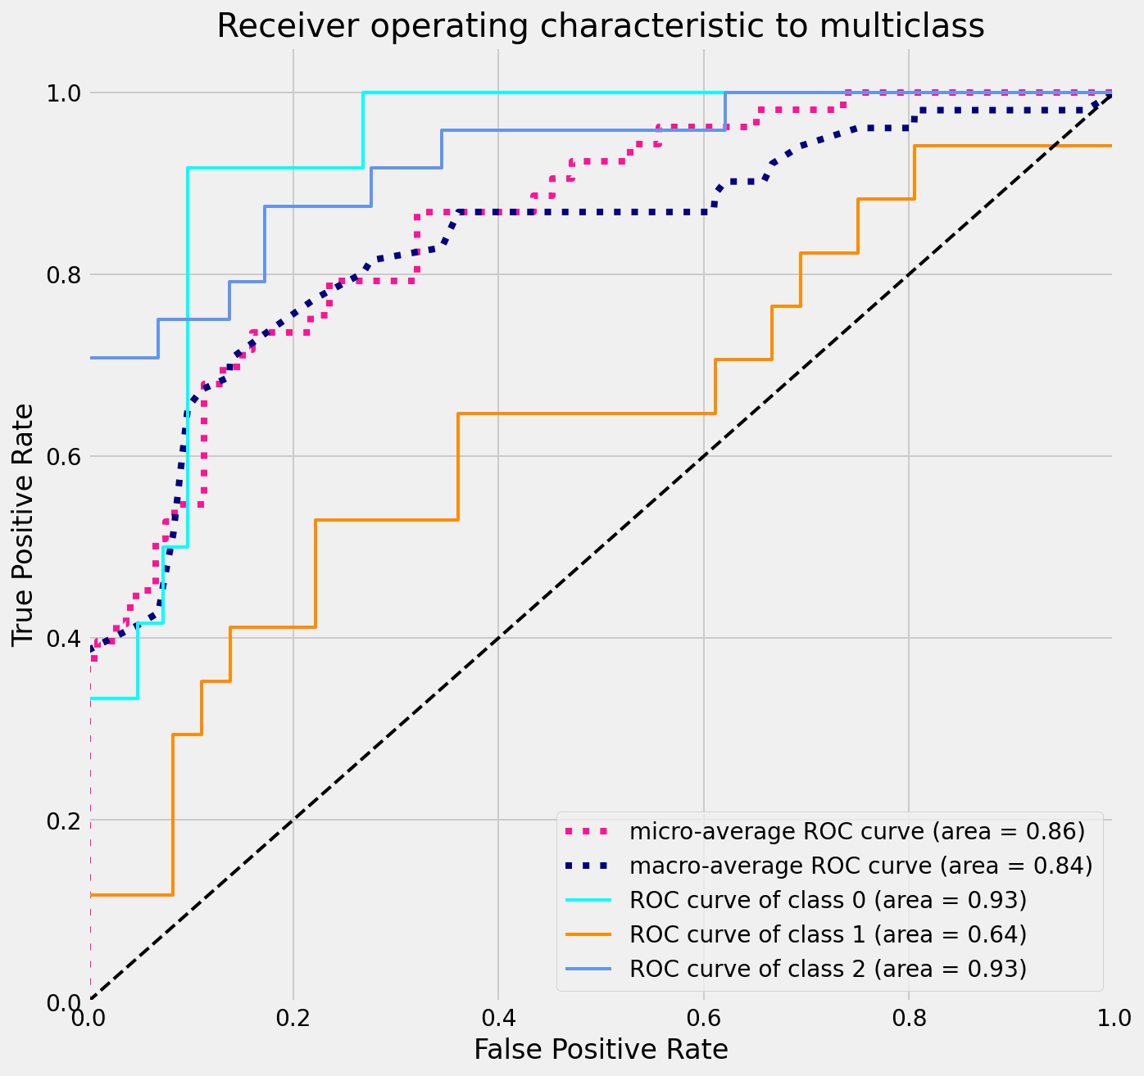

Slide 12
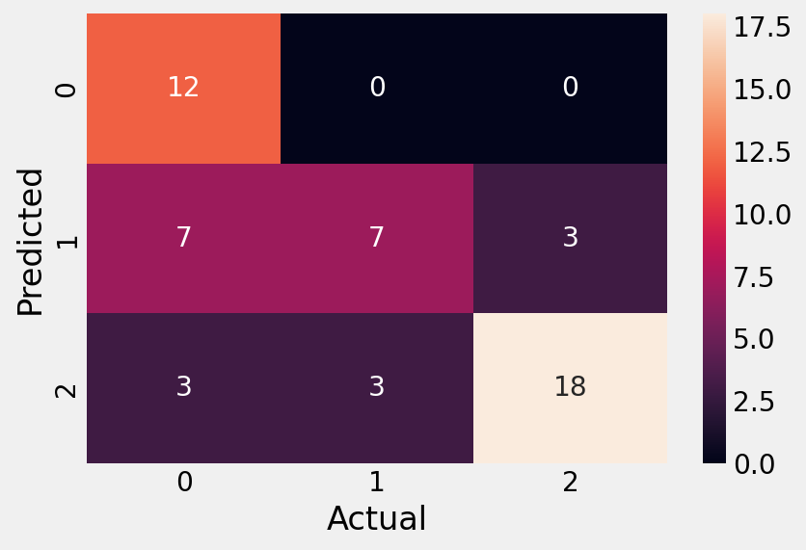
SVM
Hyperparameters used:
Kernel = ‘linear’, C=1.0
Accuracy score = 0.6981132075471698
precision recall f1-score support
0 0.55 1.00 0.71 12
1 0.70 0.41 0.52 17
2 0.86 0.75 0.80 24
accuracy 0.70 53
macro avg 0.70 0.72 0.67 53
weighted avg 0.74 0.70 0.69 53

Slide 13
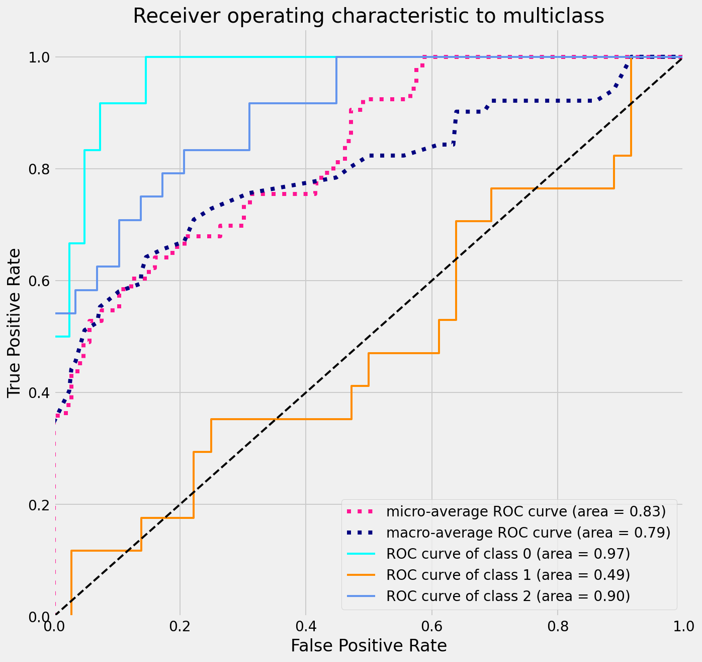

Slide 14
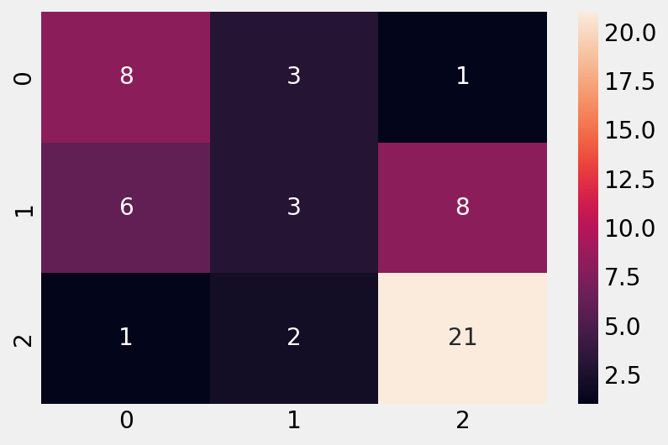
Logistic Regression 2
Hyperparameters used:
multi_class =‘multinomial’, solver=‘saga’, penalty=‘none’, C=1.0
Accuracy score = 0.6037735849056604
Repeated Stratified K-fold Cross Validataion Score = Mean Accuracy: 0.509
Accuracy score = 0.6037735849056604
precision recall f1-score support
0 0.53 0.67 0.59 12
1 0.38 0.18 0.24 17
2 0.70 0.88 0.78 24
accuracy 0.60 53
macro avg 0.54 0.57 0.54 53
weighted avg 0.56 0.60 0.56 53

Slide 15
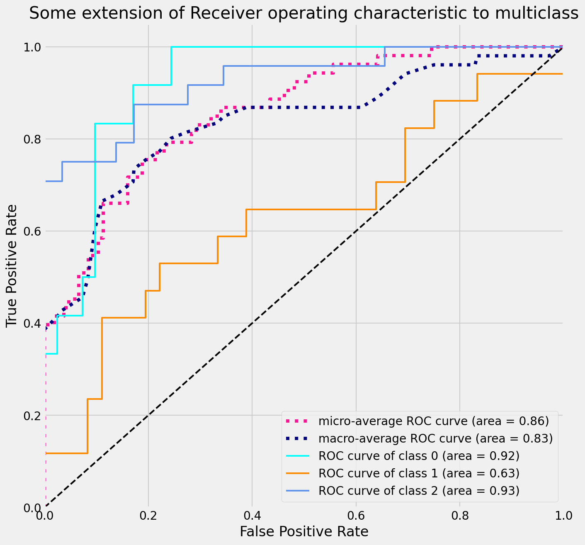

Slide 16
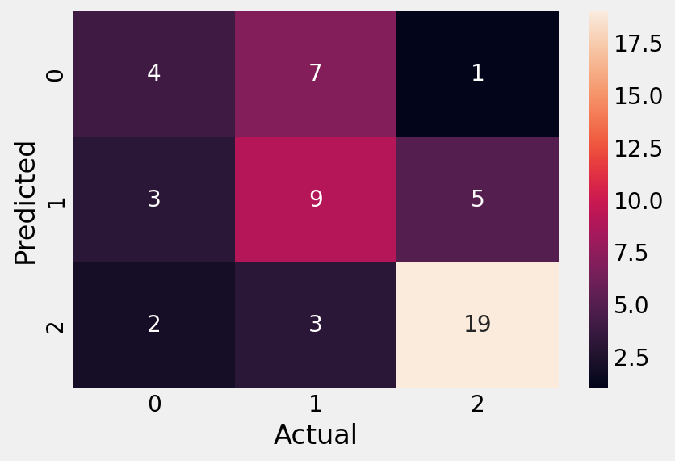
SVM 2
Hyperparameters used:
Kernel = ‘rbf’, C=50
Accuracy score = 0.6037735849056604
precision recall f1-score support
0 0.44 0.33 0.38 12
1 0.47 0.53 0.50 17
2 0.76 0.79 0.78 24
accuracy 0.60 53
macro avg 0.56 0.55 0.55 53
weighted avg 0.60 0.60 0.60 53

Slide 17
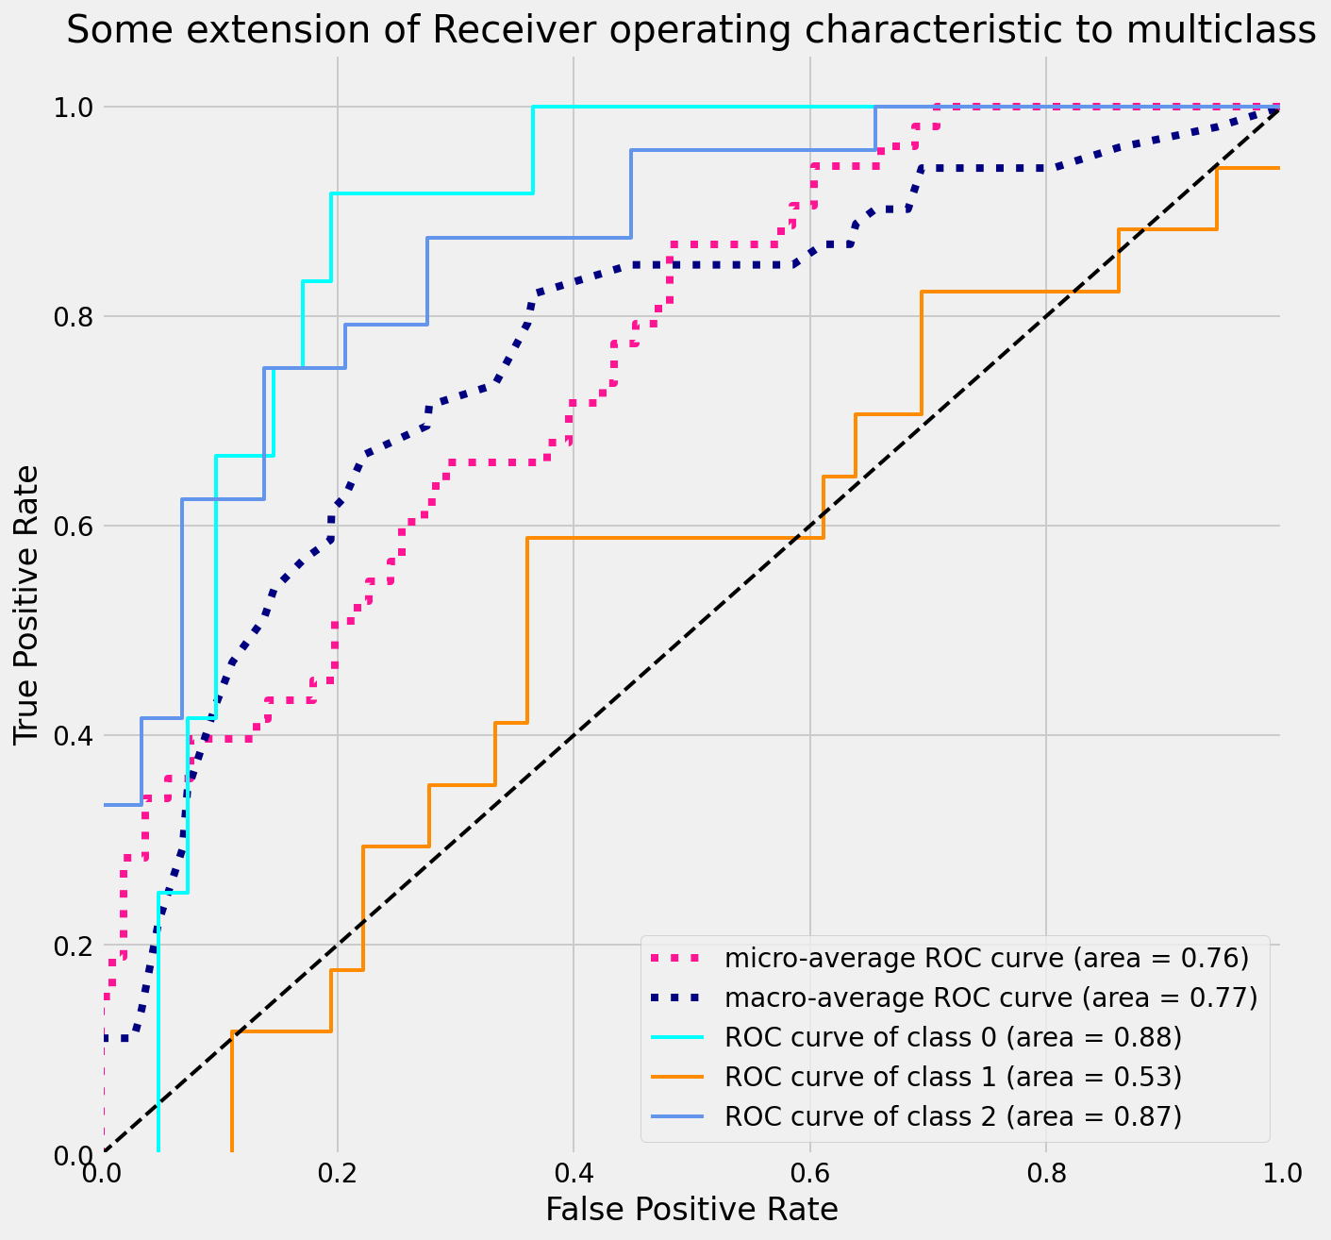

Slide 18
Conclusion
Logistic regression model performs better than SVM in accurately predicting all three classes.
For optimal match performance, the shots on target class needs to be in class 2. Logistic Regression is marginally better for class 2 as well as shown in ROC curves.
There is no significant difference between the two Log Regression models. Grid search can be performed to get optimal hyperparameters.
Features can be added or removed via feature engineering.
Other models such as decision trees and random forest can be explored.
Using these models, coaches can set targets for the various features in order to maximize the shots on target during a game.

