Slide 1

Twitter Data Analysis with SQL & Python
Nathan Annoh-Kwafo
CS 4525

Slide 2
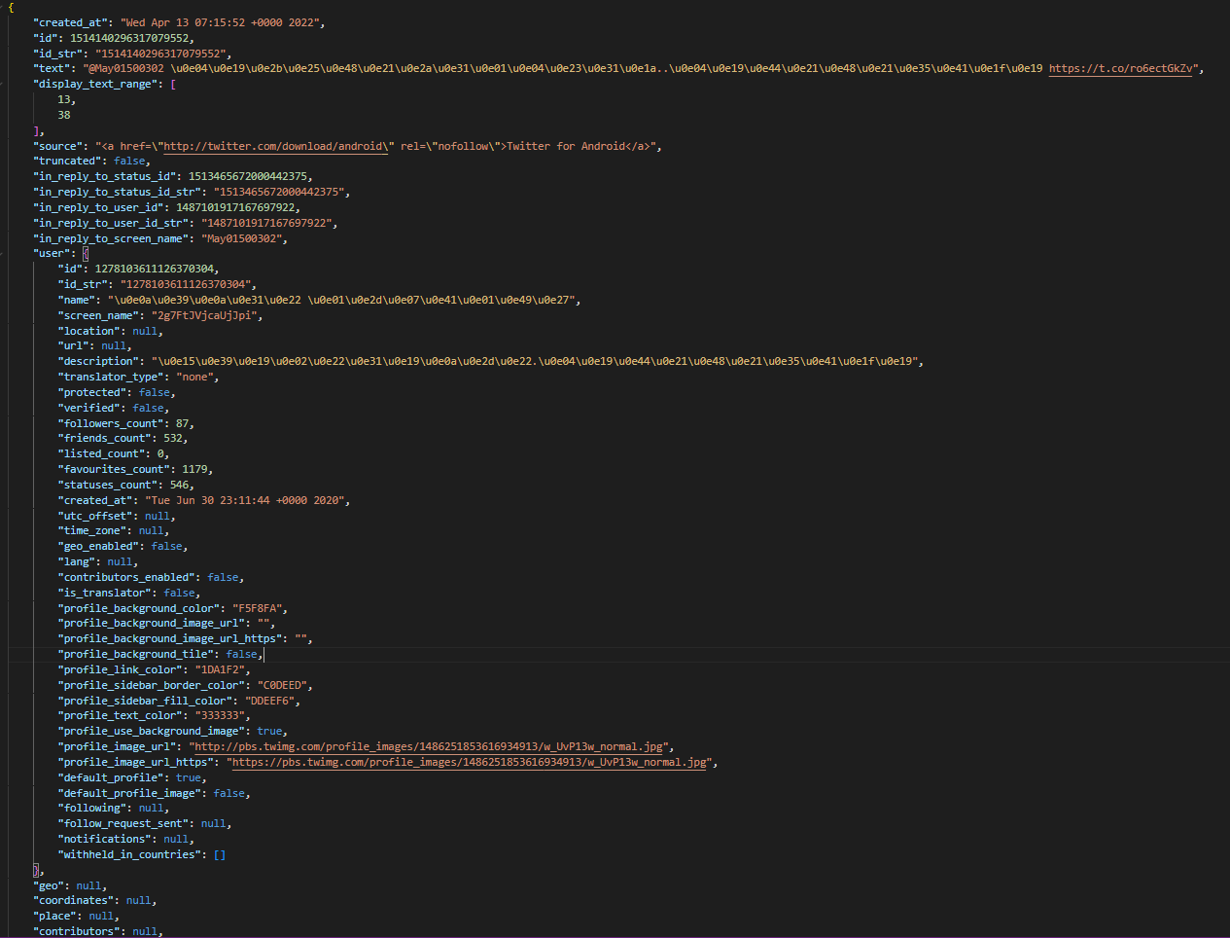

Twitter Dataset

Slide 3



SQLite
SQL
Database
Single Database file
Light weight
Transactions Follow
ACID principle
Catalogue tables
Notes:
SQLite: System Tables (techonthenet.com) := sqlite_master, sqlite_sequence, sqlite_stat1

Slide 4

This Photo by Unknown Author is licensed under CC BY-SA-NC
Advantages over SQLite
Flexible Document Schema
Easily scalable with sharding capabilities
BSON data format

Slide 5


Python Processing
Microsoft Power BI Visualization
Extract compressed files using the gzip library alongside a ChunkReader to help specify the filename
Extract the required values of desired keys from JSON objects
Insert the extracted data into SQLite
Using select queries obtain desired data and write the results to a CSV file for processing
Use CSV files obtained from the python script to populate and design data reports
This Photo by Unknown Author is licensed under CC BY-SA
This Photo by Unknown Author is licensed under CC BY
Notes:
Chunk reader is used to process similar words based on a set sequence

Slide 6


Slide 7
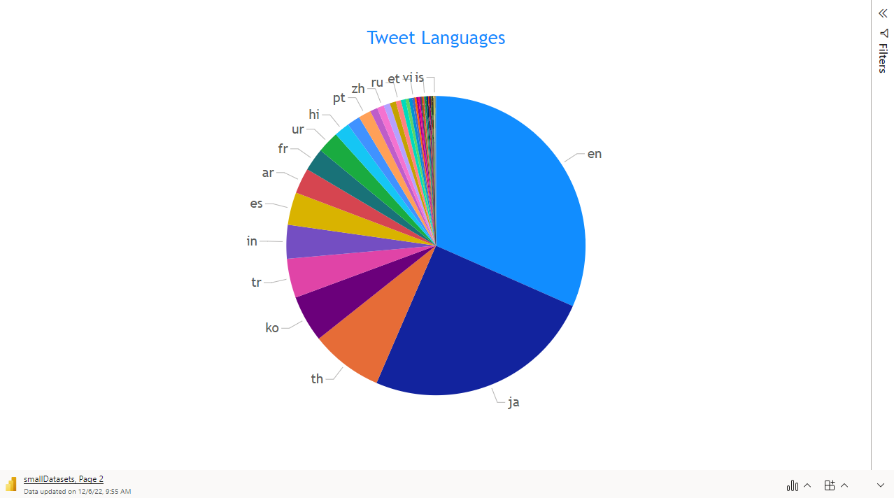

Slide 8
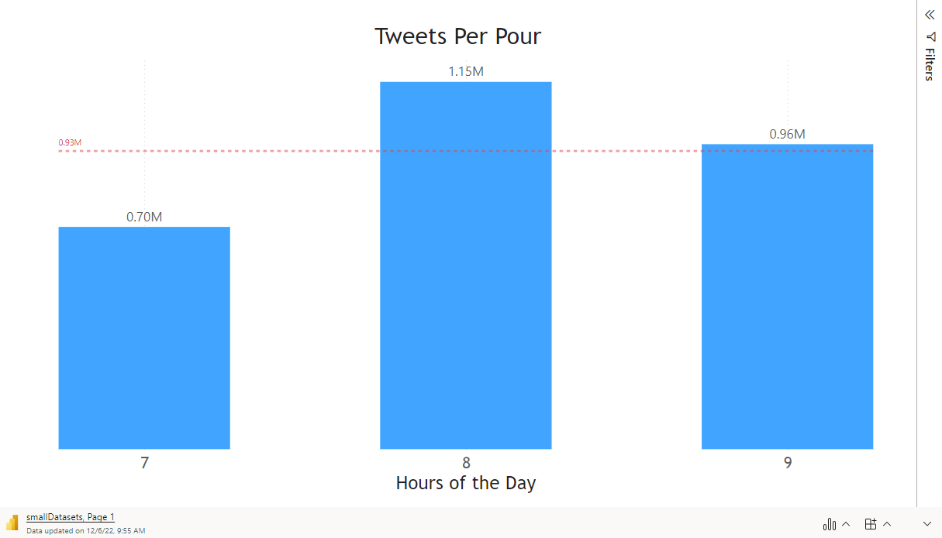

Slide 9
References
MongoDB Python Connection | MongoDB
Automated chunking of text (for learners, not search algorithms) – Brendon Albertson
The Python Standard Library — Python 3.10.6 documentation
SQLite – Python
https://github.com/nannohk/Adv-Database-prj.git

