Slide 1
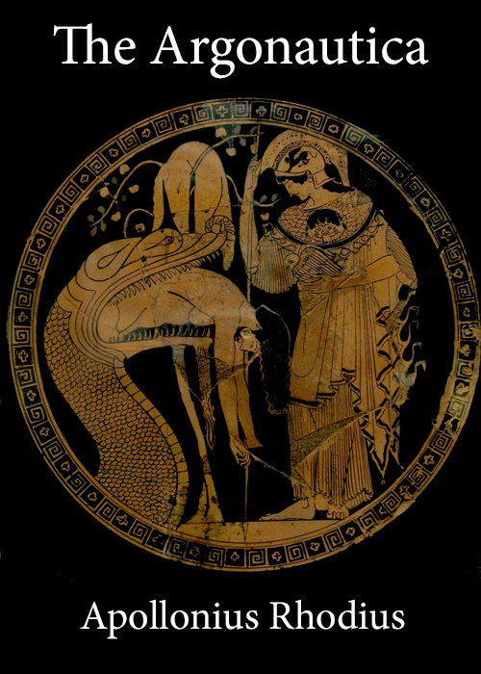
Greek Mythology Project
By Nathan Annoh-Kwafo

Slide 2
Project Aim

Slide 3
Technologies Involved

Slide 4
Process

Slide 5
Results

Slide 6
Limitations

Slide 7
References
Data Source
The Project Gutenberg EBook of The Argonautica, by Apollonius Rhodius.( https://www.gutenberg.org/files/830/830-0.txt)
Git Repository
https://github.com/nannohk/DataManagement_Greek_Mythology_Project.git

