Slide 1
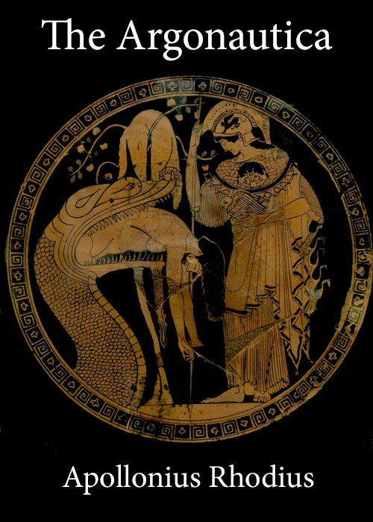
Greek Mythology Project
By Nathan Annoh-Kwafo

Slide 2
Project Aim
Create
Create a NoSQL Mongo Database of Greek mythology characters and which lines their names occur in the Argonautica.
Make
Make use of some tools learnt this semester.
Help
Help Greek mythology fans gain easily access to character content

Slide 3
Technologies Involved
Bash
Wget
Gunzip
Awk
Sed
Grep
Mongo

Slide 4
Process
Obtain the Argonautica zip file from project Gutengberg.
Unzip the zipped file with gunzip.
Using sed, Extract the Story content from the original text into a separate temporary file.
Extract character names using Awk and create respective temporal files using xargs and the touch command.
Obtain the corresponding lines for each character and place it in a prepared Mongo insert statement and pipe it into a characters Javascript file
Run Mongo and insert the character.js file to run all insert commands.

Slide 5

Sample Data and Queries

Slide 6
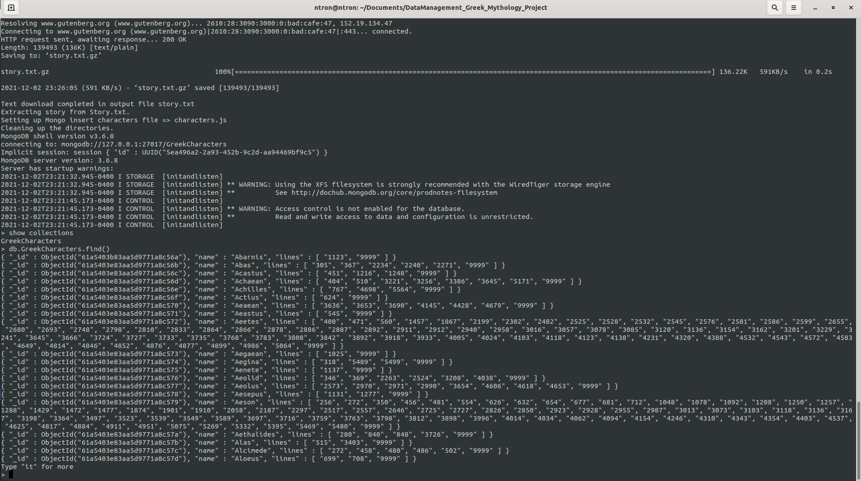

Slide 7
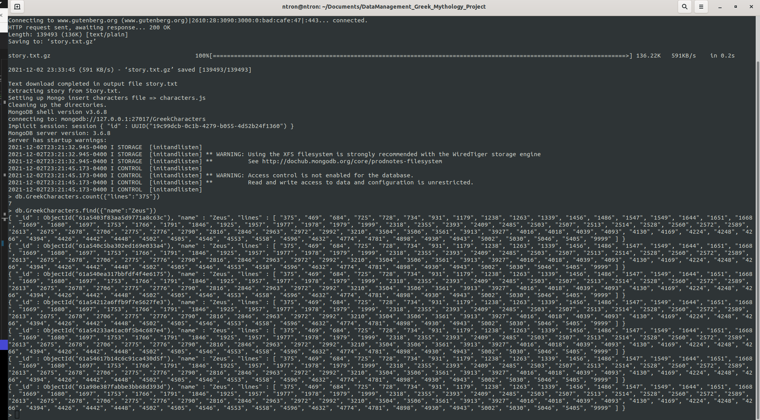

Slide 8
Limitations
Time played a major role in the volume of data each Greek character possesses in this database.
The odd phenomenon of duplicate inserts from the Mongo database is an unresolved minor issue since the data is not very large.
Mastery of the various technologies being used for this project.

Slide 9
References
Data Source
The Project Gutenberg EBook of The Argonautica, by Apollonius Rhodius.( https://www.gutenberg.org/files/830/830-0.txt)
Git Repository
https://github.com/nannohk/DataManagement_Greek_Mythology_Project.git

