Slide 1

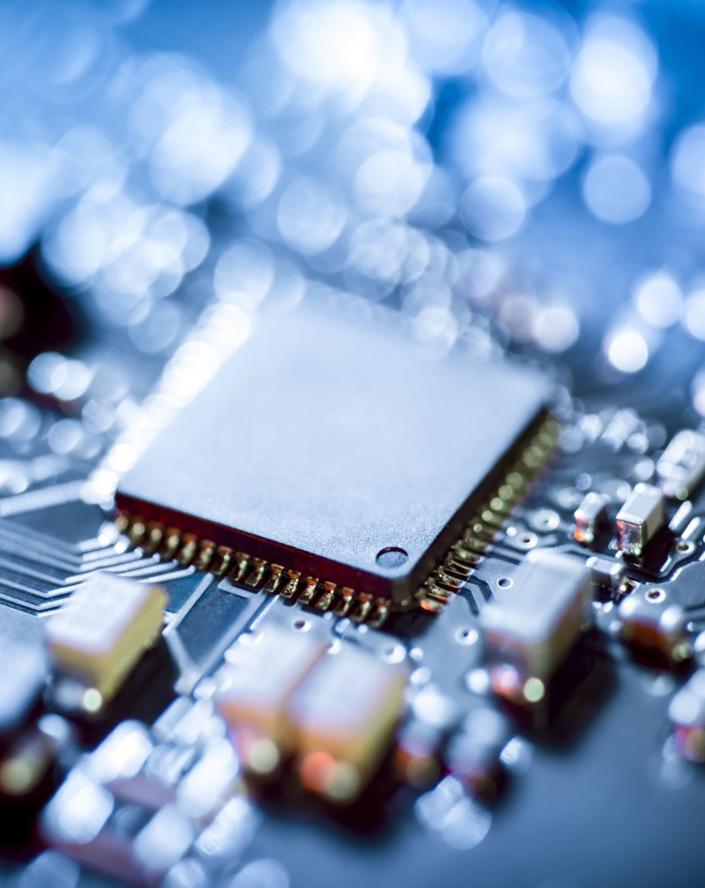
CPU / GPU Benchmark
Nathan Annoh-Kwafo
Fall CS 3813 Project

Slide 2
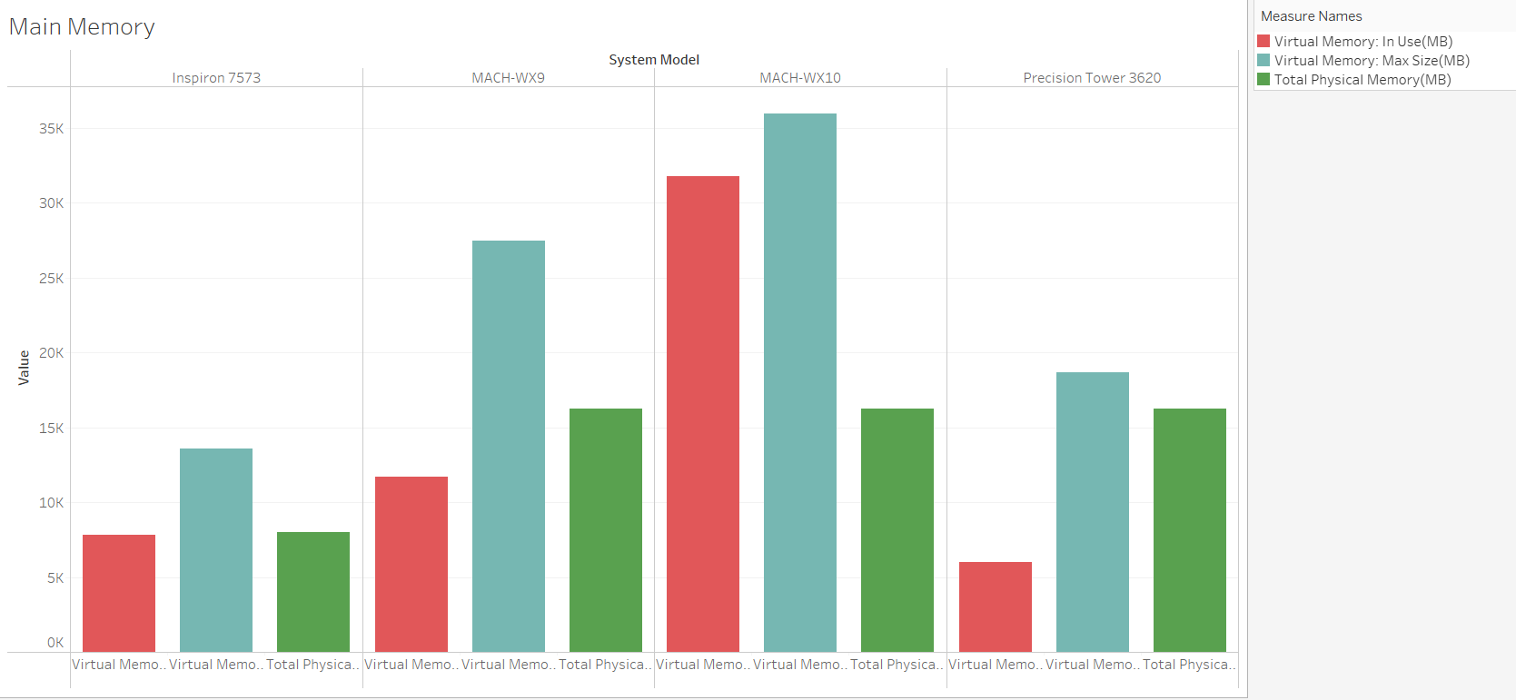

Slide 3
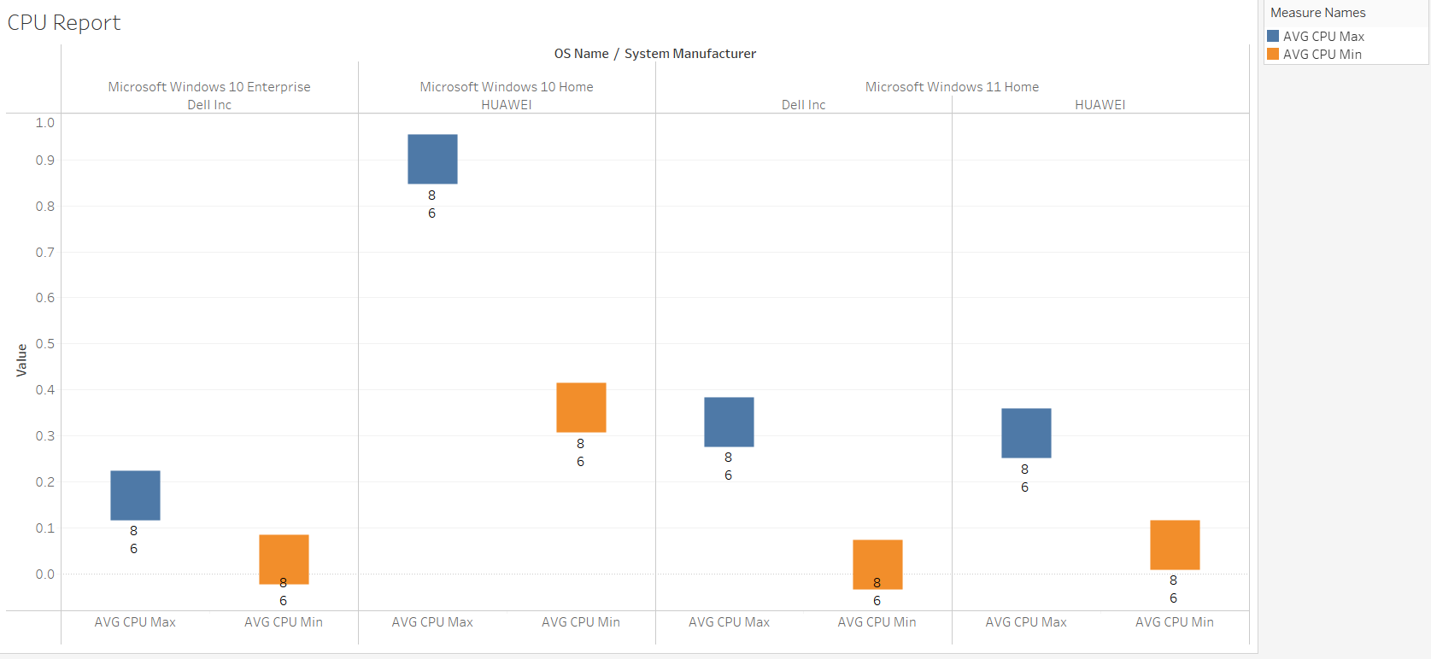

Slide 4
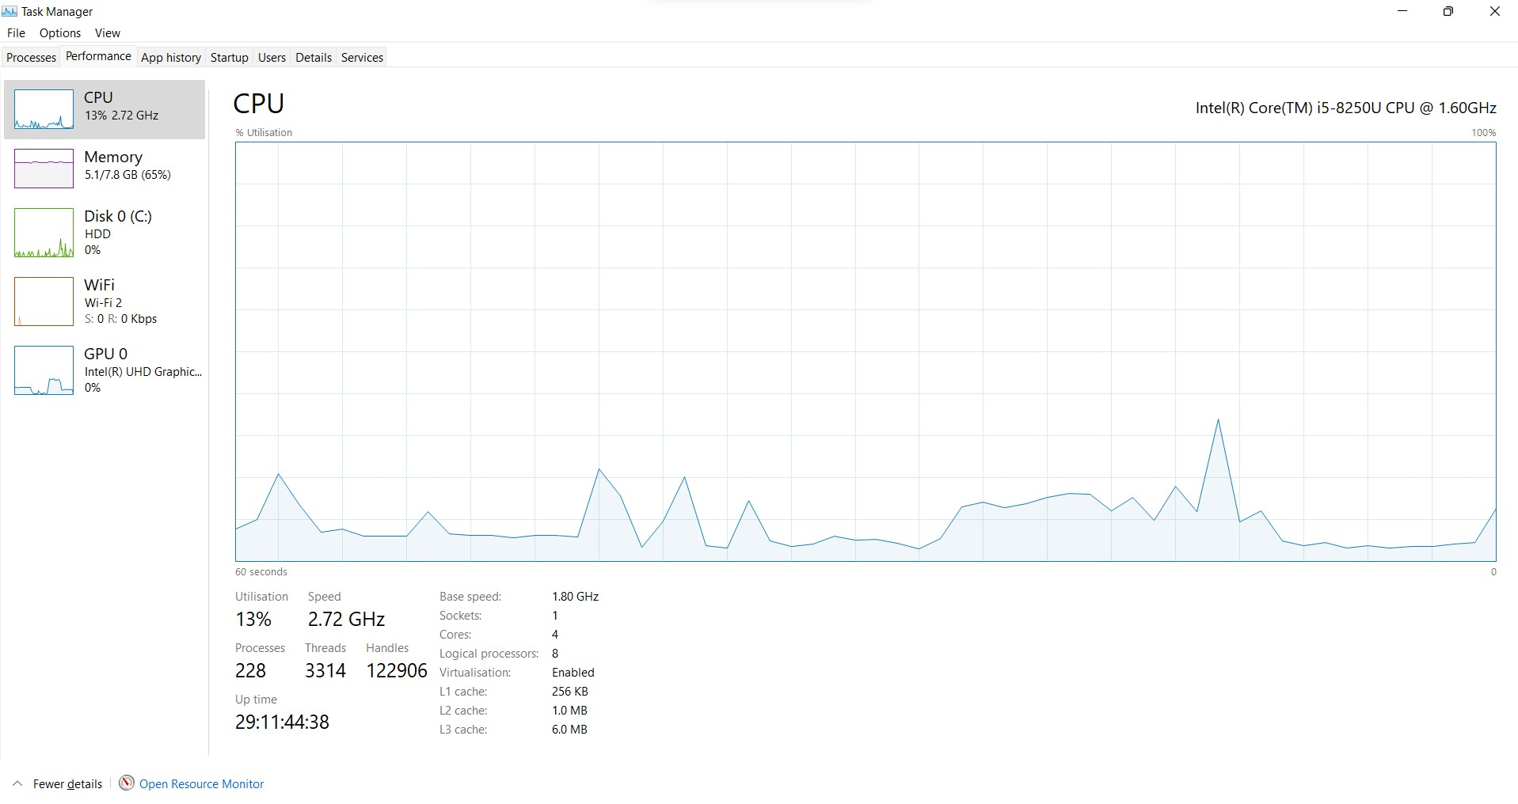

Slide 5
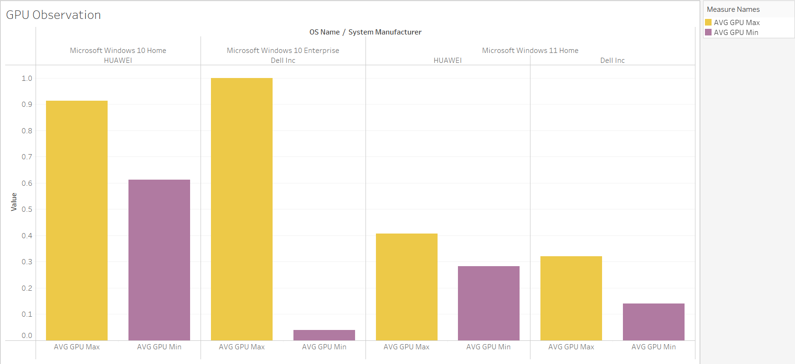

Slide 6
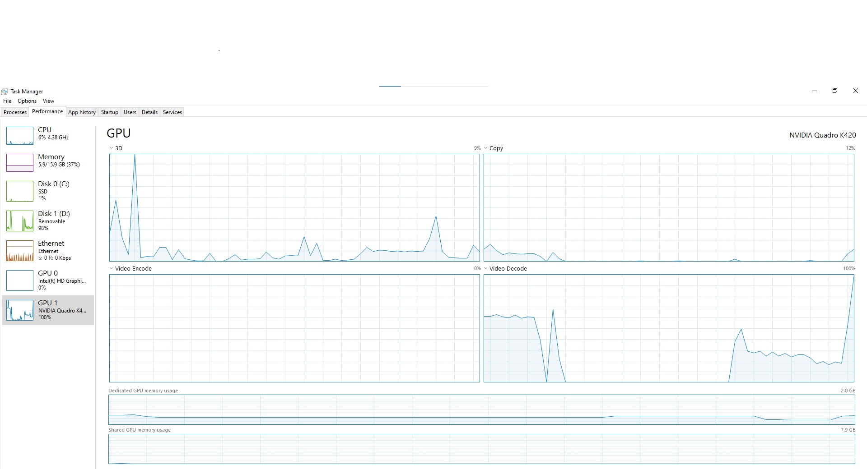

Slide 7
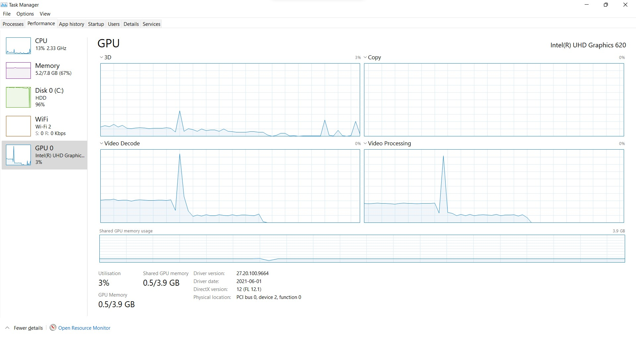

Slide 8

References
https://github.com/nannohk/GPU_Benchmark.git
https://docs.oracle.com/en/java/javase/15/docs/api/index.html
https://www.pexels.com/videos/
https://www.videvo.net/

