Slide 1


CPU / GPU Benchmark
Nathan Annoh-Kwafo
Fall CS 3813 Project

Slide 2
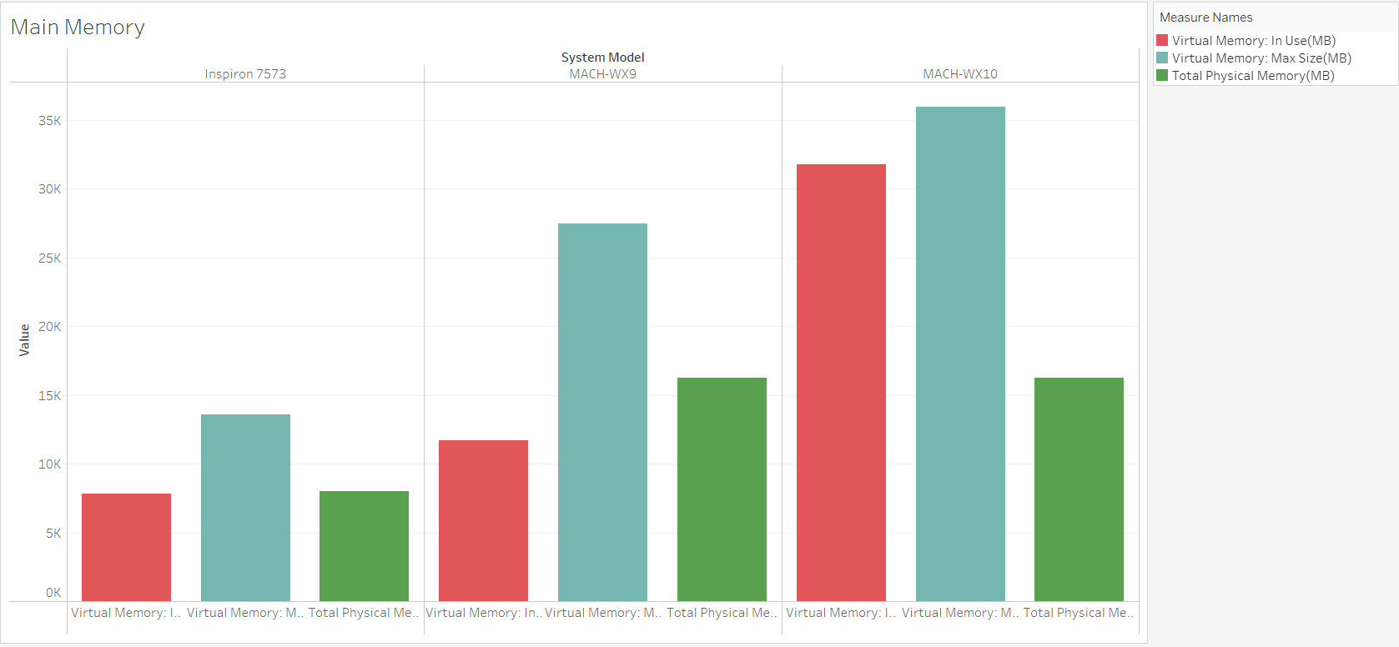

Slide 3
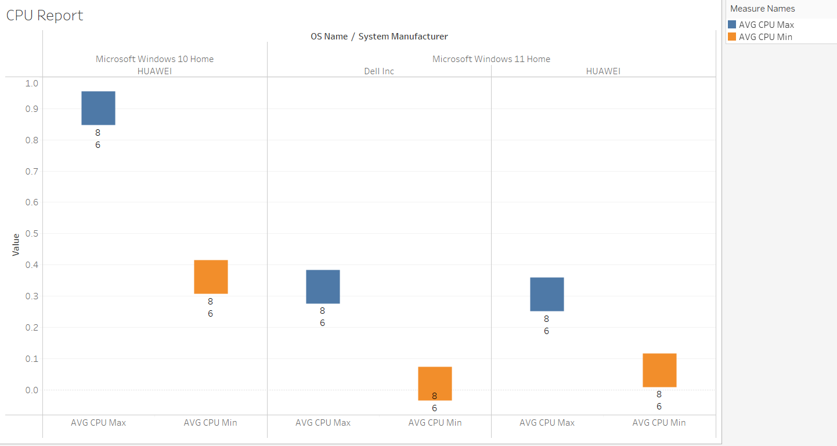

Slide 4
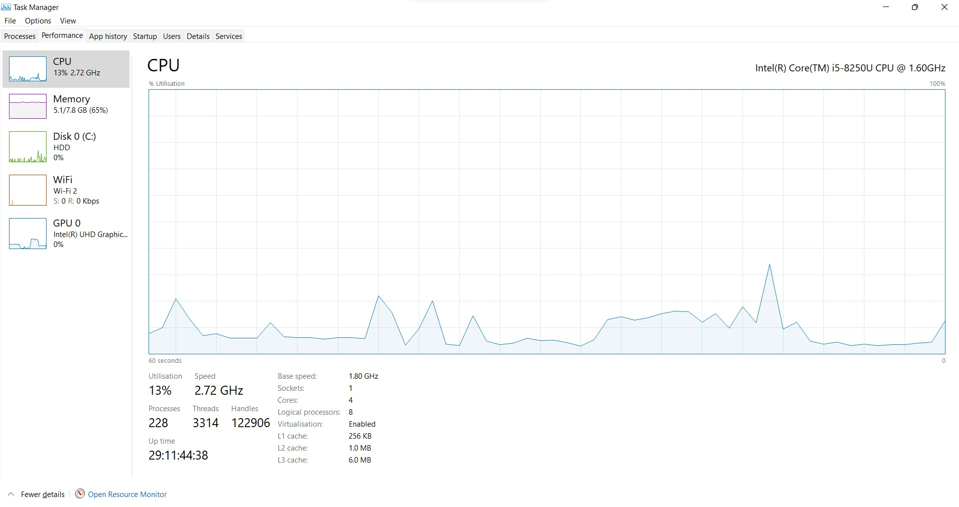

Slide 5
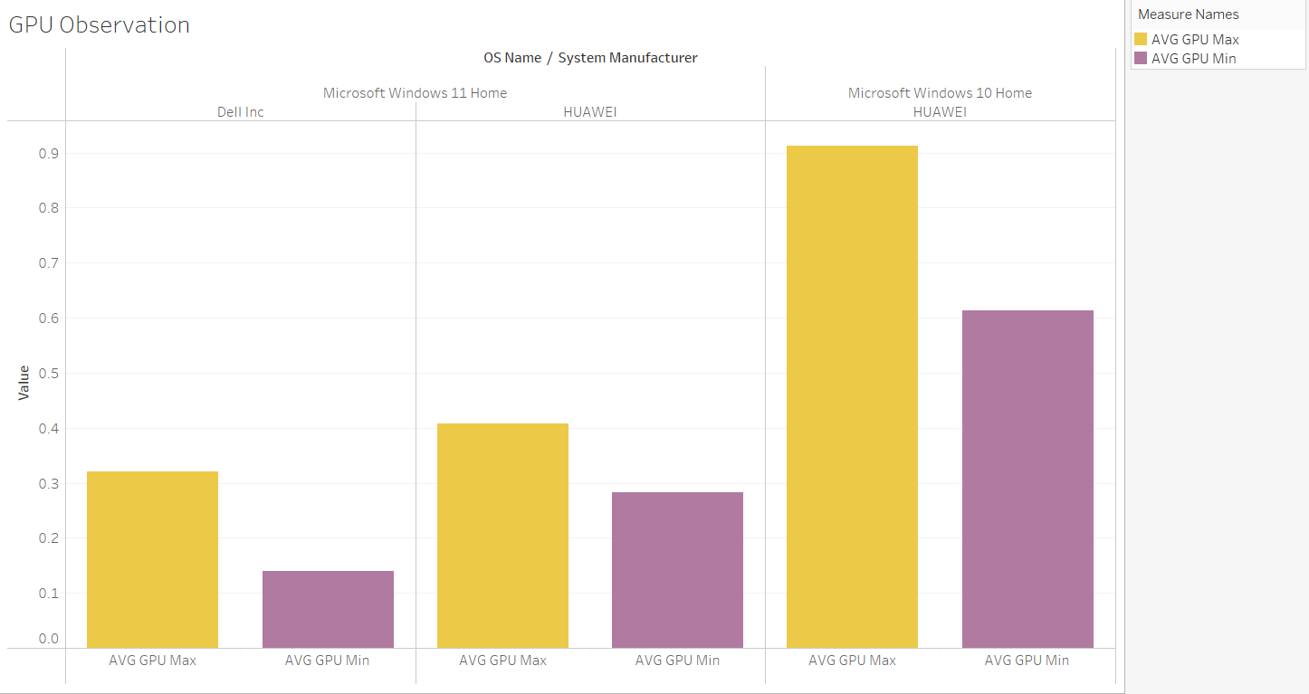

Slide 6
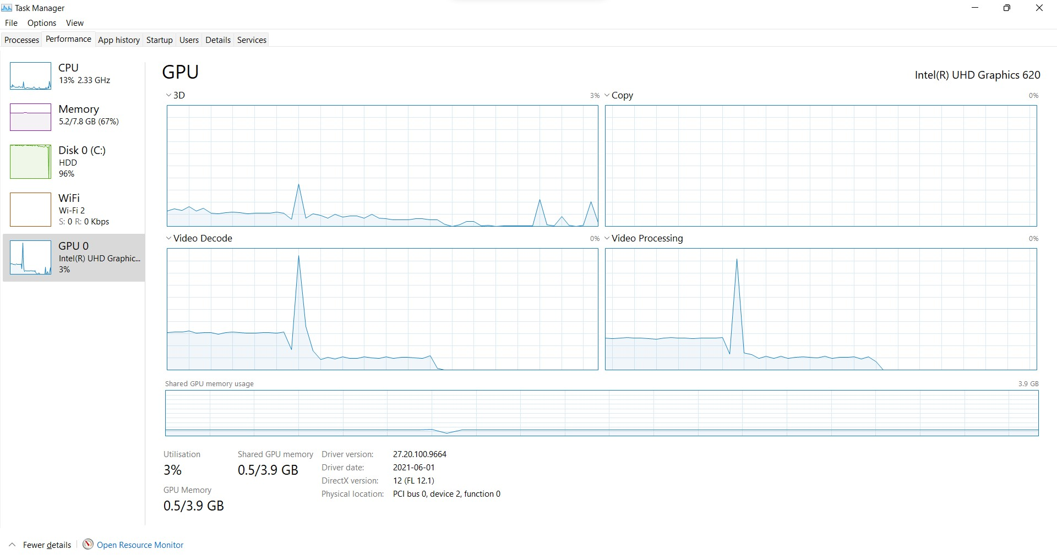

Slide 7

References

