Slide 1

Full Stack Application Development
Nathan Annoh-Kwafo
This Photo by Unknown Author is licensed under CC BY-NC

Slide 2

What is a Full Stack Application?
An end-to-end application software made up of components (stacks) that include both back (server components) and front end (client components)

Slide 3

Front-end Component (Vue.js)
A highly adaptable JavaScript framework used to create interactive user interfaces.
It has a mildly steep learning curve for beginners because of its simple and light weight nature.
Due to its lightweight properties, pages developed in Vue are highly responsive and have a short load time as compared to other JavaScript Frameworks
This Photo by Unknown Author is licensed under CC BY-SA-NC

Slide 4
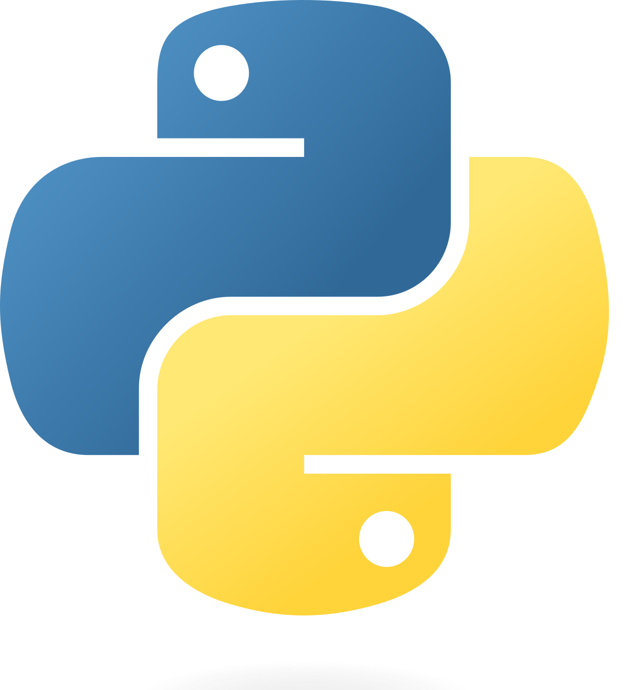
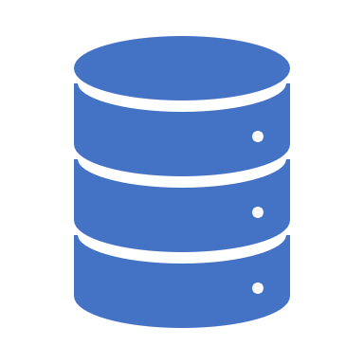
Back-end Components
Python Server Application
Contains libraries that make managing server capabilities relatively easy
Easy access to documentation
Easily interacts and manages database functionalities
SQLite Database
Follows the ACID principle
Stores data in one database file
Contains a database catalog initialized upon the database’s creation
This Photo by Unknown Author is licensed under CC BY-SA

Slide 5
Key Application Modules
Axios: A simple promise based HTTP client for browsers and node.js
Flask: A python microframework used to develop web applications quickly and efficiently by managing core functionalities such as routing
Flask Cross Origin Resource Sharing: This flask extension handles resource sharing between different domains and specified routes
JSON library: This python library is mainly used to serialize to and from JSON when processing client requests.

Slide 6

Source Code Management System
This Photo by Unknown Author is licensed under CC BY-SA-NC

Slide 7


Problem Statement
Full Stack
Web Application
Health Care companies require an in-house solution to manage both their caregivers’ information along side patient data
This Photo by Unknown Author is licensed under CC BY-SA-NC
Notes:
Mention FHIR in the presentation of the form

Slide 8
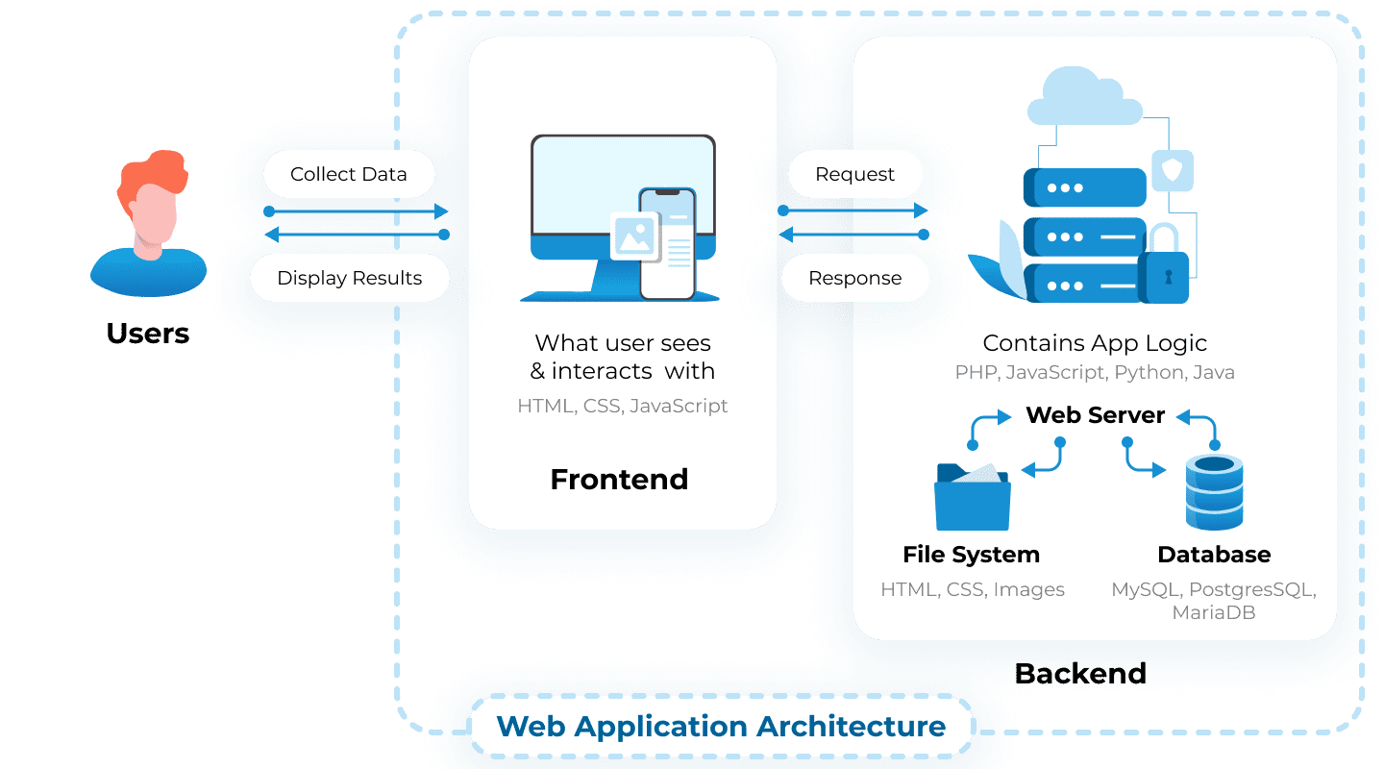
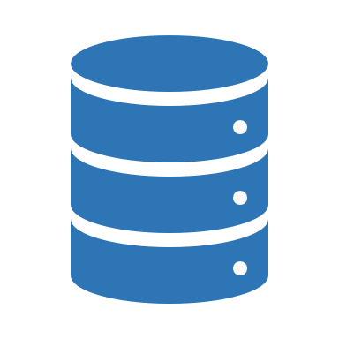
VueJS
Python
https://litslink.com/blog/web-application-architecture

Slide 9

Demo

Slide 10

Thank you!

Slide 11

References
Patient - FHIR v5.0.0-cibuild
https://build.fhir.org/datatypes.html#HumanName
Web Application Architecture: A Guide Through the Intricate Process of Building an App | LITSLINK Blog
Axios (axios-http.com)
Python Flask Introduction - Python Geeks

