Slide 1

A Case Study on Full Stack Application Development: Building a Patient-Care Community
Nathan Annoh-Kwafo
This Photo by Unknown Author is licensed under CC BY-NC

Slide 2

What is a Full Stack Application?
A modern trend of building applications
An end-to-end application software made up of components (stacks) that include both back (server components) and front end (client components)

Slide 3
Benefits of Full Stack Applications
They fit iterative development methods
Are relatively easy to upgrade
Provide better support when troubles arise

Slide 4
Full Stack Application Composition
Frontend Framework
Backend Framework

Slide 5








Choosing a Front-end Framework
This Photo by Unknown Author is licensed under CC BY-SA

Slide 6
Front-end Component (Vue.js)
A highly adaptable JavaScript framework used to create interactive user interfaces.
It has a mildly steep learning curve for beginners because of its simple and light weight nature.
Due to its lightweight properties, pages developed in Vue are highly responsive and have a short load time as compared to other JavaScript Frameworks
This Photo by Unknown Author is licensed under CC BY-SA-NC

Slide 7

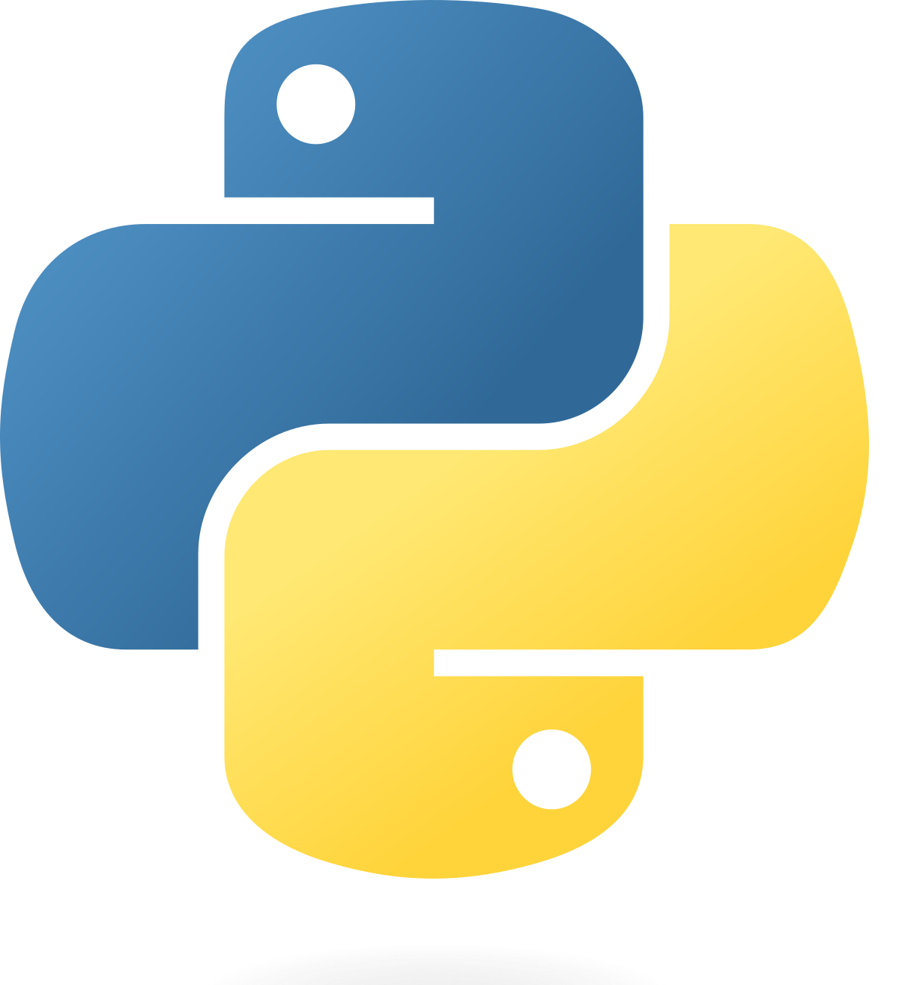
Choosing a Backend Framework
This Photo by Unknown Author is licensed under CC BY-SA
This Photo by Unknown Author is licensed under CC BY-SA

Slide 8
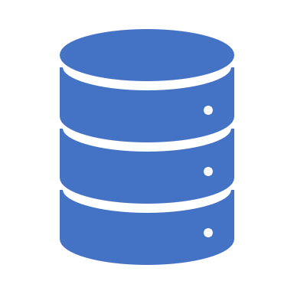
Back-end Components
Python Server Application
Contains libraries that make managing server capabilities relatively easy
Easy access to documentation
Easily interacts and manages database functionalities
SQLite Database
Follows the acid principle
Stores data in one database file
Contains a database catalog initialized upon the database’s creation
This Photo by Unknown Author is licensed under CC BY-SA

Slide 9
Key Application Modules
Axios: A simple promise based HTTP client for browsers and node.js
Flask: A python microframework used to develop web applications quickly and efficiently by managing core functionalities such as routing
Flask Cross Origin Resource Sharing: This flask extension handles resource sharing between different domains and specified routes
JSON library: This python library is mainly used to serialize to and from JSON when processing client requests.

Slide 10

Development Process
Initial Stage
Setting up the source code repository
Frontend Authentication Design
Backend Authentication Implementation
Integration Stage
Transferring Data between the front and backend
User Registration
User Profile update
Notes:
Add a few commands

Slide 11

Source Code Management System
git init
git branch
git add
git commit
git push
This Photo by Unknown Author is licensed under CC BY-SA-NC
Notes:
Add a few commands

Slide 12


Problem Statement
Full Stack
Web Application
Health Care companies require an in-house solution to manage both their caregivers’ information along side patient data
This Photo by Unknown Author is licensed under CC BY-SA-NC
Notes:
Mention FHIR in the presentation of the form

Slide 13
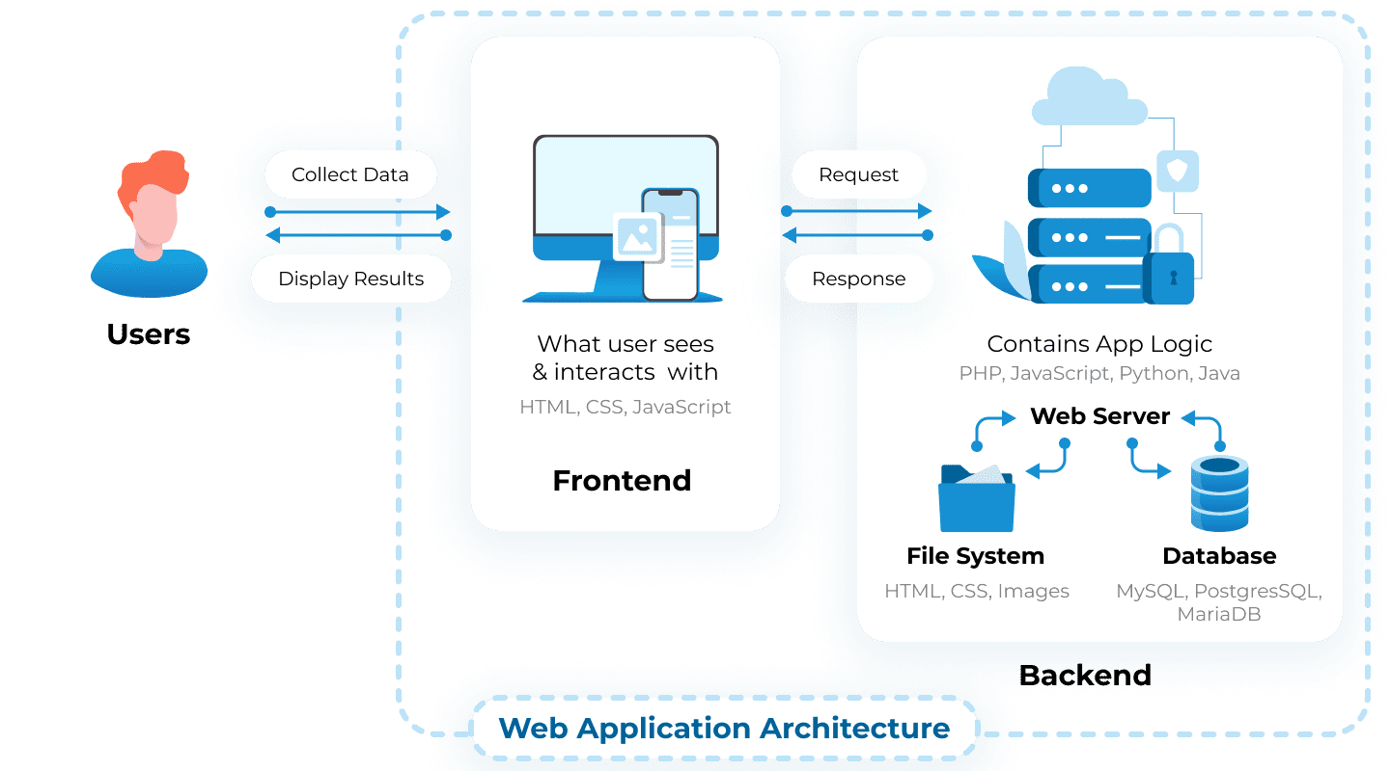
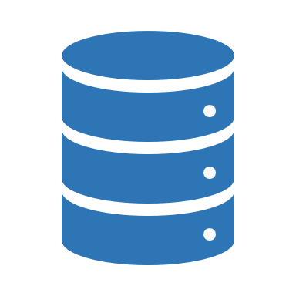
VueJS
Python
https://litslink.com/blog/web-application-architecture

Slide 14

Demo

Slide 15

Thank you!

Slide 16

References
Patient - FHIR v5.0.0-cibuild
https://build.fhir.org/datatypes.html#HumanName
Web Application Architecture: A Guide Through the Intricate Process of Building an App | LITSLINK Blog
Axios (axios-http.com)
Python Flask Introduction - Python Geeks

