Slide 1

Caregiver Management Application
Nathan annoh-kwafo
This Photo by Unknown Author is licensed under CC BY-SA

Slide 2


Industry Challenges
Difficulty in keeping track of caregivers and their aligned patients
Outsourcing patient information management technologies

Slide 3

The solution
A Web Application where both caregivers and hospitality organizations can both have access to managed patient and user information

Slide 4
Why , What, How
App story line

Slide 5
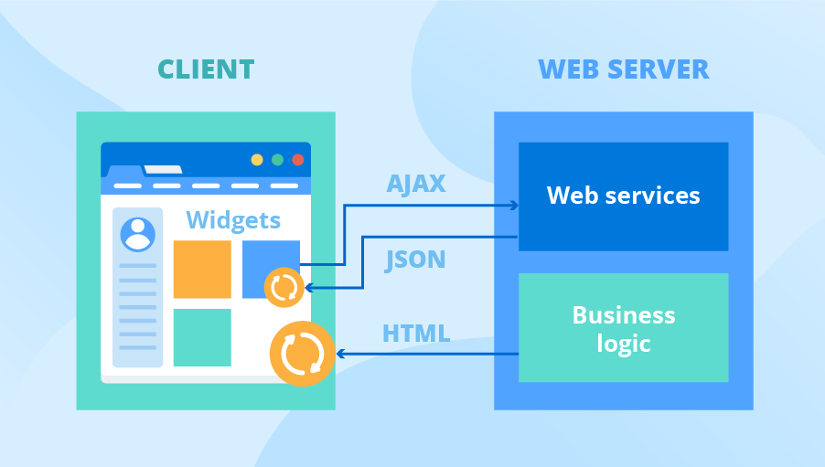
Layered Software Architecture

Slide 6
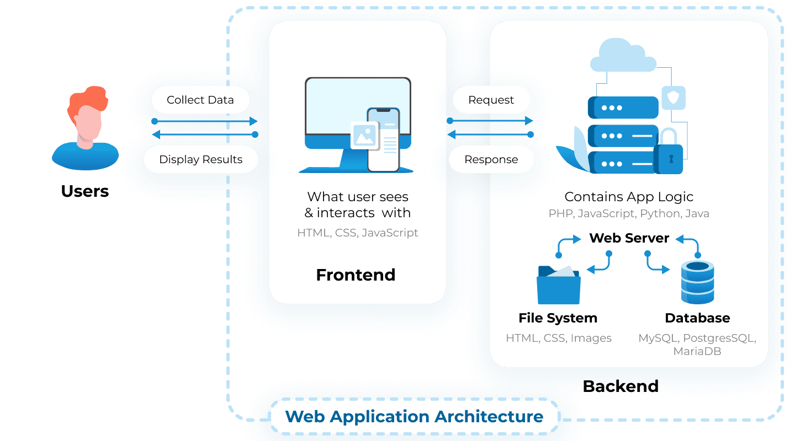

VueJS
Python
https://litslink.com/blog/web-application-architecture
Notes:
https://litslink.com/blog/web-application-architecture

Slide 7

Database

Slide 8

Processing tools

Slide 9
Vue js

Slide 10

References
Patient - FHIR v5.0.0-cibuild
https://build.fhir.org/datatypes.html#HumanName
Web Application Architecture: A Guide Through the Intricate Process of Building an App | LITSLINK Blog

