Slide 1
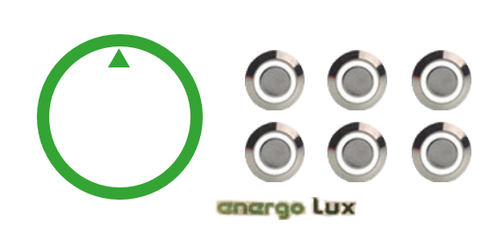
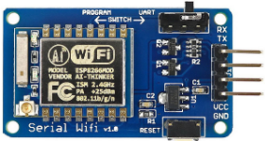
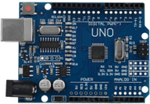
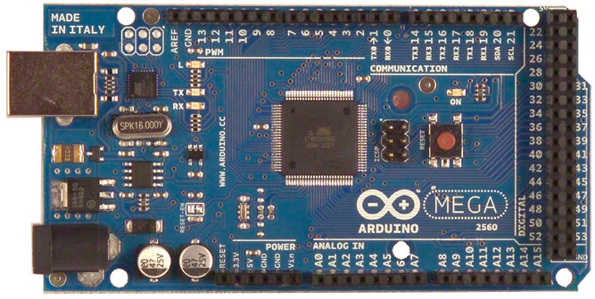
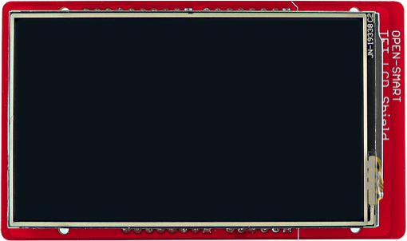
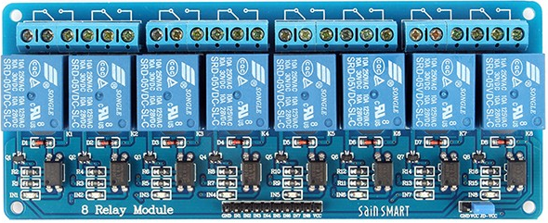
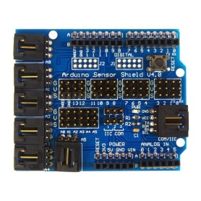
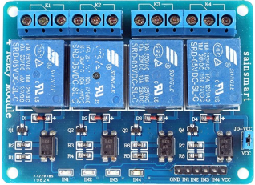


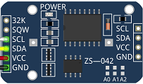
VCC
WiFi
WCU
Power Supply
+5V
+12V
UART
Digital Input
DOUT LED Control
I2C
VCC
UART
8-BIT BUS
DOUT
Relay control
DOUT Relay control
HAJDU
Electromechanical Unit
Relay Contacts
TFT LCD
MP3
Level control
and protection
unit
RTC
Digital & Analog Input
HAJDU Energo Smart
Block diagram
2017.6.1

Slide 2


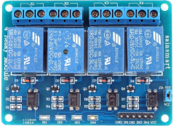

HAJDU Energo Smart
Wiring Scheme
2017.6.1
+VCC
B1
B2
B3
B4
B5
B6
B7
B8
GND
X4
X3
SCOM
T36
T55
T85
WL1
WL2
WL3
WCU
MEGA 2560
WIFI (ESP8266)
RTC (DS3231)
MP3 DFPlayer
JP10
+VCC
B9
B10
B11
B12
GND
JP11
ROT1
ROT2
ROT3
PB1
PB2
PB3
PB4
LED1
LED2
LED3
LED4
GND
+12V
+5V
DOOR_LOCK
T124FUSE
CURR_OUT
MAIN SW
GND
JP9
FLOW
RATE
SDA
SCL
+12V
GND
+M5V
PULSE
GND
JP8
JP14
JP13
WMU
Motors
Radiators
Actuators
Sensors
DISPLAY
Arduino UNO driven
+5V
GND
+5V
GND
+12V
+5V
DOOR_LOCK
T124FUSE
CURR_OUT
MAIN SW
GND
JP4
JP5
JP6
POWER BOARD
Power Supply +5V, +12V
U-Detectors 1, 2
Main SW Relay 1, 2
Current Sensor
JP3
U-DETECTOR LINES
DOOR_LOCK
T124FUSE
JP2
AC IN
WMU POWER LINE
~240VAC
AC OUT
JP1
KEYPAD
Buttons and LEDs
~240VAC

