Slide 1
Data Story
Seeds

Slide 2
Wrangling
UCI Machine Learning Repository
http://archive.ics.uci.edu/ml/datasets/seeds
3 classes(species) of wheat seeds
Kama, Rosa, Canadia
7 geometric features for each class
Area, perimeter, compactness, length, width, asymmetry coefficient, groove length
Raw data had minor corruption
Misaligned data in 5% of rows
Corrected with python, pandas, and lists

Slide 3
Description of the Data
Summary statistics

Slide 4
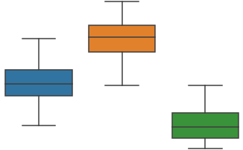
Initial EDA
Scatterplots
Show great correlation and clustering
A few possible misclassifications/outliers
Histograms somewhat normally distributed
Box plots show feature mean separation
4.0
Width (cm)
2.6
class

Slide 5
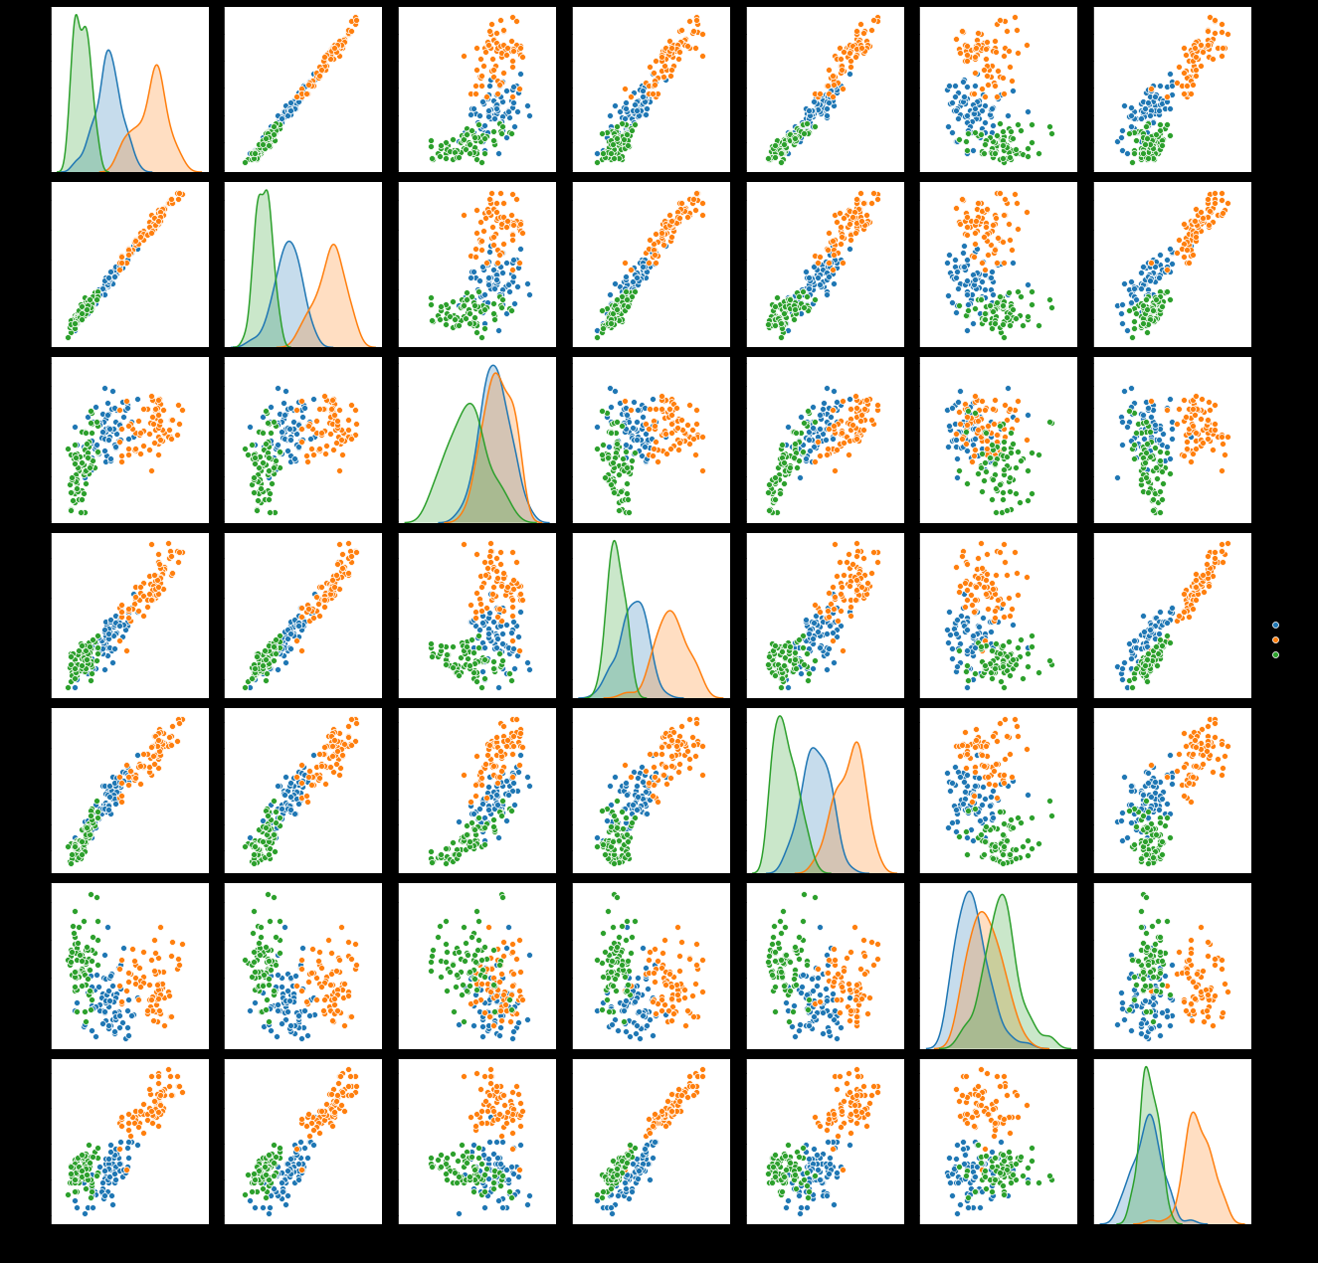
Initial EDA
Good clustering
Good linear trend in most clusters

Slide 6
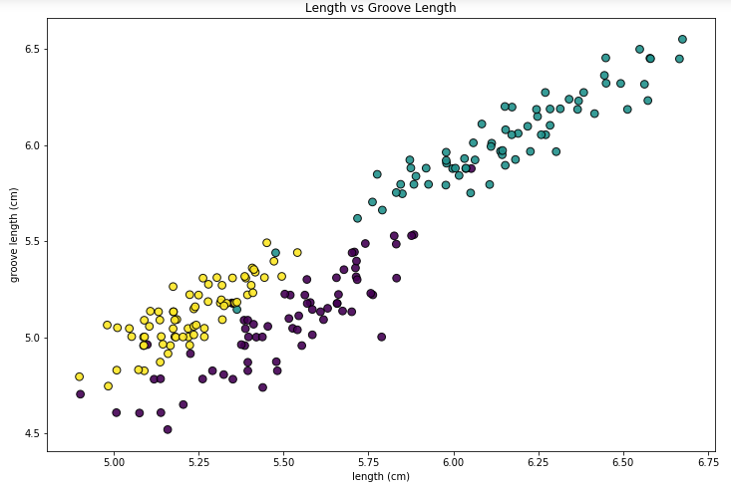
Initial EDA
Most clear clusters

Slide 7
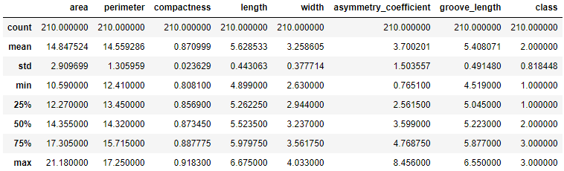
Statistical Analysis
Bootstrapping
Pearson R Coefficient & p - values

Slide 8
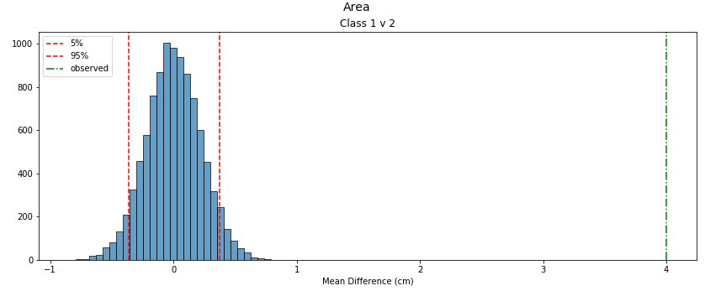
Statistical Analysis
Bootstrapping
Are observed differences in seed features representative of the overall population, or a random observation due to sample size?

Slide 9
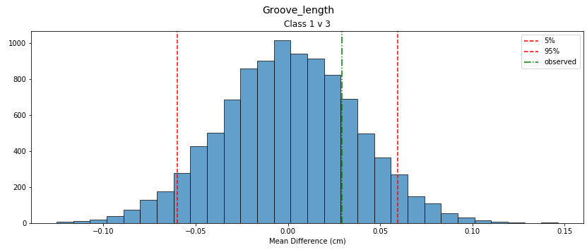
Statistical Analysis
Bootstrapping
Most values with p-value of 100%
Smallest p: 78.5%

Slide 10
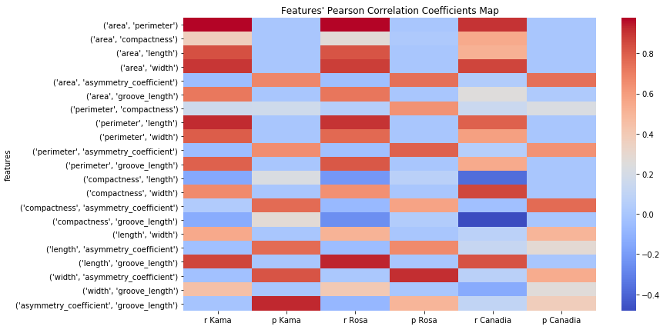
Statistical Analysis
Pearson Correlation
Heat-map of R and p

Slide 11
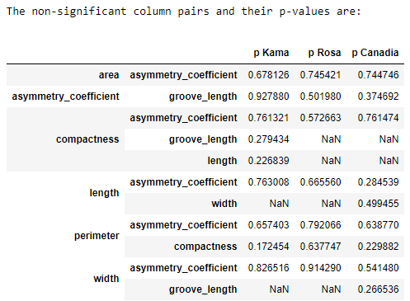
Statistical Analysis

