Slide 1
Data Story E. Erik Larsen
Capstone Project I:
Seeds

Slide 2
Wrangling
UCI Machine Learning Repository
http://archive.ics.uci.edu/ml/datasets/seeds
3 classes(species) of wheat seeds
Kama, Rosa, Canadia
7 geometric features for each class
Area, perimeter, compactness, length, width, asymmetry coefficient, groove length
Raw data had minor corruption
Misaligned data in 5% of rows
Corrected with python, pandas, and lists

Slide 3
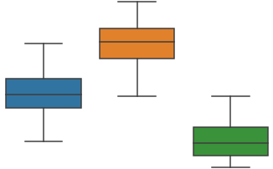
Initial EDA
Scatterplots
Show great correlation and clustering
A few possible misclassifications
Histograms somewhat normally distributed
overlapping distributions
Box plots show feature mean separation
4.0
Width (cm)
2.6
class

Slide 4
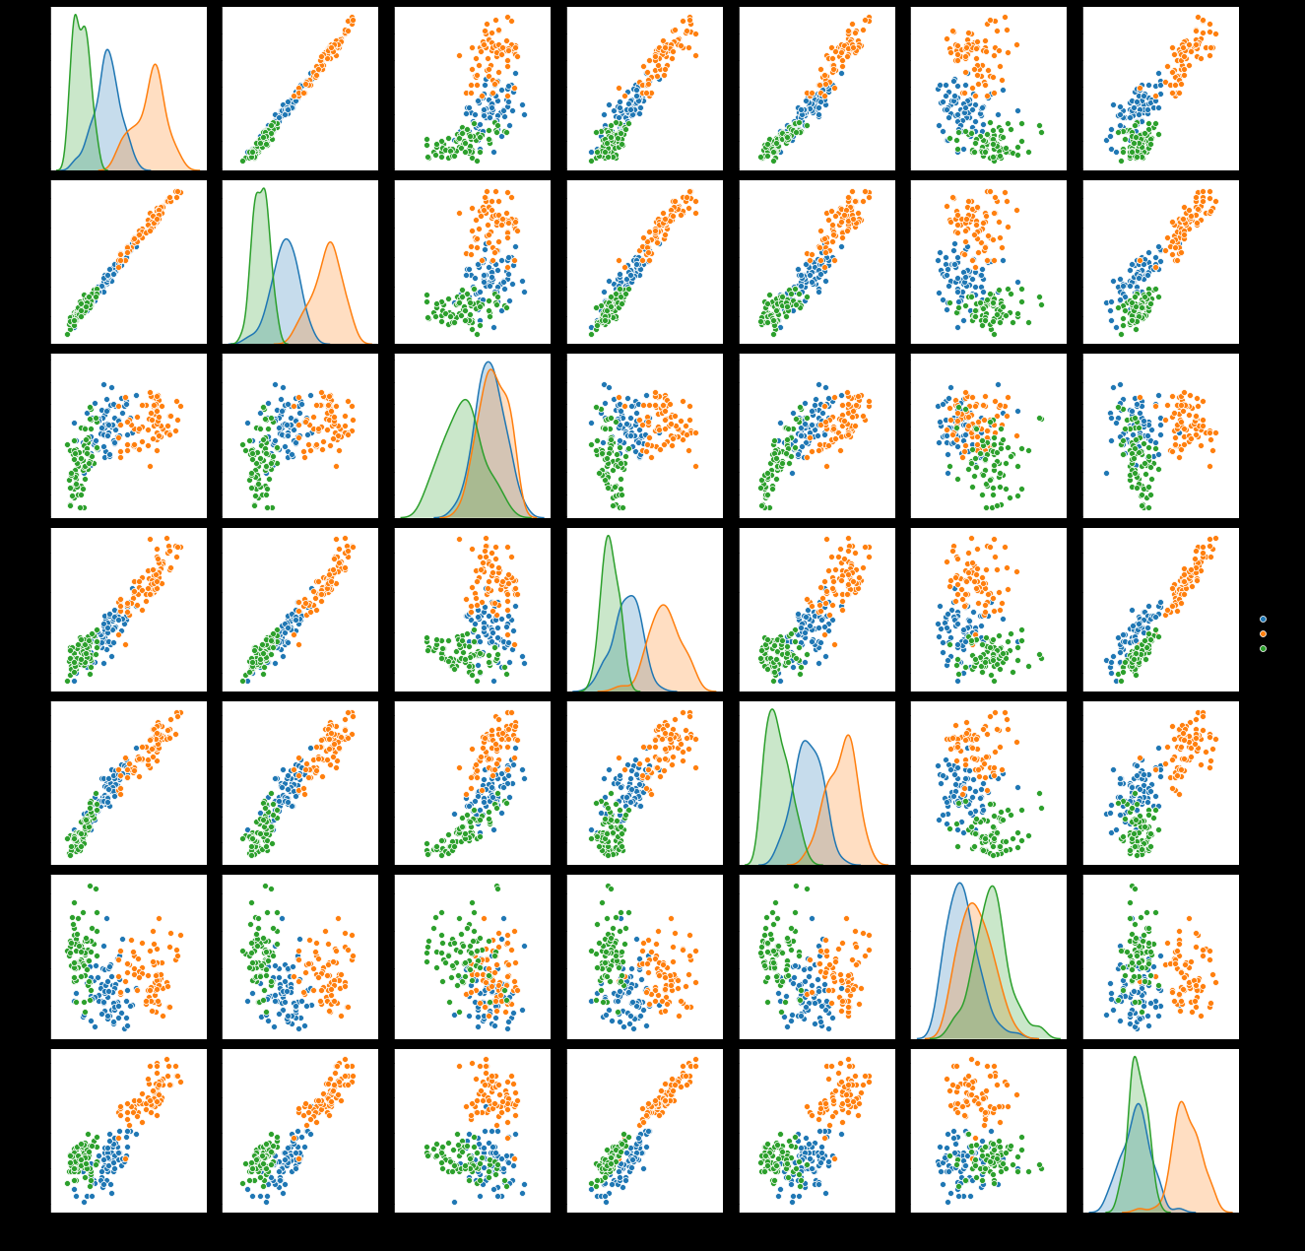
Initial EDA
Good clustering
Linear trend in many comparisons

Slide 5
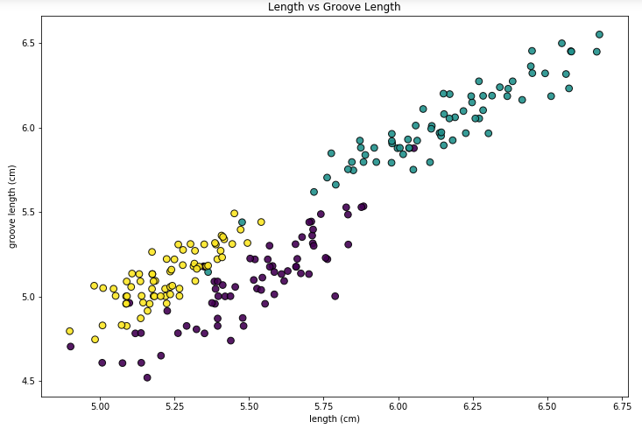
Initial EDA
Most clear clusters

Slide 6
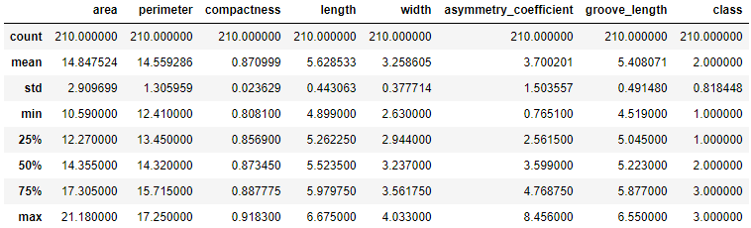
Statistical Analysis
Summary statistics
Bootstrapping
Pearson R Coefficient & p - values

Slide 7
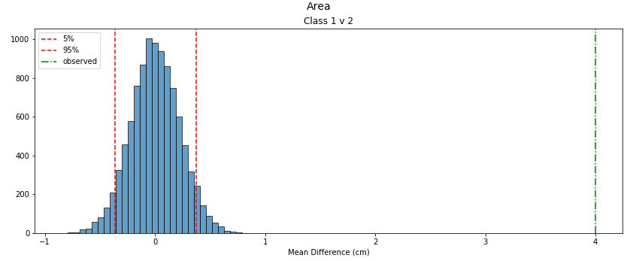
Statistical Analysis
Bootstrapping
Are observed differences in seed features representative of the overall population, or a random observation due to sample size?

Slide 8
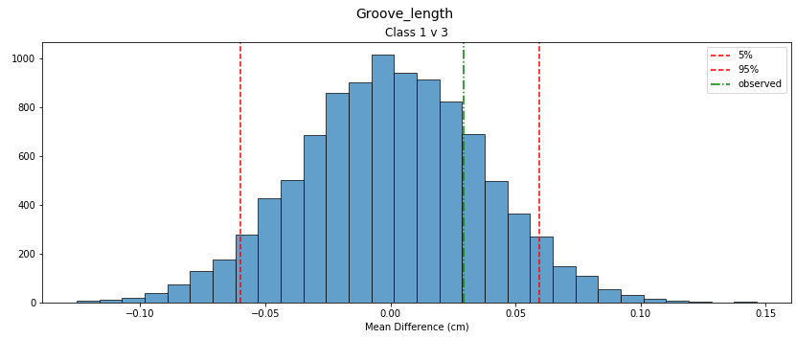
Statistical Analysis
Bootstrapping
Most values with p-value of 100%
Smallest p: 78.5%

Slide 9
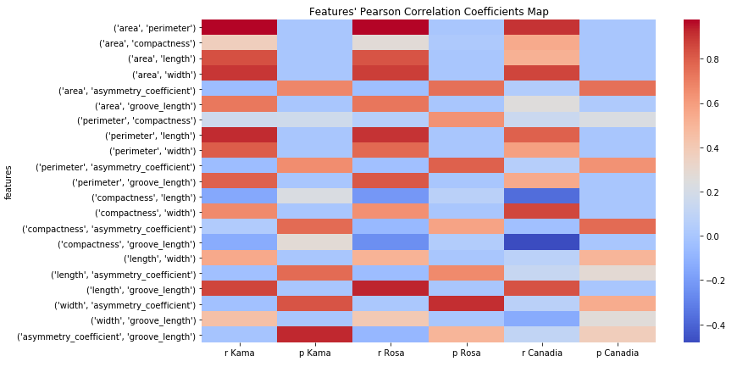
Statistical Analysis
Pearson Correlation
Heat-map of R and p

Slide 10
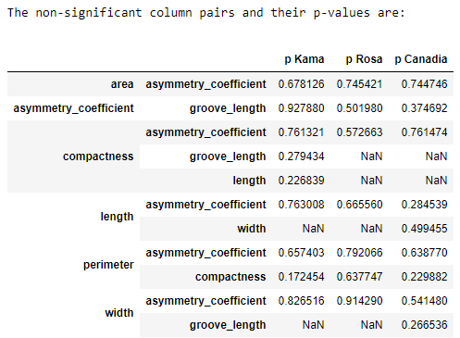
Statistical Analysis

Slide 11
Machine Learning
K-Nearest Neighbors
Logistic Regression
Naïve Bayes
K-Means
Neural Network

Slide 12
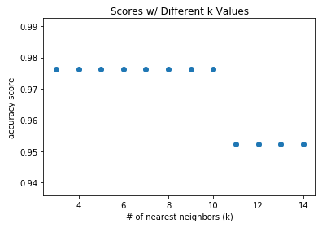
Machine Learning
K-Nearest Neighbors
n_neighbors = 5
accuracy = 97.6%
no other hyper-parameter tuning

Slide 13
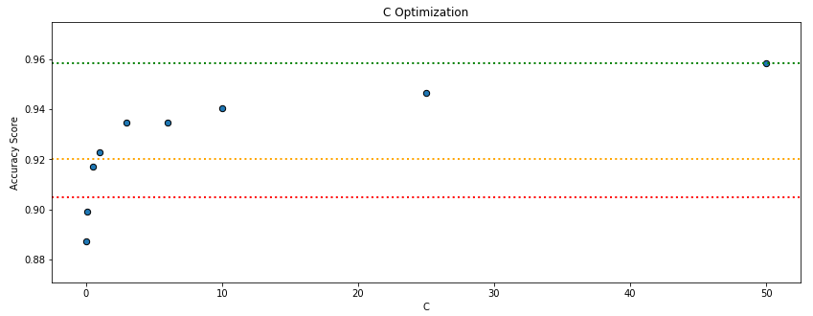
Machine Learning
Logistic Regression
initial accuracy: 90.5%
with cross validation and regularization: 95.9%
5-fold CV
optimizied C: 37.5

Slide 14
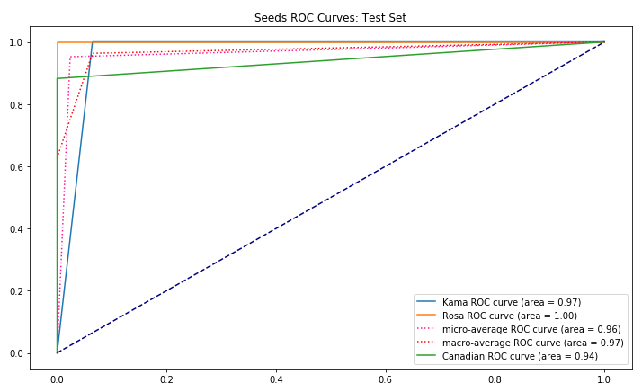
Machine Learning
Logistic Regression
ROC curve and AUC score

Slide 15
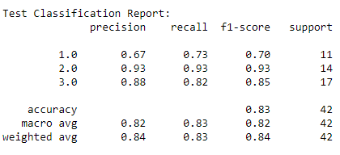
Machine Learning
Naïve Bayes
Poor performance: 85.7%
After 5-fold CV: 92%

Slide 16
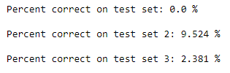
Machine Learning
K-Means
Worst performance: 14.9%
Overlapping distributions
Mixing of clusters

Slide 17
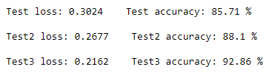
Machine Learning
Neural Network
keras
dense, Sequential model
2 hidden layers, ‘relu’ activation
output layer ‘softmax’ activation
500 epochs, ‘sparse_categorical_crossentropy’ loss
Feature selection improves performance
compactness and area removed in test 3

Slide 18
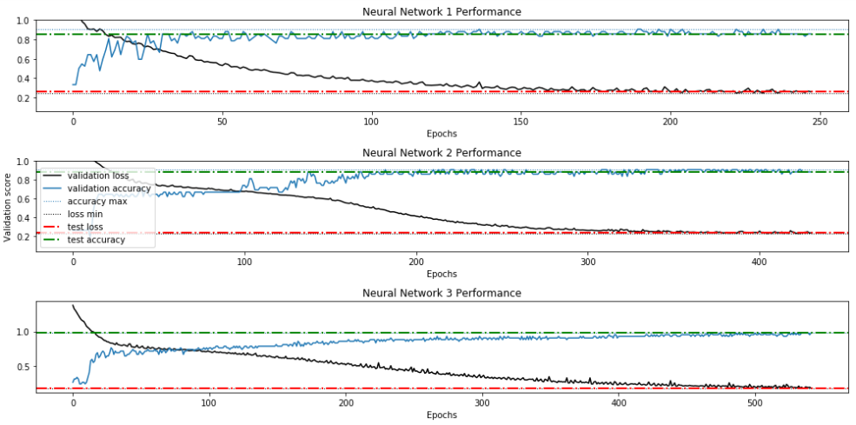
Neural Network Performance

Slide 19
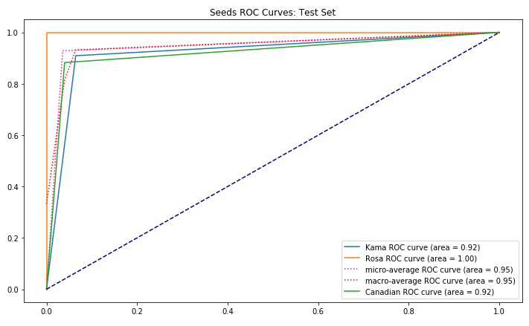
NN ROC and AUC

Slide 20
Conclusion
Seeds data set is rich with information
KNN model performs well
Logistic Regression performs well
Hyper-parameter tuning required
Naïve Bayes and K-Means perform poorly
Dense, Sequential Neural Network performs well
Next steps:
Cross-validation
Feature engineering

