Slide 1
Data Assimilation for Multiscale Dynamic Systems
Yue (Michael) Ying
yue.ying@nersc.no
DA Crash Course, NERSC, 2021

Slide 2
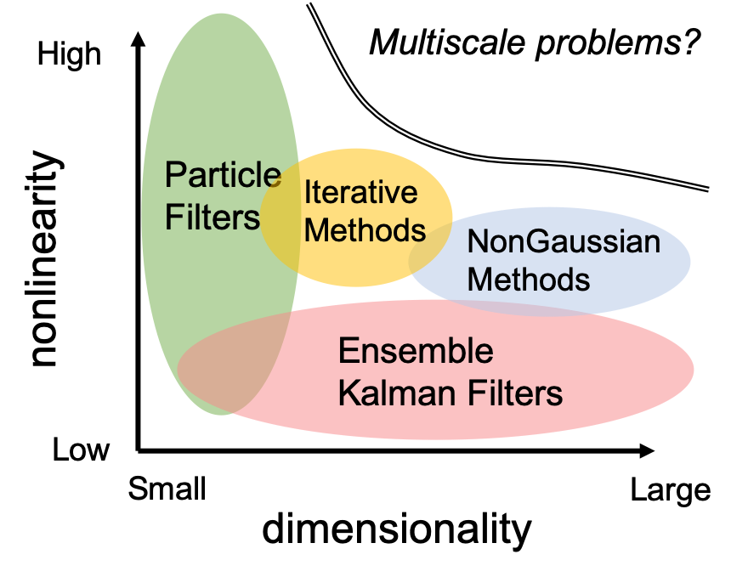
Why do we need multiscale algorithms for DA?
Models and dynamics getting more complex: multiple scale components interacting
Larger dimensionality
More nonlinearity to deal with: small-scale rapid error growth, position/phase errors

Slide 3
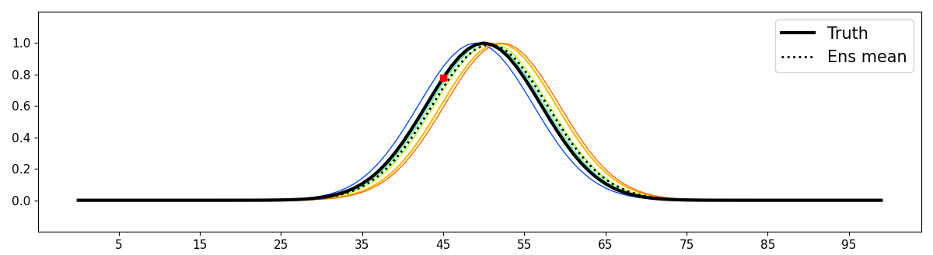
Start from a very simple scenario:
The ensemble only have position errors, and the displacements are small
Let’s use the EnKF to update the prior ensemble given the observation at 45

Slide 4
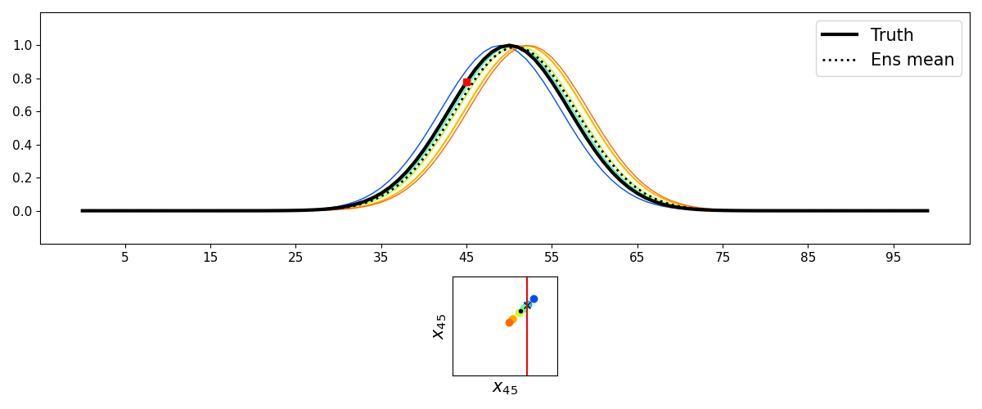
Prior state variable
Observation

Slide 5

Updated state variable (Analysis)
Observation

Slide 6
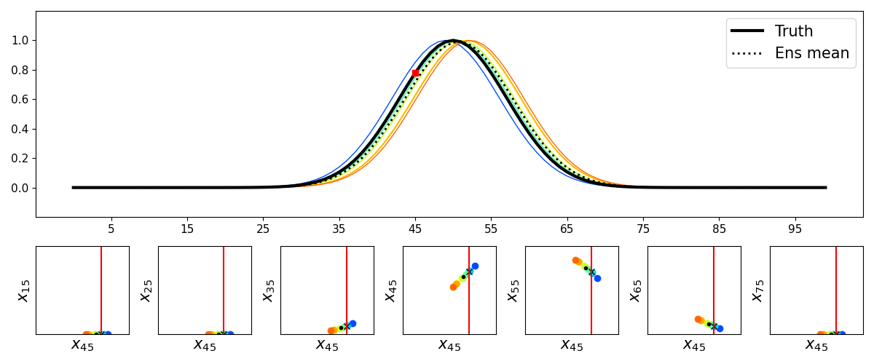
Now, let’s update all the state variables

Slide 7
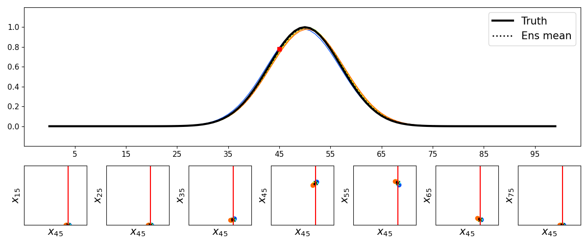
Done, update brings all members close to the truth.
The EnKF solution is optimal when errors are linear (small).

Slide 8
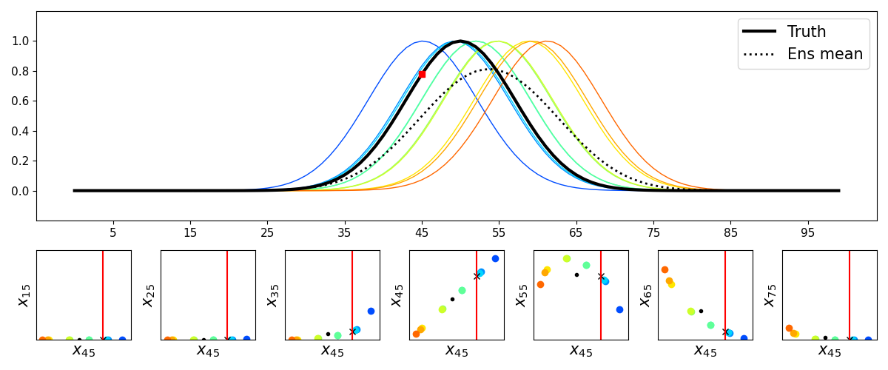
Making things a little more challenging: increasing position spread, nonlinearity occurs

Slide 9
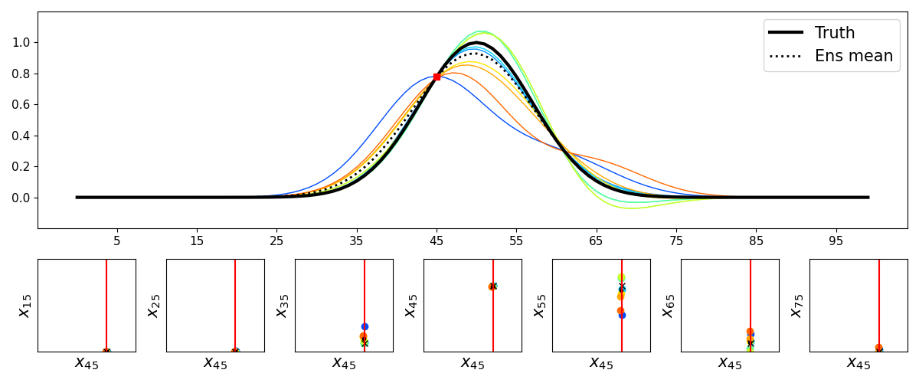
The EnKF analysis ensemble becomes problematic...

Slide 10
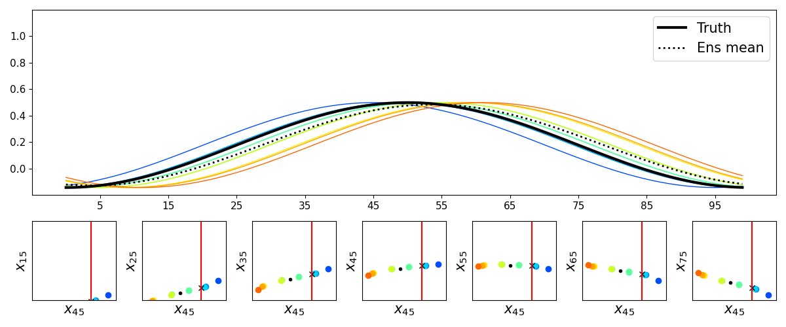
,L
,L
,L
,L
,L
,L
,L
The MSA method: let’s filter out the large scale component, and run the EnKF

Slide 11
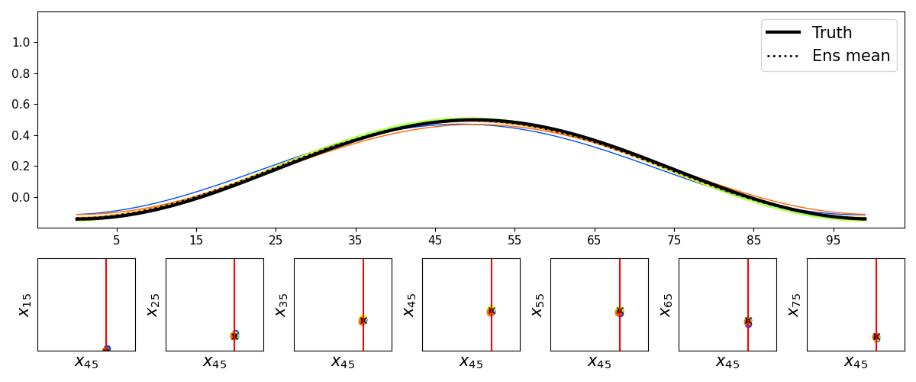
,L
,L
,L
,L
,L
,L
,L
Since displacement errors are more linear at large scale, the EnKF is effective.

Slide 12
Then, figure out the displacement vectors from the large scale increments
And apply it to the original state ensemble (above)

Slide 13
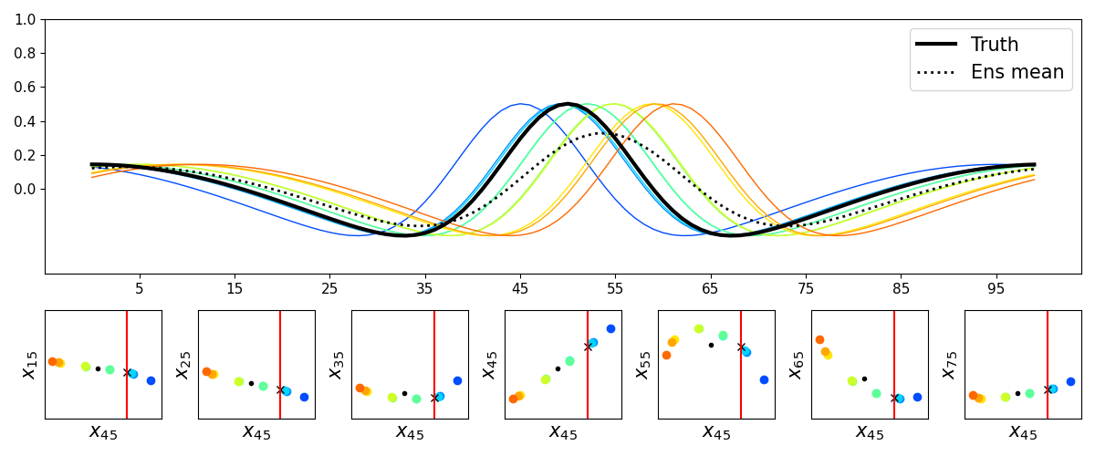
Prior ensemble at small scale
,S
,S
,S
,S
,S
,S
,S

Slide 14
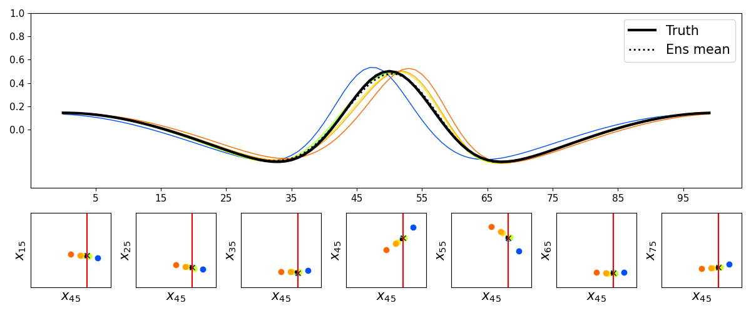
Aligned small scale ensemble according
to large scale displacement vectors
,S
,S
,S
,S
,S
,S
,S

Slide 15
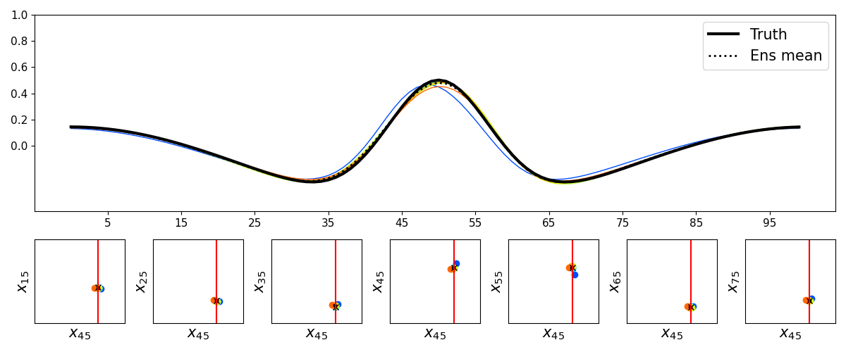
Final small scale analysis ensemble,
after running the EnKF again at small scale
,S
,S
,S
,S
,S
,S
,S

Slide 16
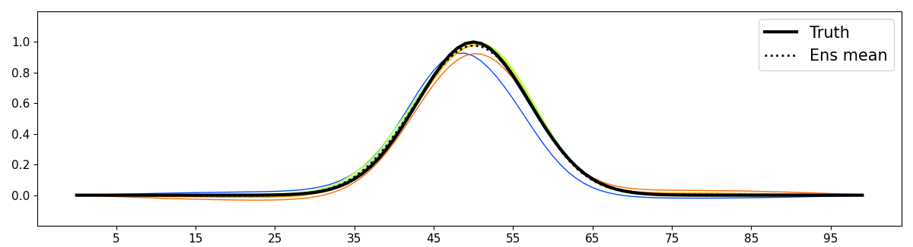
Analysis ensemble using the
original EnKF method
Analysis ensemble using the
EnKF+MSA method

Slide 17
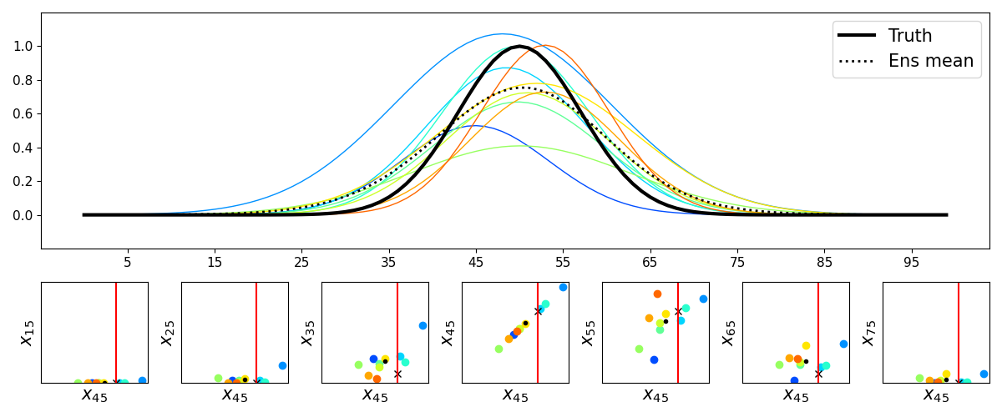
In reality, there are many sources of errors (amplitude, position, structure errors)
The data assimilation problem gets more and more challenging...

Slide 18
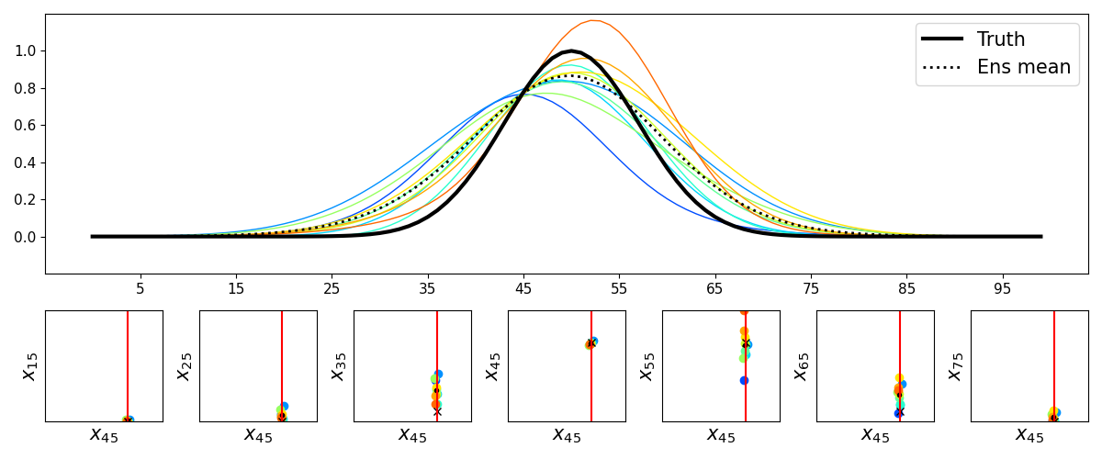

Slide 19
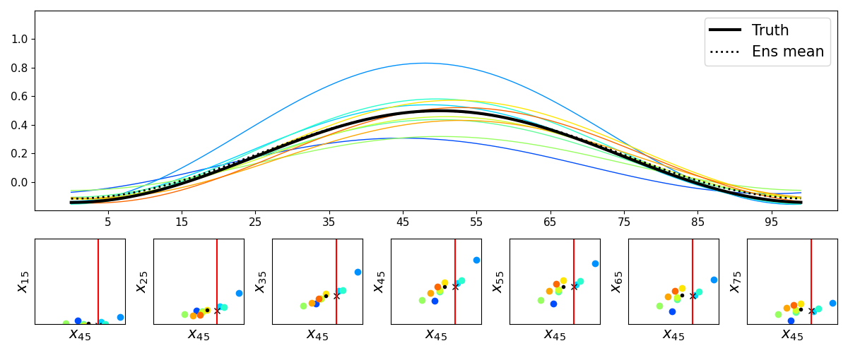

Slide 20
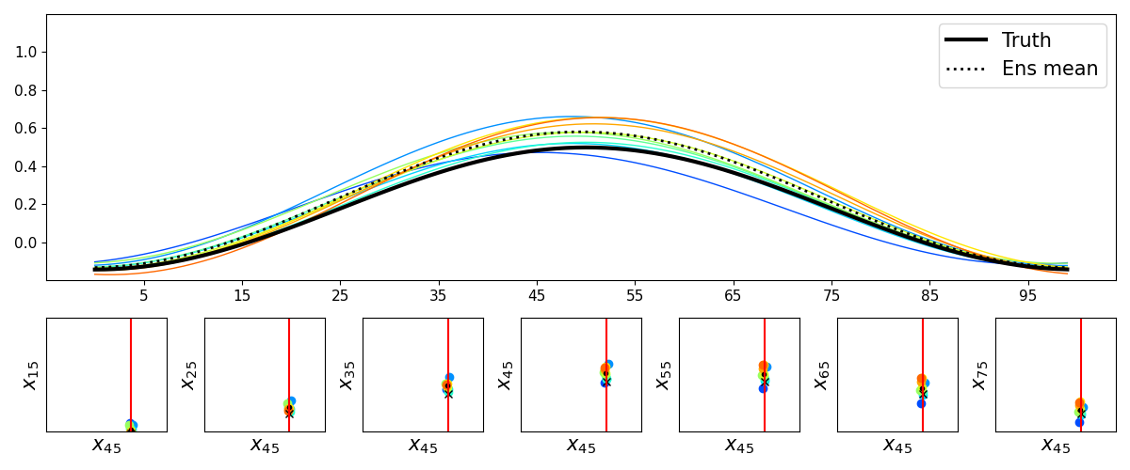

Slide 22
