Slide 1
E-Commerce product analysis
Nanthini h
Dads – may 2025

Slide 2
Introduction
This project focuses on analyzing product data from an e-commerce platform to better understand market trends and customer preferences.
By leveraging data science techniques, the project aims to improve the company’s product offerings and marketing strategies.
The project combines data collection, cleaning, storage, and machine learning to generate actionable business insights.

Slide 3
Project Overview
The main objectives of this project are to collect product data through web scraping, clean and preprocess the data, and store it in a relational database.
Furthermore, the project applies unsupervised learning to cluster products, supervised learning to predict product categories, and hyperparameter tuning to optimize model performance.
Finally, all findings and methodologies will be documented in a comprehensive report and presentation.

Slide 4
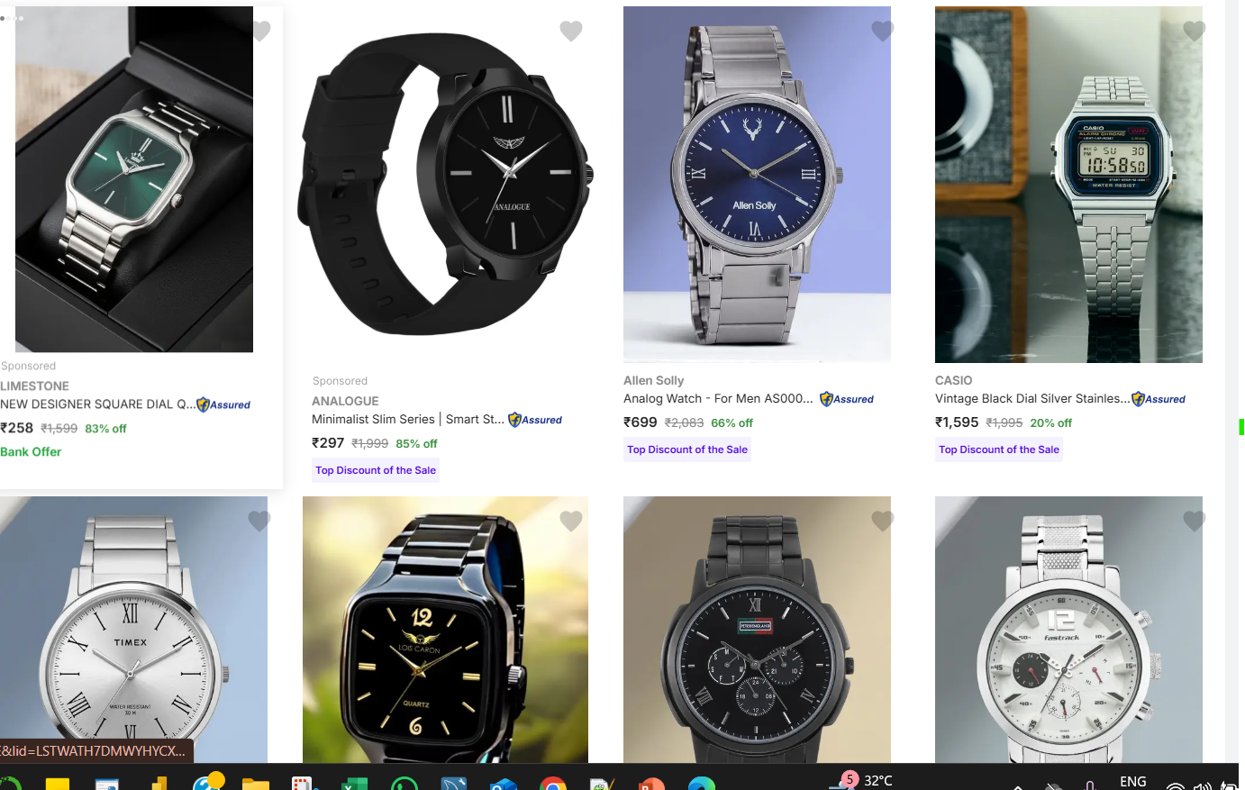
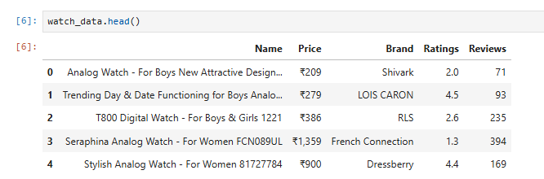
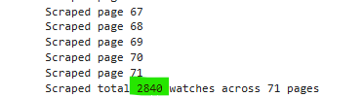
Web Scraping
The first step in this project involves web scraping, where product information such as name, price, category, ratings, and the number of reviews is collected from a suitable e-commerce website.
Python library like BeautifulSoup are used to automate this process.
The extracted data is stored in a CSV file while ensuring compliance with the website’s terms of service.

Slide 5
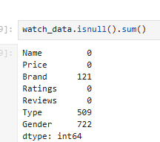
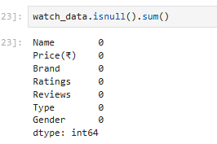
Data Cleaning
Once the raw data is collected, it is loaded into a Pandas DataFrame for cleaning and preprocessing.
Missing values are handled appropriately, irrelevant entries are removed, and formats such as currency and text casing are standardized.

Slide 6
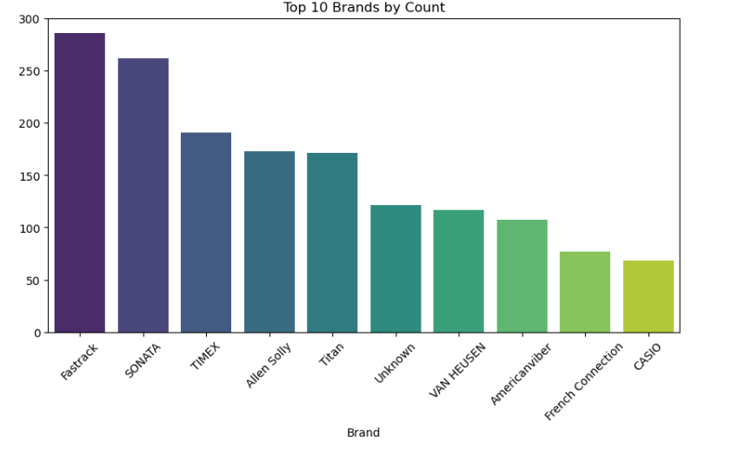
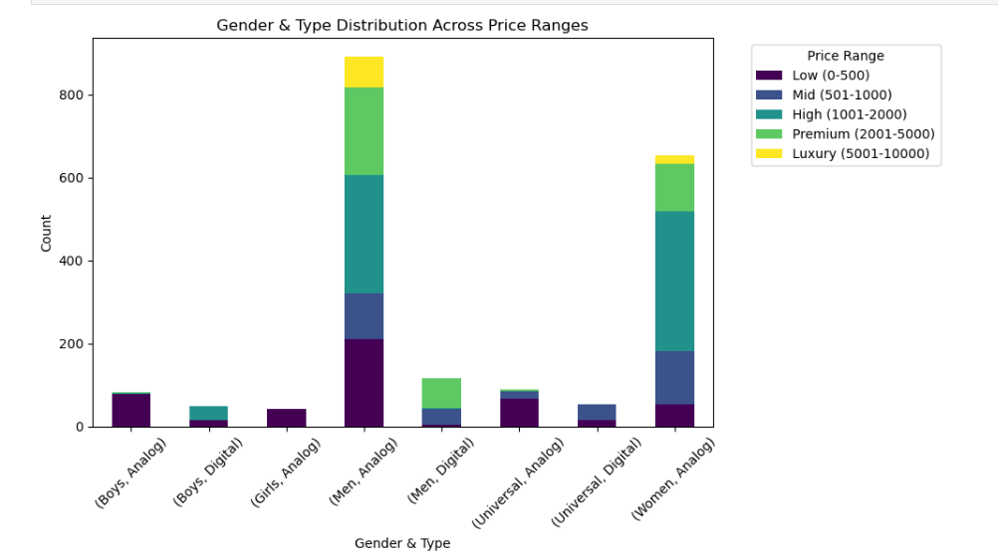
EDA
After cleaning, exploratory data analysis (EDA) is performed to uncover patterns, trends, and relationships within the dataset.
This includes analyzing data distributions, identifying outliers, and visualizing key metrics such as price ranges, ratings, and product categories.
EDA provides valuable insights that guide subsequent machine learning steps.

Slide 7
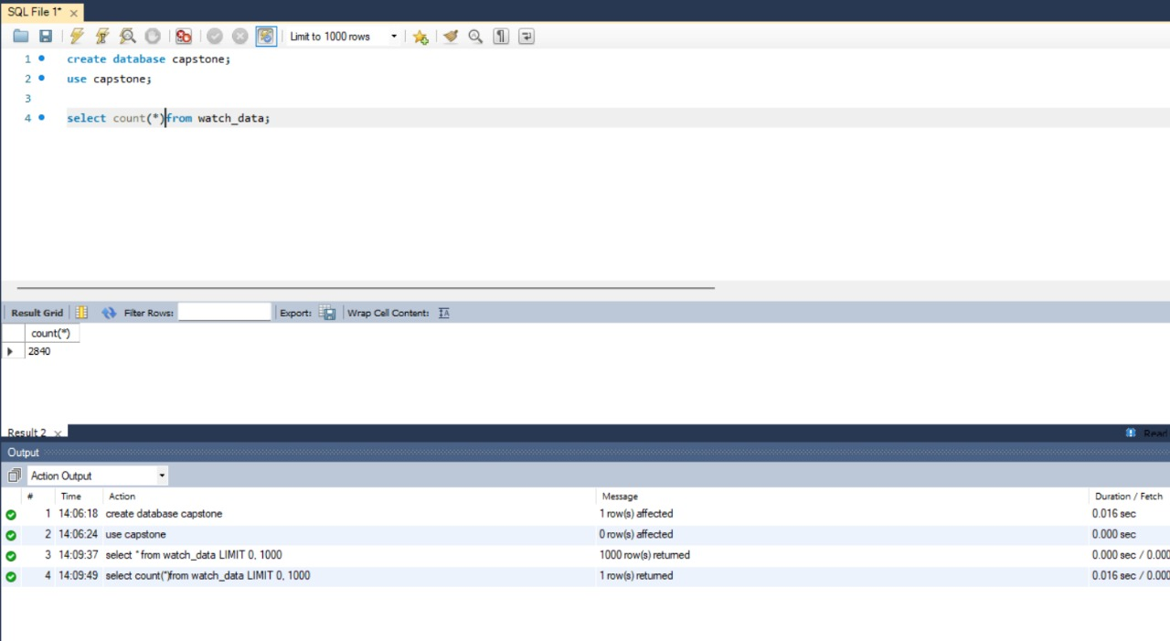
Data Storage
The cleaned dataset is stored in a relational database for structured querying and efficient access.
Tool SQLAlchemy is used to manage the data.
This step ensures that the dataset is well-organized, secure, and ready for further analysis.

Slide 8
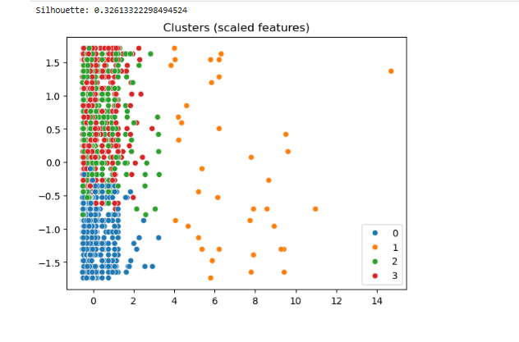
Unsupervised
Unsupervised learning is applied to the stored dataset to discover hidden patterns and group similar products.
Clustering algorithms such as K-Means are used, and the number of clusters is experimented with to find the optimal grouping.
A new column is added to the dataset to indicate each product’s cluster membership, providing meaningful segmentation insights.

Slide 9
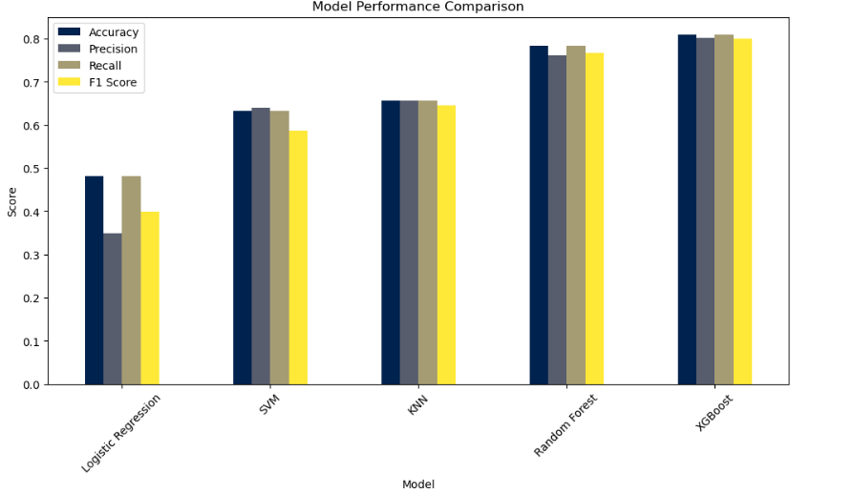
Supervised
In the supervised learning stage, classification models are implemented to predict product categories or other relevant labels based on the dataset’s features.
Algorithms used include Logistic Regression, Support Vector Machine (SVM), k-Nearest Neighbors (k-NN), Random Forest, and XGBoost.
Model performance is evaluated using metrics such as accuracy, precision, recall, and F1-score to identify the most effective algorithm.

Slide 10
Hyperparameter Tuning
After selecting the best-performing model, hyperparameter tuning is applied to further optimize its performance.
Techniques such as Grid Search and Random Search are used to experiment with different parameter configurations.
The final model configuration is documented, ensuring maximum accuracy and robustness.

Slide 11
Conclusion
By following a data-driven approach, this project enables the company to better understand customer behavior and market trends.
Clustering and classification models provide actionable insights that can be applied to optimize product offerings and marketing strategies.
Overall, the project demonstrates the effective use of data science in enhancing business decision-making.

