Slide 1
Salary Survey AnalysisAcross Global Industries -Using Excel and SQL
Name : Nanthini H
Batch : DA DS - May 25
Date : 10-08-2025

Slide 2
OBJECTIVE
The aim of this project is to analyze salary survey data to understand pay trends and patterns.
The goal is to identify how salaries vary by job title, industry, location, gender, and experience level.
The study focuses on the provided dataset, which contains detailed compensation information.

Slide 3
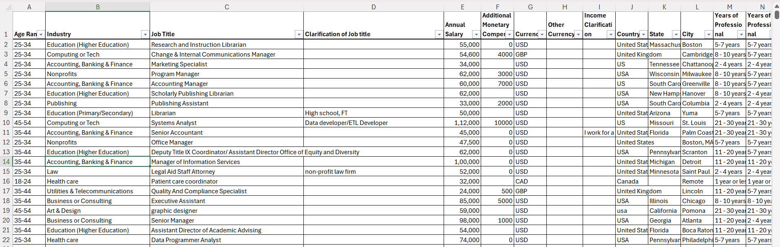
DATASET OVERVIEW
The dataset contains 28000 rows and 16 columns of salary and job-related information.
Data covers responses from professionals across multiple industries and countries.
Key fields include Job Title, Industry, Location, Experience Level, Education, Gender, Salary, Additional Compensation.
The data includes both numerical variables (salary) and categorical variables (job titles, industries, locations).

Slide 4
DATA CLEANING PROCESS
Filled missing values where possible; excluded incomplete rows when necessary.
Converted all salaries into USD for standard comparison.
Standardized job titles, industries, and country names for consistency.
Detected and addressed extreme outliers in salary data.
Verified currency conversion rates and ensured data accuracy.

Slide 5
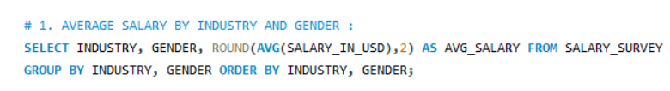
SQL QUERIES PERFORMED
Found average salary by industry and gender to see pay gaps.
Calculated total salary compensation (base + extras) by job title.
Checked salary range (min, max, avg) for each education level.
Counted employees by industry and experience level.
Found median salary by age range and gender.

Slide 6
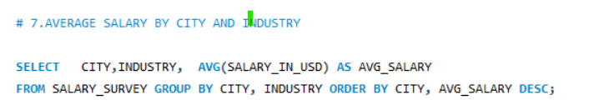
SQL QUERIES PERFORMED
Listed highest-paying job titles in each country.
Compared average salary by city and industry.
Calculated % with extra compensation by gender.
Summarized total compensation by job title and years of experience.
Compared average salary by industry, gender, and education together.

Slide 7
PIVOT TABLES AND CHARTS
Created pivot tables to compare average salaries across job titles and industries.
Built charts showing salary trends by years of experience
Used bar charts to visualize top 5 highest-paying Industries.
Top 5 Industries | Avg of Salary_in_USD
Communications & Public Relations | 105.8K
Pharmaceuticals & Biotechnology | 103.1K
Information Technology (IT) | 102.6K
Consumer Goods | 98.0K
Cosmetics & Personal Care | 92.5K

Slide 8
DASHBOARD
Designed an interactive salary analysis dashboard summarizing main KPIs.
Displayed average salary, median salary, and total respondents as headline metrics.
Used bar charts for salaries by job title, line charts for salary trends over years of experience, and pie charts for industry distribution.
Added slicers for country, gender, and experience level to filter results.

Slide 9
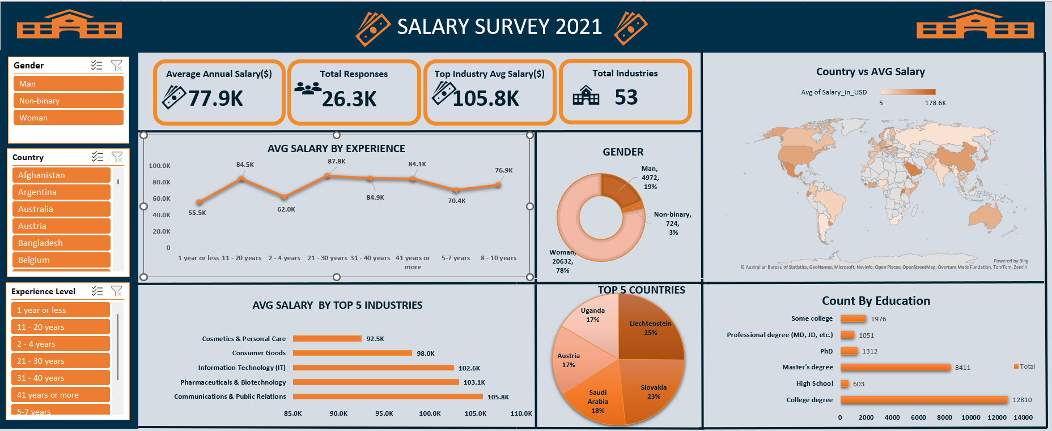

Slide 10
KEY INSIGHTS
Communications & Public Relations and Pharmaceuticals & Biotechnology are top paying industries
Professionals with advanced degrees (Master’s/PhD) earn significantly more than those with only a Bachelor’s degree.
Liechtenstein and Slovakia emerged as the top-paying countries in the dataset.

Slide 11
RECOMMENDATIONS
Encourage organizations to review pay structures for equity across genders and locations.
Provide salary transparency in recruitment to attract top talent
Align pay raises with industry benchmarks and experience levels.
Focus on skill development programs for employees in lower-paying categories.

Slide 12
CONCLUSION
The salary survey analysis provided valuable insights into compensation trends and disparities.
The dashboard offers a clear, interactive way to explore salary data across multiple dimensions.
Findings can guide fair pay policies and competitive salary offerings.
Future surveys can include more demographic variables for richer analysis.

Slide 13
THANK YOU !!

