Slide 1
Exploratory Data Analysis of Laptop Dataset
Name : Nanthini H
Batch : DA DS - May 25
Guided By : Archana B
Date : 20-07-2025

Slide 2
INTRODUCTION
This project focuses in performing an Exploratory Data Analysis of a laptop dataset containing specifications like Brand, RAM, Processor Type, Storage, Screen Resolution, Weight and Price.
The goal is to uncover the hidden patterns and relationship between the price and performance of Laptops.
By understanding this laptop data through summary statistics and visualizations, we aim to gain valuable insights that can assist customers, retailers and manufacturers in making data-driver decisions.

Slide 3
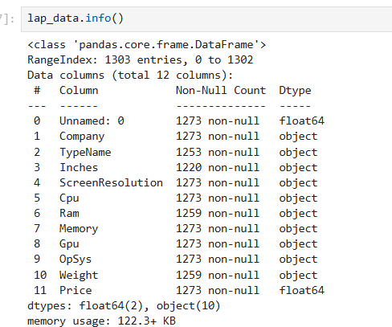
DATA UNDERSTANDING
Dataset : Laptop Data
First, load the dataset → laptop_data = pd.read_csv("laptopData.csv")
To understand the data, we can use below functions,
info() shape
describe() head()
isnull()
Rows and Columns : 1303 Rows and 12 Columns
Columns: Company, Type, RAM, Weight, Price, Memory, etc.

Slide 4

DATA CLEANING
In this dataset we have one unknown column named Unamed:0 .
Removed using drop(column =[Unamed:0 ])
Changed object data type into Numeric for numerical data using pd.to_numeric
Before converting the object datatype to numeric I removed string value in the data(like 1.2kg to 1.2, 8GB to 8)

Slide 5
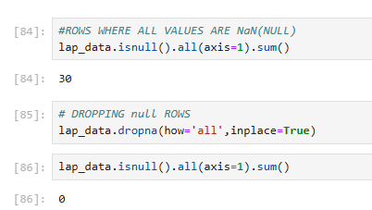
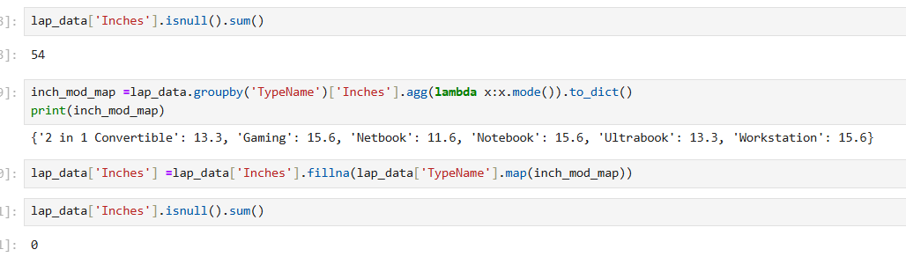
HANDLING MISSING VALUES
In this dataset we have 30 empty rows. I removed those by using dropna().
We have null values in Inches, Ram, and Weight columns. I filled the null values with mode value based on Type name.

Slide 6
OUTLIERS HANDLING
Checked outliers for numeric columns such as Price, Weight and Screen size.
For Weight and Screen size , replaced the outliers with median value based on the Types.
Didn’t handles outliers for Price and Ram columns, because based on the laptop types the price and Ram size might vary.

Slide 7
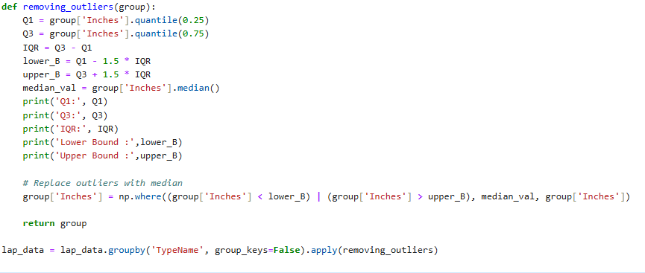
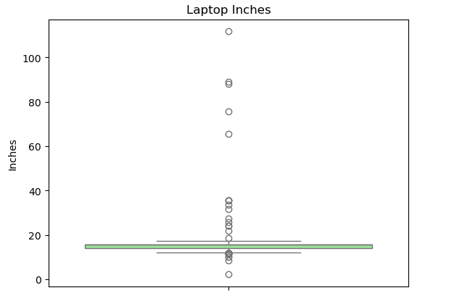
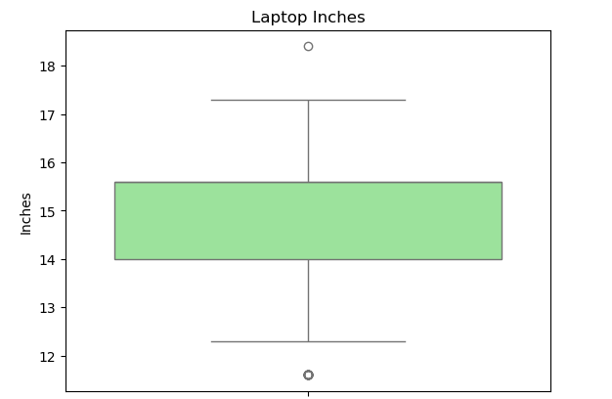
Before Removing Outliers
After Removing Outliers

Slide 8
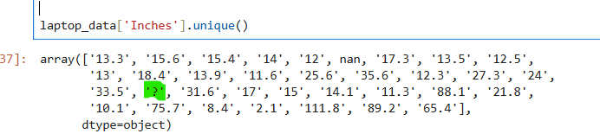
HANDLING INVALID VALUES
In Inches and Weight columns found invalid value as’ ?’.
While converting object type into numeric value, this invalid value changed as Nan.

Slide 9
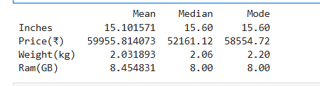
DESCRIPTIVE ANALYSIS
Descriptive Statistics are numerical summaries of data sets that help make data understandable and interpretable.
I checked Mean, Median, and Mode values for numerical columns.

Slide 10
STATISTICAL ANALYSIS
Hypothesis testing
Hypothesis testing is a method used in statistics to make decisions based on data. It helps us check if a claim or assumption about the data is true.
t-test:
Performed a t-test to check if the average price is different between Gaming laptops and Ultrabooks.
The test gave a p-value of 0.0148, which is less than 0.05.
So, rejected the null hypothesis.
Conclusion: Gaming laptops are significantly more expensive than Ultrabooks.

Slide 11
DATA VISUALIZATION
Data visualization is the Process of turning numbers into pictures . So, we can easily understand patterns, trends, and relationships in data.
Why is it Important ?
Helps us to see the big picture
Makes complex data easy to understand
Helps in finding insights quickly
Useful for making better decisions

Slide 12
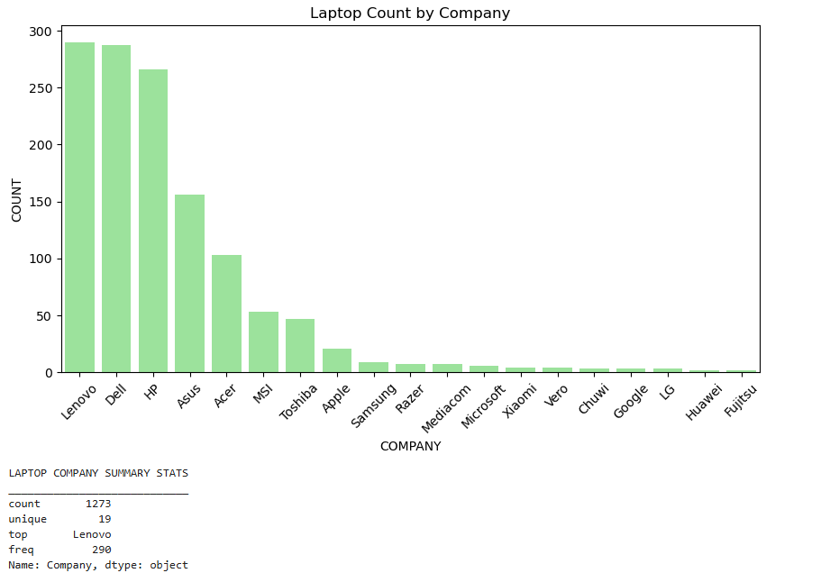
UNIVARIATE ANALYSIS
Univariate Analysis means analysing one variable at a time.
Here I used Histogram plot, Count plot and analysed Price Distribution of laptops, laptop count by company, and Memory usage distribution.

Slide 13
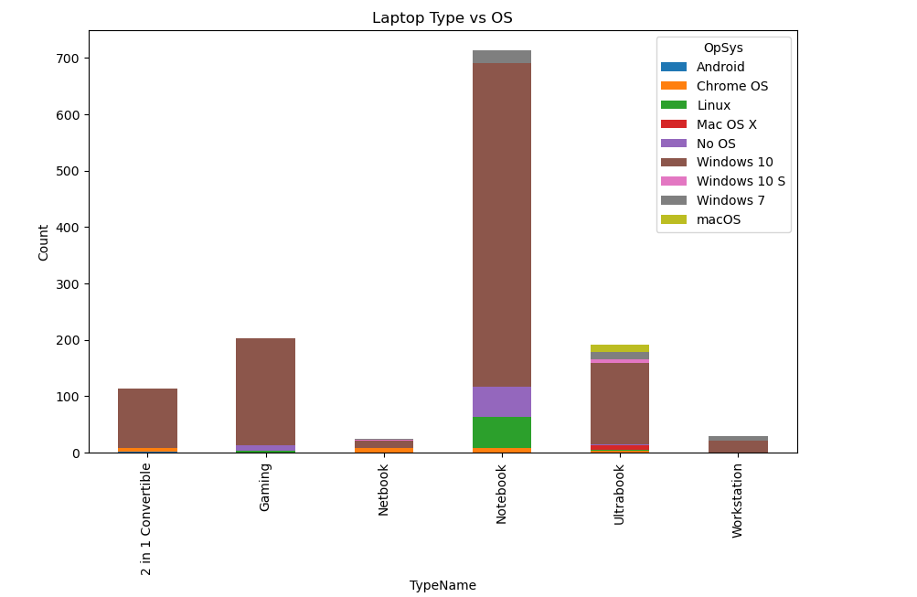
BIVARIATE ANALYSIS
Bivariate Analysis means analyzing two variables at the same time to see if there’s a relationship between them.
In this project, I used Bar Plot, Scatter plot and did for Laptop price with Screen size, Ram with price, Type with OS distribution.

Slide 14
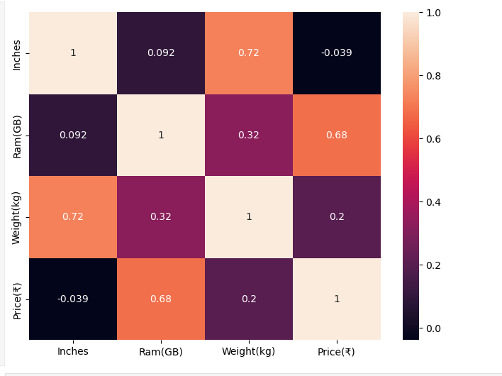
MULTIVARIATE ANALYSIS
Multivariate Analysis means analyzing more than 2 variables at the same time to understand the relationship between all of them together.
In this project by using Heatmap, 3D scatter Plot, Pair Plot I analyzed the relationship between Inches ,Weight(kg) , Price(₹), Company_Type, Ram(GB).

Slide 15
RECOMMENDATIONS
For budget buyers, laptops with SSD + 8GB RAM provide good performance at a reasonable price.
For gaming or high-performance use, look for laptops with dedicated GPUs and higher RAM.
Manufacturers should focus on producing lightweight laptops with SSD storage, as they are in demand.
Consider removing older specs (like HDD-only models) from new product lines.

Slide 16
CONCLUSION
We explored and analyzed various features of laptops like Type, RAM, Storage, CPU, and Price.
We found that specifications like RAM, Storage Type, and Processor play a big role in determining the price.
Gaming laptops are generally the most expensive, while Netbooks and Notebooks are more budget-friendly.
Brands like Apple and MSI tend to be on the higher price end, while Asus and HP offer more affordable options.

