Slide 1
Exploratory Data Analysis of Laptop Dataset
Name : Nanthini H
Batch : DA DS - May 25
Guided By : Archana B
Date : 21-07-2025

Slide 2
INTRODUCTION
This project focuses in performing an Exploratory Data Analysis of a laptop dataset containing specifications like Brand, RAM, Processor Type, Storage, Screen Resolution, Weight and Price.
The goal is to uncover the hidden patterns and relationship between the price and performance of Laptops.
By understanding this laptop data through summary statistics and visualizations, we aim to gain valuable insights that can assist customers, retailers and manufacturers in making data-driver decisions.

Slide 3
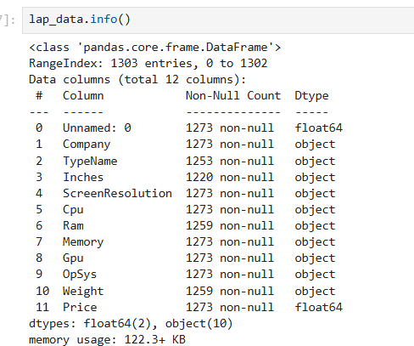
DATA UNDERSTANDING
Dataset : Laptop Data
First, load the dataset → laptop_data = pd.read_csv("laptopData.csv")
To understand the data, use below functions,
info() shape
describe() head()
isnull()
Rows and Columns : 1303 Rows and 12 Columns
Columns: Company, Type, RAM, Weight, Price, Memory, etc.

Slide 4

DATA CLEANING
The dataset have one unknown column named Unamed:0 .
Removed using drop(column =[Unamed:0 ])
Changed object data type into Numeric for numerical data using pd.to_numeric
Before converting the object datatype to numeric, string value has been removed in the data(like 1.2kg to 1.2, 8GB to 8)

Slide 5
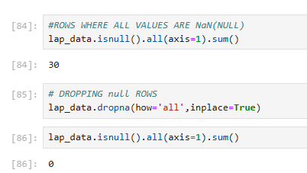
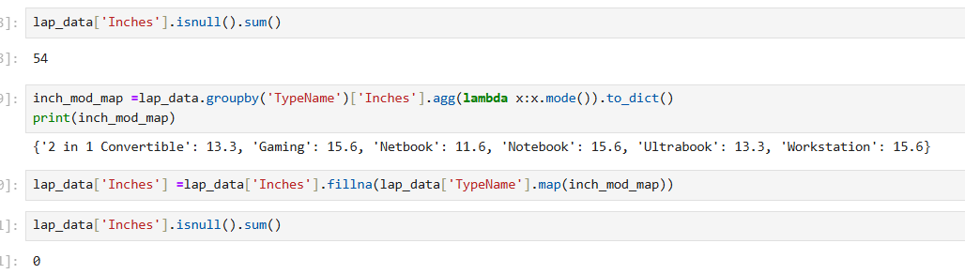
HANDLING MISSING VALUES
In this dataset we have 30 empty rows. Those has been removed by using dropna().
The dataset has null values in Inches, Ram, and Weight columns. The null values has been filled with mode value based on Type name.

Slide 6
OUTLIERS HANDLING
Checked outliers for numeric columns such as Price, Weight and Screen size.
Outliers in Weight and Screen Size were handled by replacing them with the median value within each laptop type."
Outliers in the Price and RAM columns were not removed, as these values can vary based on the type of laptop.
Total Outliers in Price : 31
Total Outliers in RAM : 166
Total Outliers in Inches : 308
Total Outliers in Weight : 70

Slide 7
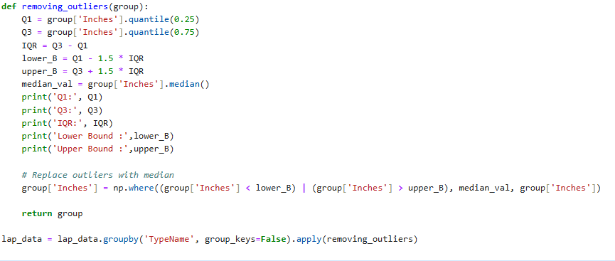
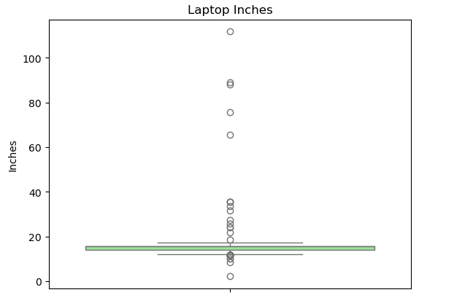
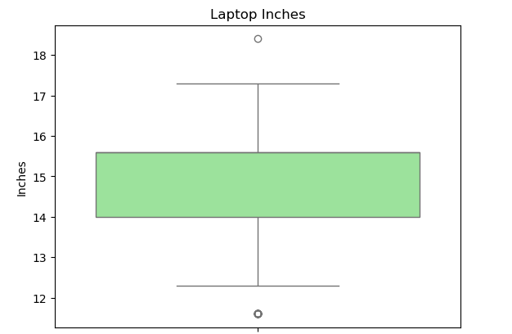
Before Removing Outliers
After Removing Outliers

Slide 8
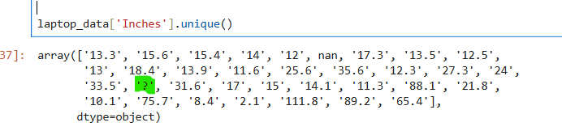
HANDLING INVALID VALUES
In Inches and Weight columns found invalid value as’ ?’.
While converting object type into numeric value, this invalid value changed as Nan.

Slide 9
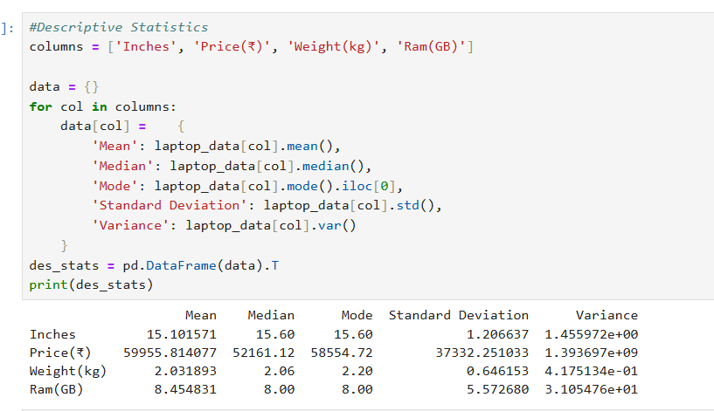
DESCRIPTIVE ANALYSIS
Descriptive Statistics are numerical summaries of data sets that help make data understandable and interpretable.
Checked Mean, Median, Mode, Standard Deviation and Variance values for numerical columns.

Slide 10
STATISTICAL ANALYSIS
Hypothesis testing
Hypothesis testing is a method used in statistics to make decisions based on data. It helps us check if a claim or assumption about the data is true.
t-test:
Compare the means of two groups to see if they are significantly different.
One Way Anova test:
Compare the means of more than two groups.
Chi-Squared test:
Check if there is a relationship between two categorical variables.

Slide 11
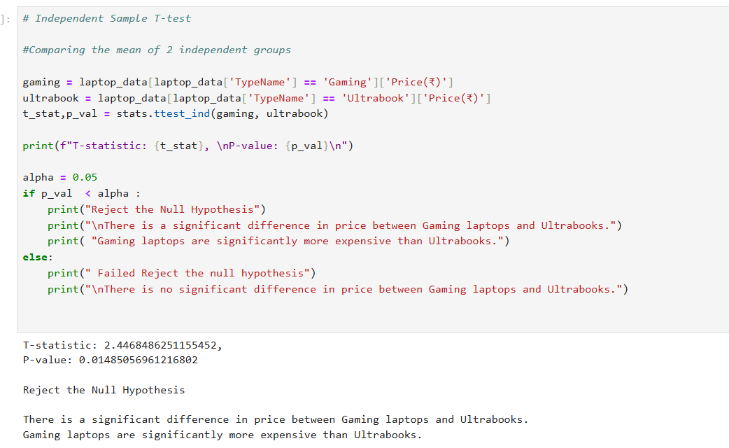
T-Test
Assumption:
Whether the Gaming laptops and Ultrabooks are same in Price or any difference is there between each other.
T-Test:
To compare the means of two independent groups and check if they are significantly different.
Performed a t-test to check if the average price is different between Gaming laptops and Ultrabooks.
The test gave a p-value of 0.0148, which is less than 0.05.
So, rejected the null hypothesis.
Conclusion: Gaming laptops are significantly more expensive than Ultrabooks.

Slide 12
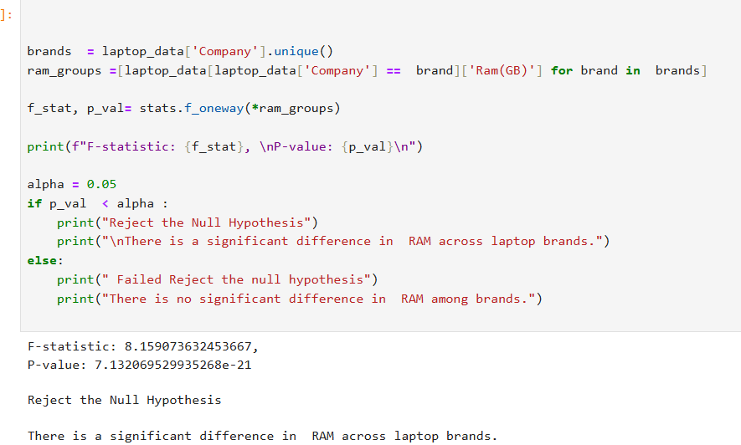
One Way Anova
Assumption:
Whether the RAM size is the same across all laptop brands, or if there is a significant difference.
One-way Anova:
One-Way ANOVA test is used to compare the average (mean) of a numerical variable across more than two groups.
one-way ANOVA test has been used to check if all laptop brands have the same average RAM. The result showed a clear difference (F = 8.15, p < 0.05).
This means some brands offer more RAM than others, and the average RAM is not the same across all brands.

Slide 13
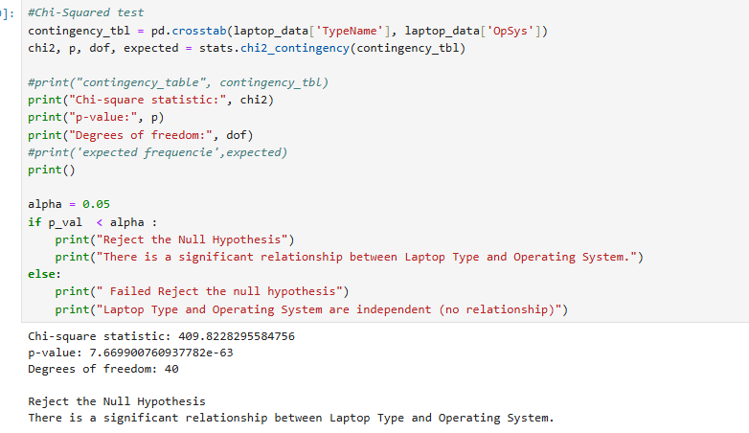
Chi-Squared
Assumption:
Whether Laptop Type and Operating System are related or independent.
Chi- Squared Test:
Chi-Squared Test is used to check if two categorical variables are related to each other.
This test has been used to check if laptop type is related to the operating system.
The result was significant (p < 0.05), so reject the null hypothesis.
This means laptop type and operating system are related certain laptop types tend to come with specific OS.
For example, Gaming laptops mostly use Windows, while MacBooks use macOS.

Slide 14
DATA VISUALIZATION
Data visualization is the Process of turning numbers into pictures . So, we can easily understand patterns, trends, and relationships in data.
Why is it Important ?
Helps us to see the big picture
Makes complex data easy to understand
Helps in finding insights quickly
Useful for making better decisions

Slide 15
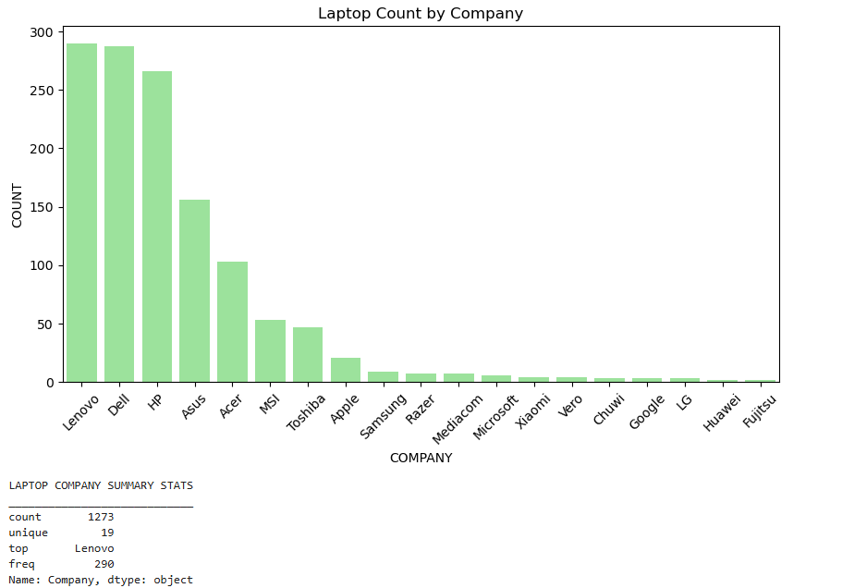
UNIVARIATE ANALYSIS
Univariate Analysis means analysing one variable at a time.
Here Histogram plot, Count plot are been used and analysed Price Distribution of laptops, laptop count by company, and Memory usage distribution.

Slide 16
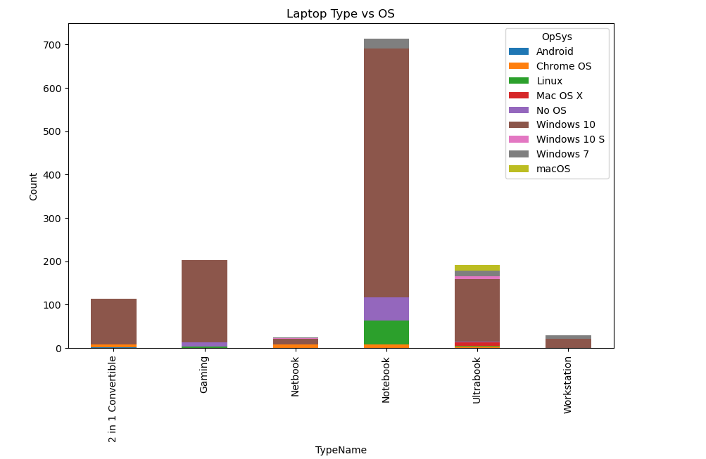
BIVARIATE ANALYSIS
Bivariate Analysis means analyzing two variables at the same time to see if there’s a relationship between them.
In this project, by using Bar Plot, Scatter plot and analyzed Laptop price with Screen size, Ram with price, Type with OS distribution.

Slide 17
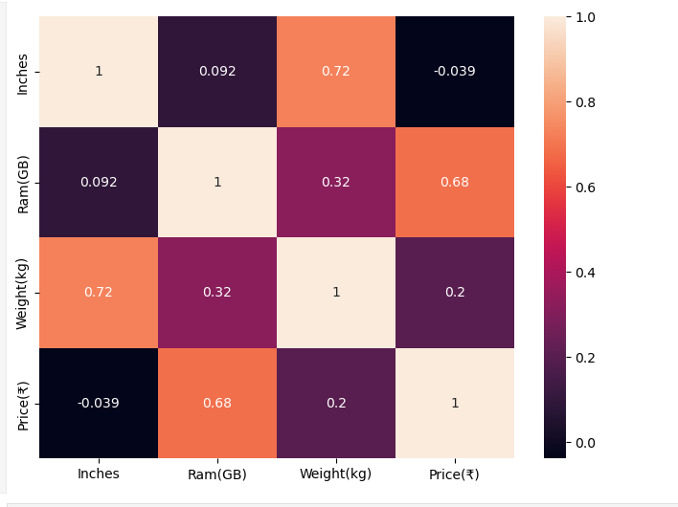
MULTIVARIATE ANALYSIS
Multivariate Analysis means analysing more than 2 variables at the same time to understand the relationship between all of them together.
In this project by using Heatmap, 3D scatter Plot, analysed the relationship between Inches, Weight(kg) , Price(₹), Ram(GB).

Slide 18
RECOMMENDATIONS
For budget buyers, laptops with SSD + 8GB RAM provide good performance at a reasonable price.
For gaming or high-performance use, look for laptops with dedicated GPUs and higher RAM.
Manufacturers should focus on producing lightweight laptops with SSD storage, as they are in demand.
Consider removing older specs (like HDD-only models) from new product lines.

Slide 19
CONCLUSION
Explored and analyzed various features of laptops like Type, RAM, Storage, CPU, and Price.
Found that specifications like RAM, Storage Type, and Processor play a big role in determining the price.
Gaming laptops are generally the most expensive, while Netbooks and Notebooks are more budget-friendly.
Brands like Apple and MSI tend to be on the higher price end, while Asus and HP offer more affordable options.

Slide 20
THANK YOU !!

