Slide 1
TEXT GENERATION WITH CHAT GPT-2

Slide 2
What’s generative ai
Generative AI refers to artificial intelligence systems designed to generate new, original content based on the data they have been trained on. Unlike traditional AI, which might focus on analyzing data and making predictions, generative AI creates new data. This can include text, images, music, and even video. A great example would be ChatGPT and LLaMa.

Slide 3
Transformer based language model
In recent years ,there has been a rise in transformer-based language used extensively in natural language processing (NLP) tasks, including GPT models that generate coherent text. models trained,including OpenAI's ChatGPT and Meta's LLaMA. The results on conditioned open-ended language generation are impressive.Besides the improved transformer architecture and massive unsupervised training data, better decoding methods have also played an important role.some of the most prominent decoding methods are
Greedy Search
Beam Search
Sampling

Slide 4
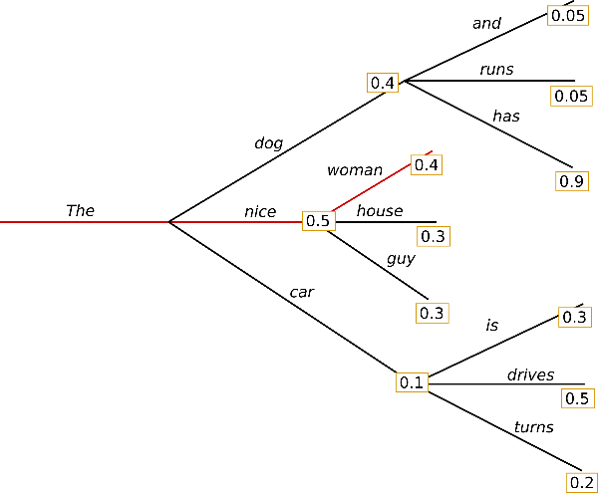
Greedy Search
Greedy search is the simplest decoding method. It selects the word with the highest probability as its next word

Slide 5
Greedy Search
From the above diagram"The", the algorithm greedily chooses the next word of highest probability "nice" and so on, so that the final generated word sequence is ("The","nice","woman")

Slide 6
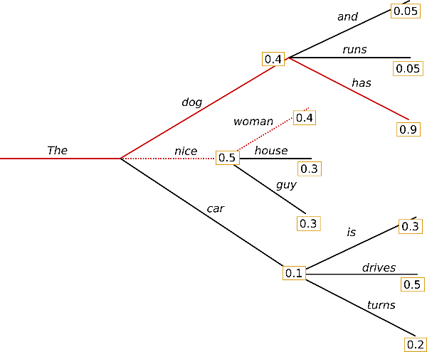
Beam Search
Beam search reduces the risk of missing hidden high probability word sequences by keeping the most likely of hypotheses at each time step and eventually choosing the hypothesis that has the overall highest probability.

Slide 7
Beam Search
besides the most likely hypothesis ("The","nice"), beam search also keeps track of the second most likely one ("The","dog"). At time step 2, beam search finds that the word sequence ("The","dog","has"), has with 0.36 a higher probability than ("The","nice","woman")

Slide 8
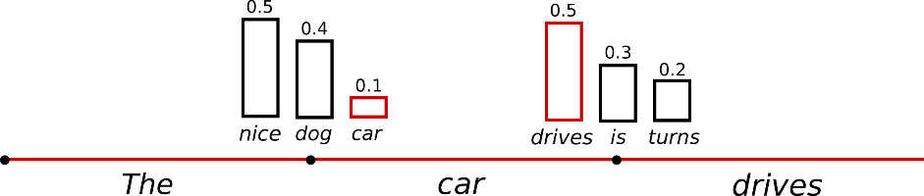
Sampling
In its most basic form, sampling means randomly picking the next word according to its conditional probability distribution
It becomes obvious that language generation using sampling is not deterministic anymore.

Slide 9
Top -K Sampling
The very powerful sampling scheme, called Top-K sampling. In Top-K sampling, the K most likely next words are filtered and the probability mass is redistributed among only those K next words. GPT2 adopted this sampling scheme, Top-K sampling is that it does not dynamically adapt the number of words that are filtered from the next word probability distribution

Slide 10
Top - P Sampling
Instead of sampling only from the most likely K words, in Top-p sampling chooses from the smallest possible set of words whose cumulative probability exceeds the probability p.While in theory, Top-p seems more elegant than Top-K, both methods work well in practice. Top-p can also be used in combination with Top-K, which can avoid very low ranked words while allowing for some dynamic selection.

Slide 11
Steps to train chat GPT -2 text generating model
Loading chat GTP-2
Mounting google drive
Uploading a text file to be trained in colaboratory
Finetune chat GPT
Load the trained model
Generate the text from the trained model

Slide 12
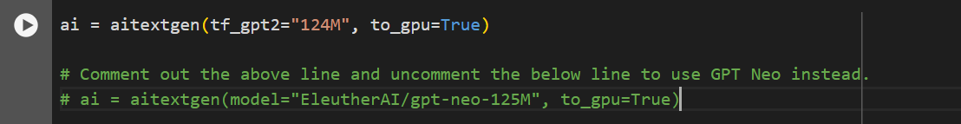
Loading chat GPT-2

Slide 13
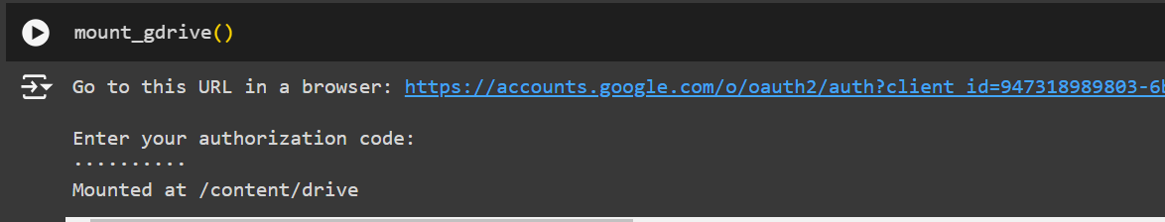
Mounting google drive

Slide 14
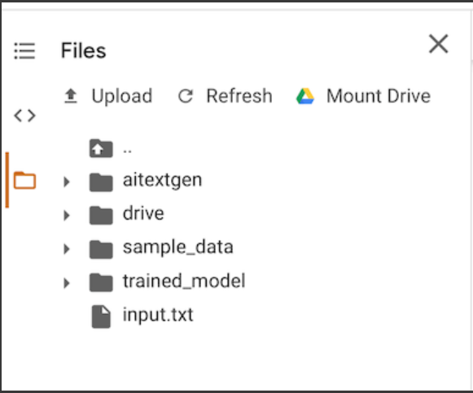
Uploading a text file to be trained in colaboratory

Slide 15
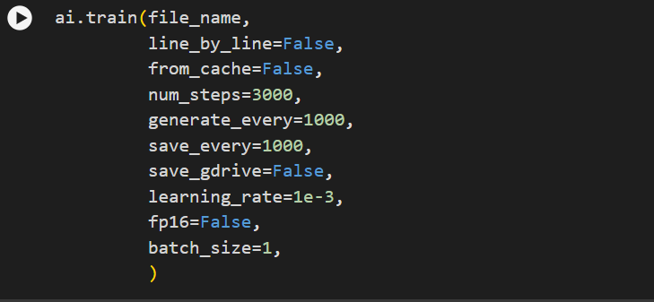
Finetune chat GPT

Slide 16
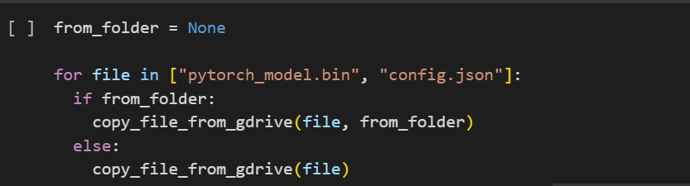
Load The Trained Model

Slide 17
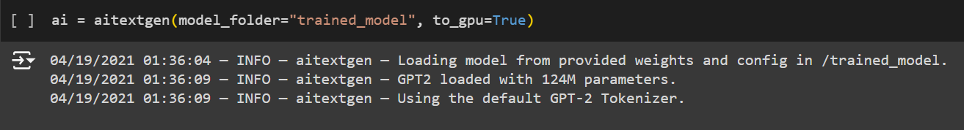
Generate The Text From The Trained Model
The Trained ModeLoad the trained modell

