Slide 1
DXS Optics Simulation
Nan Wang, Feb 24th 2021

Slide 2
Outline
Create beamline using Sirepo
Add time domain simulation
Optimize sampling parameters
Simulation results
In progress
To-do

Slide 3
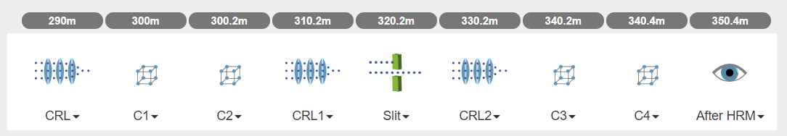
Sirepo
1. define source type and input source parameters
2. define beamline by dragging optical elements to the definition area
Note: the central photon energy for each optical element is not automatically updated. The default photon energy is 9keV.
Also, it would be nice if the radius of curvature for the CRLs can be calculated from focal distance.

Slide 4
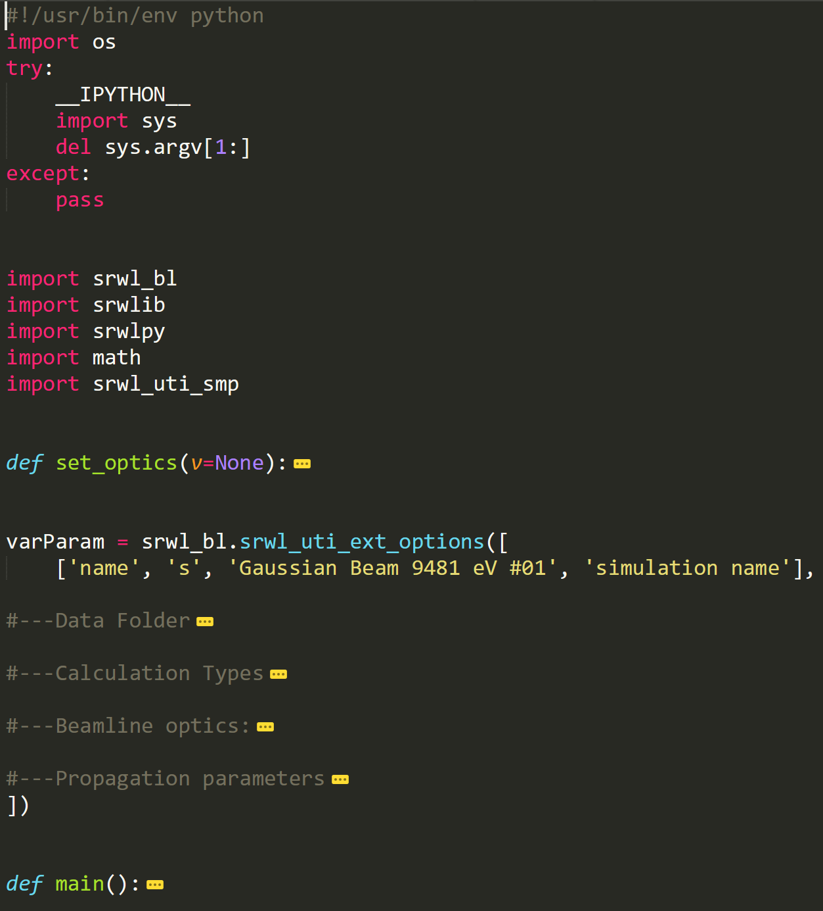
Python scripts from Sirepo
The python script generated by Sirepo is structured in the following way:
Import modules
Function for defining beamline optics, set_optics
List of parameters, varParam
Function for beam propagation, main()
The main benefit for using Sirepo is that we only need little modifications to the beamline optics and list of parameters when doing parameters scans.

Slide 5
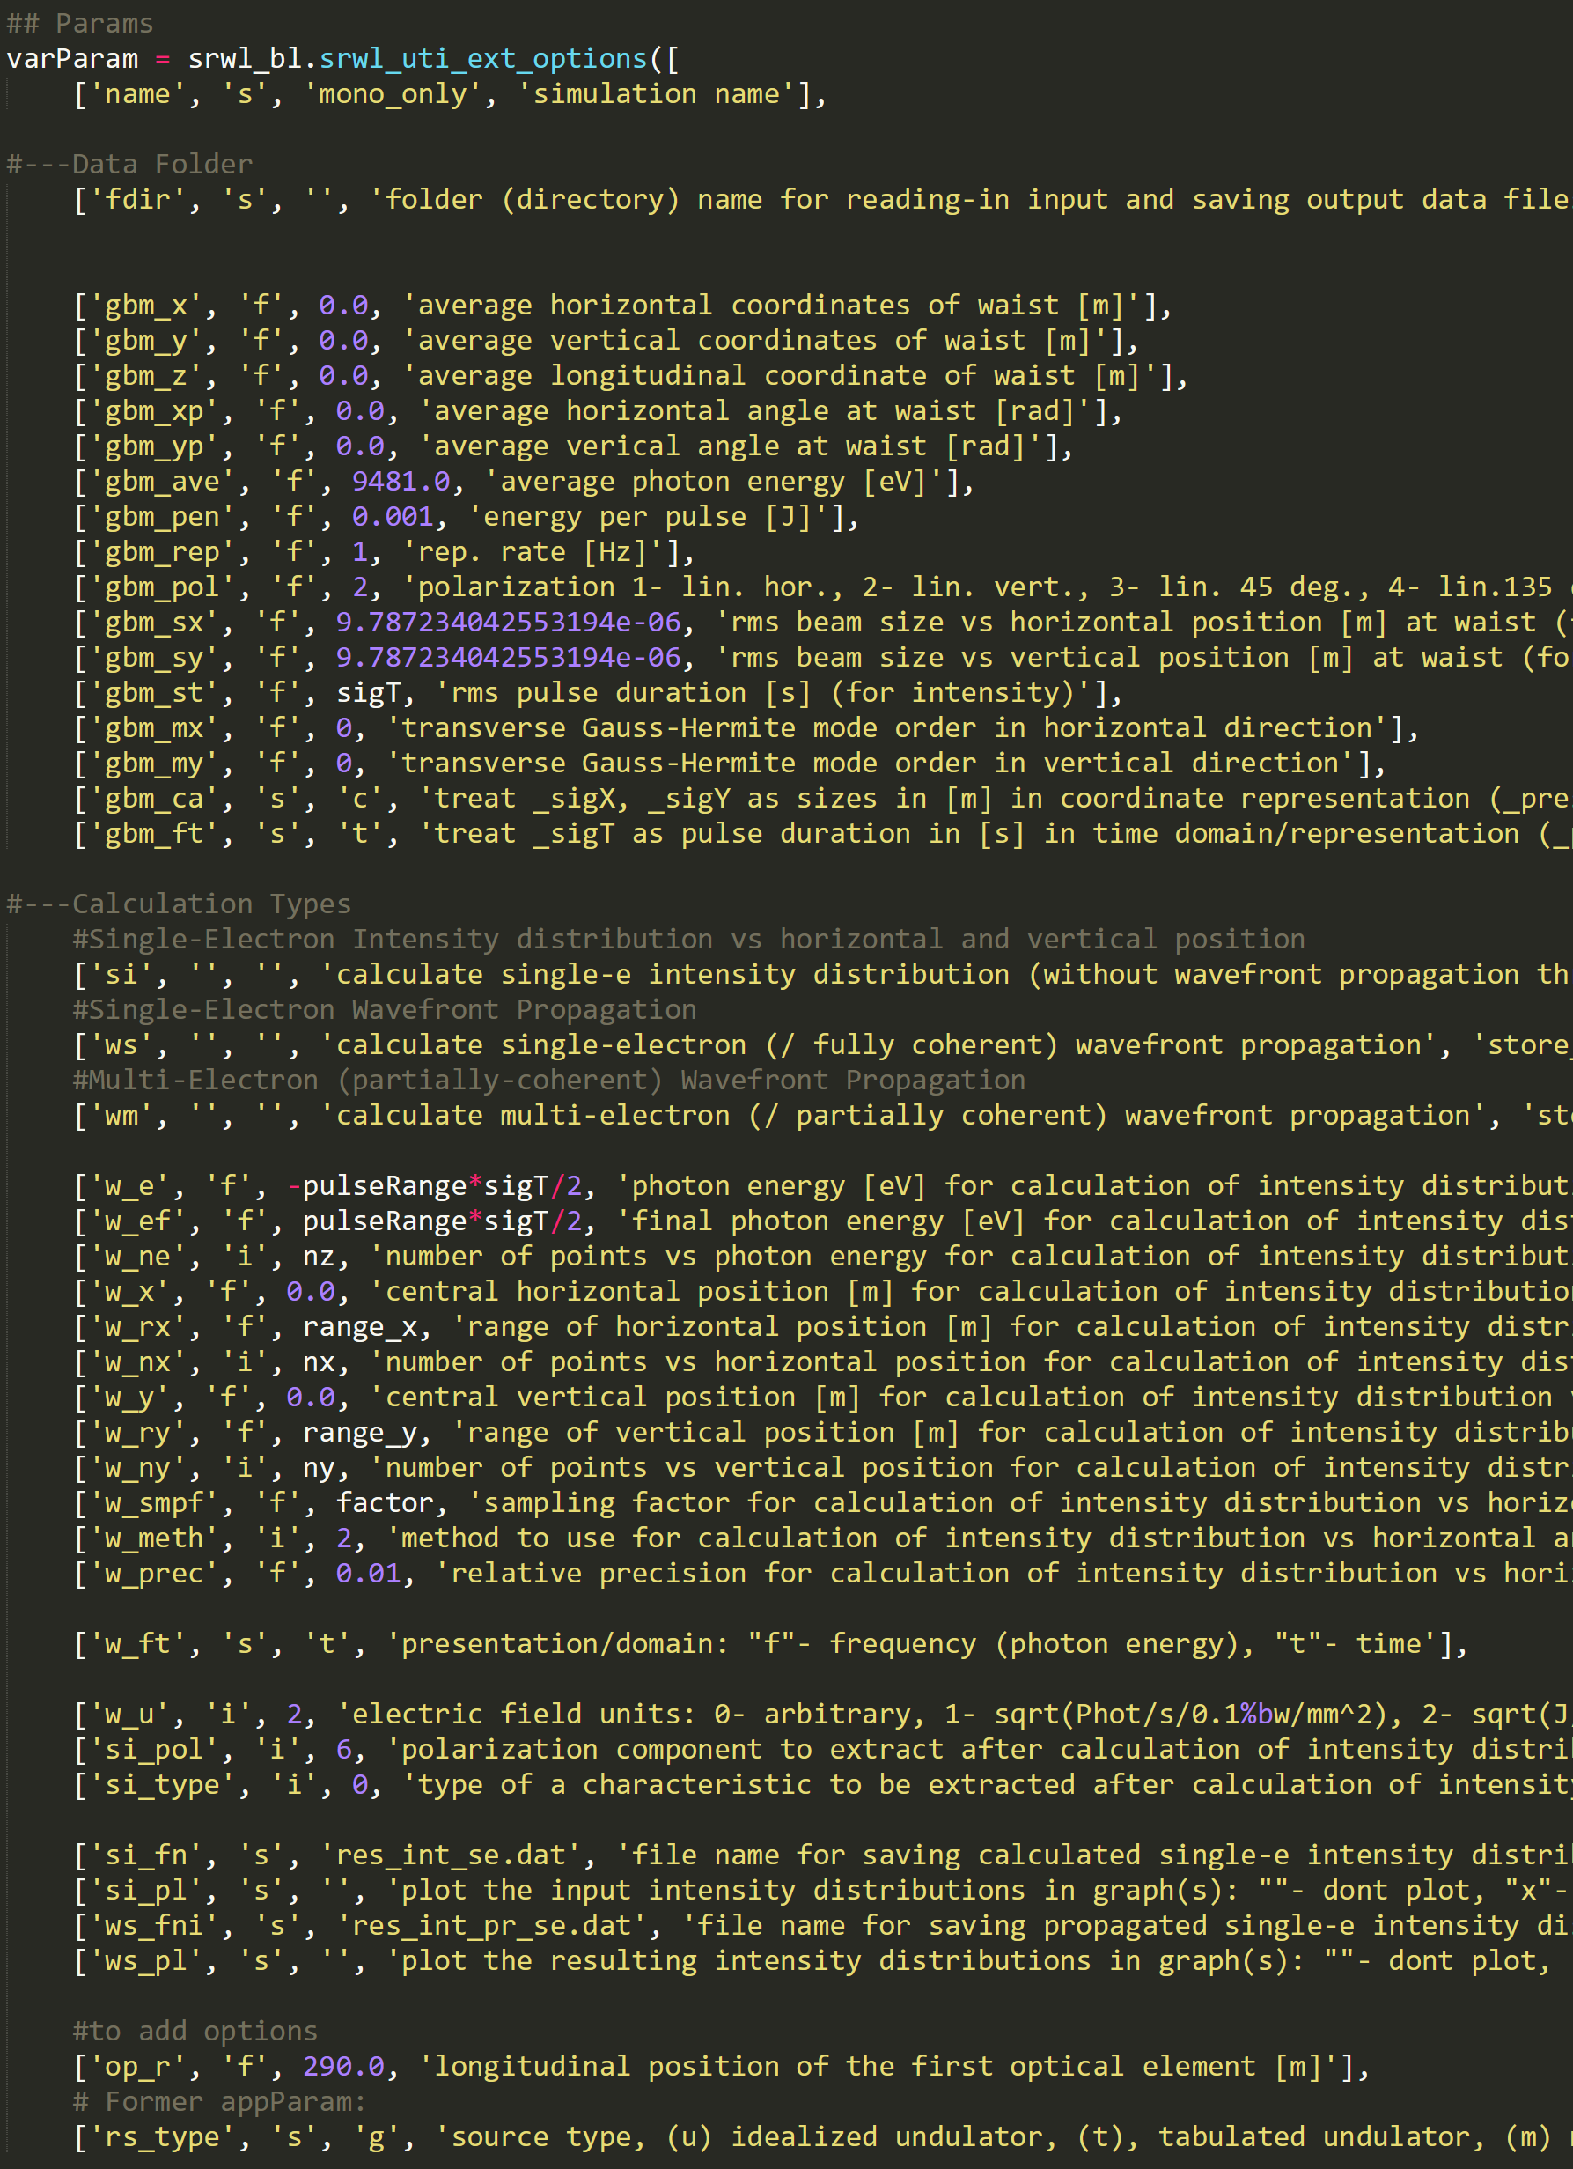
Adding time domain simulation
In the list of parameters:
In Data Folder:
Change ‘gbm_st’, ‘f’, rms pulse duration
In Calculation Types:
Change ‘w_e’, ‘f’, time_window_min
Change ‘w_ef’, ‘f’, time_window_max
Change ‘w_ne’, ‘i’, # of points in time/energy
Change ‘w_smpf’, ‘f’, sampling factor (disabled if <0)
Change ‘w_u’, ‘i’, 2, the correct electric field units
A sample of modified code can be seen on the right, note that code for other source types can be commented out/deleted since they are not used.

Slide 6
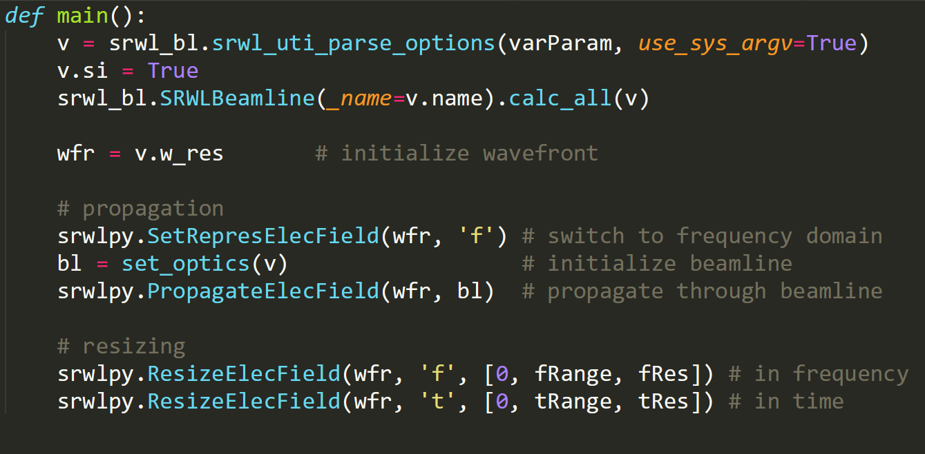
Adding time domain simulation
In the propagation function:

Slide 7
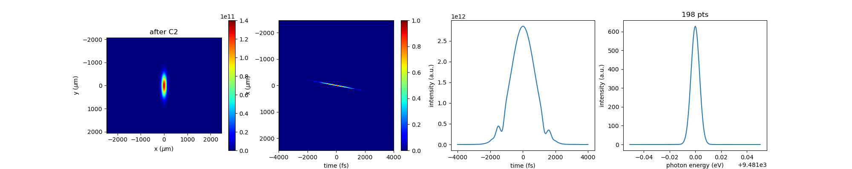
Optimize parameters
Spatial: adjust the range scaling factor in the Propagation parameters at targeted optical elements so the entire beam profile is enclosed. Then adjust the spatial sampling resolution until aliasing disappears.
Temporal: first adjust ‘w_ne’ to make sure the incident pulse profile is sampled smoothly. Then use the resize function when propagating the beam when needed.
100fs, 9481eV, one asymmetric reflection (Si 444, -29.5 degree)

Slide 8
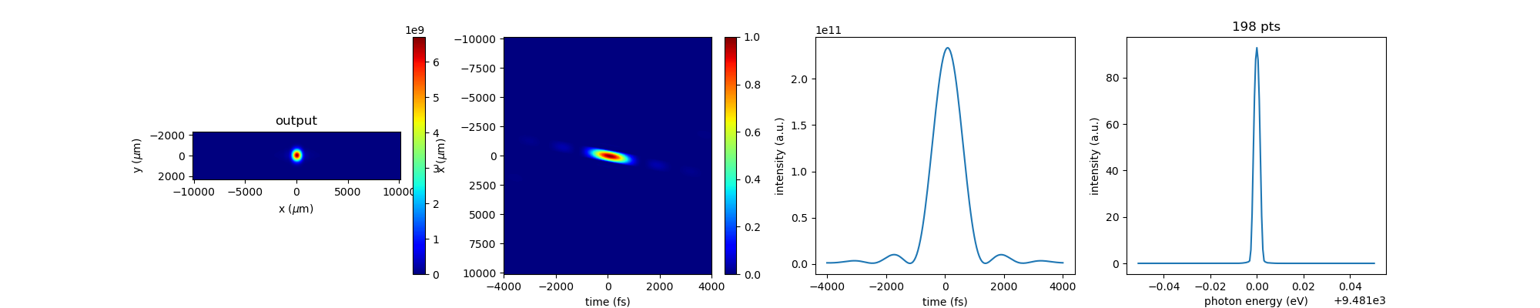
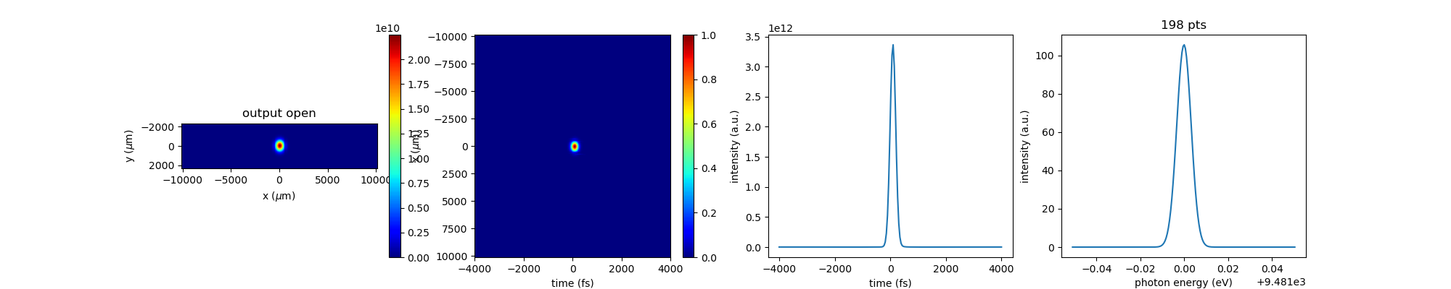
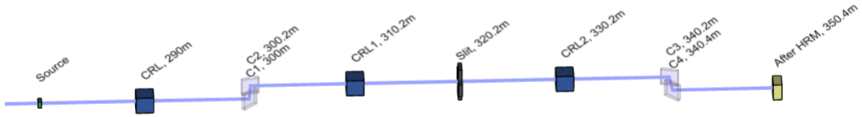
Results
Typical simulation results with open and closed slits (10 um). The beamline is shown below

Slide 9
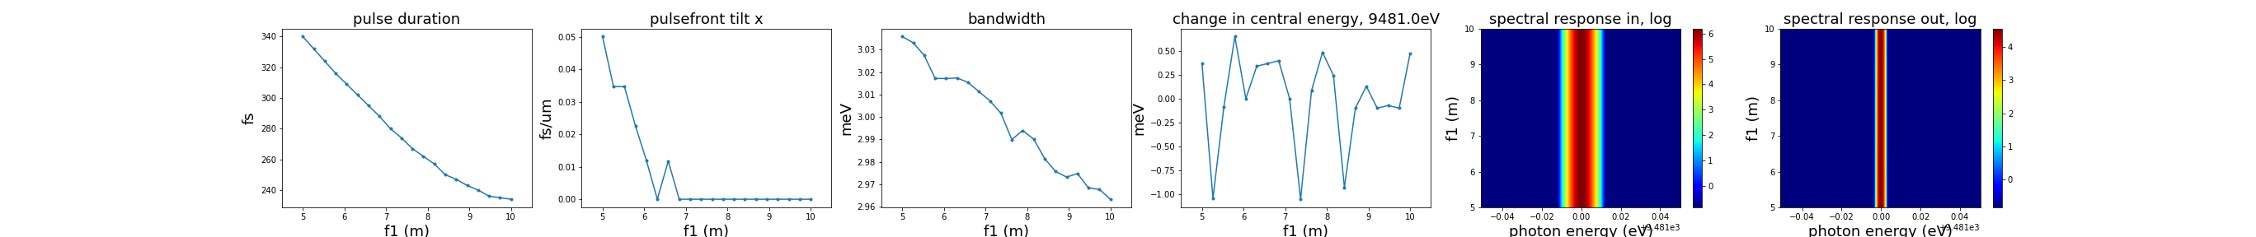
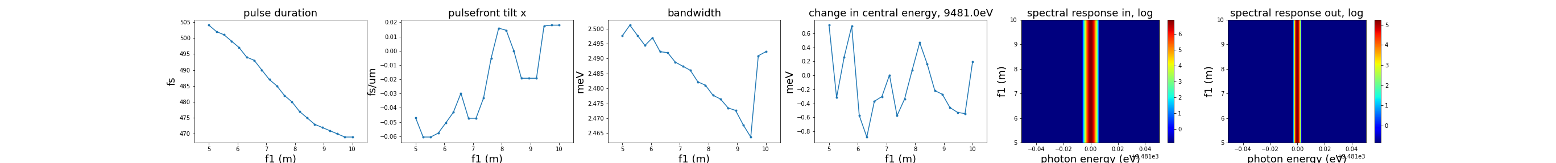
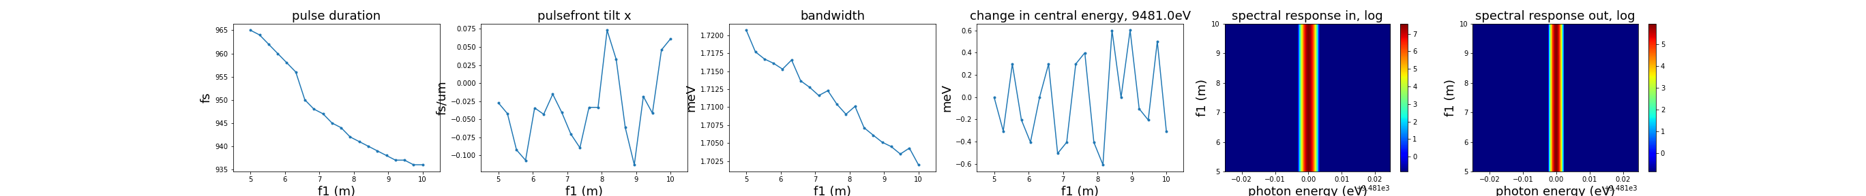
Crystal-lens distance tolerance
Changing the distance between C2-CRL1 and CRL2-C3
100fs
200fs
400fs

Slide 10
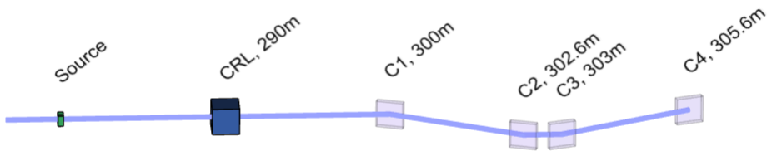
In progress
For a 4 crystal pulse stretcher/compressor using Si 111 with 5 degree asymmetry angles in the +-+- or -+-+ configuration, the output pulse durations don’t seem to be that different

Slide 11
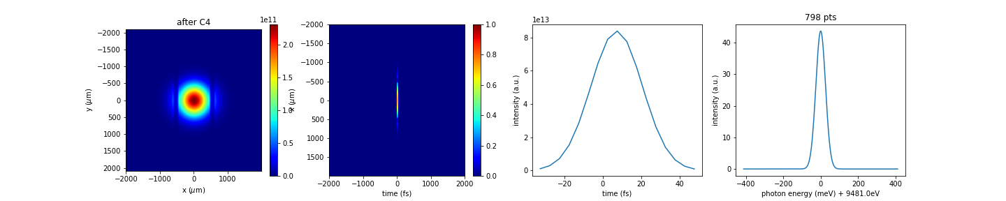
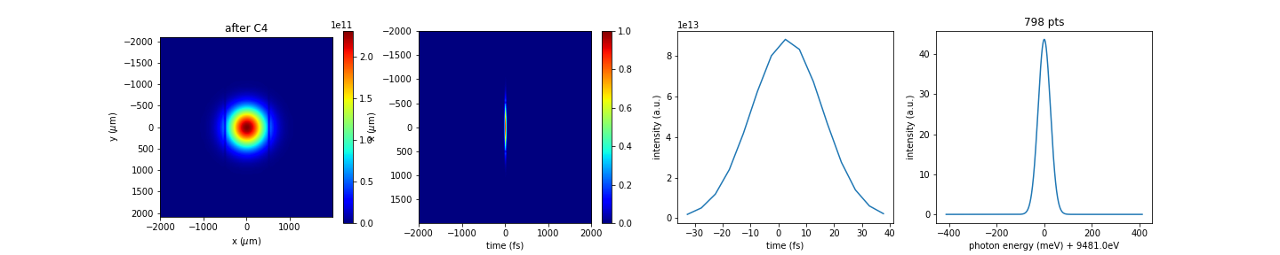
Stretcher/compressor output
-+-+
+-+-

Slide 12
To-do
SASE pulse simulation at NERSC
Thermal deformation

