Slide 1
DXS Optics ShapeErrors

Slide 2

Telescope mirror optimization

Slide 3
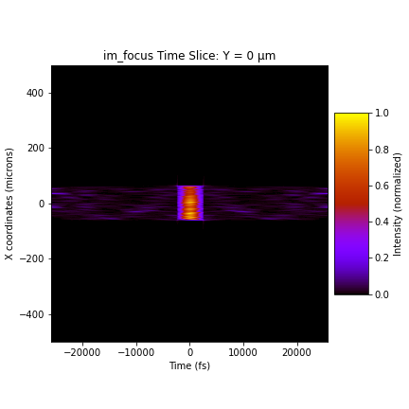
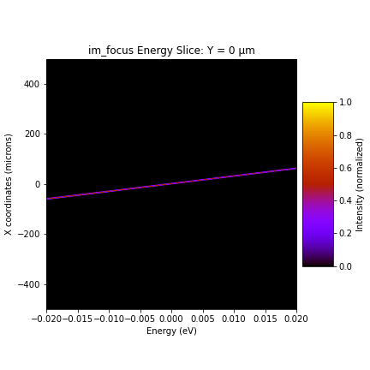
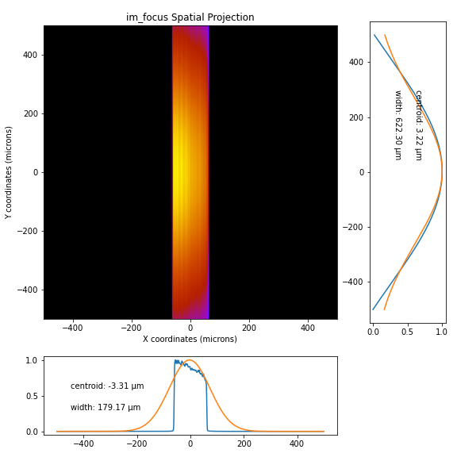
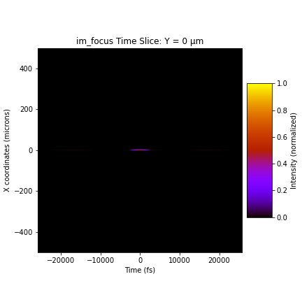
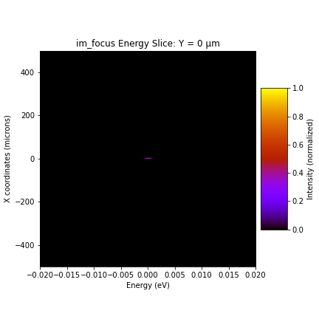
Beam profile with perfect optics, focus
Open slit, beam cut off in x due to telescope mirror 2 (1m)

Slide 4
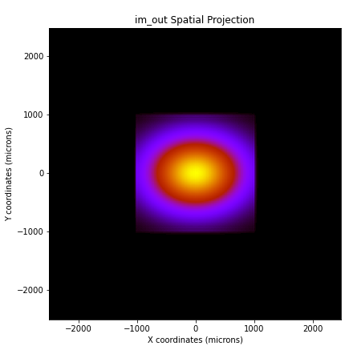

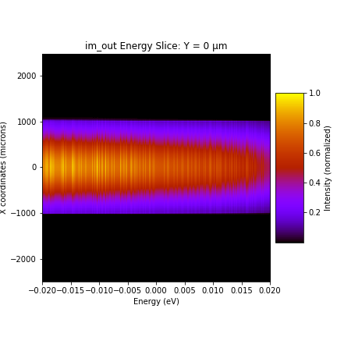
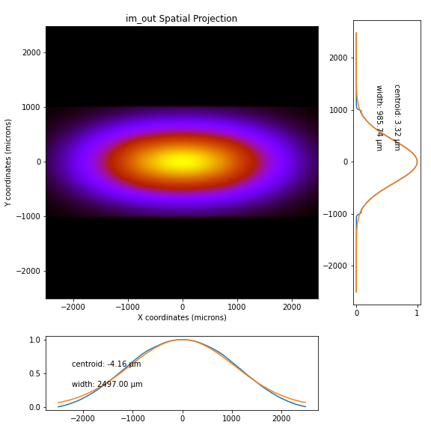
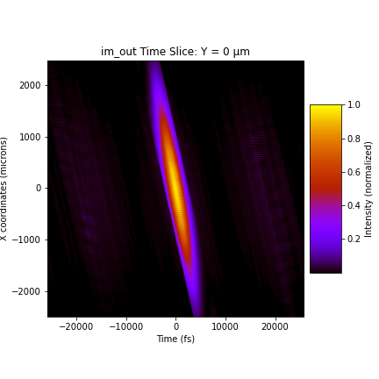
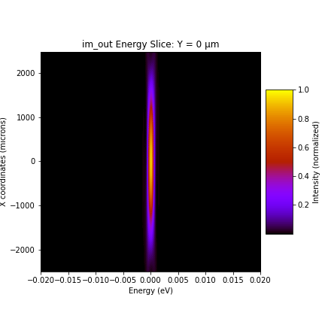
Beam profile with perfect optics, output
open
open
open
closed
closed
closed

Slide 5



HHLM1
power
1x
0.5x
0.25x

Slide 6



HHLM2
power
1x
0.5x
SASE

Slide 7



HHLM3
power
1x
3x
5x

Slide 8



HHLM4
power
1x
3x
5x

Slide 9



HRM1
power
1x
3x
5x

Slide 10



HRM2
power
1x
3x
5x

