Slide 1


Original vs -2nd order terms
20% power, HRM shapeError off

Slide 2
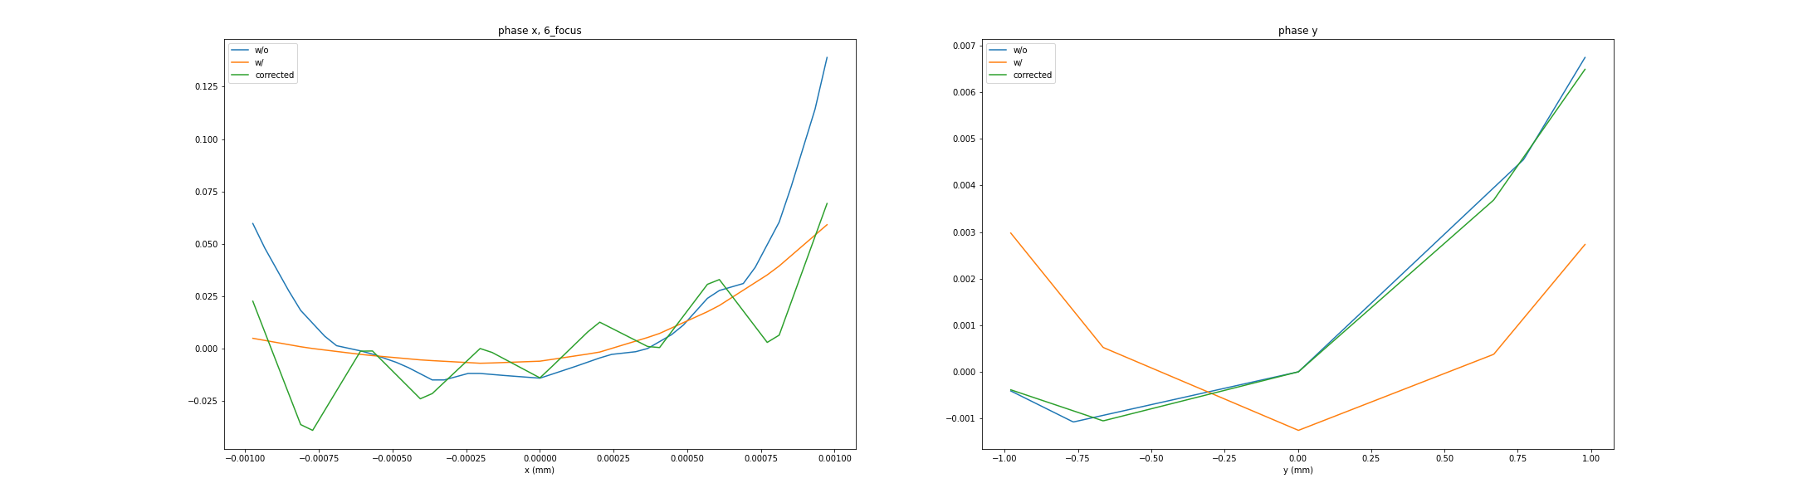
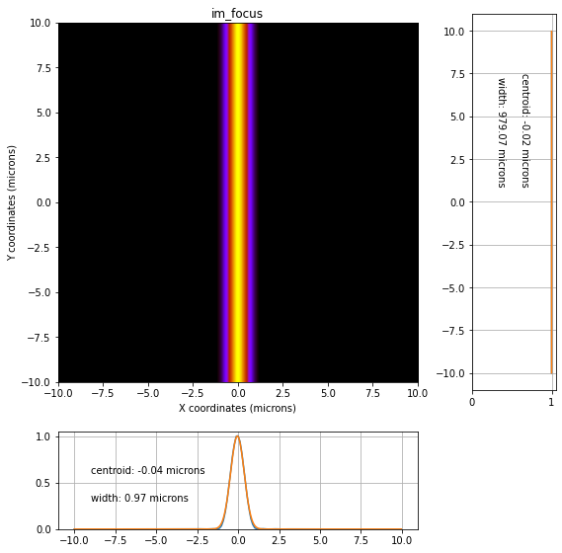
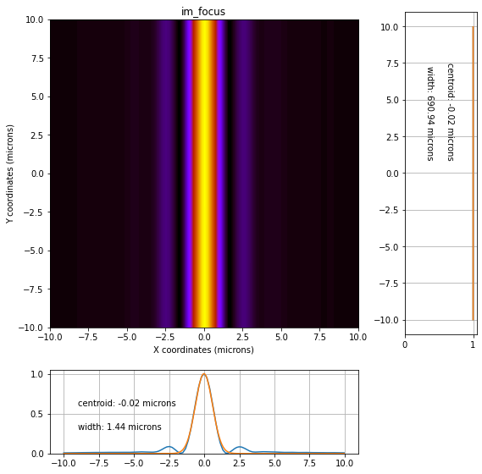
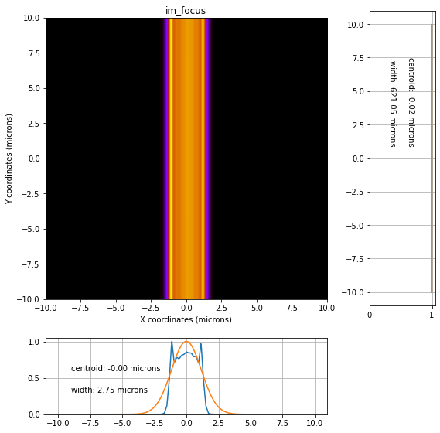
original, monochromatic
Phase at focal plane
Projection at focal plane

Slide 3

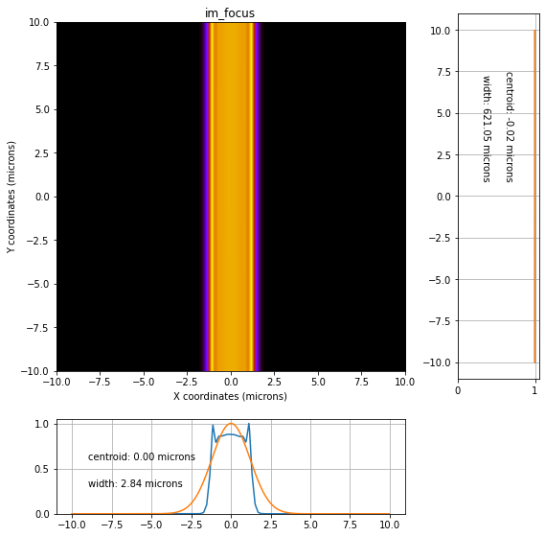
-2nd order, monochromatic
Phase at focal plane
Projection at focal plane

Slide 4

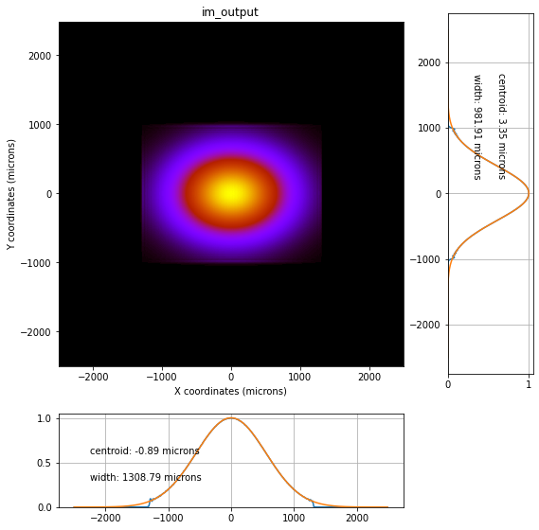

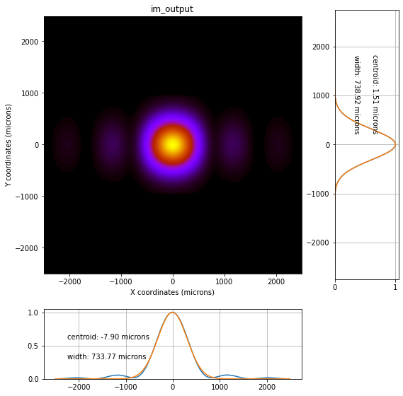
-2nd order, monochromatic
Phase at output
Projection at output

Slide 5

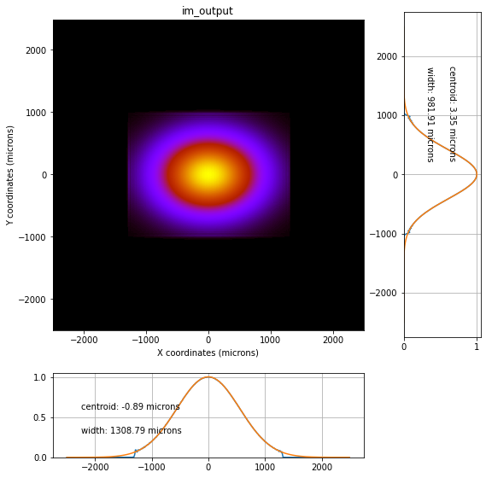
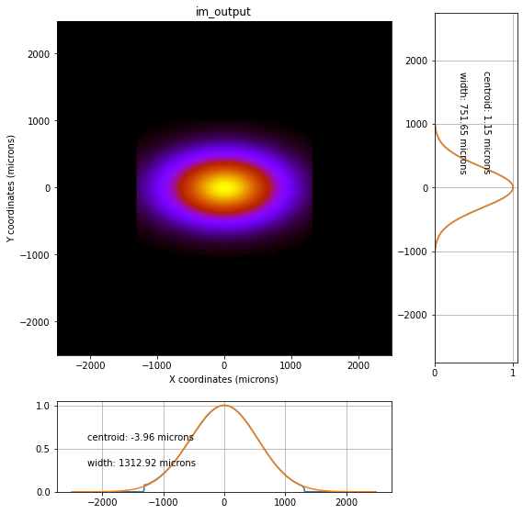
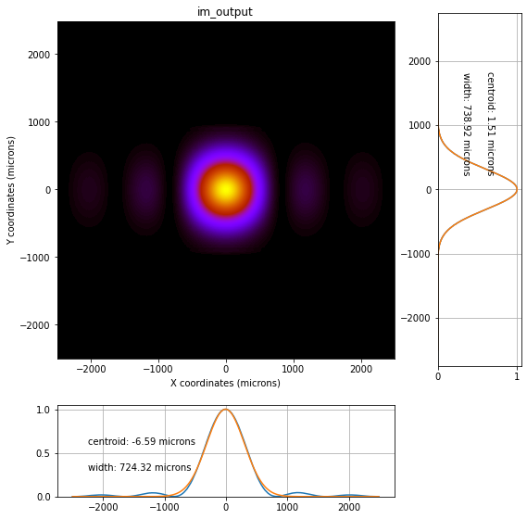
original, monochromatic
Phase at output
Projection at output

Slide 6
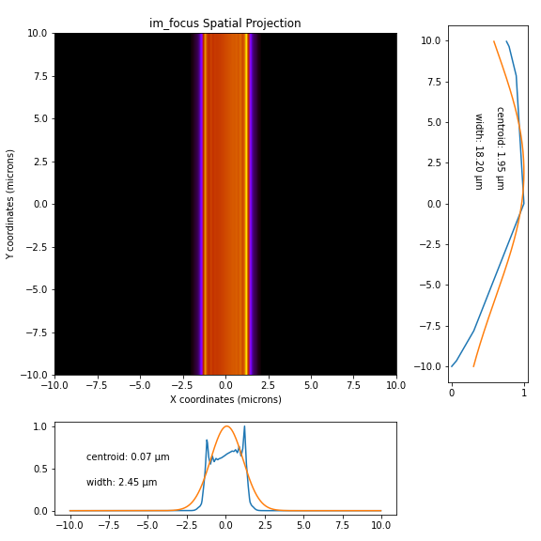
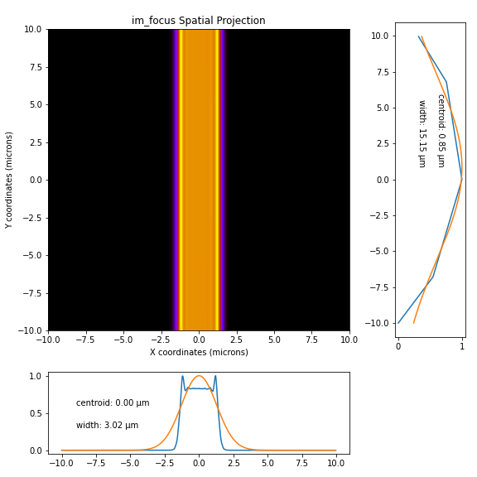
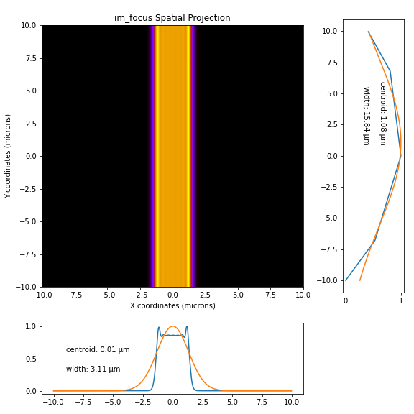

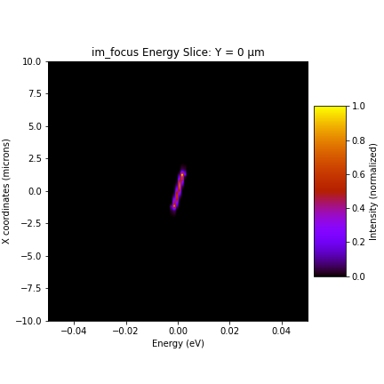
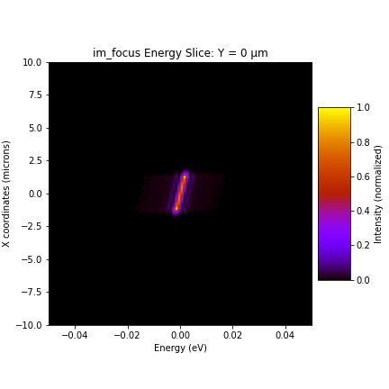
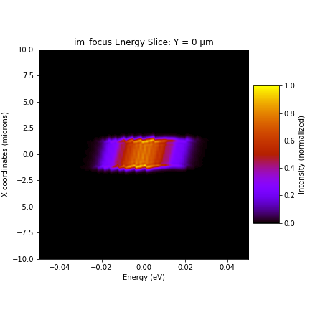
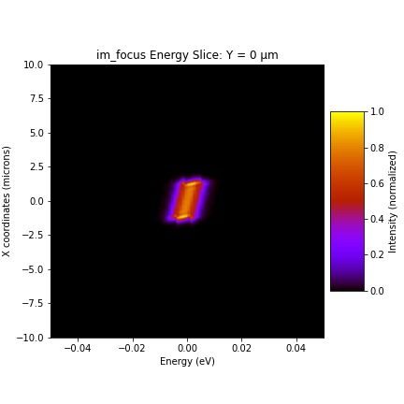
focal plane
Profile
perfect
bending
original
-2nd order
Spatial spectrum

Slide 7
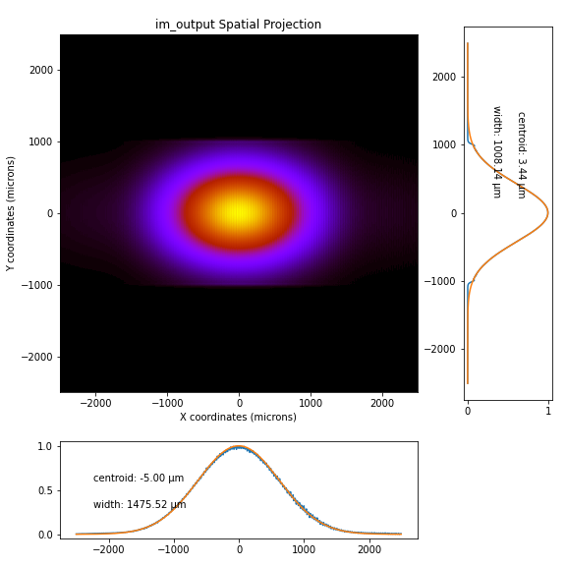
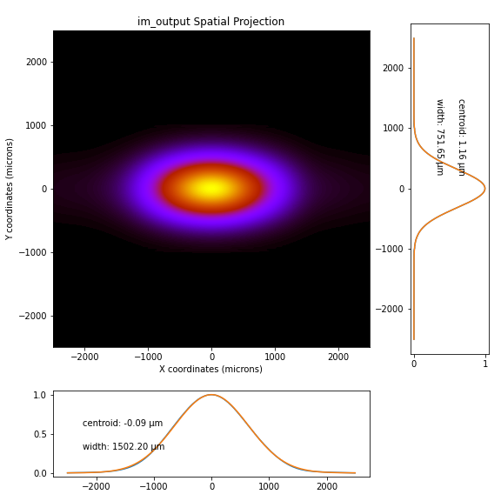

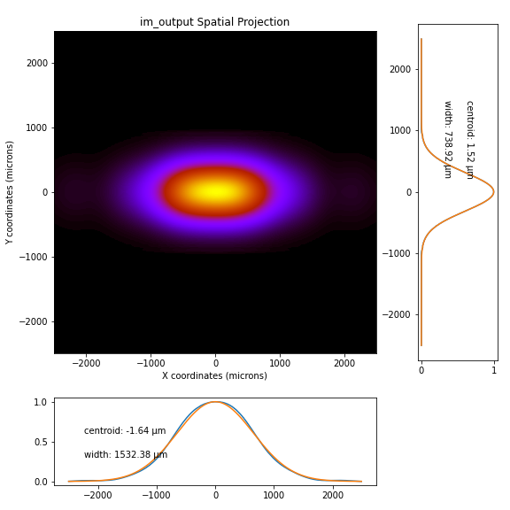
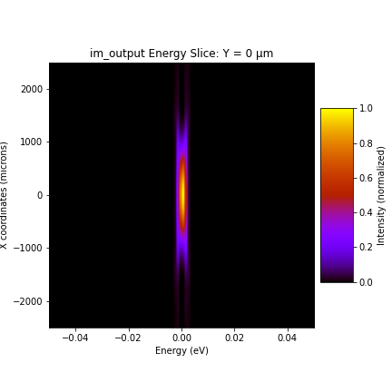

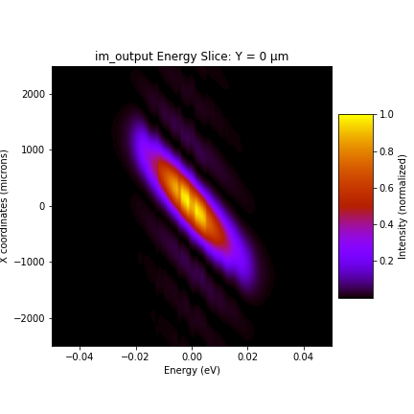

output
Profile
perfect
bending
original
-2nd order
Spatial spectrum

Slide 8


Bending after phase corrector
-2nd order
+ bending
perfect
-2nd order

Slide 9


output
Profile
perfect
-2nd order
-2nd order
Spatial spectrum

Slide 10
To-do
Bending – 2nd order terms, then scan m2_p again
If m2_p bending doesn’t fix this, put in a known phase error and do it without heatbumps to see if we can undo the introduced phase error with a phase corrector

