Slide 1
DXS Optics ShapeErrors
June 29th 2021

Slide 2

Telescope mirror optimization

Slide 3
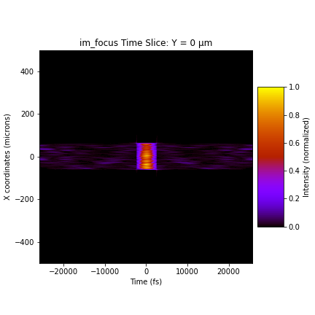
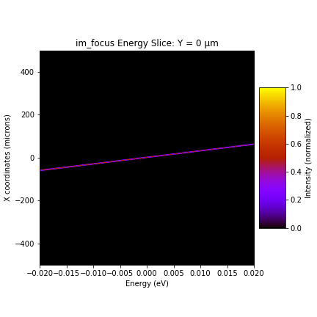
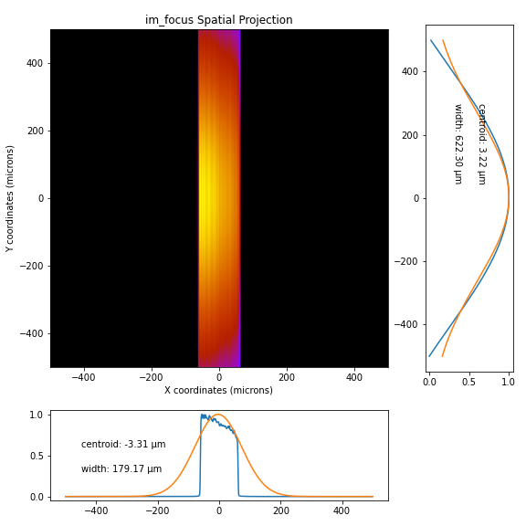
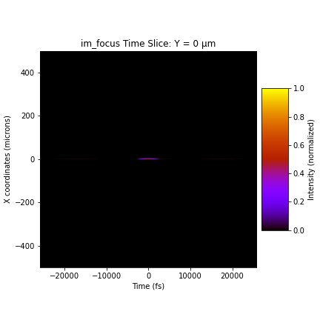
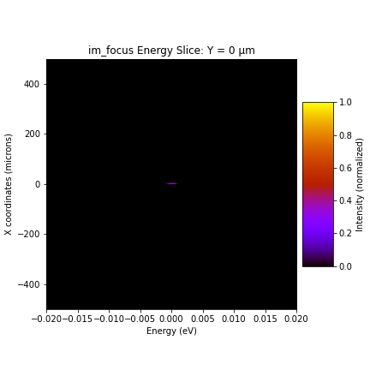
Beam profile with perfect optics, focus
Open slit, beam cut off in x due to telescope mirror 2 (1m)

Slide 4
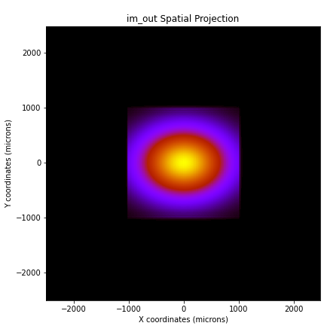

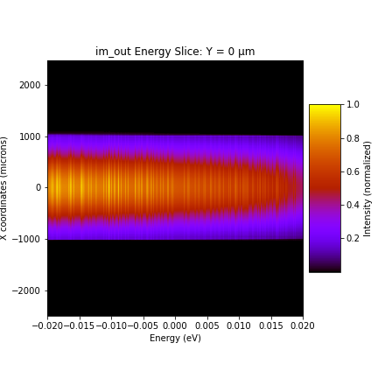
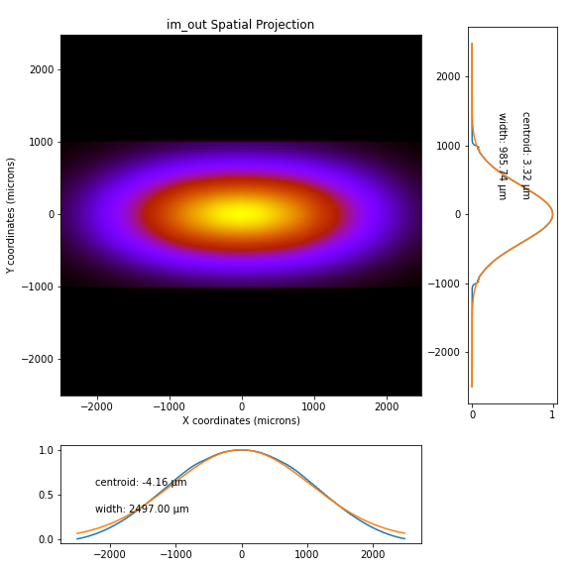
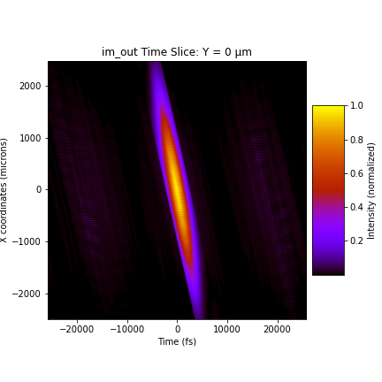
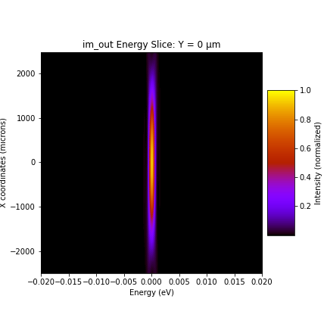
Beam profile with perfect optics, output
open
open
open
closed
closed
closed

Slide 5



HHLM1
power

Slide 6



HHLM2
power

Slide 7



HHLM3
power

Slide 8



HHLM4
power

Slide 9



HRM1
power

Slide 10


HRM2
power

Slide 11
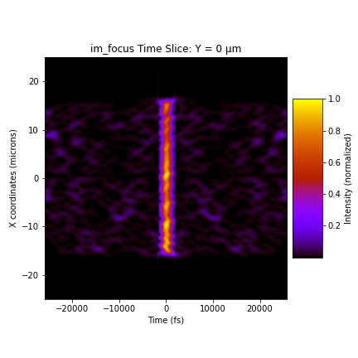
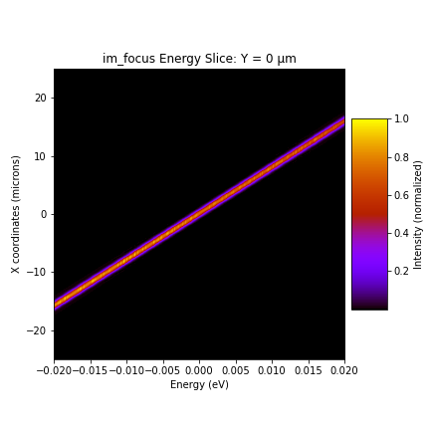
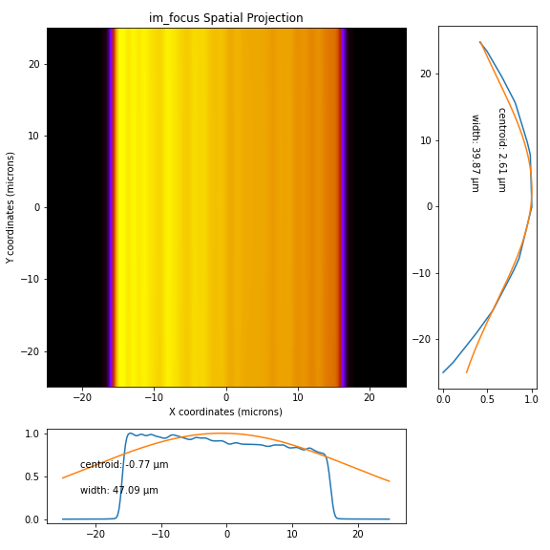
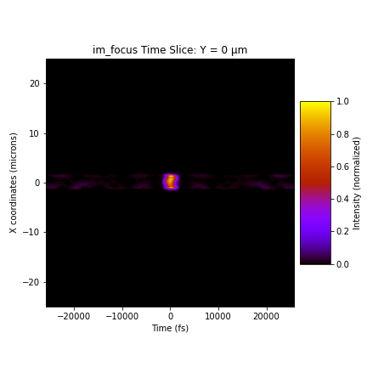

Beam profile with perfect optics, focus
Open slit, beam cut off in x due to telescope mirror 2 (1m)

Slide 12


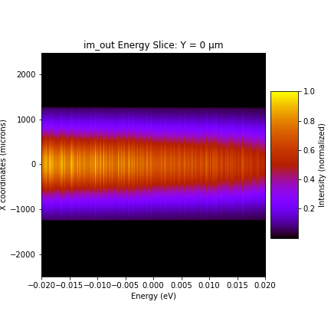
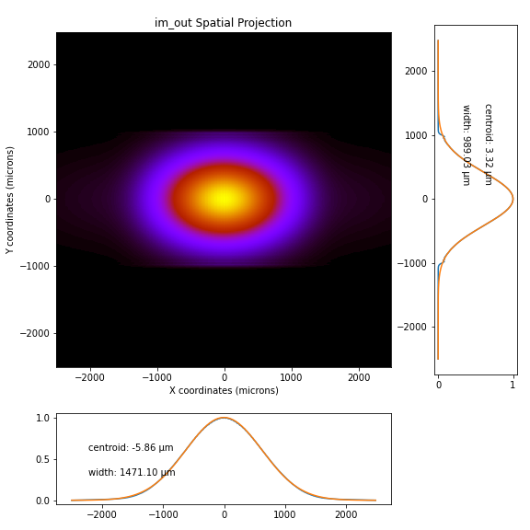
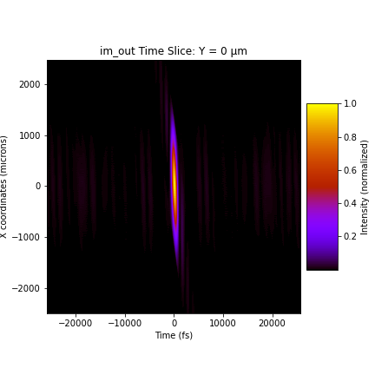
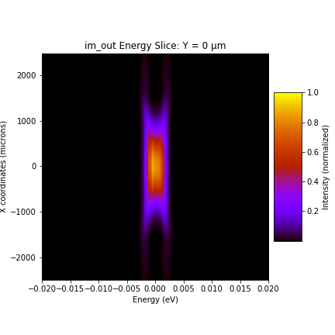
Beam profile with perfect optics, output
open
open
open
closed
closed
closed

Slide 13


Full shapeError, option 1

Slide 14


Full shapeError, option 1, reduced power

Slide 15
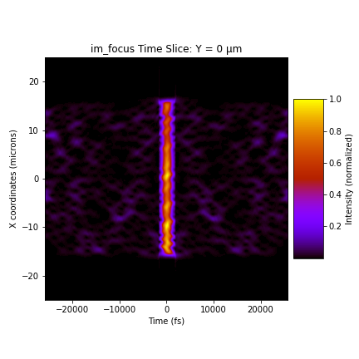




Beam profile with perfect optics, focus
Open slit, beam cut off in x due to telescope mirror 2 (1m)

Slide 16


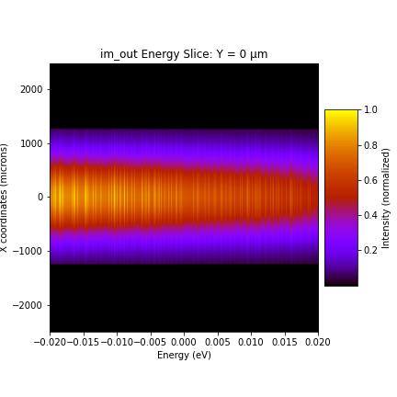


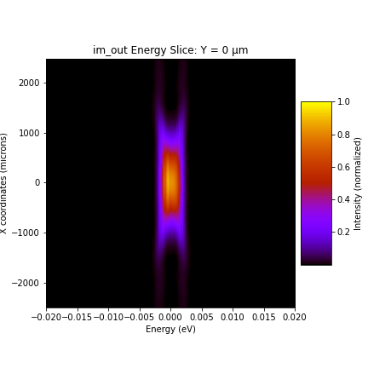
Beam profile with perfect optics, output
open
open
open
closed
closed
closed

Slide 17


Full shapeError, option 2

Slide 18


Full shapeError, option 2, reduced power

