Slide 1
Geometrical Dispersion in Crystal Optics
Matt Seaberg

Slide 2
Motivation
As we worked through the concept of the 4f monochromator, it became apparent that in addition to energy resolution considerations, the temporal effect of the monochromator also needs to be considered
Fortunately, this concept is nearly identical to the stretcher design typically used in a chirped pulse amplifier (CPA) in the visible/near-IR range, and/or a popular pulse shaper design
We can translate analytical calculations for these systems to our own concept
A useful reference
L. Walmsley, L. Waxer, and C. Dorrer, "The role of dispersion in ultrafast optics," Rev. Sci. Instrum. 72, 1–29 (2001).

Slide 3
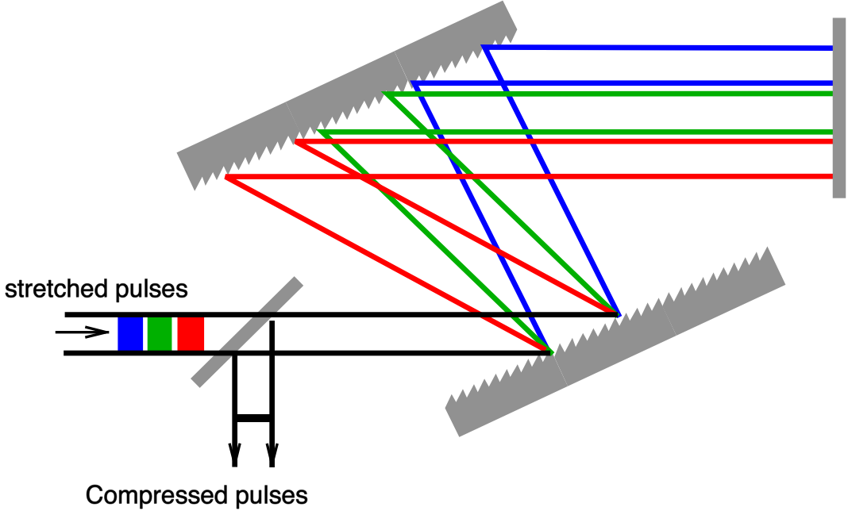


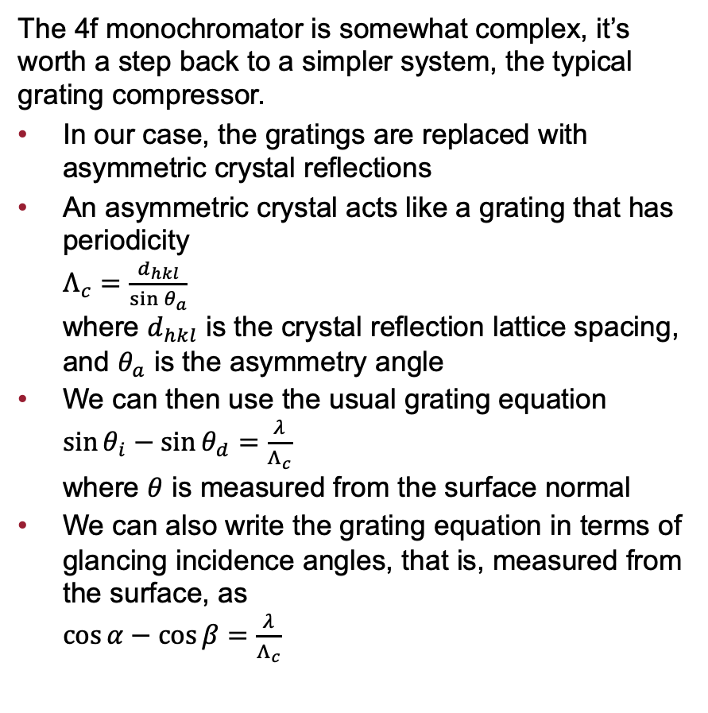


Background
The 4f monochromator is somewhat complex, it’s worth a step back to a simpler system, the typical grating compressor.
In our case, the gratings are replaced with asymmetric crystal reflections
An asymmetric crystal acts like a grating that has periodicity $Λ_{c}=\frac{d_{hkl}}{\sin{θ_{a}}}$ where $d_{hkl}$ is the crystal reflection lattice spacing, and $θ_{a}$ is the asymmetry angle
We can then use the usual grating equation $\sin{θ_{i}}−\sin{θ_{d}}=\frac{λ}{Λ_{c}}$ where $θ$ is measured from the surface normal
We can also write the grating equation in terms of glancing incidence angles, that is, measured from the surface, as $\cos{α}−\cos{β}=\frac{λ}{Λ_{c}}$
From Wikipedia
$$θ_{d}$$
$$θ_{i}$$
$$β$$
$$α$$

Slide 4
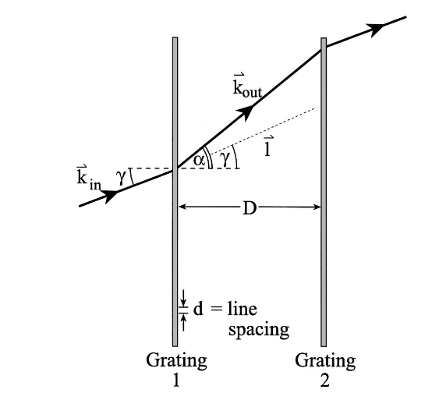
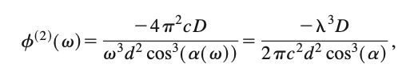
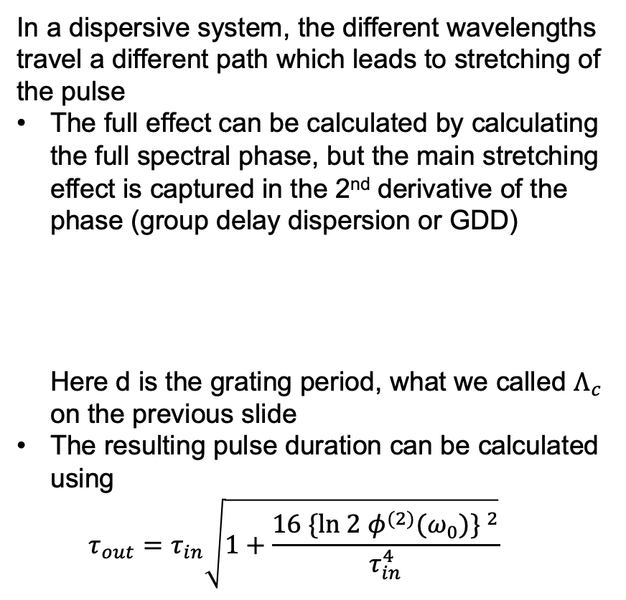
Pulse stretching from grating pair
In a dispersive system, the different wavelengths travel a different path which leads to stretching of the pulse
The full effect can be calculated by calculating the full spectral phase, but the main stretching effect is captured in the 2nd derivative of the phase (group delay dispersion or GDD) Here d is the grating period, what we called $Λ_{c}$ on the previous slide
The resulting pulse duration can be calculated using $τ_{out}=τ_{in}\sqrt{1+\frac{16 {\{\text{ln} 2 φ^{(2)}(ω_{0})\} }^{2}}{τ_{in}^{4}}}$
Figure reproduced from Walmsley et al, Rev. Sci. Instrum. 72, 1–29 (2001).

Slide 5
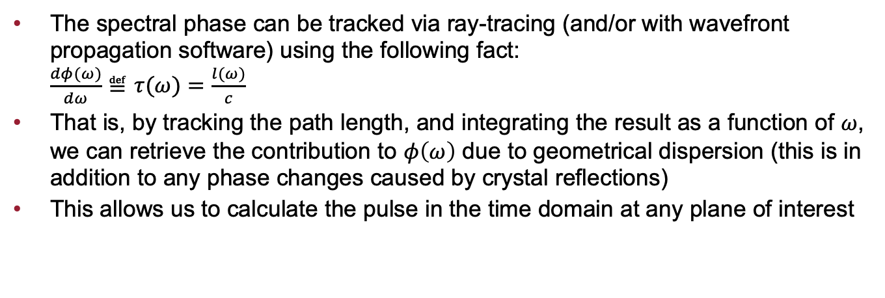
Numerical Calculation of Pulse Stretching
The spectral phase can be tracked via ray-tracing (and/or with wavefront propagation software) using the following fact: $\frac{dφ(ω)}{dω}≝τ(ω)=\frac{l(ω)}{c}$
That is, by tracking the path length, and integrating the result as a function of $ω$, we can retrieve the contribution to $φ\left(ω\right)$ due to geometrical dispersion (this is in addition to any phase changes caused by crystal reflections)
This allows us to calculate the pulse in the time domain at any plane of interest
S. D. Brorson and H. A. Haus, J. Opt. Soc. Am. B 5, 247 (1988).
E. B. Treacy, IEEE J. Quantum Electron. QE-5(9), 454–458 (1969).

Slide 6
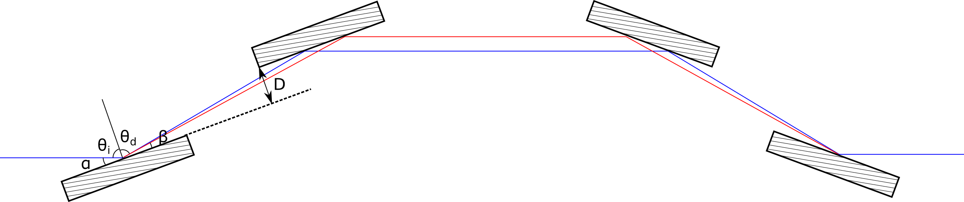
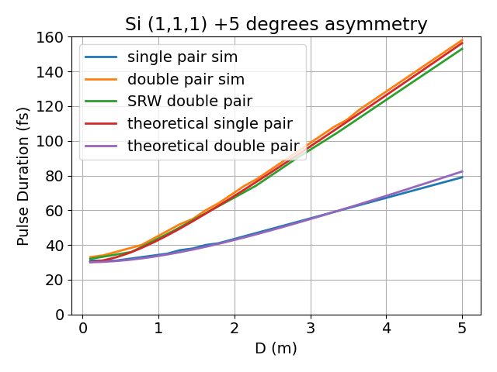
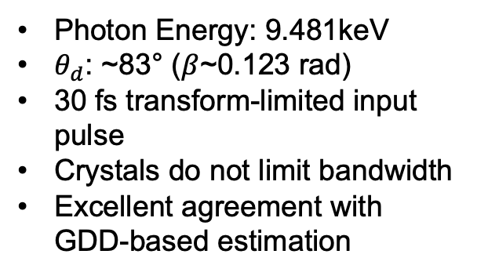
Case Study: Si (1,1,1) 5° asymmetry compressor
Simple system with only 4 crystals
Photon Energy: 9.481keV
$θ_{d}$: ~83° ($β$~0.123 rad)
30 fs transform-limited input pulse
Crystals do not limit bandwidth
Excellent agreement with GDD-based estimation

Slide 7
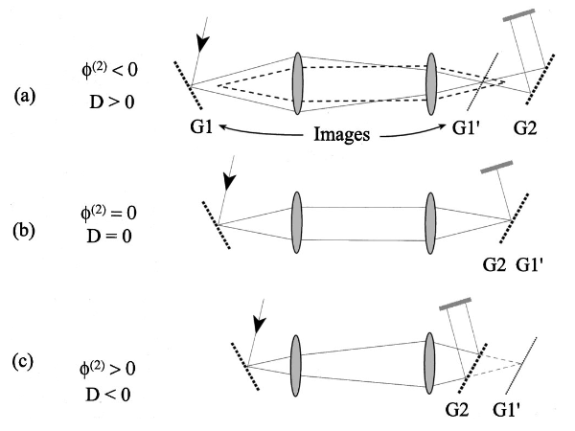

Extension to 4f mono
To apply this analysis to the 4f mono, we can consider the imaging system represented by the telescope
The GDD can be calculated based on the effective separation between the 2nd grating and the image of the 1st grating
If the two lenses have equal focal length, the grating separation D is given by $D=2(L−f)\sin{β}$
Figure reproduced from Walmsley et al, Rev. Sci. Instrum. 72, 1–29 (2001).

Slide 8
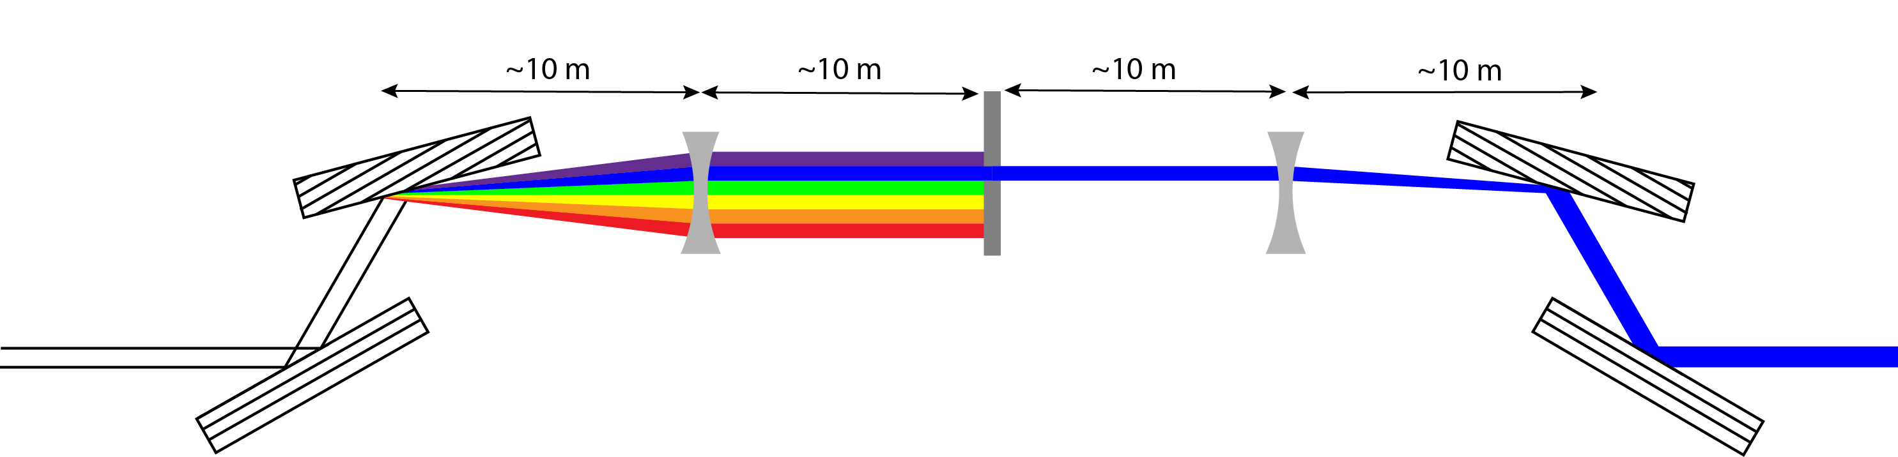
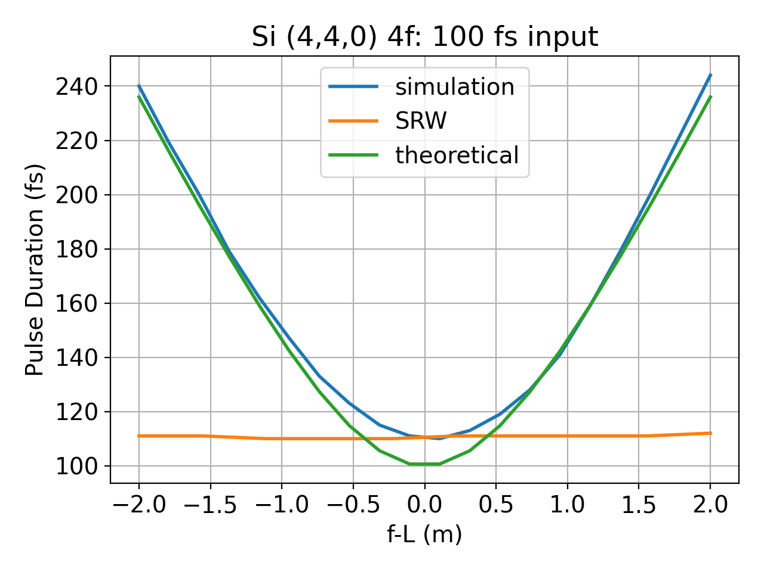
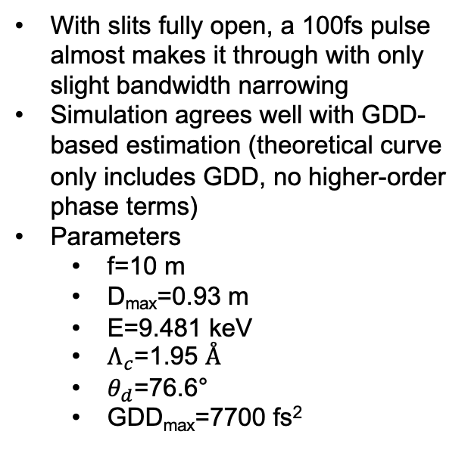
Case Study: Si (4,4,0) 29.5° asymmetry 4f mono
L
f
f
L
With slits fully open, a 100fs pulse almost makes it through with only slight bandwidth narrowing
Simulation agrees well with GDD-based estimation (theoretical curve only includes GDD, no higher-order phase terms)
Parameters
f=10 m
D_{max}=0.93 m
E=9.481 keV
$Λ_{c}$=1.95 Å
$θ_{d}$=76.6°
GDD_{max}=7700 fs²

Slide 9
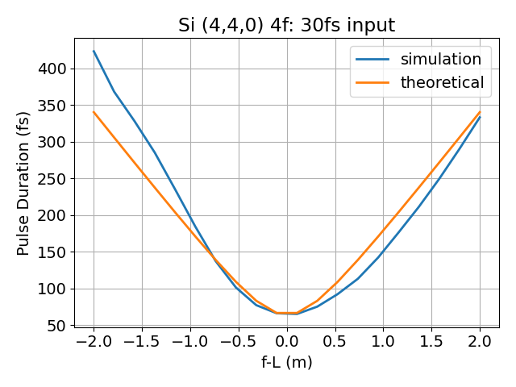
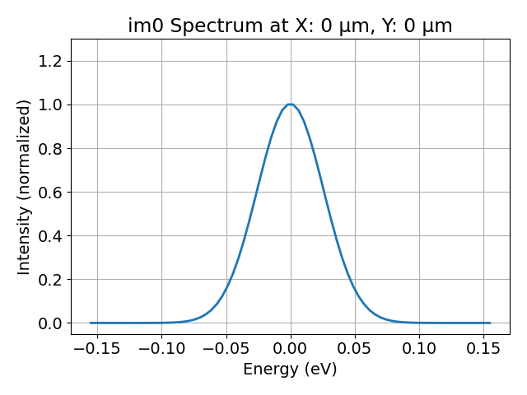
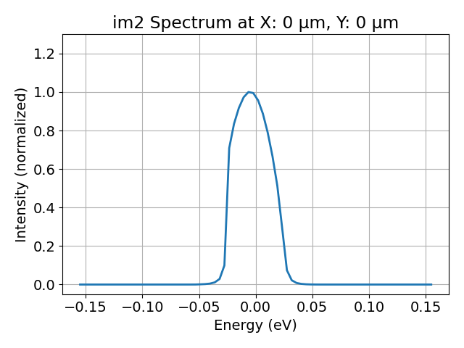
Case Study: Si (4,4,0) 29.5° asymmetry 4f mono
With shorter input pulse (here 30fs), the minimum pulse duration increases due to finite bandwidth through the system
Plot at right assumes 64fs theoretical limit

